Slide 1
Regular Expressions
Regular expressions are also referred as "REs" or "regex" or "regexp".
Use RE to specify the rules for the set of possible patterns that you want to match.
It’s a powerful string manipulation tool to search, replace, and parse complex patterns of characters or words.

Slide 2
Regular Expressions (REs)
Strings methods for searching (index, find, and count), replacing (replace), and parsing (split) use hard-coded substrings and are case-sensitive.
REs offers a flexible way to:
  Search a string (methods: search and match)
  Replace parts of a string (method: sub)
  Break strings into smaller pieces (method: split)

Slide 3
Pattern and String Description
Pattern: this is the regular expression to be matched
String: This is the string, which would be searched to match the pattern anywhere in the string.

Slide 4
Regular Expressions (REs)
REs are very useful in bioinformatics. We can use them to find DNA and Protein patterns
DNA patterns
    restriction sites
    promoters/transcription factor binding sites
Protein patterns
    conserved domains (motifs)
    active sites

Slide 5
REs Syntax
A pattern can be just a text string: 'GATC'
It can have alternative characters: 'G[AT]TC'
  The 'G[AT]TC' pattern will match a DNA string that starts with G; has A or T in the 2nd position, followed by TC.
We can specify characters individually or as a range. For example 'G[abc]TC' or 'G[a-c]TC'

Slide 6
REs Syntax
A caret (^) symbol at the start of the character class matches any one character except those given in the square brackets 'G[^AT]TC'
  This 'G[^AT]TC' pattern will match a DNA string that starts with G; has C or G in the 2nd position, followed by TC. Here: 'GCTC' or 'GGTC'.
A pattern can contain a wildcard (a dot) that matches any single character except newline: 'G.TC'

Slide 7
Repeated Things
x* matches zero or more number of x
'ca*' matches 'c', 'ca', 'caa', etc.
x+ matches one or more number of x
  'ca+' matches 'ca', 'caa', etc.
x? matches zero or one x
‘home-?work' matches ‘homework' or ‘home-work'
x{m, n} matches i number of x, where m≤i≤ n 'a{2,3}' matches 'aa' or 'aaa'

Slide 8
Repeated Things: Equivalence
x{m, n} matches i number of x, where m≤i≤ n 'a{2,3}' matches 'aa' or 'aaa'
x{0,} is same as x*
x{1,} is same as x+
x{0,1} is same as x?

Slide 9
REs Syntax
Parentheses can be used for grouping '(abc)+' matches 'abc', 'abcabc', 'abcabcabc'.
A vertical line “|” means “or”; it allows you to look for either of two completely different patterns:
'GAAT|ATTC'

Slide 10
Special Characters (or metacharacters)
  '\d' matches any digit (a number from 0-9)
  '\D' matches any non-digit
  '\w' matches any alphanumeric character
  (a letter or a number, not punctuation or space)
  '\W' matches any non-alphanumeric character
  '\s' matches white space character
  '\S' matches non-white space character
  '^' matches the beginning of a line
  '$' matches the end of a line
  '\b' matches a word boundary
  '\B' matches a character that is not a word boundary

Slide 11
How to Use REs in Python?
In order to use regular expressions in the code, we need to import re module.
The two basic methods re.search() and re.match() are used to search a pattern.
  Search looks for a pattern anywhere in a string
  Match looks for a match at the beginning
Both methods return None if the pattern isn’t found and a “match object” instance if it is.

Slide 12
Search and Match
  import re
  pat = 'a*b'
  re.search(pat, 'fooaaabcde')
  <_sre.SRE_Match object; span=(3, 7), match='aaab'>
  re.match(pat, 'fooaaabcde')
  None
  re.match('fooa*b', 'fooaaabcde')
  <_sre.SRE_Match object; span=(0, 7), match='fooaaab'>

Slide 13
Match Object
  It is an instance of the match class with the details of the match result.
  import re
  res = re.search('a*b', 'fooaaabcde')
  res.group() # group returns string matched
  'aaab'
  res.start() # index of the match start
  3
  res.end() # index of the match end
  7
  res.span() # tuple of (start, end)
  (3, 7)

Slide 14
Match Object
  It is an instance of the match class with the details of the match result.
  import re
  res = re.match('fooa*b', 'fooaaabcde')
  res.group() # group returns string matched
  ‘fooaaab'
  res.start() # index of the match start
  0
  res.end() # index of the match end
  7
  res.span() # tuple of (start, end)
  (0, 7)

Slide 15
split() method
  The re.split() is like split but can use patterns.
  re.split('\W+', 'This... is a test, short and sweet, of split()')
  ['This', 'is', 'a', 'test', 'short', 'and', 'sweet', 'of', 'split', '']
  The '\W+' means split on all non-alphanumeric characters.

Slide 16
sub() and findall() methods
  re.sub() substitutes all occurrences of RE pattern in string with a new pattern.
  re.sub('blue|white|red', 'black', 'blue socks and red shoes')
  'black socks and black shoes’
  re.findall() finds all matches and returns them as a list
  re.findall('\d+','12 dogs,11 cats, 1 egg')
  ['12', '11', '1']

Slide 17
Compile Patterns
  If you plan to use a re pattern more than once, compile it to a re object
  import re
  p = re.compile('a*b')
  res = p.search('fooaaabcde')
  res.group() # group returns string matched
  'aaab'
  res.start() # index of the match start
  3
  res.end() # index of the match end
  7
  res.span() # tuple of (start, end)
  (3, 7)

Slide 18
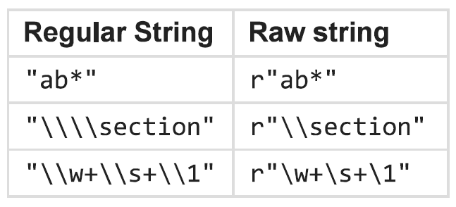
Backslash and Raw Strings
  RE use backslash character (‘\’) to indicate special meanings. However, if we want to use them without their special meaning then we have escape them either using backslashes or raw strings (preferable).

