Slide 1
Name: Engidawork Desalegn Roll no: 91900103183 Batch: B Class: CE TC3
The project title is: to-do list app This web app include: registration, login , homepage, edit, delete and update pages

Slide 2
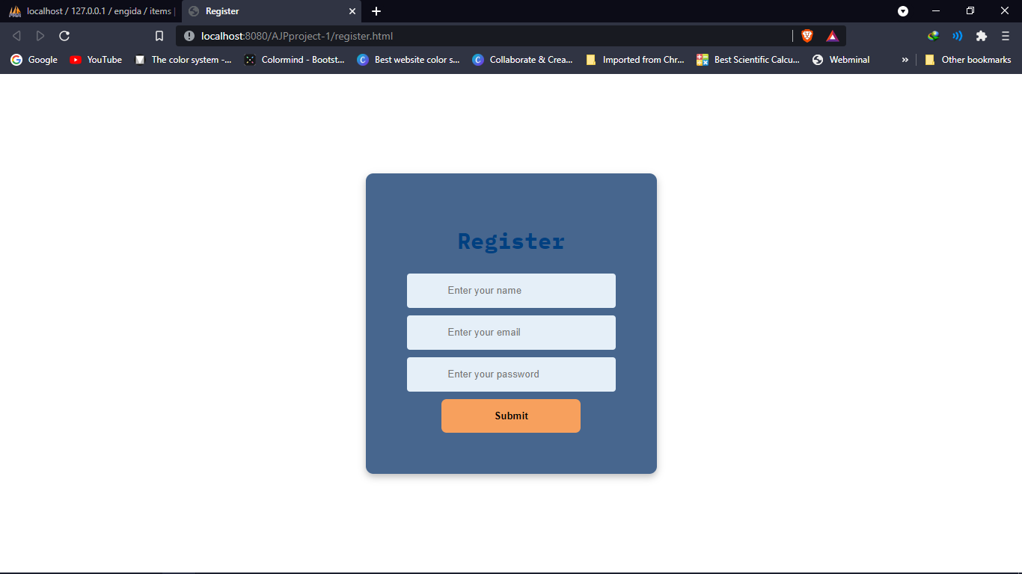
Registration page

Slide 3
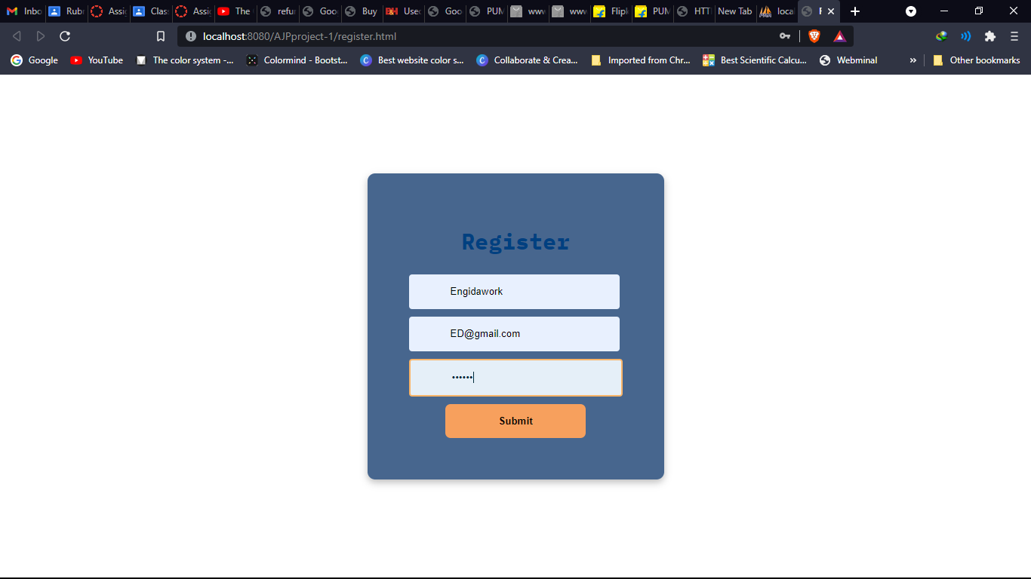
Registration page with data

Slide 4
After registration of you name, email and password you will redirect to the home page.

Slide 5
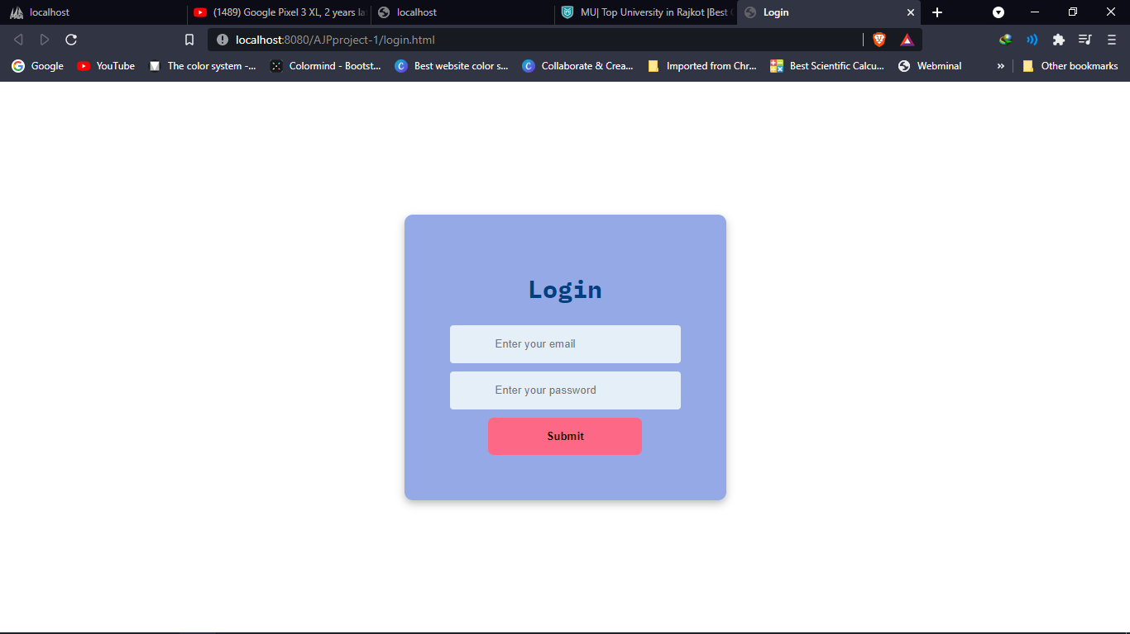
Login page

Slide 6
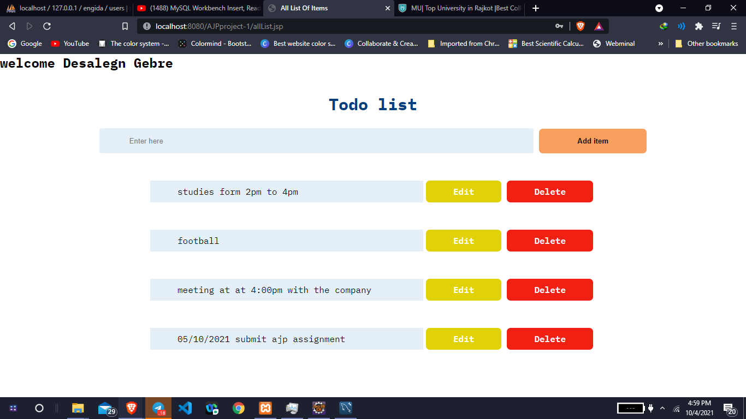
This is the home page that you get you name at the top of the page it says welcomea and your name I did this using session. Below that there is a list of things you will do you can add any to-do list and it will append it bellow

Slide 7
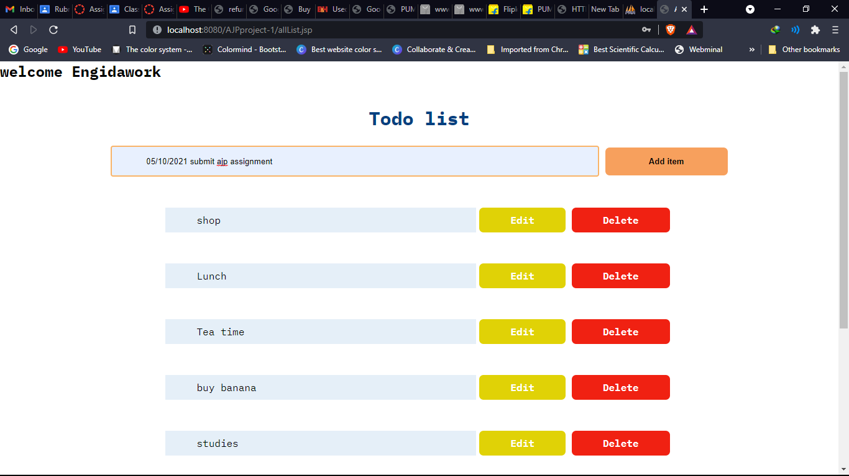
Adding items to the list it will be registered in the database and append bellow the list

Slide 8
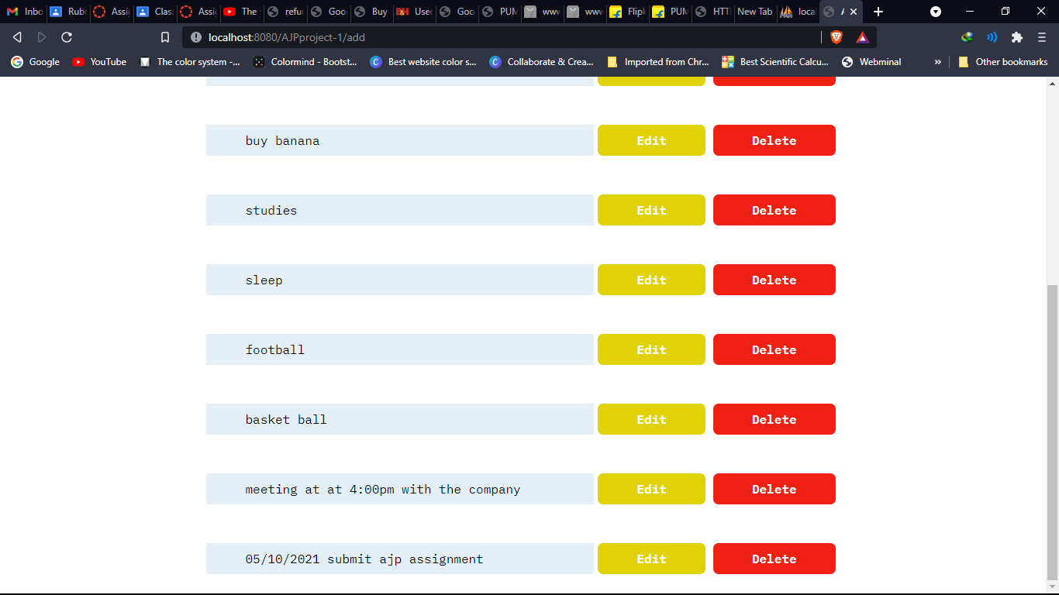
Added item is appended below the list

Slide 9
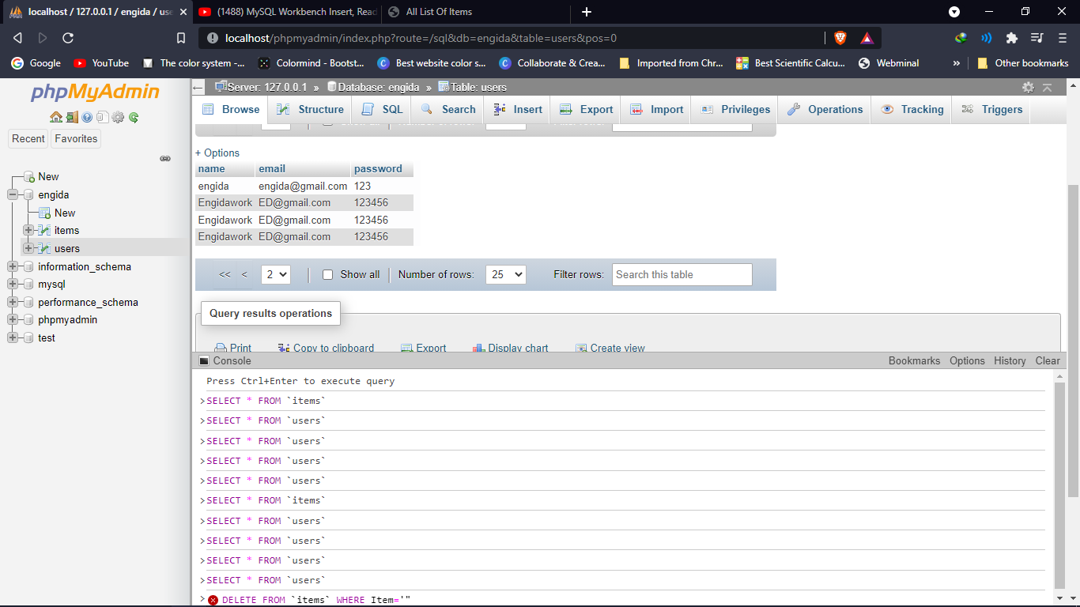
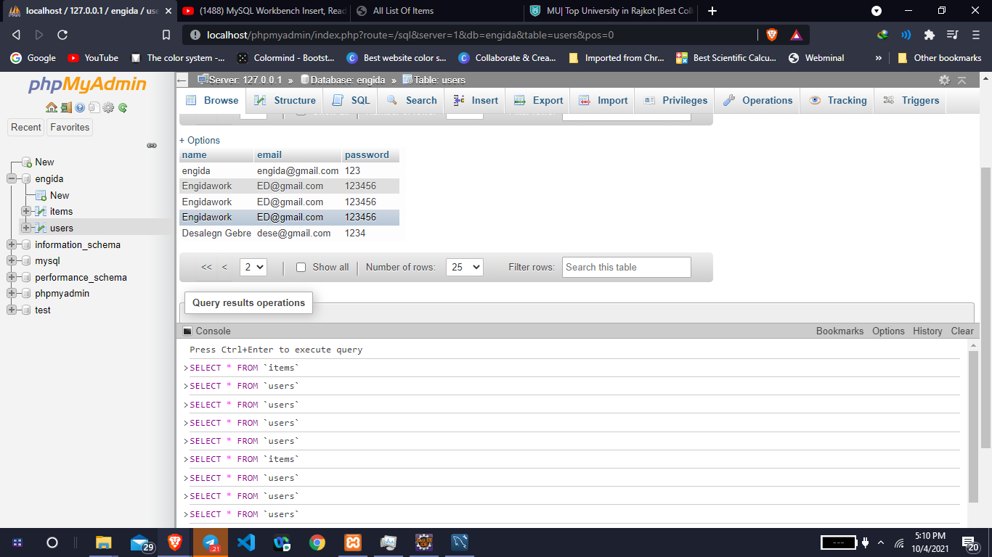
This is the user database table which are registered. Our data is entered to database.

Slide 10
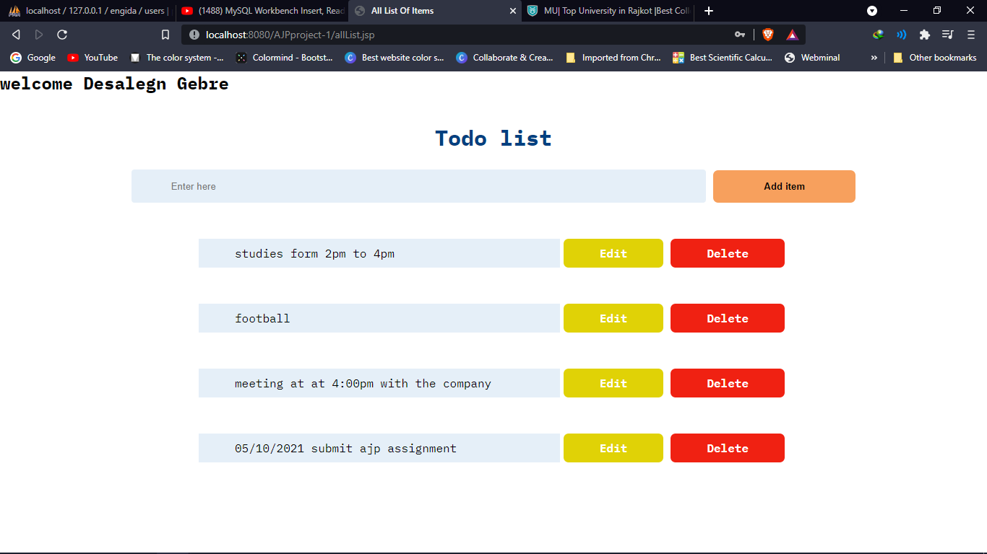
On the home page we can do the to-do list there are four operations (create, update, delete, edit)

Slide 11
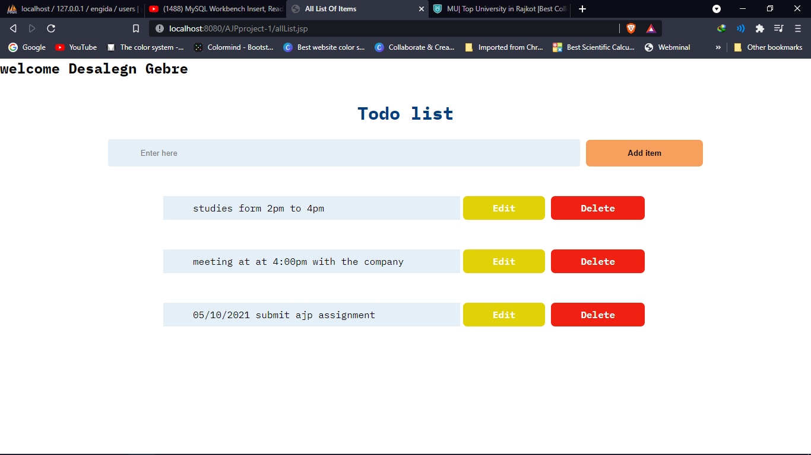
After deleting one item

Slide 12
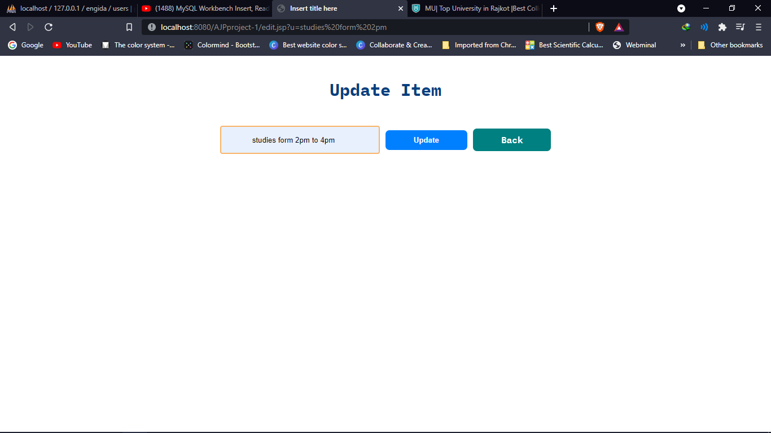
Editing one item

Slide 13

After editing the first item

Slide 14
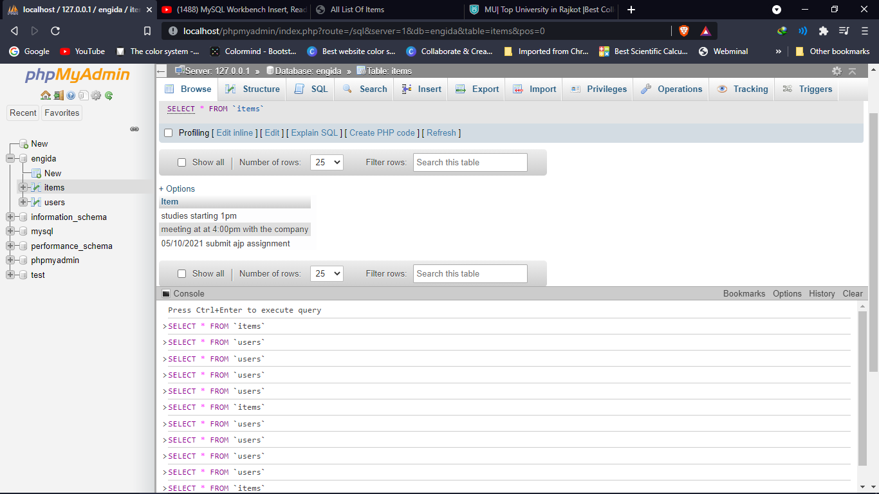
The database after deleting and updating the list

