Slide 1
Switching Power Supply Design: EMI Reduction
<numero>
Notes:
<numero>

Slide 2
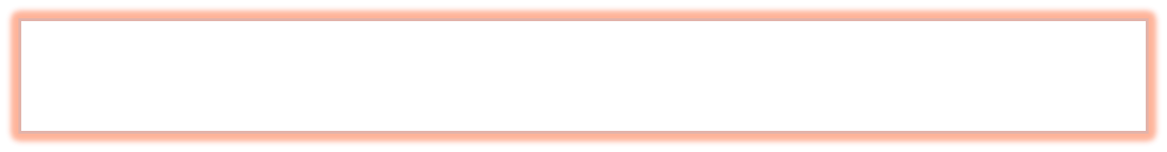
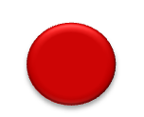
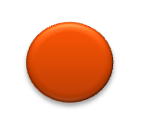

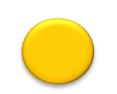

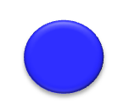
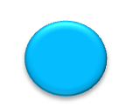
AGENDA
Introduction – EMI Overview
✓
Noise Sources Identification
✓
Minimize EMI Generation by Layout
✓
Protect Sensitive Circuits From Noise
✓
Conducted EMI and EMI Filters
✓
Summary
✓
© 2011 National Semiconductor Corporation.
<numero>
Notes:
Transcript:
So, the agenda for this presentation, I'll start with an introduction of EMI problems in switch mode power supply, and then, how to identify the source of the noise in such topologies, then how to reduce the noise generation by PCB layout. And at the same time, how to protect the sensitive circuits on the same board from the noise, and then, I will cover briefly conducted EMI and the EMI filter. After this section, there will be an isolated and a high-power density PowerPoint design prepared by Youhao Xi.

Slide 3
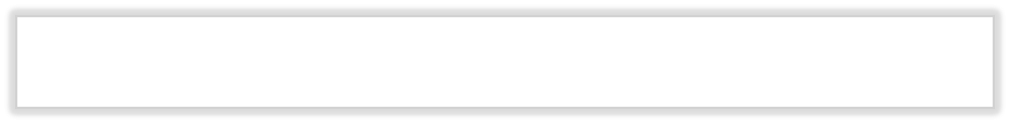
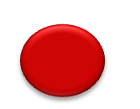

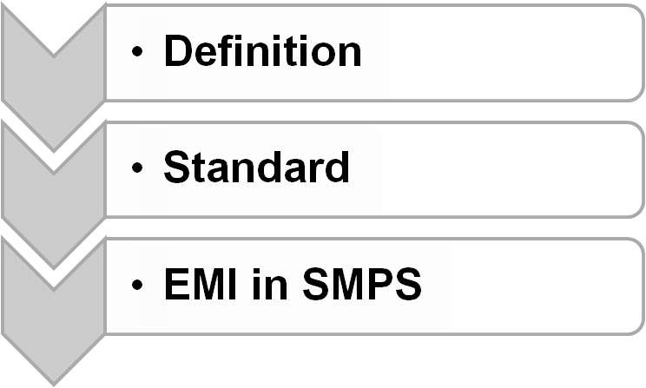




AGENDA
Introduction – EMI Overview
✓
Noise Sources Identification
✓
Minimize Noise Generation by Layout
✓
Protect Sensitive Circuits from Noise
✓
Conducted EMI and EMI Filters
✓
Summary
✓
<numero>
Notes:
<numero>
So, the first part of my presentation is an introduction. I will talk about the definition of the EMI, the standards, and the EMI problems in switch mode power supplies.

Slide 4
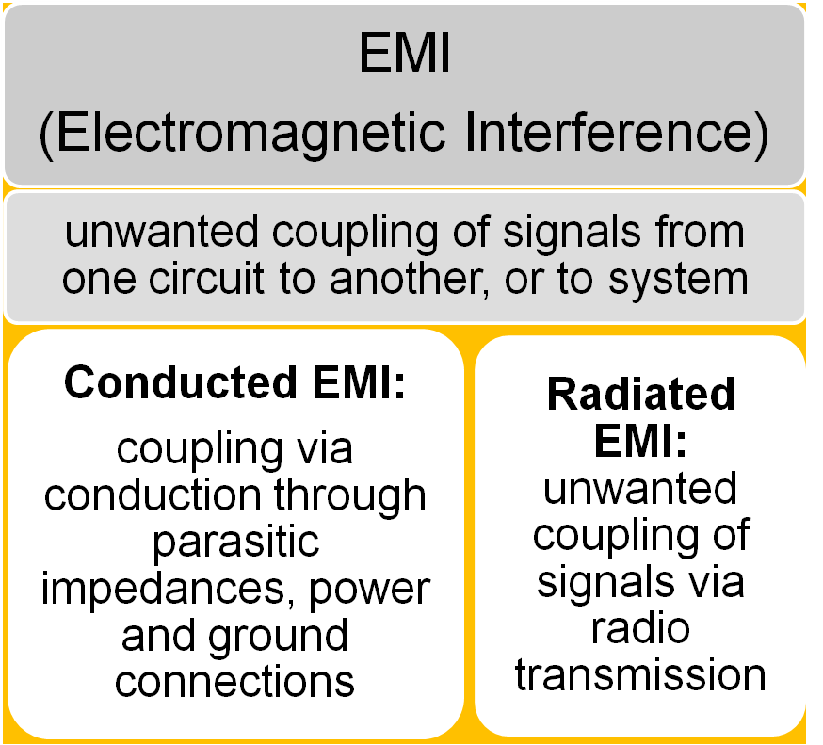
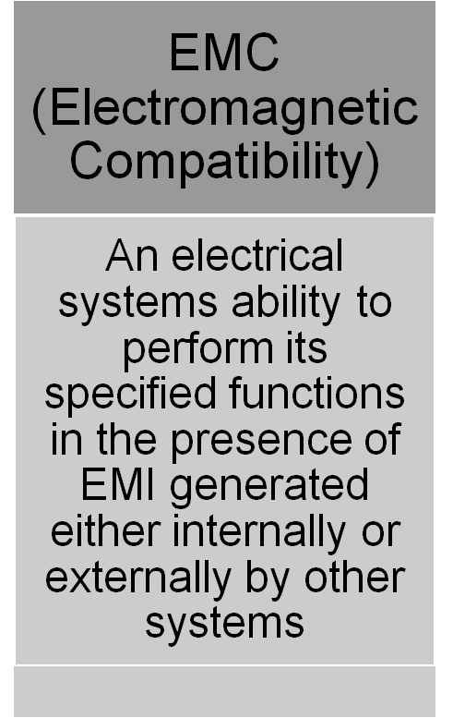
What is EMI & EMC?
<numero>
Notes:
EMI stands for electromagnetic interference. They are unwanted coupling of signals from one circuit to another or to the whole system. It has two major parts.
One is conducted EMI. One is radiated EMI.
Conducted EMI is coupled via conductions through the parasitic impedance, the power, and ground connections.
Radiated EMI are coupled through radio transmissions, and EMC stands for electromagnetic compatibility. It stands for electrical systems' ability to perform its specified functions in the presence of EMI generated by internally or externally by the other systems,
<numero>

Slide 5
EMI/EMC Standards
EMC Standards vary by…
  Region
    US = FCC
    Europe = CISPR = EN
  Application usage
    Consumer
    Medical
    Automotive
  What standards do we use
    FCC part 15 B
    CISPR 22 = EN 55022
<numero>
Notes:
<numero>
<numero>
The standards can vary by the region, by the application, so even two customers who are trying to use the same IC, they can apply totally different standards. So pay attention to special region and applications of a particular customer. And the standards we usually apply for our power supply is FCC part 15, sub-part B, and CISPR 22, which is the same as EN 55022,

Slide 6
EMI/EMC Standards Organizations
United States
Electrostatic Discharge Association (ESD)
Federal Communication Commission (FCC)
Institute of Electrical and Electronic Engineers (IEEE)
Institute of Interconnecting and Packaging Electronic Circuits (IPC)
National Institute of Standards and Technology (NIST)
International Society for Measurement and Control (ISA)
National Standards System Network (NSSN)
Society of Automotive Engineers (SAE) International
Telecommunication Industry Association (TIA)
Underwriters Laboratories, Inc (UL)
US Standard Developing Organizations (ANSI)
International
European Committee for Electrotechnical Standardization (CENELEC)
European Telecommunications Standards (ETSI)
Institute of Electrical and Electronic Engineers (IEEE)
International Electrotechnical Commission (IEC)
International Organization for Standardization (ISO)
International Special Committee on Radio Interference (CISPR)
International Telecommunication Union (ITU)
<numero>

Slide 7
Links
EU EMC Directives: http://ec.europa.eu/enterprise/sectors/electrical/documents/emc/legislation/index_en.htm
EU EMC Standards List (24 Feb 2011):
http://eur-lex.europa.eu/LexUriServ/LexUriServ.do?uri=OJ:C:2011:059:0001:0019:EN:PDF
FCC Rules (Title 47 Telecommunications, Part 2): http://www.access.gpo.gov/nara/cfr/waisidx_10/47cfr2_10.html
FCC Rules (Title 47 Telecommunications, Part 15) Information Technology Equipment (ITE):
http://www.access.gpo.gov/nara/cfr/waisidx_10/47cfr15_10.html
FCC Rules (Title 47 Telecommunications, Part 18) Industrial, Scientific, & Medical Equipment (ISM):
http://www.access.gpo.gov/nara/cfr/waisidx_10/47cfr18_10.html
FDA Inspection and Compliance (Medical devices are exempt from FCC regulations):
http://www.fda.gov/ICECI/Inspections/InspectionGuides/ucm090621.htm
<numero>

Slide 8
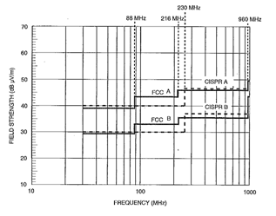
Conducted vs. Radiated Emission Limits
Conducted
Radiated
FCC/CISPR Conducted Emission Limits
FCC/CISPR Radiated Emission Limits
Measured at 10m
FCC and CISPR standards the same
FCC and CISPR standards somewhat different
FCC B (consumer) much more stringent than FCC A (commercial, industrial, and business)
<numero>
Notes:
<numero>
<numero>
<numero>
We showed the two most commonly used standards in our power supply design for both conducted and radiated in this slide. So, the CISPR and FCC standards are pretty close to each other, and CISPR is stricter than the FCC in the radiated specs.
Class B is even more restricted than Class A. So, we trying to design our power paths as Class B, so that it can be used by all the customers in different regions,
Conducted limits ends at 30Mhz
Radiated limits start at 30Mhz
If you fail conducted you will probably fail radiated.

Slide 9
How Does Noise Show Up in the System?
NOISE SOURCE
Emissions
ENERGY COUPLING MECHANISM
Conducted
Electric Fields
Magnetic Fields
Radiated
Low Frequency
Low, Mid Frequency, LC Resonance
High Frequency
SUSCEPTIBLE SYSTEM
Immunity
<numero>
Notes:
<numero>

Slide 10
Engineering Approach To Mitigate EMI
NOISE SOURCE
Identify Significant EMI Sources
Unwanted Emissions
EMI Filters
Shielding
Figure Out EMI Coupling Paths
ENERGY COUPLING MECHANISM
Conducted
Electric Fields
Magnetic Fields
Radiated
Engineer Circuit Layout To Mitigate EMI
EMI Filters
Shielding
Add EMI Filter / Snubber / Shielding
SUSCEPTIBLE SYSTEM
<numero>
Notes:
So, as power engineers, what should we do to reduce the problem? We shall start with identifying the source of the noise, and then, figure out the path of the noise transmission. Then, use the proper PCB layout to reduce the noise generation and the transmission. If these are not good enough, we can add some EMI filters, add some snubbers, and some additional shielding to add further protection to the susceptible systems.
<numero>

Slide 11


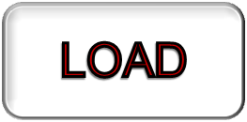

SMPSs Are Big Generators Of Radiated And Conducted Emissions
Due to
  High power
  High di/dt on the switches and diodes
  Fast transients (voltage and current)
  Not generally enclosed (not shielded)
  Parasitic inductance and capacitance in current paths
Causing
  Noise Conducted to Supply and / or Load
  Interfere with circuits in the same system
  Interfere with other systems
<numero>
Notes:
<numero>
<numero>
Switch mode power supplies are generally big generators of radiated and conducted emissions. Due to its high-power, high di/dt on the power switches, fast transitions, and the fact that they are not generally enclosed. This is exacerbated by the parasitic inductance and capacitance in the current paths.
Switch mode power supplies can also generate large conducted emissions that might make it back to the supply or the load, and compromise their operation.

Slide 12
Electrically Small Loop Antennas
Electro Magnetic Field Energy is *:
  f: frequency of interest (Hz)
  A: loop area of the current path (meters squared)
  I : Current magnitude at the frequency of interest (A)
  r is measured distance between source and receiver (meters)
*Henry Ott’s classic Noise Reduction Techniques in Electronic Systems
<numero>
Notes:
This comes from Henry Ott's EMI reduction techniques. It claims that the electromagnetic field energy is proportional to the square of the frequency. And also, it's proportional to the loop area enclosed by the current paths and proportional to the current magnitude at the frequency of interest and the inverse proportional to the measured distance from the source of the noise. So, it comes to a conclusion from here that to reduce the noise generation, we could reduce the switching frequency. We could reduce the high-frequency component in the di/dt current transition or we can reduce the high-frequency current loop area.
<numero>

Slide 13
Theory Behind EMI Mitigation by PCB Layout
Any Current must go from a source of energy and they must RETURN to the same source
Self Inductance
Voltage Spike
Reduce loop area reduces L
B fields cancel each other if current return path is close to current path
<numero>
<numero>
Notes:
<numero>
First of all, a current. A current always has to come from a source of energy, and they must go back to the same source. So, there will always be a current loop, and the self-inductance of the current loop is proportional to the area enclosed by the current loop. If there is di/dt current transition exists in the current loop-- a voltage spikes is going to be generated, and the voltage spikes is proportional to its self-inductance and proportional to the di/dt.
If we can reduce the loop area similar to the picture shown at the bottom, you can see that the loop area is largely reduced. So, the self-inductance can be smaller, and the voltage spikes can be reduced. Also, if the current return paths can be very close to the current paths, the B field generated by the two opposite direction current can be almost canceled.

Slide 14
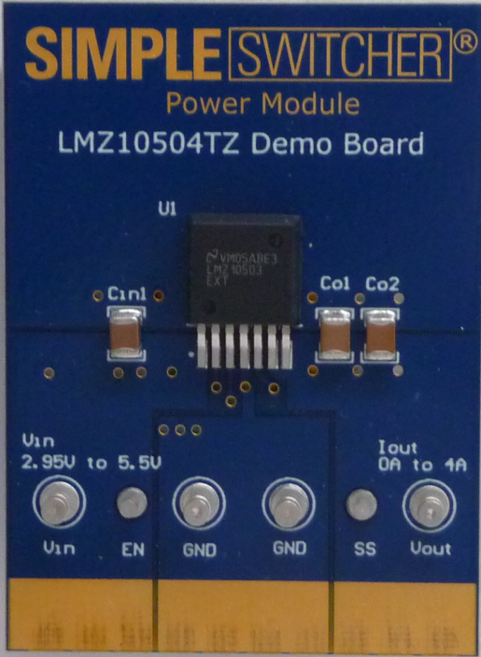
Theory Behind EMI Mitigation by PCB Layout
Which PATH is the current going to take?
Current Takes the Path of Least IMPEDANCE, NOT the Path of Least RESISTANCE!
Z = R + jX
  High freq components contained by high di/dt current can go through different path than their low freq counterpart
Thus, the loop area enclosed by high freq components can be completely different
HF Current Path
DC Current Path
<numero>
Notes:
<numero>
How can we identify the paths that the current is going to take?
It comes from the characteristic of the current. It always takes the path of the least impedance, but not the path of the least resistance. And the impedance is a combination of the resistance, the inductance, and the capacitance on the path. So, the high current components contained by the high di/dt current can go through different paths than their low-frequency counterpart, and the loop area enclosed by the high-frequency component can be completely different as well. An example is shown on the right by a Simple Switcher Power Module board. So, the right arrow shows the DC current paths defined by the PCB layout design when you do the board. You have input current go in from Vin and go out to ground, and the output current go out to Vout and go back to ground. But the high current component in the input and output current is going to see the capacitors as smaller impedance paths at high frequency. So, the paths they are going to go is shown by the current loops on the picture, and is completely different than the DC current path.

Slide 15
Theory Behind EMI Mitigation by PCB Layout
ElectroMagnetic Field Energy is Proportional To*:
  f²: frequency of the harmonic of interest
    From switching frequency and di/dt
  A: loop area of the current path
  I_{f}: current magnitude at the frequency of interest
  1/r: measured distance r
Reduce Noise Generation
  Reduce fsw and high freq component in di/dt
  Reduce high freq loop area
*Henry Ott’s classic Noise Reduction Techniques in Electronic Systems
<numero>
Notes:
<numero>

Slide 16
EMI Mitigation
Choice of Switching Frequency
Not just for efficiency/space trade-offs
Beware of EMI “keep out” zones
  Automotive = 500kHz < AM Band > 2MHz
  ADSL = >1.24MHz to avoid channel interference
  Harmonics
Choose switching frequency that keeps beat frequency and harmonics out of the EMI range
Spread-Spectrum Switching
LM5088 dithers frequency
and shows up to 20dB
decrease in EMI
Fundamental switching frequency spike reduction and sidebands using spread spectrum switching in the LM5088
<numero>
Notes:
<numero>
<numero>
<numero>
<numero>
We discussed briefly the choice of switching frequency in terms of meeting conducted emissions, but also it could be application specific. For example, there may be keep out zones that the customer's trying to meet. He has a range of frequency where it needs to be particularly quiet at because he's sampling at that rate, for example. For automotive applications, we know that it has an AM receiver; And typically in the old cars you'll put it on the AM band and you're twiddling with the knob, and you press on the accelerator, you can actually hear the engine, the revs per minute. You can hear the (inaudible) on the radio. That's typically an EMI problem. That band is between 500KHz and 2MHz, so automotive applications are particularly sensitive to noise in that range.
Another technique, if you like, for minimizing EMI noise is spread-spectrum switching. As you can on the graph on the right hand side, you can see where you're not dithering the frequency, you can see a huge energy pulse at the switching frequency. However, for example, by using the LM5088, this dithers the frequency in a controlled fashion by plus or minus 5%, thereby spreading the energy that's seen in the frequency domain over a wider range, bringing its peak to a lower level. And thereby it could be the difference between passing and failing EMI certification.

Slide 17
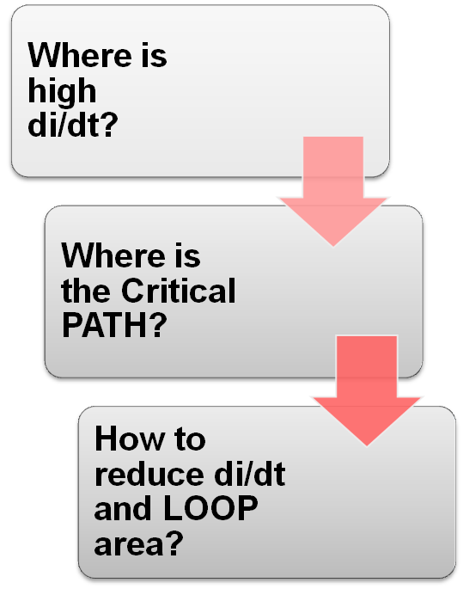
Steps To Mitigate EMI In PCB
Switching components generate high di/dt current ➔ where is the return path?
Loop Contains high di/dt current is CRITICAL PATH.
Slow down switching action
Reduce high freq path enclosed area
<numero>
Notes:
And so, in switch mode power supply PCB design, we should first identify the location of the high di/dt noise, and then, identify the return paths of the high di/dt current, which we call the Critical Paths of the board design, and then, we can reduce the di/dt and reduce the loop area, to reduce the noise generation.
<numero>

Slide 18


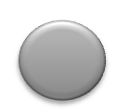

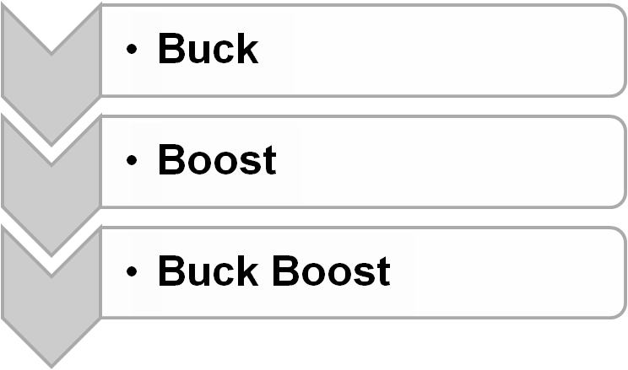




AGENDA
EMI Overview – definition and standards
✓
Noise Sources Identification
✓
Minimize EMI Generation by Layout
✓
Protect Sensitive Circuits from Noise
✓
Conducted EMI and EMI Filters
✓
Summary
✓
Isolated and High Power Density Power Supply Board
✓
<numero>
Notes:
<numero>
So, the first step is to identify the source of the noises in switch mode power supplies. So, in my section of the presentation, I'm going to cover the non-isolated DC-DC converter topologies, which is Buck converter, Boost converter, and Buck-Boost converter, and in the coming session, we'll cover the isolated converter topologies.

Slide 19
Identify Critical Path
Buck Converter
Switching Current exist in the input side
Boost Converter
Buck-Boost Converter
Critical path
<numero>
Notes:
<numero>
<numero>
<numero>
<numero>
In a Buck converter, it is obvious that the power switches is going to be part of the high di/dt loop, but which ground connection is more critical than the others? How we find out is by identifying the current path of the two sub-sections in switching period of this converter.
When the high-set FET is on, the current is going to go through the blue trace, and when the low-set FET is on, the current is going to through the pink trace, shown in this slide. And if a branch contains both of the two colored lines, that means 100% of the time of the switching period, there is current going through this branch, and we consider that a DC current path. If a branch only contains one of the colored lines, that means only a part of the switching period has a current going through this branch, and the current is going to be discontinuous.
So, we consider those to be high di/dt paths and the critical paths of the PCB layout. So, in Buck converter, this is shown as the shaded loop, which contains the high-side switch, the low-side switch, and the input capacitor.

Slide 20
Identify Critical Path
Buck Converter
Boost Converter
Buck-Boost Converter
Critical path
<numero>
Notes:
<numero>
<numero>
<numero>
<numero>
We can do the same thing in the Boost converter, and the critical path is contained by the two switching components and the output capacitor.

Slide 21
Identify Critical Path
Non-Inverting
Buck Converter
Boost Converter
Inverting
Critical path
Buck-Boost Converter
<numero>
Notes:
<numero>
<numero>
<numero>
<numero>
Now, inverting Buck boost is shown here, and the Buck boost. In both the input and output current are discontinuous.

Slide 22
What Can We Do In PCB Layout?
--Buck example
Buck Converter
Boost Converter
Buck-Boost Converter
Minimize critical path area
Separate noisy ground path from quiet ground
<numero>
Notes:
<numero>
<numero>
<numero>
Layout the pcb with the small loops. Sometimes extra capacitors are
Needed to bypass the noise.

Slide 23
What Can We Do In PCB Layout?
--Buck-Boost example
Non-Inverting
Buck Converter
Boost Converter
Buck-Boost Converter
<numero>
Notes:
<numero>
<numero>
<numero>
<numero>

Slide 24
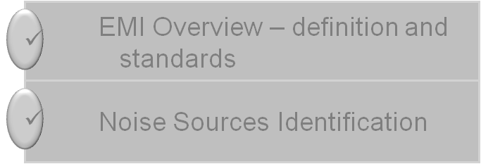

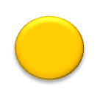
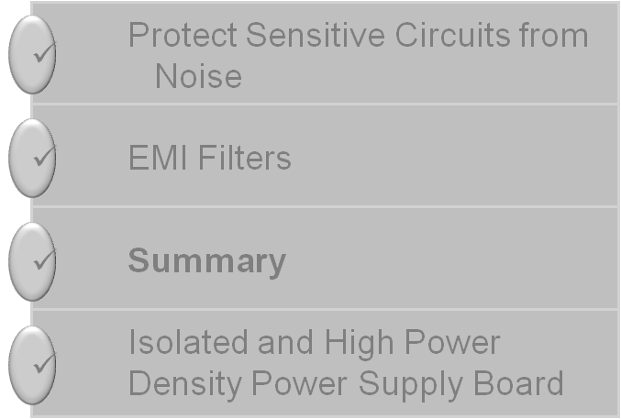
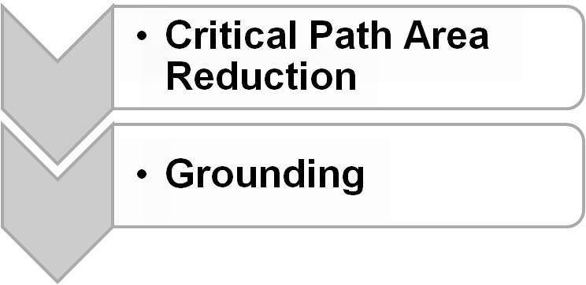
AGENDA
Minimize EMI Generation by Layout
✓
<numero>
Notes:
<numero>
So, now, we are going to talk about PCB layout. How do we minimize the EMI generation, and we are going to talk about it in two-folds. One is, how to reduce the path's loop area. The other is, how proper grounding can help in EMI reduction?

Slide 25


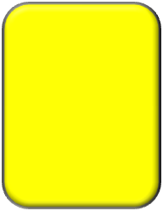
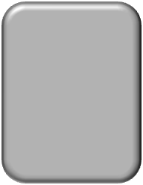

EMI Mitigation by PCB Layout
Critical Path Area Reduction
Grounding
BUCK Example
Bypass Caps in High di/dt loop should be placed as close as possible to the switching components
Low side FET SOURCE should be connected as close as possible to the input capacitor
Apply to critical paths in other SMPS topologies
High di/dt Caps
SW Node
FETs & Driver
<numero>
Notes:
So, we go back to the Buck example. As we said before, the goal is to put the Bypass Caps in the high di/dt loops as close as possible to the switching components. And the low-set FET source should be connected as close as possible to the Bypass Caps ground, and the same thing applied to all the other topologies.
<numero>

Slide 26
Lower EMI can be achieved by…
Place capacitors on
same side of board
as component being
decoupled
Locate as close to
pin as possible
Keep trace
width thick
and
minimized
Connecting to decoupling capacitors
Connecting to output capacitors
<numero>
Notes:
<numero>
<numero>
<numero>
<numero>

Slide 27
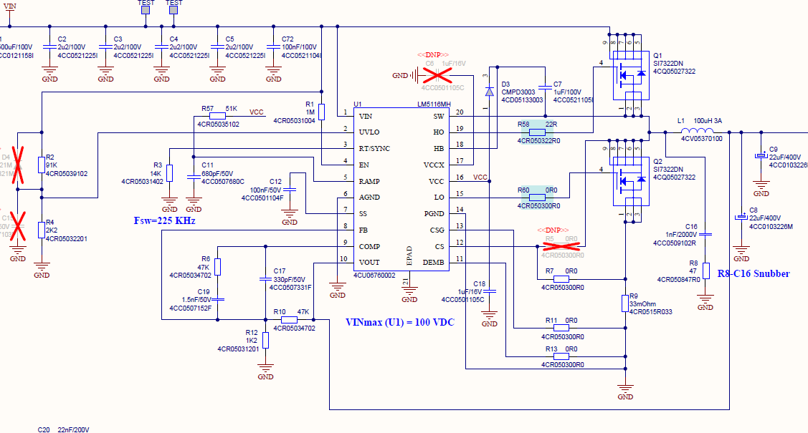
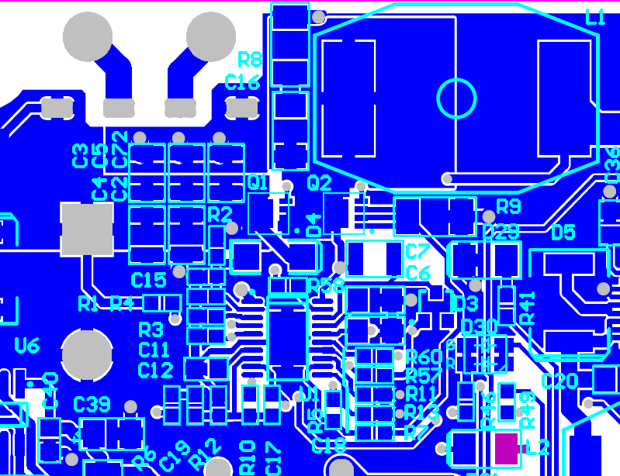
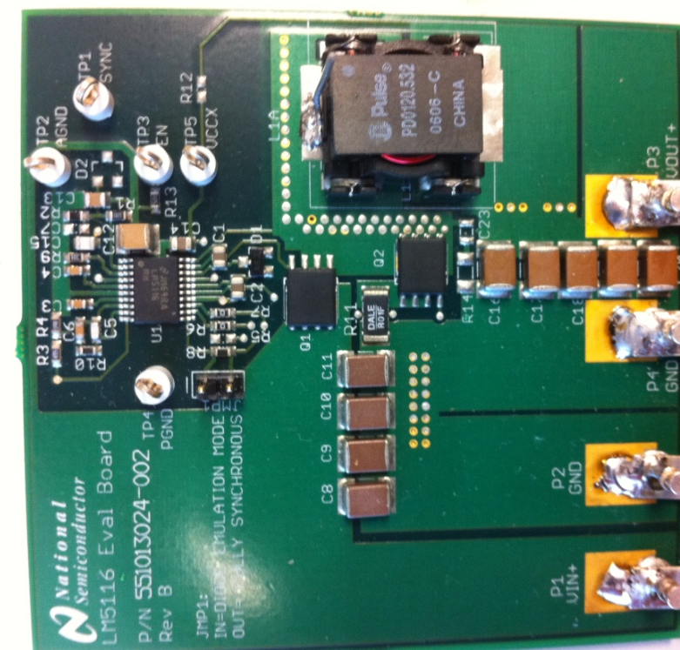
Customer Layout Example
BUCK controller Input Cap GND connection
Input Cap GND
LS FET GND
Bad Layout
Good Layout
Input Cap GND
LS FET GND
LS FET GND
Input Cap GND
<numero>
Notes:
<numero>

Slide 28


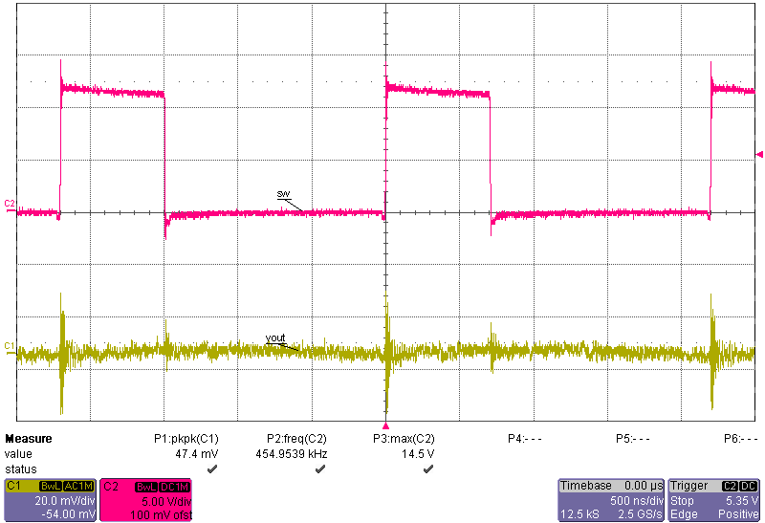
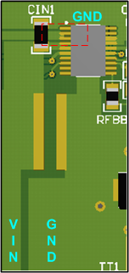
EMI Mitigation by PCB Layout
Critical Path Area Reduction
Grounding
Buck Regulator Comparison with Cin location (single Cin, smaller loop area)
High di/dt Caps
SW Node
SW 14.5V max
41dBµV/m
VOUT 47mVpp
FETs & Driver
VOUT
VIN
<numero>
<numero>
Notes:
Also, to show the effect of the high di/dt paths, bypass capacitors, we did an experiment here. We have only one -- this board is a Buck regulator switch amp load, and we only use one input capacitor for this comparison. And in the first case, the capacitor is put as close as possible to the IC pins, which contains the switching components inside. So, we measure the switch node at the peak current, the Vout peak-to-peak ripple, and the radiated EMI data.
<numero>

Slide 29
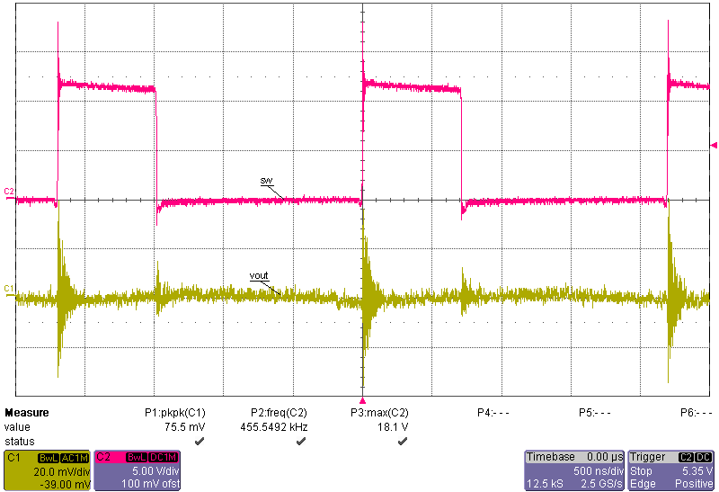
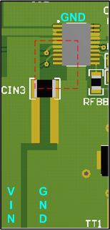
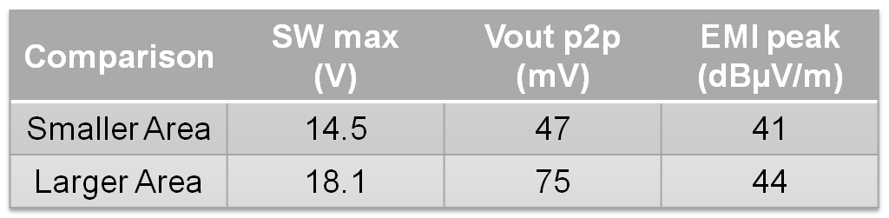
EMI Mitigation by PCB Layout
Critical Path Area Reduction
Grounding
Buck Regulator comparison with Cin location (single Cin, 2.5 times larger area)
High di/dt Caps
SW 18.1V max
SW Node
44dBµV/m
FETs & Driver
VOUT 75mVpp
<numero>
<numero>
Notes:
And as a comparison, the input capacitor is moved to be a little bit further away from the pins, and the loop area is about 2.5 times bigger comparing to the first case. And the measurement we did, we see that the switch node maximum voltage is about 3.6 volts more, and the Vout peak-to-peak ripple is about 50% more, and the EMI peak also shows 3 dB micro volt per meter more. And all the other parts of the board -- all the other part of the BOM are identical in this comparison.
<numero>

Slide 30
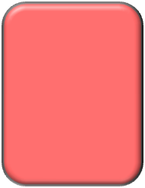
EMI Mitigation by PCB Layout
Critical Path Area Reduction
Grounding
SW Swings from V_{IN} or V_{OUT} to ground at Fsw. Very high dv/dt node! Electrostatic radiator
Requires a contradiction:
  As large as possible for current handling,
  yet as small as possible for electrical noise reasons
Solutions:
  Switch node short and wide
  Minimum Copper Width Requirement:
    Roughly 30mils/Amp for 1 Oz Cu and 60 mils/Amp for ½ Oz Cu, or
    Where T = Trace width in mils, A is current in Amps, and CuWt is copper weight in Ounces. Formula approximates IPC recommendation for a 10 degree rise for currents from 1A to 20A.
High di/dt Caps
SW Node
FETs & Driver
<numero>
Notes:
After talking about the bypass capacitors, there is a node in this high di/dt loop we normally call the switch node because the voltage swings from Vin or Vout to ground at the switching frequency, and it is a very high dv/dt node. It can be a radiator of EMI, but the layout of this node has a contradiction.
It should be as big as possible for the current handling and thermal handling, and yet, as small as possible to reduce the noise radiation. So, the solution should be that we should keep the inductor as close as possible to the FETs and keep the switch node trace to be short and only as wide as necessary to carry the current.
To make matters worse the SW is also often a heat-sink for the low side switch.
<numero>

Slide 31
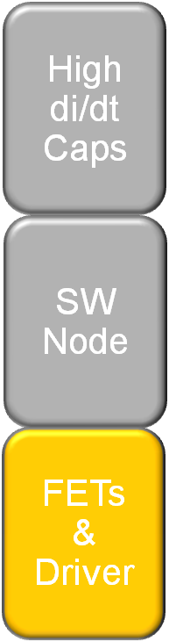
EMI Mitigation by PCB Layout
Critical Path Area Reduction
Grounding
Minimize loop area enclosed by high-side FETs, low-side FETs, and bypass caps
Connect the low-side FET’s source to the input- cap ground directly on the same layer, then connect to the ground plane
Use copper pours for drain and source connections to power FETs
Minimize stray inductance in the power path
<numero>
Notes:
<numero>

Slide 32
EMI Mitigation by PCB Layout
Critical Path Area Reduction
Grounding
Gate drives are also high di/dt paths, lower current level
Place drivers close to MOSFETs
Keep C_{BOOT} and V_{DD} bypass caps very close to driver and FETs
Minimize loop area between gate drive and its return path: from source of FET to bypass cap ground
Minimize stray inductance in the power path
  Avoid vias in di/dt path
  Short trace and width > 20mil for C_{BOOT}, C_{VDD-bypass}, and Gate drive
<numero>
Notes:
Gate drive signals are also high di/dt signals. They just have smaller power level comparing to the power track current.
So, the drivers should also be placed as close as possible to the MOSFETs, and the Boot capacitors and the VDD bypass capacitors should be placed as close as possible to the drivers and the FETs. And the loop area between the gate drive and its return paths should be as small as possible, the paths being from the source of the FET to the bypass caps ground. To minimize the stray inductance in the gate drive paths, vias should be avoided in the gate drive signal, and also the traces for the Boot cap, the Bypass caps, and the gate drive would be best to be short and wide.
<numero>

Slide 33
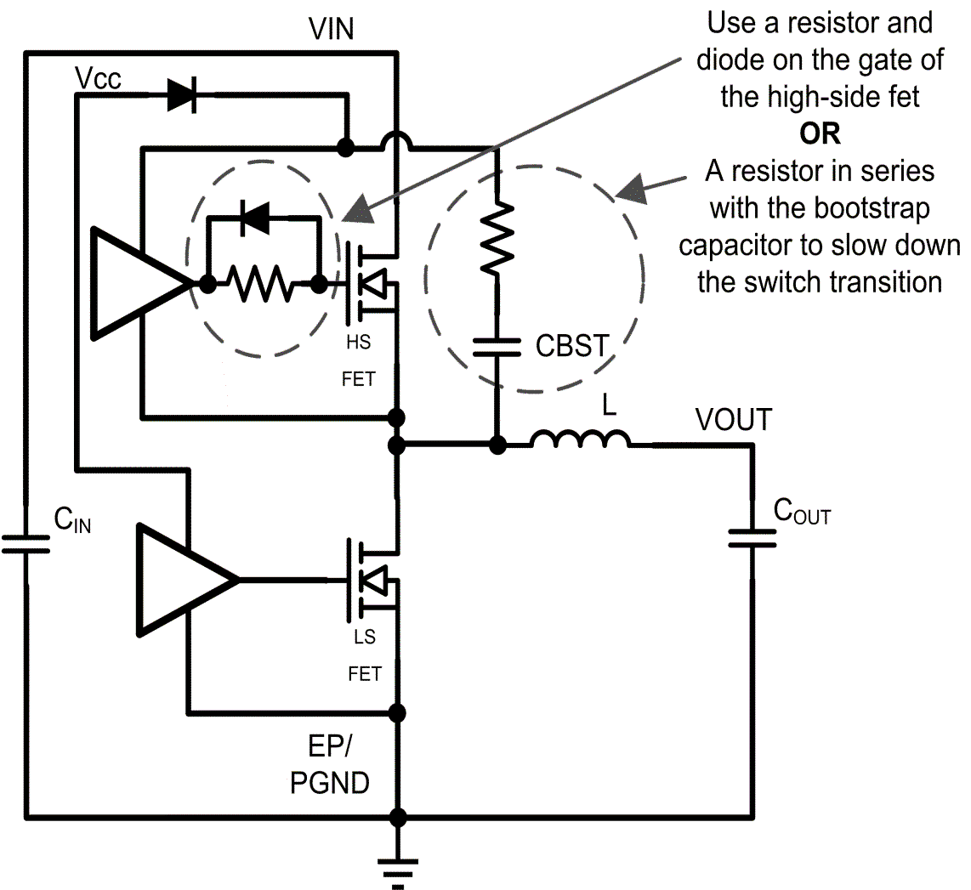
EMI Mitigation by PCB Layout
Critical Path Loop Reduction
Grounding
Contradiction on SW node transition rate:
Faster Rising and Falling Times
= Less Losses
=Higher EMI
Resistor Value:
Start with 1-10 ohms and adjust from there
<numero>
Notes:
Here is another contradiction in the switch node transition rate design. If you have a faster rising and falling time on the switching current, which is controlled by the gate drive of the MOSFET, then you will have smaller switch losses, but at the same time, the EMI generated by the di/dt is going to be higher.
So, here, I showed two options of how to slow down the rise and fall time of the power MOSFET if it is needed. The idea is to add gate resistors to slow down the Pin and Pout time. The resistor should be kept to about 1 to 10 ohms, and if in a controller case, you have access to the gate, then a schottky diode can be added in parallel to the gate resistors to increase the falling time, and also to pull on the gate harder to reduce the likelihood of shoot-through problems.
<numero>

Slide 34


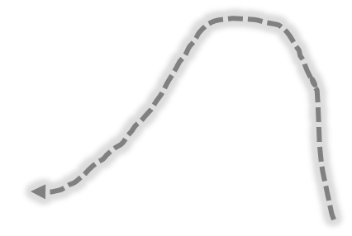



EMI Mitigation by PCB Layout
Critical Path Loop Reduction
Grounding
Ground Plane
  Return Current Takes The Least IMPEDANCE Path
  Unbroken Ground Plane Provides Shortest Return Path – Image current return path
Trace or Cut on the ground plane
Ground Plane
Current flow in top layer trace
Ground Plane
Return current path in unbroken ground plane directly under path
Area minimized
B field minimized
Return current path enclose much larger area if the direct path is blocked
<numero>
Notes:
So, after talking about the critical paths loop reduction, I want to also cover how to design the ground plane and shielding and how that is going to help with the EMI problem. So, an unbroken ground plane could provide the best -- the least impedance paths for a counter trace on the top or on the bottom to return to the current source. And if the current is right on top of each other, the loop area is minimized, and the EMI generated by the loop is small as possible, and the B-field can be canceled as well. The case shown on the right that if you have a cut in the ground plane, then, the return current has to find a longer path to go around the cut, to return to the current source. Then, the area enclosed by the current is much bigger and the EMI problem is going to be worse.
<numero>

Slide 35
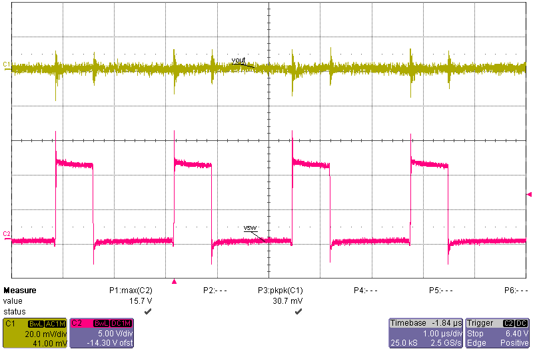
EMI Mitigation by PCB Layout
Critical Path Area Reduction
Grounding
Ground Shielding Example – Two Layer Board
VOUT 30mVpp
SW 15.7V max
32.5dBμV/m
<numero>
Notes:
In the first case, we have a two-layer board, which is also a Buck regulator 3 amp load level, and we also married the Vout peak-to-peak ripple, the switch node maximum voltage spike, and also, the radiated EMI number.
<numero>

Slide 36
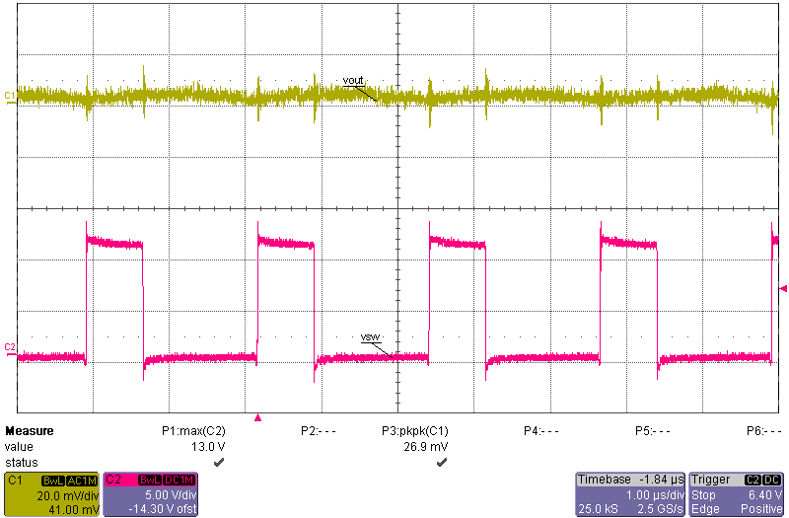
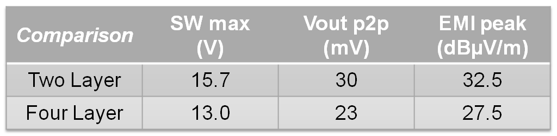
EMI Mitigation by PCB Layout
Critical Path Area Reduction
Grounding
Ground Shielding Example – Four Layer Board w/ Identical Layout / BOM – Two GND Planes in between
VOUT 23mVpp
SW 13V max
27.5dBμV/m
<numero>
Notes:
It's the same board. It's the same layout and it's the same BOM and it's the same part as built up in a four-layer board with two ground planes in the middle, and to compare the things we care about. We can see that at the switch node, peak ripple is reduced by 2.7 volts. The peak-to-peak on the Vout is 7 millivolt smaller, and also, the peak of the radiated EMI is 5 dB microvolt per meter smaller.
<numero>

Slide 37
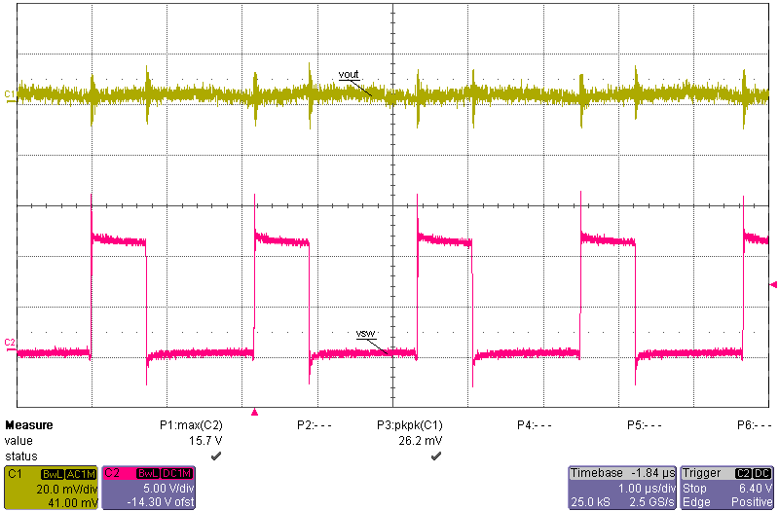
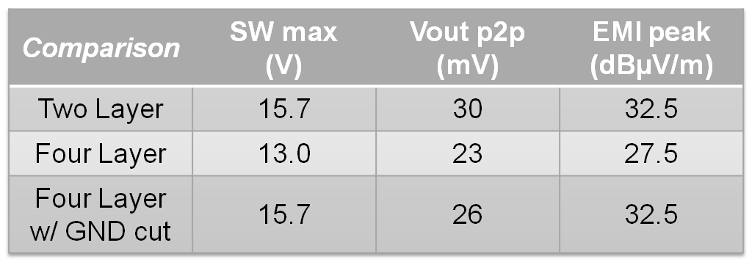
EMI Mitigation by PCB Layout
Critical Path Area Reduction
Grounding
Ground Shielding Example – Four Layer Board w/ Identical Layout / BOM – w/ CUT under SW node
VOUT 26mVpp
SW 15.7V max
32.5dBμV/m
<numero>
Notes:
A third case we did is, all the same thing as before, but we have a cut on the ground plane right underneath the switch node. And then, from the table here, we can see that shielding is not as good as a solid ground plane. The switch node ripple, the Vout peak2peak and the EMI are all higher than the second case, which has two solid ground planes in between.
<numero>

Slide 38
EMI Mitigation by PCB Layout
Critical Path Area Reduction
Grounding
Ground Plane
  Unbroken Ground Plane provides shortest return path to EMI and Best Shielding
  Don’t cut ground plane
  Keep high power, high di/dt current away from ground plane, run separate paths on the top layer to contain it
  Ground plane is for DC distribution and signal reference only, ideally, there should be no current flow on ground plane
  Bypass to ground PINs, not the plane
<numero>
Notes:
General rules for the ground plane. An unbroken ground plane provides the shortest return path to EMI and best shielding. So, don't cut the ground plane, and we should keep the high power high di/dt current away from the ground plane. Run separate paths on the top layer to contain the high di/dt current. The ground plane is only for the DC distribution and signal reference. Ideally, there should be no current flow through the ground plane.
<numero>

Slide 39
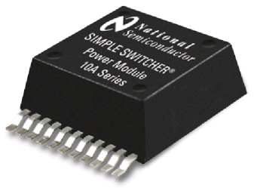
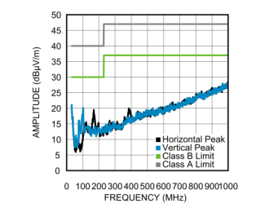
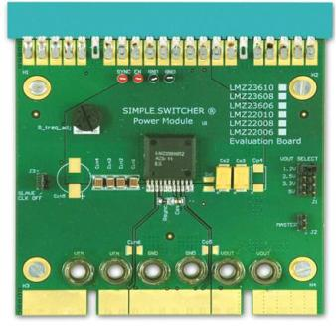
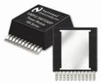
Switcher Power Modules
(LMZ23610)
15 mm
5.9 mm
Ease of Use
  Webench, Ease to mount & rework
  Internal Comp
Dual Lead frame
Built in Vin Capacitors to solve EMI issue, & shielded inductor
15 mm
2.8 mm
10 Amp Current Sharing Eval board
CISPR 22 Measurements
EMI Configuration
<numero>
Notes:
03/26/14
<numero>

Slide 40
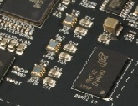
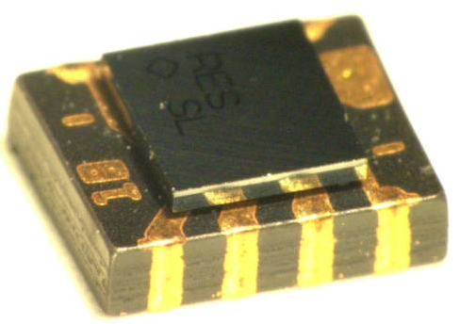
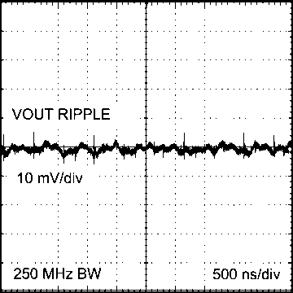
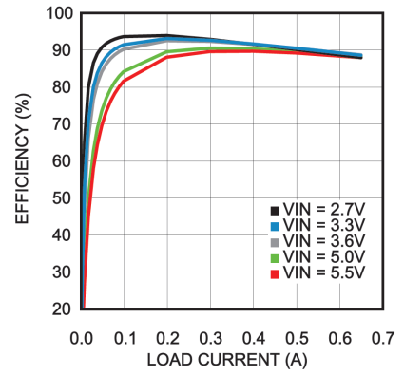
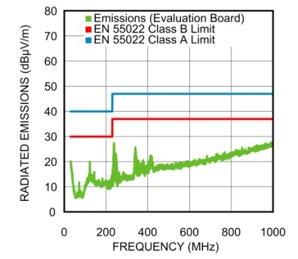
Nano Module – LMZ10501/0 (1A/650mA)
Extremely Small Solution Size
Place on front-side or back-side of PCB
LLP-8 Footprint
1.2 mm
2.5 mm
3 mm
Mounted on PCB
Expanded View
Excellent Performance
Low output voltage ripple
High efficiency
Fast transient response
C_{OUT} = 10uF
Vout = 1.8V
Low EMI
Complies with CISPR22 Class B Standard
<numero>
Notes:
<numero>

Slide 41
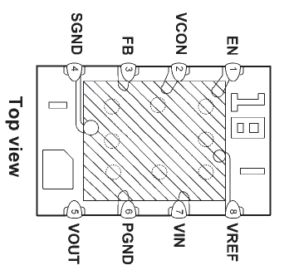


Innovative Packaging
Key Features:
  LLP Footprint
  Micro SMD is a standard National package running in high volume
  Moisture sensitivity level 3
  Standard soldering process
  Reliability testing on complete module according to NSC standards
  RoHS compliance to IPC 1752
1.2 mm
2.5 mm
3 mm
Top View
Side View
Solder Reflow Profile
<numero>
Notes:
Here is a closer look at the Nano Module packaging. At 2.5 x 3 x 1.2mm, the Nano Module is the smallest 1A DC/DC solution in the market today. It has a standard LLP-like 8 pin footprint with the silicon die as a uSMD mounted on top of the inductor. This uSMD silicon is a standard package that currently runs in high volume in our manufacturing facilities. This package has passed the moisture sensitivity level 3 test, the standard soldering process up to 260 degrees Celsius, and all reliability tests that come standard to any product from SIMPLE SWITCHER.
<numero>

Slide 42


Passing CISPR22 Class B Radiated EMI
The evaluation board with the default components complies with the CISPR 22 Class B radiated emissions standard.
5Vin, 1.8Vout, 1A load
10uF input capacitor
10uF output capacitor
1nF VCON capacitor
<numero>
Notes:
See AN-2168
<numero>

Slide 43





Nano Module - Cispr 25 Class 5 EMI (Radiated)
<numero>
<numero>
Notes:
<numero>

Slide 44




Passing CISPR 25 Class 5 Radiated EMI
Adding two small 0.1μF 0805 input capacitors results in CISPR 25 Class 5 radiated emissions standard compliance
<numero>
Notes:
<numero>

Slide 45




AGENDA
Protect Sensitive Circuits from Noise
✓
<numero>
Notes:
<numero>

Slide 46

Protect EMI Sensitive Nodes from Noise
Sensitive Nodes: Control and Sensing Circuits
Noisy Nodes: Any Nodes in High di/dt Loop
  Vout sensing path and feedback node
  Compensation network
  Current sensing path
  Frequency setting
  Monitoring and Protecting Circuits
  … …
  SW node
  Inductor
  High di/dt bypass caps
  MOSFETs
  Power Diodes
  … …
  Shielded by Ground / Power Planes
  Away from EMI source
<numero>
Notes:
On a switch mode power supply, we have all these noisy nodes in the high di/dt loop, and we also have some sensitive nodes including the control and sensing circuits, including the Vout sensing paths and the feedback node, the compensation network, the current-sensing paths, the frequency setting network, and the monitoring or protecting circuits, and more if you have more functions. Well, I think there are two ways to protect these sensitive nodes. One is to shield them by the ground or power planes, put them on the other side of the shielding. The other way, if you cannot -- if it is not possible to put them on the other side, then put them further away from the source of noise.
<numero>

Slide 47
Good Practice to Protect EMI Sensitive Nodes
Use Layers – four layer board stack-up plan
  Top: All high power parts and high di/dt paths, signals that can be routed away from high di/dt paths
  Mid1: Ground Plane
  Mid2: Ground Plane / Power Plane / Signal & low power traces
  Bottom: low power and signal traces
  Flood unused area with copper for improved thermal performance and shielding
Place and Route
  Keep all bypass caps close to pins
  The higher the impedance and/or gain, the smaller the node should be, especially inputs to op-amps: FB pin, comp pin, etc
  Low impedance nodes can be wide, such as VIN and VOUT
<numero>
Notes:
It is good practice to protect the sensitive nodes. One is to use the layers, and here, I have a commonly used four-layer board stack-up plan. We have the majority of the power components on the top layer. So, we keep the high-power high di/dt paths also on the top layer. And also, we can have some signals that can be routed away from the high di/dt paths on the top layer. And the middle layer one should be a solid, unbroken ground plane. The middle layer 2 can be a ground plane, can be a power plane, and can be a low-power and signal trace plane based on the complexity of the board you are designing. And the bottom is purely for the more sensitive nodes and traces and the components, so that we can put it on the other side of the shielding. And also, we should flood the unused areas with copper to improve the thermal performance and to have better shielding.
For place and route, general rule is to put all bypass capacitors as close as possible to the pins. The higher the impedance or gain of a node, the smaller the size of the node should be, especially the input to the op-amps. For example, the feedback node and the compensation, and the low impedance node can be wide, such as the Vin and Vout traces.
<numero>

Slide 48


Protect EMI Sensitive Nodes – Cont.
Make long runs to low impedance nodes, short runs to high impedance nodes. Apply to
  Place output voltage divider close to the FB node (high impedance), farther from Vout (low impedance), if have to choose
Route Sense+/Sense- traces parallel to one another – minimize differential-mode noise pickup. Apply to
  Current sensing traces
  Voltage remote sense lines
Keep sensitive small signal traces thin and further away from surrounding signals – lower capacitance coupling
<numero>
Notes:
Another thing we need to pay attention to is that, if you choose to run a long trace for the Vout feedback, you should run it from the Vout to the top of the resistor divider.
We know that the feedback node is a high impedance node. If any noise is coupled in it, voltage spikes are going to be generated, and in the contrary, the Vout is low impedance node. Any noises coupled can be conducted out. So, the best way is to put the resistor divider closer to the feedback node, and to run a longer trace to Vout if you have to choose.
For sensing traces, if you have differential sensing, for example, for the current sensing or Vout remote sensing, the two traces should be run in parallel to each other to minimize the differential mode noise pickup.
<numero>

Slide 49

Customer Layout Example
LM20k 5A Buck regulator
SW
FB trace
Identified layout problems
Vout sensing point is right under the inductor – noise pick up
FB trace route very close to SW node and di/dt loop – noise coupling
L
Res Divider
<numero>
<numero>
Notes:
<numero>

Slide 50
Customer Layout Example
More problems in this layout
COMP RC
GND
CIN
PGND pins
CIN GND to LS source path (high di/dt) undefined, through gnd plane
AVIN bypass cap gnd return path very long
Comp network close to high di/dt loop
AVIN
GND
<numero>
Notes:
<numero>

Slide 51

Check List
If your board can not pass Radiated EMI
  Check high di/dt loop layout, especially CIN gnd to LS FET source connection
  Check GND shielding
  Suggest Shielded L
  Use twisted pair at input / output (where switching current exists)
  Suggest to reduce f_{sw} or switch transition rate
  Consider adding conducted EMI filter (also alleviate Radiated EMI)
If your board is not working properly (no schematic reason) or too much volt spikes, check
  High di/dt loop layout
  GND shielding
  Sensitive nodes layout, especially FB divider and routing
  Sensitive node grounding
  Bypass caps
  Add small bypass caps (e.g. 47nF) to Vin and Vout as close as possible
  Add snubber to SW node
<numero>
Notes:
If a board cannot pass radiated EMI, what can you check?

Slide 52



AGENDA
Conducted EMI and EMI Filters
✓
<numero>
Notes:
<numero>

Slide 53





DM Conducted EMI
Differential Mode Conducted EMI
  In DC-DC converter topology, only Hot and Neutral lines, no CM EMI involved
  Involves the Normal Operation of the Circuit
  Does not involve Parasitics, except input / output CAP ESR and ESL
  Only Related to CURRENT, not voltage
  For example, with the same power level Buck converter, lower input voltage means higher input current, thus worse conducted EMI
Why we care?
  Excessive Input and/or Output Voltage Ripples can compromise operation of Supply and/or Load
<numero>
Notes:
Conducted EMI in the switch mode power supplies -- the switch mode power supplies always have two wires to connect it to the supply and to the load. So, any current goes in has to go out through the other wire, so the sum of the two currents is always zero. There is no common mode conducted EMI involved in the non-isolated switch mode power supply design. So, we only consider differential mode conducted EMI here.
For a differential mode, conducted EMI in switch mode power supplies, it involves the normal operation of the circuit. PCB layout cannot quite help to reduce the problem. It does not involve other parasitic except the ESR and ESL of the capacitor in the part with discontinuous current, and it is only related to the current of the discontinuous port, but not the voltage.
So, for example, in fixed power level Buck converter, if the input voltage is reduced, then the input current is going to be higher, and the differential mode conducted EMI problem is going to be worse. So, why do we care? The conducted EMI can go back to the power supply or go to the load, and could compromise their operation.
<numero>

Slide 54



DM Conducted EMI Mitigation
EMI filter design
  Add filter to prevent noise conducted to Supply or Load
  Must be designed so it does not affect SMPS stability
  See Application Note for practical EMI filter design (AN-2162)
(Buck)
<numero>
<numero>
Notes:
That’s why we should reduce them, and the effective way to do it is to add an EMI filter to prevent the high-frequency noise from going back to the supply or the load, but the filter added could affect the switch mode power supply stability.
<numero>

Slide 55

Input Filter Design for Conducted EMI
There are two basic requirements for the conducted EMI filter:
Must meet noise attenuation requirement to meet regulations (i.e. CISPR 22)
Must not interfere with the normal operation of the SMPS converter
  If filter impedance exceeds the negative impedance of the input supply, it will cause interaction and stability issues.
Example of a Buck regulator
No input filter
Fails CISPR 22 regulation limits
This regulator needs an input filter to meet regulations.
But how do we estimate how much filter attenuation to add?
<numero>
Notes:
Moving onto the next slide, we're going to discuss input filters for, let's just say, a DC to DC buck converter.
Let's say you just have an input in your buck converter, you want to minimize the amount of noise seen on the input for another switching supply.
Now one of the careful things we need to adhere to is the input filter will interact with our control loop of our buck converter. We're going to make sure that the output impedance of our input filter is much lower than the input resistance of our buck converter. The input resistance of our buck converter is negative. Now why do we say that? Input resistance is negative because as the voltage goes up on a buck converter, its current comes down. So we call it negative resistance. As I mentioned, the output impedance of our input filter needs to be much lower than the Rin.

Slide 56


Necessary Input Filter Attenuation
Methods of estimating the filter attenuation without LISN and Spectrum Analyzer
Method 1 – estimation using oscilloscope measurement
  Measure the input ripple voltage using a wide bandwidth scope and calculate the attenuation.
  VMAX is the allowed dBμV noise level for the particular EMI standard.
Method 2 – Estimation using the first harmonic of input current
  Assume the input current is a square wave (small ripple approximation)
  VMAX is the allowed dBμV noise level for the particular EMI standard.
  CIN is the existing input capacitor of the Buck converter.
  D is the duty cycle , I is the output current, Fs is the switching frequency
<numero>
Notes:
<numero>

Slide 57





Typical Conducted EMI Filter
Follow the design steps described in AN-2162.
Calculate the required attenuation using Method 1 or Method 2.
Capacitor CIN represents the existing capacitor at the input of the switching converter.
Inductor Lf is usually between 1μH and 10μH, but can be smaller to reduce losses if this is a high current design.
Calculate capacitor Cf. Use the larger of the two values (Cfa and Cfb) below:
Capacitor Cd and its ESR provides damping so that the Lf Cf filter does not affect the stability of the switching converter.
<numero>
Notes:
<numero>

Slide 58

Conducted EMI Filter Design Tool
Excel based tool is available to help design the conducted EMI filter.
The tool is based on the steps described in
AN-2162.
The filter design can be printed on one page.
double click to open calculator
<numero>
Notes:
<numero>

Slide 59


Conducted EMI Before and After Filter
VIN = 30V, VOUT=3.3V,
IOUT = 1.6A, CIN = 10μF + 1μF,
Fs = 370kHz
Results before installing filter:
Results with the following filter:
Lf = 3.9 μH, Cf = 10 μF, Cd = 100 μF
<numero>
<numero>
Notes:
This picture just shows a before and after of the conducted EMI environment before and after EMI filter. So, on the left is before the filter, and the first highest spike happens at the switching frequency of this converter, and the following spikes are sub-harmonics, and some frequency components could come from the di/dt of the switching action.
On the right is after the filter, and we can see that the sub-harmonic spikes are pretty much all filtered out, and the switching frequency is also greatly reduced, and the data we captured is peak noise values. So, it should be compared to the pink lines on the top. So, after the filter, this converter actually passes the EMI limits.
<numero>

Slide 60






AGENDA
EMI Overview – definition and standards
✓
Noise Sources Identification
✓
Minimize EMI Generation by Layout
✓
Protect Sensitive Circuits from Noise
✓
Conducted EMI and EMI Filters
✓
Summary
✓
<numero>
Notes:
<numero>

Slide 61
SUMMARY
EMI is Electromagnetic Interference. There are many EMC standards, based on regions and applications
SMPSs are big source of radiated and conducted EMI
EMI comes from high power switching action
EMI problems can be mitigated by identifying high di/dt loop and reducing loop area by careful board layout
Sensitive circuits should be protected with careful layout and shielding
Filters can be designed to attenuate conducted EMI to protect supply / Load
Filters also help reduce radiated EMI
<numero>
Notes:
<numero>

Slide 62



AGENDA
Questions
✓
<numero>
Notes:
<numero>

Slide 63
Isolated and High Power Density Power Supply Board
Youhao Xi
Phoenix Design Center
April 2011
<numero>
Notes:
<numero>

Slide 64
Outline
Identify critical paths in isolated power circuits
Considerations for high power density board layout: copper layer thickness, trace width, and trace spacing and width
The isolation boundary
PCB Heat-sink
An isolated power supply example
Summary
<numero>
Notes:
<numero>

Slide 65
Identify Critical Paths In Isolated Converters
Flyback
Converter
Forward Converter
Push-Pull Converter
Half Bridge Converter
Critical paths
Full Bridge Converter
<numero>
<numero>
Notes:
<numero>
<numero>
<numero>
<numero>

Slide 66
Identify Critical Paths In Isolated Converters
Flyback
Converter
Forward Converter
Push-Pull Converter
Half Bridge Converter
Critical paths
Full Bridge Converter
<numero>
<numero>
Notes:
<numero>
<numero>
<numero>
<numero>

Slide 67
Identify Critical Paths In Isolated Converters
Flyback
Converter
Forward Converter
Push-Pull Converter
Half Bridge Converter
Full Bridge Converter
Critical paths
<numero>
<numero>
Notes:
<numero>
<numero>
<numero>
<numero>

Slide 68
Identify Critical Paths In Isolated Converters
Flyback
Converter
Forward Converter
Push-Pull Converter
Half Bridge Converter
Full Bridge Converter
Critical paths
<numero>
<numero>
Notes:
<numero>
<numero>
<numero>
<numero>

Slide 69
Identify Critical Paths In Isolated Converters
Flyback
Converter
Forward Converter
Push-Pull Converter
Half Bridge Converter
Critical paths
Full Bridge Converter
<numero>
<numero>
Notes:
<numero>
<numero>
<numero>
<numero>

Slide 70
Isolated and High Power Density Board
The good practices and generic rules covered previously all apply to the isolated power board layout.
There are some additional considerations for isolated and high power density power boards:
  Spacing requirement to sustain the potential difference between adjacent traces;
  PC Board copper layer thickness and trace widths;
  PC Board heatsink;
  Isolation boundary.
<numero>
Notes:
<numero>

Slide 71
High Power Density Board
What does it mean by high power density?
  Power density is measured by the ratio of power capacity to the physical volume of the unit, usually expresses in the unit of W/in³, or W/cm³ .
  Regarding PC Board design, power density normally means the ration of power capacity to the board size, expressed as W/in², or W/cm².
  High power density implies the board involves high current, and/or high voltage, traces.
    For typical communication applications, on the power board the current can be >30A, and the voltage can be >150V (mainly switching node voltage).
    High current traces requires large copper usage to reduce conduction losses
    High voltage traces requires certain minimal spacing between each other.
    Components are small, and placed densely.
<numero>
Notes:
<numero>

Slide 72

High Power Density Board: Components
Use Small Sized Components, and Place Densely, as long as it does not violate the minimum spacing defined in the next slide.
  To achieve high power density, select small components, place densely. Note that the ratings must meet the application requirements.
    Resistors: voltage and power ratings. For example:
      R0201 size: 30V max, 0.05W max @70C
      R0402 size: 50V max, 0.063W max @70C
      R0603 size: 75V max, 0.10W max @70C
      R0805 size: 150V max, 0.125W max @70C
      R1206 size: 200V max, 0.250W max @70C
    Capacitors: voltage rating; ripple current rating.
    Inductor: current rating; power dissipation.
    MOSFET: voltage rating; power dissipation.
    Diode: voltage rating; power dissipation.
A 200W 8th Brick Board
<numero>
Notes:
<numero>

Slide 73
High Power Density Board Trace Spacing
PC Board Trace Spacing Guidelines
  IPC-2221: A widely accepted standard in Industry
In power circuit board that you commonly see:
There are other standards which are applicable case by case.
IPC-2152
IPC-9592
UL-60950
etc.
For signal traces
For high voltage traces
<numero>
Notes:
<numero>

Slide 74
High Power Density Board Copper Layers
PC Board Copper Thickness
  Typical power converter PC Board can be done with copper layer thickness of 1 Oz and 2 Oz.
    1 Oz = 0.0014 in, or 35 μm.
    1 Oz copper layer is normally for signals traces.
    2 Oz copper layer is for power circuit traces that conduct high current.
  For high power density board dealing with high current, heavy copper --- 3 Oz or thicker copper layers --- can be used.
<numero>
Notes:
<numero>

Slide 75
High Power Density Board Trace Width
PC Board Trace Width
  It is NOT ALWAYS TRUE that a wider trace is better. It depends on the function of the trace.
    If it conducts power current, a wider traces means lower resistance and hence lower conduction losses.
    If it conducts a low current signal, a wider trace may (or may not) increase the susceptibility to noise interference via capacitive coupling.
    Switch node pads, though conducting high current, should be kept as small as possible to minimize the radiated EMI.
  For traces conducting small signals, like feedback and control signals, typically use 0.010~0.015 inch.
<numero>
Notes:
<numero>

Slide 76
High Power Density Circuit Trace Width
PC Board Trace Width (ref: IPC-2125)
  For trace current >0.25A, refer to the following for minimum width.
Try to make it wider if board room permits.
An example: 10A trace, 10C rise, 2 Oz copper
Figure A indicates to 420 mil², leading to 160 mil wide trace according to Figure B. For inner layers, double the width (2x160 = 320 mil).
<numero>
Notes:
<numero>

Slide 77


PC Board Heatsink
PC Board Heatsink
  For surface mount (SMT) power components, like power MOSFETs, power rectifier diodes, etc, PC Board copper pads can help heatsinking these components in addition to additional heatsink devices.
  Typical PCB heatsink:
    Heatsink is realized by enlarging footprint of power component. For instance, the drain pad of a DPAK power MOSFET.
    Heatsink also extends to all other layers through the PC board, connected thermally and electrically with an array of thermal via holes.
<numero>
Notes:
<numero>

Slide 78
Isolation Boundary
Isolation boundary
  Depending on application, the requirement of isolation strength is different.
    For telecom, it is usually 1.5kVac rms, or 2.2kV dc.
    For medical, it is 2.5kVac rms up to 5kVac rms.
    Some applications may require 10.1kVdc.
  Isolation boundary needs to be clear of conductors, or clear of copper traces. The clearance should confirm the spacing per applicable safety regulations and standards.
  In power supply, there are four types of devices that are usually placed across the isolation boundary.
    Power transformers fulfilling isolated power transfer
    Opto-couplers, or solid state isolators
    Pulse transformers for isolated gate drive
    A common mode capacitor (always reserve a position on PCB, even if not intended to use initially).
<numero>
Notes:
<numero>

Slide 79

An Example
A Flyback Converter: LM5072 POE Eval Board Schematic
<numero>
Notes:
<numero>

Slide 80
An Example
Example circuit board
  Top Side
Isolation boundary
Primary
Seondary
Rectifier Heatsink
MOSFET Heaksink
<numero>
Notes:
<numero>

Slide 81

An Example
Example circuit board
  Bottom Side
Isolation boundary
Primary
Seondary
Rectifier Heatsink
MOSFET Heaksink
Opto-Coupler
Cross Boundary Cap
<numero>
Notes:
<numero>

Slide 82
Summary
Switching current paths are critical, and need to follow the rules previously discussed for high di/dt circuit loops.
  Identify the high di/dt circuit loops on both the primary and secondary sides.
  Good practices for non-isolated circuit board layout also apply to isolated circuit.
Considerations for high power density circuit boards:
  Use components as small as possible;
  Follow industry standards for layer thickness, trace width and trace spacing;
  Minimize the trace width for low current signal traces.
  Enlarge PC board pads of power components to enhance heat-sinking;
  Pay attention to isolation boundary. Remember to reserve a position for a common mode capacitor.
<numero>
Notes:
<numero>

Slide 83
Thank You
<numero>
Notes:
<numero>

Slide 84
Appendix A) Snubbers
David Baba
Power Design Group
<numero>
Notes:
<numero>

Slide 85
Lower EMI can be achieved by…
Use snubbers and clamps to minimize both dv/dt and di/dt of switching waveforms
Typical snubbers in switching power supplies
<numero>
Notes:
<numero>
<numero>
<numero>
<numero>
We can also achieve lower EMI by using snubbers. As I mentioned, you always are going to have a certain amount of inductance. And you're always going to have a certain amount of capacitance that's going to ring out at the frequency of 1/2pvLparasitic x Cparasitic. What we want to do is dampen out that ring or clamp that ring. Firstly I would suggest we dampen out the ring as a first choice. Typically we do that on buck converters for the FET, and also we typically use the diode snubber on, let's say, isolated supplies where we're rectifying on the secondary. What the main component of is this is the R. It's the R that's dampening out the ring because, as you know, if you have a change in current and you have no R and you just have an L and C, or you have a change in voltage that's seen across an L and C, what you're typically going to see, if it has no resistance in that circuit, it's going to ring out for ever more. But obviously we do see the ring settle to a DC value again. However, it's because there's not enough resistance. So we place an extra resistance in the circuit. But we don't just want to put that resistor -- let's say we throw into figure (a) on this slide -- we don't just want to put resistor across the Q. That would be highly dissipative, and it certainly wouldn't give you a good switch if you've got a resistance across it. So we typically use a capacitor in series with that so that we don't allow DC or lower frequencies to flow. We just want the higher frequency ring, typically at 10s of MHz, 100MHz to flow through that circuit where the C becomes a short at them higher frequencies, and the R provides a dampening at the frequencies of interest. Same thing with the diode. Referring to (c), really on a flyback convertor, you have a voltage reflected, let's say, from the secondary to the primary. Let's say you have a 2:1 turns ratio from primary to secondary. Let's say you had 5V on the secondary, that's going to be 10V reflected to the primary. With that 10V, that's going to sit on top of your input voltage, that's what it's going to see on the flyback convertor. That's why when you look at the square wave on a flyback convertor that's down the drain of the MOSFET, you typically see it higher than Vin because you have sitting on top of that the reflected output voltage determined by the turns ratio from primary to secondary. You by no means want to clamp any of that. But you certainly want to perhaps clamp the ring or overshoot that goes above and beyond the input voltage plus the reflected voltage. That's where the sizing of that clamp voltage, the clamp or the transorb is comes in. Also you have a RCD snubber in (d), which again provides you with the same sort of clamp as the one in (c), but it's less dissipative than the (c) version. We're going to talk more about that in the following slides.

Slide 86


Designing RC Snubbers
RC to damp out ringing
  Determine R
    Measure the Ring at the switch node
    Determine Cswitch
    If it is a Diode Look at Junction capacitance.
    If FET
Make Rsnub = Rchar
Determine Power Dissp Rsnub
Determine Characteristic Impedance
Notes:
In terms of the RC snubber, we need to determine what the R is, as I mentioned, in order to damp that ring out. One way we can do this is measure the ring frequency. So we put a probe, a low impedance path between the ground -- in other words, put the probe right across the source and the drain of your MOSFET, for example. We want to measure the ring frequency. Okay, so then we need to determine what the R characteristic or the snubber value is. Once we know what the ring frequency is, we need to determine what the C is. I've provided a rough estimate of C switch estimate. If you're using a MOSFET, look in the MOSFET datasheet. It has a gate charge between the gate and the source. It gives you a typical value. Multiply that by four and divide it by the voltage at the gate. The voltage at gate, typically if it's a 5V gate signal, it's divided by 5. We get an estimate of the switch node capacitance. Multiply it by the ring frequency that you measured, times two, times p, divided into one gives you the R characteristic or the characteristic resistance, which is basically equivalent to the snub resistance.
You want to use as high a snubber capacitance as you can, but you don't want to select something too high, that causes you dissipate too much power. Now remember, whatever dissipation you're going to have, that's going to be dissipated in the snub resistor.

Slide 87

Guidelines to designing RCD Snubber
SetC snub to 10nF to 100nF
For a set leakage inductance the Resistor value will determine the Clamp voltage and the losses in the snubber circuit.
Typical clamp voltages to be set at ~2 x VRO.
Select Rsnub based on power dissipation
Notes:
Transcript:
The next one, guidelines for designing RCD Snubbers, we set the C for the RCD snubber, which was in figure (d) of the slide where we showed the different configurations. For a set leakage inductance, the resistor value will determine the clamp voltage. That is to say the higher the resistor value, the higher the clamp voltage will be. So it's just like using a higher transorb, a higher voltage transorb. It's not going to start clamping until a higher voltage. That's what happens if you use a higher resistor value. Again, we typically want to use twice the reflected output voltage.
We need to know what the Rsnub value is. And really we typically find out what the Rsnub value is by following the power dissipation followed by the leakage inductors, which is typically given to you by the transformer manufacturer. The peak current, which you'd have to calculate, the switching frequency multiplied by 0.5 gives you the power in the snubber. So obviously the higher the resistor value, the less power dissipation there's going to be but it's lower clamping value. Hope that makes sense.

Slide 88



Designing Clamps for Flybacks
Determine reflected voltage to Primary
Add a transorb whose value is GREATER than
Use Schottky for clamp
Notes:
I have 10V on the input and 10V reflected, the clamp is sitting at 10V already. So we know that it's going to ring out to double the reflected voltage, which is 20V. We want a transorb value of around 20V

Slide 89
Appendix B) Component Selection
David Baba
Power Design Group
<numero>
Notes:
<numero>

Slide 90
Well-Chosen Components/Packages
Reduce Amplitude of Ringing Waveforms
Resistors/Capacitors
Inductors/Transformers
Power MOSFETs
Rectifier Diodes
Concerns with components dealing with high
di/dt and dv/dt stresses
  Cin, Cout, FET decoupling, snubbers, sense resistors
Biggest concern is stray inductance
  Surface mount parts have less inductance than through-hole
Use
  Low inductance resistors for current sense applications to preserve waveform shape
Avoid Using
  Wirewound Resistors
<numero>
Notes:
<numero>
<numero>
Moving onto the next slide where we're talking about well chosen components/packages, which could reduce the amplitude of the ringing waveform. This is because we really have concerns, obviously, by the changing current over time and its inductance. If you have a greater inductance and a very fast or large changing current over a very short period of time, that's going to give rise to a very big ring of voltage that's seen across that parasitic inductance. One way to minimize the parasitic inductance and capacitances can be seen by the placement and selection of components of the input capacitor, could be seen by the output capacitor in terms of measuring the output ripple, the FET decoupling, again, about how you're going to wire the switch node for the top FET, how you're going to wire between the Cin and the drain of the FET. Also there's obviously going to be certain amount of parasitic inductance and capacitances, particularly with the capacitor inductances we use snubber circuits and we're going to talk about that. Also we need to be careful of current sense resistors because that has a big effect on the loop control for current mode control, for example. A big concern, as I said, was stray inductance.
In terms of current sense resistors, we need to use low inductance resistors. By no means do we use wire wound. We use specific current sense resistors to minimize the inductance and thereby minimize the amount of noise that we see as we're measuring or we're sensing the current across that resistor.

Slide 91
Well-Chosen Components/Packages
Reduce Amplitude of Ringing Waveforms
Resistors/Capacitors
Inductors/Transformers
Power MOSFETs
Rectifier Diodes
Use shielded inductors for all power inductor paths
  If cannot find shielded coupled inductor, specify two shielded inductors
Transformers major problem in EMI
  Flyback voltages can be very high
  Reflected voltages must be snubbed
  Different cores have different leakage flux
  Work with a reputable transformer manufacturer such as Pulse or Coilcraft to ensure quiet transformer design
<numero>
Notes:
<numero>
<numero>
Moving onto the next slide, we can see that in terms of the inductor and if we're using a transformer, our first choice would be to use shielded inductors. If we can't find shielded inductors, we want to make sure the inductor's well-placed on the board so as not to upset any noise-sensitive circuitry because we're going to see some magnetic fringing coming off of that inductor. We're going to make sure that we don't wire a, let's say, sensitive feedback paths underneath that or near that inductor. In terms of transformers, for example, a flyback convertor, the voltage or you have what's called leakage inductance. The higher the leakage inductance, obviously the worse the amount of ring that there's going to be across that inductor. We'd have to use obviously snubbers. You also have reflected voltages to the secondary that need to be snubbed. Different cores have different leakage flux, and also with a flyback we store energy mainly in the gap. And also that gap we typically would put on the center limb and not on the outer limb so we could actually get some shielding of the fringing that comes off of that center limb. Typically we'd obviously want to use a shielded transformer. What we recommend is to work with a reputable transformer manufacturer so as to use good course material selection, good gap lengths. Also we want to make sure we have low leakages between the primary and secondary. Last but not least, we want to make sure that if we have a bobbin that has a nice manufactured shield around it, then we want to implement that to minimize the noise.

Slide 92
Well-Chosen Components/Packages
Reduce Amplitude of Ringing Waveforms
Resistors/Capacitors
Inductors/Transformers
Power MOSFETs
Rectifier Diodes
Come in many packages (TO-220, SO-8, DPAK, etc)
Surface mount devices have EMI advantages
  Lower lead inductance
  Use copper traces to cool part and
  reduce EMI
  Through-hole cooled via insulator
  which creates parasitic capacitance
  and radiates during switching cycles
  Method to reduce this noise shown
  using faraday shield
Drain-heatsink (chassis) capacitance of thru-hole components and its neutralization with a Faraday screen.
<numero>
Notes:
<numero>
<numero>
Power MOSFETs, we're looking here at if we were to use through-hole MOSFETs. You obviously have a heat sink and obviously the tab that's found on TO-220 is light, and we obviously want to put a piece of insulator in-between that to the chassis. What we have, as you can see, is a parasitic capacitance between the tab of the MOSFET to the actual chassis, which has its own local ground. Now generally with noise what we want to do is we want to return the current back to its local source. We do not want to supply paths of electric fields and thereby injecting currents into grounds that are far away because then that makes big loops. It doesn't help your conducted emissions because that's really what conducted emissions are. It's currents flowing not into its local source, but it's flowing into an external or far away ground. We want to minimize that in order to minimize common mode noise and also to minimize the radiated noise. What we do here is on the right hand side diagram, we use a faraday screen that is not basically connected to the chassis. But it's connected to its local ground, returning its current back to the local source.

Slide 93
Well-Chosen Components/Packages
Reduce Amplitude of Ringing Waveforms
Resistors/Capacitors
Inductors/Transformers
Power MOSFETs
Rectifier Diodes
Used as freewheeling diodes in asynchronous bucks, secondary side rectifiers for transformer-based topologies, voltage doublers, valley fill circuits, etc.
Same package concerns as FETs
Budget space for RC snubber across diodes
Several different types
  General purpose – High reverse voltage but too slow for SMPS
  Schottky – Low Vf, very fast but limited to <100V apps
  Ultra and super fast – High Vr, fast recovery, low leakage, but high Vf
<numero>
Notes:
<numero>
<numero>
Also rectifier diodes, there's one thing to consider with rectifier diodes is that we know we want to use ultrafast or superfast diodes in order to limit the current, the reverse current. But we also know that by using slower general purpose diodes, it's too slow for the switch mode power supply, which increases our losses and decreases efficiency. On one hand, the slower switching of a rectifier diode really helps us with the EMI but doesn't help us with losses. Whereby the Schottky diode and the ultrafast and superfast diodes certainly help us with losses. But because of its ability to switch fast, it doesn't help us with EMI. They occupy different ends of where we need to be. That's the same with MOSFETs, I didn't make mention of that, but switching MOSFETs as well. You certainly want to make sure that you have a happy medium between transitional losses and switching too fast, which will cause higher noise levels at the switching frequency.

Slide 94

Reverse recovery effects EMI
Resistors/Capacitors
Inductors/Transformers
Power MOSFETs
Rectifier Diodes
Main trade-off
  Faster recovery = higher efficiency but higher EMI
Use Schottky diodes for best performance (low capacitive types like MBR series even better)
<numero>
Notes:
<numero>
<numero>
Reverse recovery effects and EMI, you can see here that if it is the TRR, or Reverse Recovery Time, if that's longer, obviously the reverse currents are going to be higher. And thereby the losses are going to be higher too. We want to the keep the TRR as small as possible to keep reverse currents, or the di by dt, that's going to be higher, the dt's going to be higher, but the reverse currents are going to be lower.

Slide 95
Thank You
Questions?
<numero>
Notes:
<numero>

