Slide 1






ABP v10.0 Highlights & Community News
@EngincanVeske
Engincan VESKE
EngincanV
Software Engineer at Volosoft
✍️
engincanveske.substack.com
@engincanv

Slide 2


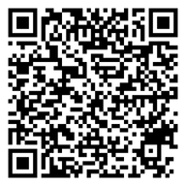
ABP 10.0 Highlights
Upgraded to .NET 10.0
Upgraded to Blazorise v1.8.2
Elsa Workflow Module (PRO)
New Object Mapper: Mapperly
Localization: Nested Object Support in JSON Files
EF Core Shared Entity Types on Repositories
Angular SSR Support
Read the blog post
Notes:
https://abp.io/community/announcements/announcing-abp-10-0-release-candidate-86lrnyox

Slide 3
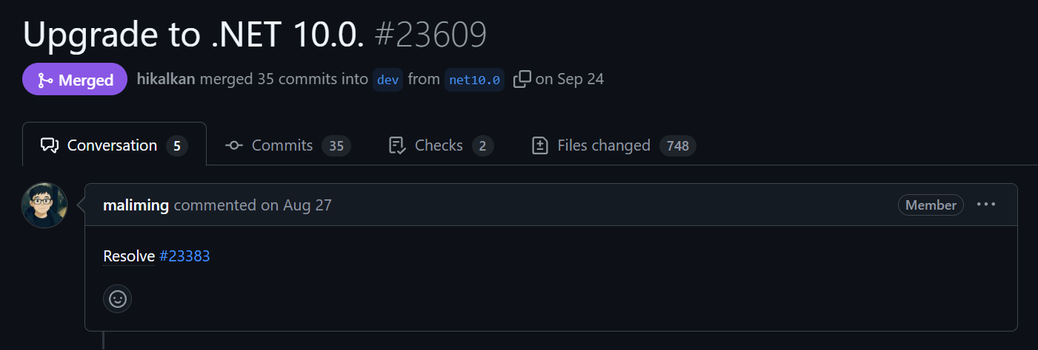
Upgraded to .NET 10.0

Slide 4
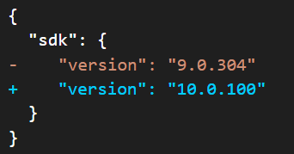
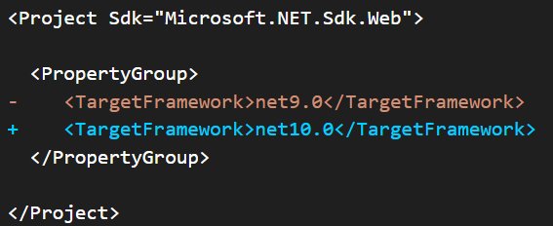
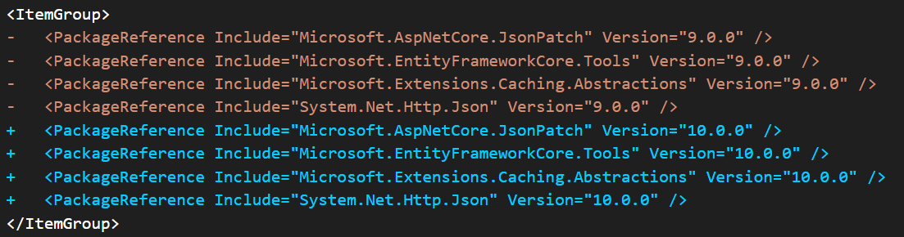
1-) Update global.json files:
2-) Update the target framework:
3-) Update package references:

Slide 5
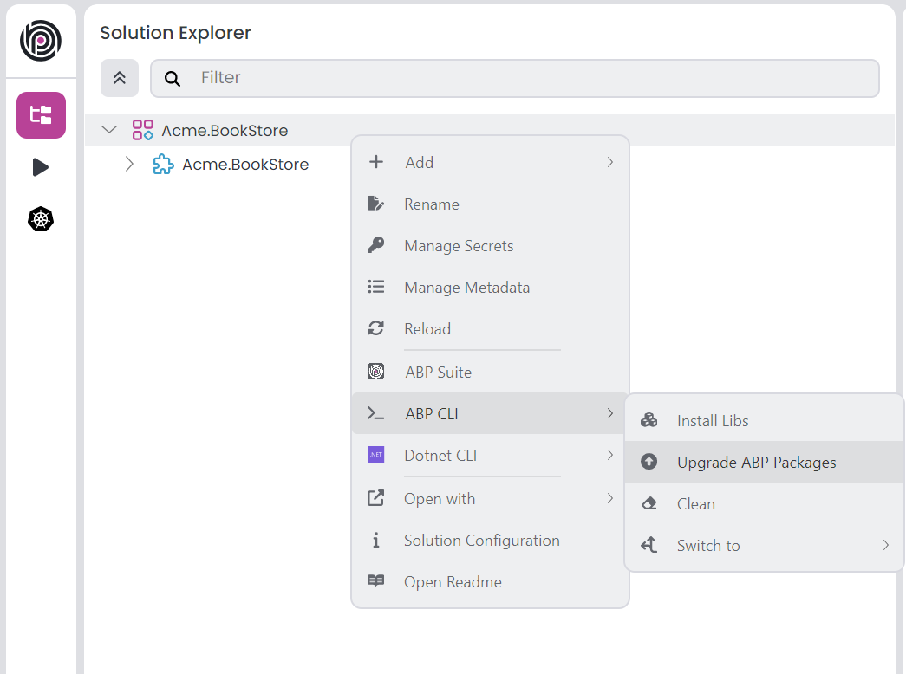
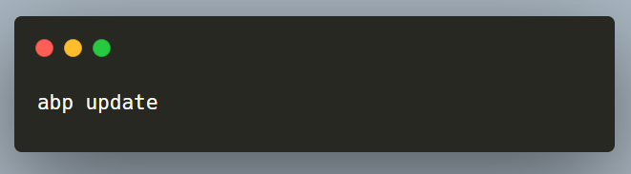
4-) Check release notes & migration guides (and apply the required changes):
Migrate from ASP.NET Core in .NET 9 to ASP.NET Core in .NET 10 Guide
Breaking Changes in .NET 10 Documentation
5-) Use ABP Studio (or ABP CLI) to update to ABP 10.0 (and check the migration guide for fixes on your side):

Slide 6
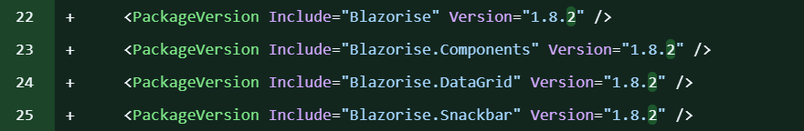
Upgraded to Blazorise v1.8.2

Slide 7
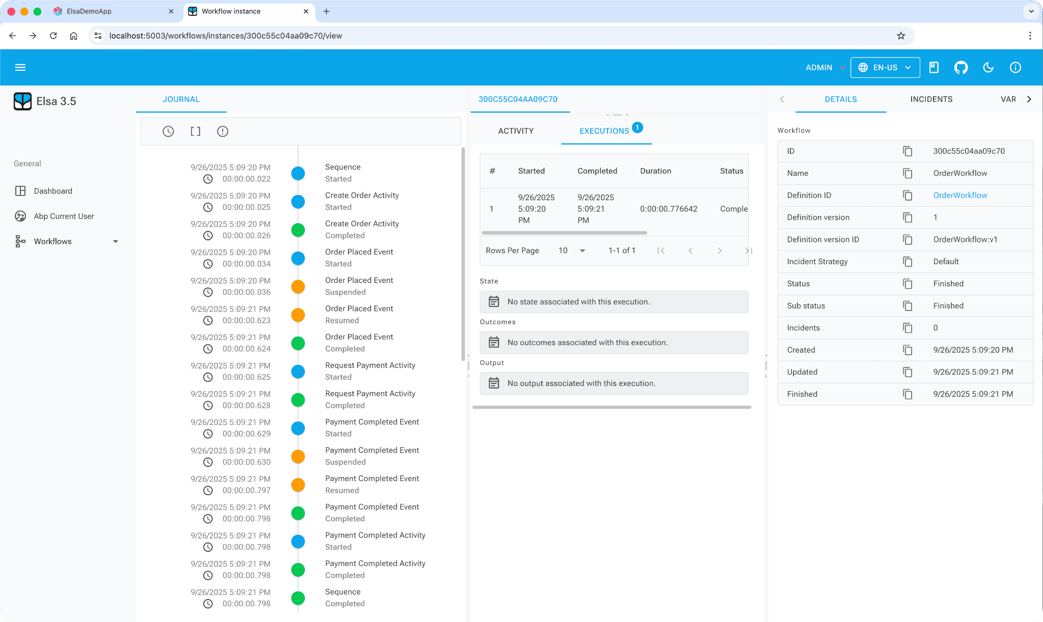
Elsa Workflow Module (PRO)

Slide 8
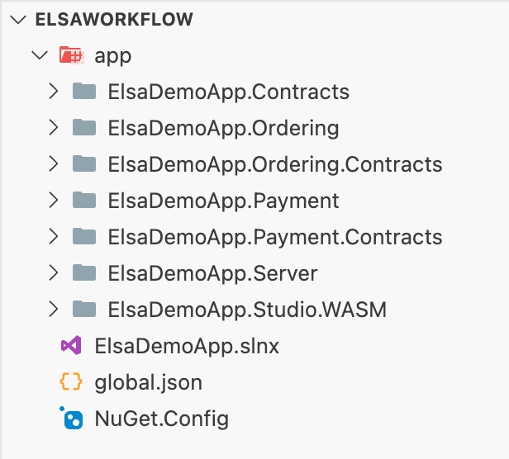
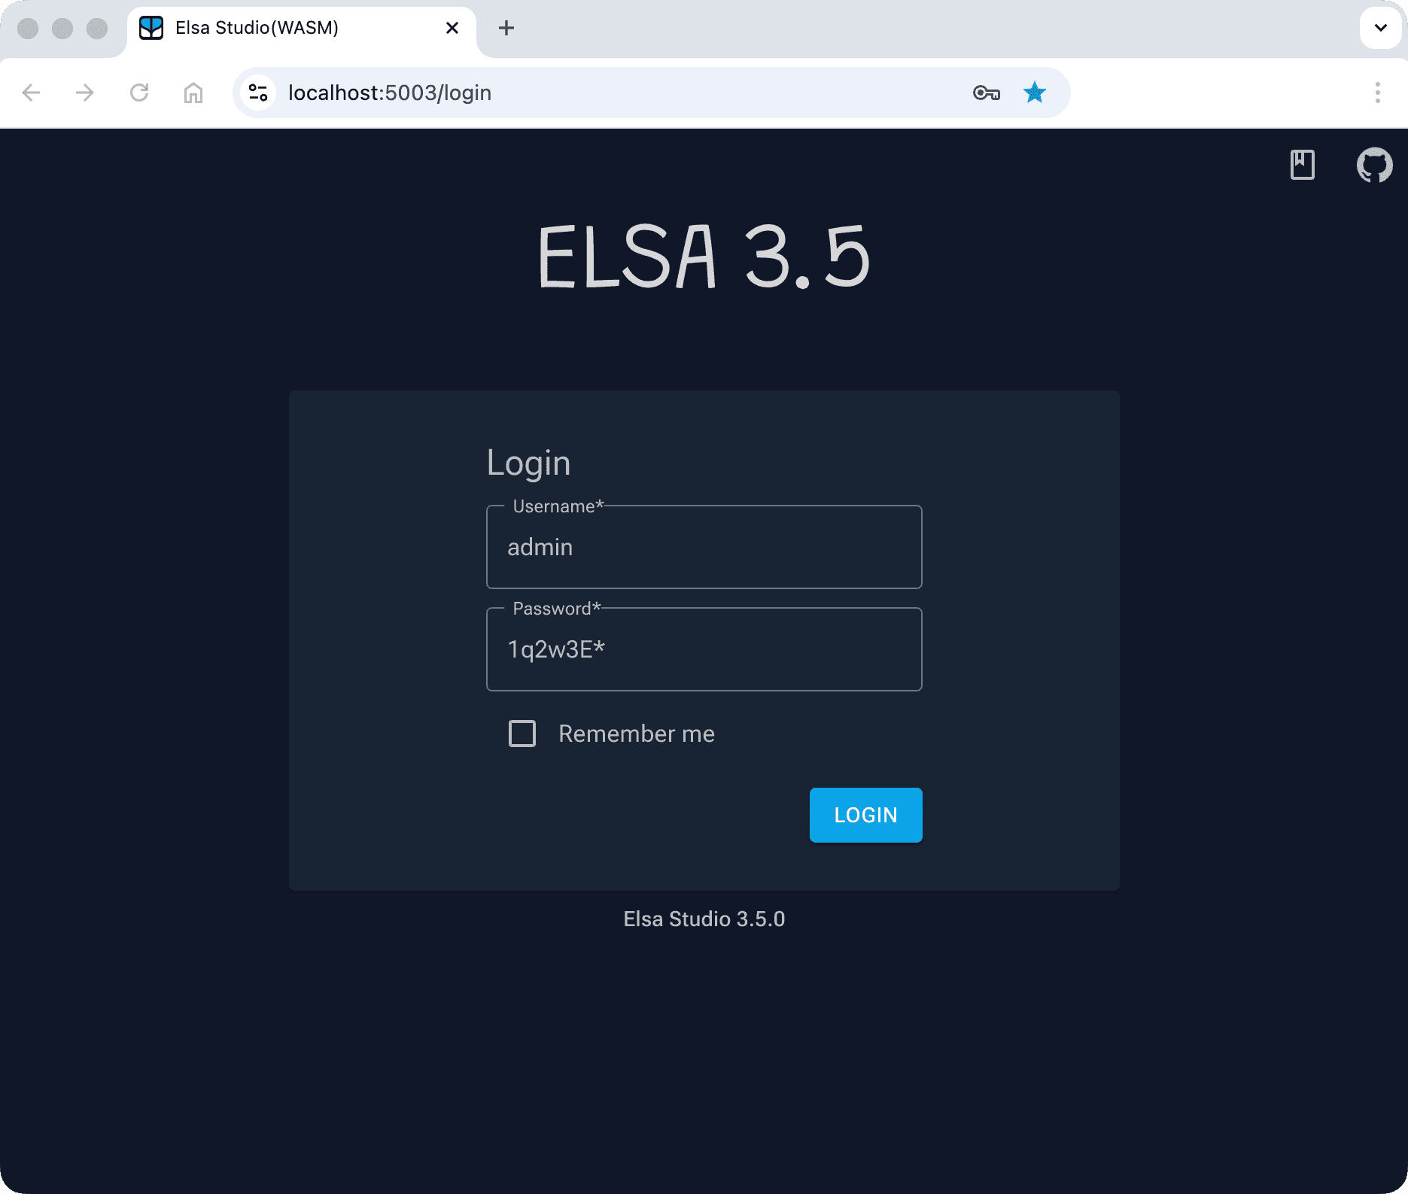
Sample: https://abp.io/docs/10.0/samples/elsa-workflows-demo
Documentation: https://abp.io/docs/10.0/modules/elsa-pro

Slide 9
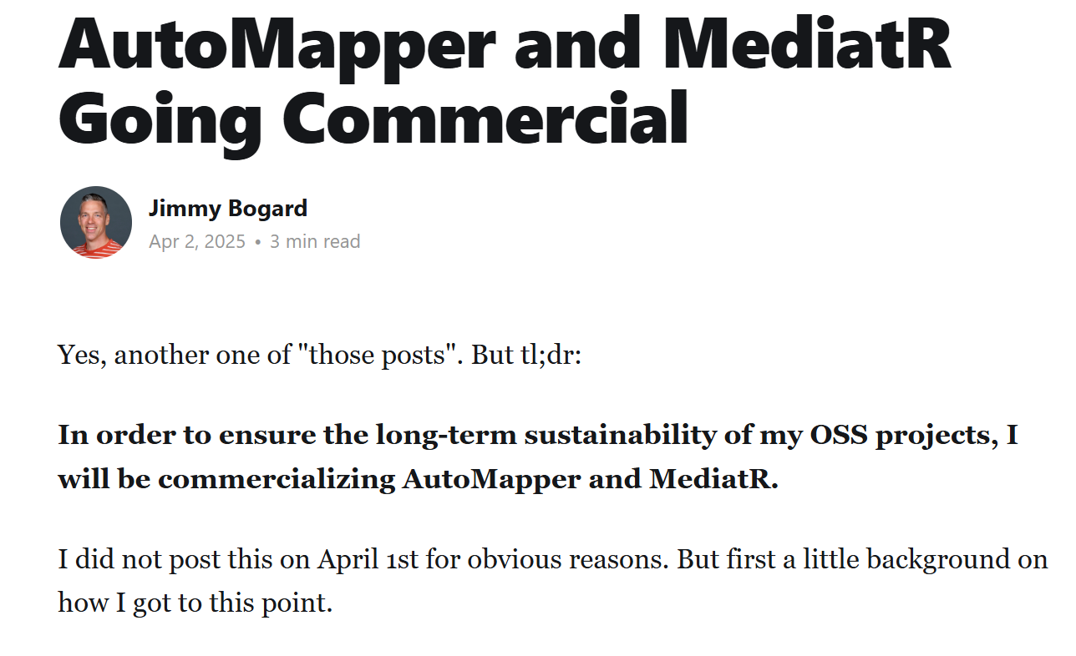
New Object Mapper: Mapperly

Slide 10
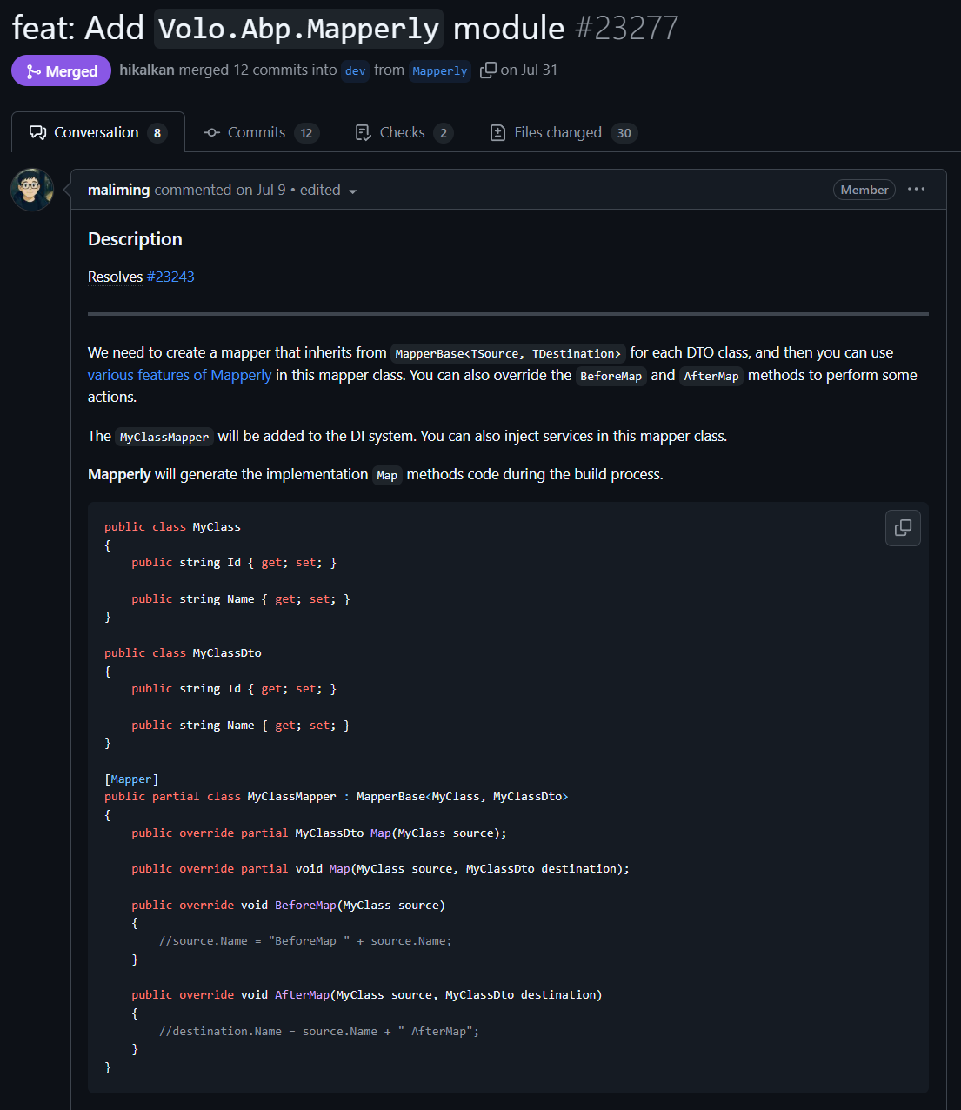
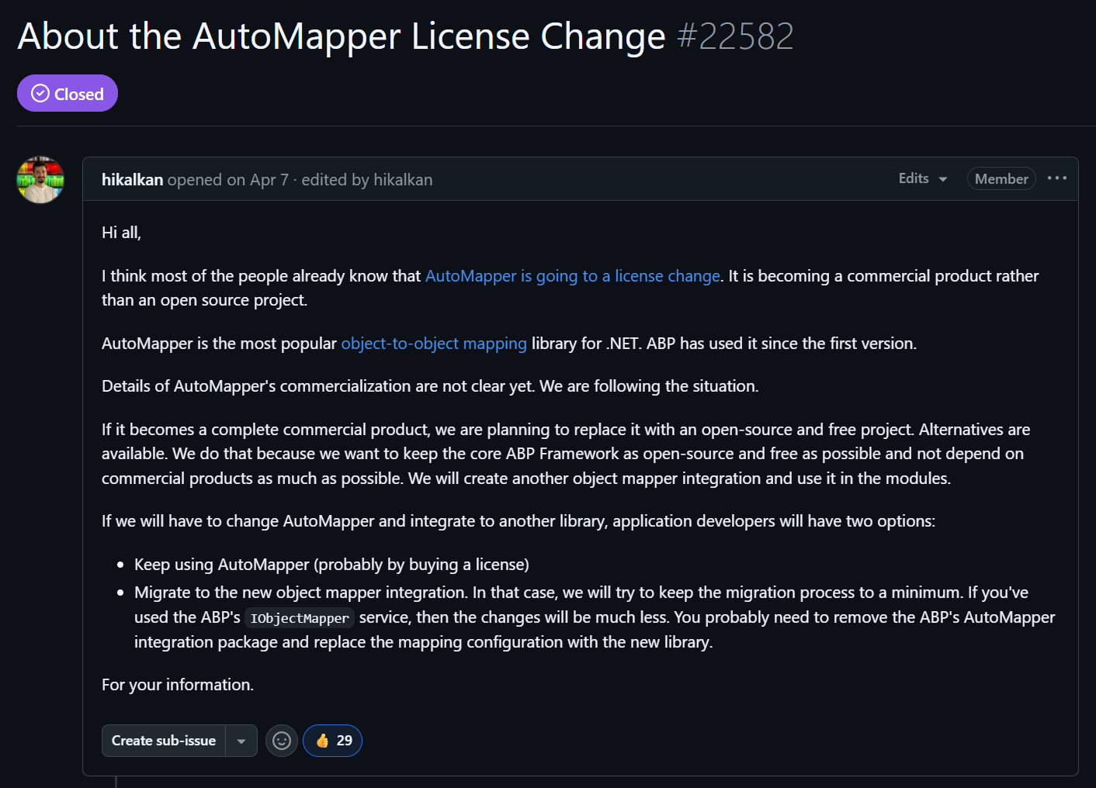
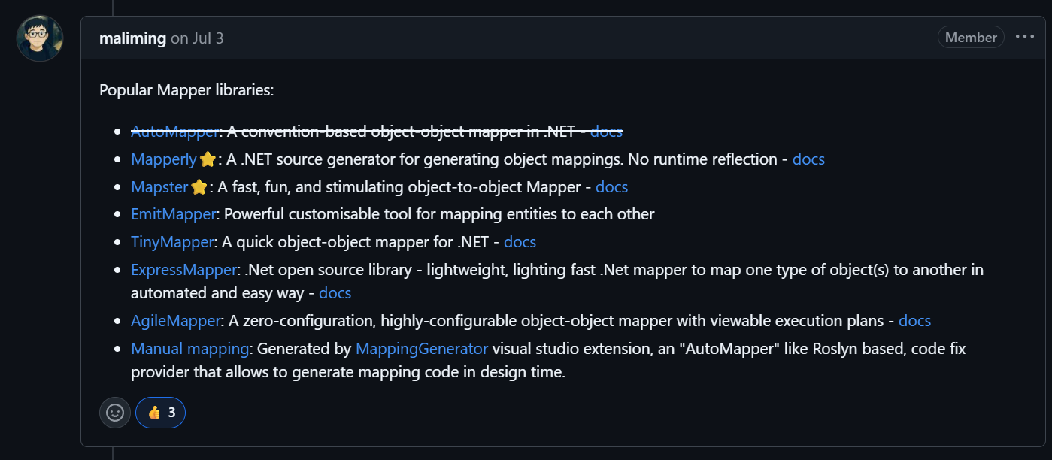

Slide 11
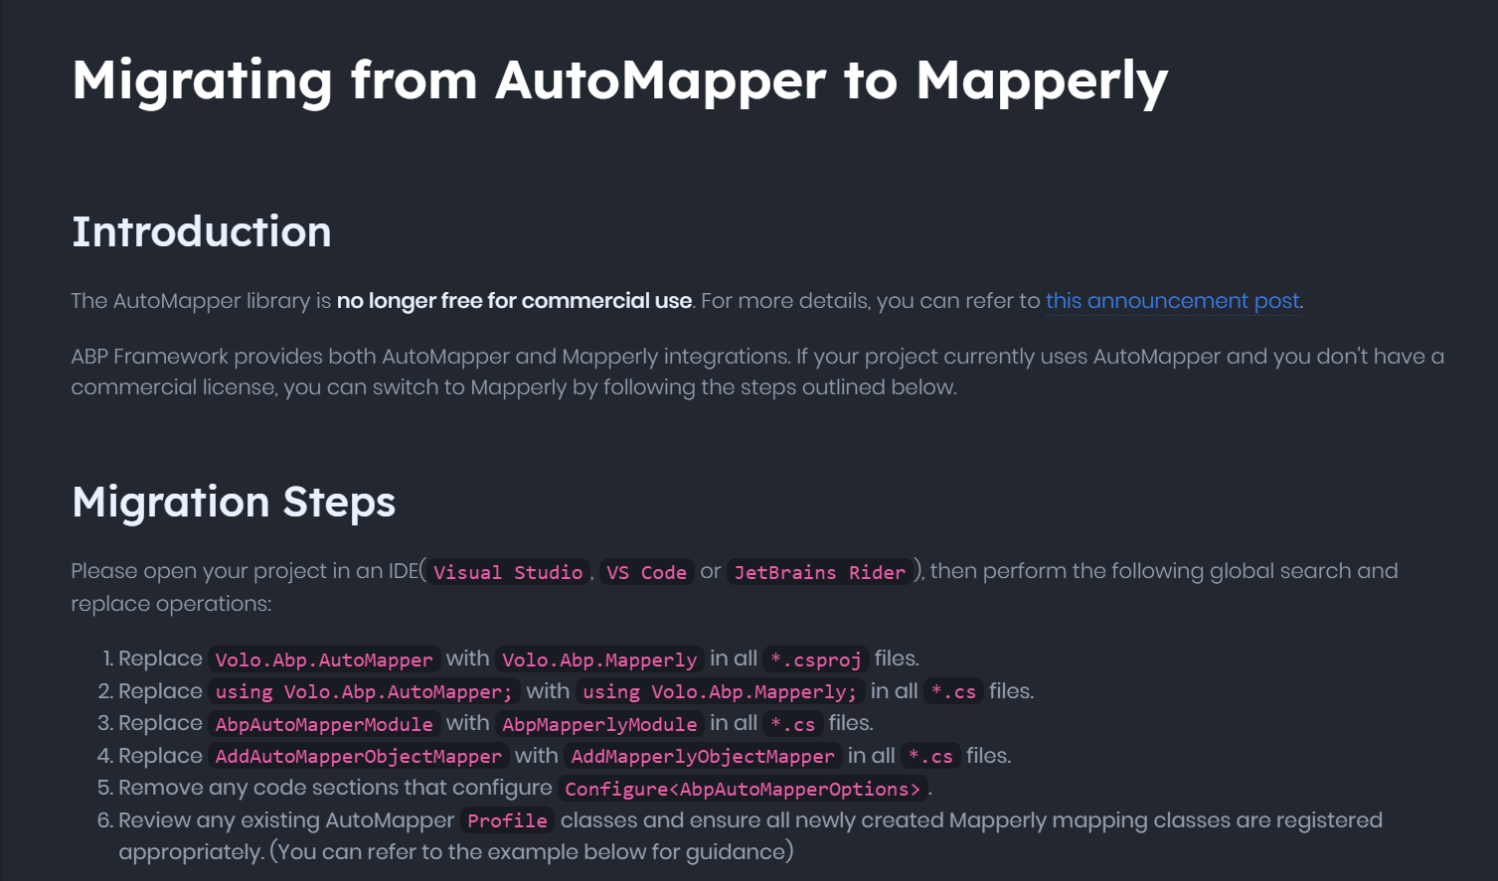
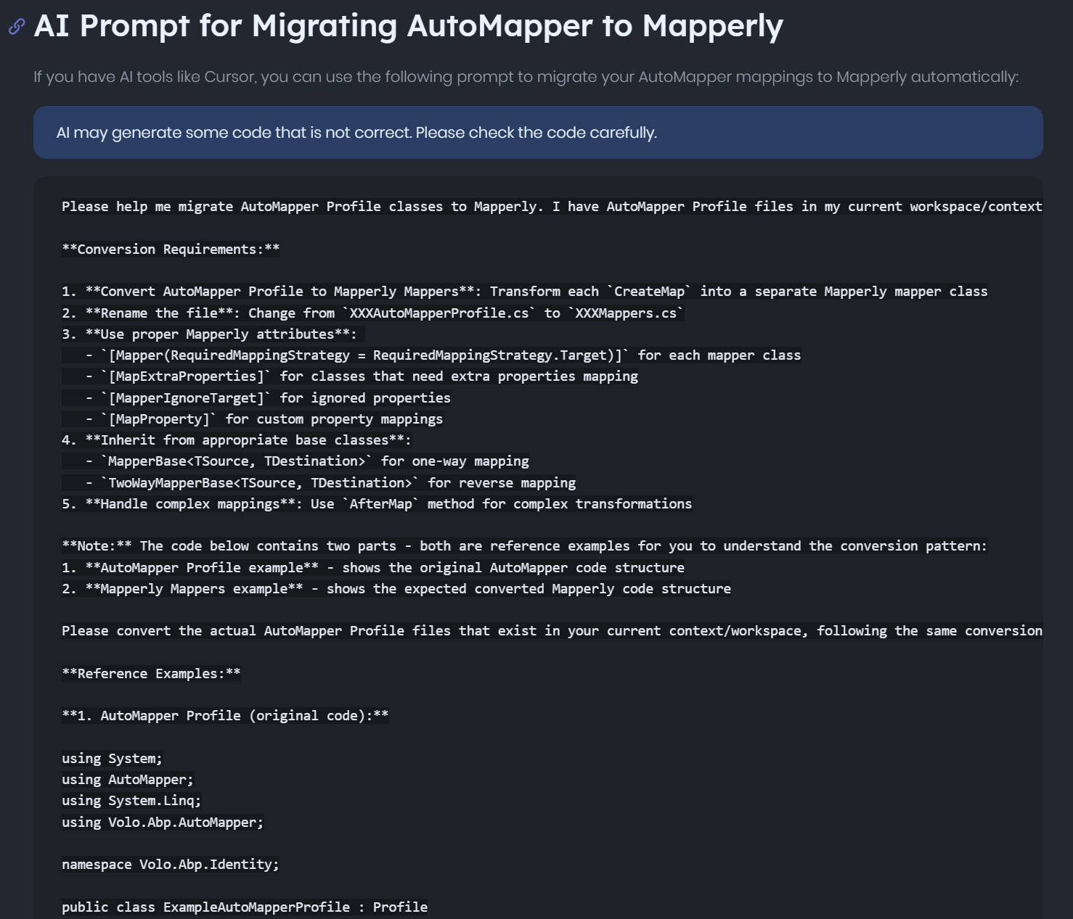
⚠️Volo.Abp.AutoMapper package remains available for backward compatibility. You can keep using AutoMapper in your solutions, but you are responsible for obtaining and managing its license if needed.
Read the migration guide:

Slide 12
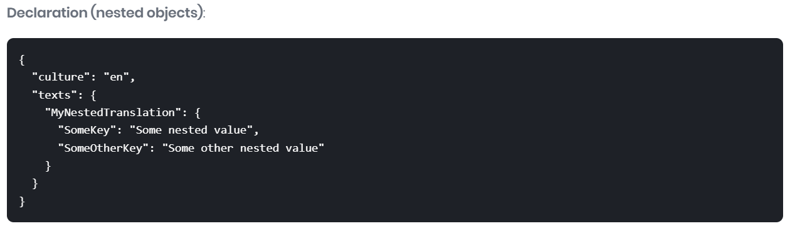
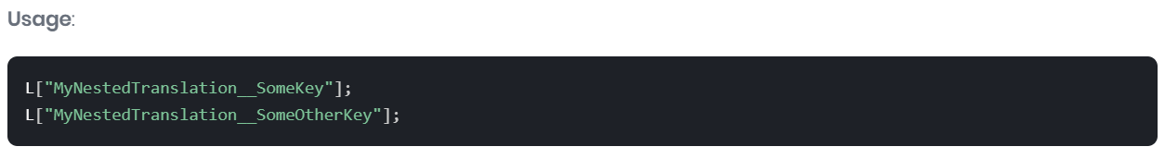
Localization: Nested Object Support in JSON
Notes:
ABP now supports nested objects (and arrays) in JSON localization files, allowing you to organize translations hierarchically and access them using the double underscore (__) separator. This improves maintainability for larger resource files and aligns lookups with familiar key paths.

Slide 13
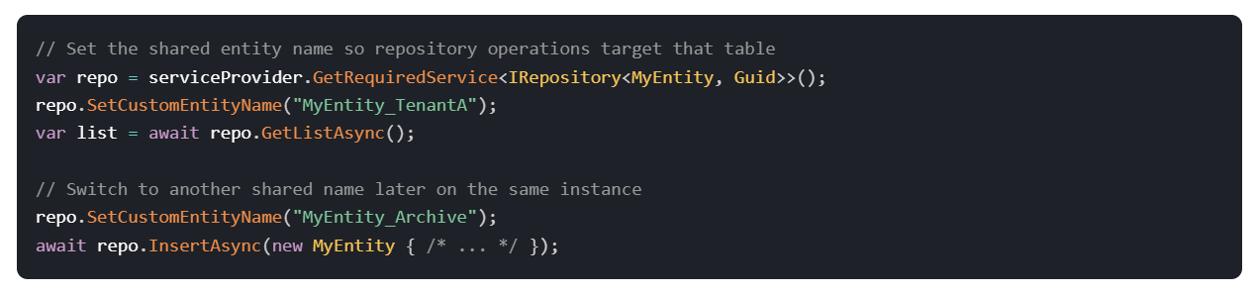
EF Core Shared Entity Types on Repositories
ABP now support EF Core shared-type entity types by allowing a custom entity name to be set on a repository before performing operations. Internally, it uses EF Core’s DbContext.Set<T>(string name) to target the correct DbSet/table for the same CLR type, enabling scenarios like per-tenant tables, archives, or partitioning, and you can switch the target at runtime.

Slide 14
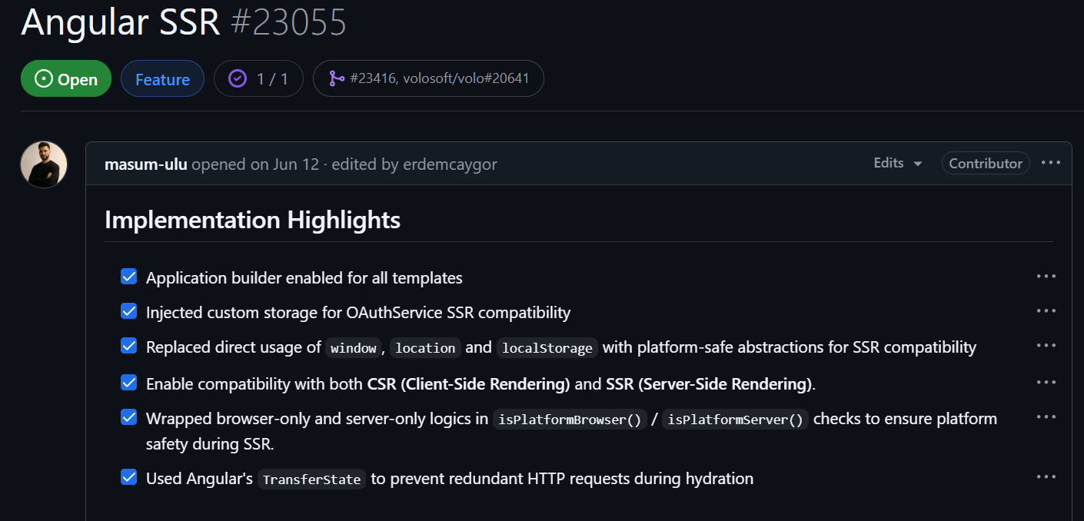
Angular SSR
Notes:
ABP Angular templates now support Server-Side Rendering (SSR) with the Angular Application Builder, enabling hybrid rendering (SSR + CSR) for improved first paint, SEO and perceived performance. This includes SSR-safe platform checks (no direct window/location/localStorage), OIDC auth compatibility via cookie-backed storage, and TransferState to prevent duplicate HTTP GETs during hydration. For implementation highlights and usage (including how to run the SSR dev server and the transferStateInterceptor), see the issue and PR: Angular SSR, Hybrid Rendering & Application Builder.

Slide 15
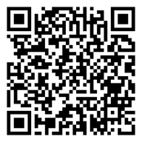
Migration Guides (v9.x to v10.0)
Upgraded to .NET 10.0 (Migrate from .NET 9 to .NET 10)
Upgraded to OpenIddict 7.X
Migrated from AutoMapper to Mapperly
Removed Obsolete Services (RazorRuntimeCompilation and IActionContextAccessor)
Added BLOB Storing Memory Provider (for testing purposes)
Read the migration guide

Slide 16
Community News
Community Posts (20+ articles & videos)
Announcements
  Sponsored to .NET Conf 2025!
  Weekly Webinar: Discover ABP Platform

Slide 17
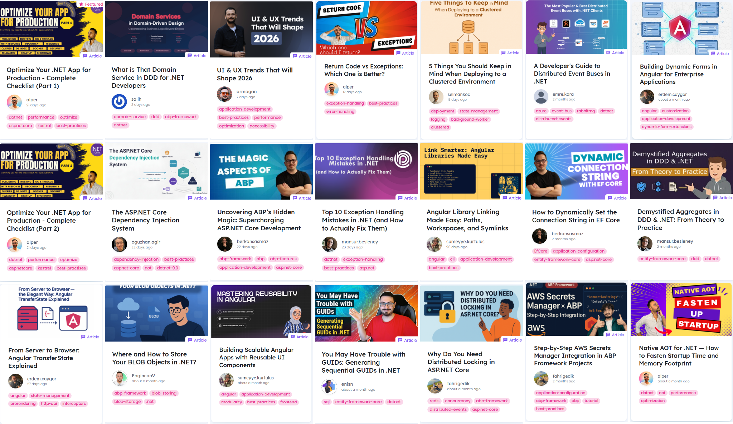
Community Posts
(20+ articles & videos)
https://abp.io/community/
Notes:
https://abp.io/community

Slide 18
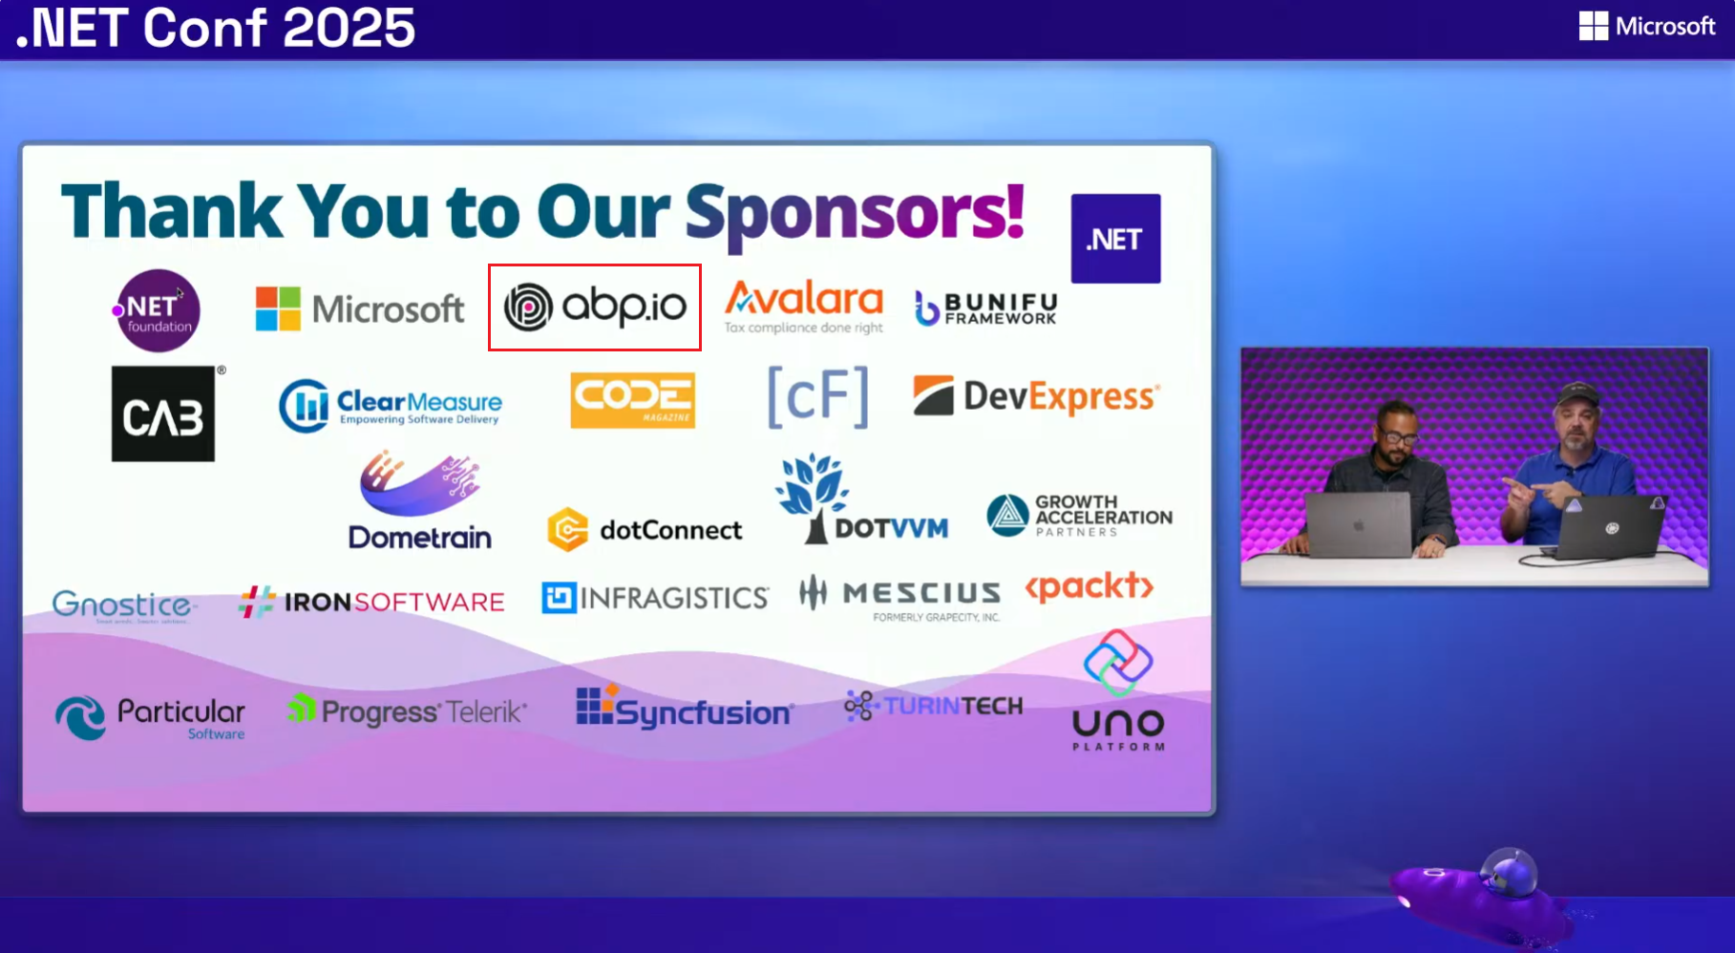
Sponsored to .NET Conf 2025!

Slide 19
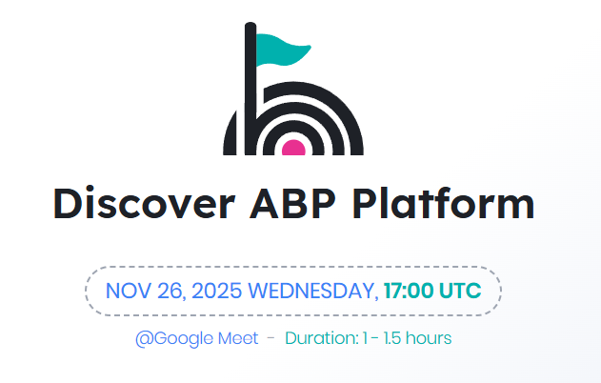

Weekly Webinar: Discover ABP Platform
For free registration:
Notes:
We’ve started a weekly live webinar series designed for developers who want to get the most out of the ABP Platform. This event is designed for those new to ABP to help you understand its core features, capabilities, and licensing models.
Every webinar features live coding demos, practical examples, and an open Q&A segment where you can get your questions answered directly by the ABP team. Whether you’re just starting with ABP or looking to explore advanced scenarios, these sessions will help you build better apps faster.

Slide 20
Thanks for listening!
Notes:
Thanks everyone for following along with the ABP 9.3 highlights and the latest updates from the community.
As the ABP team, we’re really excited about what’s coming next in this session.
We’re happy to welcome our guest speaker Sipke Schoorstra, (I hope that I’ve pronounced it correctly), the creator of the Elsa Workflows library. Sipke has been doing great work in the .NET ecosystem, and today he’ll be showing us how to empower Elsa Workflows with AI, and how the library integrates with ABP-based applications.
He also prepared a demo for us, so we’ll get to see everything in action.
Feel free to drop your questions in the chat as the session goes on — we’ll try to address them.
So, Sipke, over to you!

