Slide 1



What’s new with ABP 8.0?
Engincan VESKE
Software Engineer at Volosoft

Slide 2

Overall
https://blog.abp.io/abp/announcing-abp-8-0-release-candidate
Upgrading to .NET 8.0
Upgrading to Angular 17
Dynamic Claims
Bundling & Minification: CDN Support
Read-Only Repositories
New Features for Account Module
Other News…
What’s New with ABP Commercial 8.0?
Notes:
Today, I will some important features that came with ABP Framework 8.0. If you want to learn more, you can check the blog post.

Slide 3
Upgrading to .NET 8.0
ABP v8.0 RC.1 has been shipped based on .NET 8.0. Therefore, if you are going to upgrade your existing projects to .NET 8.0, you need to make some changes to your project.
For example, you need to change the Target Framework, and update Microsoft’s package versions and so on. For that purpose, you can check the Microsoft’s Migrate from ASP.NET Core 7.0 to 8.0 documentation.
Migration Guides
ABP Framework 7.x to 8.0
ABP Commercial 7.x to 8.0
Notes:
ABP v8.0 RC.1 has been shipped based on .NET 8.0 and we are proud to say that we are one of the early adopters. If you are going to create a new application and start from scratch, you can check the get started documentation and you are free to start over. But if you are going to upgrade your existing projects to .NET 8.0, you need to make some changes in your project.
…

Slide 4
Upgrading to Angular 17
Angular 17 has been released on November 8 and ABP Framework & ABP Commercial startup templates are immediately migrated to Angular 17!
So, when you create a new solution with the Angular UI, you will take advantage of the new Angular with the new cutting-edge features and enhancements right from the start!
Notes:
ABP v8.0 RC.1 has been shipped based on .NET 8.0 and we are proud to say that we are one of the early adopters. If you are going to create a new application and start from scratch, you can check the get started documentation and you are free to start over. But if you are going to upgrade your existing projects to .NET 8.0, you need to make some changes in your project.
…

Slide 5
Dynamic Claims
The Dynamic Claims feature is used to dynamically generate claims for the user in each request. This was needed because claims-based authentication is using in the ASP.NET Core, and because it stores the claims in the cookie or token, and they are being static, they don’t change until a next re-login.
In other words, Dynamic Claims allows you to get the latest user claims without need to re-login in each time.
It’s already been documented: https://docs.abp.io/en/abp/8.0/Dynamic-Claims

Slide 6
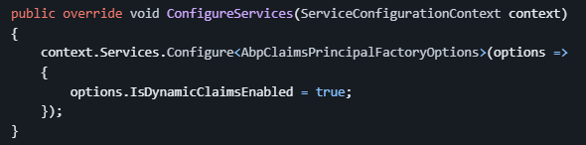
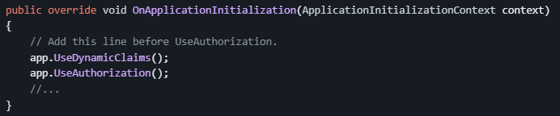
Dynamic Claims
Configure the AbpClaimsPrincipalFactoryOptions and set the IsDynamicClaimsEnabled option as true 👉
Add the DynamicClaims middleware into the request pipeline 👉
Notes:
After the configurations, the DynamicClaims middleware will use the IAbpClaimsPrincipalFactory to dynamically generate claims for the current user in each request.

Slide 7
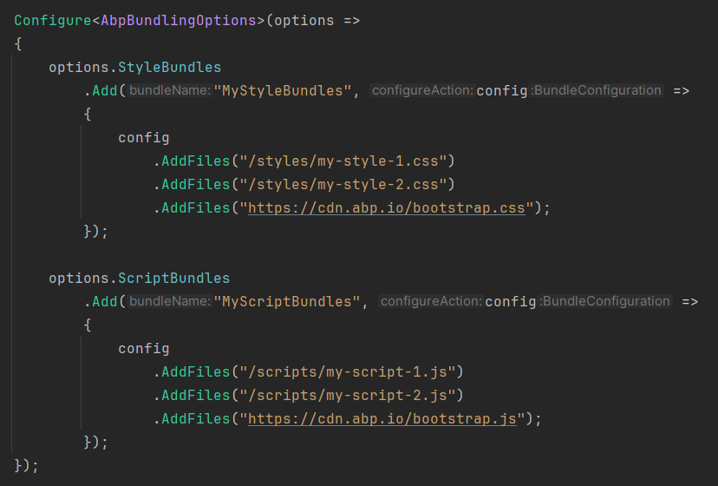
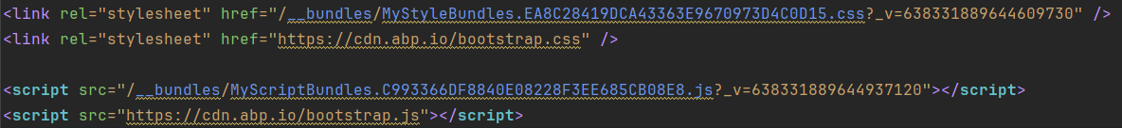
Bundling & Minification: CDN Support
In this version on, ABP Framework’s Bundling System provides CDN Support for bundling.
The bundling system automatically recognizes the external/CDN files and places them as script tags into the page along with the bundled inline CSS/JS files.

Slide 8
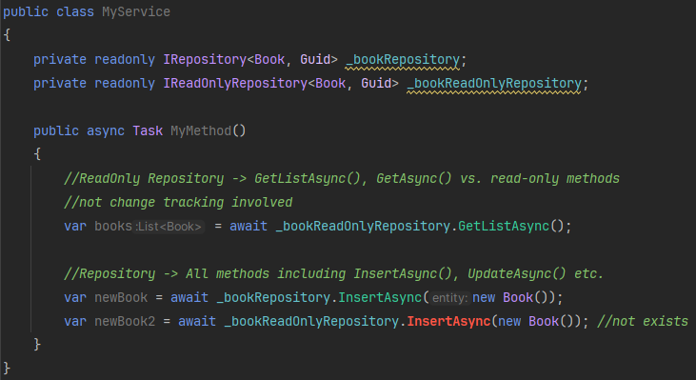
Read-Only Repositories (AsNoTracking())
In this version, ABP Framework provides read-only repository interfaces (IReadOnlyRepository<T> or IReadOnlyBasicRepository<T>) to explicitly indicate that your purpose is to query data, but not change it.
Entity Framework Core read-only repository implementation uses EF Core’s No-Tracking feature and that means the entities returned from the repository will not be tracked by the EF Core change tracker and this makes significant performance improvements.

Slide 9
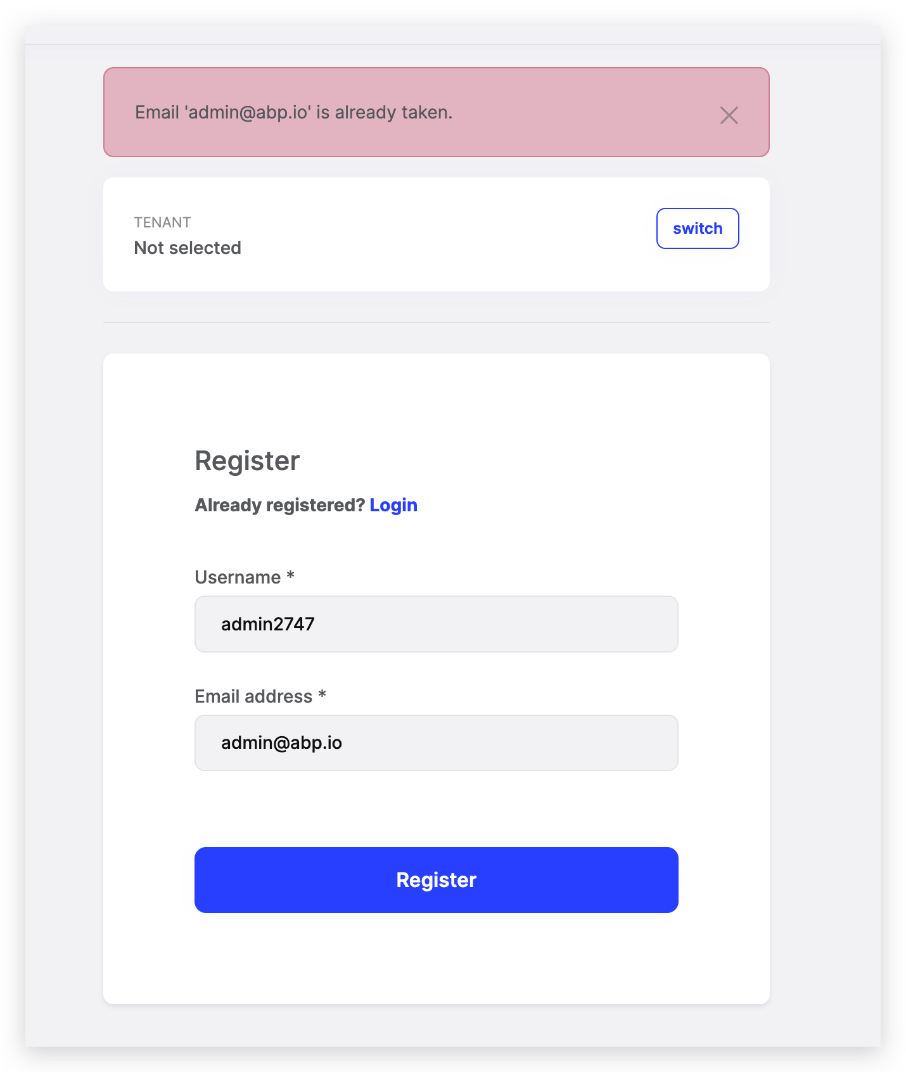
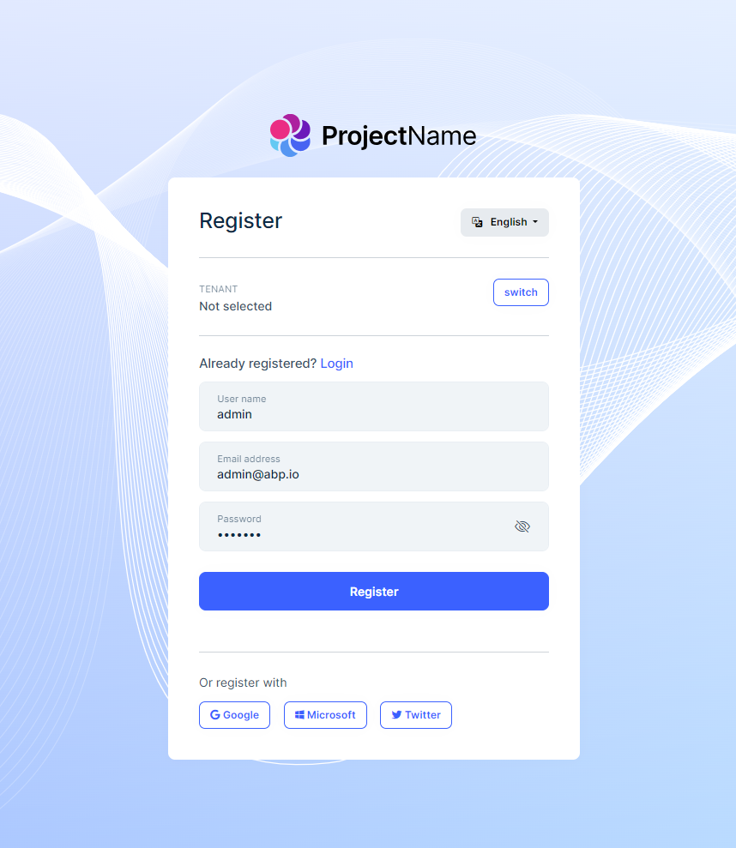
New Features for Account Module
Allowing to set username on social registration
Adding “register with” option (social registration)
Notes:
GDPR dan bahset 1. Özellik için!!
—
In this version, there are two new features in the Account Module: “Allowing to set username on social registration” and “adding social media register options to the register page”.
Prior to this version, when you register with your social accounts in the first time, your email address was becoming your username and it was shown everywhere in the application. So, you would need to update your username later on.
With this version now, whenever you register as an external user, a username and email address shown you in a form for you to revise and update them if you need before login into the application. Thanks to that, after the social registration you would not need to update your username and email address.
And the second feature is adding register with option to the Register Page. In the previous, version the external authentication options was only seen on the login page, and that might lead users to miss the social login options. Therefore, in this version, we have added social media register options to the Register Page as you can see in the figure.

Slide 10
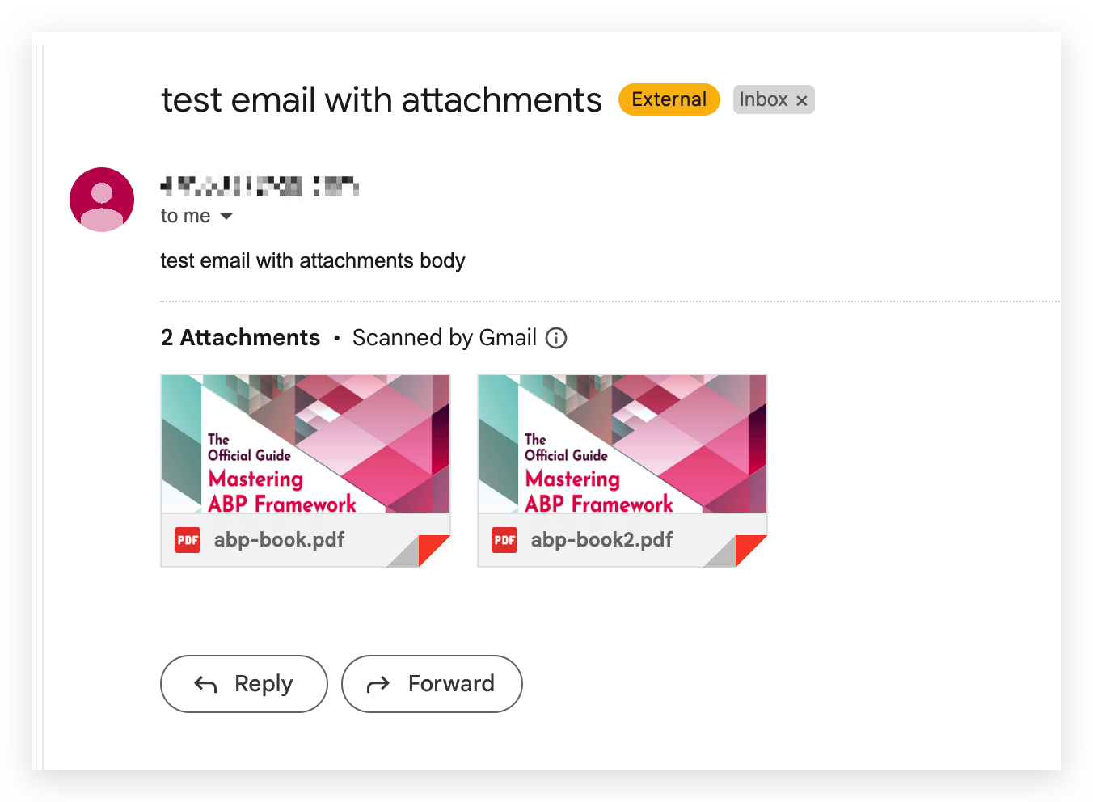
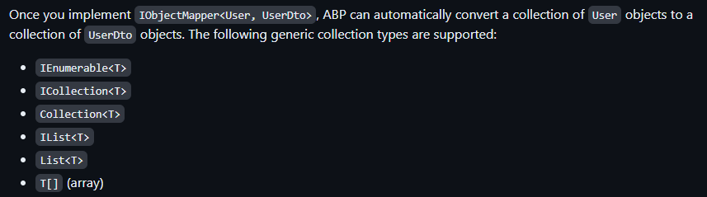
Other News
LDAP over SSL (LDAPS) setting has been added and recommended to establish a secure connection.
Object Mapping Enhancements (supports mapping collection of objects for custom object mappers)
Email Sending Enhancements (allowing sending attachments with IEmailSender.QueueAsync() method)

Slide 11
What’s New with ABP Commercial 8.0?
Try to get profile picture from social/external logins
Switch from Ocelot to YARP for the API Gateway (Microservice Solution Template)
Password complexity indicators for MVC & Blazor UIs
Read-only view for Identity/Users page
Export & Import Users as Excel/CSV
Suite: Generating Master/Detail Forms

Slide 12
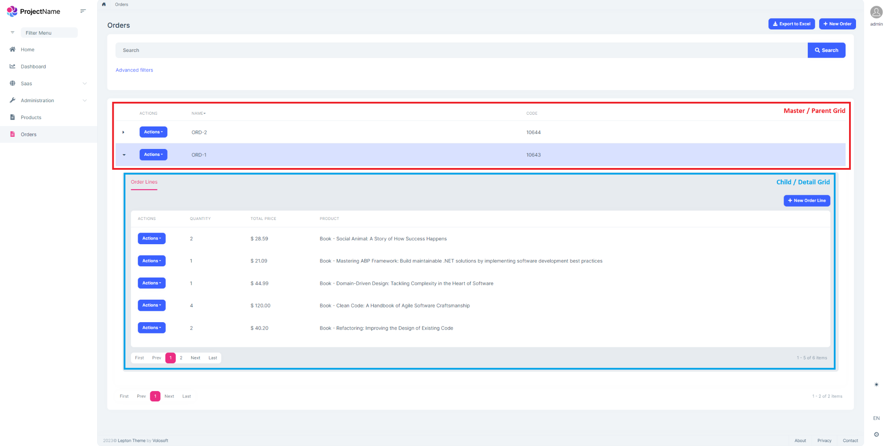
Suite: Generating Master/Detail Forms
ABP Suite allows you to create a master-detail relationship with a few clicks. It generates the necessary code for the master and detail tables, including the foreign key relationship between the two tables.
Notes:
Suite: Most Wanted Feature diye bahset!!!

Slide 13


THANKS FOR
WATCHING

