Slide 1








Sentiment Analysis in .NET
EngincanV
engincanv.github.io
@EngincanVeske
Software Engineer at Volosoft

Slide 2
Agenda
Machine Learning in .NET
Which libraries or tools do we have in .NET for Machine Learning?
ML.NET
What is the ML.NET framework used for?
Sentiment Analysis
What is the sentiment analysis?
Demo: Spam Detection
Applying Sentiment Analysis to CMS Kit’s Commenting Feature

Slide 3




Machine Learning in .NET
ML.NET https://github.com/dotnet/machinelearning | SciSharp Stack BotSharp, TensorFlow.NET etc.
Accord.NET https://github.com/accord-net/framework | Spark .NET for Apache Spark

Slide 4
ML.NET
What is ML.NET?
Uses AutoML
Integrations with other popular libraries
ML.NET is a machine learning framework for .NET developers; you can use ML.NET to integrate custom machine learning models into your .NET applications.
You can use ML.NET for many scenarios, such as Sentiment Analysis, Price Prediction, Product Recommendation, Image Classification, Object Detection, and more…
ML.NET offers Model Builder (a simple UI tool) and ML.NET CLI to make it easy to build custom ML Models.
These tools use AutoML (Automated ML), which refers to the process of automating the end-to-end process of applying machine learning to real-world problems.
ML.NET is an extensible platform and allows to consume other popular ML Frameworks (TensorFlow, ONNX (Open Neutral Network Exchange), Infer.NET, and more…).
Notes:
AutoML is a really helpful system that helps us to select the best-performing algorithms for the given tas for a given dataset. This automation enables users with limited machine learning expertise to build high-quality models efficiently and effectively.
For example, you might not have an expertise on the machine learning and data-science. In this case, you can get benefit of the AutoML system, which creates the pipeline your behalf and compare and select the best possible algorithm for the given task.

Slide 5
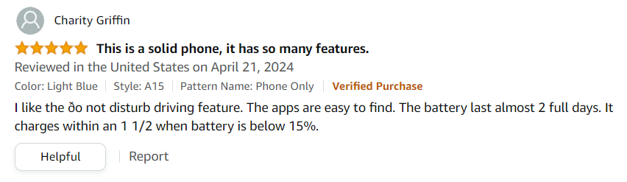


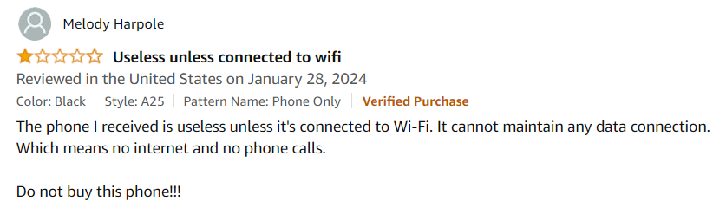
Sentiment Analysis
Notes:
At its core, sentiment analysis is the process of computationally identifying and categorizing opinions expressed in a piece of text, whether it's a social media post, product review, or any other form of communication. It's like having a digital empathy, capable of understanding the tone and underlying emotions behind words.
Sentiment analysis goes beyond just classifying sentiments; it can also uncover deeper insights such as identifying trends, understanding customer preferences, or even predicting future behavior based on current sentiment trends

Slide 6
Demo: Applying Sentiment Analysis to CMS Kit’s Commenting Feature
Notes:
In a typical machine-learning process, we mainly have four or five steps:
First, we need to have a data-set and build a model according to that.
Then, we should train the model (for this we should choose an algorithm to tune the parameters of the model).
After that, for the third step, we need to evaluate the model to see the accuracy of our model on new data. If we are not satisfied with the quality of the model, then we should try to improve it by providing larger training datasets and by choosing different training algorithms with different parameters.
After evaluating the model and be okay with its accuracy, finally we can consume the model.
If you look at these flow, for our example, we have the same step by step flow, and I will show you that on the code.
We will first add a comment, then a machine-learning model will be build and make a sentiment analysis, the model will evaluate the results and will predict a result for us (either positive or negative) and then the system will approve or reject our comment in the background.
Now, Let’s see the demo in action and then deep dive into the code.

Slide 7

Demo: Spam Detection
Comment
Sentiment Analysis
(Spam Detection)
Evaluate Results
Approve or Reject the Comment
Repository: https://github.com/EngincanV/SentimentAnalysisDemo
Notes:
In a typical machine-learning process, we mainly have four or five steps:
First, we need to have a data-set and build a model according to that.
Then, we should train the model (for this we should choose an algorithm to tune the parameters of the model).
After that, for the third step, we need to evaluate the model to see the accuracy of our model on new data. If we are not satisfied with the quality of the model, then we should try to improve it by providing larger training datasets and by choosing different training algorithms with different parameters.
After evaluating the model and be okay with its accuracy, finally we can consume the model.
If you look at these flow, for our example, we have the same step by step flow, and I will show you that on the code.
We will first add a comment, then a machine-learning model will be build and make a sentiment analysis, the model will evaluate the results and will predict a result for us (either positive or negative) and then the system will approve or reject our comment in the background.
Now, Let’s see the demo in action and then deep dive into the code.

Slide 8
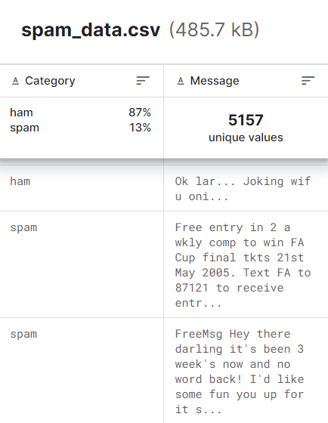
Sentiment Analysis Flow:
Load the data
Split the data as train and test data
Data transformations (transforming to numeric vectors) and choosing the correct algorithm
Train the model
Predict the sample data
Comment
Notes:
Note: Before using the model, it should be tested against the splitted test data. Accuracy and other metrics should be evaluated and if it does not meet the criterias then a new algorithm should be selected and the dataset should be populated.

Slide 9
Thank you!

