Slide 1


Accessing the Source Code
Installing via ABP CLI
You can use the get-source command of the ABP CLI to download the source code:
Also, you can download the source code of a certain version by using the —-version option. You can check the ABP CLI documentation for other options.

Slide 2
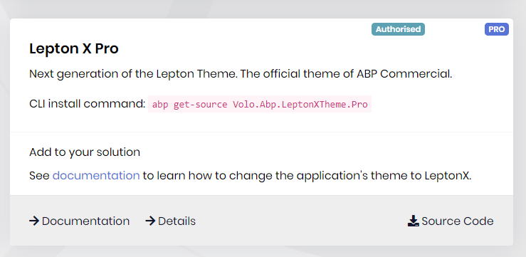
Downloading via ABP SUITE

Slide 3
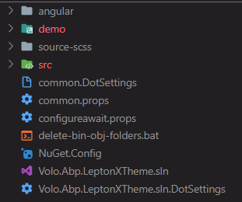
Folder Structure of the Source Code
When you installed the source code, you will have a folder structure as in the image.
You will have all projects independent from UI technology.
Also, you will find demo projects in the demo folder, you can run them to see the LeptonX Theme in action.

Slide 4

LeptonX - SCSS Files
You can see the source-scss folder when you installed the source code.
There are three zip files that contain SCSS files for three UI types.
You can unzip them, examine them, change them, and also compile them to CSS.

Slide 5
LEPTONX - SCSS FILES

Slide 6
Customizing LeptonX Theme for MVC UI
Topics
Customizing a component
Changing layouts (Side Menu / Top Menu)
Customizing the account layout
Customizing styles

Slide 7
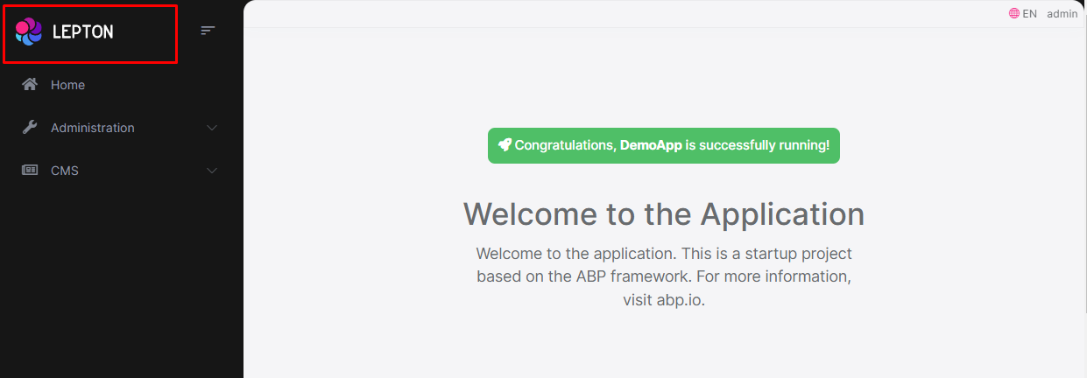
Customizing a component
Customizing the Branding Component (Logo)

Slide 8
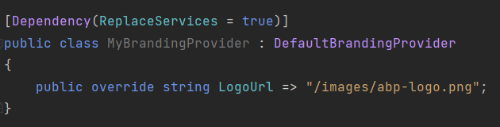
Customizing the Branding Component (Logo)
You can customize the branding component (logo) in the following ways:
1-) Overriding the component
You can override the component by creating a file with the same name and under the same folder (/Themes/LeptonX/Components/Common/MainHeaderBranding/Default.cshtml).
2-) Branding Provider

Slide 9
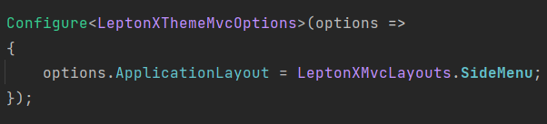
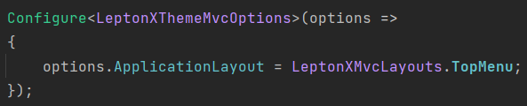
Changing Layouts (Side Menu / Top Menu)
You can change layouts by configuring the LeptonXMvcOptions in your module class easily:
Side Menu
Top Menu

Slide 10
Customizing the Account Layout
You can override the Account Layout by creating a file under the /Themes/LeptonX/Layouts/Account/Default.cshtml.
Also, you can override the Footer component in the Account Layout by creating a file under the /Themes/LeptonX/Layouts/Account/_Footer.cshtml. This file is already came with startup templates. Therefore, you can directly open this file and make your changes.

Slide 11
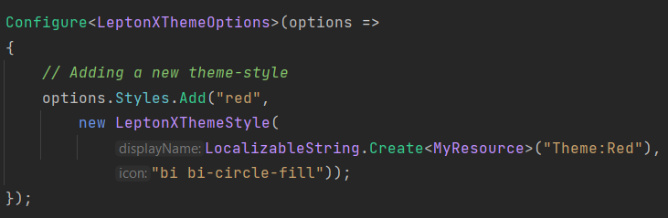
Customizing Styles
You can add a theme style by configuring the LeptonXThemeOptions in your module class easily:

Slide 12
Others…
You can see the following documentation for other customizations of the LeptonX Theme for MVC UI:
Customization on LeptonX Lite Theme
Customization on LeptonX Theme
In these documents, you can find how to customize Toolbars, Footers, Breadcrumbs, Settings, and more…

Slide 13
Thanks for listening…

