Slide 1



ABP CMS Kit: DEMO
Engincan VESKE
Software Engineer at Volosoft

Slide 2

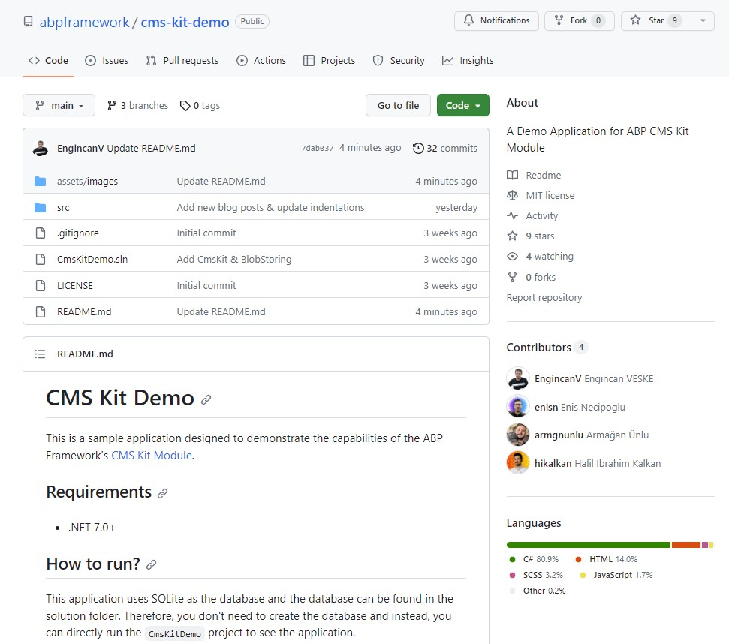
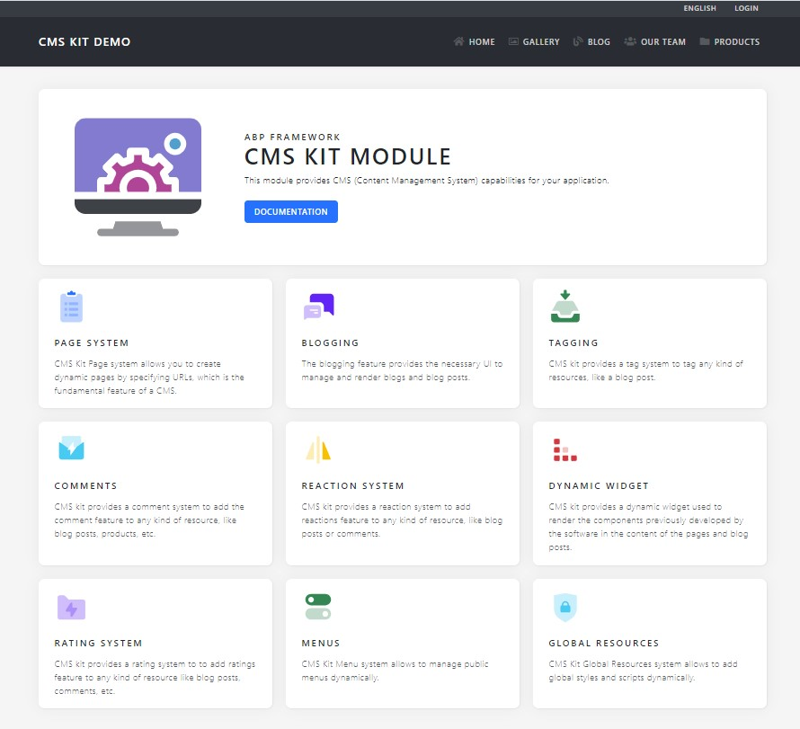
ABP CMS Kit: Demo - Repository & Website
Repository: https://github.com/abpframework/cms-kit-demo
Website: cms-kit-demo.abp.io (will be live soon)

Slide 3
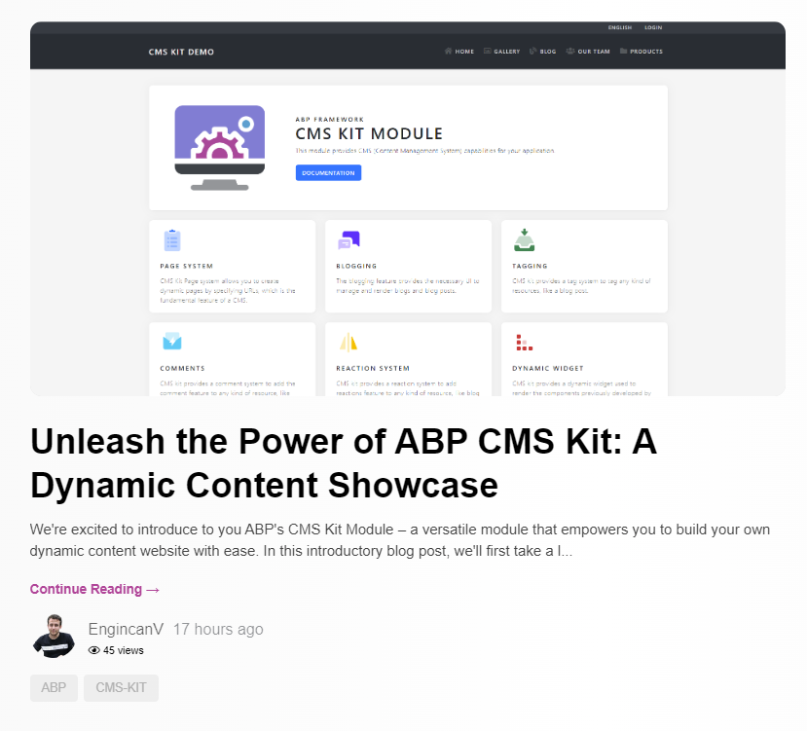
Unleash the Power of ABP CMS Kit: A Dynamic Content Showcase
https://blog.abp.io/abp/Unleash-the-Power-of-ABP-CMS-Kit-A-Dynamic-Content-Showcase

Slide 4
ABP CMS Kit: Demo - Main Structure
This is the navbar of the application and each page corresponds to a CMS Kit Feature:
Gallery: Custom implementation (image gallery) with CMS Kit’s Comment & Reaction Features
Blog: Blogging Feature (with Ratings, Comments, Tags, and Reactions features as enabled)
Our Team & Products: Pages Feature (with dynamic content, styles & scripts)
The application menu items are created & ordered dynamically with CMS Kit’s Menu System.

Slide 5

DEMO

Slide 6
Customization
https://github.com/abpframework/abp/tree/dev/modules/cms-kit
https://docs.abp.io/en/abp/latest/UI/AspNetCore/Customization-User-Interface
Thanks to the Virtual File System, an application (or another module) can override a virtual file of a module just like placing a file with the same name and file extension into the same folder of the virtual file.
Styles, Scripts & Pages
/Pages/Public/CmsKit/Blogs
BlogPost.cshtml
blogPost.css
View Components
/Pages/CmsKit/Shared/Components

Slide 7


THANKS FOR
WATCHING

