Slide 1


State of ABP
How the Platform is Evolving in the AI
Engincan Veske & Enis Necipoğlu
Community Talks 2026.4 · Volosoft
Notes:
Per-question deck, normal slide format. Open the slide that matches the question as the conversation reaches it.

Slide 2

How tonight works
AI is changing how software gets built. Tonight Enis and I step back and talk honestly about where ABP fits, and where we are taking it.
Conversation format: we trade questions as we go. Bring yours, we keep open Q&A for the end.
Engincan
Enis
Open Q&A
Notes:
Set the format: we trade questions as we go, audience brings theirs, open Q&A at the end. Don't over-explain who covers what. The two-chip visual makes the point: two of us, one platform, lots of questions.

Slide 3
Why a platform still matters in the AI era?
AI writes code fast. The real question is whether it writes the right code, in the right place, the same way every time.
A platform gives the model structure to work inside: one architecture, clear conventions, and the context it needs. That is what turns “fast” into fast, correct, and safe to ship.
Build
Modern Wizard, React UI, and an agent that knows your project.
Support
AI first, then the engineers who actually build ABP.
Learn
Free live webinars and hands-on, practical trainings.
Notes:
Throughline for my whole part. If Enis asks 'why a framework at all, and why ABP?' answer here: AI is fast, but fast isn't enough; a platform gives the model one architecture, conventions, and context. The three cards (Build, Support, Learn) are what I walk through next.

Slide 4
What we have shipped lately
ABP Studio AI Coding Agent
A solution-aware agent built natively for ABP.
Modern Wizard & React UI
A simpler, AI-friendly way to start, with the new React UI.
AI Management module
RAG, MCP, and OpenAI-compatible endpoints for AI-integrated apps.
Framework & module updates
Ongoing improvements across Identity, SaaS, and more, every release…
Notes:
Q3. Shipped lately (10.4 + 10.5/10.6 previews): Modern Wizard & React UI, AI Coding Agent, AI Management (RAG/MCP/OpenAI-compatible), framework/module updates.

Slide 5
The Modern Wizard - React UI
& the mental shift
Same ABP. A simpler, AI-friendly place to start.
Notes:
Section divider. The Modern Wizard isn't a new product, it's a simpler starting point built with AI-assisted development in mind. Take 'is ABP really AI-ready?' here if it comes up.

Slide 6
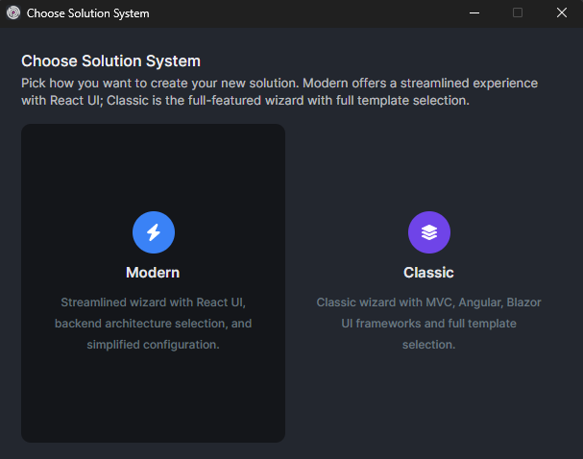
Notes:
Section divider. The Modern Wizard isn't a new product, it's a simpler starting point built with AI-assisted development in mind. Take 'is ABP really AI-ready?' here if it comes up.

Slide 7
Classic vs. Modern Wizard
Classic Wizard
Mature, with the full set of UI options (MVC, Angular, Blazor (and variations)...)
Battle-tested across years of real projects
Modern Wizard
The new default starting point
Opinionated: fewer choices, a clearer path
React UI on a stack AI tools already know: Vite, TanStack, shadcn/ui
Shaped for AI-assisted development
Why does React live in the Modern Wizard? Because that is where we are building the simpler, AI-first path. Classic stays as-is for existing stacks.
Notes:
Q to field: 'Difference between Modern and Classic, and why does React live in Modern?' Classic = mature, all UI options, fully supported. Modern = new default, opinionated, React on the AI-friendly stack. React lives in Modern because that's the AI-first path. Also: 'Is Classic still supported?' Yes.

Slide 8
Is the Classic Wizard still supported?
Yes. Classic is fully supported, and nothing you have built on it goes away.
Modern is an additional path for new, AI-first projects, not a replacement. You choose the one that fits your project.
Notes:
Q6. Classic is fully supported, nothing lost. Modern is an extra path, not a replacement.

Slide 9
Why React UI, and why now
The stack AI tools understand best. Vite, TanStack and shadcn/ui are everywhere in training data, so there is less custom abstraction for a model to guess at.
A simpler mental model. Fewer layers between you and the UI, so a prompt lands closer to working code.
Familiar to the wider frontend world. Easier to hire for, easier to extend, easier to onboard new developers.
The practical difference. You describe a screen; the agent generates into a clean, conventional structure, and you review less guesswork.
Notes:
Q to field: 'Why React now, and what practical difference does it make?' Four points: AI knows the stack, simpler mental model, hiring/extending, and the real payoff (describe a screen, agent generates into clean structure). Reassure: Classic stays, nothing built goes away.

Slide 10
The React UI stack (this is the point)
ABP 10.4 did not just add React. It chose the exact stack that AI assistants already know well.
Build & test
Vite
Vitest
Routing & data
TanStack Router
TanStack Query
Axios
UI & styling
shadcn/ui
Radix UI
Tailwind CSS
Forms & types
React Hook Form
Zod
TypeScript
Auth
OpenID Connect (OIDC)
Notes:
Detail slide. The point isn't 'React', it's the exact stack: Vite, TanStack Router/Query, shadcn/ui (Radix + Tailwind), React Hook Form, Zod, TypeScript, OIDC. All heavily represented in training data. Key line: page code lives in your project, not hidden in packages, so the agent has real context.

Slide 11
What you actually get
Your React app
The developer-owned SPA. Your pages and features live in react/src/pages, as real code in your solution.
ABP Admin Console
The ready-made admin UI for ABP modules (Volo.Abp.AdminConsole): users, roles, settings, tenants, all wired up.
abp new Acme.BookStore --template app --modern --ui-framework react
Or pick the Modern flow in ABP Studio’s New Solution wizard (v3.0+). It preconfigures ports, OIDC clients, theme, and the React + Admin Console wiring for you.
Notes:
Detail slide. A modern React solution has two surfaces: your own SPA (pages in react/src/pages) and the ready-made ABP Admin Console (Volo.Abp.AdminConsole) for users/roles/settings/tenants. Show the one-line CLI command; note ABP Studio's Modern wizard wires ports, OIDC, theme and Admin Console for you. Demo hook if screen-sharing.

Slide 12
End-to-end support, in the AI era
Faster answers, with a real person behind them.
Notes:
Section divider. Support is changing shape in the AI era, but the goal is the same: get you unblocked fast. Tee up the two support questions.

Slide 13
How support works now: abp.io/support
1
Ask at abp.io/support
An AI assistant trained on ABP docs and source answers first, instantly, any hour.
2
Hands off to the ABP team
The same engineers who build the framework pick it up from there.
3
Consultancy & 1:1 sessions
One-on-one live support for the cases that call for it.
Is support going AI-only?
No. The AI handles the fast, common questions so the team has more time for the hard ones.
Will a real person be there?
Yes. Someone on the ABP team owns your question end to end.
Notes:
Q to field: 'Is support going AI-only? Will a real person be there?' Walk the 3-step flow: AI assistant first (instant, any hour) -> ABP team engineer -> consultancy/1:1. Headline: AI handles the fast common stuff so the team has more time for the hard ones. A real person owns your question end to end.

Slide 14
DailyTalking, a new Volosoft app
Different domain, same philosophy: build what people actually need. It is a signal of where else we are putting our energy.
Notes:
Section divider. Support is changing shape in the AI era, but the goal is the same: get you unblocked fast. Tee up the two support questions.

Slide 15
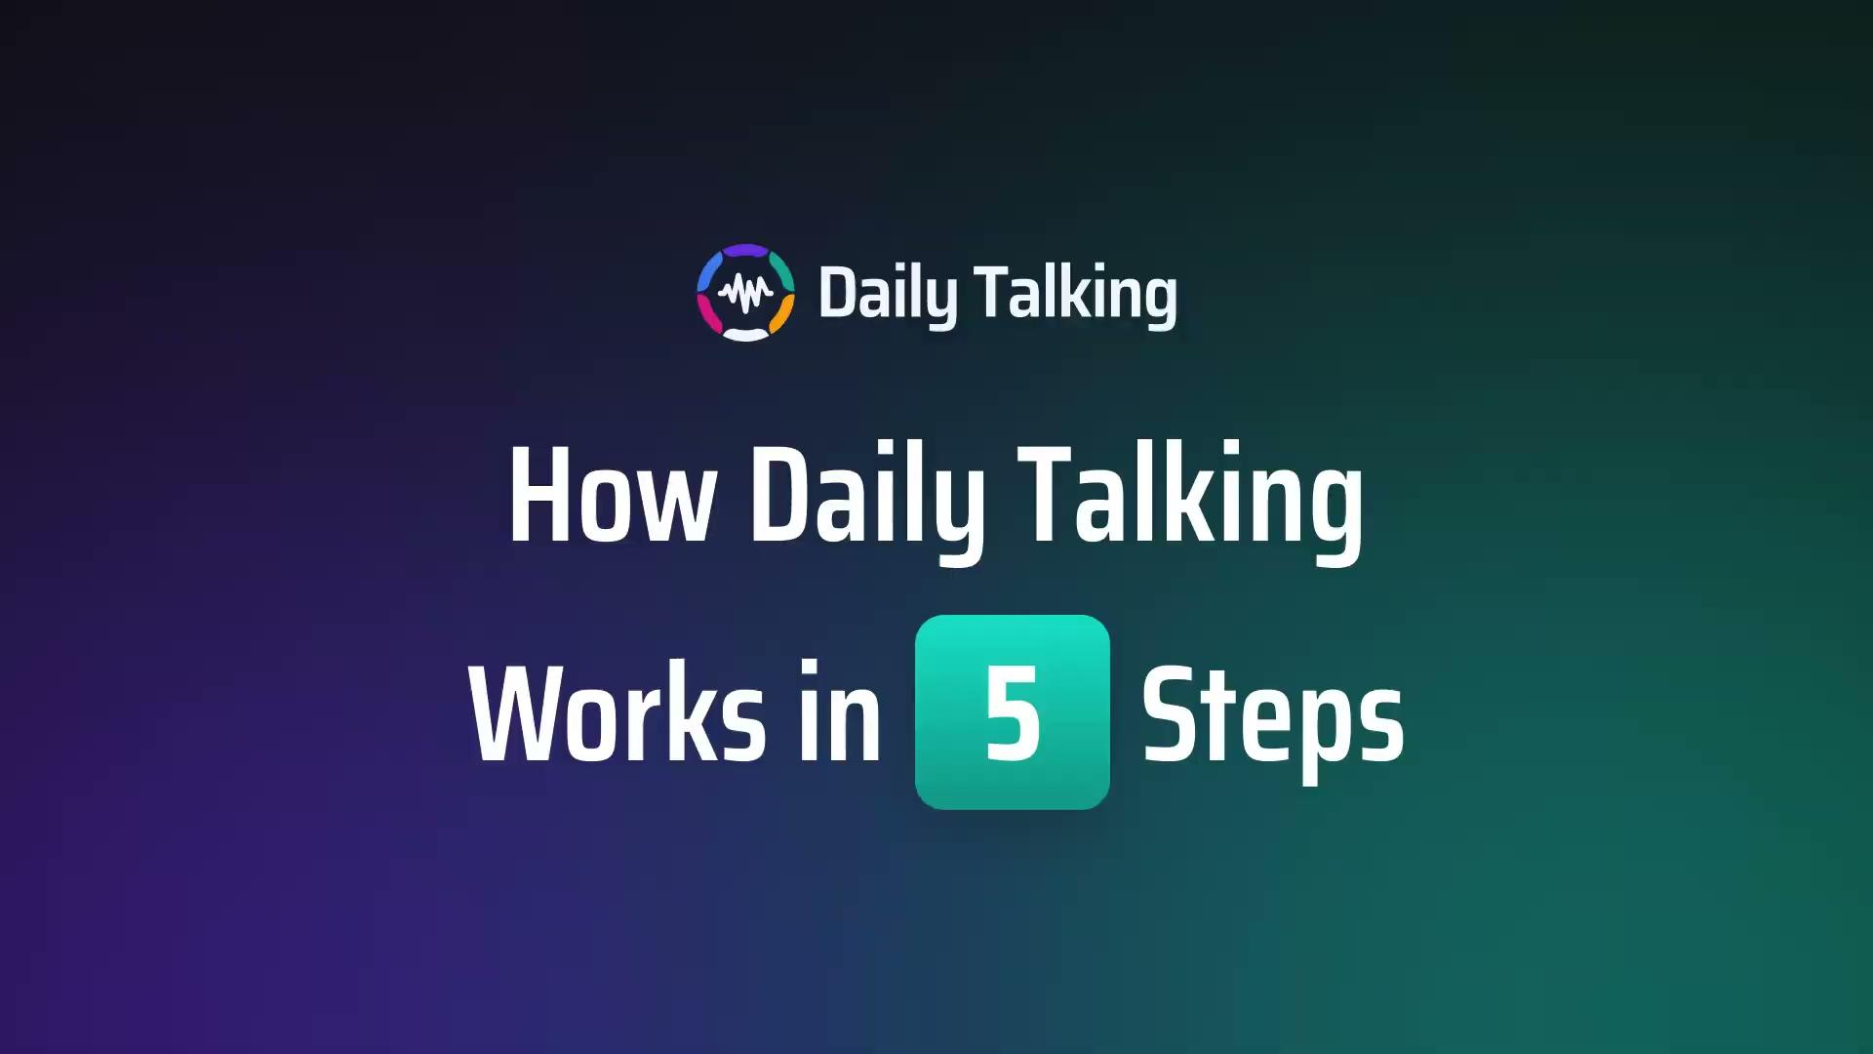
Notes:
Q13. New products too, e.g. DailyTalking. Same philosophy: build what people need. Enis introduces it.

Slide 16
Q&A
Notes:
Hand to Enis: 'What else should we expect, new products?' is his cue (DailyTalking) plus the agent, modules, trainings/bootcamp. Then open the floor for Q&A, keep it tight, 15-20 minutes.

