Slide 1






Microsoft Agent Framework
@EngincanVeske
Engincan VESKE
EngincanV
Software Engineer at Volosoft
✍️
engincanveske.substack.com
@engincanv

Slide 2

Agenda
Core Concepts & Building Blocks
  Agents
  Workflows
DEMOs (with MCP tool usages, state-management with AgentThread, and workflows…)

Slide 3







Core Concepts & Building Blocks
⭐
⭐
Agents
Workflows
Agents are systems that combine reasoning, context and tools to pursue objectives.
Workflows structure complex objectives into sequences of steps, coordinating tasks across people or systems to reach a goal efficiently.
State Management (AgentThread)
Tools / Plugins
AgentThread is the state manager that carries an agent’s conversation history so it can reason consistently across turns.
The capabilities. Functions or MCP Servers that allow agents to interact with the real world.

Slide 4
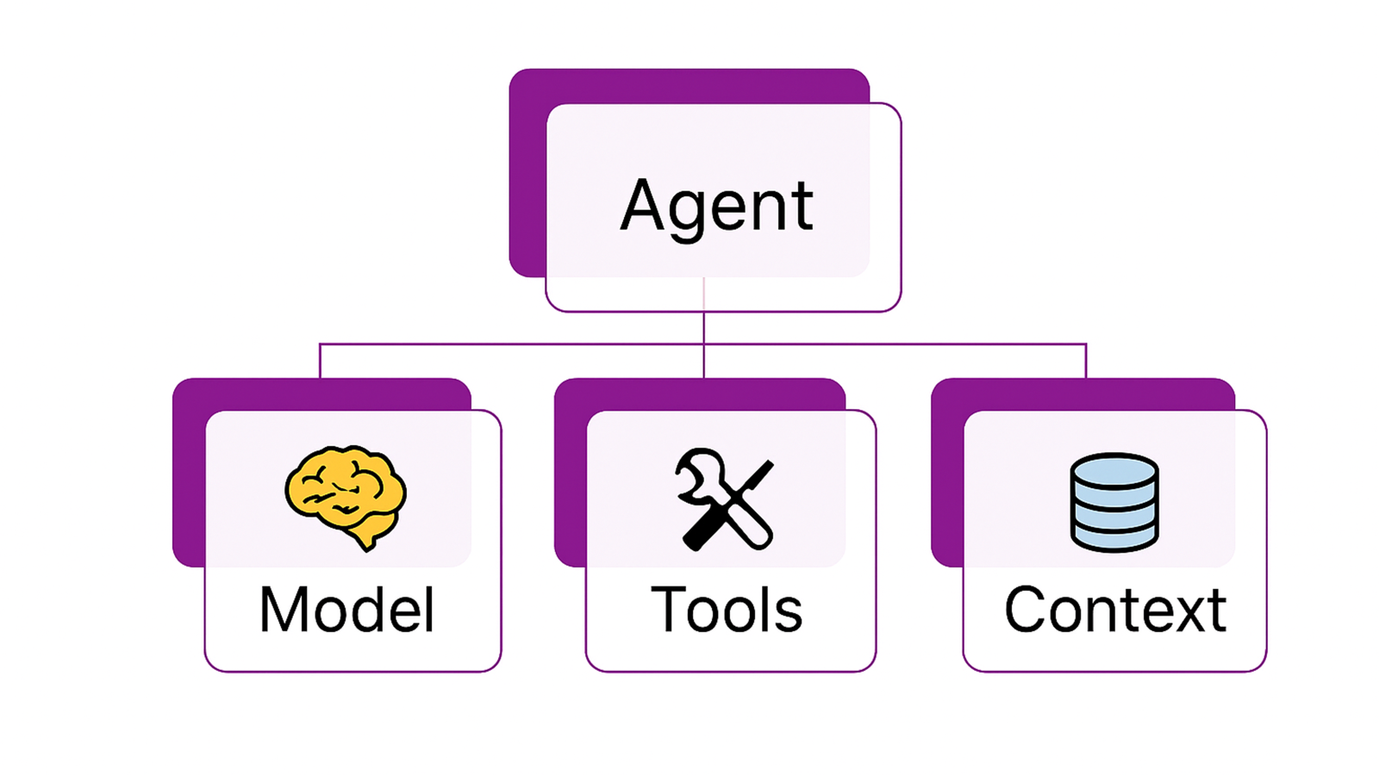
Core Concepts: Agents
Notes:
Individual agents that use LLMs to process user inputs, call tools and MCP servers to perform actions, and generate responses.

Slide 5
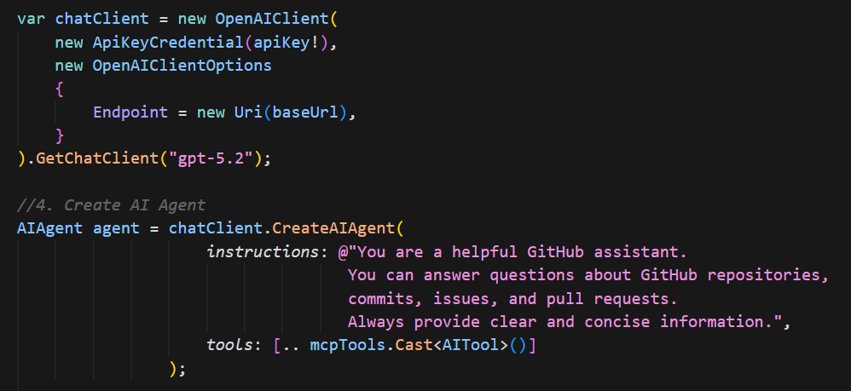
Individual agents that use LLMs to process user inputs, make decisions, call tools and MCP servers to perform actions, and generate responses.
Agents are wrappers around ChatClient.
They support streaming and structured outputs.

Slide 6
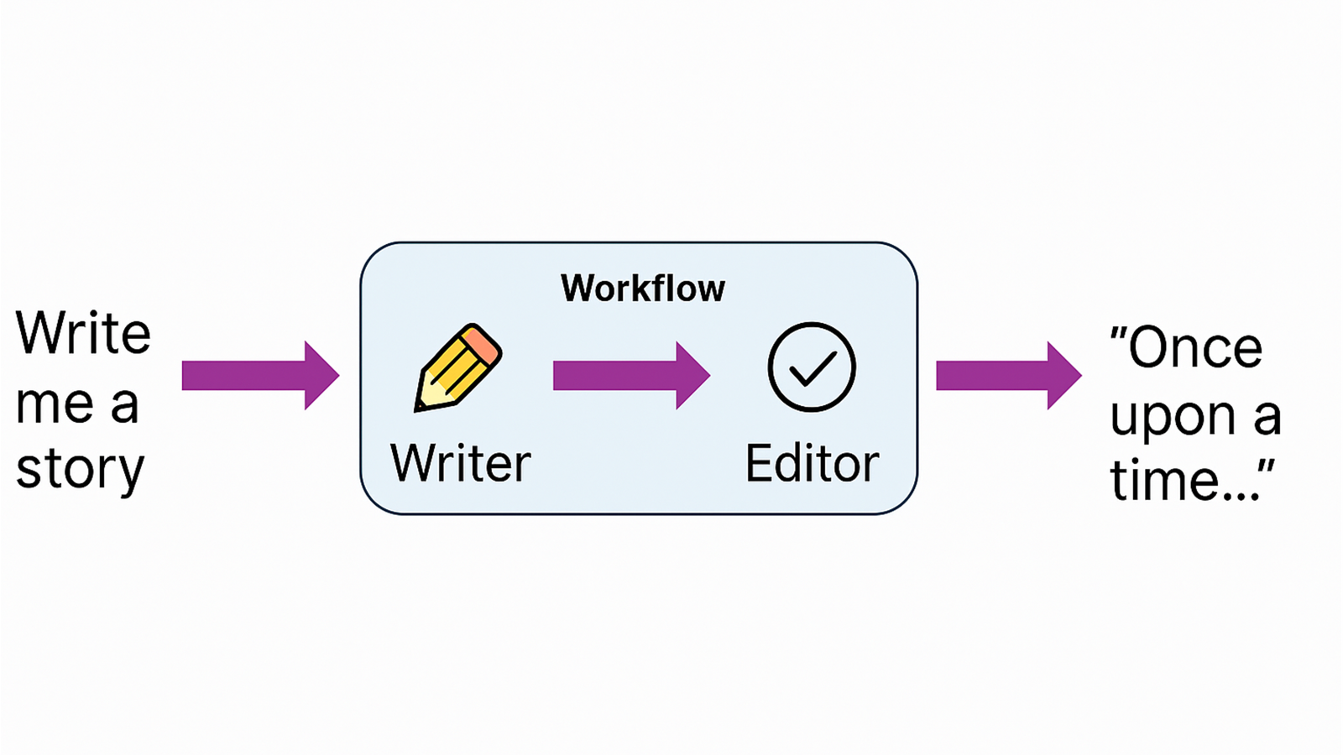
Core Concepts: Workflows
Notes:
Graph-based workflows that connect multiple agents and functions to perform complex, multi-step tasks.

Slide 7
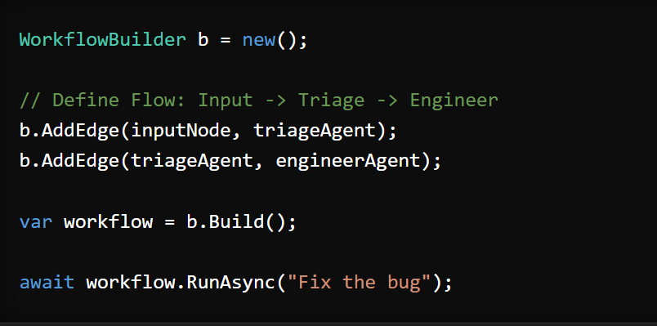




↓
↓
↓
Notes:
Graph-based workflows that connect multiple agents and functions to perform complex, multi-step tasks.

Slide 8
DEMO: MCP Usage & State Management with AgentThread
1-) MCP Integration: Connects to Github’s MCP Server using @modelcontextprotocol/server-github NPM package. The agent automatically discovers all available Github tools (commits, issues, PRs) and uses them dynamically (no manuel tool definition needed).
2-) AgentThread for State Management: Maintains conversation context across multiple queries. It answers directly from memory without making another Github API Call, or any other tool calls!
Source Code: https://github.com/EngincanV/samples/tree/main/IssueCopilotDemo

Slide 9
DEMO: Release Notes Workflow
1-) Writer Agent: Technical Release Notes Writer
2-) Reviewer Agent (Marketing Agent): Polishes the technical release notes and makes it customer-friendly!
Source Code: https://github.com/EngincanV/samples/tree/main/ReleaseNotesWorkflowDemo

Slide 10
Thanks for listening!

