Slide 1



ABP CMS Kit: DEMO
Engincan VESKE
Software Engineer at Volosoft

Slide 2

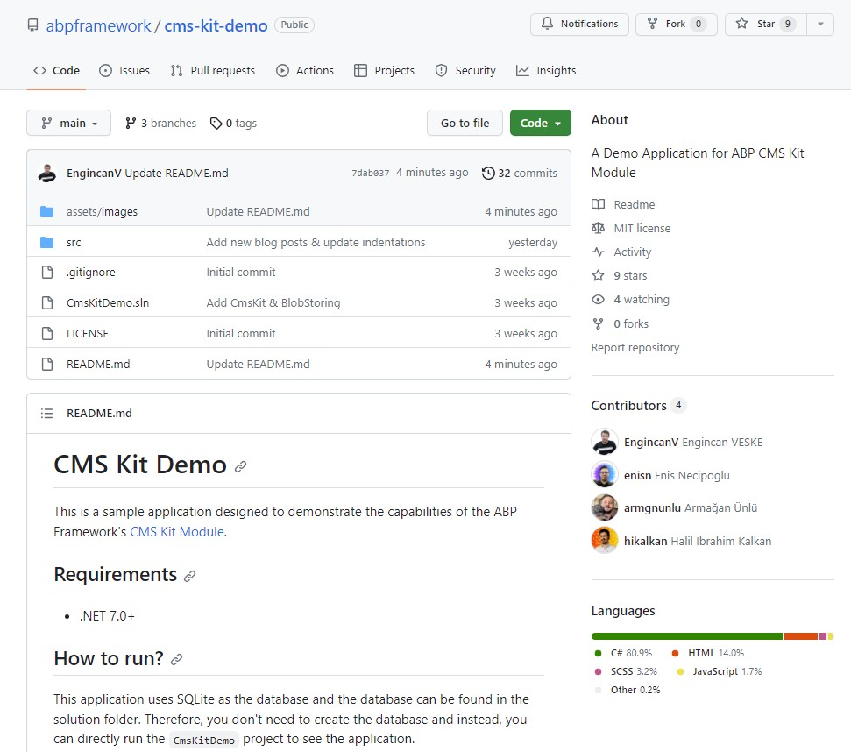
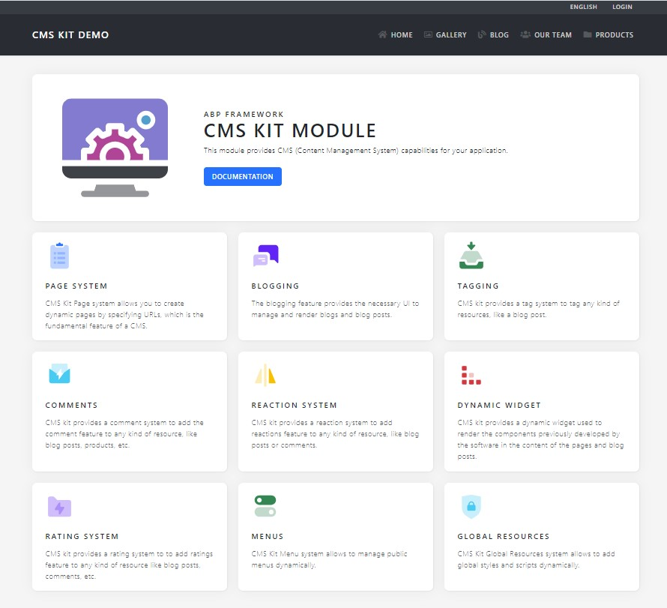
ABP CMS Kit: Demo - Repository & Website
Repository: https://github.com/abpframework/cms-kit-demo
Website: cms-kit-demo.abp.io
Notes:
We as the core ABP development team created a sample application to show what ABP’s CMS Kit Module is capable of. You can check the source code of the application from cms-kit-demo repository and also you can visit the cms-kit.abp.io website to see the demo application on live.
Today, I will show you this application and we will see some CMS Kit features such as Pages, Blogging, Menu System and other features in action.

Slide 3
ABP CMS Kit: Demo - Main Structure
This is the navbar of the application and each page corresponds to a CMS Kit Feature:
Gallery: Custom implementation (image gallery) with CMS Kit’s Comment & Reaction Features
Blog: Blogging Feature (with Ratings, Comments, Tags, and Reactions features as enabled)
Our Team & Products: Pages Feature (with dynamic content, styles & scripts)
The application menu items are created & ordered dynamically with CMS Kit’s Menu System.
Notes:
Before showing you the application, let’s just first take a glance at the main structure.

Slide 4

DEMO

Slide 5
Customization
https://github.com/abpframework/abp/tree/dev/modules/cms-kit
https://docs.abp.io/en/abp/latest/UI/AspNetCore/Customization-User-Interface
Thanks to the Virtual File System, an application (or another module) can override a virtual file of a module just like placing a file with the same name and file extension into the same folder of the virtual file.
Styles, Scripts & Pages
/Pages/Public/CmsKit/Blogs
BlogPost.cshtml
blogPost.css
View Components
/Pages/CmsKit/Shared/Components

Slide 6


THANKS FOR
WATCHING

