Slide 1






MCP Servers & OpenAI-Compatible Endpoints
@EngincanVeske
Engincan VESKE
EngincanV
Software Engineer at Volosoft
✍️
engincanveske.substack.com
@engincanv

Slide 2

AGENDA
01
02
MCP Servers
OpenAI-Compatible
Endpoints
Connect AI assistants directly to your ABP application via the Model Context Protocol.
Expose your ABP app as an OpenAI-spec API — drop-in replacement for any OpenAI client.

Slide 3
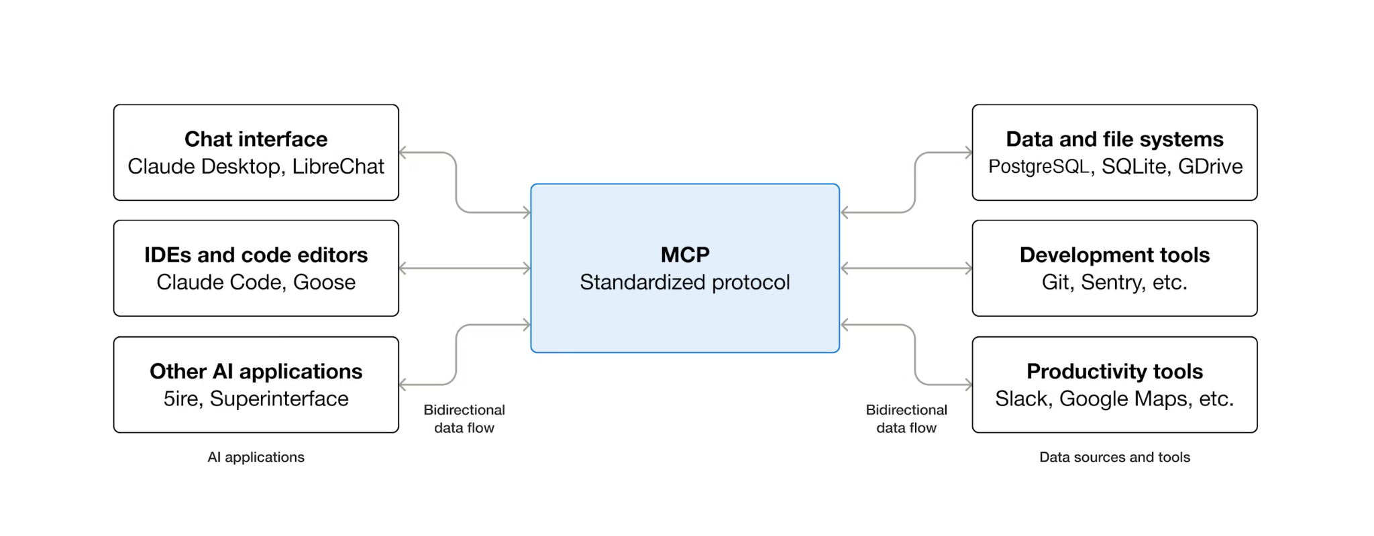
Model Context Protocol (MCP)
Notes:
https://modelcontextprotocol.io/docs/getting-started/intro

Slide 4
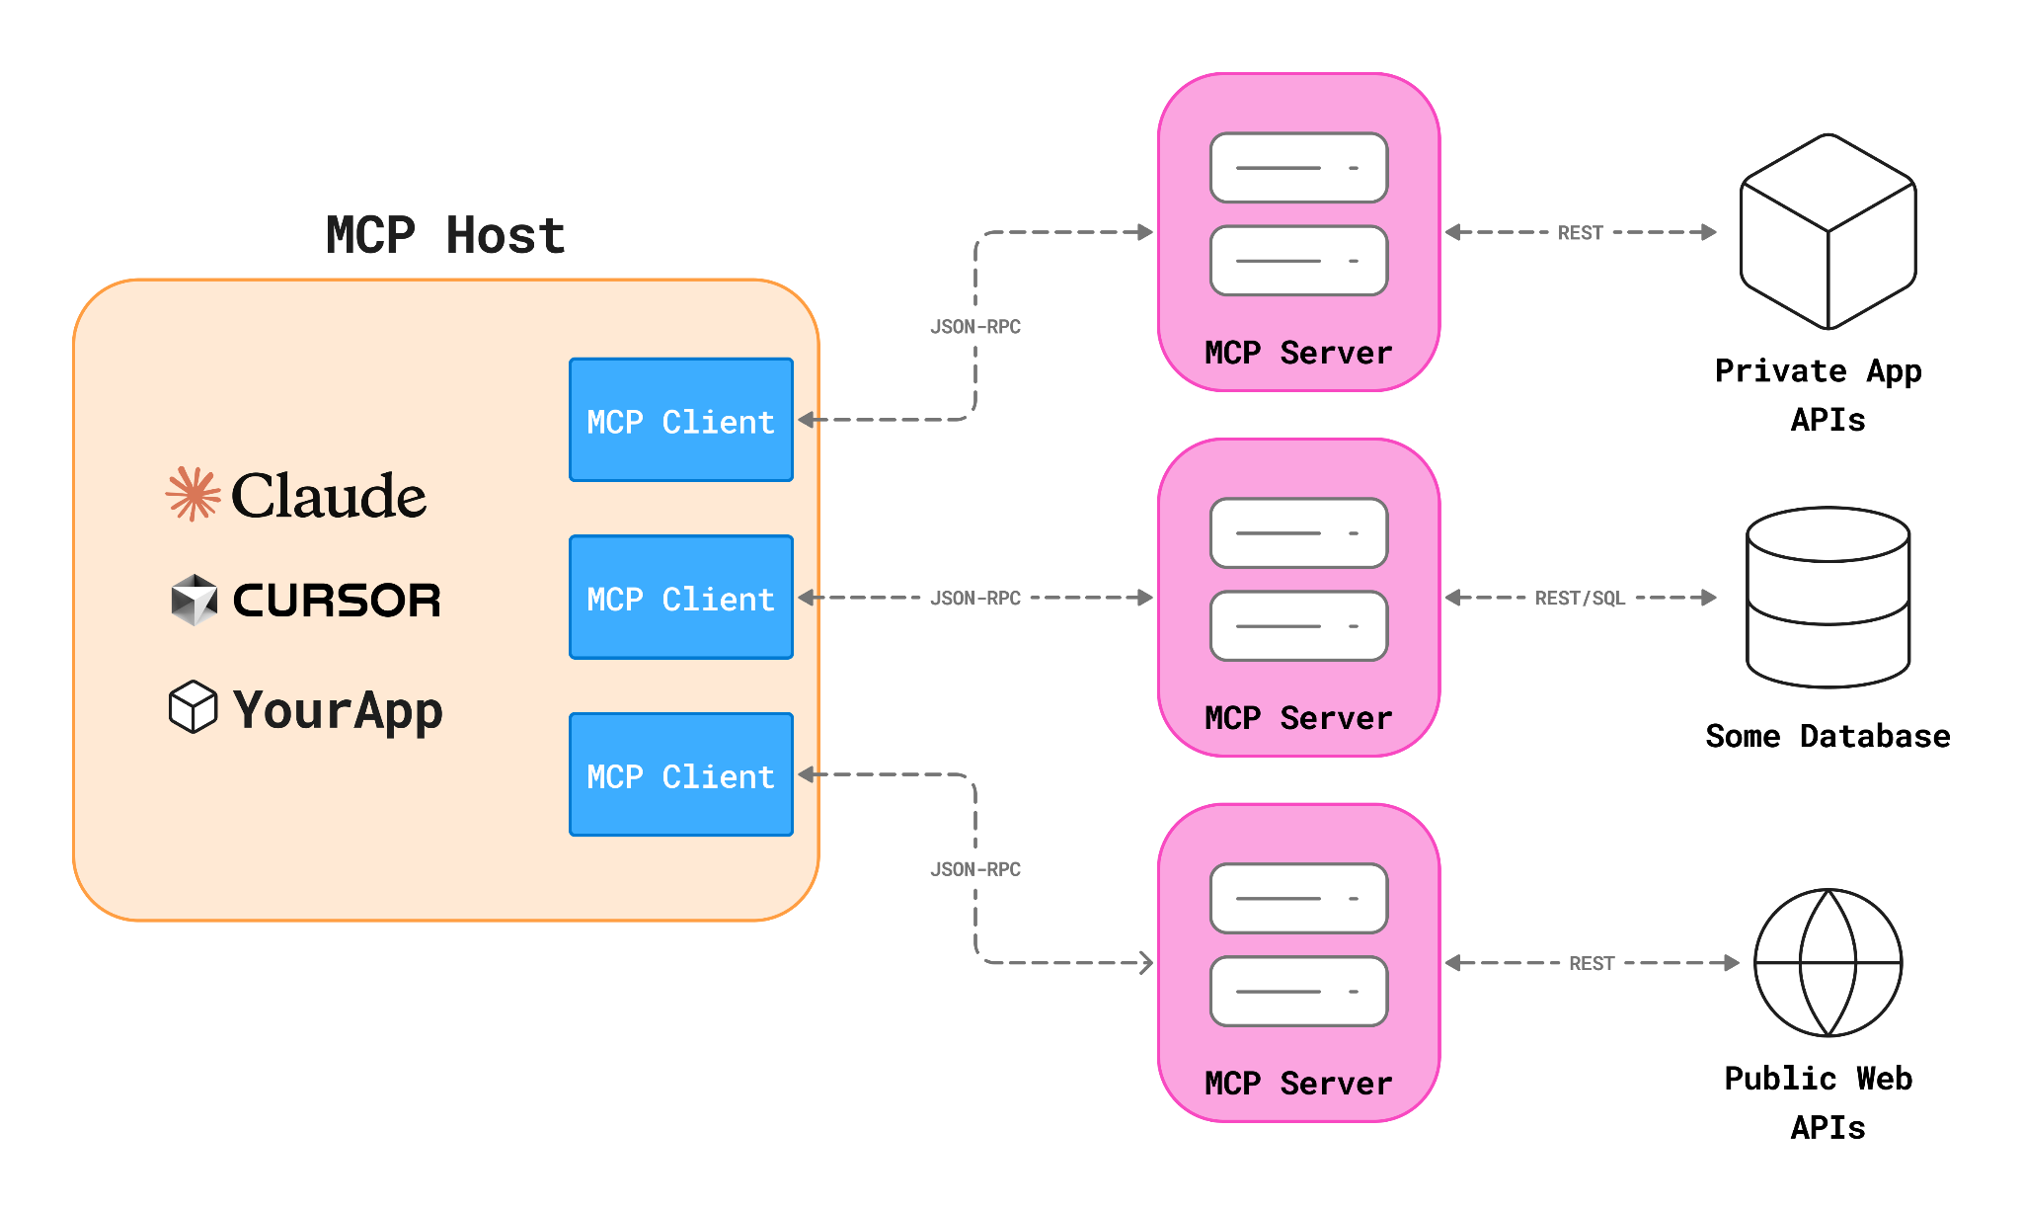
Architecture (Host/Server/Client)
Notes:
https://modelcontextprotocol.io/docs/getting-started/intro

Slide 5
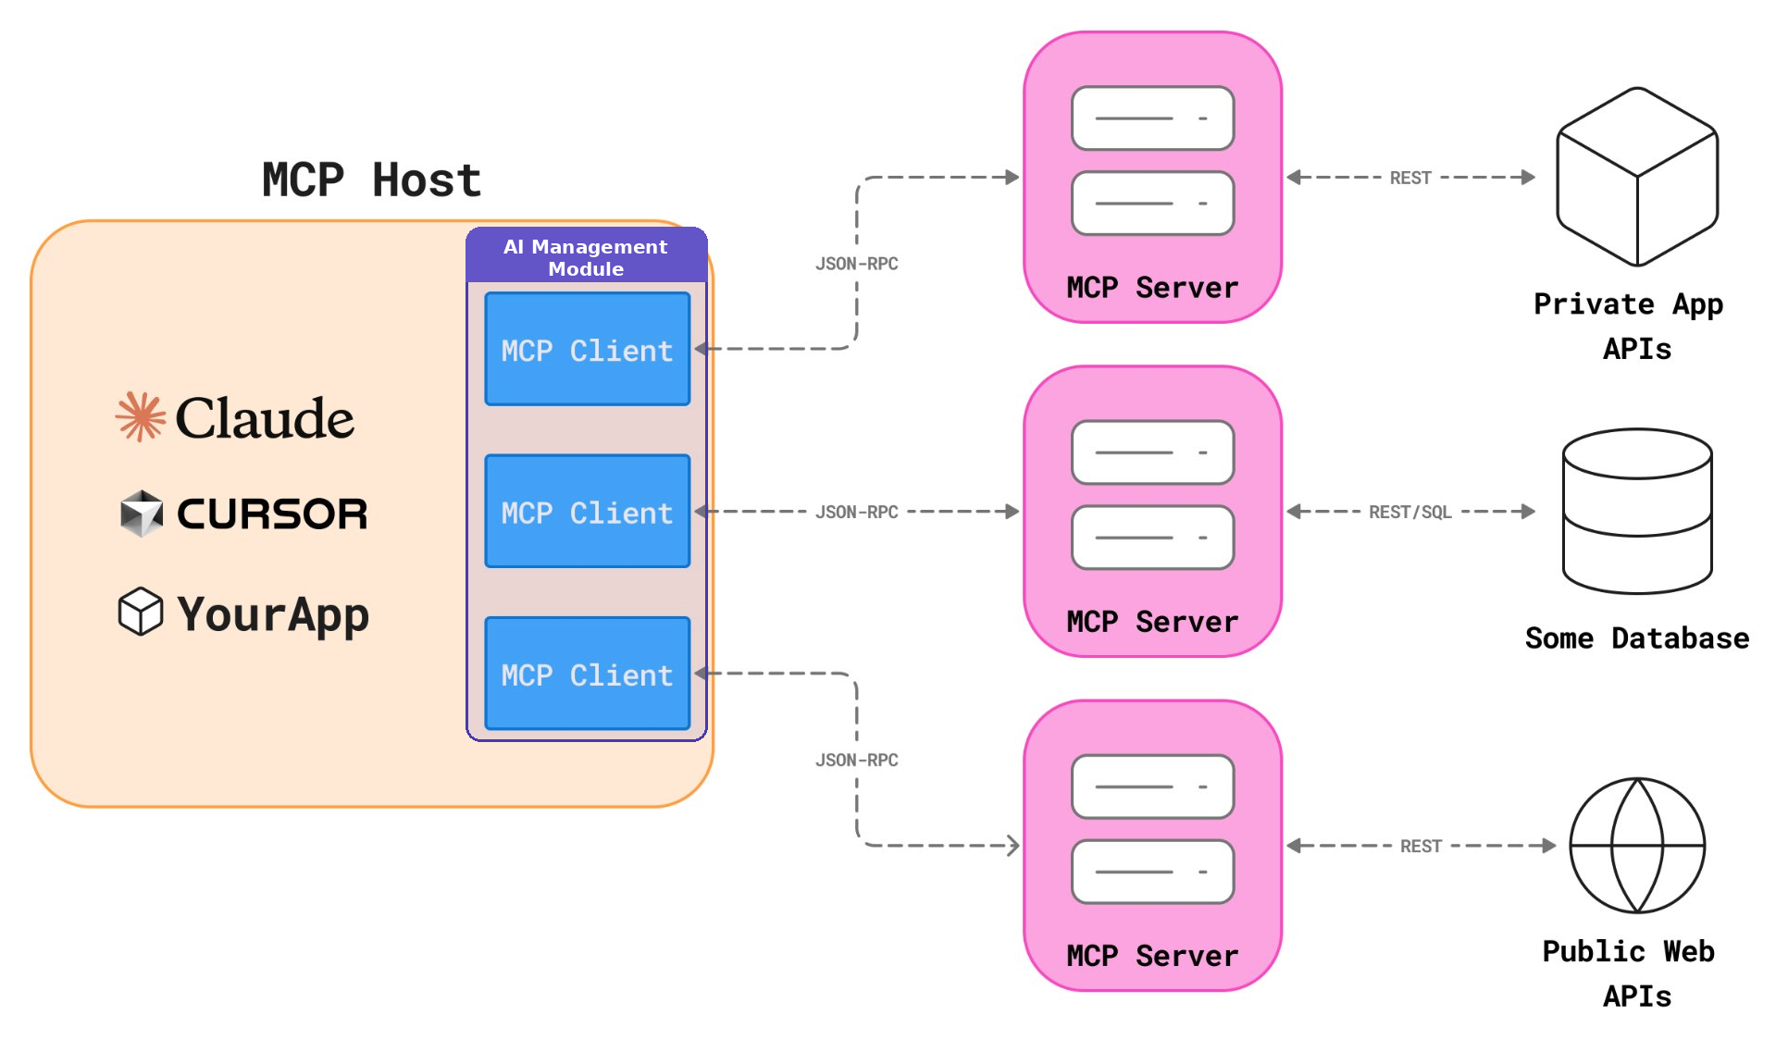
So… Where Does ABP Fit in This Picture?
Notes:
https://modelcontextprotocol.io/docs/getting-started/intro

Slide 6
HOW IT WORKS?
1
2
3
Create &
Test Connection
Connect
Use
Create a new MCP Server & list available tools (test connection)
Connect MCP Servers with the relevant workspaces
Test it in the chat playground or consume it in your system directly
Docs: https://abp.io/docs/10.2/modules/ai-management#mcp-servers

Slide 7
Demo: Connecting MCP Servers & Workspaces

Slide 8
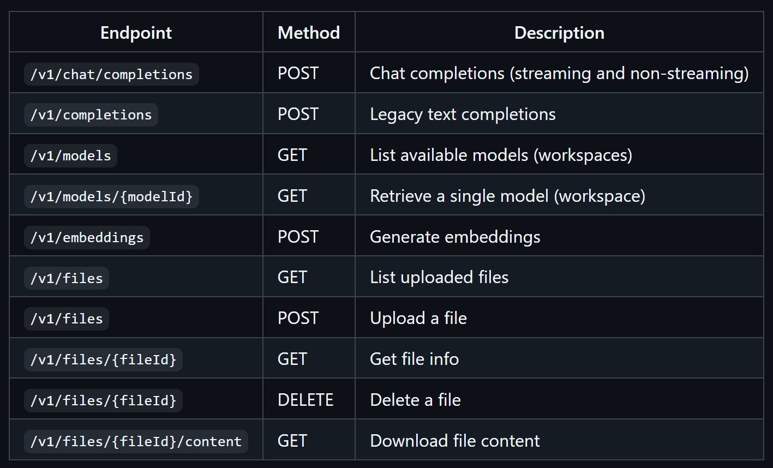
OpenAI-Compatible Endpoints Exposure
The AI Management Module exposes an OpenAI-compatible REST API at the /v1 path. This allows any application or tool that supports OpenAI API format (e.g. AnythingLLM, Dify etc.) to connect directly to your AI Management instance.
Notes:
The AI Management module exposes an OpenAI-compatible REST API at the /v1 path. This allows any application or tool that supports the OpenAI API format -- such as AnythingLLM, Open WebUI, Dify, or custom scripts using the OpenAI SDK -- to connect directly to your AI Management instance.

Slide 9
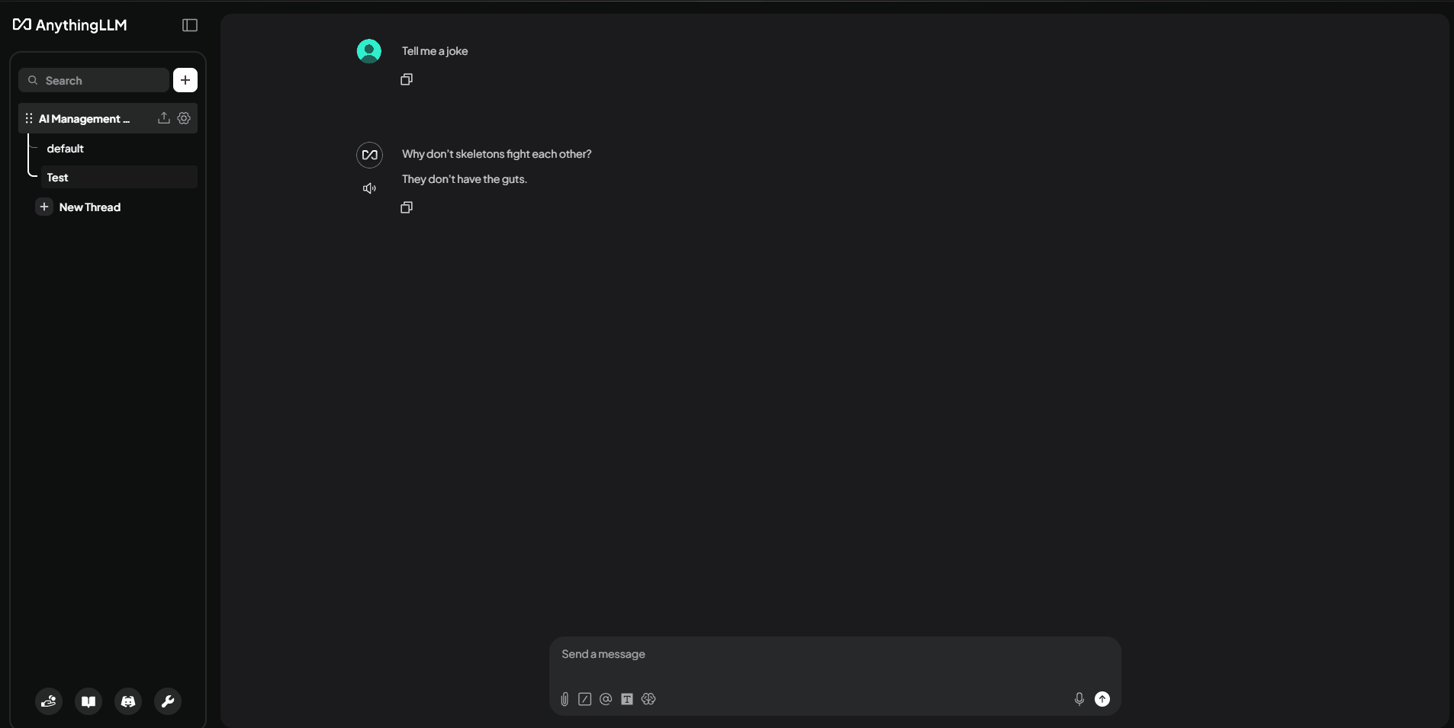
AnythingLLM

Slide 10
DEMO: AnythingLLM Setup

Slide 11
Thanks for listening!

