Slide 1

New Features Came with v6.0
ABP Framework
LeptonX is now the default theme for startup templates
New .NET MAUI startup template
ABP Commercial
New .NET MAUI mobile application
GDPR module: Cookie consent
To see other features, please read the v6.0 blog post.
Notes:
Today, I will briefly mention the important features that came with v6.0 for ABP Framework and ABP Commercial.
Let’s start with ABP Framework.
LeptonX Theme became the default theme for startup templates
A new .NET MAUI startup template has been added
For ABP Commercial,
A new .NET MAUI Mobile Application has been added as an alternative to React Native mobile application.
Cookie Consent Feature has been added to the GDPR Module.
I’m gonna only talk about these four features, so if you want to see the full list of new features and enhancements, please see the v6.0 blog post.

Slide 2
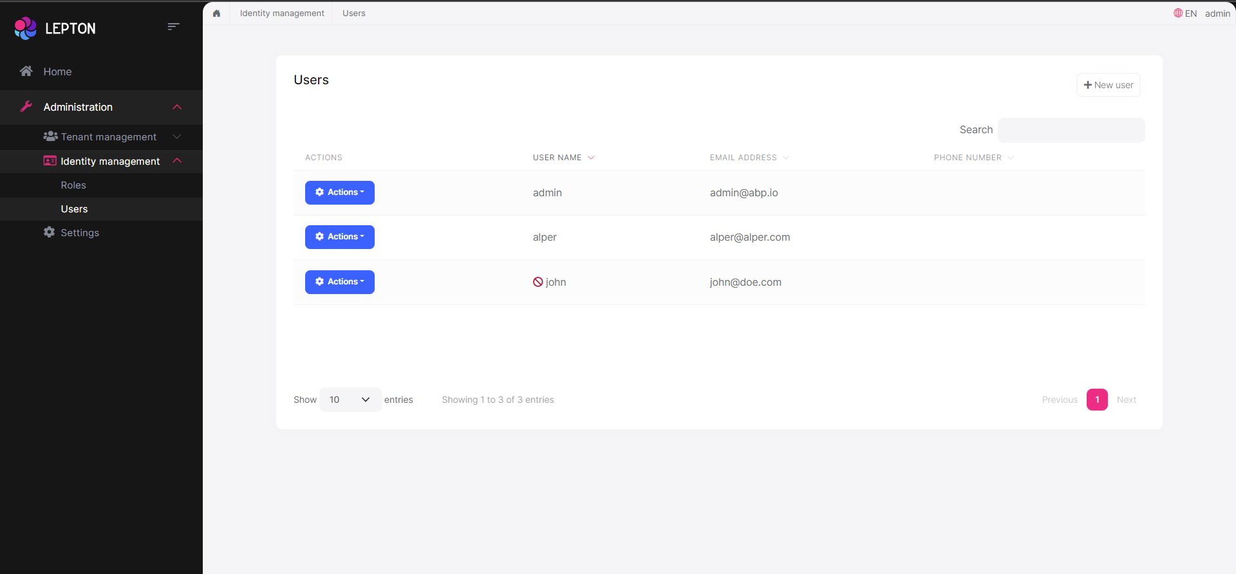
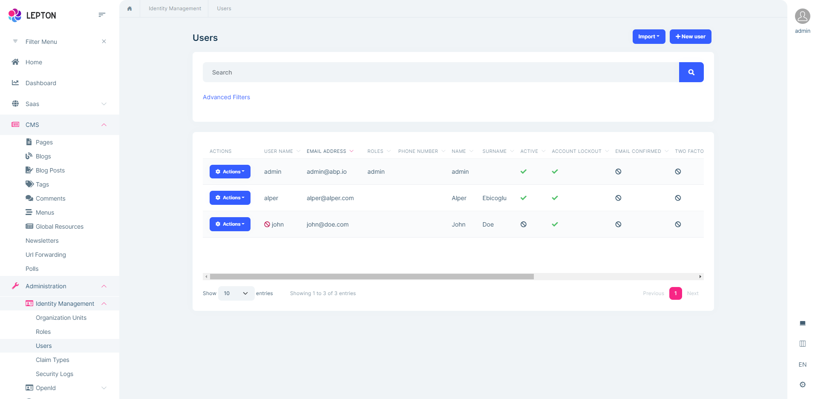
LeptonX Theme on Startup Templates
LeptonX Lite Theme
LeptonX Theme
Notes:
LeptonX Lite and LeptonX Themes are now the default themes for startup templates. LeptonX Lite Theme for open-source side and LeptonX Theme for ABP Commercial
.
If you create an application, your project will be pre-installed with one of these themes by default. However, it’s possible to choose a theme while creating an application by using the ABP CLI or using the Get Started page of abp.io website or via ABP Suite for ABP Commercial customers.

Slide 3



Theme Selection via ABP CLI
You can specify the theme by using the --theme option while creating an application with ABP CLI as below:
For free templates, LeptonX Lite Theme(default) and Basic Theme are the options.
For pro templates, LeptonX Theme(default), Lepton Theme and Basic Theme are the options.
Notes:
You can specify the theme by using the --theme option while creating an application with ABP CLI as shown in here.
There are two theme options for free templates and they are LeptonX Lite Theme (it’s default theme) and Basic Theme. If you don’t specify the theme, LeptonX Lite Theme will be used in your application.
For pro templates, LeptonX Theme (it’s default theme for pro templates), Lepton Theme and Basic Theme are the options. You can go with any of them you want, by just specifying the theme option with one of these theme names.

Slide 4
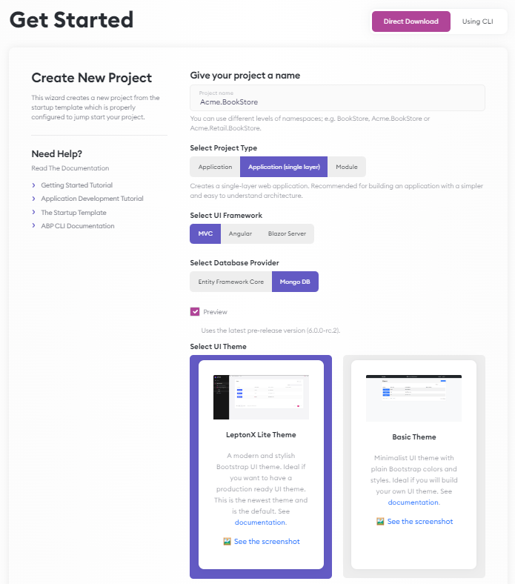
Theme Selection on Get Started Page
Notes:
You can also create your projects on the GetStarted page of abp.io website for free templates and select a theme you want.
You need to check the “Preview” checkbox to be able to select a theme on this page, because otherwise a project will be created with the latest stable version and which is 5.3.4 for now (and this theme selection option is not available in the v5.3.4).

Slide 5
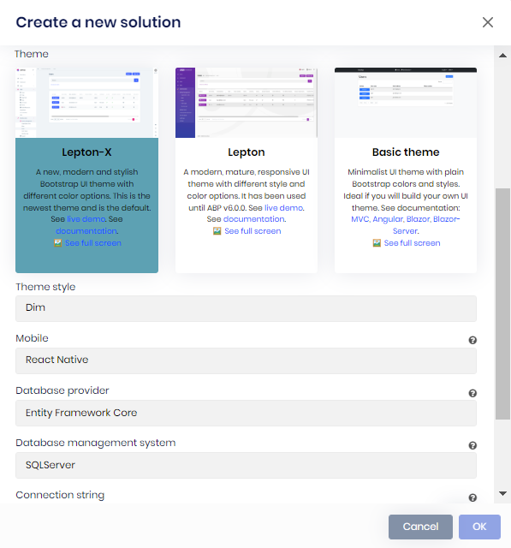
Theme Selection via ABP Suite
You can also select a theme while creating a project from ABP Suite. You can select LeptonX Theme(default), Lepton Theme or Basic Theme as the theme of the application.
If you select the LeptonX Theme, you can also choose the theme style. System, Dim, Light and Dark are the options for theme style.
Notes:
You can also select a theme from the project creation modal of ABP Suite. There are three options as you seen in the screenshot. LeptonX Theme, Lepton Theme and Basic Theme.
If you select the LeptonX Theme, you can also choose the theme style. Dim, Light and Dark are the option for theme styles.

Slide 6
DEMO

Slide 7
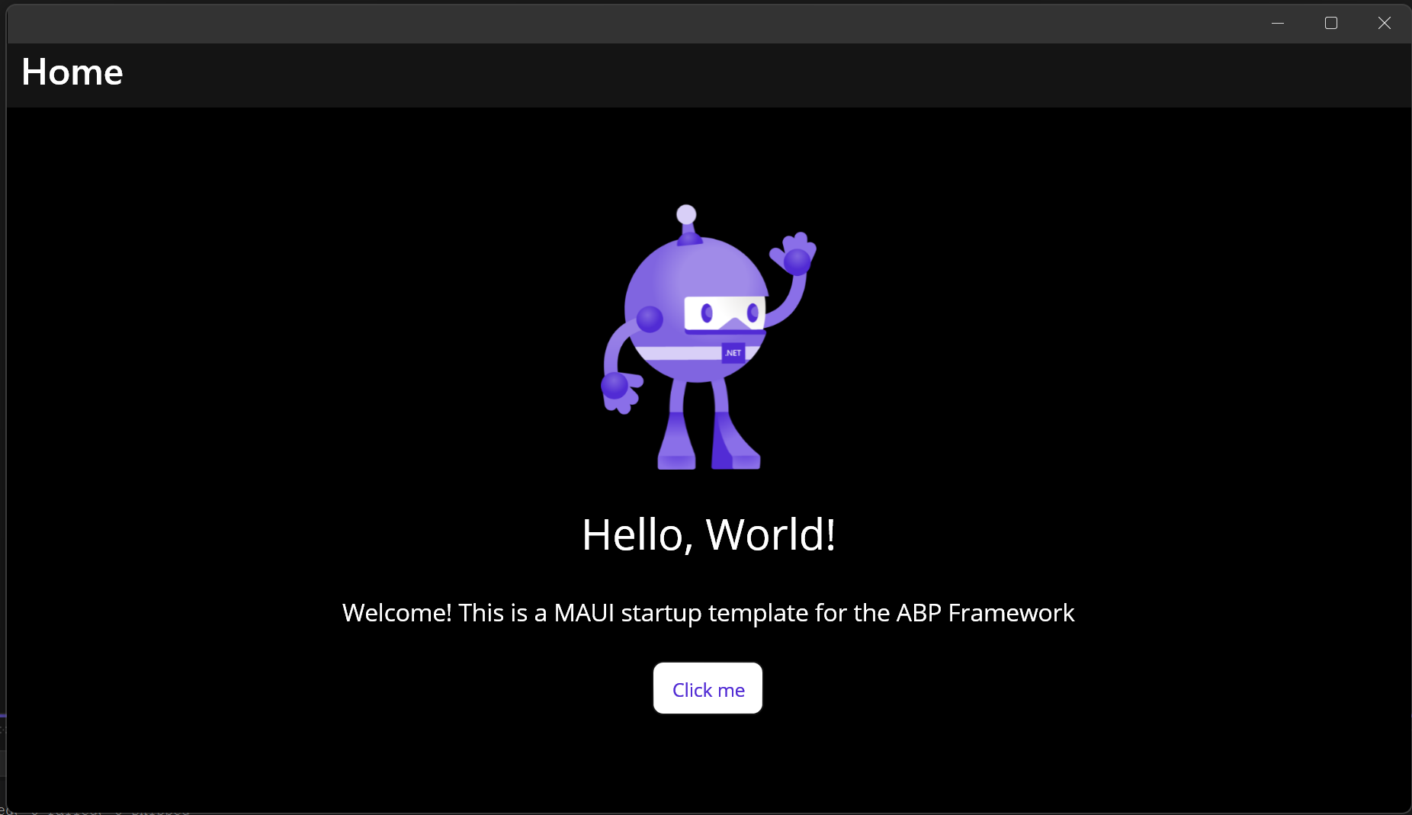

.NET MAUI Startup Template
You can create a new .NET MAUI project with the command below:
You can read the MAUI Application Startup Template documentation for more info.
Notes:
ABP Framework provides .NET MAUI startup template with this version. This template created to provide a minimalist MAUI application with minimal ABP packages integrated. Only ABP Autofac package is pre-installed with this project now. But you can also use other ABP modules within this MAUI application by your needs.
You can create a new .NET MAUI project, by specifying the theme as maui, as shown here.

Slide 8
.NET MAUI Mobile Application
To create a new Application Startup Template with the .NET MAUI mobile application, use the command below:
Notes:
ABP Commercial has already been providing a React Native as mobile application for a while. Alternative to this application, we created a new .NET MAUI mobile application with this version. This new .NET MAUI mobile application is can be created with the application pro template.

Slide 9
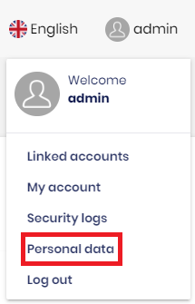
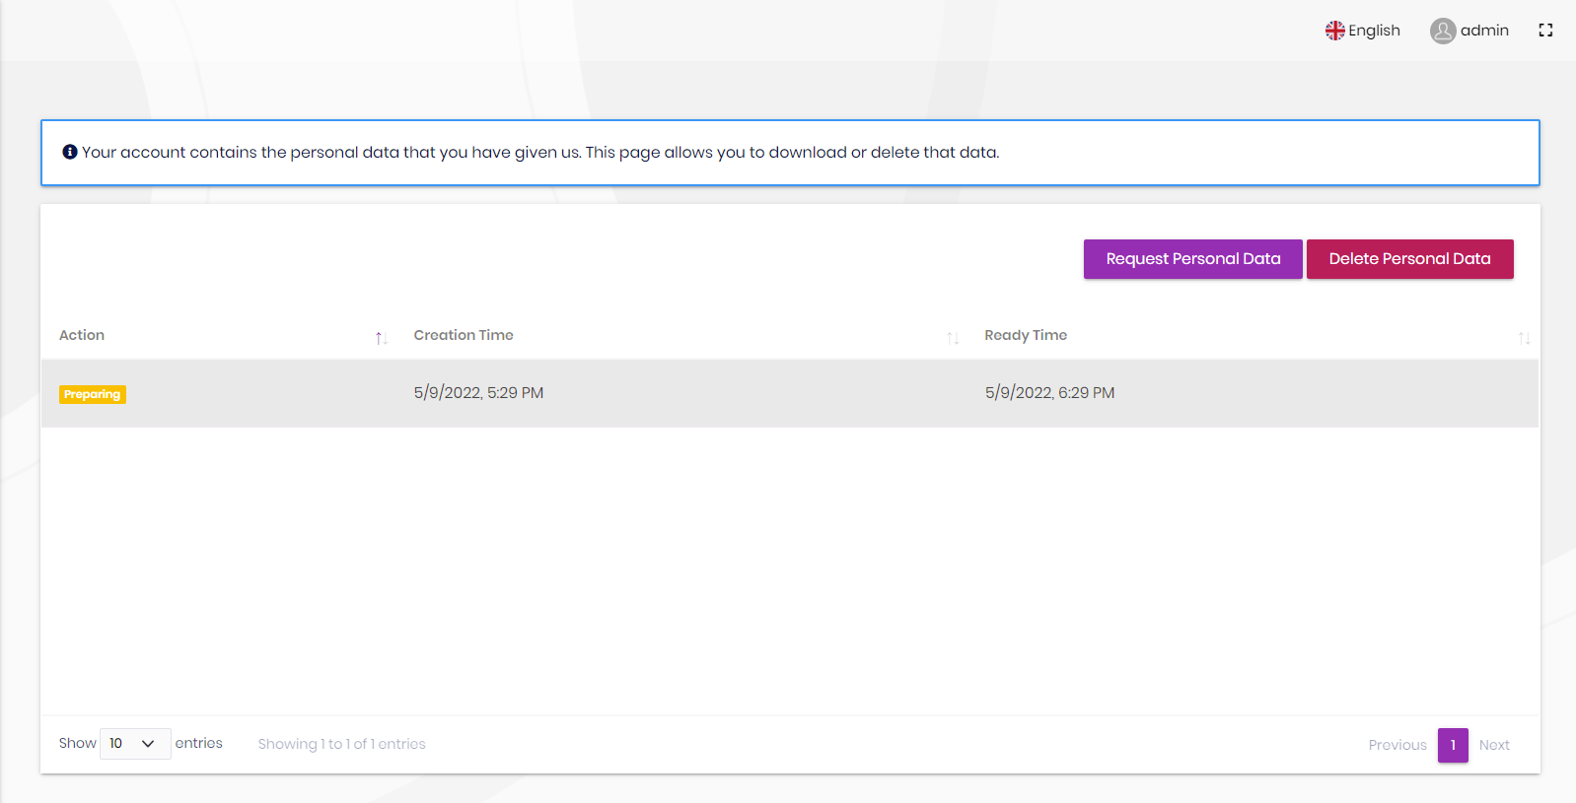
GDPR Module
Personal Data Management Page
Notes:
We have implemented and introduced the GDPR module for ABP Commercial customers in v5.3 and made it pre-installed for the startup templates. “Download Personal Data” and “Delete Personal Data” features were added to this module within v5.3.
You as a user, can request to download your personal data which collected by the application. You also have right to delete your personal data and delete your account permanently. In other words, according to GDPR you have right to manage your personal data that you provided to applications and right to request or delete it any time you want.
GDPR module designed to help you in this point. And these two features have been announced in the previous versions.

Slide 10
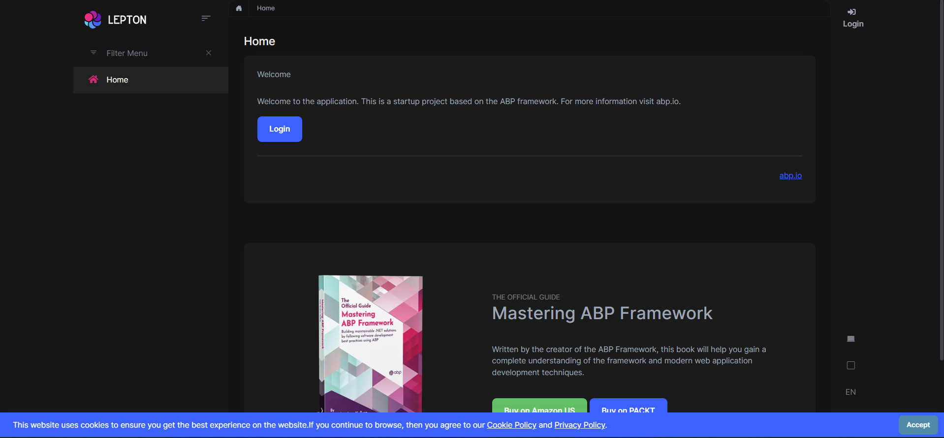
GDPR Module: Cookie Consent
https://docs.abp.io/en/commercial/6.0/modules/gdpr#cookie-consent
Notes:
We have announced that we will implement some features for GDPR module in the next versions. And in this version, the Cookie Consent feature has been added to the GDPR module and it’s enabled by default for the new startup templates. So, you don’t need to manually install it.
If you want to use the Cookie Consent feature of the GDPR module in your existing project, please see the GDPR Module documentation.

Slide 11
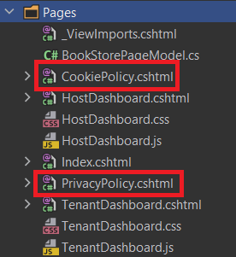
GDPR Module: Cookie Consent
Cookie Policy and Privacy Policy pages have been added to the template to provide users a general content for these policies.
You can see the content of these pages and change the content or url of these pages by your needs.
You can directly delete these pages if you don’t need them.
Notes:
If you create a new startup template from v6.0, you will see the extra two pages in your project. One for “Cookie Policy” and the other one for the “Privacy Policy” pages.
We’ve added these two pages to the templates for providing users a general content for these policies. You can see the content of these pages and change the content or url of these pages by your needs. Or you can directly delete these pages if you don’t need them.

Slide 12
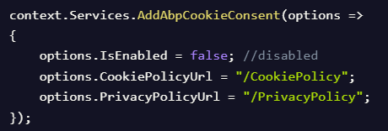
GDPR Module: Cookie Consent
If you want to disable/hide the Cookie Consent, you can simply open your module class and set the IsEnabled property as false:
Notes:
As i said just before, Cookie Consent feature is enabled by default from v6.0. So you might want to disable cookie consent. If you want to disable or hide the “Cookie Consent”, you can simply open the startup project module class and set the `IsEnabled` property as false. You can also change the cookie policy and privacy policy page urls like in the screenshot.

