Slide 1

What’s new with .NET 7.0?
ASP.NET Core
Rate Limiting
Output Caching Middleware
Built-in HTTP/3 Support
Request Decompression
gRPC - JSON Transcoding
Blazor
Custom Elements
Improvements on JavaScript Interop
C#11
Required Members
Generic Attributes
Raw String Literals
List Patterns
Notes:
Hello everyone, today we are going talk about what’s new with .NET 7.0. We will examine new features within 5 sub-heading and these are: ASP.NET Core, Blazor, C#11

Slide 2
What’s new with .NET 7.0?
Entity Framework Core
JSON Columns
Improvements on Bulk Updates & Deletes
Performance Improvements on SaveChanges & SaveChangesAsync
MAUI
Map Control
Performance Improvements on Mobile Rendering & Desktop Enhancements
Notes:
, EF Core 7 and MAUI.

Slide 3
ASP.NET Core
Rate Limiting
Output Caching
Built-in HTTP/3 Support
Request Decompression
gRPC - JSON Transcoding
Blazor
Custom Elements
Improved JavaScript Interop on WASM
Notes:
Can you tell us what’s new on ASP.NET Core & Blazor Sides with .NET 7.0?
Thanks, X. There are great features come within this release. We have new rate-limiting middleware, output caching middleware, built-in HTTP/3 support, request, decompression and more… Let’s start with Rate Limiting.

Slide 4
Rate Limiting
Rate Limiting is a way to prevent applications to get frequent requests and bottlenecks on the systems. Also, helpful to stop some common attacks such as DDos attacks by limiting the requests for a certain time.
.NET 7 introduces built-in Rate Limiting support.
.NET applications can configure rate limiting policies and then attach these policies with their endpoints.
Notes:
Rate limiting is a way to limit request frequency for a limit of time. Before, .NET 7 we weren’t have built-in support so we would needed to implement it ourselves or use some NuGet packages around.
Or let our CDN provider do this on server level behalf of us. Cloudflare is one of this CDN providers. With .NET 7, built-in Rate Limiting support have been added and we can easily define rate-limiting policies and attach them with our endpoints.
Links:
https://devblogs.microsoft.com/dotnet/announcing-rate-limiting-for-dotnet/
https://learn.microsoft.com/en-us/aspnet/core/performance/rate-limit?view=aspnetcore-7.0

Slide 5
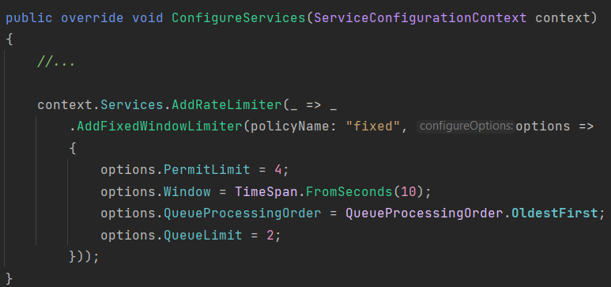
Rate Limiting
Notes:
To use rate-limiting mechanism, we first need to register the related services by using the `AddRateLimiter` method and then select the Rate Limiting algorithm we want. There are couple of rate limiter algorithm, such as Fixed Window, Sliding Window and Token Bucket.
In this example, we use the “fixed window limiter” algorithm.

Slide 6
Rate Limiting
Notes:
After registring the related services, now we can use the `Rate Limiter` middleware and attach our defined rate-limiting policy with an endpoint.
Then if we run our application, and send request to our rate-limited endpoint we should see it working. For this example, If more than 4 request come to this endpoint in 10 seconds, then rate limiting middleware will not process for 10 seconds and after 10 seconds it will return the result.

Slide 7
Output Caching Middleware
Output Caching is a new middleware that provides a caching mechanism and allow to store results from your web application and serve them from a cache rather than computing everytime. This improves performance and frees up resources for other tasks.
The output caching middleware can be used in all types of ASP.NET Core applications: Web APIs, MVC and Razor applications.
Notes:
The second feature came with this version is Output Caching middleware.
Links:
https://devblogs.microsoft.com/dotnet/asp-net-core-updates-in-dotnet-7-preview-6/#output-caching-middleware

Slide 8
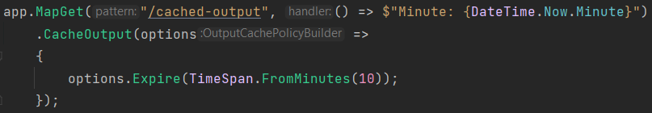
Output Caching Middleware
It’s pretty straightforward to use output caching in minimal APIs.
You just need to create an endpoint and use the `CacheOutput` method with an expire time. Then when someone sends a request to your endpoint, it will be cached for specified time and not calculate the result every time.
Notes:
For the following example, same result will be returned for 10 minutes.

Slide 9
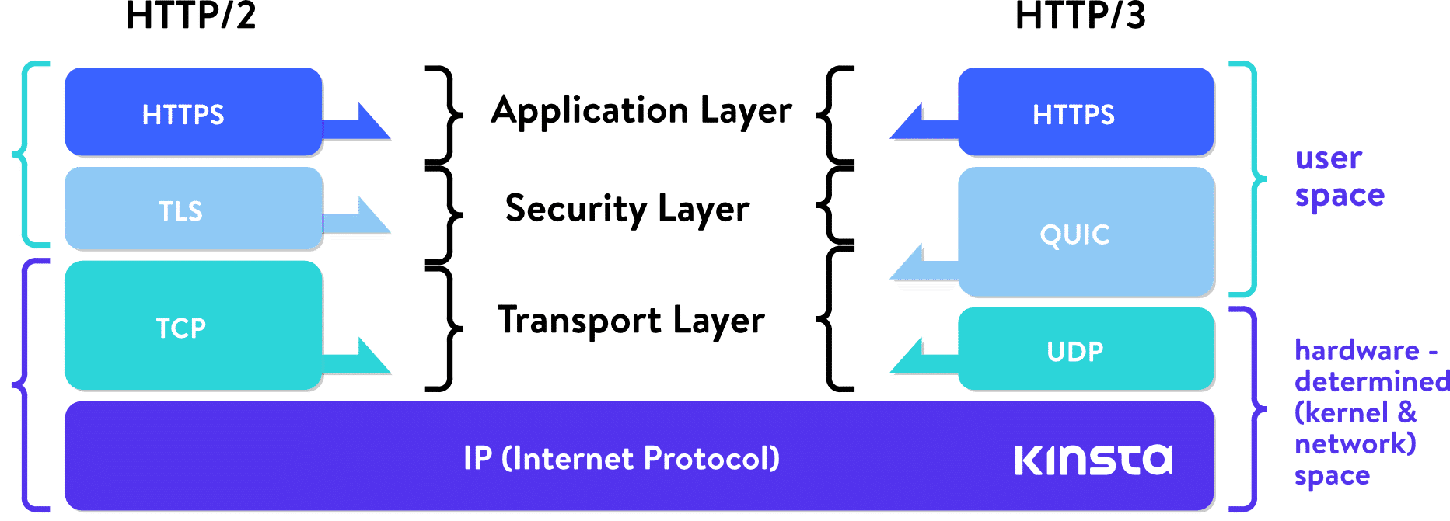
HTTP/3 Support
HTTP/3 is a new version of HTTP and supported by most modern browsers.
Notes:
HTTP/3 uses the same request methods, status codes, headers with HTTP/1.1 and HTTP/2. The main difference between HTTP/2 and HTTP/3 is “Transport Layer”. HTTP/2 uses the TCP protocol and HTTP/3 uses the QUIC protocol that built on UDP protocol.
This brings serious speed and performance gains. Such as faster response time of the first request, fever round-trips between the client and the server and more…
Links:
https://learn.microsoft.com/en-us/aspnet/core/fundamentals/servers/kestrel/http3?view=aspnetcore-7.0

Slide 10
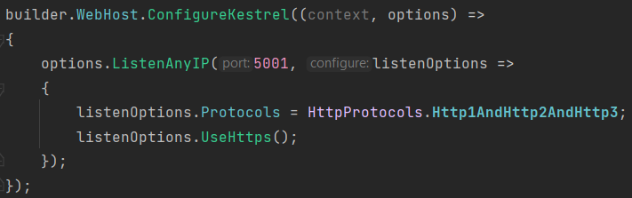
HTTP/3 Support
In .NET 6, HTTP/3 was introduced for an experimental purposes and with .NET 7 now it’s fully supported.
HTTP/3 is not enabled by default but it can be configured easily as follows:

Slide 11
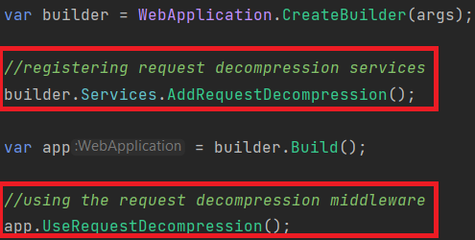
Request Decompression
Request Decompression middleware accept request with compressed content. Uses the Content-Encoding HTTP Header to automatically identify and decompress requests which are compressed.
Notes:
Compressing the request content is a good candidate for speed up an endpoint response time.
Links:
https://learn.microsoft.com/en-us/aspnet/core/fundamentals/middleware/request-decompression?view=aspnetcore-7.0

Slide 12
gRPC - JSON Transcoding
gRPC is a high-performance RPC framework and uses HTTP/2 and Protobuf. Despite the benefits that gRPC brings, REST APIs have an important place in modern web applications.
gRPC - JSON Transcoding is an extension for ASP.NET Core that creates RESTful JSON APIs for gRPC services.
Notes:
In other words, JSON Transcoding provides us a flexible way to combining gRPC and REST APIs in a way.
Links:
https://learn.microsoft.com/en-us/aspnet/core/grpc/json-transcoding?view=aspnetcore-7.0

Slide 13
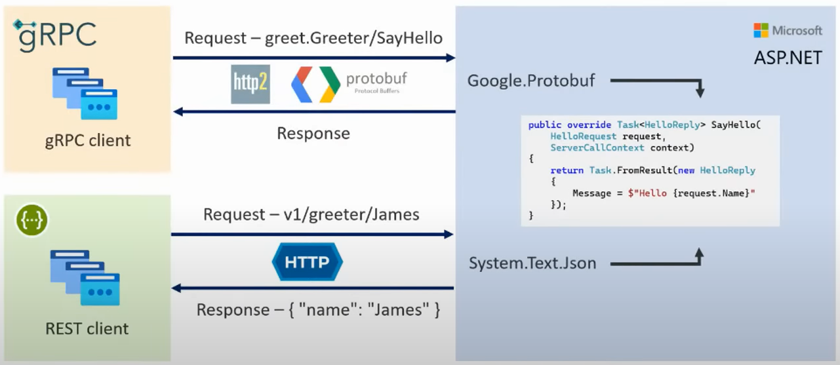
gRPC - JSON Transcoding

Slide 14

Blazor - Custom Elements
Registering Custom Elements
Using the Custom Element
Notes:
Blazor Custom Elements are not experimental anymore and supported officially with .NET 7.0
Blazor Custom Elements provide a way to dynamically render Razor Components from other SPA frameworks such as Angular and React.
To be able to use custom elements, there are two steps need to be done:
1-) Registering Custom Elements
2-) Using the registered custom element
Links:
https://learn.microsoft.com/en-us/aspnet/core/blazor/components/?view=aspnetcore-7.0#blazor-custom-elements

Slide 15
Blazor - Improvements on JavaScript Interop
JavaScript [JsImport] / [JsExport] interop API released with .NET 7 and this allow us to interact with JavaScript in a Blazor WASM application easily.
To import a JS function to call it from C# -> [JsImport]
To export a .NET method so that it can be called from JavaScript -> [JsExport] attributes should used.
Notes:
Links:
https://learn.microsoft.com/en-us/aspnet/core/blazor/javascript-interoperability/import-export-interop?view=aspnetcore-7.0

Slide 16
C# 11
Required Members
Generic Attributes
Raw String Literals
List Patterns
Notes:
Thanks Hamza. Today I’ll be mentioning about what’s new in C# 11, EF Core 7 and .NET MAUI 7. Let’s start with C# 11.
There are great features that came with C#11. Such as Required Members, Generic Attributes, Raw String Literals and List Patterns. Let’s see them with examples.

Slide 17
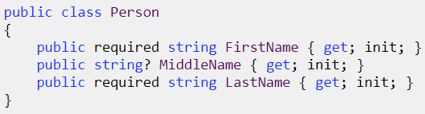
Required Members
C#11 introduces the required keyword to ensure property initialization.
By using the required keyword, we can ensure the marked properties will be initialized. Otherwise, it will give compile-time errors.
Notes:
C# 11 introduces a new required keyword to allows us to ensure property initialization while object creation. We just need to use the required keyword before the property type. That’s it. Then if we try to create an object without initializing the required properties, compile-time errors will shown.

Slide 18
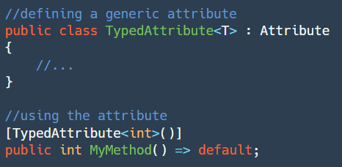
Generic Attributes
Before C#11, to create a typed attribute you would need to pass the Type object through the constructor and assign it to your property to use.
Now with C# 11, it’s possible to easily create generic attributes and use them:
Notes:
Generic Attributes is also one of the good features that came with C# 11. Before C#11, creating a typed attribute was cumbersome. We would need to pass a Type object as argument to our constructor and assign it to a property in our attribute class and do stuff with this Type property.
With C#11, Generic Attributes is introduced. Now, it’s possible to easily create generic attributes like creating generic classes.

Slide 19
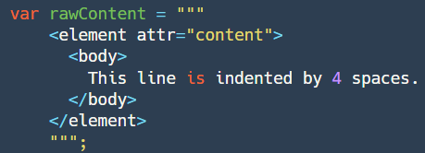
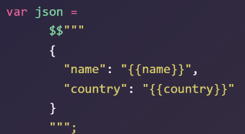
Raw String Literals
C# 11 introduces “raw string literals”. It allows containing arbitrary text without escaping.
By wrapping a string with three double quotes (”””...”””), we are free to put any string value into variables:
Notes:
Raw String Literals is a great syntactic-sugar that came with C#11. It allows containing arbitrary text without escaping.
We just need to wrap string content within three double quotes. Then we can define any text inside of it including multi-line text, that can be seen in here.
Also, we can use string interpolation with this new syntax. We just need to add $ sign before the first triple quotes.

Slide 20
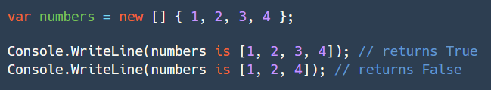
List Patterns
C# 11 introduced the “List Pattern”. It expands the pattern matching for lists and arrays.
You can match an array or a list against a sequence of patterns:
Notes:
The last feature that we gonna talk about for C#11 is List Patterns. It’s a good extension to pattern matching for lists and arrays.
List Patterns allow us to match an array or a list against with another sequence of values.

Slide 21
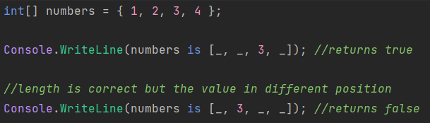
List Patterns
There are three different ways for list pattern matching:
1-) Discard Pattern
Notes:
There are three different ways for list pattern matching:
1-) Discard Pattern: This pattern can be helpful to match one or more elements from a sequence, if we know the length of the sequence.

Slide 22
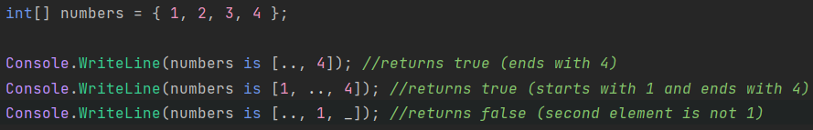
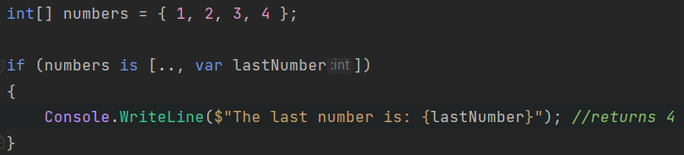
List Patterns
2-) Range Pattern
3-) var Pattern
Notes:
2-) Range Pattern: If the length of the sequence is not know, then range pattern may be useful. We can use this pattern to check the first or/and last element from a sequence.
3-) var Pattern: This pattern allows us to capture a element at that position and use the variable in our code.

Slide 23
Entity Framework Core
JSON Columns
Improvements on Bulk Updates & Deletes
Performance Improvements on SaveChanges & SaveChangesAsync
Notes:
Let’s continue with what’s new in EF Core 7. There are too many improvements and new features that shipped with EF Core 7, but today we will only talk about these three feature.

Slide 24
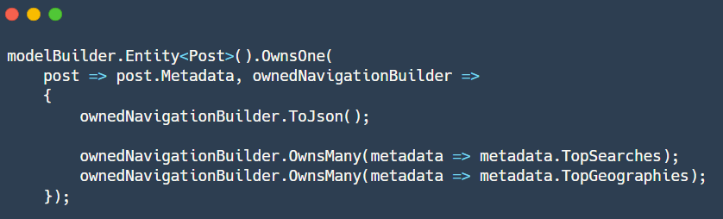
JSON Columns
JSON Columns allows relational databases to use the advantage of document databases. EF7 supports JSON columns and this allows mapping of aggregates built from .NET types to JSON documents.
Notes:
It’s a common thing to need of storing some extra values as JSON in a database table column.
EF 7 supports JSON Columns and this allows mapping of aggregates built from .NET types to JSON documents. It allows us to make combine relational databases and document-based databases in a way.
We can mark a column as JSON Column and that’s it!

Slide 25
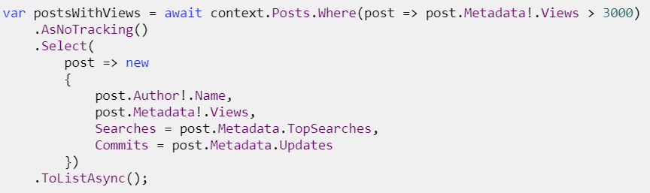
JSON Columns
Also, it’s possible to query JSON by using the LINQ with this version as follows:
Notes:
Also with this version, LINQ JSON query support have been added. So, we can query over JSON column as seen in here.

Slide 26
Improvements on Bulk Updates & Deletes
EF 7 introduces the new ExecuteUpdateAsync and ExecuteDeleteAsync methods. These methods are applied to a LINQ query and update/delete entities in the database immediately based on the results of that query without the need to track records.
With this feature, there is no need to load entities into memory and update them. Many entities can be updated with a single command without needing to load into memory.
Notes:
EF 7 introduces the new ExecuteUpdateAsync and ExecuteDeleteAsync methods. By using these methods while making bulk updates or deletes, we can take out the change tracker in this process and this brings great performance gains.
In other words, with this feature there is no need to load entities into memory and update them. We can do it by using ExecuteUpdateAsync method without needing to load records into memory.

Slide 27
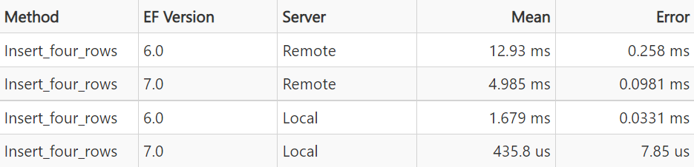
Performance Improvements on SaveChanges & SaveChangesAsync
In EF7, the performance of SaveChanges and SaveChangesAsync has been significantly improved. According to the EF Team, saving changes is now four times faster than EF Core 6.
Notes:
With EF 7, there are significant performance improvements on SaveChanges & SaveChangesAsync methods. According to the EF Core team, in some cases saving changes are now four times faster that EF 6. You can see a simple benchmark result from the EF Core blog post in here.
Even after inserting just four records, there is a significant performance gain. When record count increased also the performance gains will be much more important.

Slide 28
MAUI
Map Control
Performance Improvements on Mobile Rendering & Desktop Enhancements
Notes:
As you know, .NET MAUI is a cross-platform framework for creating native mobile and desktop applications by using C# and XAML. By using the .NET MAUI, apps can be developed that can run on Android, IOS, macOS and Windows from a single-code base.
It’s a new technology, so it's evolving and the .NET MAUI team introduces good features with every release.
Today, I will only talk about a new feature called “Map Control” and some enhancements made in .NET 7.

Slide 29

Map Control
.NET MAUI 7 introduces Map Control. This provides us a native map control provided by each platform.
It supports pins, polygons, polylines, circles, geolocation and more…
Notes:
.NET MAUI 7 introduces MAP Control. This provides us a good native map experience.
We can pin some point on the map, draw circles and more…

Slide 30
Improvements on Mobile Rendering & Desktop Enhancements
.NET MAUI 7 came with an optimized rendering for mobile applications and is much faster than .NET MAUI 6.
In addition to that, there are some enhancements and improvements on the desktop:
Window size and position
Context menus
Tooltips
Gestures etc.
Notes:
There are good improvements that comes with .NET 7. Mobile rendering performance significantly improved and beside of that, MAUI controls now provide much more smoothness.
Also, there are some good enhancements on the desktop side.
.NET MAUI team, got feedbacks from developers and make some improvements on desktop, such as:
Window size and position,
Context Menus, (which there was a kind of bug and it was not seen on collection view),
Tooltips and Gestures.

Slide 31
Thanks for listening…

