Slide 1



What’s new with ABP 8.0?
Engincan VESKE
Software Engineer at Volosoft

Slide 2

ABP Framework 8.0 Highlights
https://abp.io/b/v80
Upgraded to .NET 8.0
Upgraded to Angular 17
Dynamic Claims
CDN Support for Bundling & Minification system
Read-Only Repositories: Don’t track changes by default
Account Module: Set username after social login
Notes:
Today, I will some important features that came with ABP Framework 8.0. If you want to learn more, you can check the blog post.

Slide 3
Upgraded to .NET 8.0
Migration Guides
Microsoft’s Migrate from ASP.NET Core 7.0 to 8.0 documentation
ABP Framework 7.x to 8.0
ABP Commercial 7.x to 8.0
Notes:
ABP v8.0 RC.1 has been shipped based on .NET 8.0 and we are proud to say that we are one of the early adopters. If you are going to create a new application and start from scratch, you can check the get started documentation and you are free to start over. But if you are going to upgrade your existing projects to .NET 8.0, you need to make some changes in your project.
And for that purpose, you can read these migration guides. You can find the links down below on the comment section or in the v8.0 release blog post.

Slide 4
Upgraded to Angular 17
Angular 17 has been released on November 8
ABP 8.0 Angular UI is based on Angular 17
Notes:
Angular 17 has been released on November 8 and ABP Framework & ABP Commercial startup templates are based on Angular 17.
So, when you create a new solution with the Angular UI, you will take advantage of the new Angular with its new cutting-edge features and enhancements right from the start!

Slide 5
Dynamic Claims
Dynamic Claims allows you to get the latest user claims without need to re-login in each time.
The Dynamic Claims feature is used to dynamically generate claims for the user in each request. This was needed because claims-based authentication is using in the ASP.NET Core, and because it stores the claims in the cookie or token, and they are being static, they don’t change until a next re-login.
It’s already been documented: https://docs.abp.io/en/abp/8.0/Dynamic-Claims

Slide 6
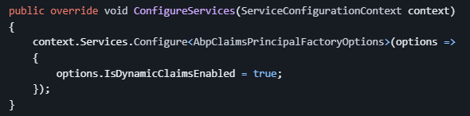
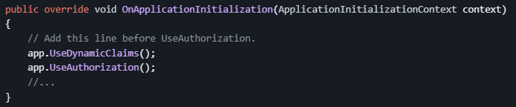
Dynamic Claims
Configure the AbpClaimsPrincipalFactoryOptions and set the IsDynamicClaimsEnabled option as true 👉
Add the DynamicClaims middleware into the request pipeline 👉
Notes:
After the configurations, the DynamicClaims middleware will use the IAbpClaimsPrincipalFactory to dynamically generate claims for the current user in each request.

Slide 7
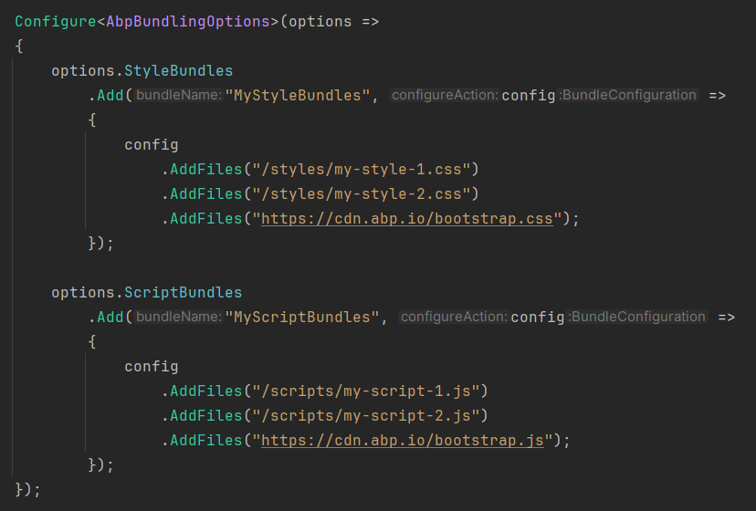
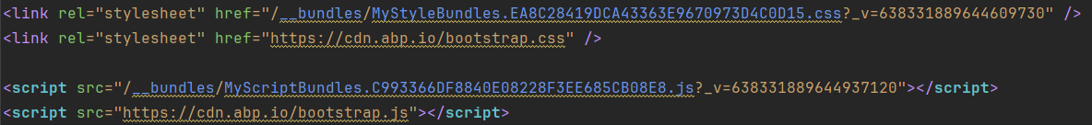
CDN Support for Bundling & Minification System
In this version on, ABP Framework’s MVC / Razor Pages UI’s Bundling System provides CDN Support.
The system automatically recognizes the external/CDN files and places them as script tags into the page along with the bundled CSS/JS files.

Slide 8
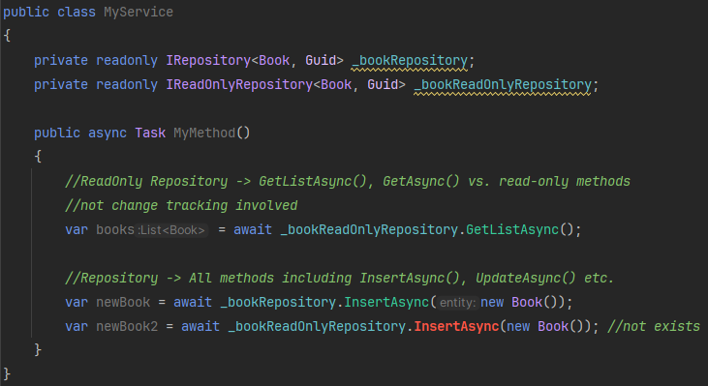
Read-Only Repositories: Don’t track changes by default
In this version, ABP Framework provides read-only repository interfaces (IReadOnlyRepository<T> or IReadOnlyBasicRepository<T>) to explicitly indicate that your purpose is to query data, but not change it.
Notes:
EF Core read-only repository implementation uses EF Core’s No-Tracking Feature and that means the entities returned from the repository will not be tracked by the EF Core change tracker and this makes significant performance improvements.

Slide 9
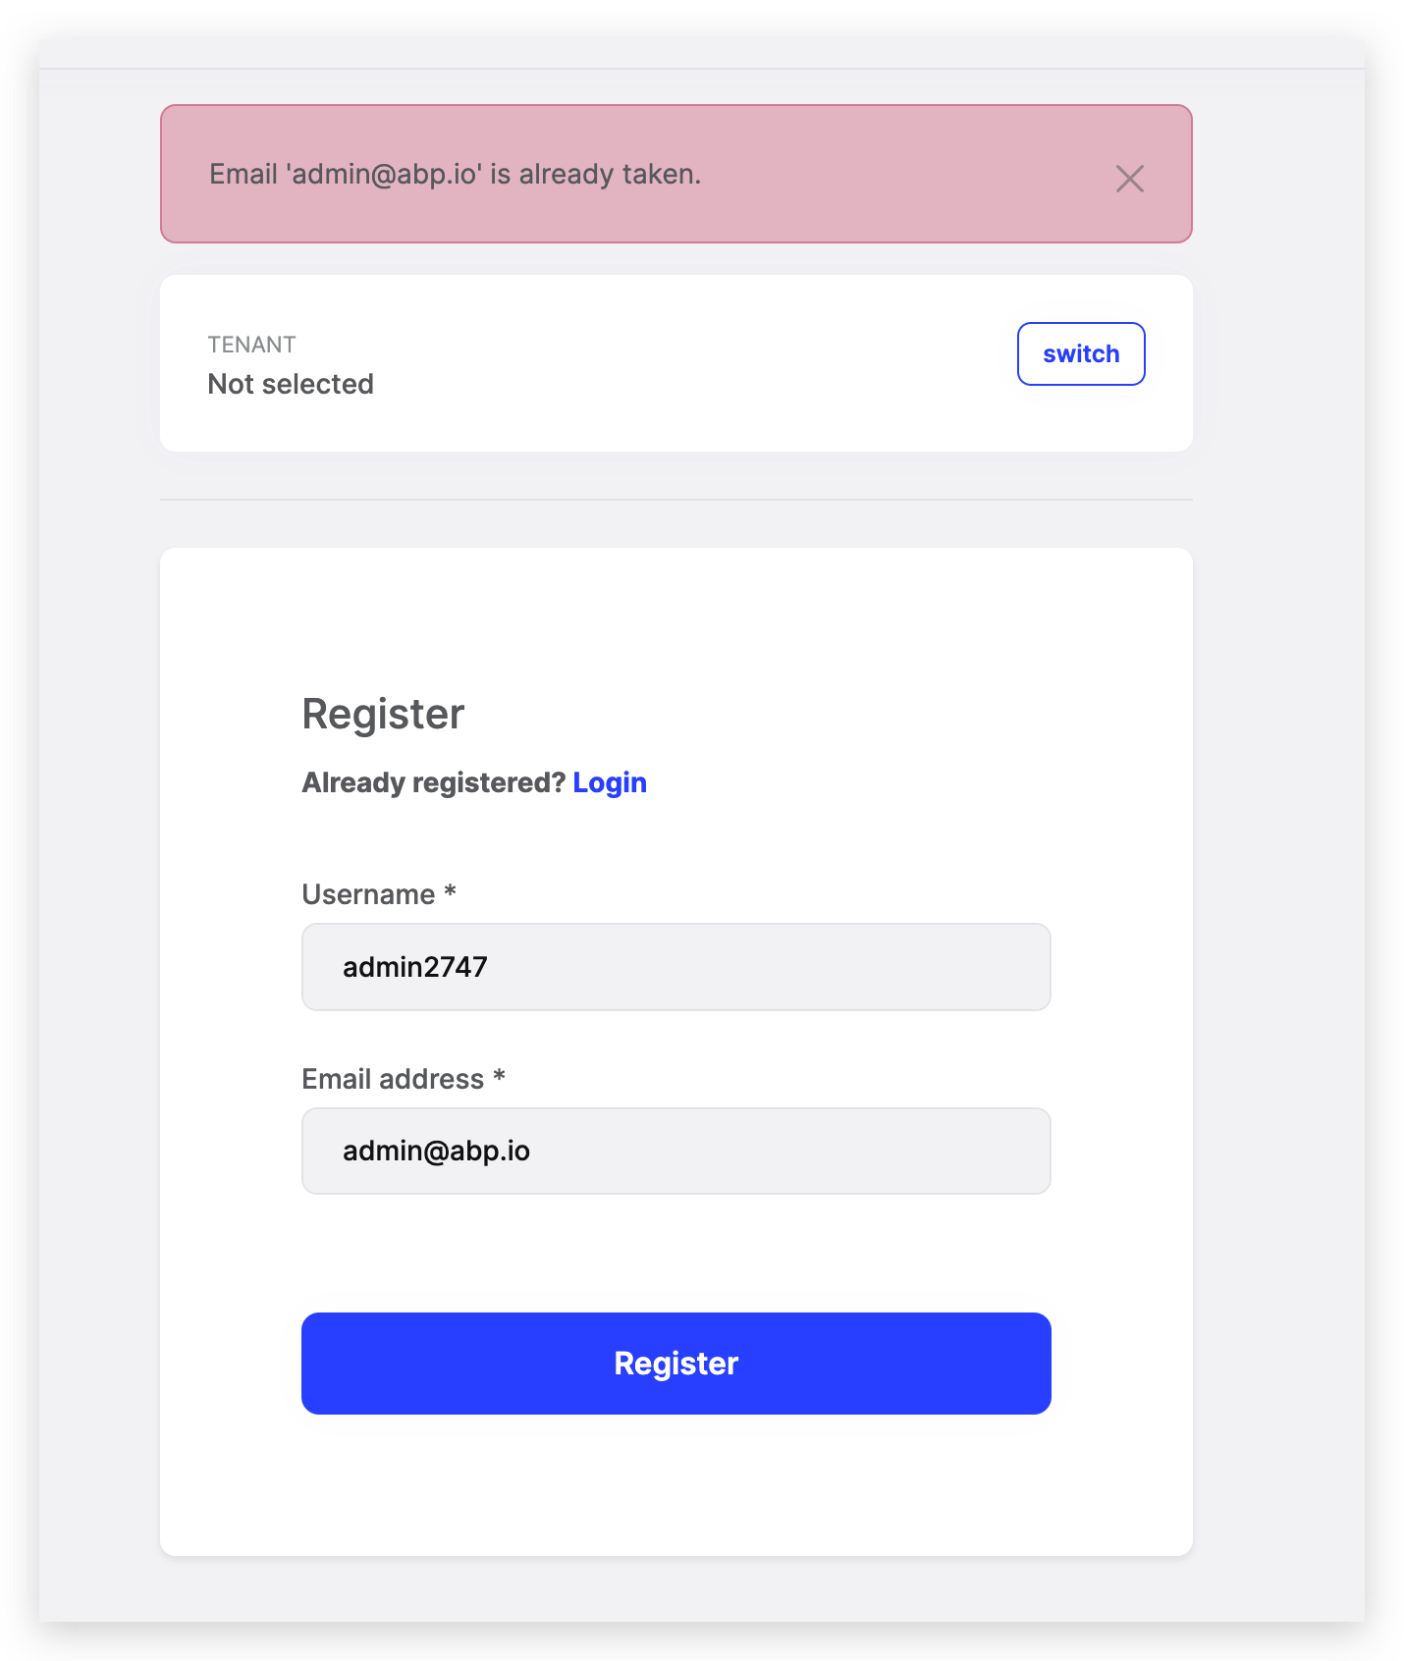
Account Module: Set username after social login
Notes:
Prior to this version, when you register with your social accounts in the first time, your email address was becoming your username and it was shown everywhere in the application. So, you would need to update your username later on.
With this version now, whenever you register as an external user, a username and email address shown you in a form for you to revise and update them if you need, before login into the application. Thanks to that, after the social registration you would not need to update your username and email address. This is also good at the point of GDPR regulations because your email address will not be shown as username and will not be exposed.

Slide 10
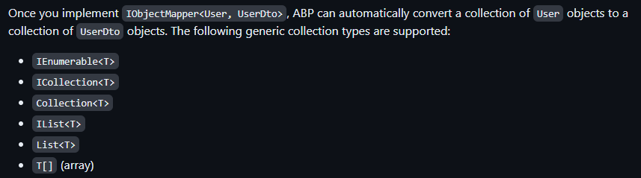
Other News
LDAP over SSL (LDAPS) setting has been added and recommended to establish a secure connection.
Object Mapping Enhancements (supports mapping collection of objects for custom object mappers)
Sending attachments with IEmailSender.QueueAsync() method

Slide 11
ABP Commercial 8.0 Highlights
Suite: Generating Master/Detail Relationship
Get profile picture from social/external logins
Switch from Ocelot to YARP for the API Gateway (Microservice Solution Template)
Password complexity indicators for MVC & Blazor UIs
Export & Import Users as Excel/CSV

Slide 12
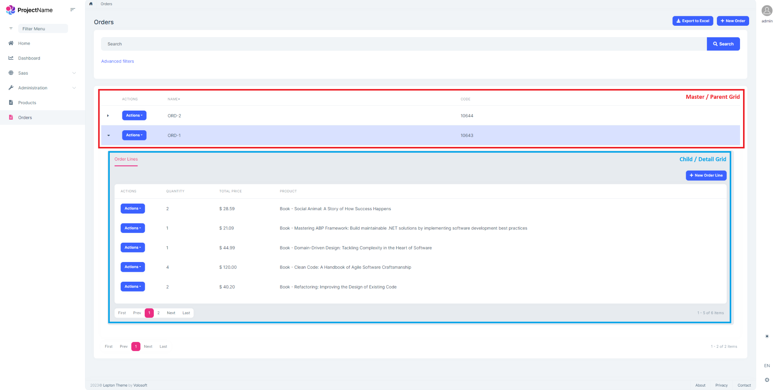
Suite: Generating Master/Detail Relationship
Notes:
ABP Suite allows you to create a master-detail relationship with a few clicks. It generates the necessary code for the master and detail tables, including the foreign key relationship between the two tables. It was one of the most wanted features and we are introducing it with ABP Commercial v8.0.
It’s already documented and you can find the documentation link in the description section below, give it a shot to the master/detail feature and provide feedback.

Slide 13


THANKS FOR
WATCHING

