Slide 1

Unleashing the Power of Local RAG Systems for Education Institutes in the Digital Era
Tao Wu
Zhujiang College of South China Agricultural University
ORCID：https://orcid.org/0000-0003-3536-1845
on https://www.icetc.org/is.html
Notes:
Hello, everyone. I am Tao Wu, and very happy to receive the invitation from ICETC to share with you my views on the application prospects of the latest technologies such as RAG in education. My talk may not cover all the current hot topics, but I only hope that it will inspire you to set the direction for related research and move on.

Slide 2


Presenter Introduction
Tao Wu
Associate Professor, Zhujiang College of South China Agricultural University
Educational technology enhances learning in different environments；
Curriculum Development and Pedagogy.
Phone: +8613922253713 Email：
Research interest
Contact Information
Notes:
I'm an Associate Professor at Zhujiang College of South China Agricultural University, and I was also the Associate Editor of the International Journal of Web-Based Learning and Teaching Technologies. Today, I'm really excited to chat with you today about a new and exciting way of learning that uses technology. It's called Retrieval-Augmented Generation, or RAG systems. This amazing technology has the potential to change the way we learn forever! It can provide personalized learning experiences that are tailored to each student's need.

Slide 3
Embracing the digital education era and seizing opportunities through innovative means
Notes:
It's time for our wonderful educators to embrace the amazing digital age through innovative means!

Slide 4
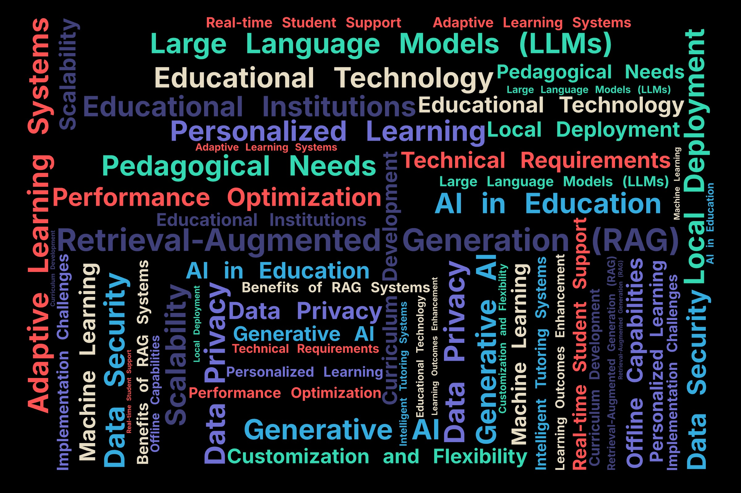
Outline
Introduction
Background
Literature Review
Local Deployment of RAG Systems and Personalized Learning
Advantages and Architecture of Locally Deployed RAG Systems
Teaching Case
Future outlook and opportunities
Q&A
[使用此空间放置最能捕捉主要观点 #1 的图像]
Notes:
My speech is divided into six parts:, and the key words are shown in the figure.

Slide 5
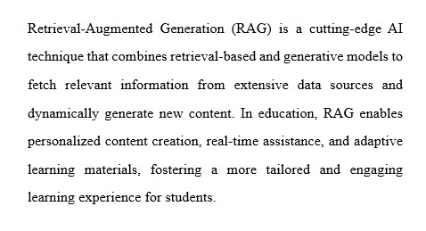
Introduction
Understanding Retrieval-Augmented Generation (RAG)
Retrieval-Augmented Generation (RAG)s potential in education
Aim and Scope of the RAG Application
[使用此空间放置最能捕捉主要观点 #2 的图像]
Notes:
Let's begin by understanding what RAG actually is. Retrieval-Augmented Generation is a cutting-edge AI technique that marries the power of retrieval-based models with generative AI. This fusion allows RAG to accomplish something truly remarkable: it can sift through vast amounts of data, extract relevant information, and then use that information to generate new, contextually appropriate content.
But why should this matter to us as educators? Well, the potential applications of RAG in education are nothing short of transformative. Imagine a world where we can offer truly personalized content creation for each student, tailored to their individual learning needs and pace. With RAG, this becomes possible.
Moreover, RAG opens up exciting possibilities for real-time assistance in the classroom. Picture a scenario where students have access to an AI tutor that can instantly provide relevant information, explanations, and examples, all dynamically generated based on the student's current learning context.
Perhaps most excitingly, RAG enables the development of adaptive learning materials. These are resources that can evolve and adjust based on a student's progress, challenges, and learning style. This means we can create learning experiences that are not just personalized, but also responsive and engaging.
The aim of implementing RAG in education is clear: to foster a more tailored and engaging learning experience for our students. By leveraging this technology, we have the opportunity to meet each student where they are, provide them with the specific support they need, and ultimately enhance their educational journey.
As we delve deeper into this topic today, we'll explore the mechanics of RAG, examine specific use cases in education, and discuss the potential impact on teaching methodologies and learning outcomes. I'm excited to share this journey with you as we look towards a future where AI like RAG can help us unlock the full potential of every learner.

Slide 6
Background
What is the problem for LLM？
Limited Context Windows: Inability to process and understand large amounts of context
Specialized Content Generation: Difficulty in generating accurate and specialized content
Generalized Expressions: Tendency to produce generic and non-specific responses
Hallucinations: Interference of false or irrelevant information in generated content
Generative AI, particularly Large Language Models (LLMs), has emerged as a transformative force in education, providing numerous opportunities to enhance interaction and engagement in the learning process.
LLMs are designed to provide personalized learning experiences by adapting content and explanations to individual student needs, fostering a more engaging and effective learning environment.
However, the implementation of generative AI in education requires careful consideration of several key factors, including ethical implications, privacy, and the need for human oversight to ensure the accuracy and appropriateness of content.
Notes:
As we delve into this topic, it's essential to understand the broader context—the rapid evolution of Generative AI. This technology has emerged as a transformative force in education, offering opportunities to enhance engagement and interaction among students. Large Language Models (LLMs) are at the forefront of this transformation, designed to create personalized learning experiences by adapting content to meet diverse student needs. However, their implementation raises important considerations regarding ethical implications and the necessity for human oversight to ensure accuracy.

Slide 7
Literature review
Applications of LLMs in education include generating learning materials, providing instant tutoring support, and reducing instructor workload.
Retrieval-Augmented Generation (RAG) has emerged as a prominent solution to address key challenges faced by LLMs, such as hallucination and outdated knowledge, by integrating external databases to increase accuracy and credibility in knowledge-intensive tasks
In the educational context, RAG has significant potential to improve various aspects of learning and teaching, such as creating personalized learning content, powering intelligent tutoring systems, and supporting curriculum development, assessment, and research[24-26].
A. Abd-Alrazaq, R. AlSaad, D. Alhuwail, A. Ahmed, P. M. Healy, S. Latifi, S. Aziz, R. Damseh, S. Alabed Alrazak, and J. Sheikh, “Large Language Models in Medical Education: Opportunities, Challenges, and Future Directions,” JMIR Med Educ, vol. 9, pp. e48291, Jun 1, 2023.
C. D. Kloos, C. Alario-Hoyos, I. Estévez-Ayres, P. Callejo-Pinardo, M. A. Hombrados-Herrera, P. J. Muñoz-Merino, P. M. Moreno-Marcos, M. Muñoz-Organero, and M. B. Ibáñez, "How can Generative AI Support Education?." pp. 1-7.
J. Chen, H. Lin, X. Han, and L. Sun, "Benchmarking large language models in retrieval-augmented generation." pp. 17754-17762.
M. Kang, S. Lee, J. Baek, K. Kawaguchi, and S. J. Hwang, “Knowledge-augmented reasoning distillation for small language models in knowledge-intensive tasks,” Advances in Neural Information Processing Systems, vol. 36, 2024
A. Asai, Z. Wu, Y. Wang, A. Sil, and H. Hajishirzi, “Self-rag: Learning to retrieve, generate, and critique through self-reflection,” arXiv preprint arXiv:2310.11511, 2023.
Z. J. Wang, and D. H. Chau, "MeMemo: On-device Retrieval Augmentation for Private and Personalized Text Generation." pp. 2765-2770.
Q. Huang, S. Fu, X. Liu, W. Wang, T. Ko, Y. Zhang, and L. Tang, “Learning retrieval augmentation for personalized dialogue generation,” arXiv preprint arXiv:2406.18847, 2024.
Notes:
Recent studies have highlighted various applications of LLMs in education, such as generating learning materials and providing instant tutoring support. However, these models face challenges like hallucination—the generation of false information—and outdated knowledge. This is where RAG comes into play, integrating external databases to improve accuracy and credibility, ultimately enhancing learning outcomes.

Slide 8
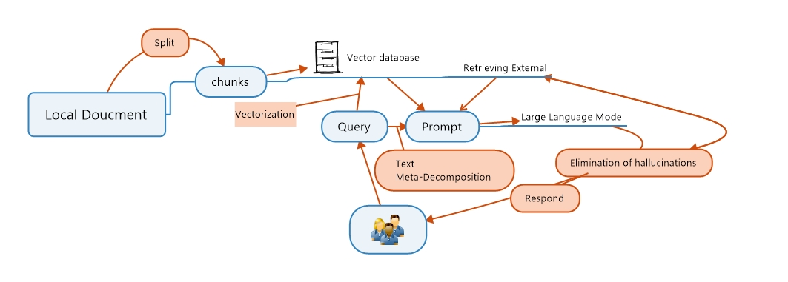
Local Deployment of RAG Systems and Personalized Learning
Locally deployed RAG:
On-premises RAG system enhances data security and control.
Proposed architecture:
Retrieval module for efficient access, generation module for tailored content, decision module for retrieval-generation mediation.
Notes:
One significant advantage of RAG systems is their ability to be deployed locally within educational institutions. This approach enhances data security and control while allowing for greater customization to meet specific institutional needs. By utilizing on-premises systems, we can ensure that sensitive student data remains protected while still benefiting from advanced AI capabilities. 1. Start with a local document.
2. Split it into chunks.
3. Turn these chunks into vectors and store them in a database.
4. When a user asks a question, it becomes a query.
5. The system finds relevant information from the vector database.
6. It creates a prompt using this information and the original query.
A large language model uses this prompt to generate a response.
The response goes through a process to remove any made-up information.
Finally, the cleaned-up answer is given to the user.

Slide 9
How RAG Enhances Personalized Learning
Dynamic Content Generation
Customized to individual student needs
Adapts complexity with student progress
Addresses specific weaknesses
2. Real-Time Assistance
Immediate support for student queries
Maintains learning flow
Retrieves and explains relevant information instantly
3. Adaptive Learning Paths
Personalizes topic sequence
Adjusts based on student performance
Ensures efficient and effective learning
4. Engaging Interactive Learning
Creates context-aware interactions
Generates personalized scenarios
5. Supporting Teachers and Educators
Accuracy
Professional
Timely
Notes:
Dynamic Content Generation RAG systems excel in dynamic content generation by customizing materials based on individual student needs. They adapt complexity according to student progress and address specific weaknesses promptly. Moreover, these systems provide real-time assistance—immediate support for student queries—ensuring that the learning flow remains uninterrupted.

Slide 10
Advantages and Architecture of Locally Deployed RAG Systems
Feature | Local Deployment | Cloud Deployment
Data Security | Higher security and control over data | Data security managed by cloud provider
Infrastructure | Requires on-premises infrastructure | Scalable infrastructure provided by cloud
Cost | Higher upfront costs for infrastructure | Pay-as-you-go pricing model
Scalability | Limited scalability | Highly scalable
Customization | Higher degree of Customization possible | Limited customization options
Reasons for deploying locally hosted RAG systems in educational institutions include data security and privacy, customization and alignment, performance optimization, seamless integration, offline capabilities, and regulatory compliance
The system architecture for a personalized learning agent based on a local RAG system starts with defining learning goals, followed by data selection and preprocessing
Notes:
Now it is advantages and Architecture of Locally Deployed RAG Systems. When we compare local deployment with cloud solutions, several key advantages emerge:Data Security: Local systems offer higher security and control over sensitive data compared to cloud-managed solutions.
Customization: Institutions can tailor the system architecture to align with their educational goals more effectively than with limited cloud options.
Performance Optimization: Local deployment can optimize performance by reducing latency associated with cloud access.
The architecture typically involves a retrieval module for efficient access, a generation module for tailored content creation, and a decision module that mediates between retrieval and generation processes.

Slide 11
What is the Infrastructure need for local deployment RAG？
Infrastructure Needs for Local Deployment of RAG
Component | Description | Requirements
Hardware | Servers, storage, and networking equipment | High-performance CPUs, GPUs, and RAM
Operating System | Software that manages computer hardware resources | 64-bit Linux or Windows Server
Storage | Disk space for storing data, models, and logs | High-capacity storage (e.g., HDD, SSD, or NAS)
GPU Acceleration | Hardware acceleration for machine learning computations | NVIDIA GPU (e.g., Tesla V100, Quadro RTX 8000)
Memory | RAM for running applications and storing data | 64 GB or more of RAM

Slide 12
Infrastructure Needs for Local Deployment of RAG
Software | Description | Requirements
RAG Software | Retrieval-Augmented Generation software | RAG software package (e.g., Python library, executable)
Machine Learning Framework | Software for building and training machine learning models | Machine learning framework (e.g., TensorFlow, PyTorch)
Programming Language | Language for developing and scripting RAG applications | Programming language (e.g., Python, Java)

Slide 13
Teaching Case
Case Law Research
Task: A law student is researching a case involving a contract dispute between two companies.
RAG Input: The student inputs the relevant facts of the case, including the parties involved, the contract terms, and the disputed issues.
RAG Output: The RAG system searches through a locally deployed database of case law and returns a list of relevant precedents, including summaries of the cases and links to the full text of the opinions.
Result: The student is able to quickly and accurately identify relevant precedents that support their argument, including a landmark case that establishes a key principle of contract law.
Constitutional Law Research
Task: A law student is researching a constitutional law issue involving a challenge to a state statute.
RAG Input: The student inputs the relevant facts of the case, including the statute at issue and the constitutional provisions implicated.
RAG Output: The RAG system searches through a locally deployed database of constitutional law cases and returns a list of relevant precedents, including cases that have addressed similar constitutional issues in the past.
Result: The student is able to identify a key precedent that establishes a controlling principle of constitutional law, which helps to resolve the issue.
Notes:
To illustrate the effectiveness of RAG systems, consider a case where a law student utilizes a locally deployed RAG system for constitutional law research. By inputting relevant facts into the system, they receive a curated list of precedents that guide their understanding efficiently. Such examples underscore how RAG can significantly enhance both teaching and learning experiences.

Slide 14
Future outlook and opportunities
Advantages of RAG for Education
Leveraging External Knowledge: RAG models can access and leverage external knowledge sources beyond the fixed training data, allowing them to provide more up-to-date and comprehensive information to students.
Sample Efficiency: RAG models can be more sample-efficient, as they can utilize existing knowledge bases rather than relying solely on limited training data. This can be particularly beneficial in education where data may be scarce.
Improved Performance: By combining retrieval and generation capabilities, RAG models can outperform traditional language models in tasks like question answering, content generation, and personalized learning.
Practical Considerations for RAG Deployment in Education
Data Management and Preprocessing
Effective data management and preprocessing are essential, including sourcing and curating relevant knowledge sources, cleaning and preprocessing data, and implementing efficient indexing and retrieval strategies.
Model Serving and Inference
Robust model serving and inference capabilities are required to handle real-time requests from students and teachers, leveraging techniques like batching, caching, and offline generation.
Monitoring and Maintenance
Comprehensive logging and monitoring infrastructure are crucial for maintaining and troubleshooting RAG deployments, enabling performance optimization and model updates.
Notes:
Looking ahead, there are exciting opportunities for further development in this field. We anticipate advancements in multilingual applications that cater to diverse linguistic backgrounds, as well as the integration of multimodal data sources—such as images or videos—into our educational frameworks. Additionally, ensuring privacy-preserving strategies will be crucial as we deploy these technologies in sensitive educational environments.

Slide 15
Future outlook and opportunities
Future Directions and Opportunities
Multilingual and Cross-Lingual Applications：
Deploying RAG models for multilingual and cross-lingual educational applications, addressing challenges like linguistic diversity and cultural context.
Multimodal Data Integration：
Incorporating multimodal data sources, such as images, videos, and structured data, into RAG models to enable more comprehensive and engaging educational experiences.
Privacy-Preserving and Secure Deployment：
Developing privacy-preserving and secure deployment strategies for RAG models in educational settings, ensuring the protection of sensitive student data and information.
Notes:
Future directions for RAG models in education include deploying them for multilingual and cross-lingual applications to tackle linguistic diversity and cultural contexts, as well as integrating multimodal data sources like images and videos to create richer educational experiences. Additionally, there is a focus on developing privacy-preserving strategies to ensure secure deployment while protecting sensitive student data.

Slide 16
Comparison | Graph RAG | RAG
Knowledge Source | Structured knowledge graphs | Unstructured text documents
Retrieval Method | Traverses graph structure to retrieve relevant subgraphs | Performs vector similarity search on text embeddings
Contextual Information | Provides rich context through entity properties, relationships, and hierarchies in the graph | Provides limited context through text snippets
Explainability | Offers more transparency by tracing reasoning through the graph structure | Lacks explainability as it relies on black-box vector similarity
Domain Specificity | Allows integration of domain-specific knowledge graphs for specialized applications | Relies more on general text corpora
Notes:
Although Graph RAG has various advantages, once a relationship is determined, it is difficult to change.

Slide 17

Q&A
Thank you for your listening

