Slide 1
Your 1st, 2nd, 3rd, and N^{th} Game Engine
Sean Middleditch
DigiPen Game Engine Architecture Club

Slide 2
Who I Am
Your 1st, 2nd, 3rd,
and Nth Game Engine
Sean Middleditch
http://seanmiddleditch.com/
DigiPen RTIS Senior
Subsonic, SONAR, Core
Too many years experience
Total architecture nerd
DigiPen Game Engine Architecture Club – Copyright © 2012

Slide 3
This Lecture
Your 1st, 2nd, 3rd,
and Nth Game Engine
Sean Middleditch
http://seanmiddleditch.com/
Starting from scratch
Getting a game done
Consistent strategy to success in games
DigiPen Game Engine Architecture Club – Copyright © 2012

Slide 4
What is a Game Engine?
Your 1st, 2nd, 3rd,
and Nth Game Engine
Sean Middleditch
http://seanmiddleditch.com/
“A game engine is a software system designed for the creation and development of video games.” – Wikipedia
I don't like this definition
A game engine is the framework underneath any game
  Rarely is it something “designed for games”
DigiPen Game Engine Architecture Club – Copyright © 2012

Slide 5
What is Software Architecture?
Your 1st, 2nd, 3rd,
and Nth Game Engine
Sean Middleditch
http://seanmiddleditch.com/
“The software architecture discipline is centered on the idea of reducing complexity through abstraction and separation of concerns.” – Wikipedia
DigiPen Game Engine Architecture Club – Copyright © 2012

Slide 6
What is Software Architecture?
Your 1st, 2nd, 3rd,
and Nth Game Engine
Sean Middleditch
http://seanmiddleditch.com/
“The software architecture discipline is centered on the idea of reducing complexity through abstraction and separation of concerns.” – Wikipedia
Fancy way of saying:
“Make it as simple as possible... but no simpler.”
DigiPen Game Engine Architecture Club – Copyright © 2012

Slide 7
What is Software Architecture?
Your 1st, 2nd, 3rd,
and Nth Game Engine
Sean Middleditch
http://seanmiddleditch.com/
“The software architecture discipline is centered on the idea of reducing complexity through abstraction and separation of concerns.” – Wikipedia
It is not about adding tons of cool features or complex algorithms.
DigiPen Game Engine Architecture Club – Copyright © 2012

Slide 8
Write Games, Not Engines
Your 1st, 2nd, 3rd,
and Nth Game Engine
Sean Middleditch
http://seanmiddleditch.com/
http://scientificninja.com/blog/write-games-not-engines
“You can sit down and write a game without writing a pre-written engine, and in fact this is very often the better approach, regardless of why you want to write an engine.” – Josh Petrie
Everyone should read this
DigiPen Game Engine Architecture Club – Copyright © 2012

Slide 9
Look For The Bare Necessities
Your 1st, 2nd, 3rd,
and Nth Game Engine
Sean Middleditch
http://seanmiddleditch.com/
You don't need to use all the cool tricks we talk about
  Components aren't necessary
  Metadata isn't necessary
  Scripting isn't necessary
  Editors aren't necessary
  Threading isn't necessary
  Art pipelines aren't necessary
DigiPen Game Engine Architecture Club – Copyright © 2012

Slide 10
The Simple Bare Necessities
Your 1st, 2nd, 3rd,
and Nth Game Engine
Sean Middleditch
http://seanmiddleditch.com/
You need a game
  Window with graphics
  Collect input
  Run game logic
  Menus, intros, help, win/lose screen
DigiPen Game Engine Architecture Club – Copyright © 2012

Slide 11
Keep It Simple, Superdev
Your 1st, 2nd, 3rd,
and Nth Game Engine
Sean Middleditch
http://seanmiddleditch.com/
You have a game idea
  Write only what you need for that game idea
Be lazy
  Write the least code you can get away with
Be smart
  Write the most useful code first
DigiPen Game Engine Architecture Club – Copyright © 2012

Slide 12
Getting Started
Your 1st, 2nd, 3rd,
and Nth Game Engine
Sean Middleditch
http://seanmiddleditch.com/
You need a game
  Window with graphics
  Collect input
  Run game logic
  Menus, intros, help, win/lose screen
Create a window
Draw a triangle/quad
DigiPen Game Engine Architecture Club – Copyright © 2012

Slide 13
Getting Started
Your 1st, 2nd, 3rd,
and Nth Game Engine
Sean Middleditch
http://seanmiddleditch.com/
You need a game
  Window with graphics
  Collect input
  Run game logic
  Menus, intros, help, win/lose screen
Read Win32 message loop input messages
Move the tri/quad around with arrow keys
DigiPen Game Engine Architecture Club – Copyright © 2012

Slide 14
Getting Started
Your 1st, 2nd, 3rd,
and Nth Game Engine
Sean Middleditch
http://seanmiddleditch.com/
You need a game
  Window with graphics
  Collect input
  Run game logic
  Menus, intros, help, win/lose screen
Detect when “player” hits another tri/quad
Make another tri/quad chase player
DigiPen Game Engine Architecture Club – Copyright © 2012

Slide 15
Getting Started
Your 1st, 2nd, 3rd,
and Nth Game Engine
Sean Middleditch
http://seanmiddleditch.com/
You need a game
  Window with graphics
  Collect input
  Run game logic
  Menus, intros, help, win/lose screen
Necessary TCR stuff
Just get it working for now
DigiPen Game Engine Architecture Club – Copyright © 2012

Slide 16
Status Check
Your 1st, 2nd, 3rd,
and Nth Game Engine
Sean Middleditch
http://seanmiddleditch.com/
A game has been born
Yes, it's horrible, ugly, and probably not too fun
But it works
Foundation to build on
DigiPen Game Engine Architecture Club – Copyright © 2012

Slide 17
Building Up
Your 1st, 2nd, 3rd,
and Nth Game Engine
Sean Middleditch
http://seanmiddleditch.com/
Identify tools that make life easier
  Move repeated code to functions/objects
  Abstract complex operations into simple ones
Refactor
  The initial code is probably “bad”
  Clean it up if (and only if) it's being a problem
DigiPen Game Engine Architecture Club – Copyright © 2012

Slide 18
Case Study
Your 1st, 2nd, 3rd,
and Nth Game Engine
Sean Middleditch
http://seanmiddleditch.com/
Proof of concept that you can play with
I made a game in roughly 8 hours
The source is available
The game is playable and kinda fun
Here's how I did it
DigiPen Game Engine Architecture Club – Copyright © 2012

Slide 19
Bad-ass Bubble Battle Boid Bots Bonanza
Your 1st, 2nd, 3rd,
and Nth Game Engine
Sean Middleditch
http://seanmiddleditch.com/
1 – 4 players
PvP and PvE
Shield for defense and offense
Flocking enemies (which can turn into projectiles)
Walls, pits, survival
Totally bad-ass (in a quiet, soundless kind of way)
This is my N^{th} game engine
DigiPen Game Engine Architecture Club – Copyright © 2012

Slide 20

Hour 1
Your 1st, 2nd, 3rd,
and Nth Game Engine
Sean Middleditch
http://seanmiddleditch.com/
DigiPen Game Engine Architecture Club – Copyright © 2012

Slide 21
Hour 1
Your 1st, 2nd, 3rd,
and Nth Game Engine
Sean Middleditch
http://seanmiddleditch.com/
Visual Studio setup and boilerplate work
OpenGL + GLUT main window
Very simple inheritance-based GameObject
Wall object (white square) and Pit object (black rectangle)
Close window on Escape key
DigiPen Game Engine Architecture Club – Copyright © 2012

Slide 22

Hour 2
Your 1st, 2nd, 3rd,
and Nth Game Engine
Sean Middleditch
http://seanmiddleditch.com/
DigiPen Game Engine Architecture Club – Copyright © 2012

Slide 23
Hour 2
Your 1st, 2nd, 3rd,
and Nth Game Engine
Sean Middleditch
http://seanmiddleditch.com/
Added Boid object
Implemented simple (buggy) flocking
Added Vec2 math library, a few other support functions
DigiPen Game Engine Architecture Club – Copyright © 2012

Slide 24
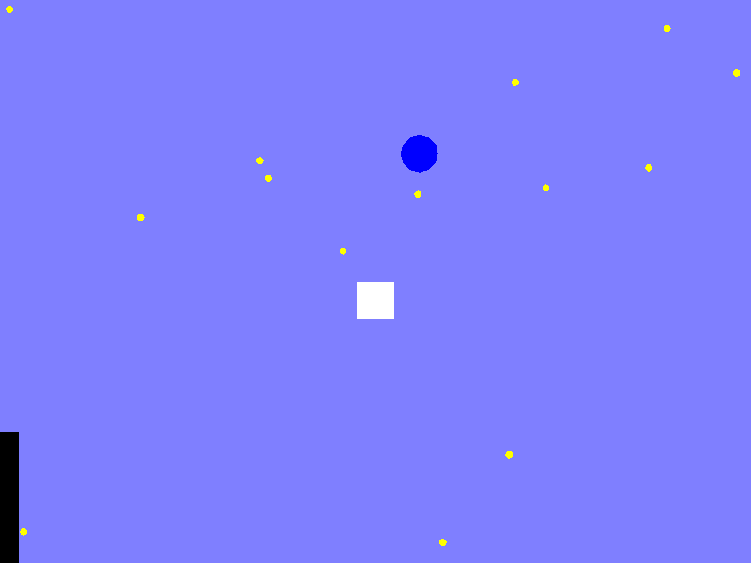
Hour 3
Your 1st, 2nd, 3rd,
and Nth Game Engine
Sean Middleditch
http://seanmiddleditch.com/
DigiPen Game Engine Architecture Club – Copyright © 2012

Slide 25
Hour 3
Your 1st, 2nd, 3rd,
and Nth Game Engine
Sean Middleditch
http://seanmiddleditch.com/
Added Player object
Super simple Xinput handling for gamepad
Introduced a severe bug with flocking (oops)
DigiPen Game Engine Architecture Club – Copyright © 2012

Slide 26
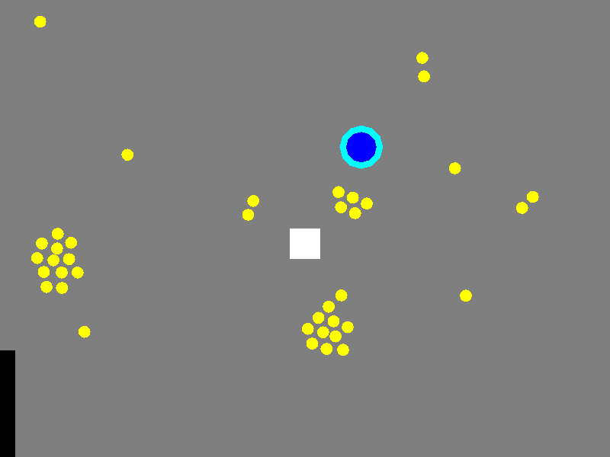
Hour 4
Your 1st, 2nd, 3rd,
and Nth Game Engine
Sean Middleditch
http://seanmiddleditch.com/
DigiPen Game Engine Architecture Club – Copyright © 2012

Slide 27
Hour 4
Your 1st, 2nd, 3rd,
and Nth Game Engine
Sean Middleditch
http://seanmiddleditch.com/
Fixed flocking and made algorithm work nicely
Added first attempt at player shield mechanic
Some (broken) physics is implemented
DigiPen Game Engine Architecture Club – Copyright © 2012

Slide 28
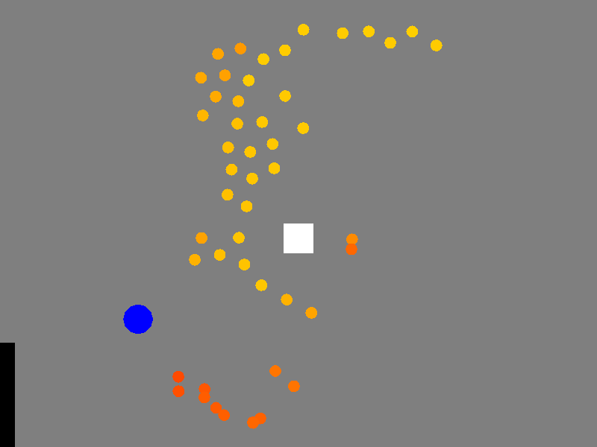
Hour 5
Your 1st, 2nd, 3rd,
and Nth Game Engine
Sean Middleditch
http://seanmiddleditch.com/
DigiPen Game Engine Architecture Club – Copyright © 2012

Slide 29
Hour 5
Your 1st, 2nd, 3rd,
and Nth Game Engine
Sean Middleditch
http://seanmiddleditch.com/
Implemented Boid anger
  Get redder over time
  Chase player when angry enough
Graphics finalized, no more iteration there
DigiPen Game Engine Architecture Club – Copyright © 2012

Slide 30
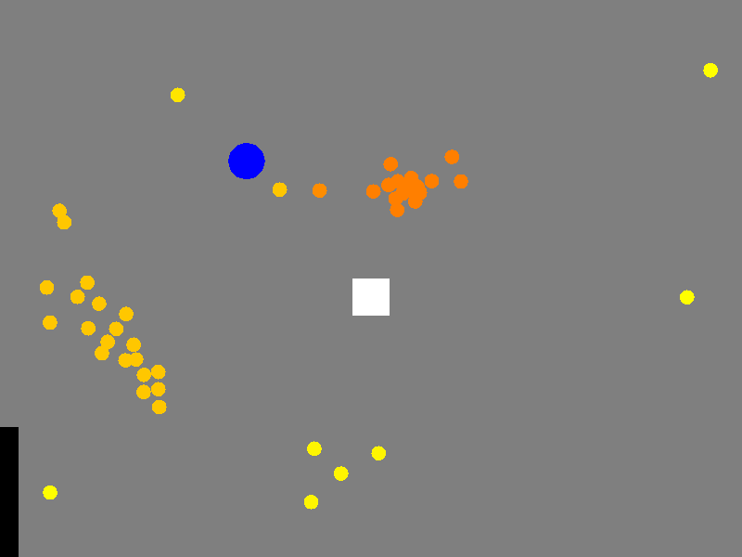
Hour 6
Your 1st, 2nd, 3rd,
and Nth Game Engine
Sean Middleditch
http://seanmiddleditch.com/
DigiPen Game Engine Architecture Club – Copyright © 2012

Slide 31
Hour 6
Your 1st, 2nd, 3rd,
and Nth Game Engine
Sean Middleditch
http://seanmiddleditch.com/
Tons of physics work
Shield can bounce you off walls and bounce Boids
By far the “hardest” part of the game for me
DigiPen Game Engine Architecture Club – Copyright © 2012

Slide 32
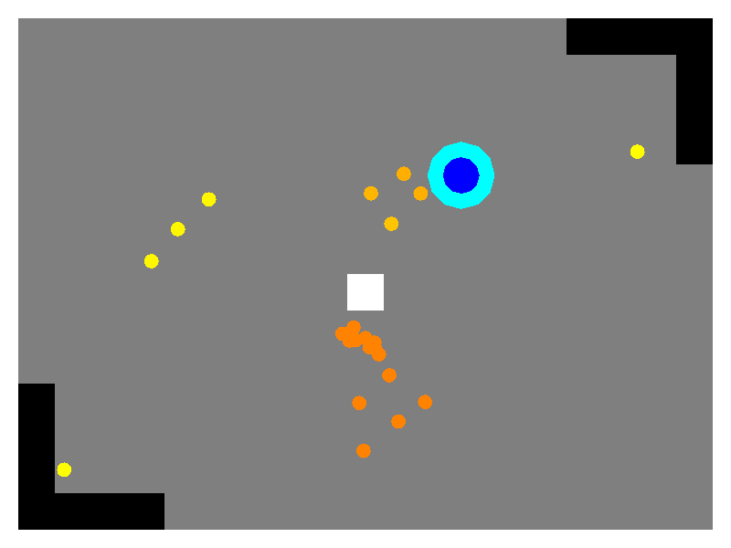
Hour 7
Your 1st, 2nd, 3rd,
and Nth Game Engine
Sean Middleditch
http://seanmiddleditch.com/
DigiPen Game Engine Architecture Club – Copyright © 2012

Slide 33
Hour 7
Your 1st, 2nd, 3rd,
and Nth Game Engine
Sean Middleditch
http://seanmiddleditch.com/
Bigger pits (you still can't fall in them)
Boids spawn over time from pits
… more physics fixes and tweaks
… more Boid behavior tweaking
Implemented 2+ players
DigiPen Game Engine Architecture Club – Copyright © 2012

Slide 34
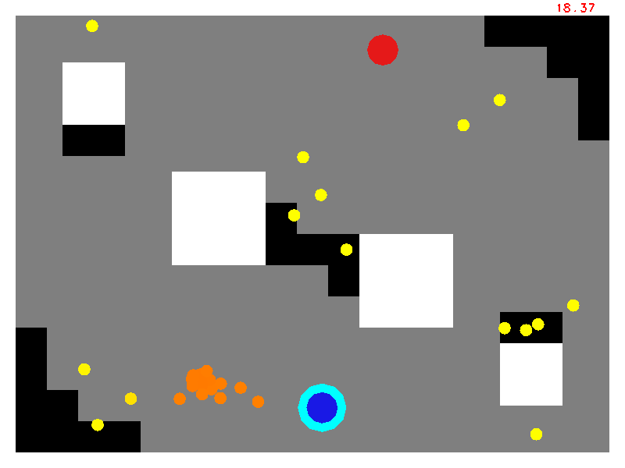
Hour 8
Your 1st, 2nd, 3rd,
and Nth Game Engine
Sean Middleditch
http://seanmiddleditch.com/
DigiPen Game Engine Architecture Club – Copyright © 2012

Slide 35
Hour 8
Your 1st, 2nd, 3rd,
and Nth Game Engine
Sean Middleditch
http://seanmiddleditch.com/
Scaled boxes for walls
Pits kill you if you aren't moving fast enough
Ridiculously simple (and bad) menus
Other tweaks and fixes
DigiPen Game Engine Architecture Club – Copyright © 2012

Slide 36
8 Hour Game Summary
Your 1st, 2nd, 3rd,
and Nth Game Engine
Sean Middleditch
http://seanmiddleditch.com/
Still has some bugs and needs more tweaks to be “awesome fun”
In pretty good shape for only 8 hours
Tiny, simple code will make it easy to iterate further
Imagine what a whole team of four DigiPen students with a whole weekend could do!
http://github.com/seanmiddleditch/BubbleBattleBoids
DigiPen Game Engine Architecture Club – Copyright © 2012

Slide 37
Demo Time!
Your 1st, 2nd, 3rd,
and Nth Game Engine
Sean Middleditch
http://seanmiddleditch.com/
Visual Studio... Engage!
DigiPen Game Engine Architecture Club – Copyright © 2012

Slide 38
Bubble Battle Boids Post-Mortem
Your 1st, 2nd, 3rd,
and Nth Game Engine
Sean Middleditch
http://seanmiddleditch.com/
Less time to write than my last game object library
  More fun to write, too
Most bugs were me failing at simple math
Still having fun hacking away at it
  Will post more GitHub updates eventually
Lots of gameplay bugs and needs tweaks, but the core game idea seems solid and entertaining
  A great prototype if nothing else
DigiPen Game Engine Architecture Club – Copyright © 2012

Slide 39
The Next Step
Your 1st, 2nd, 3rd,
and Nth Game Engine
Sean Middleditch
http://seanmiddleditch.com/
There can only be a “next” step after taking the first
Think about game features first
  Power-ups? Sound?
  Random levels?
The engine grows only when I need it to
  More object types → components
  More intricate and reliable physics
Not even thinking about complexity it'll never need
DigiPen Game Engine Architecture Club – Copyright © 2012

Slide 40
DigiPen Game 200/300/400
Your 1st, 2nd, 3rd,
and Nth Game Engine
Sean Middleditch
http://seanmiddleditch.com/
Aside from the menus/TCR issues, this game will almost certainly pass Game 200
Juniors would need better graphics and less physics bugs, but otherwise... same deal
Seniors need to concentrate even more heavily and visual pizazz (and not at all on internals that potential employers can't see)
DigiPen Game Engine Architecture Club – Copyright © 2012

Slide 41
But... Architecture is Fun!
Your 1st, 2nd, 3rd,
and Nth Game Engine
Sean Middleditch
http://seanmiddleditch.com/
Some of us (me) really love coding
  We want to solve interesting problems
  Learn new techniques
  Do awesome stuff with code
Learning advanced techniques is important
  Gain proficiency and expand code toolbox
Refactor your game after it's working and playable
  Rest of the semester to goof off experiment
DigiPen Game Engine Architecture Club – Copyright © 2012

Slide 42
Exceptional Games
Your 1st, 2nd, 3rd,
and Nth Game Engine
Sean Middleditch
http://seanmiddleditch.com/
Some games need some particular tech to work
Nitronic Rush's first milestone
  3D car driving around on a flat plane
  Quick and dirty proof of concept
  Up and running first, crazy-awesome after
DigiPen Game Engine Architecture Club – Copyright © 2012

Slide 43
AAA Titles
Your 1st, 2nd, 3rd,
and Nth Game Engine
Sean Middleditch
http://seanmiddleditch.com/
Big AAA titles are quick and dirty, too
They still prototype games first
  Use “old” engine or licensed engine
  UDK, CryEngine, Unity, Source, etc.
Saves time by having tons of complex features
Opposite situation to DigiPen students
  Save time by not even thinking about complex features
DigiPen Game Engine Architecture Club – Copyright © 2012

Slide 44
AAA Engines
Your 1st, 2nd, 3rd,
and Nth Game Engine
Sean Middleditch
http://seanmiddleditch.com/
Poorly kept secret:
  There is no perfect universal engine
  They all suck
They all grew organically out of games they were hacked together for
  Just like your engines could (and should) be
DigiPen Game Engine Architecture Club – Copyright © 2012

Slide 45
Summary
Your 1st, 2nd, 3rd,
and Nth Game Engine
Sean Middleditch
http://seanmiddleditch.com/
Make games, not engines
Write what you need and nothing more
Quick and dirty first, pretty and cool after
Prototypes can still be fun (and pass your game class)
Engines come from games, not the other way around
DigiPen Game Engine Architecture Club – Copyright © 2012

Slide 46
Thank You
Your 1st, 2nd, 3rd,
and Nth Game Engine
Sean Middleditch
http://seanmiddleditch.com/
Questions? Comments? Praise and Adoration?
DigiPen Game Engine Architecture Club – Copyright © 2012

