Slide 1
Introduction to Component Based Design for C++ Games
Sean Middleditch

Slide 2
About Me
Sean Middleditch
  DigiPen RTIS Senior
  Game Projects
    Subsonic (2010)
    SONAR (2011)
    Core (2012)
  18 years C/C++ experience
  http://seanmiddleditch.com

Slide 3
About This Lecture
Introduction to C++ and OOP
Component Based Design Overview
Data Driven Components
Best Practices

Slide 4
Object Oriented Programming Primer

Slide 5
Object Oriented Programming Primer
What is OOP?
  Designing code in functional units
  Communicating between units with abstract interfaces
  Encapsulating implementation details
  Making code comprehensible

Slide 6
Object Oriented Programming Primer
What is OOP not?
  Designing code around real-world objects
  One-to-one mappings of programmer ideas and classes
  Useless abstractions and excess layers

Slide 7
Object Oriented Programming Primer
Classes vs Interfaces vs Objects
  Classes are concrete functionality
    “A sprite”
  Interfaces define how different parts of a program communicate
    “Something that can be drawn”
  Objects are specific instances of a concept
    “The hero sprite”

Slide 8
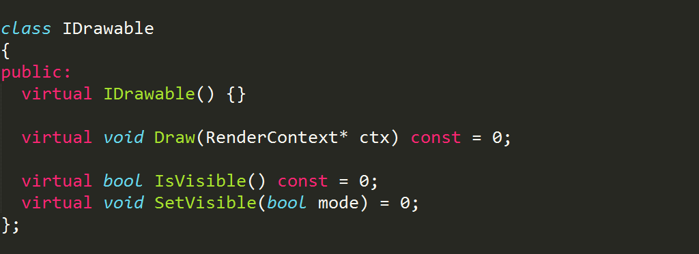
Object Oriented Programming Primer
Interfaces in C++
  Defining an interface

Slide 9
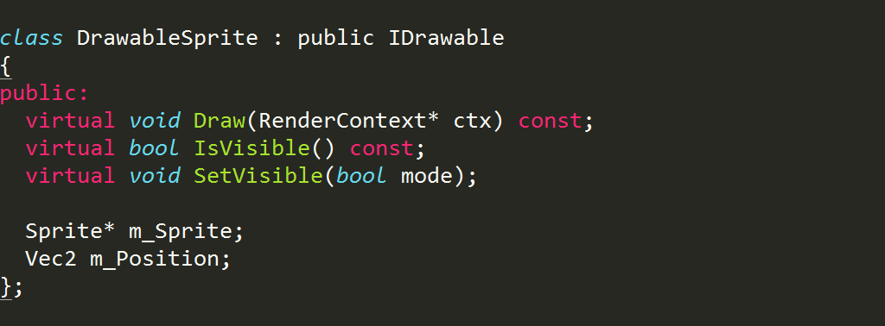
Object Oriented Programming Primer
Interfaces in C++
  Consuming an interface

Slide 10
“Classic” Object Oriented Design

Slide 11
Common Misinformation
Proper OOP design practices have been well understood for several decades
However, bad practices are frequently used for introductory material
  … and there's not really much “advanced design” material around
The result is that there are a lot of programmers who learned how to use OOP totally wrong
You don't want to be one of them

Slide 12
Real World Objects
Common Bad Design Practice
  Almost always the basis for “what is OOP” course material and tutorials
  Classes that reflect things in real life
    A car class
  Interfaces that reflect things people do
    A gas pedal interface
  Objects that represent a specific real thing
    A Ford 2003 Focus object instance

Slide 13
Real World Objects
Real World Object Complexity
  Car class, abundance of interfaces
  Door locking, opening, closing
  Windows up, down
  Wipers on, off
  Brake pressure
  Gas pressure
  Steering
  Stereo
  Etc.

Slide 14
Real World Objects
Real World Object Code Proliferation
  Car class
  Tank class
  Motorcycle class
  Jet class
  Sailboat class
  Steam locomotive class

Slide 15
Real World Objects
Real World Taxonomy
  Sharing code between “similar” objects
  Vehicle base class
    Motorized class
      Wheel class
      Jet class
      Boat class
        … sailboats are a problem

Slide 16
Real World Objects
Real World Taxonomy
  Try number two
  Vehicle base class
    LandVehicle class
      MotorLandVehicle class
      ManualLandVehicle class
    NauticalVehicle class
      MotorboatVehicle class
      WindPoweredVehicle class
  “Motorized” code is duplicated

Slide 17
Real World Objects
Real World Taxonomy
  The “solution” (not really)
  Vehicle base class
    Land functionality
    Water functionality
    Motor functionality
    Sailing functionality
    Subclasses to select options
      Car class (enables land, motor)
      Plane class (enables air, motor)
      Sailboat class (enables water, sailing)
      All subclasses have all data/features

Slide 18
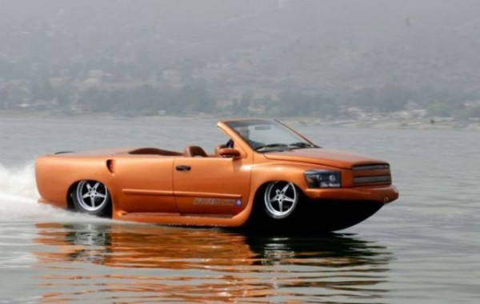
Real World Objects
Real World Taxonomy

Slide 19
Real World Objects
Real World Taxonomy
  Creates very large objects with excess data
  Creates very large interfaces that are hard to document and use
  Creates huge class diagrams that are hard to explain to new developers
  Creates a big mess that will slow you down

Slide 20
Good Object Oriented Design

Slide 21
Computer Program Objects
Computers are all about data and logic
  Data structures contain information
    What objects exist in the world
    What color are the walls
    How much life does the player have
  Logic uses data to simulate the game world
    Objects and textures used to draw world
    Player and enemy weapon data used in combat

Slide 22
Computer Program Objects
Computers are all about data and logic
  Classes and interfaces for data
    Vehicle body mesh
    Engine performance characteristics
    Storage compartment contents and dimensions
  Classes and interfaces for logic
    Navigation logic
    Traction control logic
    Physical simulation logic

Slide 23
Computer Program Objects
Focus on abstractions
  Motor, not CarEngine
  Navigation, not NauticalCharting
  Storage, not TruckBed
Reusable components
  Motor can be used with a car, train, plane, boat, crane, conveyer belt, bottling machine, elevator, automatic door, ventilation system, etc.

Slide 24
Computer Program Objects
Classes in C++
  Think about what they DO, not what they ARE
    Button, Lever, Switch, and PressurePlate all trigger actions, so just make one Trigger class

Slide 25
Computer Program Objects
Classes in C++
  Think about what they DO, not what they ARE
    Button, Lever, Switch, and PressurePlate all trigger actions, so just make one Trigger class
  Think about what they CONTAIN
    PlayerDude, BulletIcon, and EnemyFace all have an image, so just make one Sprite class

Slide 26
Computer Program Objects
Classes in C++
  Think about what they DO, not what they ARE
    Button, Lever, Switch, and PressurePlate all trigger actions, so just make one Trigger class
  Think about what they CONTAIN
    PlayerDude, BulletIcon, and EnemyFace all have an image, so just make one Sprite class
  Think about how they are USED
    World and Inventory both contain objects, but are used very differently, so make them separate (and thus smaller and simpler)

Slide 27
Aggregation vs Inheritance

Slide 28
Inheritance in C++
Inheritance allows C++ to “extend from” the data and logic of a class
  Use this when you have an extended interface
  Logger can be used anywhere, but FileLogger adds the ability to write to files
  Almost always has virtual methods
  Read as “is-a”
    FileLogger is a Logger

Slide 29
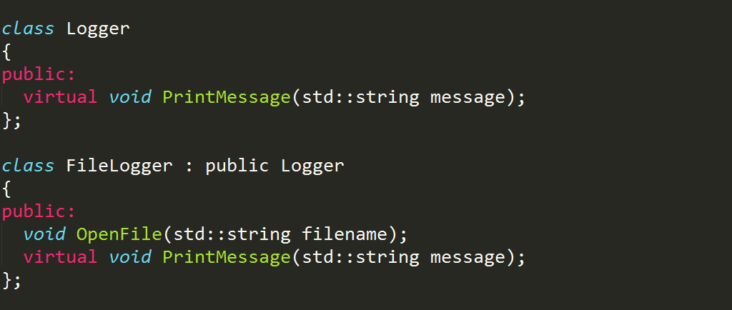
Inheritance in C++
Inheritance allows C++ to “extend from” the data and logic of a class

Slide 30
Inheritance in C++
Inheritance can “add to” a class
  Backwards design
  Doesn't read as “is-a”
    “Enemy is a Health” doesn't seem right
  Can cause conflicts
  Hard to document
  Just don't do it

Slide 31
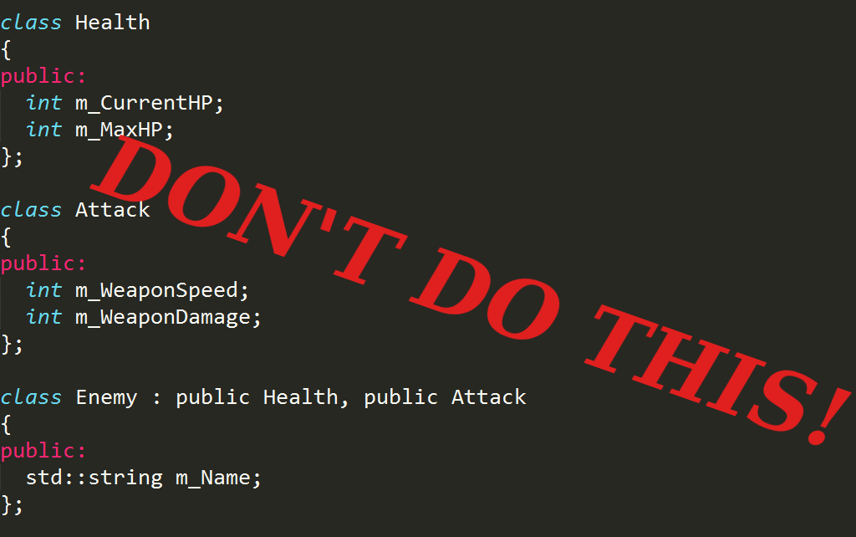
Inheritance in C++

Slide 32
Aggregation in C++
Aggregation is containment
  Reads as “has” or “has-a”
    “Enemy has Health”
    “Enemy has an Attack”
    Much better
  Treat objects as data instead of structure
  Simpler to document
  Way less problems

Slide 33
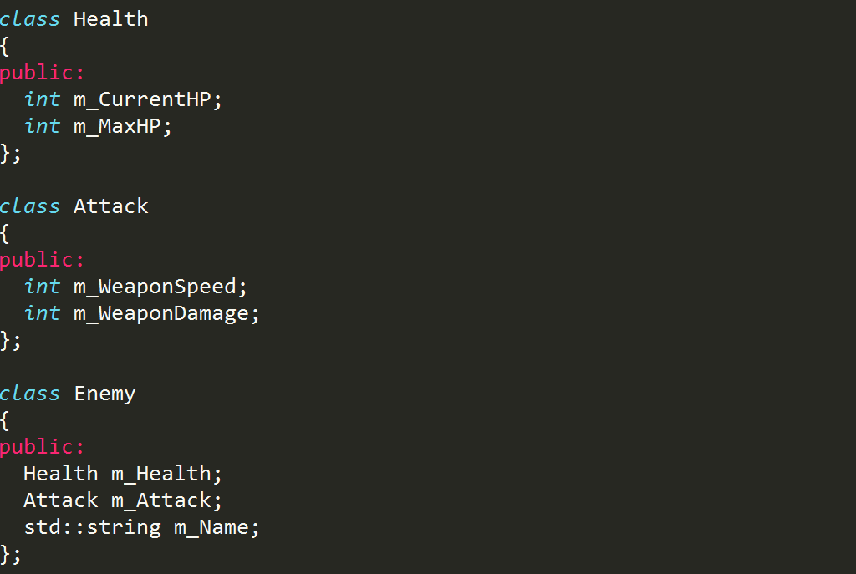
Aggregation in C++

Slide 34
Component Based Design

Slide 35
Component Based Design
Use aggregation for everything
  A GameObject is not a Sprite
    Game objects have a Sprite
  A GameObject is not a Physics
    Game objects have Physics
  The Engine is not a Graphics
    Engines have Graphics

Slide 36
Component Based Design
More than just aggregation
  Component based design is a way of thinking about designing systems
  Aggregation is a way of building a class
  Component based design is a way of building an entire software application

Slide 37
Component Based Design
Components make up larger systems
  Components are self-contained pieces of functionality or data that are used to make up a whole
  A game object has many pieces
    Visual representation
    Physics data
    AI logic
    Location in world
  Each of these pieces is a separate component

Slide 38
Component Based Design
Components are separate from each other
  Graphics does not care about physics
  Physics does not care about graphics
  They share the Transform (position, rotation, scale)
  Three components
    One for graphics data
    One for physics data
    One for shared transform data

Slide 39
Component Based Design
Components are decoupled
  Graphics does not care about AI
  You can add or remove AI to a game object without affecting graphics at all
  Different game objects can have different sets of components
    The player doesn't have an AI component
    Enemies don't have a Controller component
    Items don't have AI or Controller components
    Triggers don't even have a graphics component

Slide 40
Component Based Design
Communicate along well-defined interfaces
  Physics component has an interface
    SetVelocity(x, y)
    Update(dt)
    SetMass(kg)
    GetMass()
  Controller component uses that interface
    Player moves forward, Controller component sets a forward velocity on Physics component

Slide 41
Component Based Design
Prefer smaller, simpler interfaces
  Larger interfaces can be split up
  “Physics” is two different things
    Collision detection
    Collision resolution and integration

Slide 42
Component Based Design
Prefer smaller, simpler interfaces
  These are two different components
    Collider component
    Physics component
  Don't always need both
    Triggers need to know if they collide with the player, but can't be pushed around and are not affected by gravity

Slide 43
Component Based Design
Prefer smaller, simpler interfaces
  Simpler Collider interface
    IsColliding(GameObject* other_object)
  Can swap out different implementations
    BoxCollider vs CircleCollider
    Both have the same interface
      Using “good” inheritance in C++
  Triggers don't care about how they're colliding
  They only care that they are colliding

Slide 44
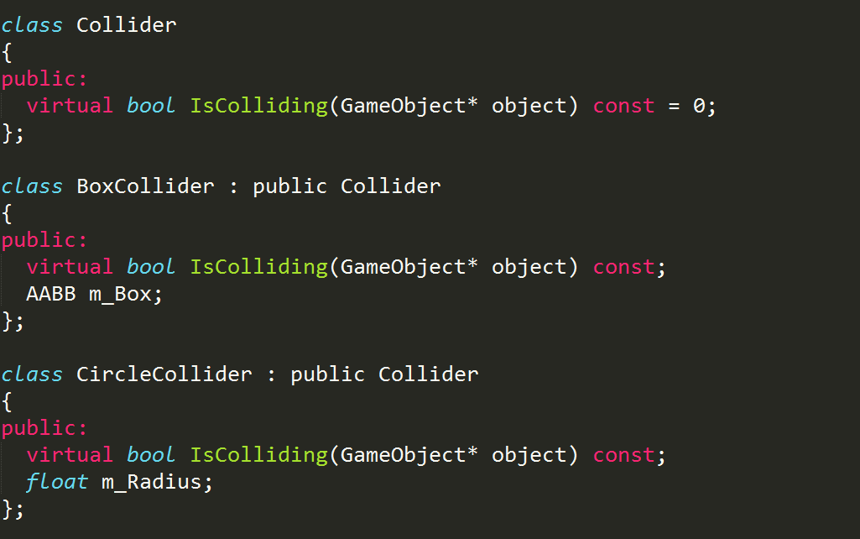
Component Based Design

Slide 45
Data Driven Design

Slide 46
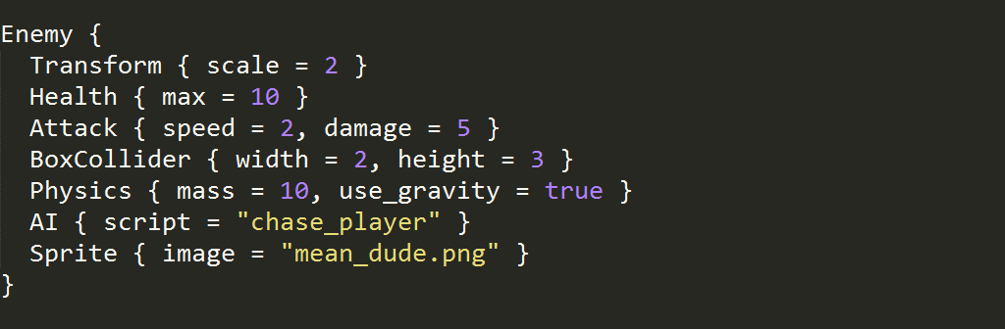
Data Driven Design
Using data to control logic
  i.e., read a list of commands from a text file
  This can include commands for building objects
    Lists of components and data

Slide 47
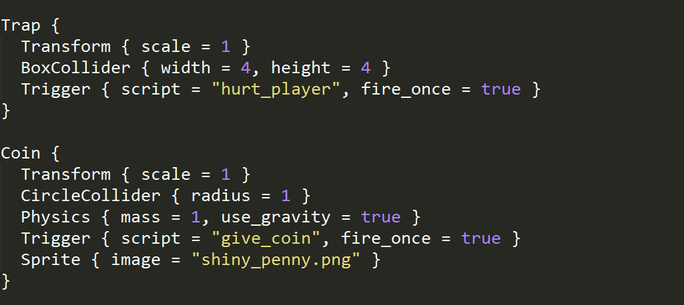
Data Driven Design
Easily build new objects from existing components

Slide 48
Data Driven Design
Reduces iteration time
  Designers don't need to wait on programmers for every change
  Does not require a recompile of the game
Use it everywhere you can
  Remove as much data as possible from the code

Slide 49
Coding Components in C++

Slide 50
Components in C++
Actually using components requires some work
  This requires some in-depth knowledge of C++
  Not hard stuff, but it may all be new to you
  Topics include:
    Inheritance
    Virtual functions
    Standard containers
    Object lifetime management
    Constructors and destructors

Slide 51
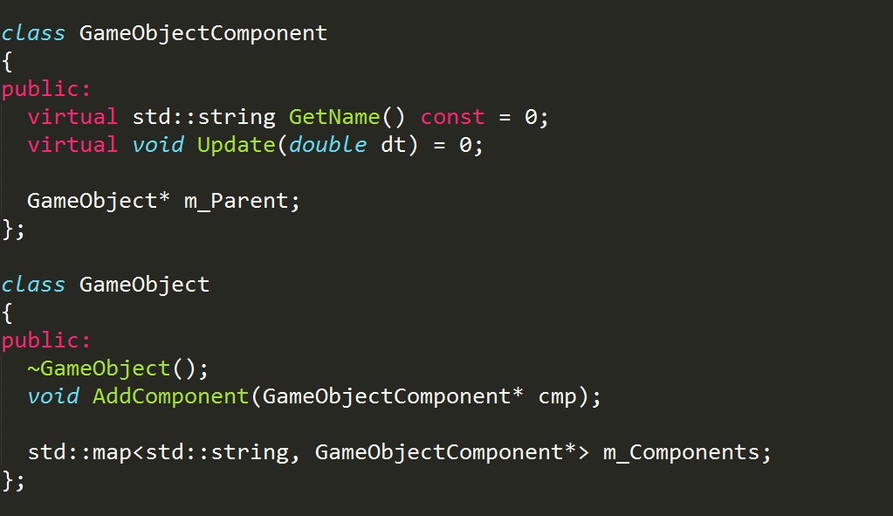
Component in C++

Slide 52
Components in C++
GameObjectComponent is an interface
  Every component has a name (Sprite, Transform, etc.)
  Every component can be updated each frame
    (actually not that great of a design, but it fits on a slide)
  “Pure virtual” methods define interface
GameObject is just a container of components
  It aggregates other objects to make a more interesting whole

Slide 53
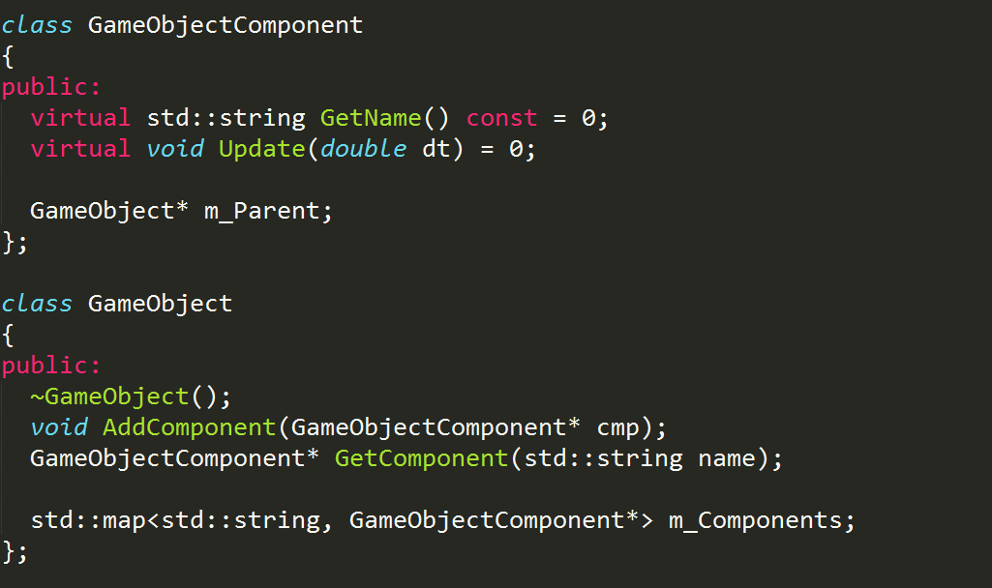
Components in C++

Slide 54
Components in C++
Sprite and Trigger are specific components
  They implement the same component interface
    Can ask for their name and update them
    They do not require any special code to interact with them
    Yet they do totally different things
  In C++ terms, they derive from a common base class and override virtual methods

Slide 55
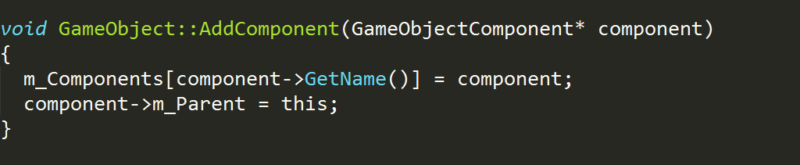
Components in C++
Add a component to an object
  Really simply
  Basic use of STL containers
  Inserts component into map, sets parent

Slide 56
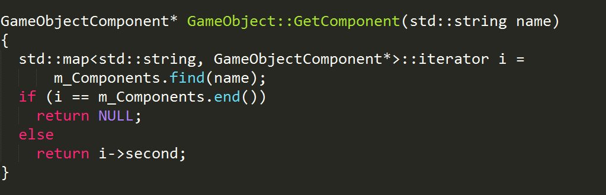
Components in C++
Finding components
  Basic (but really ugly) use of STL containers
  Checks if component exists and returns it

Slide 57
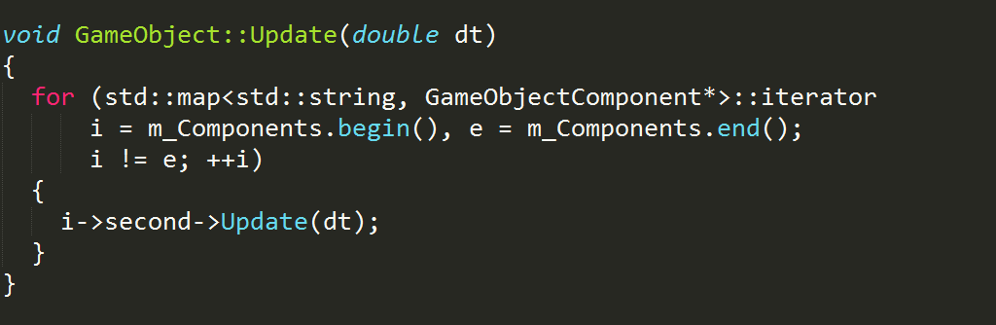
Components in C++
Updating components
  Basic (but really ugly) use of STL containers
  Forwards a method call to all components

Slide 58
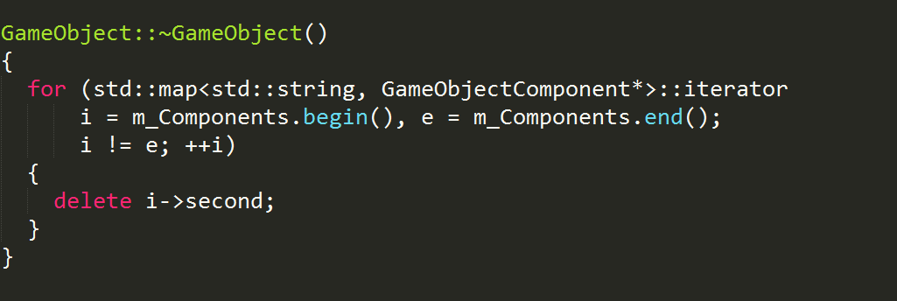
Components in C++
Clean up after yourself
  GameObject owns its components
  It's responsible for freeing their resources

Slide 59
Data-Driven Components

Slide 60
Data-Driven Components
Real power of components comes from data
  Ability to dynamically create objects from text files
  Needs a text file reader/parser
    TinyXML
      http://www.grinninglizard.com/tinyxml2/index.html
    Jansson
      http://www.digip.org/jansson/
    IO Streams
      Standard C++ library

Slide 61
Data-Driven Components
Mapping text to code
  Text file will specify names of components
  Text file will specify component data
  Need a method to create a component from text name
  Need a method to popular component fields from text values

Slide 62
Data-Driven Components
Factory pattern
  A factory is a method for creating objects based on an identifier
  Often implemented as a simple switch statement or a series of if/else statements
  More complicated and flexible factories are possible, but totally unnecessary in most cases

Slide 63
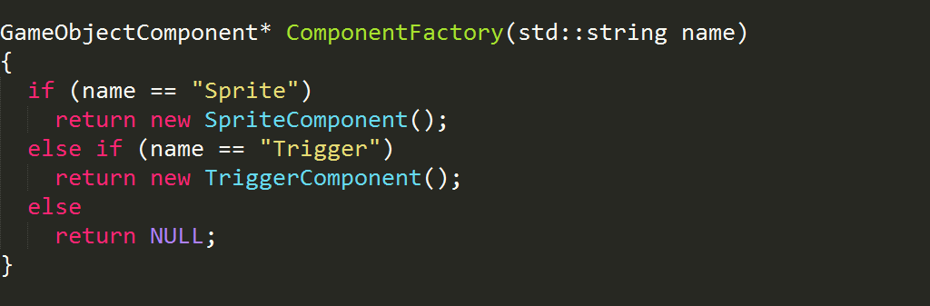
Data-Driven Components
Component factory
  Add an “if” statement for each component

Slide 64
Data-Driven Components
Reading component data
  Components have member variables
    e.g., SpriteComponent has an image property
  Need to convert from text to these values
  Called “deserialization” or “unmarshalling”
    Convert to a file is “serialization” or “marshalling”
  Requires a new interface method in GameObjectComponent

Slide 65
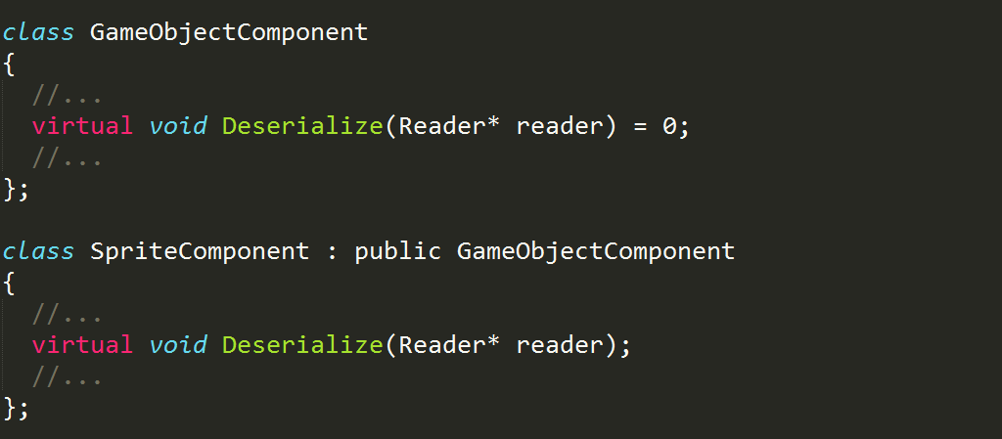
Data-Driven Components
Add a new set of methods to the interface

Slide 66
Data-Driven Components
Reader is an interface
  It has a ReadNext() method
  What or how it reads is irrelevant
    Maybe it reads XML, maybe JSON, maybe binary, maybe some custom text protocol
    Components don't need to know or care
  Actual implement might be XmlReader
    Same interface no matter which implementation
    We only care about what it DOES, not what it IS

Slide 67
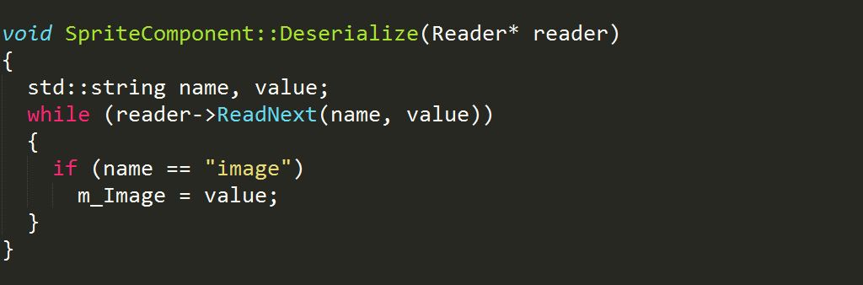
Data-Driven Components
Implement Deserialize for each component
  Add a new “if” statement for each property
  Simple, unsophisticated, works just fine

Slide 68
Component Design

Slide 69
Component Design
Logic or Data?
  Components can contain logic, like the Update() method
  Components contain data used by logic
  Some components are just data, like Transform
  Some components are just logic, like AI
  Some components can be both, like Sprite
    It contains data about the sprite to draw
    It can have the logic to draw... but should it?

Slide 70
Component Design
Components should be used everywhere
  That means that the game engine is made up of components, too
    No, not GameObjectComponents, but EngineComponents, i.e. Systems
    PhysicsSystem, GraphicsSystem, InputSystem, LogicSystem, etc.
  Should these be primarily logic or data?
    Does GraphicsSystem do any drawing, or does it just contain scene data for game objects?

Slide 71
Component Design
Use logic in engine systems
  All physics logic is done by PhysicsSystem
  All rendering is done by GraphicsSystem
Use only data in game object components
  SpriteComponent just references a sprite
  PhysicsComponent just has mass and velocity
Systems manipulate game objects
  Iterate list of game objects, or lists of components

Slide 72
Component Design
Advantages to keeping logic in systems
  Control over ordering
    Ensuring all physics updates happen before all graphics updates
  Efficiency
    No need to call Update() on objects that don't have any components that need updating
  Easier to handle more complex inter-object logic needs
    Sorting sprites for rendering, etc.

Slide 73
Component Design
Intrusive linked lists are your friends
  Each component class has next and previous members
  Each system has a Register/Unregister pair of methods to register their relevant components
  Components register themselves with systems
  Systems can iterate over all relevant components easily

Slide 74
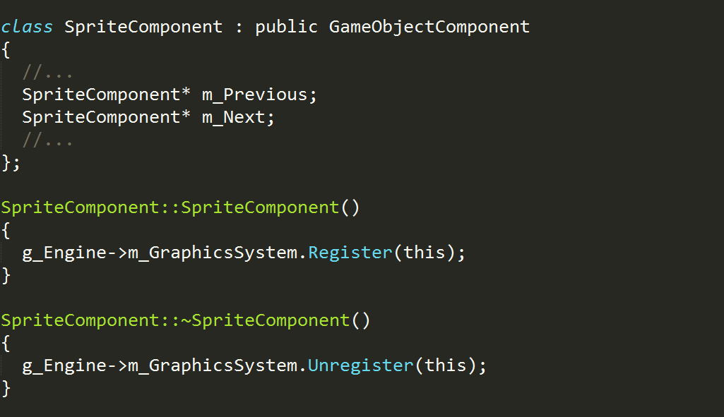
Component Design

Slide 75
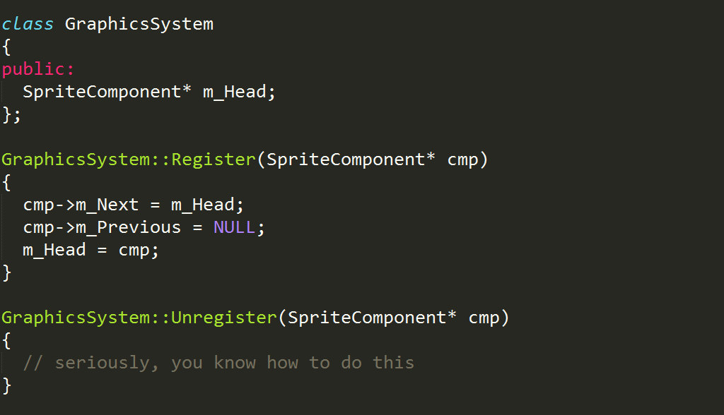
Component Design

Slide 76
More Component Usage

Slide 77
More Component Usage
There are many places to use components
AI Behaviors
  Build complex intelligent agents out of small, simpler behaviors
    ChaseBehavior
    FleeBehavior
    GuardBehavior
    PatrolBehavior
    FindCoverBehavior

Slide 78
More Component Usage
User Interface Controls
  ClickableControl
  ScrollableControl
  DraggableControl
  TextControl
  IconControl
  ContainerControl

Slide 79
More Component Usage
Particle effect system
  SpawnEffect
  GravityEffect
  TimeEffect
  DistanceEffect
  ForceEffect
  InterpolateEffect

Slide 80
Closing Thoughts

Slide 81
Closing Thoughts
Components are a tool
  You don't need to use every tool
  For simpler games, the costs of adding components might outweigh the benefits
  Thousands and thousands of games have been written, shipped, and loved, all without components
  Same goes for other tools (scripting, metadata, editors, even C++)

Slide 82
Additional Resources
Evolving Your Hierarchy (Mick West)
  http://cowboyprogramming.com/2007/01/05/evolve-your-heirachy/
Game Object Structure: Inheritance vs Aggregation (Kyle Wilson)
  http://www.gamearchitect.net/Articles/GameObjects1.html
Game 200 Lectures (Chris Peters, Ben Ellinger)
  DigiPen Institute of Technology, GameCentral on Moodle

Slide 83

Questions?

