Slide 1

VLSI Finite-State Machines (FSM)
Cairo University
Faculty of Engineering
Computer Engineering Department
Sandra Wahid

Slide 2
FSM
If a system transits between finite number of internal states, then finite state machines (FSM) can be used to design the system.
The FSM can change from one state to another in response to some inputs; the change from one state to another is called a transition.
An FSM is defined by a list of its states, its initial state, and the inputs that trigger each transition.

Slide 3
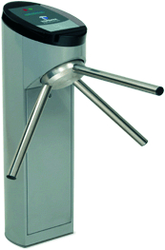
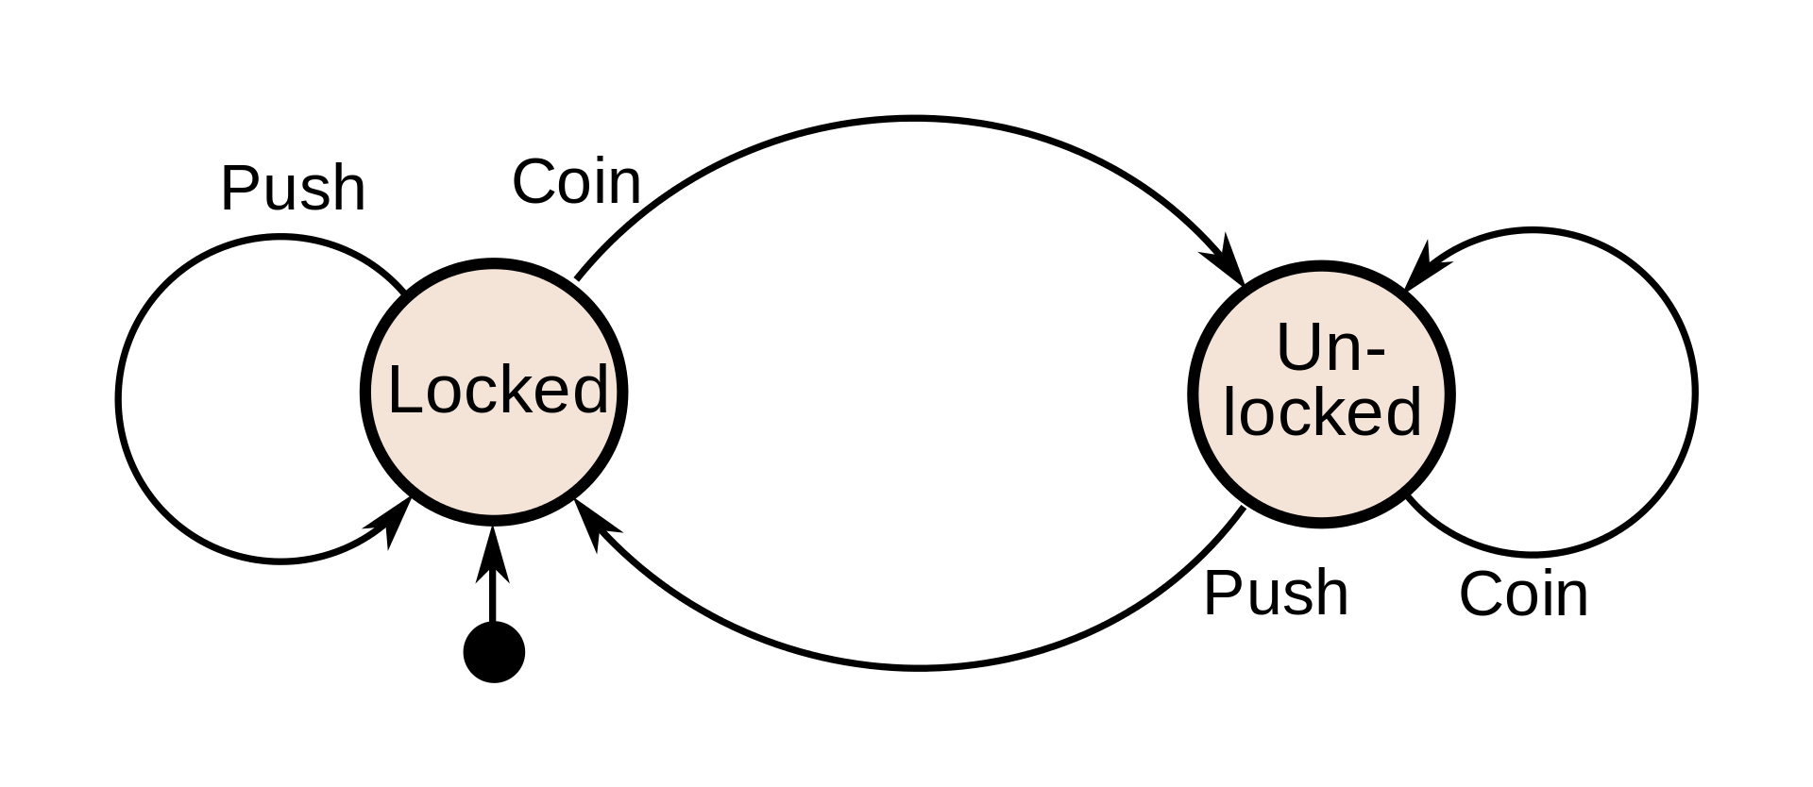
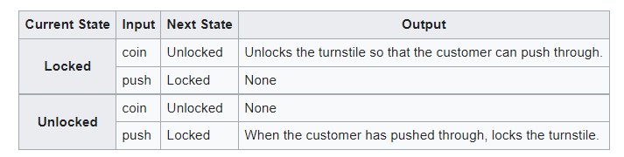
Example

Slide 4
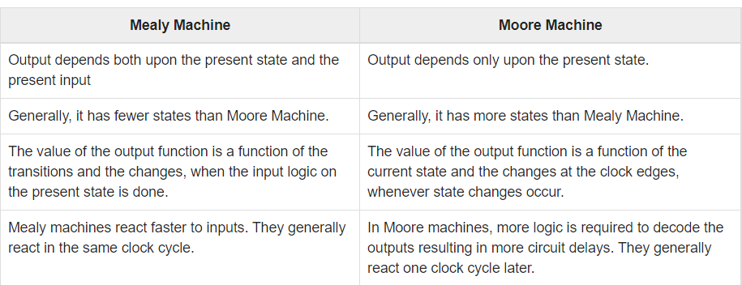
FSM Behavior Types
FSM can be divided into two different behavior types:
Mealy machines
Moore machines

Slide 5
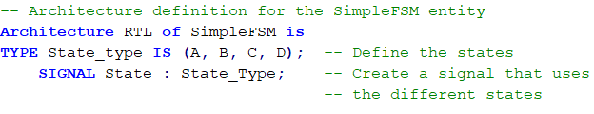
FSM States in VHDL

Slide 6
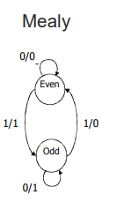
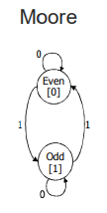
Example: Parity checker
Serial input string
OUT=1 if odd # of 1s in input
OUT=0 if even # of 1s in input
Input/output:

Slide 7
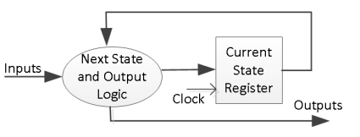
Mealy Machine: 2 blocks
A general model of a Mealy machine consists of:
a combinatorial network which generates the outputs and the next state,
and a state register which holds the present state as shown below. The state register is normally modeled as D flip-flops. The state register must be sensitive to a clock edge

Slide 8
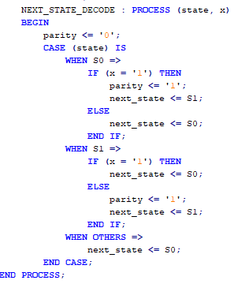
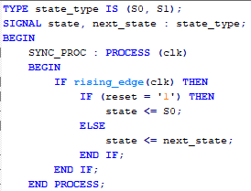
Mealy Machine: 2 blocks
Even: S0
Odd: S1

Slide 9
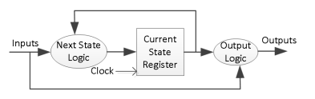
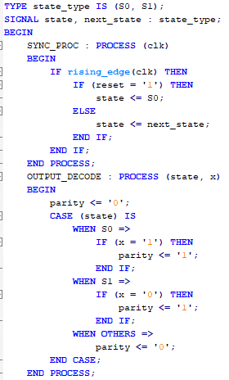
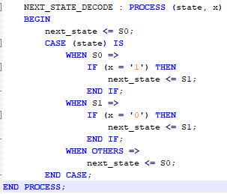
Mealy Machine: 3 blocks

Slide 10
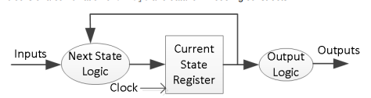
Moore Machine: 3 blocks
A general model of a Moore machine consists of:
combinatorial network which generates the outputs,
combinatorial network which generates the next state
and a state register which holds the present state as shown below. The state register is normally modeled as D flip-flops. The state register must be sensitive to a clock edge

Slide 11
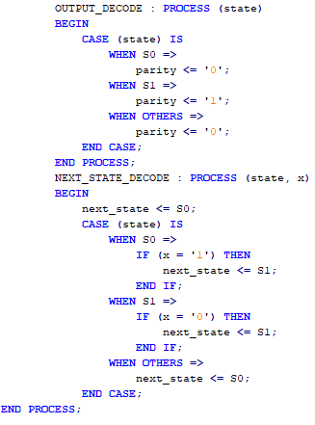
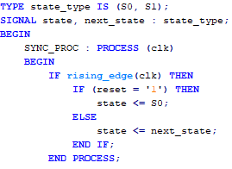
Moore Machine: 3 blocks
Even: S0
Odd: S1

Slide 12
Thank You

