Slide 1
Unit 1: DB Basic Concepts
Chapter 1: DB and DB Users
This material is a modified version of the slides provided by Ramez Elmasri and Shamkant Navathe for their book “Fundamentals of Database Systems”, 5th edition.

Slide 2
Outline
Examples of Database Applications
Basic Definitions
Database System Environment
Example of a Database (UNIVERSITY)
Database Vs File Systems
Main Characteristics of the Database Approach
Typical DBMS Functionality
When Not to Use Database
Database Systems
Basic Concepts

Slide 3
Examples of Database Applications
Purchases from the supermarket
Purchases using your credit card
Booking a holiday at the travel agents
Hotel reservation
Database Systems
Basic Concepts
© Pearson Education Limited 1995, 2005

Slide 4
Basic Definitions
Database:
  A collection of related data.
Data:
  Known facts that can be recorded and have a meaning.
Mini-world:
  Some part of the real world about which data is stored in a database. For example, student grades and transcripts at a university.
Database Management System (DBMS):
  A collection of programs that enables users to create and maintain a database.
  A general purpose software system that facilities the process of defining , constructing, manipulating, and sharing databases among different users ad applications
Database System:
  The DBMS software together with the data itself. Sometimes, the applications are also included.
Database Systems
Basic Concepts
Notes:
Define database :

Slide 5
Basic Definitions
Application Program:
  Access the database by sending queries or requests for data to the DBMS.
  Query : causes some data to be retrieved , inserted , deleted or updated
.
Database Systems
Basic Concepts
Notes:
Define database :

Slide 6
Database Properties
Database
Source
from which data
is delivered
Degree of interaction with events in the real
world
Audience
that is interested in
its contents
Database Systems
Basic Concepts

Slide 7

Simplified database system environment
Database Systems
Basic Concepts

Slide 8
Example of a Database
Mini-world for the example:
  Part of a UNIVERSITY environment.
Some mini-world entities:
  STUDENTs
  COURSEs
  SECTIONs (of COURSEs)
  (academic) DEPARTMENTs
  INSTRUCTORs
Database Systems
Basic Concepts

Slide 9
Example of a Database
Some mini-world relationships:
  SECTIONs are of specific COURSEs
  STUDENTs take SECTIONs
  COURSEs have prerequisite COURSEs
  INSTRUCTORs teach SECTIONs
  COURSEs are offered by DEPARTMENTs
  STUDENTs major in DEPARTMENTs
Note: The above entities and relationships are typically expressed in a conceptual data model, such as the ENTITY-RELATIONSHIP data model (see Chapter 7)
Database Systems
Basic Concepts

Slide 10

Example of a simple database
Data record
Data elements
Each has a
data type
Database Systems
Basic Concepts

Slide 11
File System
Each user define and implement the files needed for a specific software application.
Example:
  Grade reporting office -> define files related to student data and grades
  Accounting office : keep track of students’ fees and their payments
Database Systems
Basic Concepts

Slide 12
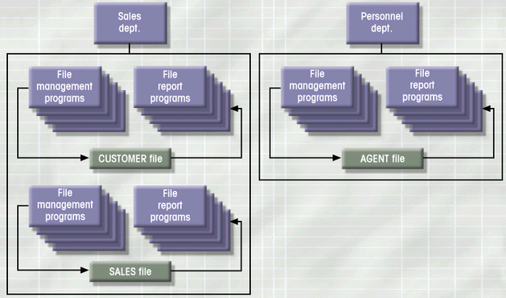
Simple File System
Database Systems
Basic Concepts

Slide 13
File System Critique
Redundancy in defining and storing data which results in wasted storage space
Redundant effort to maintain common up to date data.
Any change to the structure of a file may require changing all programs that access that file
Data Dependence
  Change in file’s data characteristics requires modification of data access programs
Database Systems
Basic Concepts

Slide 14
Database Systems
Database consists of logically related data stored in a single repository
Provides advantages over file system management approach
  Eliminates inconsistency, data dependency, and structural dependency problems
  Stores data structures, relationships
Database Systems
Basic Concepts

Slide 15
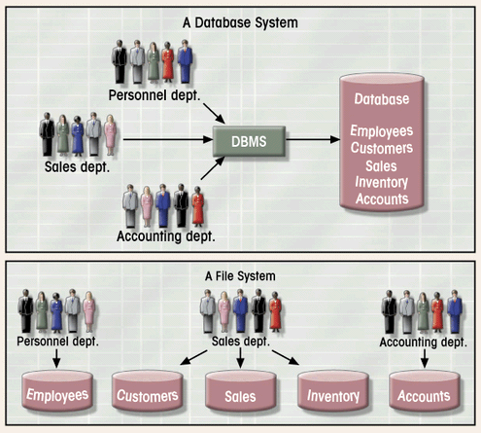
Database vs. File Systems
Database Systems
Basic Concepts

Slide 16
Main Characteristics of the Database Approach
Self-describing nature of a database system:
  A DBMS catalog stores the description of a particular database (e.g. data structures, types, and constraints)
  The information stored in the catalog is called meta-data.
  This allows the DBMS software to work with different database applications.
Insulation between programs and data:
  Called program-data independence.
  Allows changing data structures and storage organization without having to change the DBMS access programs.
Data Abstraction:
  A data model is a type of data abstraction that used to hide storage details and present the users with a conceptual view of the database.
  Programs refer to the data model constructs rather than data storage details
Support of multiple views of the data:
  Each user may see a different view of the database, which describes only the data of interest to that user.
Sharing of data and multiuser transaction processing
  Allow multiple users to access the database at the same time..
Database Systems
Basic Concepts

Slide 17

Example of a simplified database catalog
Database Systems
Basic Concepts

Slide 18
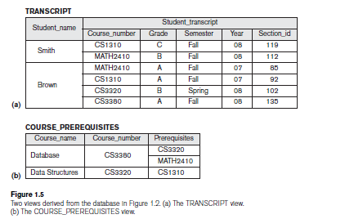
Example: Views
Database Systems
Basic Concepts

Slide 19
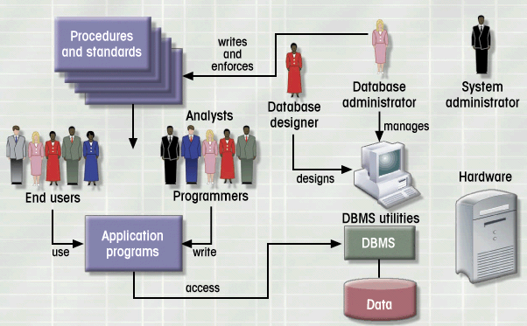
Database System Environment
Database Systems
Basic Concepts

Slide 20
Typical DBMS Functionality
Define a particular database in terms of its data types, structures, and constraints
Construct or Load the initial database contents on a secondary storage medium
Manipulating the database:
  Retrieval: Querying, generating reports
  Modification: Insertions, deletions and updates to its content
  Accessing the database through Web applications
Processing and Sharing by a set of concurrent users and application programs – yet, keeping all data valid and consistent
Database Systems
Basic Concepts

Slide 21
Typical DBMS Functionality
Other features:
  Protection or Security measures to prevent unauthorized access
  Presentation and Visualization of data
  Maintaining the database and associated programs over the lifetime of the database application
    Called database, software, and system maintenance
Database Systems
Basic Concepts

Slide 22
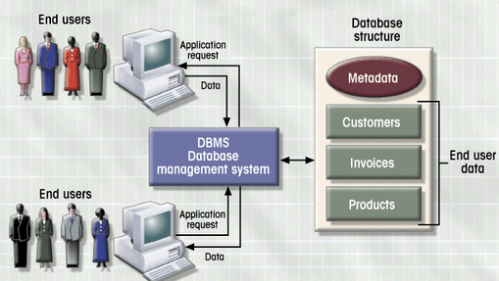
DBMS Manages Interaction
Database Systems
Basic Concepts

Slide 23
Additional Benefits of Database Technology
Controlling redundancy in data storage and in development and maintenence efforts.
Sharing of data among multiple users.
Restricting unauthorized access to data.
Providing multiple interfaces to different classes of users.
Representing complex relationships among data.
Enforcing integrity constraints on the database.
Providing backup and recovery services.
Potential for enforcing standards.
Flexibility to change data structures.
Reduced application development time.
Availability of up-to-date information.
Database Systems
Basic Concepts

Slide 24
When not to use a DBMS
Main inhibitors (costs) of using a DBMS:
  High initial investment and possible need for additional hardware.
  Overhead for providing generality, security, concurrency control, recovery, and integrity functions.
When a DBMS may be unnecessary:
  If the database and applications are simple, well defined, and not expected to change.
  If there are stringent real-time requirements that may not be met because of DBMS overhead.
  If access to data by multiple users is not required.
Database Systems
Basic Concepts

Slide 25
Summary
Examples of Database Applications
Basic Definitions
Database System Environment
Example of a Database (UNIVERSITY)
Database Vs File Systems
Main Characteristics of the Database Approach
Typical DBMS Functionality
When Not to Use Database
Database Systems
Basic Concepts

