Slide 1
CRM Customer Relationship Management
Presented by
Gauri Pawar

Slide 2
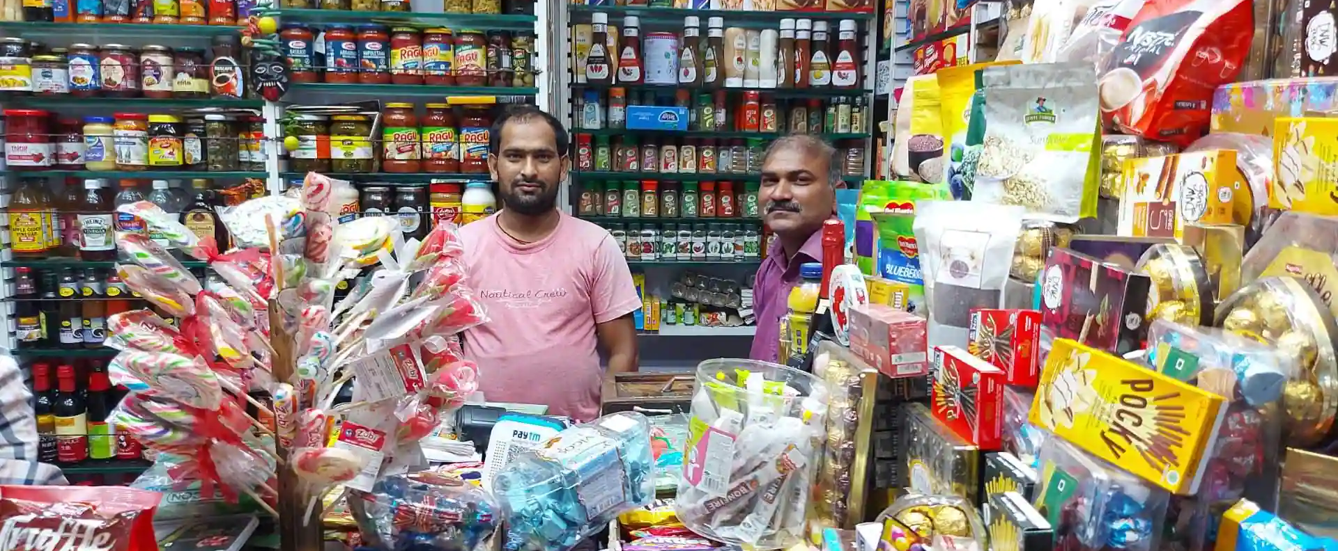

Slide 3
What is CRM?
CRM is an approach that helps business improve existing customer relationships and acquire new customer faster.
A CRM tool lets you store customer and prospect contact information, identify sales opportunities, record service issues, and manage marketing campaigns, all in one central location – and make information about every customer interaction available to anyone at your company who might need it.

Slide 4
What is CRM?
Today, when you hear about CRM, it mostly refers to CRM software.
This software ensures that every step of the interaction with consumers goes smoothly and efficiently in order to increase the overall profits. The software gathers customer data from multiple channels. Hence, CRM stores detailed information on overall purchase history, personal info and even purchasing behaviour patterns.

Slide 5
“It is not your Customers job to remember you. It is your Obligation and responsibility to make sure they don’t have the chance to forget you.” Patricia Fripp

Slide 6
Thank You

