Slide 1
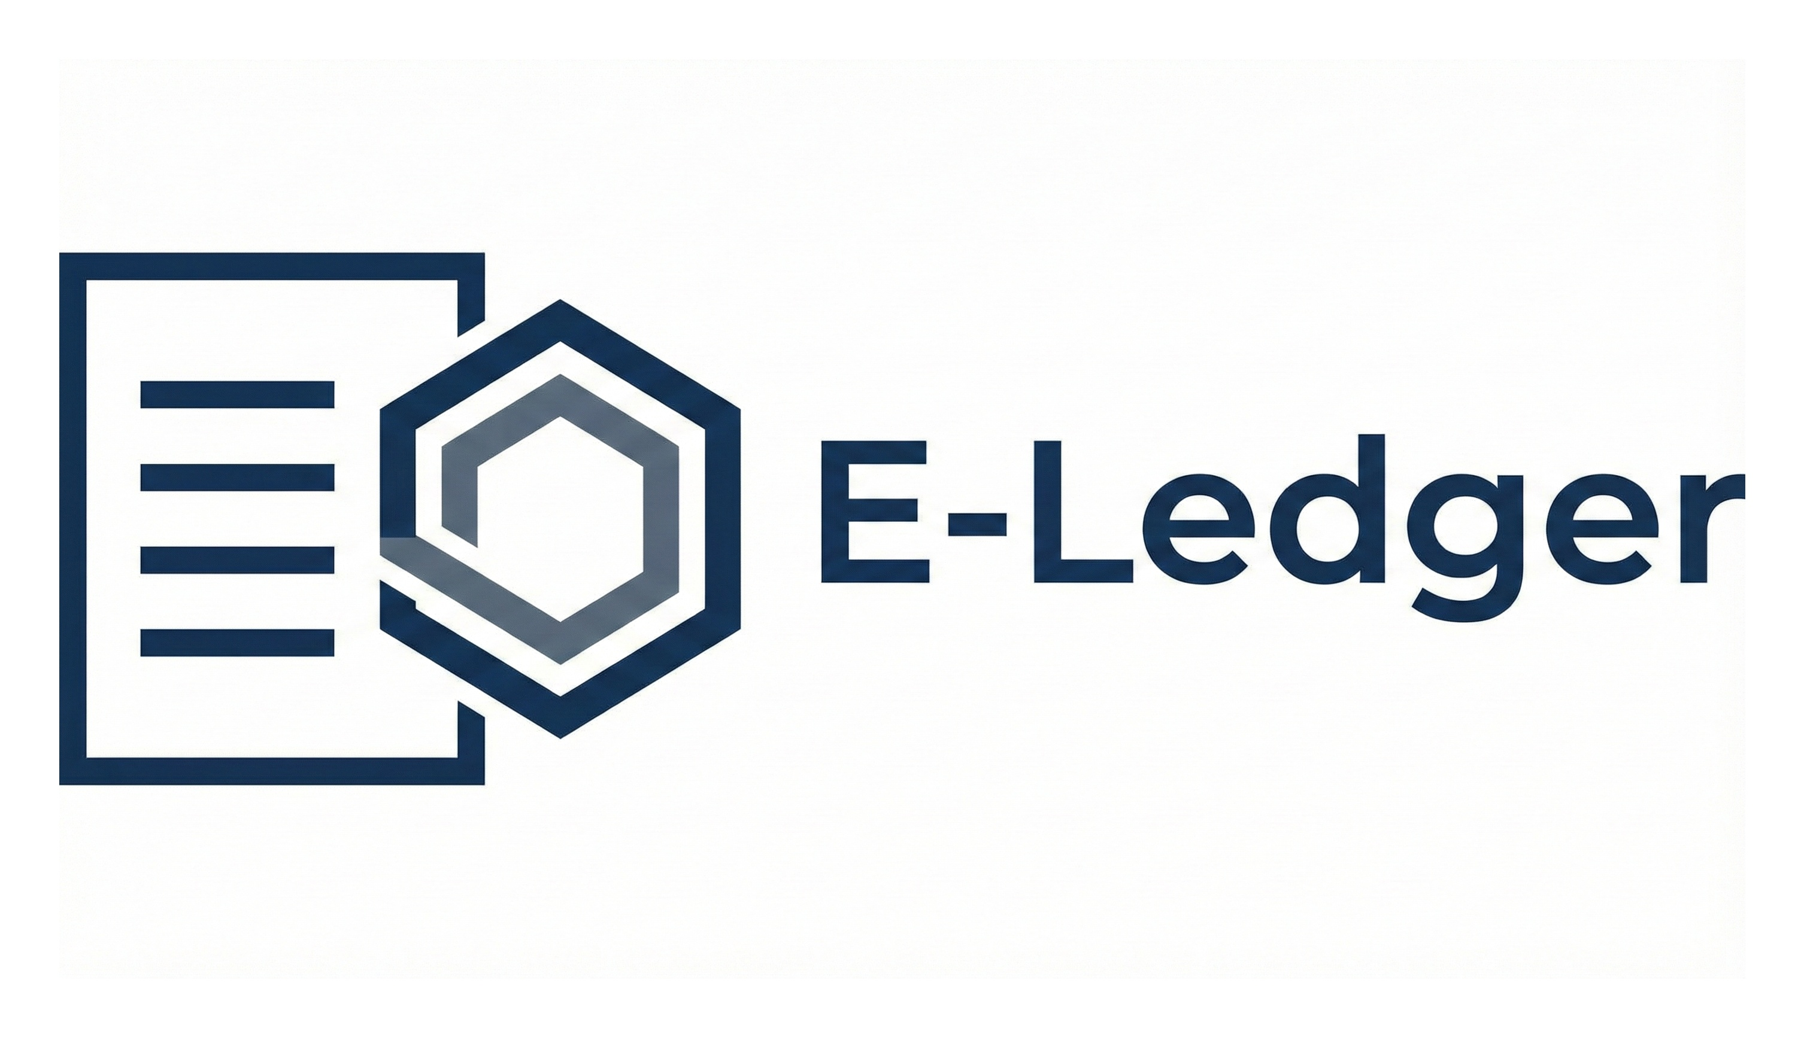
E-Ledger: Dedicated Blockchain Infrastructure for Supply Chain & Governance Transparency
“E M P O W E R I N G S C A L A B L E , S E C U R E ,
S U S T A I N A B L E W E B 3 I N F R A S T R U C T U R E ”

Slide 2
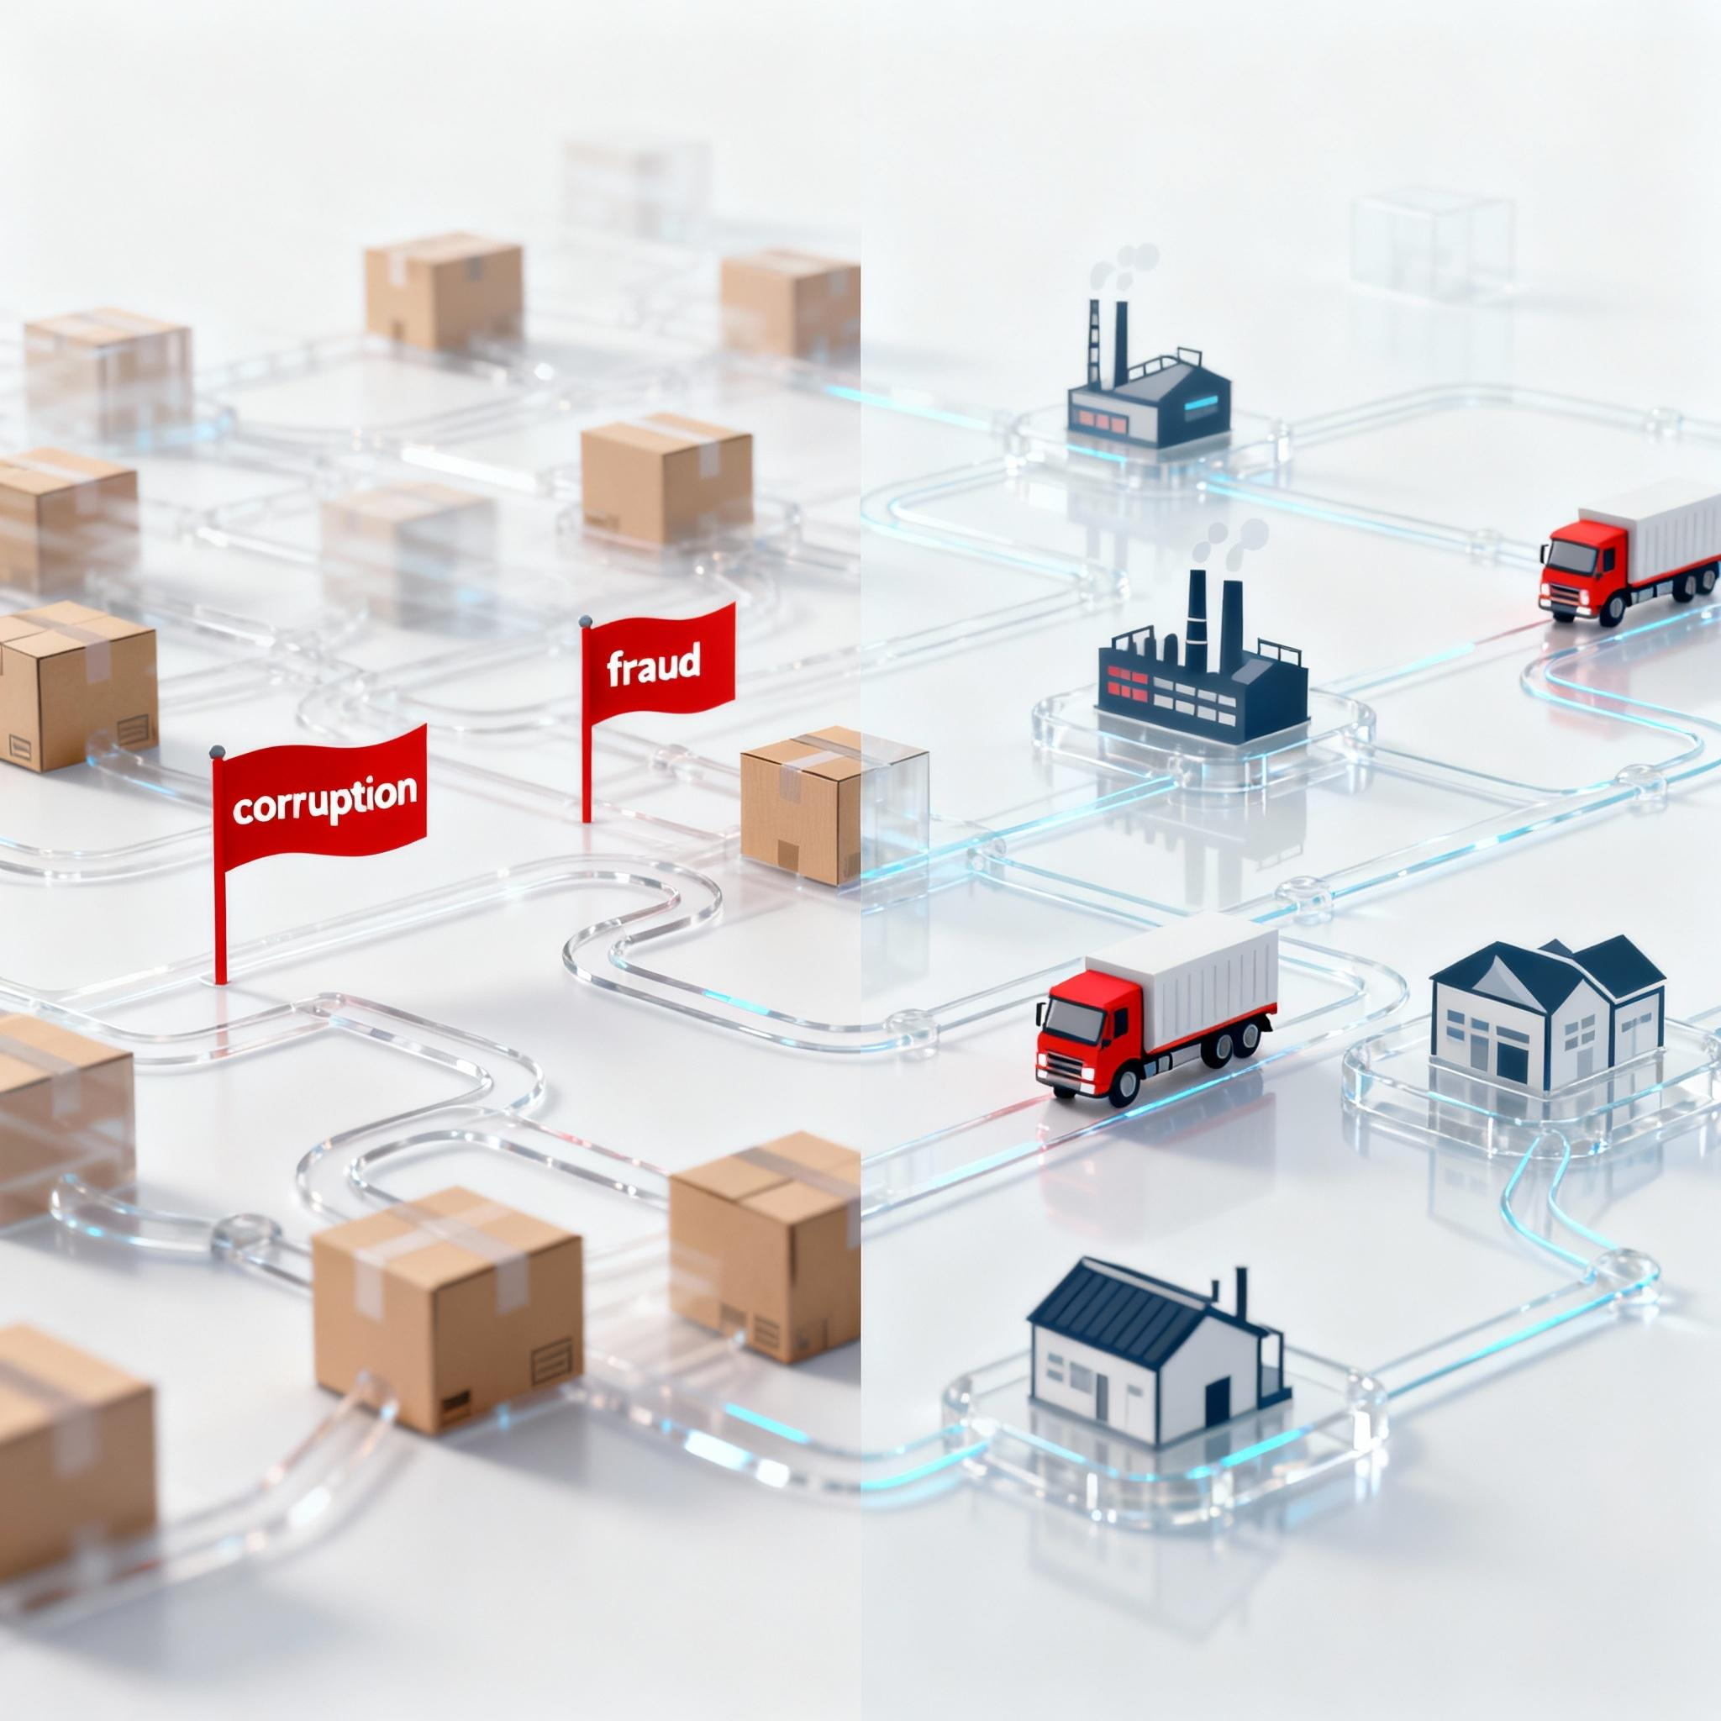
Problem:
Supply chains today suffer from lack of transparency, fraud, and inefficiency.
Governments and enterprises struggle with data tampering, corruption, and inconsistent tracking.
Stakeholders lack real-time visibility into goods movement, compliance, and authenticity.
“Every stage from production to delivery has blind spots and that’s where corruption and losses begin.”

Slide 3
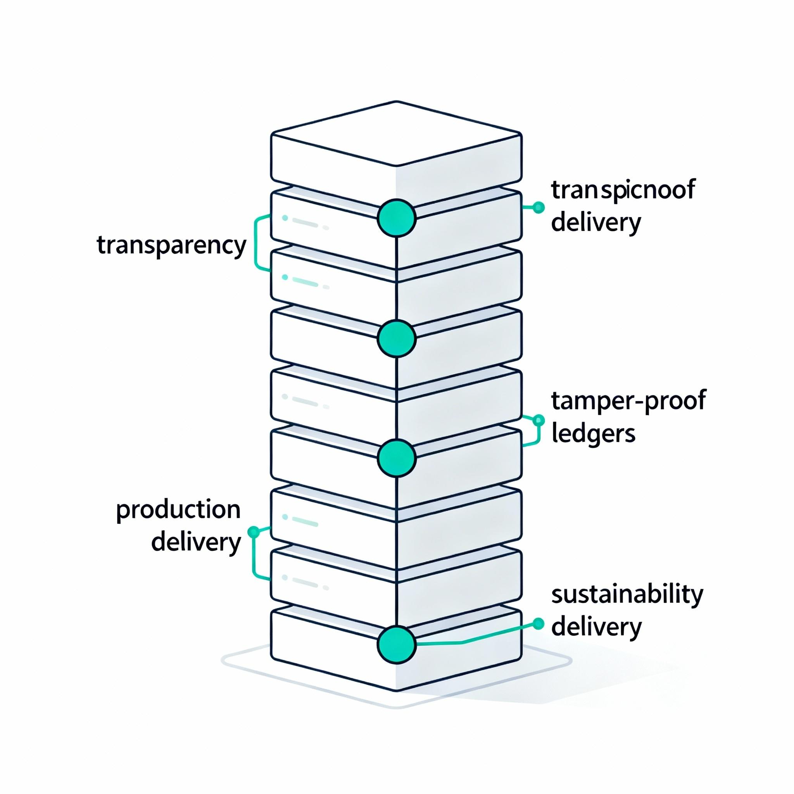
Solution:
Blockchain-based ledgers that provides transparent, tamper-proof, and sustainable solutions for supply chain management and governance systems – Astryx.
Key Features:
Immutable record of every transaction and process
Smart contracts for automatic verification and compliance
Real-time tracking and analytics dashboard
Integration with IoT and AI for predictive insights

Slide 4

Product architecture:
Standalone chains for Pharma, Excise, Agri, Mining, Governance. Each chain is independent but follows Astryx Core standards for security, audit, and compliance.
Dedicated permissioned blockchains for each sector.
Independent, tamper-proof, sustainable networks.
Custom-built for regulatory and operational needs.

Slide 5
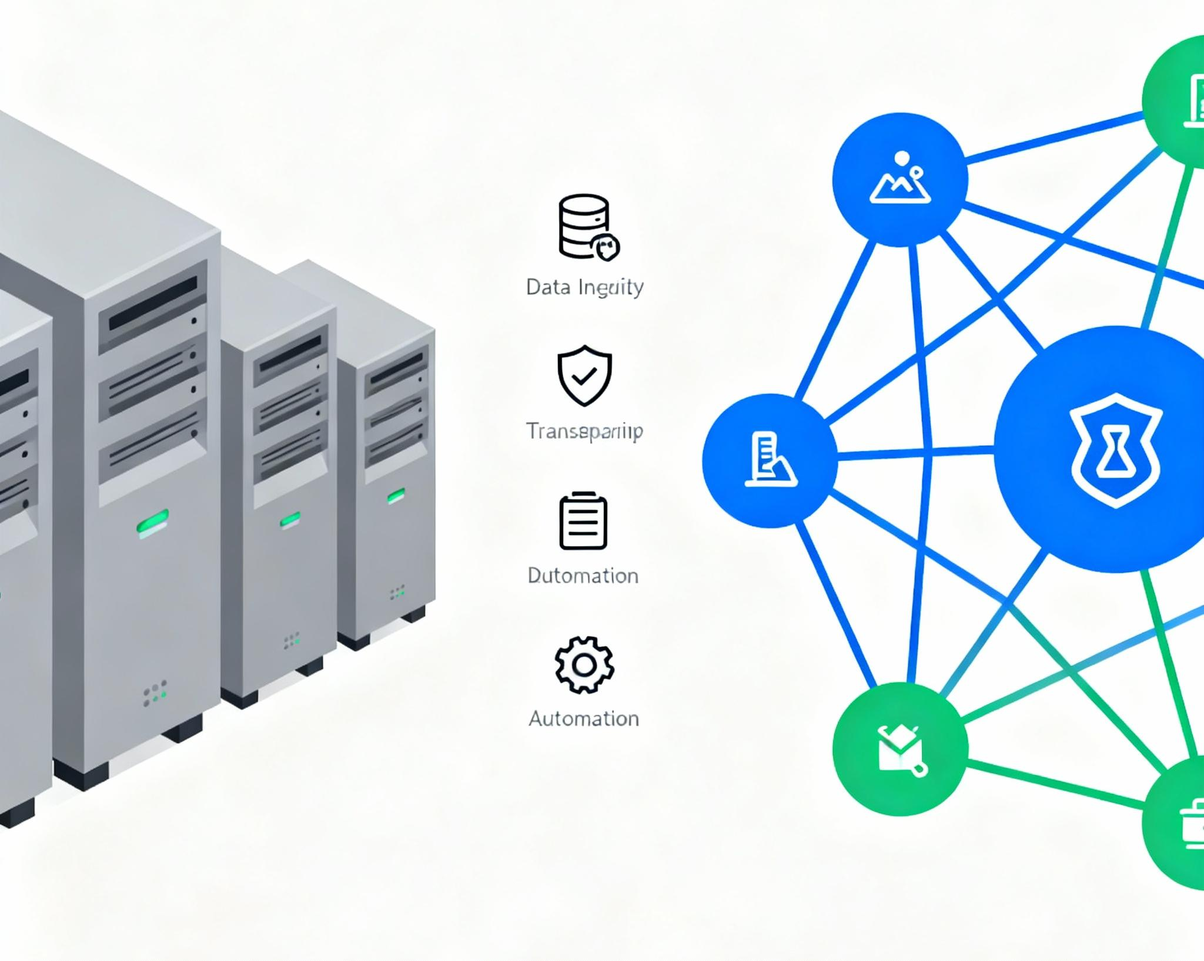
Why WEB3 :
Data Integrity: Immutable vs alterable records
Transparency: Shared ledger vs siloed data
Decentralization: No single point of failure vs centralized servers
Smart Contracts: Automated compliance vs manual approvals
Collaboration: Secure permissioned access vs insecure sharing
Audit: Real-time immutable vs slow manual audits

Slide 6
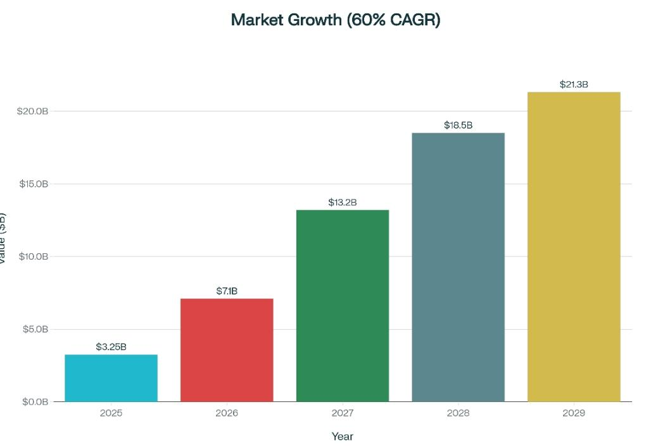
Market opportunity:
Blockchain in SCM worth $3.25B in 2025, expected to hit $21.3B by 2029 (CAGR 59.8%)
Target Sectors:
Agriculture & Food Supply
Mining & Natural Resources
Healthcare & Pharmaceuticals
Government Procurement ( excise)

Slide 7
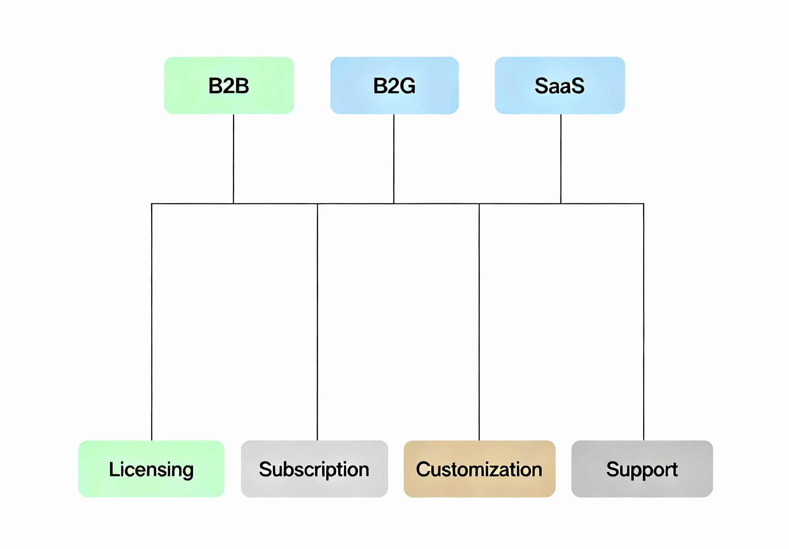
Business model:
QB2B + B2G SaaS & Licensing Model
Revenue Streams:
Subscription plans for enterprises
Licensing for government departments
Blockchain setup & customization fees
Long-term support, audit & training packages
Each blockchain project functions as a separate revenue vertical ensuring steady, diversified income growth.

Slide 8
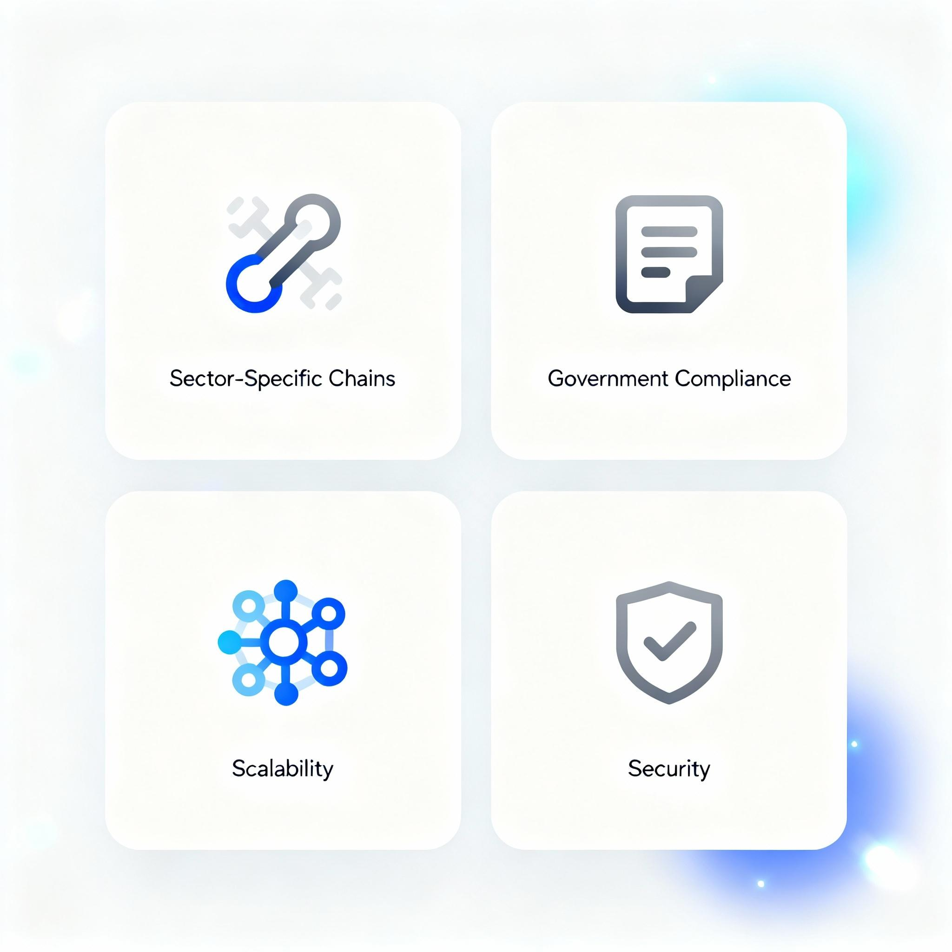
Competitive advantage:
Sector-specific independent chains
Full compliance control
Government-ready infrastructure
Scalable and sustainable

Slide 9
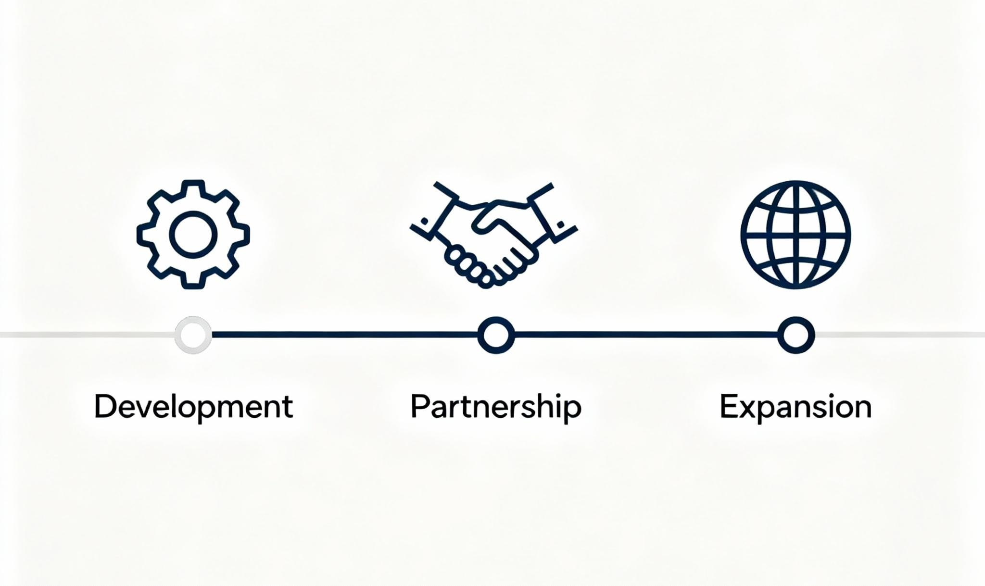
Roadmap:
Q4 2025: Prototype development and pilot (Agriculture or Pharma or excise)
Q1 2026: MVP + MoUs with at least 2 government departments
Q3 2026: Commercial rollout and strategic partnerships
2027: Expansion to international governance systems

Slide 10
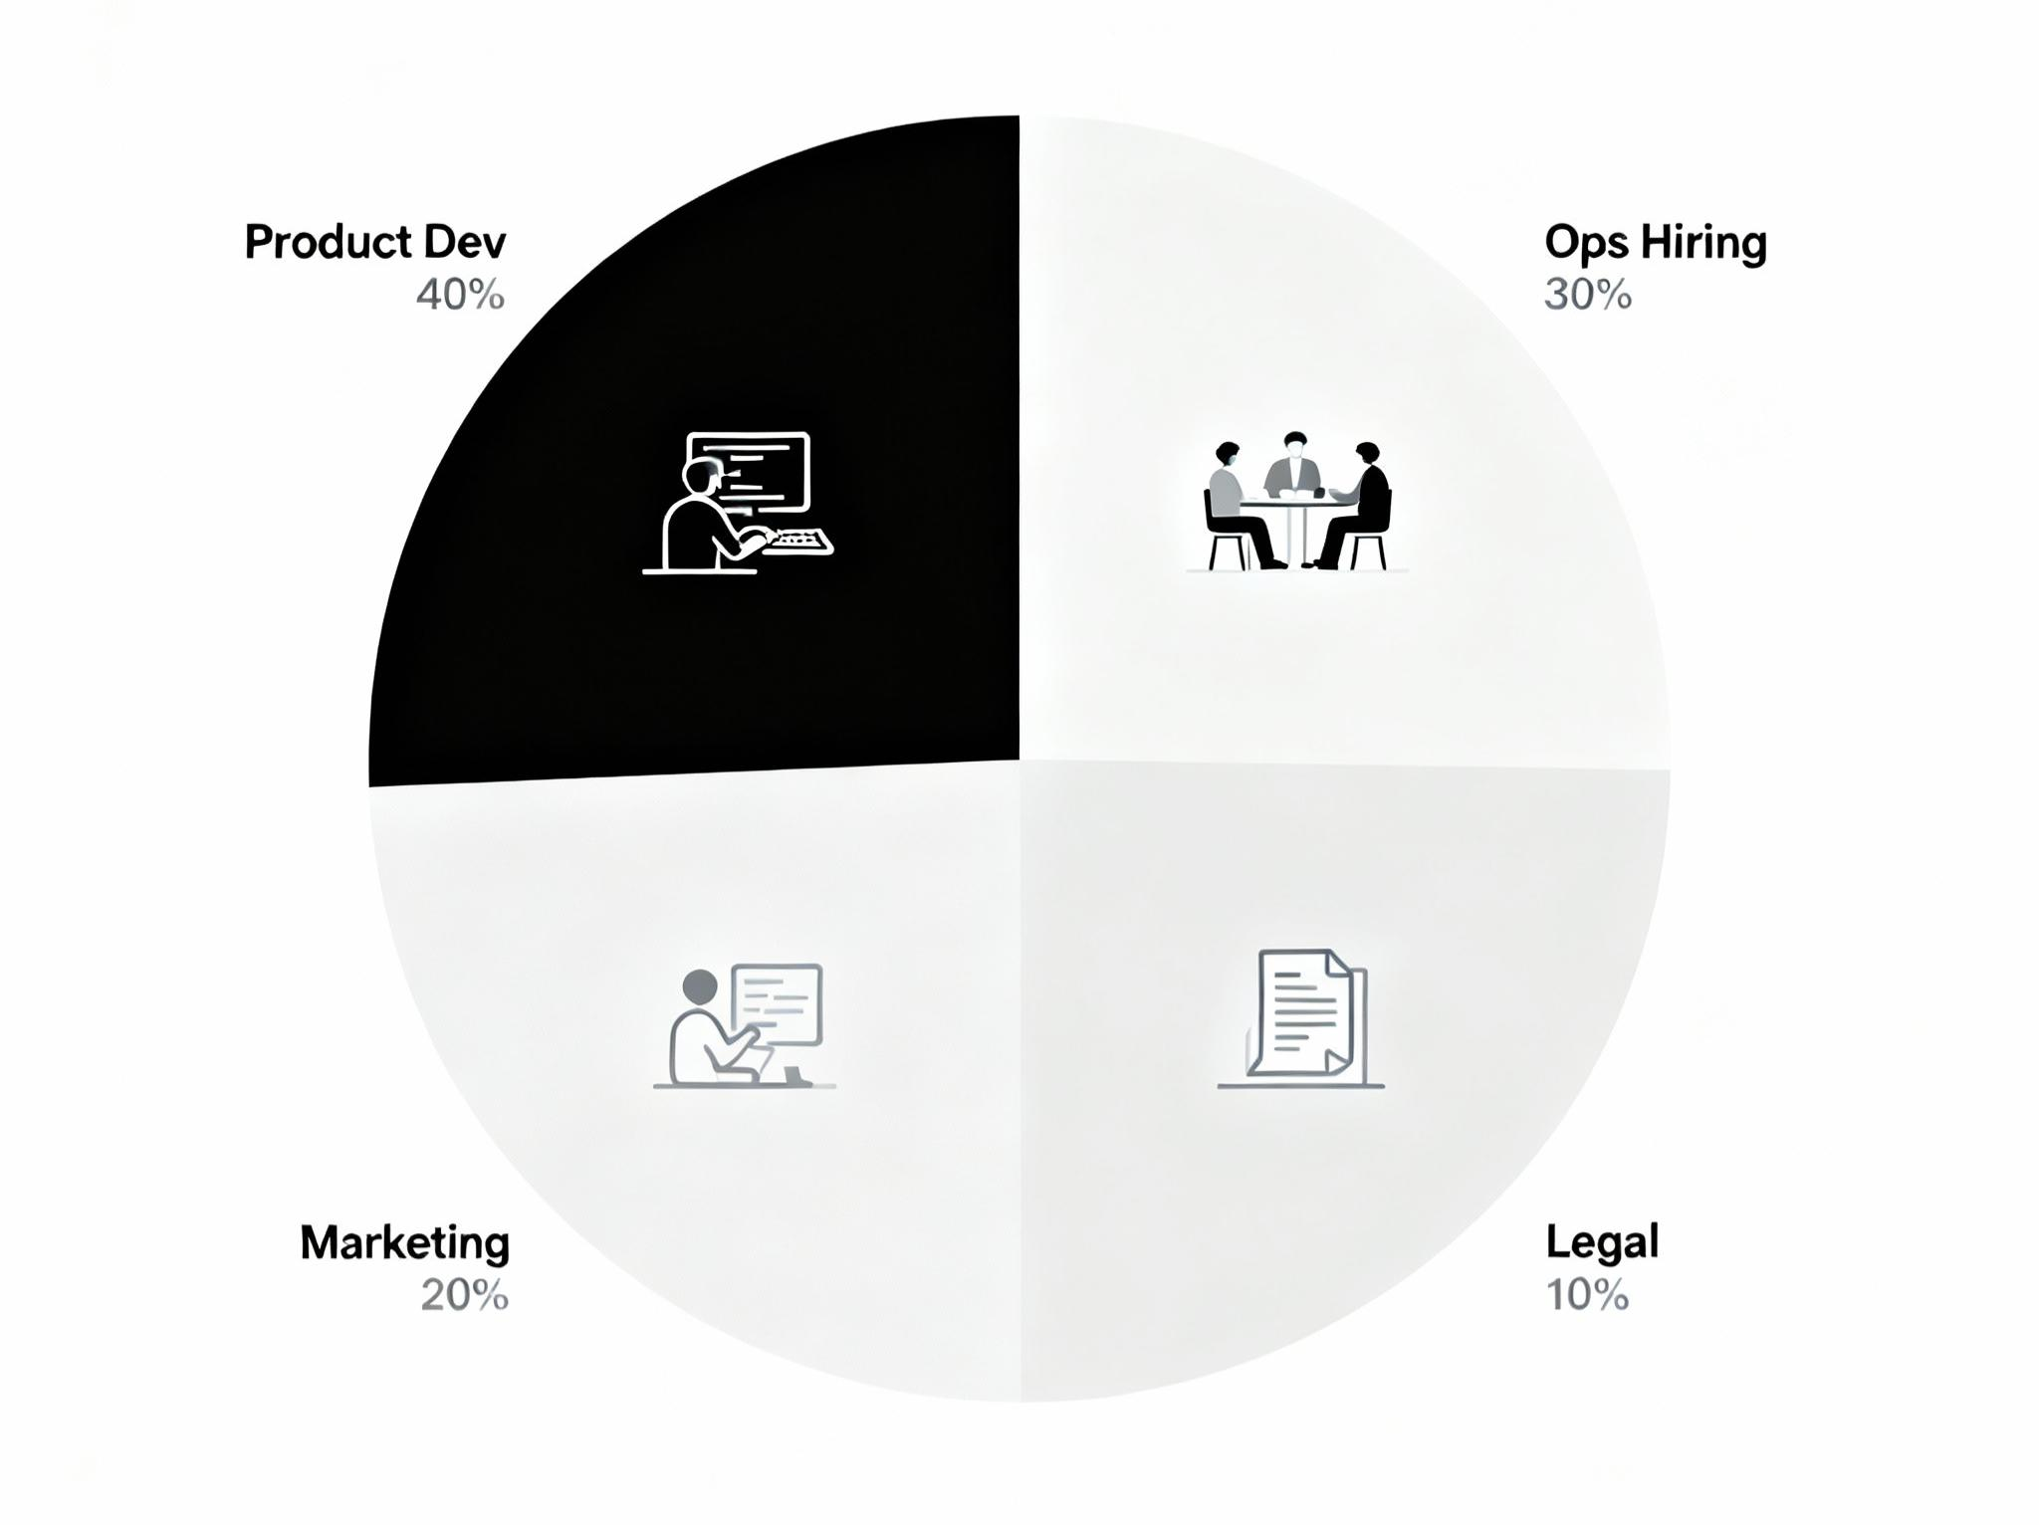
Funding Requirements:
Raising: $100,000
Use of Funds:
- 40% Product Development (Core + first two sectoral chains)
- 30% Operations & Hiring
- 20% Marketing & Partnerships
- 10% Legal & Compliance

Slide 11
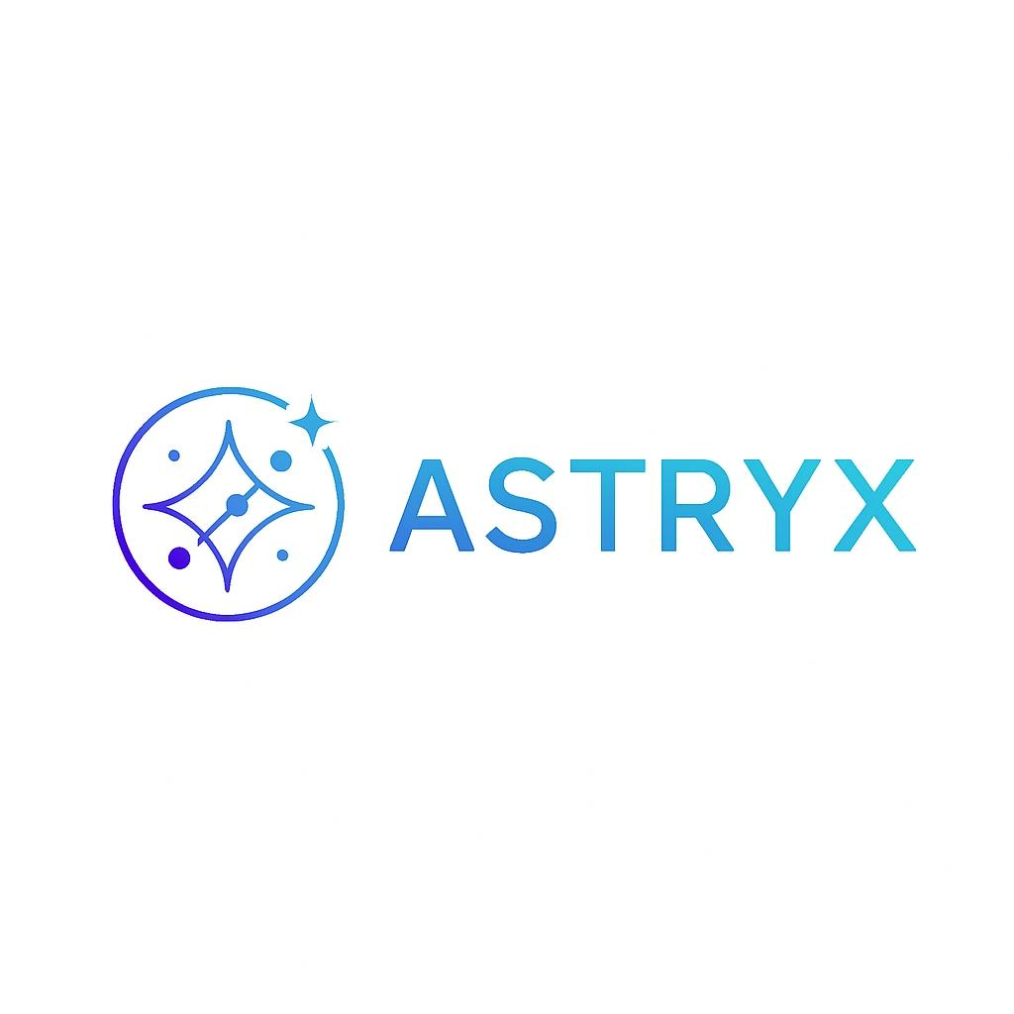
“We are building the infrastructure for trust, one industry at a time.”
            - Thank you
Contact info: astryx.web3@gmail.com, query.rv@gmail.com

