Slide 1



Cross-Validation for training and testing co-occurrence network inference algorithms
Daniel Agyapong
da2343@nau.edu
PhD student
Dr. Toby Hocking
Toby.Hocking@nau.edu
Machine Learning Director

Slide 2

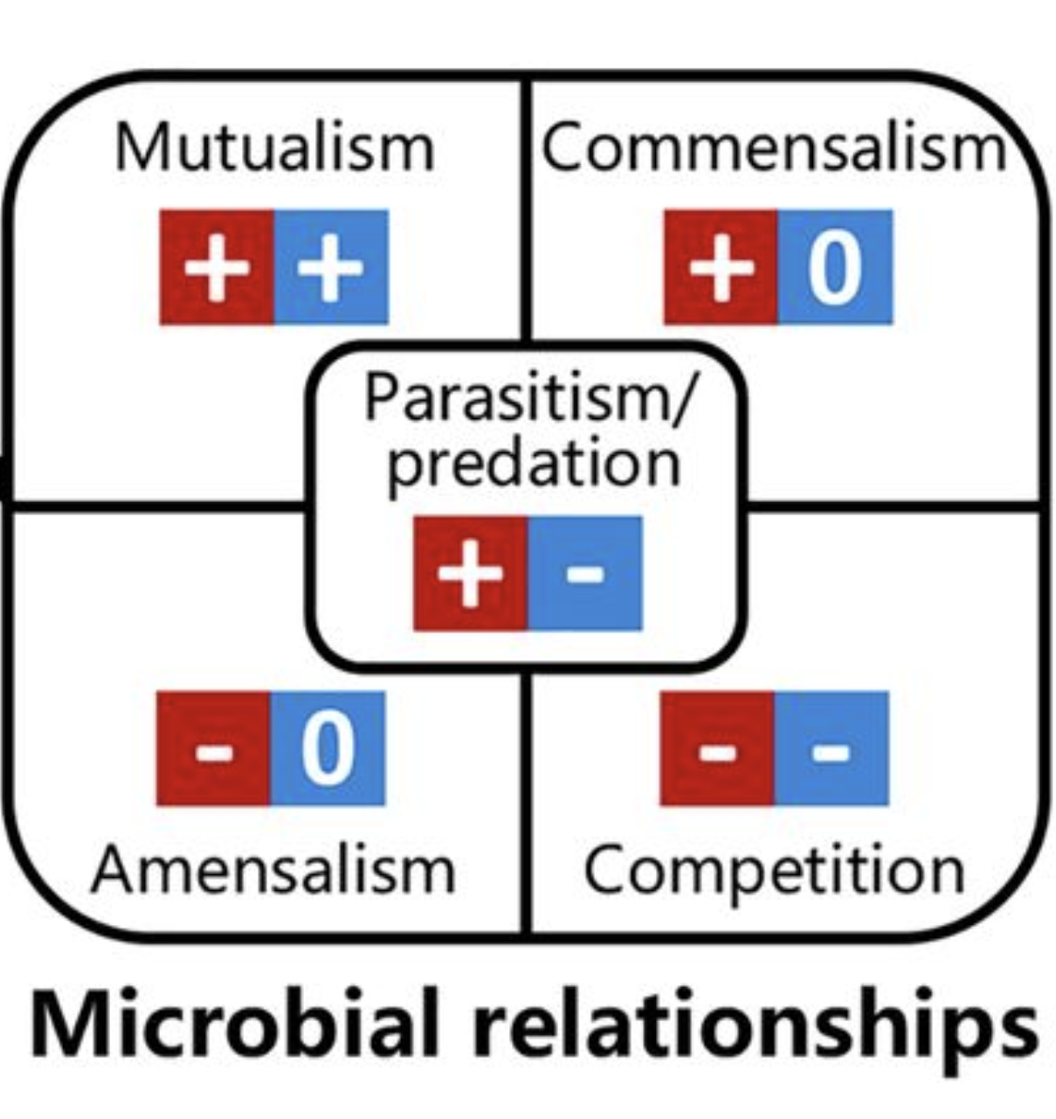
INTRODUCTION
Most state-of-the-art methods focus on inferring positive and negative associations between bacteria.
Reconstructing microbial networks to represent these interactions would help to understand the complex behaviors in microbial communities.
Source: https://journals.asm.org/doi/10.1128/mSystems.00124-19

Slide 3
Real Microbiome Abundance Data
Data | Citation | Samples | Taxa
amgut1 | https://journals.plos.org/ploscompbiol/article?id=10.1371/journal.pcbi.1004226 | 289 | 127
amgut2 |  | 296 | 138
hmp216S | https://ibdmdb.org/tunnel/public/summary.html | 47 | 45
hmp2prot |  | 47 | 43
enterotype | https://journals.plos.org/plosone/article?id=10.1371/journal.pone.0061217 | 280 | 553
esophagus |  | 3 | 58
crohns | https://www.mcgill.ca/statisticalgenetics/software | 100 | 5
Baxter_CRC | http://www.raeslab.org/companion/ocean-interactome.html | 490 | 117
glne007 |  | 490 | 338
iOraldat | https://bmcbioinformatics.biomedcentral.com/articles/10.1186/s12859-020-03911-w | 86 | 63
Each data set is a matrix of counts, for example:
Taxa
0 15 761
4 0 98
53 74 0
0 32 0
11 0 0
0 24 65
Samples

Slide 4
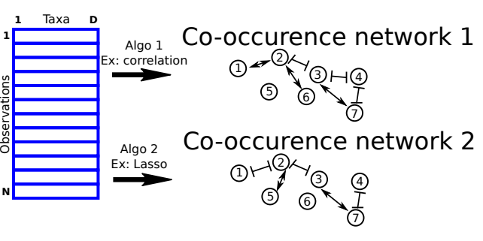
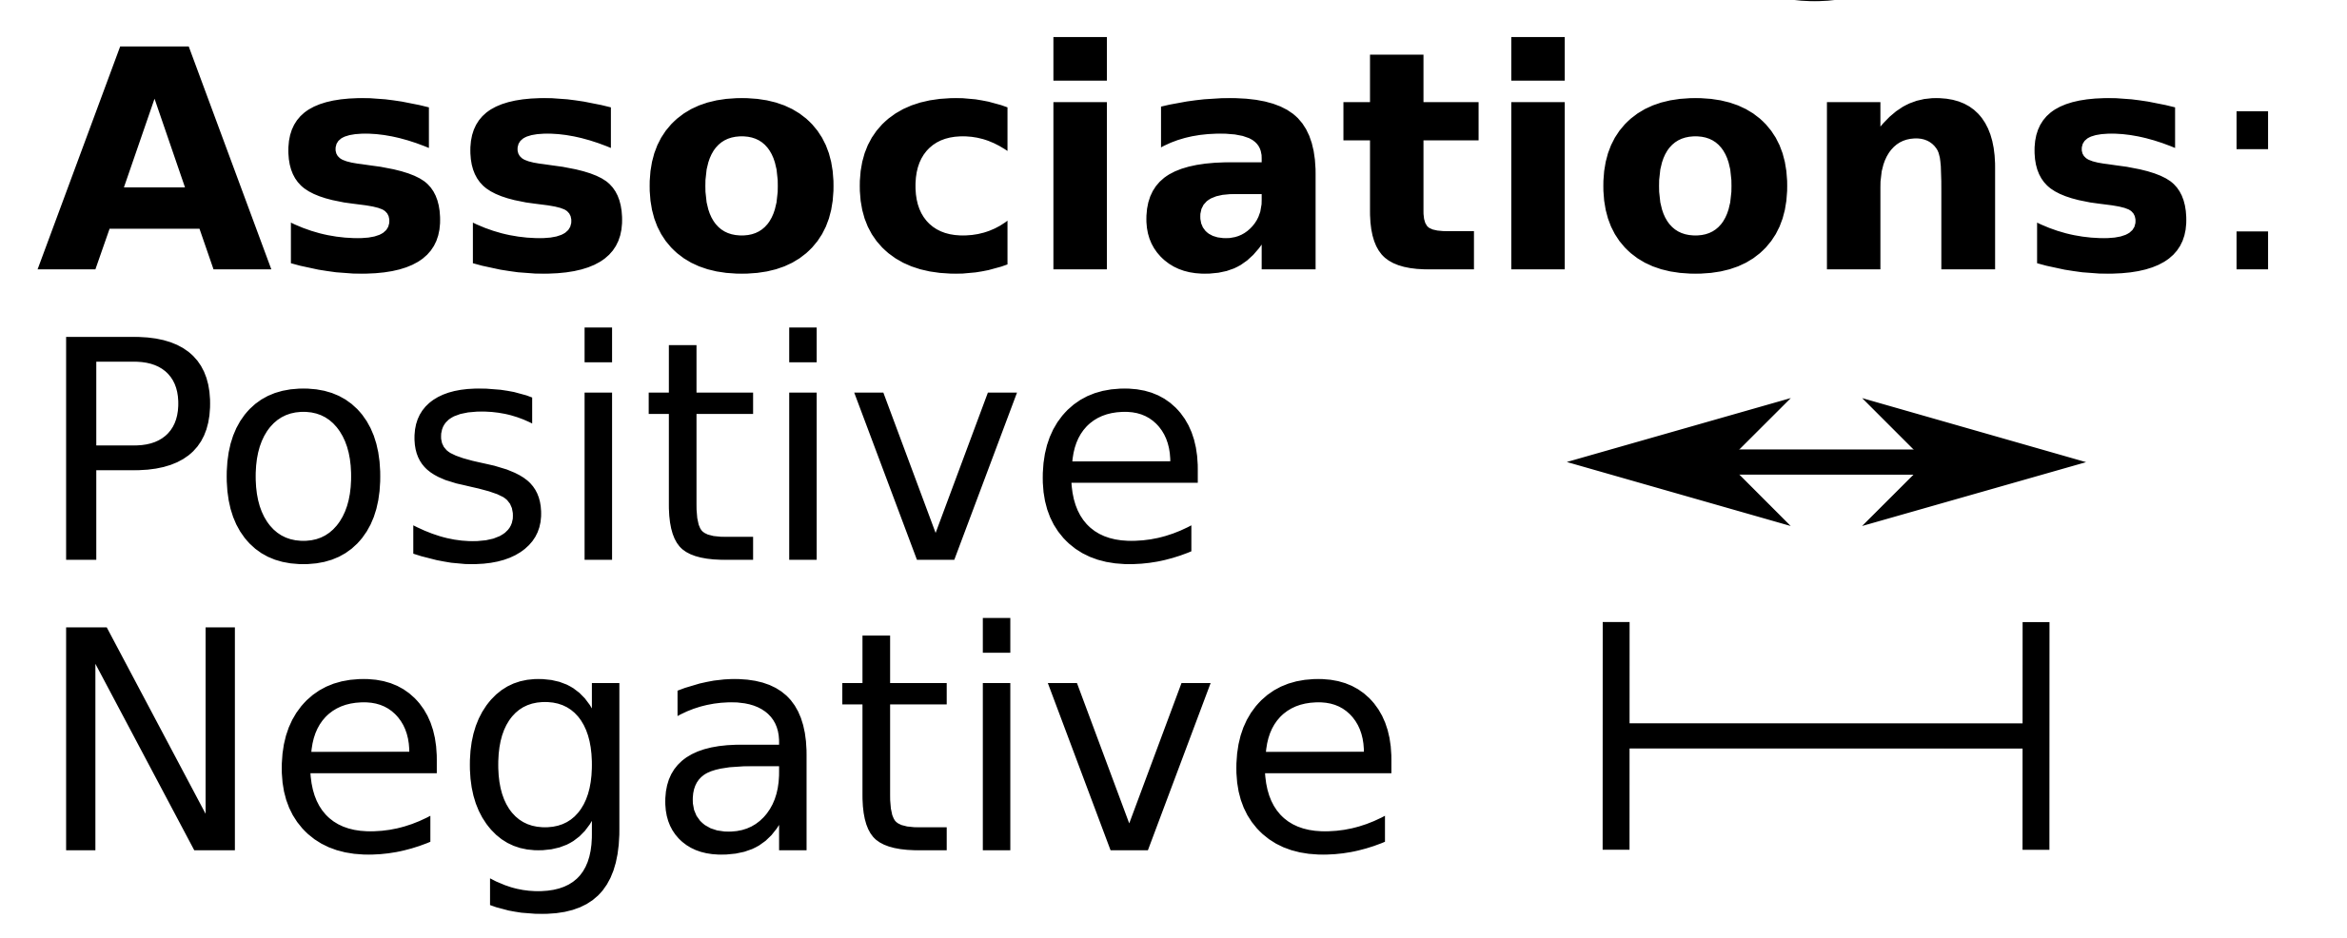
Different algorithms infer different
co-occurence networks
Which is a more accurate interpretation for these data?

Slide 5
Research Questions
For some particular real data sets:
How can we automatically learn hyper-parameters? (let the data tell us the “best” threshold, rather than choosing arbitrarily)
Which of the available microbial network analysis algorithms is most accurate and gives least test error ?
How many samples are needed for Cross Validation to be useful.

Slide 6
What are some of the Existing Algorithms?
There are a lot of existing algorithms, each with various
hyper-parameters which determine the sparsity
(number of edges) in network.
Pearson/Spearman Correlation
Threshold on correlation constant
Least Absolute Shrinkage and Selection Operator (LASSO)
Degree of L1 regularization
Gaussian Graphical Model (GGM)
Inverse Covariance (Precision) Matrix

Slide 7
Existing Evaluation Types
Category of Evaluation Type | External Data | Sub-Sample Analysis
Methods | SparCC, REBACCA, SPIEC-EASI, gCoda, COZINE, HARMONIES, mLDM | CClasso
Issues | Lack of generalizability Lack of ground truth Biases in external data | Sensitivity to the choice of subsampling parameters Limited scope

Slide 8
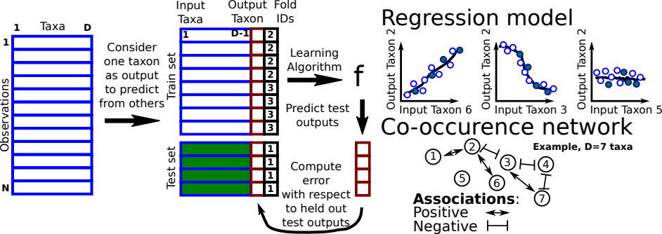
Proposal: Cross-validation for training and testing co-occurrence network inference algorithms
Repeat for each output taxon and Fold ID

Slide 9
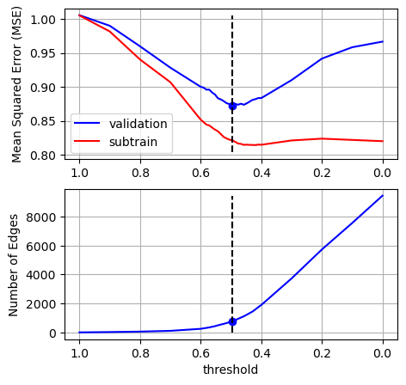
Results: Training the Pearson correlation threshold using cross-validation
Subtrain error decreases as the model complexity increases whilst the validation error shows a U shape.
We select the threshold which gives the minimum validation error, in this example r2=0.5 (Best number of edges = 785).

Slide 10
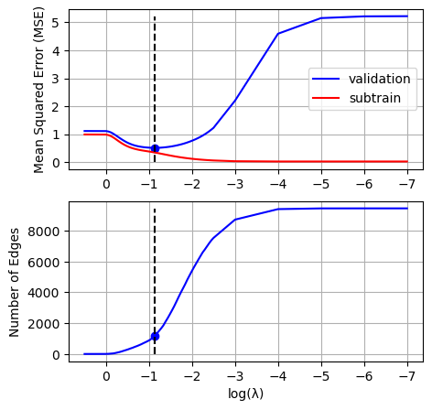
Results: Training the Lasso algorithm with cross-validation
Train set split into subtrain set (used to learn regression coefficients) and validation set (used to learn model complexity, degree of L1 regularization, which controls sparsity / number of edges in co-occurence network).
The lamda value (degree of L1 regularization) which has the minimimum the validation error corresponds to 1176 edges.

Slide 11
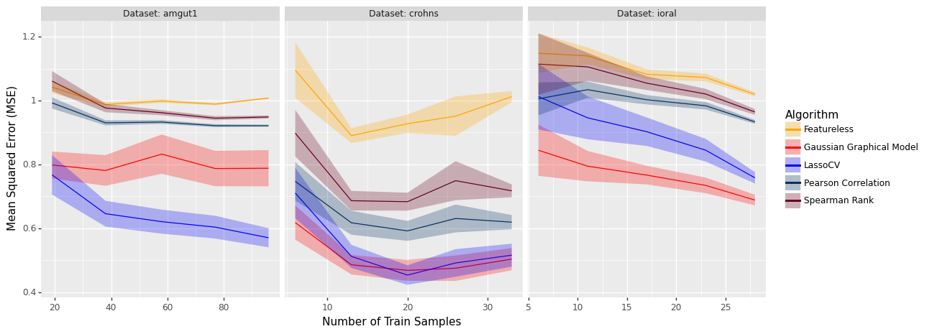
Results: Algorithms can be compared using test error

Slide 12
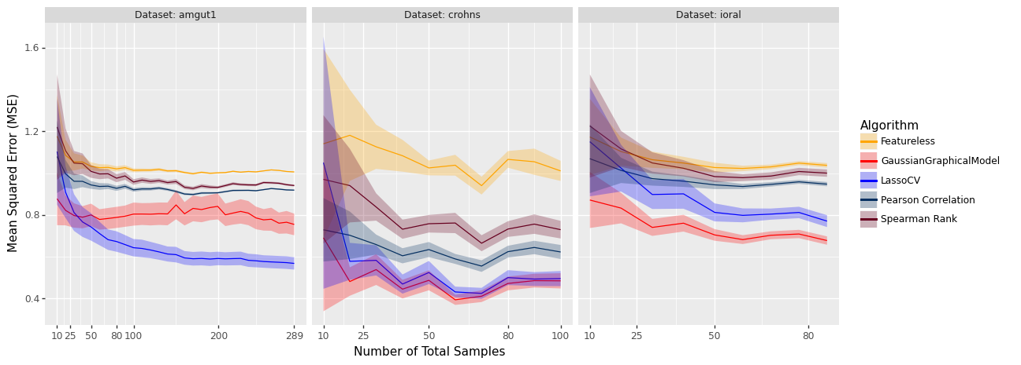
Results: How many samples are needed for CV to be useful

Slide 13
REFERENCES
https://www.liebertpub.com/doi/10.1089/cmb.2021.0406
https://smnh.tau.ac.il/en/interactions-among-living-organisms/
https://scikit-learn.org/stable/modules/cross_validation.html
https://www.ncbi.nlm.nih.gov/pmc/articles/PMC7768662/
https://journals.plos.org/ploscompbiol/article?id=10.1371/journal.pcbi.1004226
https://www.sciencedaily.com/releases/2018/05/180515092931.htm
Contact: da2343@nau.edu
Reproducibility: https://github.com/EngineerDanny/CS685-Microbe-Network-Research

Slide 14
ANY QUESTIONS?
THANK YOU

