Slide 1



Network Analysis Methods for studying microbial communities
Daniel Agyapong
da2343@nau.edu
PhD student
Dr. Toby Hocking
Toby.Hocking@nau.edu
Machine Learning Director

Slide 2
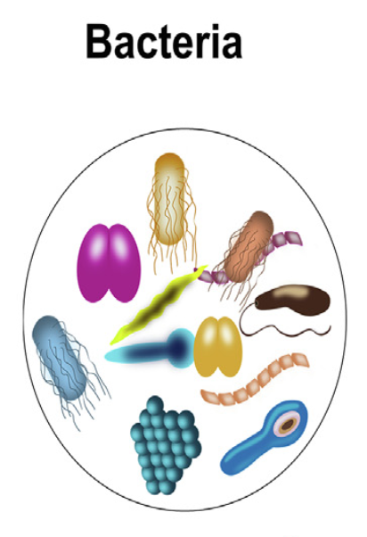
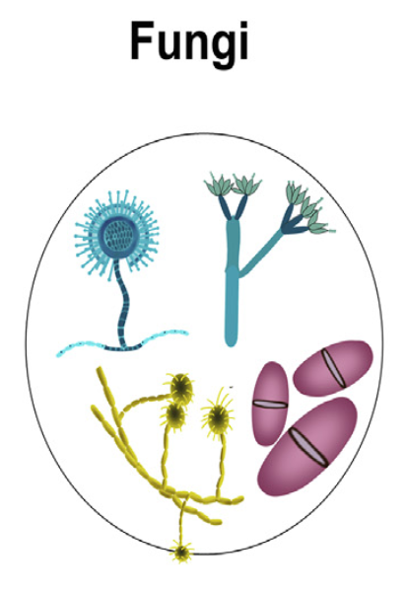
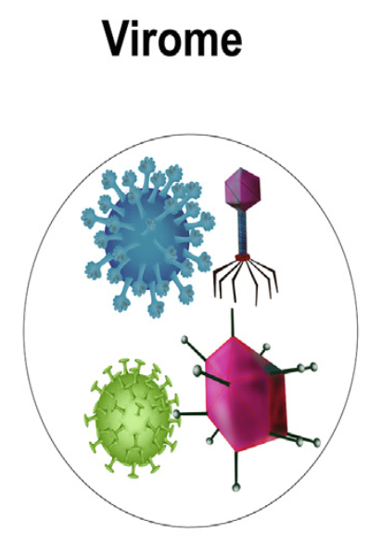
INTRODUCTION
Microbial communities consist of micro-organisms such as bacteria, virus and fungi.
Micro-organisms have built robust ecosystems in various environments such as soil, sea water and various human organs.
Microbiome has been associated with conditions such as obesity, colorectal cancer and inflammatory bowel disease.
Understanding microbial interactions and relationships may provide great insights in restoring a healthy microbial community.

Slide 3
INTRODUCTION
Studies have revealed several cases of complex dynamics such as interactions between micro-organisms and their effects on the host.
Network-based analytical approaches have helped in the study of systems with complex microbial interactions.
Two of the most popular methods for determining microbial interactions are the Pearson Correlation method and the Least Absolute Shrinkage and Selection Operator (LASSO) method.

Slide 4
Real Microbiome Composition Datasets
Data | Citation | No of Samples | No of Taxa
amgut1 | https://journals.plos.org/ploscompbiol/article?id=10.1371/journal.pcbi.1004226 | 289 | 127
amgut2 |  | 296 | 138
hmp216S | https://ibdmdb.org/tunnel/public/summary.html | 47 | 45
hmp2prot |  | 47 | 43
enterotype | https://journals.plos.org/plosone/article?id=10.1371/journal.pone.0061217 | 280 | 553
esophagus |  | 3 | 58
crohns | https://www.mcgill.ca/statisticalgenetics/software | 100 | 5
Baxter_CRC | http://www.raeslab.org/companion/ocean-interactome.html | 490 | 117
glne007 |  | 490 | 338
iOraldat | https://bmcbioinformatics.biomedcentral.com/articles/10.1186/s12859-020-03911-w | 86 | 63

Slide 5
RESEARCH QUESTION
Which of the available microbial network analysis methods is most accurate and gives least error when applied to a particular existing real dataset ?

Slide 6
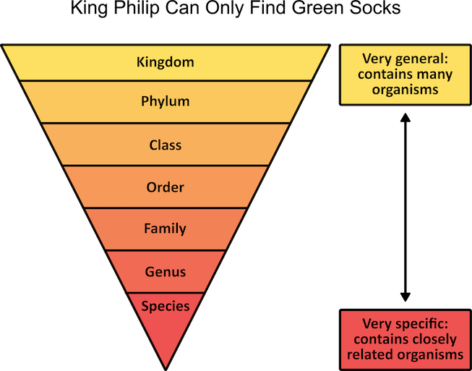
BACKGROUND
Animal Example | Taxonomic Rank | Bacteria Example
Animalia | Kingdom | Bacteria
Chordata | Phylum | Proteobacteria
Mammalia | Class | Gamma proteobacteria
Primate | Order | Vibrionales
Hominidae | Family | Vibrionaceae
Homo | Genus | Vibrio
sapiens | Species | Vibrio Cholerae
Human | Common Name | Vibrio Cholerae
Ref: https://www.mometrix.com/academy/biological-classification-system

Slide 7
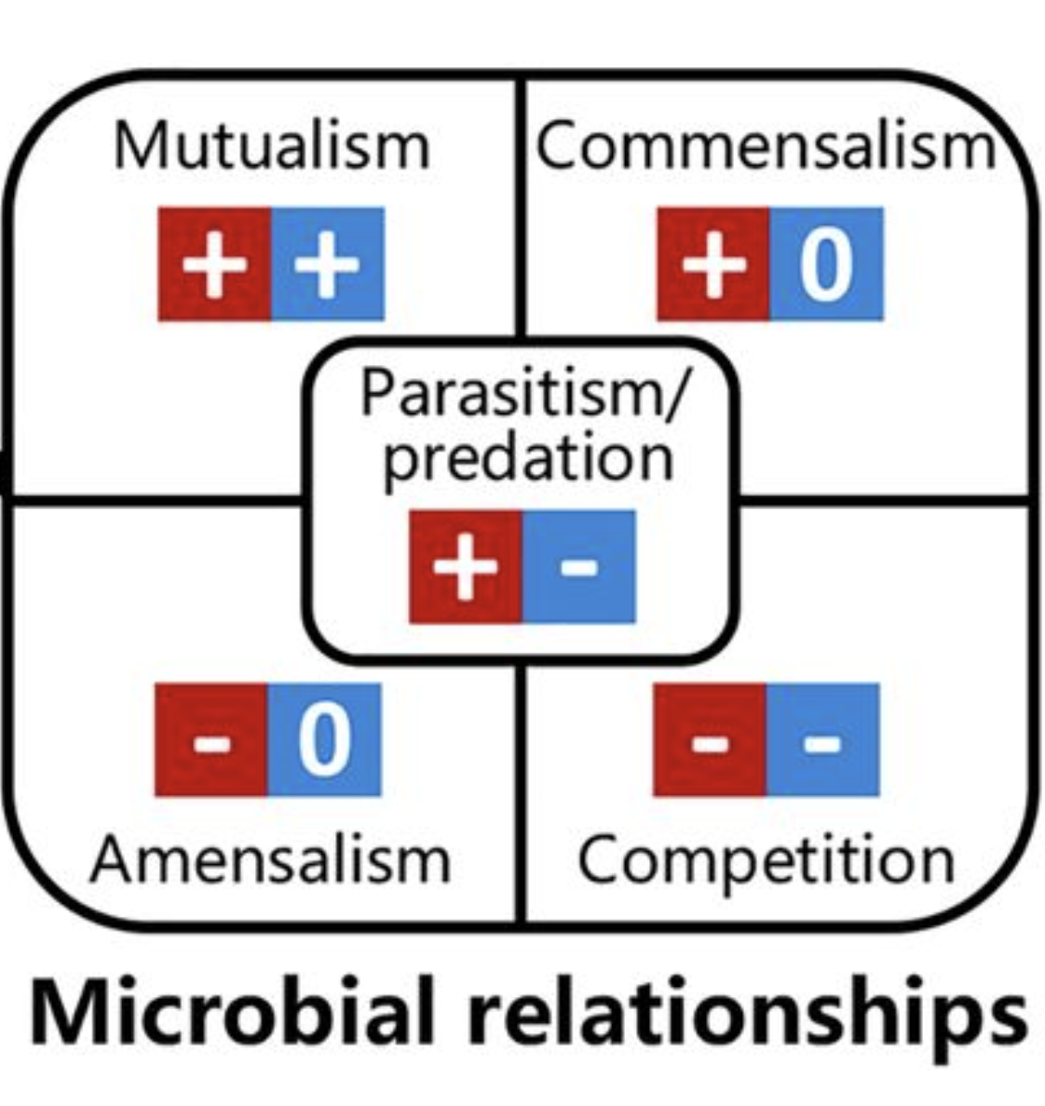
BACKGROUND
Micro-organisms form complex ecological interactions :
Mutualism: Both parties benefit. Mutual cross-feeding.
Parasitism/Predation: One side benefits whilst the other side loses. Relationships such as predator-prey and host-parasite interactions.
Competition: Both parties lose. When there is insufficient resources for both organisms, they compete for the limited resources.
Commensalism: One organism benefits without harming the other.
Amensalism: One organism is harmed but the other is unaffected.
Reconstructing microbial ecological networks to represent these interactions would help to understand the complex behaviors in microbial communities.

Slide 8
Correlation Based Methods
Method | SparCC (2012) | REBACCA(2015)
Link | https://rdrr.io/github/zdk123/SpiecEasi/man/sparcc.html | https://faculty.wcas.northwestern.edu/hji403/REBACCA.htm
Algorithms Compared | SparCC, Pearson | REBACCA, SparCC, BP, ReBoot
How they compare | Computing the number of true-positives (TP), false-positives (FP), true-negatives (TN) and false-negatives (FN) detected in the Pearson network by treating the SparCC network as the true one. | Consistency of correlated pairs identified independently from the three datasets (A correlated pair of OTUs is consistent between two datasets if the pair has the same signs of correlations in both datasets).
Category of Evaluation Type | External data | External data

Slide 9
LASSO Based Methods
Method | SPIEC-EASI (2015) | CCLasso (2015)
Link | https://journals.plos.org/ploscompbiol/article?id=10.1371/journal.pcbi.1004226#pcbi-1004226-g006 | https://github.com/huayingfang/CCLasso
Algorithms Compared | SPIEC-EASIE, SparCC, CCREPE | CCLasso, SparCC
How they compare | Consistency between two models by computing Hamming Distance (the difference between the upper triangular part of the two adjacency matrices) between reference and new models. | Frobenius Accuracy with respect to estimating correlation matrix from data using half samples (measured by the Frobenius norm distance between the estimated correlation matrices and a reference correlation matrix). Reproducibility (measured by the fraction of the same edges shared for the two steps in the first reference network which only the top 1/4 edges is used)
Category of Evaluation Type | External Data (Amgut Dataset) | Sub-sample analysis

Slide 10
K-FOLD CROSS VALIDATION ALGORITHM
K- fold cross validation algorithm is a technique used to train model parameters and compare prediction accuracy
Learning the parameters of a prediction function and testing it on the same data leads to over-fitting (When a model does very well on testing data but does poorly new or unseen data).
To avoid over-fitting, it is a common practice in Machine Learning to hold out some of the data as the test set.
3-FOLD CROSS VALIDATION
DATASET
FOLDID 0
FOLDID 0
FOLDID 0
FOLDID 0
FOLDID 1
FOLDID 1
FOLDID 1
FOLDID 1
FOLDID 2
FOLDID 2
FOLDID 2
FOLDID 2
LEGEND
Train Dataset
Test Dataset

Slide 11
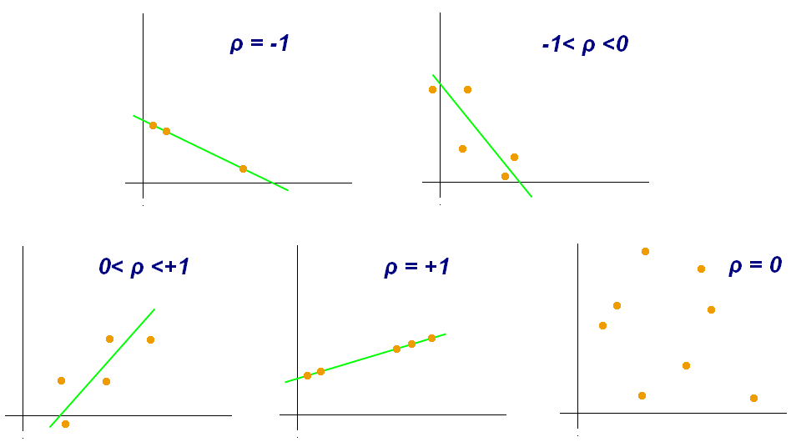
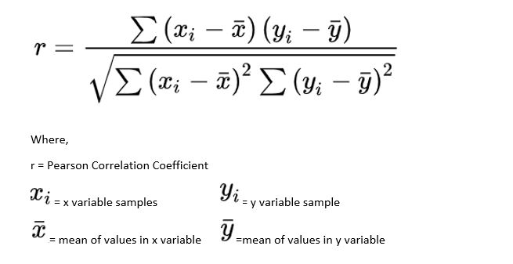
PEARSON CORRELATION MODEL
Pearson’s correlation coefficient is the standard tool to infer a network through correlation analysis among all pairs of OTU (Operational Taxonomic Unit) samples.
It is a number that ranges from –1 to 1 and measures the strength and direction of the relationship between two variables.
Pearson Coefficient Formular :

Slide 12
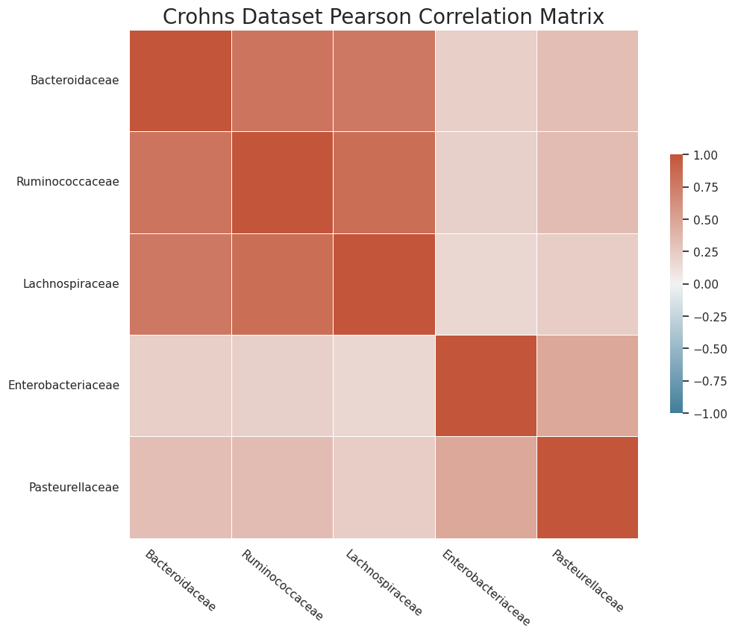
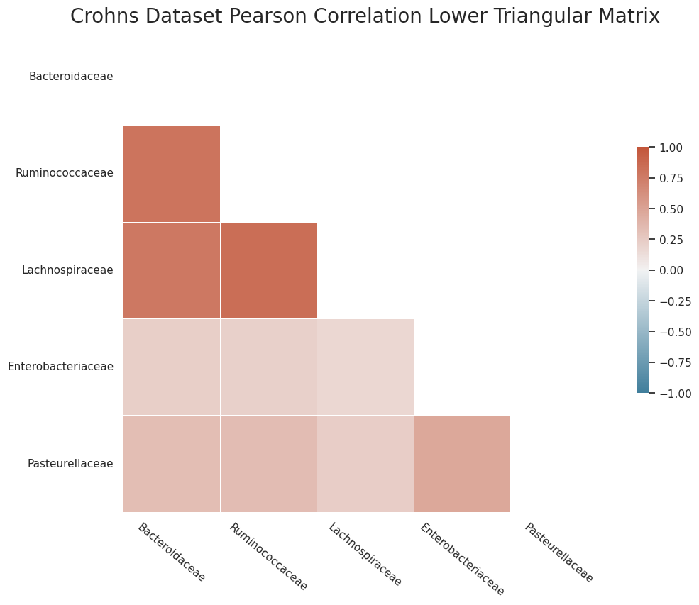
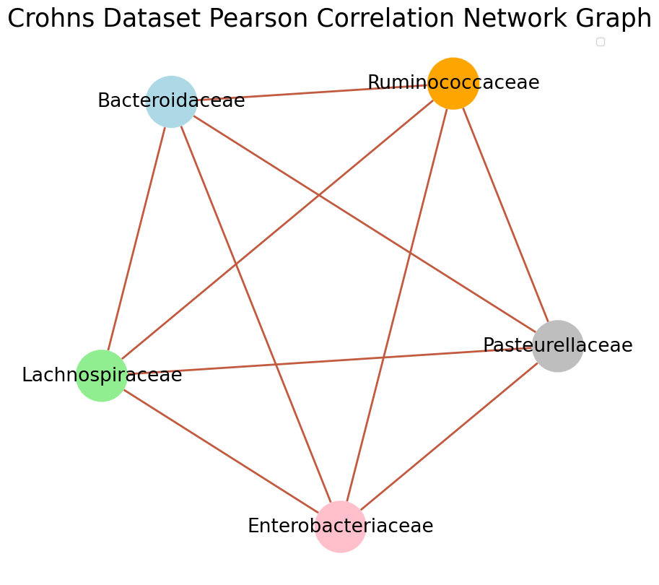
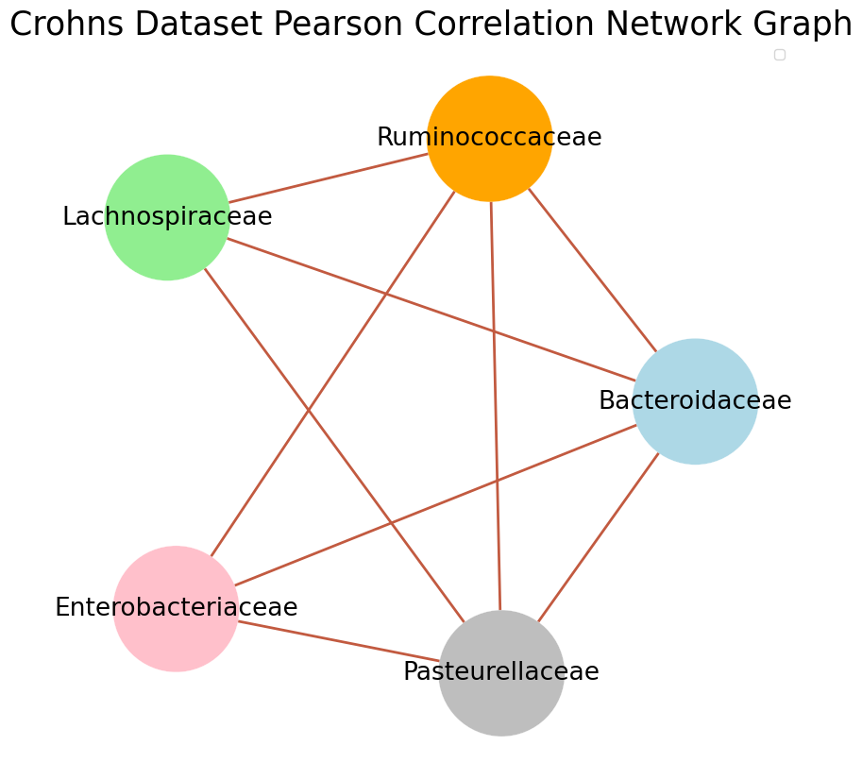
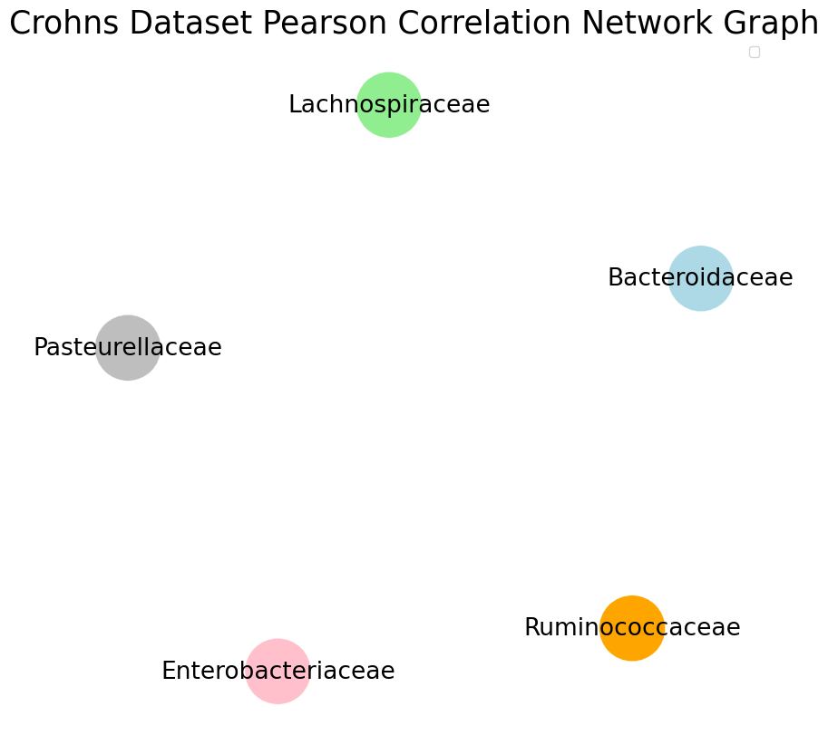
PEARSON CORRELATION MATRIX
NETWORK GRAPH
Threshold = 0
Threshold = 0.2
Threshold = 1

Slide 13
MULTI-COLUMN TEST ERROR FOR PEARSON CORRELATION
Taxa 3 is predicted using Taxa 1 and Taxa 2
Taxa 2 is predicted using Taxa 1 and Taxa 3
Taxa 1 is predicted using Taxa 3 and Taxa 2
TAXA1
TAXA2
TAXA3
TAXA1
TAXA3
TAXA2
TAXA3
TAXA2
TAXA1
The mean of each of the taxa predictions are computed resulting in one big taxa prediction column.
The Mean Squared Error of the prediction with respect to the actual taxa labels is computed.
The average of the Mean Squared Error is noted for each number of samples used.

Slide 14
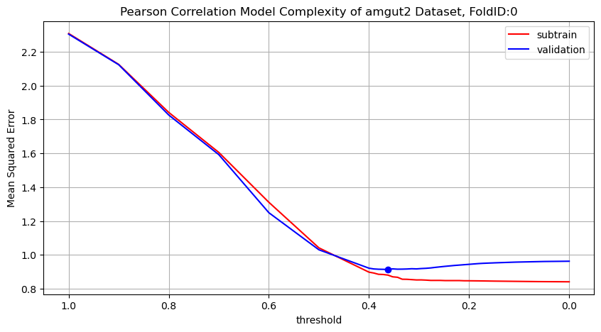
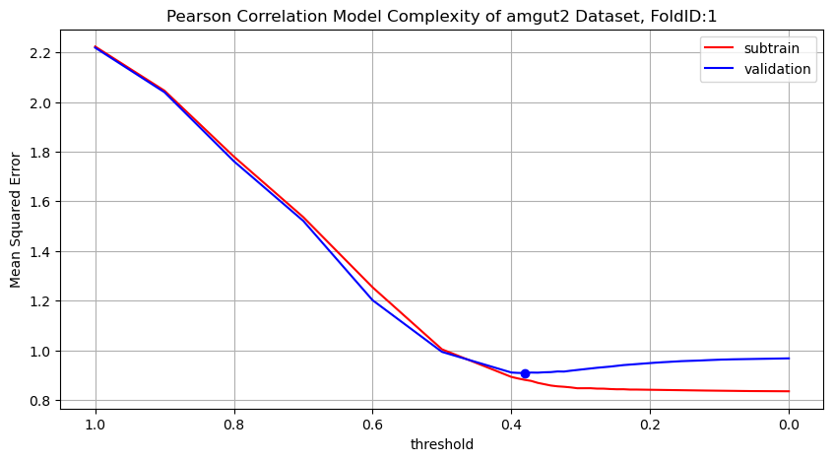
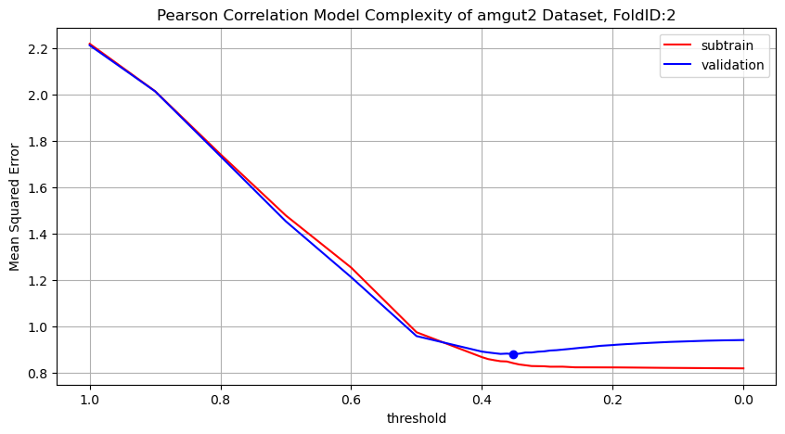
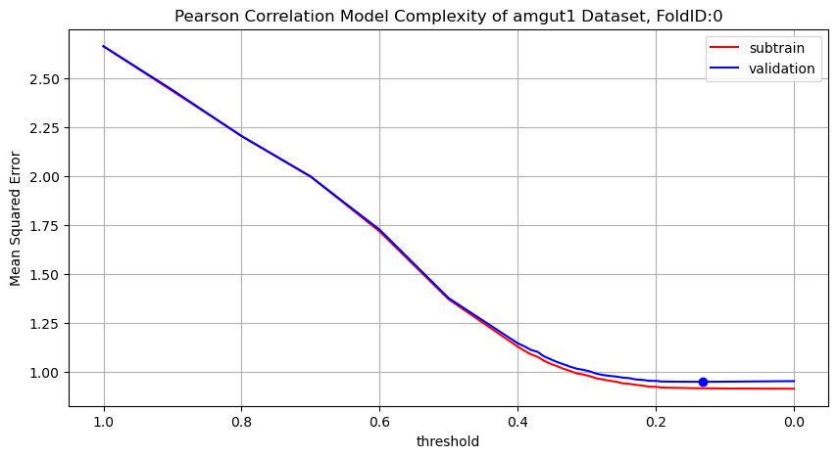
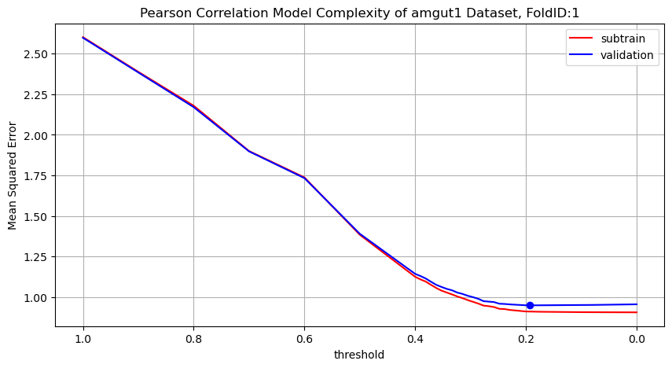
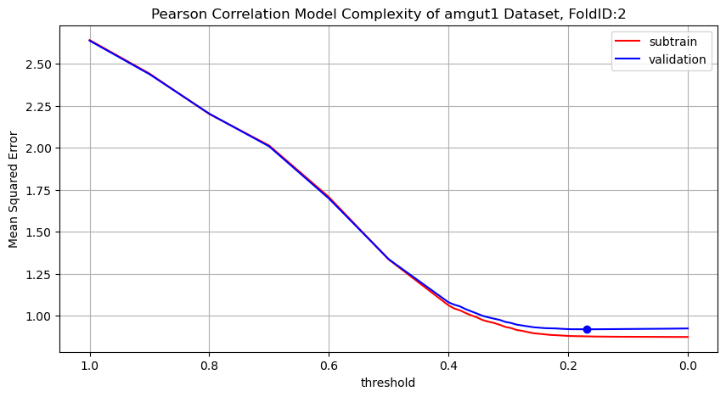
MODEL COMPLEXITY OF THE PEARSON CORRELATION MODEL
AMGUT2
AMGUT1
Subtrain error decreases as the model complexity increases whilst the validation error shows a U shape.
The threshold which gives the minimum validation error is what we are interested in.

Slide 15
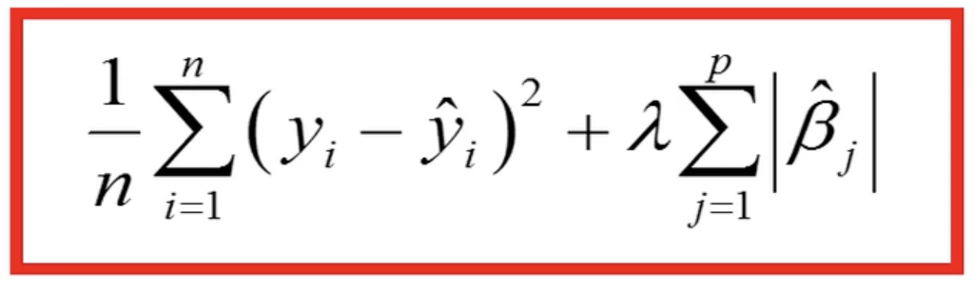
LASSO REGRESSION MODEL
The LASSO is also known as Least Absolute Shrinkage and Selection Operator. It is a form of linear regression which uses L1 regularization technique and variable selection to increase the accuracy of prediction.
L1 regularization adds a penalty which causes the regression coefficient of the less contributing variable to shrink to zero or near zero.
Loss function:
ƛ is a tuning parameter (amount of shrinkage). When ƛ = 0, no parameters are eliminated.

Slide 16
MULTI-COLUMN TEST ERROR FOR LASSOCV MODEL
Taxa 3 is predicted using Taxa 1 and Taxa 2
Taxa 2 is predicted using Taxa 1 and Taxa 3
Taxa 1 is predicted using Taxa 2 and Taxa 3
TAXA 1
TAXA 2
TAXA 3
TAXA 1
TAXA 3
TAXA 2
TAXA 2
TAXA 3
TAXA 1
The Mean Squared Error of predicting each of the taxa columns is computed.
The average of the Test Error is recorded.
The experiment is performed for different number of samples in the datasets.
The coefficients of the model with the optimum alpha is recorded.

Slide 17
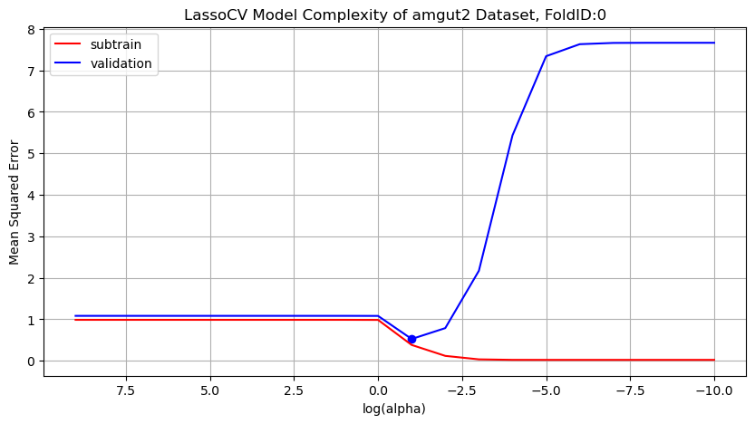
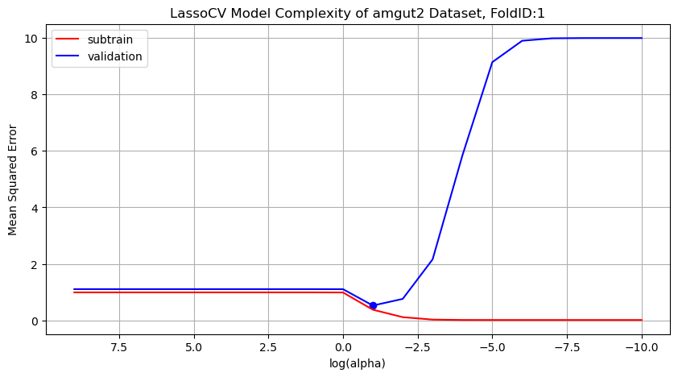
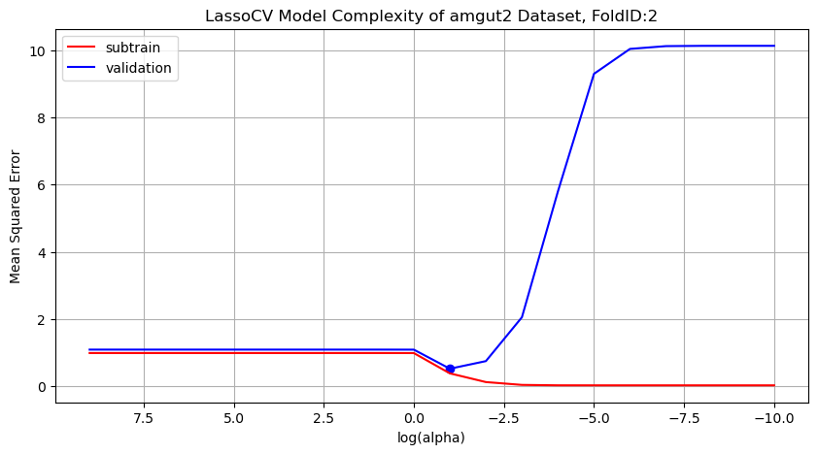
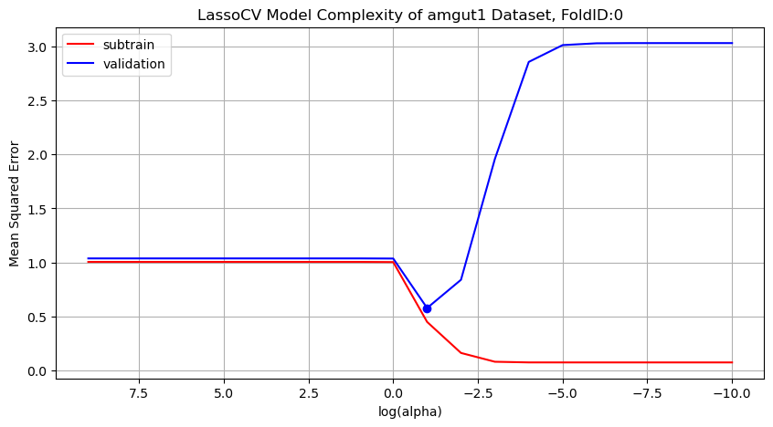
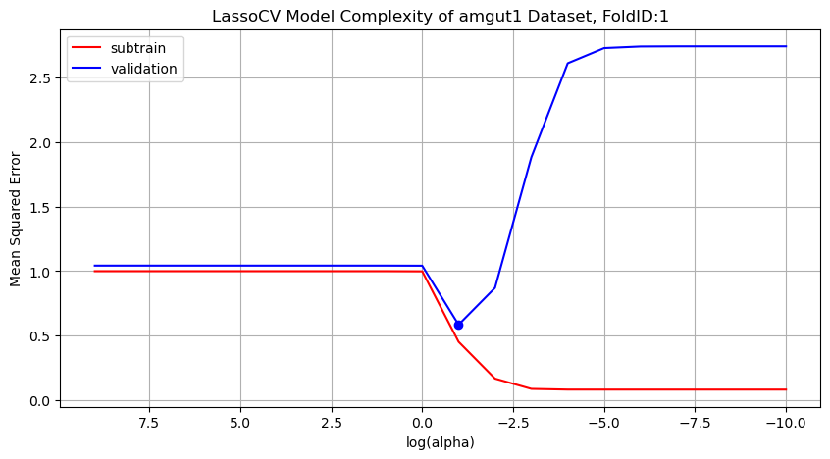
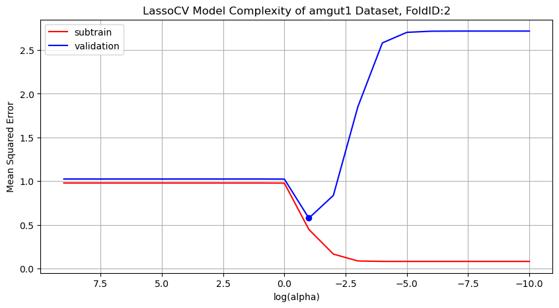
MODEL COMPLEXITY OF THE LASSOCV MODEL
AMGUT2
AMGUT1
Subtrain error decreases as the model complexity increases whilst the validation error shows a U shape.
The alpha at where the validation curve is minimum is what we are interested in.

Slide 18
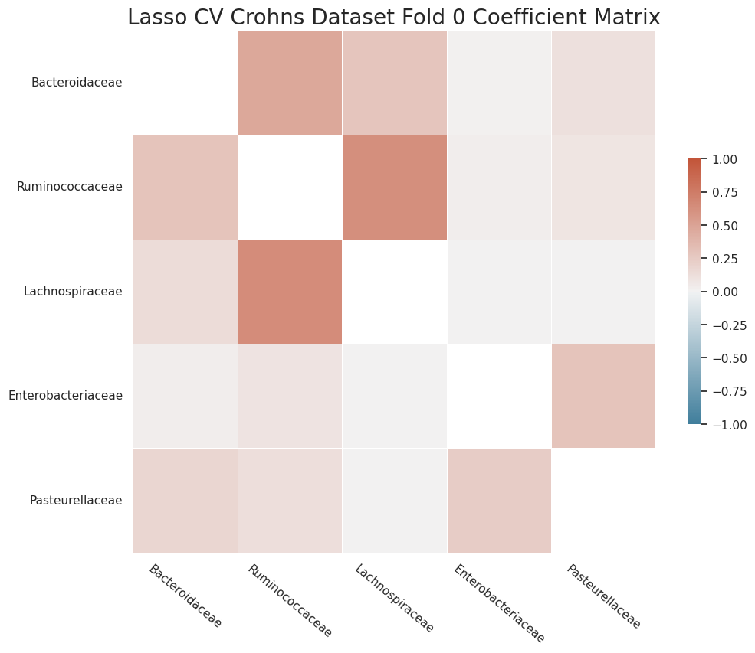
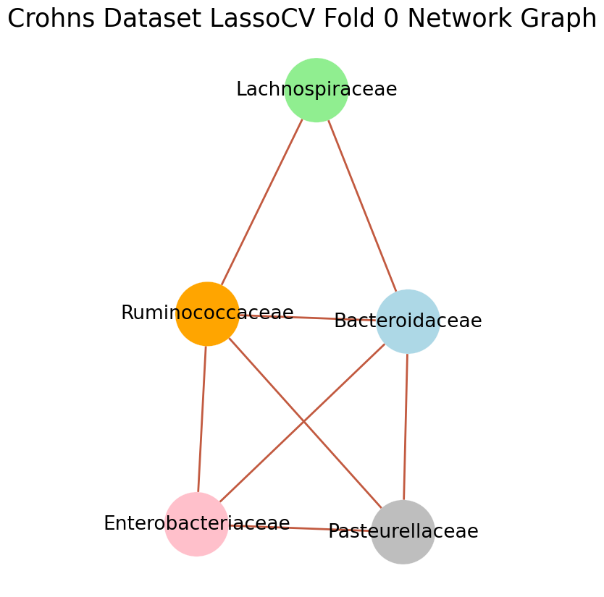
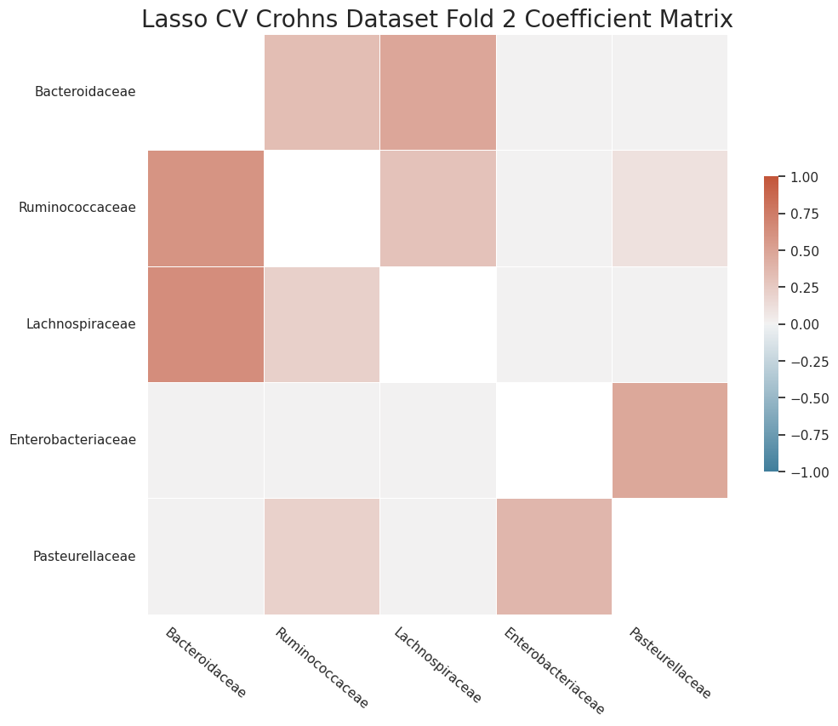
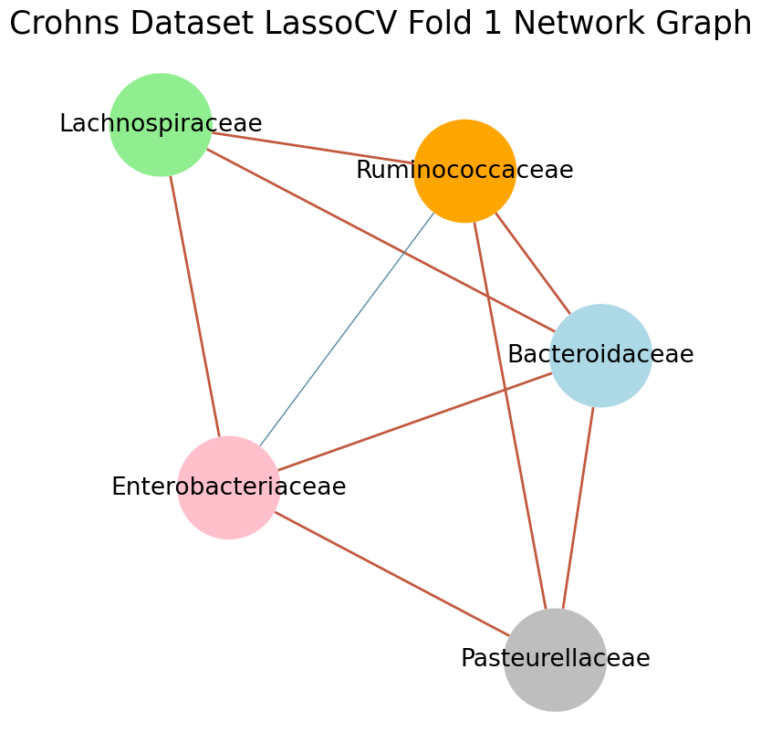
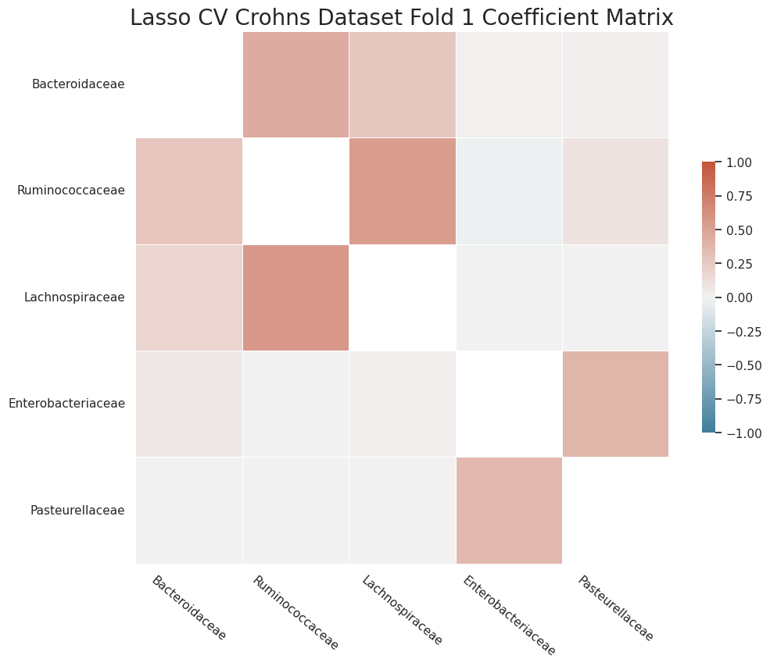
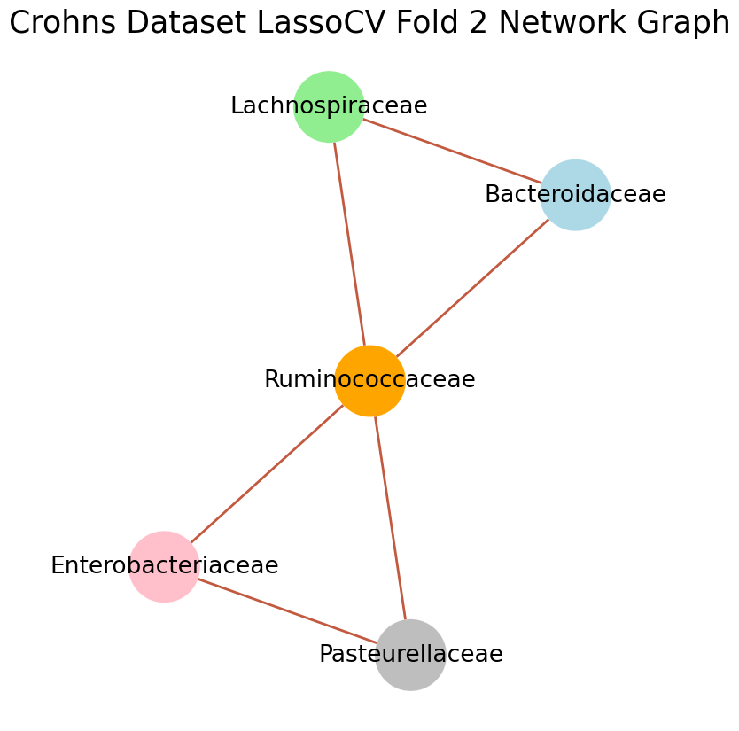
LASSOCV COEFFICIENT MATRIX
Each of the FoldID gives a different coefficient matrix hence different network graph.
All of the network graphs are valid for each fold.

Slide 19
MULTI-COLUMN TEST ERROR FOR FEATURELESS/BASELINE
Taxa 3 is predicted using the mean of Taxa 3 train column
Taxa 1 is predicted using the mean of Taxa 1 train column
Taxa 2 is predicted using the mean of Taxa 2 train column
TAXA 3
TRAIN
DATASET
TAXA 3
TAXA 1
TRAIN DATASET
TAXA 1
TAXA 2
TRAIN
DATASET
TAXA 2
The mean of each of the taxa predictions are computed resulting in one big taxa prediction column.
The Mean Squared Error of the prediction with respect to the actual taxa labels is computed.
The average of the Mean Squared Error is noted for each number of samples used.

Slide 20
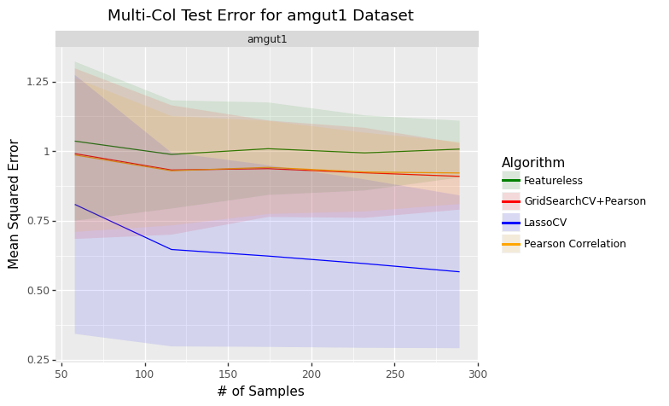
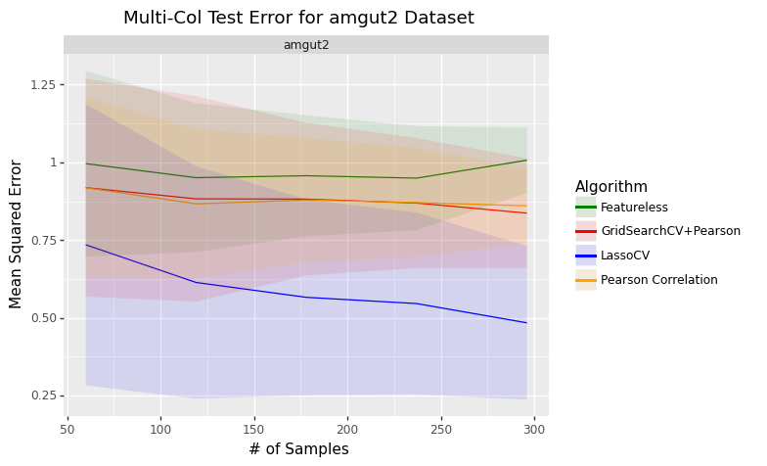
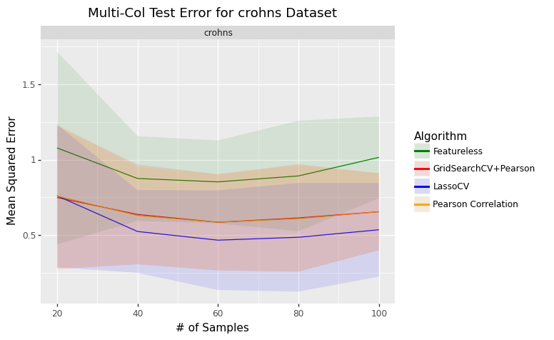
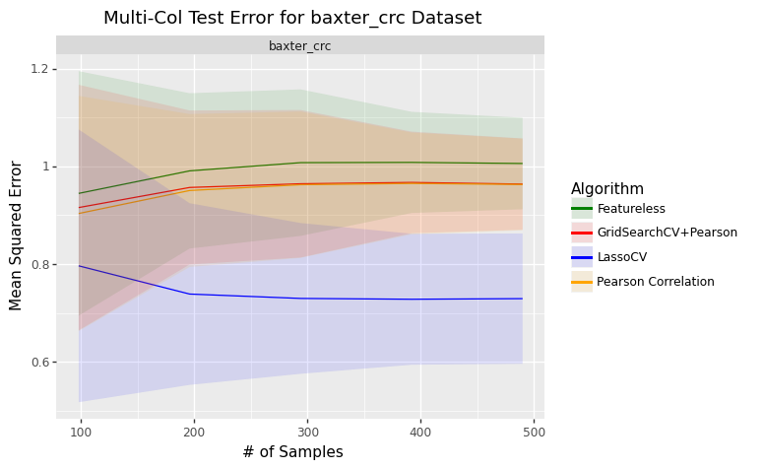
RESULTS

Slide 21
CONCLUSION
It can be inferred from the graph on the previous slides that:
The test error decreases as the number of samples in the dataset increases.
The LASSOCV Model does better than the Pearson Correlation Algorithm.

Slide 22
REFERENCES
https://www.liebertpub.com/doi/10.1089/cmb.2021.0406
https://smnh.tau.ac.il/en/interactions-among-living-organisms/
https://scikit-learn.org/stable/modules/cross_validation.html
https://www.ncbi.nlm.nih.gov/pmc/articles/PMC7768662/
https://journals.plos.org/ploscompbiol/article?id=10.1371/journal.pcbi.1004226
https://doi.org/10.1128/mSystems.00124-19
https://www.thoughtco.com/commensalism-definition-and-examples-4114713
https://www.sciencedaily.com/releases/2018/05/180515092931.htm

Slide 23
ANY QUESTIONS?
THANK YOU

