Slide 1



Cross-Validation for Training and Testing Co-occurrence Network Inference Algorithms
Daniel Agyapong
da2343@nau.edu
PhD student
Dr. Toby Hocking
Toby.Hocking@nau.edu
Machine Learning Lab Director

Slide 2

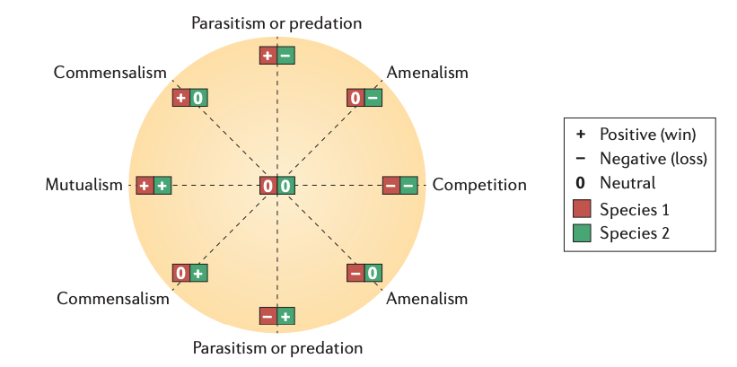
Introduction
Micro-organisms form complex ecological interactions.
Extensive research has been done on interactions between host and its microbiome which have revealed several cases of complex dynamics.
Reconstructing microbial ecological networks to represent these interactions would help to understand the complex behaviors in microbial communities.
Faust et. al 2012
Matchado et. al, 2021
Notes:
Micro-organisms also known as microbes are very tiny organisms that you can only see
them with a sophisticated device like a microscope.
Microbes are found in almost every environment.
Water, soil and even inside the human body. What we know so far from a lot of research in microbiome literature is that
microbes form associations/interactions with each other and the hosts.
In humans, these associations play a crucial role in our health as they can influence our metabolism and immunity.
Faust wrote about these associations in detail in 2012.
There are basically five associations between the micro-organisms.
The main ones are mutualism which is a positive association where both organisms involved benefit from the association
and competition which is a negative association where both organisms fight for the same limited resources like light, space and nutrients .
So reconstructing ecological networks to represent these interactions
would help us understand the complex behaviors in microbial communities.
……………
Mutualism is a type of symbiotic relationship where both organisms involved benefit from the association.
For example, in the human gut, certain bacteria synthesize vitamins that are beneficial to the host,
while the host provides nutrients and a suitable environment for the bacteria to thrive.
On the other hand, competition occurs when two organisms vie for the same limited resources, such as nutrients, space, or light.
So reconstructing ecological networks to represent these interactions would help us understand the complex behaviors in microbial communities.
The classical approaches simplify it to just two associations (Positive and Negative).
Specific Examples of Associations
Mutualism: Bifidobacterium helps digest food and synthesize vitamins, while the human provides a habitat and nutrients.
Commensalism: Bacteria Demodex, which lives on human skin and consumes dead skin cells without affecting the host.
Parasitism: Bacterium Mycobacterium tuberculosis, which causes tuberculosis in humans.
Amensalism: The bread mold Penicillium, which secretes penicillin, inhibiting the growth of nearby bacteria.
Predation: The bacterium Bdellovibrio bacteriovorus, which preys on other bacteria.

Slide 3
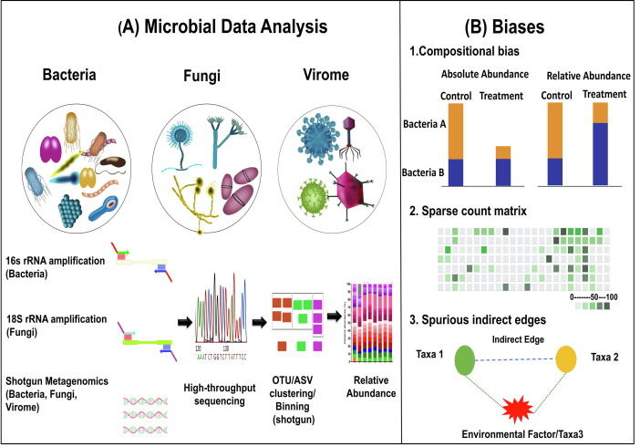
Microbiome Data
High-throughput sequencing techniques help in characterizing microbial communities by sequencing suitable molecular targets.
There are three important biases in microbiome studies: compositionality, sparsity and spurious correlations in microbial co-occurrence network analysis.
OTU - Operational Taxonomic Unit
rRNA - Ribosomal Ribonucleic Acid
ASV - Amplicon Sequencing Variants
Matchado et. al, 2021
Notes:
(A)
Microbial Data Analysis involves all the processes from getting the raw samples to the relative abundance of taxa.
The first step is to extract the total DNA from the sample, which contains the genetic material of all microorganisms present.
Then you amplify the 16S rRNA gene which contains both conserved regions, which are similar across different species,
and variable regions, which can provide species-specific signatures.
The amplified 16S rRNA genes are then sequenced using next-generation sequencing (NGS) technologies.
The sequencing reads are processed and analyzed using bioinformatics tools.
The number of reads corresponding to each bacterial taxon is counted.
The relative abundance of each taxon is calculated by dividing the number of reads for that taxon by the total number of reads for all taxa.
This step amplifies the 16S rRNA genes present in the sample, making them more abundant and easier to sequence.
The variable regions within the 16S rRNA gene allow for the identification of different bacterial taxa.
This gives a proportion or percentage that represents the abundance of each bacterium relative to the entire bacterial community in the sample.
(B)
Firstly, microbiome data are compositional;
i.e. microbial counts represent proportions instead of absolute abundances.
Secondly, sparsity in the dataset can lead to false associations of microorganisms.
A zero indicates either the absence of a microorganism, or an insufficient sequencing depth.
Thirdly, it is challenging to differentiate between direct and indirect associations, in particular if these are related to environmental factors.
Direct associations occur when two species interact with each other without any external influence.
Indirect associations, however, can arise when two species are independently influenced by the same environmental factors,
creating a correlation that doesn’t reflect a direct biological interaction.

Slide 4
Publicly Available Real Microbiome Data
Data | Citation | Samples | Taxa
*amgut1 | https://journals.plos.org/ploscompbiol/article?id=10.1371/journal.pcbi.1004226 | 289 | 127
*amgut2 |  | 296 | 138
hmp216S | https://ibdmdb.org/tunnel/public/summary.html | 47 | 45
hmp2prot |  | 47 | 43
enterotype | https://journals.plos.org/plosone/article?id=10.1371/journal.pone.0061217 | 280 | 553
esophagus |  | 3 | 58
*crohns | https://www.mcgill.ca/statisticalgenetics/software | 100 | 5
Baxter_CRC | http://www.raeslab.org/companion/ocean-interactome.html | 490 | 117
glne007 |  | 490 | 338
*iOraldat | https://bmcbioinformatics.biomedcentral.com/articles/10.1186/s12859-020-03911-w | 86 | 63
Each data set is a matrix of counts, for example:
Taxa
0 15 61
4 0 98
53 74 0
0 32 0
11 0 0
0 24 65
Samples
Agyapong et. al, 2025
* show datasets used in the analysis in our paper.
Notes:
So we collected some real Microbiome composition datasets.
The dataset consists of counts of bacteria where each column represents a different type of bacteria, and each row represents a different sample from a specific environment.
The amgut data set is a collection of samples from the American Gut Project, which is a citizen science initiative that aims to map the diversity and function of the human microbiome.
The crohns data set is a subset of samples from the Human Microbiome Project, which is a large-scale research project that characterized the microbiome of healthy and diseased individuals.
The iOraldat data set contains samples from the oral sites of participants

Slide 5
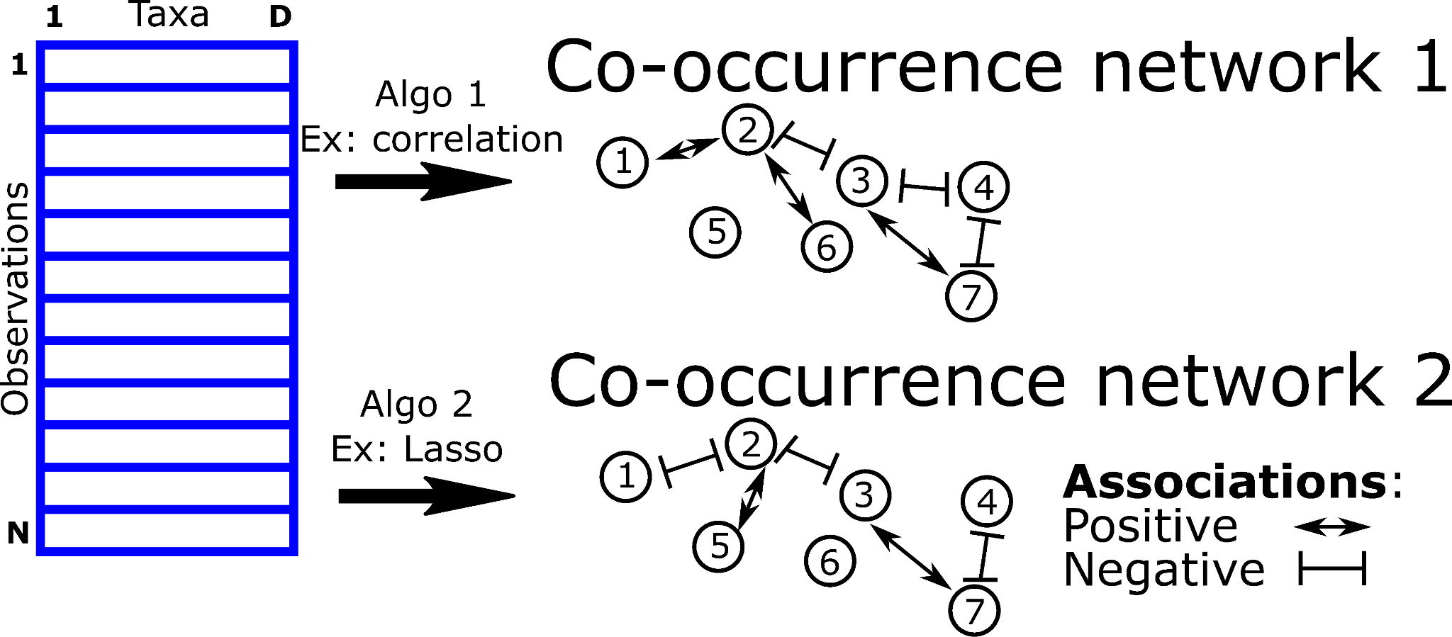
Different Algorithms Infer Different Co-occurrence Networks
Previous algorithms
SparCC (Jonathan et al 2012)
SPIEC-EASI (Zachary et al 2015)
COZINE (Min et al 2020)
Which is a more accurate interpretation for these data?

Slide 6
Categories of Some of Existing Algorithms
There are a lot of existing algorithms, each with various hyper-parameters which determine the sparsity (number of edges) in network.
We grouped them into three different categories.
Category of Algorithm | Pearson/Spearman Correlation | Least Absolute Shrinkage and Selection Operator (LASSO) | Gaussian Graphical Model (GGM)
Sparsity Constraint | Threshold on correlation constant | Degree of L1 regularization | Degree of trace norm regularization
Algorithm | SparCC (Friedman et. al 2012) MENAP (Deng et. al 2012) CoNet (Faust et. al 2016) | CCLasso (Fang et. al 2015) REBACCA (Ban et. al 2015) SPIEC-EASI (Kurtz et. al 2015) | SPIEC-EASI (Kurtz et. al 2015) gCoda (Fang et. al 2017) MDiNE (McGregor et. al 2019) HARMONIES (Jiang et. al 2020) mLDM (Yang et. al 2020) COZINE (Ha et. al 2020) PLNmodel (Chiquet et. al 2021)
Agyapong et. al, 2025
Notes:
Over the years there has been a lot of research into microbial network inference, hence a lot of algorithms have been proposed.
Some include:
Correlation based methods like Pearson and Spearman where we calculate the correlation coefficient between each pair of node and limit the network to edges above a certain threshold.
Least Absolute Shrinkage and Selection Operator (LASSO) algorithm is a linear model that uses a regularization technique called L1 regularization to penalize the number of edges and shrink the coefficients of the weak edges to zero.
Gaussian Graphical Model models the data as a multivariate normal distribution and estimates the inverse covariance matrix/precision matrix, which represents the conditional dependencies between the nodes.
gCoda (Fang et. al 2017): gCoda is used for Conditional Dependence Network Inference for Compositional Data. It models the microbiome data using logistic normal distribution and estimates the sparse structure of inverse covariance for latent normal variables.
MDiNE (McGregor et. al 2019): MDiNE estimates network changes with respect to a binary covariate. It models counts of individual taxa through a multinomial distribution influenced by a latent Gaussian random variable.
PLNModels and variants (Chiquet et. al 2021): used for a variety of multivariate problems when count data are at play, including
principal component analysis for count data, discriminant analysis, model-based clustering and
network inference.

Slide 7
Research Questions
For some particular real data sets:
How can we automatically learn hyper-parameters? (let the data tell us the “best” threshold, rather than choosing arbitrarily)
Which of the available microbial network analysis algorithms is most accurate and gives least test error?
How many samples are needed for cross validation to be useful.

Slide 8
Previous Evaluation Types
Category of Evaluation Type | External Data | Network consistency between sub-samples
Algorithms | SparCC (Friedman et al 2012), SPIEC-EASI (Kurtz et al 2015) | CCLasso (Fang et al 2015)
Issues | Lack of ground truth (external data are not always available) Biases in external data | Trivial model has perfect consistency (featureless model with no edges has 100% accuracy)
Agyapong et. al, 2023
Notes:
These are some of the existing evaluation types.
Most literature use external data or network consistency between sub-samples to validate the quality of the inferred co-occurrence network.
With external data, the quality of the inferred networks is validated across a hypothetical ground truth data set.
The issue with using external data is, external data are not always available.
Also, they are bias because different external data may result in different model performance.
With network consistency between sub-samples, the data set is divided into samples and the idea behind this is that, the network inferred on one sub-sample should be the same as the network inferred on the other sub-sample.
The problem with that is a trivial model such as the featureless/baseline model with no edges has perfect network consistency and 100% accuracy.

Slide 9
Summary of Contributions
Algorithm | Cross-Validation for Training | Cross-Validation for Testing
LASSO | CCLasso (Fang et. al 2015) REBACCA (Ban et. al 2015) SPIEC-EASI (Kurtz et. al 2015) | Proposed
GGM | gCoda (Fang et. al 2017) MDiNE (McGregor et. al 2019) COZINE (Ha et. al 2020) | Proposed
Correlation(Pearson/Spearman) | Proposed | Proposed
Agyapong et. al, 2025

Slide 10
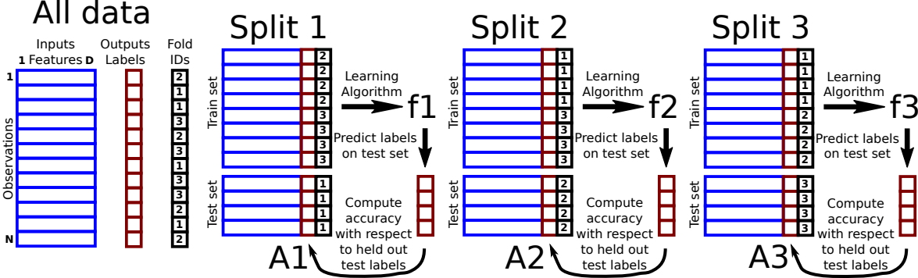
Cross-Validation for Supervised Learning
K-Fold cross-validation: each observation assigned a fold ID, K=3 means fold IDs from 1 to 3.
For each fold ID, use corresponding observations as a test set to evaluate generalization ability of learning algorithm (trained on all other observations).

Slide 11
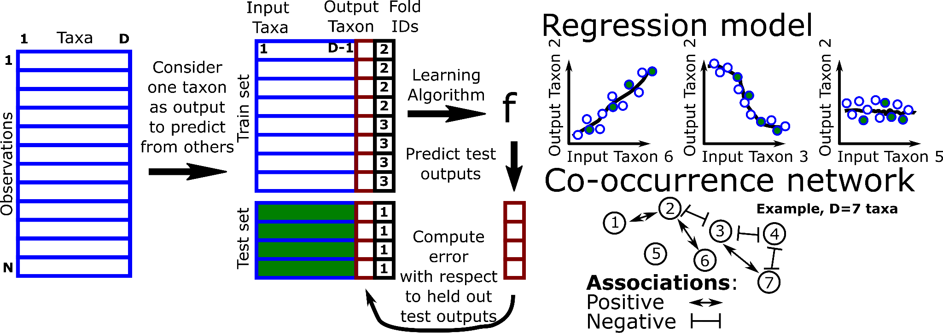
Proposal: Cross-Validation for Training and Testing Co-occurrence Network Inference Algorithms
Repeat for each output taxon and Fold ID

Slide 12
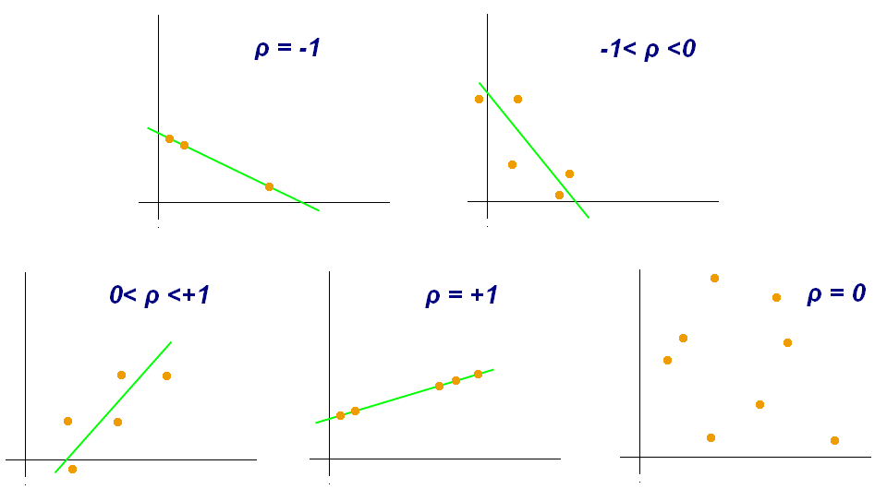
Correlation-Based Models
Pearson’s correlation coefficient (⍴) is the standard tool to infer a network through correlation analysis among all pairs of OTU (Operational Taxonomic Unit) samples.
Spearman's Rank Correlation coefficient is often adopted when dealing with non-linear relationships between taxa.
Notes:
It is a number that ranges from –1 to 1 and measures the strength and direction of the relationship between two variables.
Just like Pearson, Spearman’s rank correlation coefficient ranges from –1 to
+1, with -1 indicating a perfect negative monotonic relationship, 0
indicating no monotonic relationship, and +1 indicating a perfect positive
monotonic relationship.

Slide 13
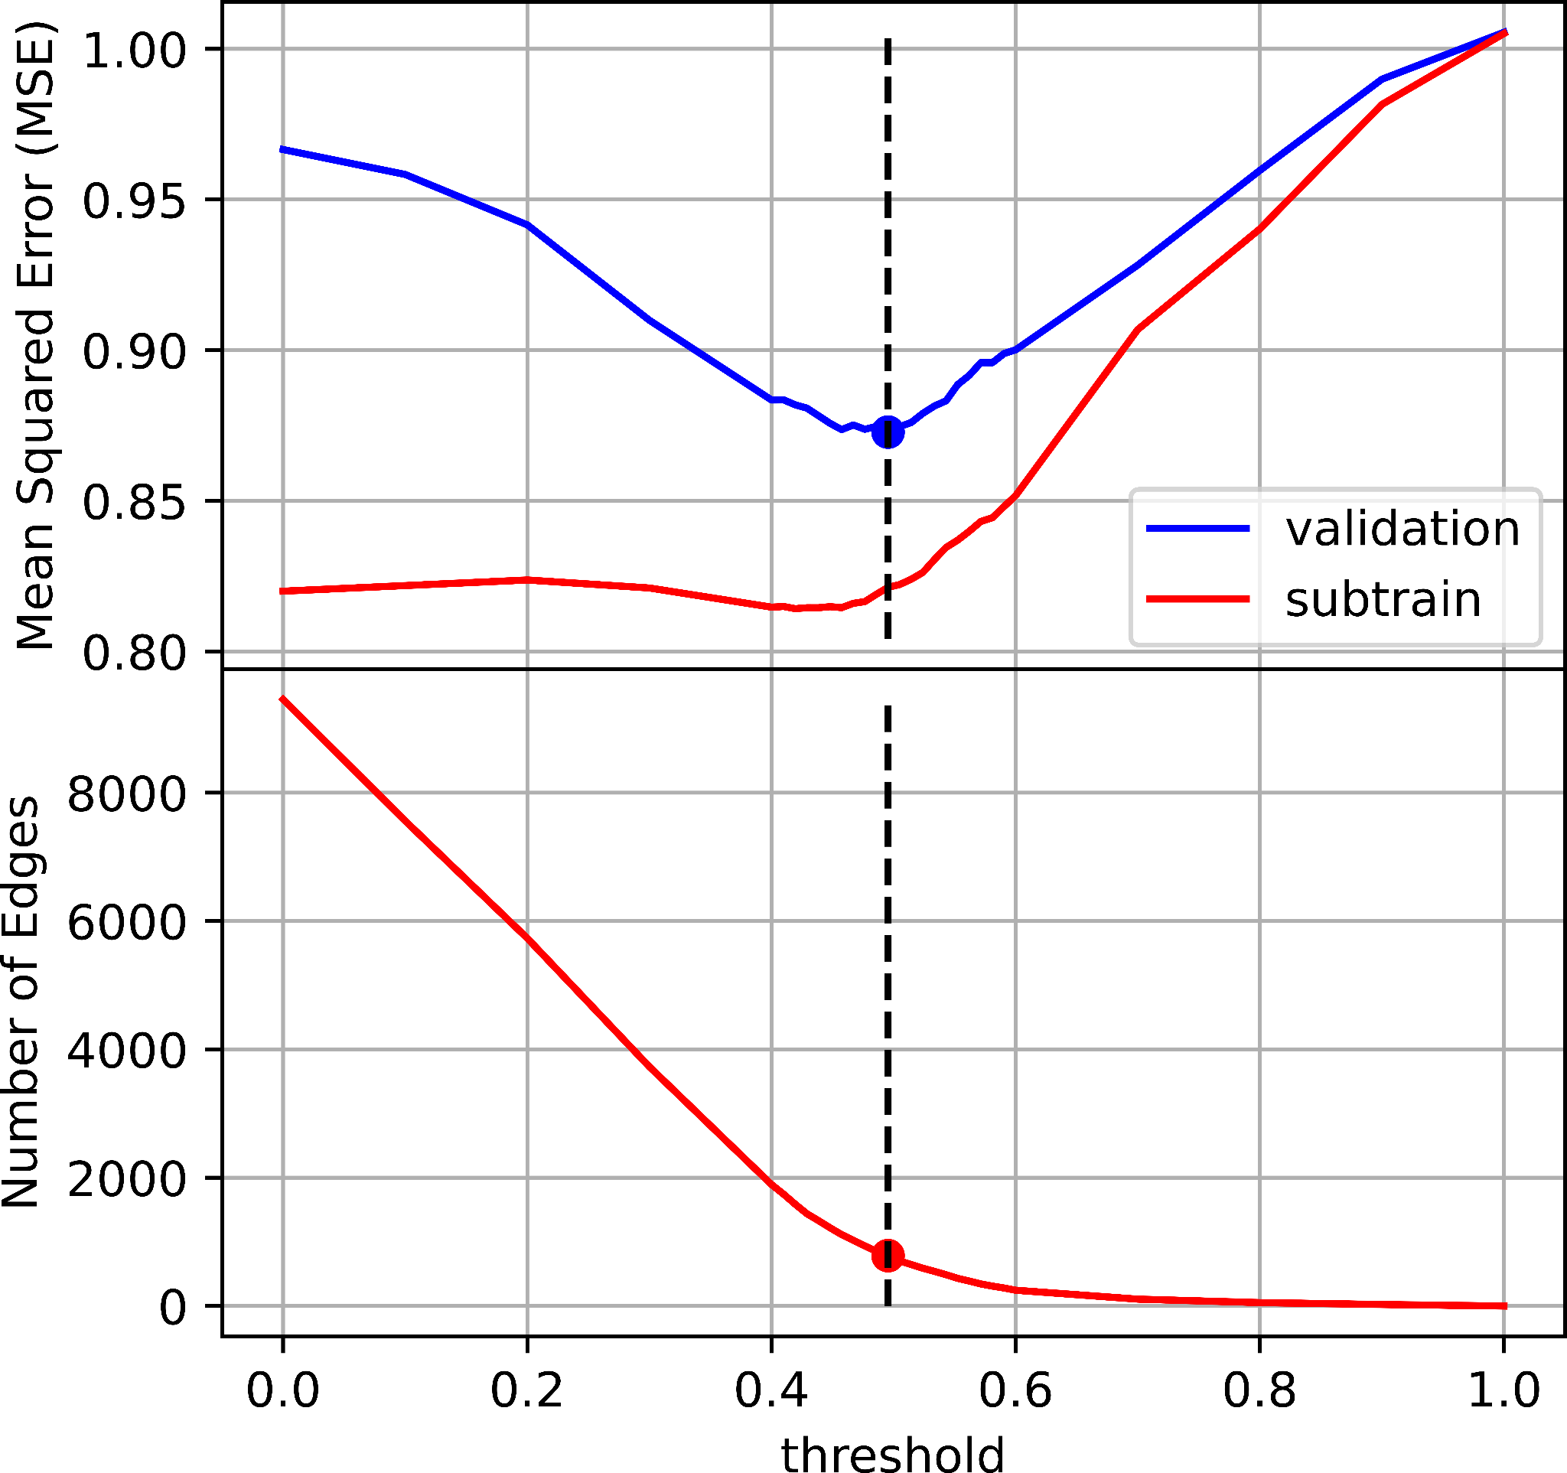
Results of Proposed Method for Training the Pearson Correlation Threshold using Cross-Validation
Pearson is common in microbiome literature. SparCC (Jonathan et al 2012) uses 0.3 as an arbitrary threshold (not learned).
Validation error shows the expected U shape, overfitting for small thresholds (many edges), underfitting for large thresholds (few edges).
We select the threshold which gives the minimum validation error, in this example r2=0.5 (Best number of edges = 785).

Slide 14
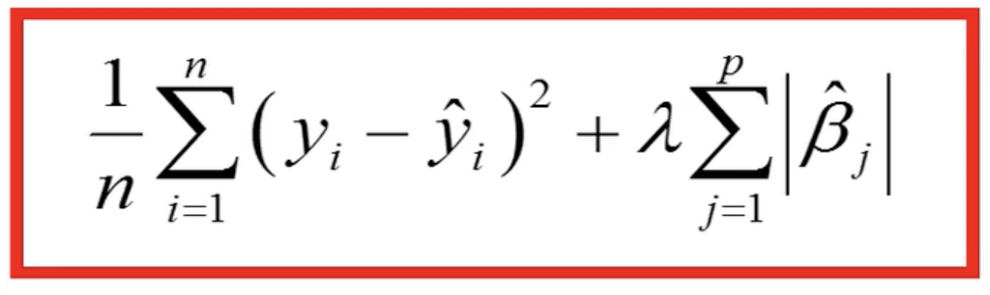
Least Absolute Shrinkage and Selection Operator (LASSO)
The LASSO is a form of linear regression which uses L1 regularization technique to increase the accuracy of prediction. L1 regularization adds a penalty which causes the regression coefficient of the less contributing taxa to shrink to zero or near zero.
Consider an n rows by p columns matrix where (y, ŷ) is the (output,predicted) taxon and 𝞫 is the coefficients of the predictor taxa (X).
Linear Regression Model: ŷ = 𝞫^{T}X
Loss function:
𝜆 is a tuning parameter (amount of shrinkage). When 𝜆 = 0, no parameters are eliminated.

Slide 15
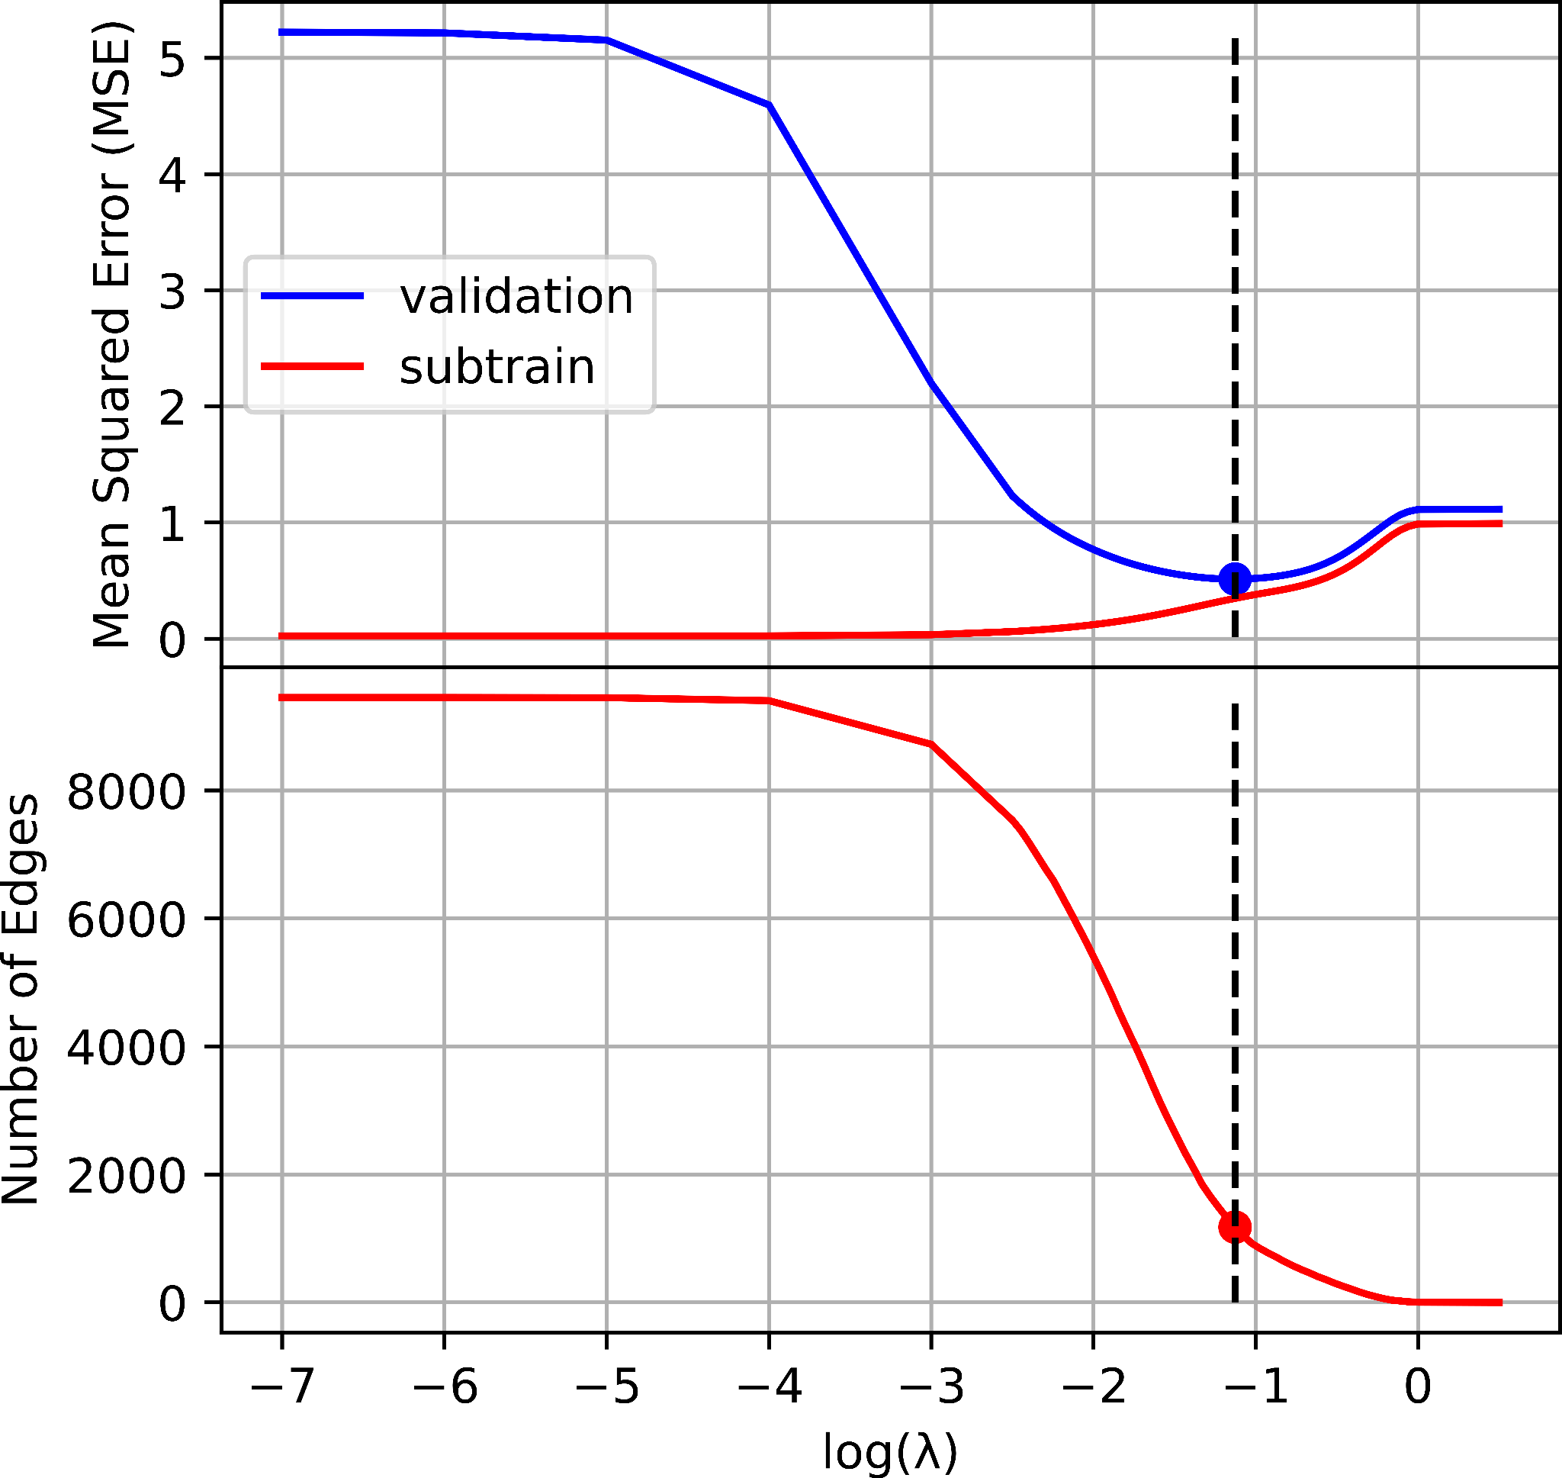
Results of Previous Method for Training the LASSO Algorithm with Cross-Validation
Train set split into subtrain set (used to learn regression coefficients) and validation set (used to learn model complexity, degree of L1 regularization, which controls sparsity / number of edges in co-occurrence network).
The lambda value (degree of L1 regularization) which has the minimum the validation error corresponds to 1176 edges.
Huaying et al proposed CCLasso for microbial network inference.

Slide 16
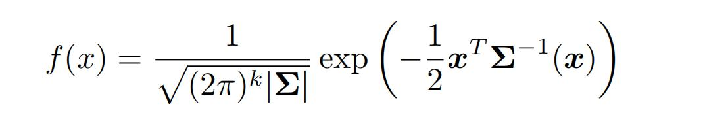
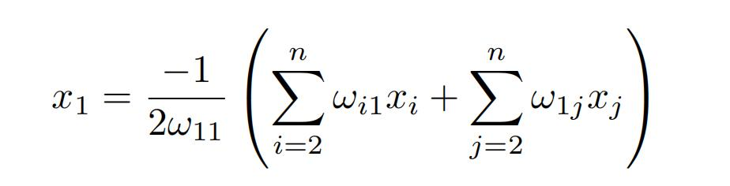
Gaussian Graphical Model (GGM)
The Gaussian distribution is a continuous and symmetrical probability distribution that explains how the outcomes of a random variable are distributed.
Most observations are clustered around the mean so there is a less chance of occurrence as the observations move further away of mean.
The Probability Density Function (PDF) of the distribution is :
x is a k dimensional vector variable
Σ is the k × k covariance matrix
ω is a value in the k x k precision matrix
Conditional mean (predicted value) is :

Slide 17
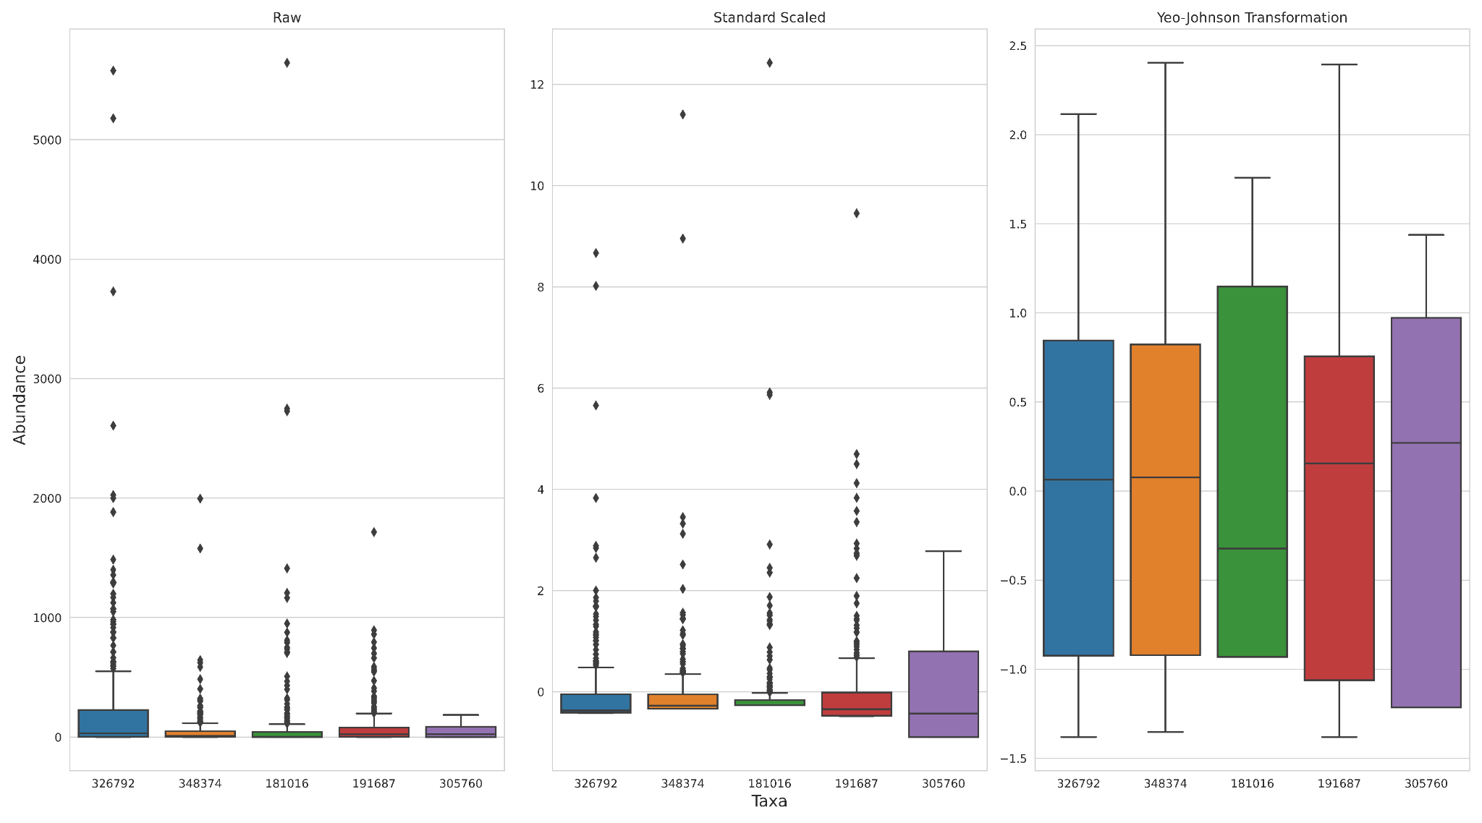
Boxplot of Different Data Transformation Techniques on the Amgut2 data set
Which data transformation technique above would you choose?

Slide 18
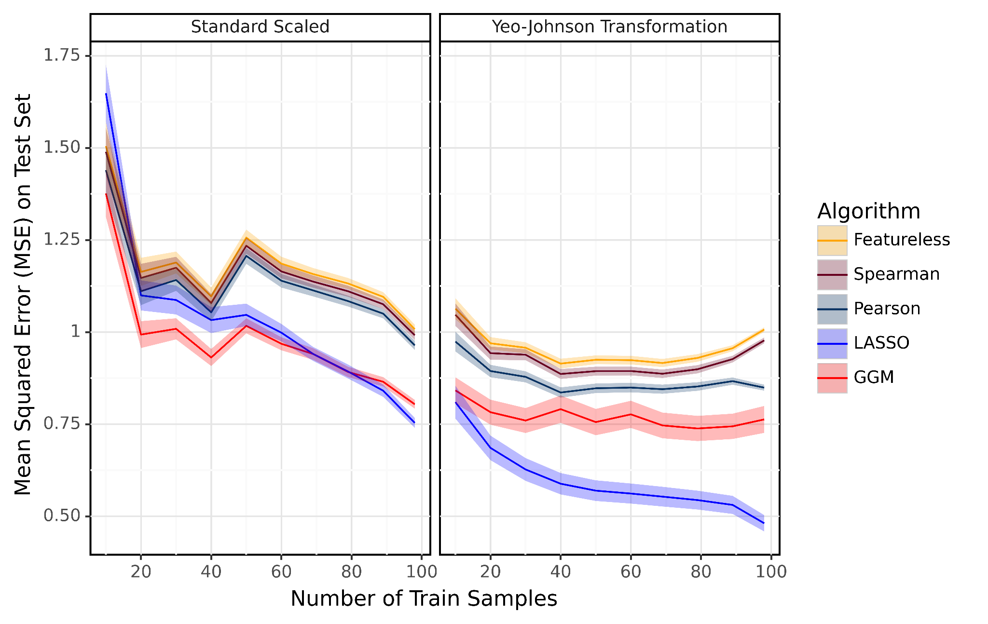
How Different Data Transformation Techniques affect the Test Error
This figure evaluates the performance of the various algorithms on the Amgut2 real dataset.
The results imply that just standard scaling alone yields lower accuracy than the combination of Yeo-Johnson and standard scaling for the algorithms compared.

Slide 19
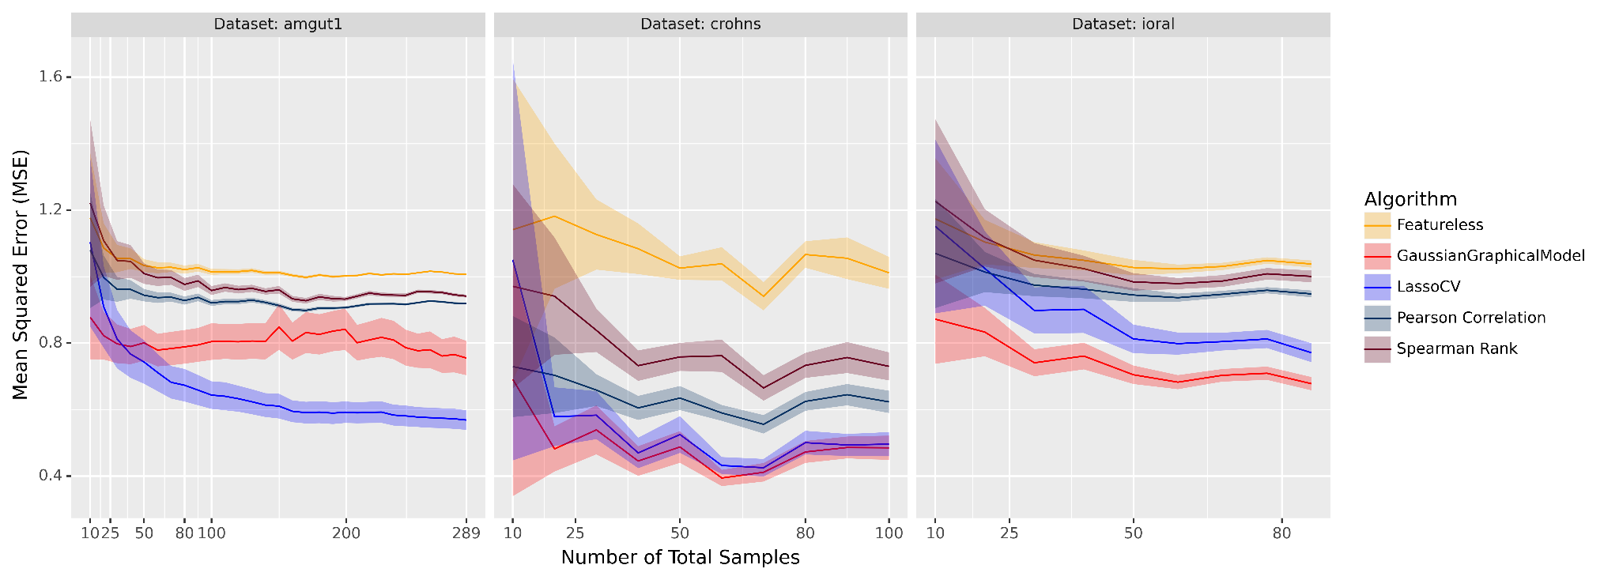
Proposed Cross-Validation Method requires only 10-20 Samples to see Differences in Test Error between Algorithms
LASSO best
LASSO and GGM similar
GGM best

Slide 20
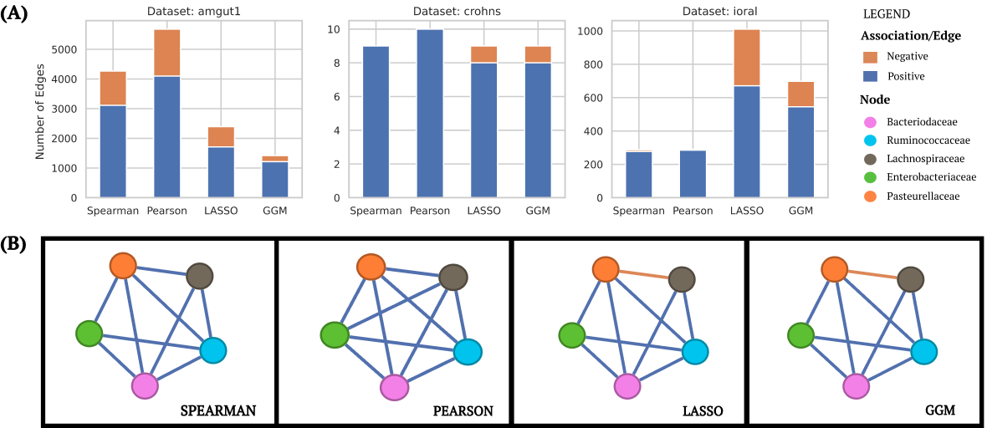
(A) Model Comparison using Inferred Positive and Negative Association
(B) Microbial Network Graph of crohns Data Set
Which inferred co-occurrence network above would you choose?

Slide 21
Conclusion and Current Work
We have proposed the cross-validation machine learning technique as a more robust way of testing the quality of the networks inferred.
Collaborate with Dr. Julien Chiquet about an extension to his Poisson LogNormal Models (PLNmodel, Chiquet et. al 2021).
PLNmodel is under GGM category and infers co-occurrence network by using graphical lasso to penalize elements of the precision matrix except the diagonals.

Slide 22

Thank You
Any Questions ?
Funding: NSF grant #2125088 from Rules of Life Program
Contact: da2343@nau.edu

