Slide 1


LASSO Regression modeling on prediction of medical terms among seafarers’ health documents using tidy text mining
A peer review by :
Daniel Agyapong
da2343@nau.edu
PhD student
Dr. Toby Hocking
Toby.Hocking@nau.edu
Machine Learning Director

Slide 2
INTRODUCTION
Sailors are regularly on the move and working at sea.
Due to their mode of transportation, they face higher risk of illness and diseases.
Typically, there are no or less on-board doctors and this makes disease diagnosis extremely difficult.
The onshore doctors however may be able to provide medical service through a process called telemedicine.
Telemedicine is the remote diagnosis and treatment of patients by means of telecommunications technology.

Slide 3
INTRODUCTION
Text mining (also known as text analysis) is the process of transforming unstructured text into structured data for easy analysis.
Text mining techniques are adopted to help in extracting diagnostic information from clinical texts.
The lexicon sentimental analysis was used previously to label healthcare terms from the seafarers’ text healthcare documents as either positive or negative.
Subject’s emotions and behavior can be analyzed when studying medical documents with text.

Slide 4
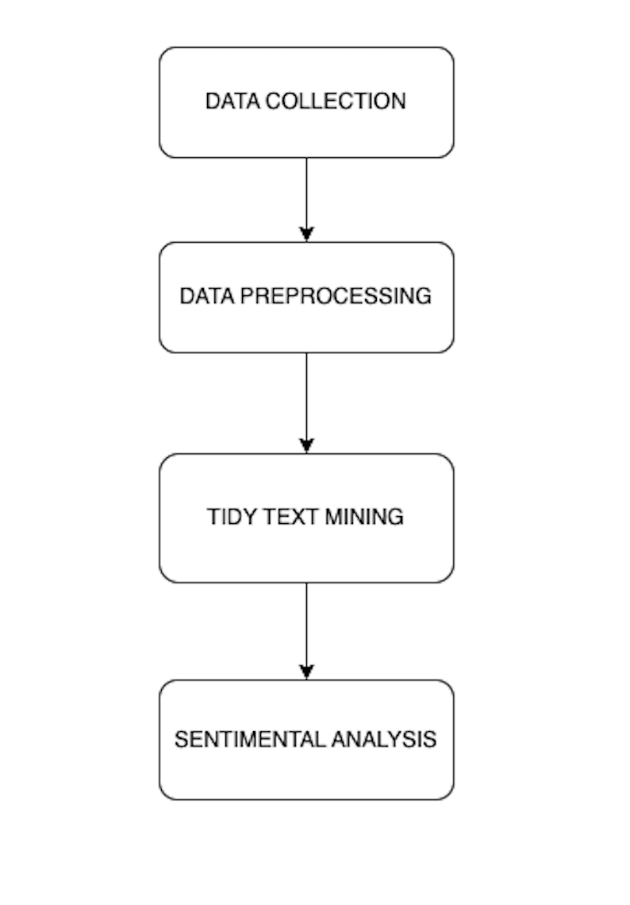
METHODOLOGY
Methods used for analysis include :
Data Collection
Data Preprocessing
Tidy Text Mining
Sentimental Analysis

Slide 5
DATA COLLECTION
Medical text data of seafarers were examined from 2006 to 2021 and data was analyzed among 41292 seafarers who got telemedical assistance through the International Radio Medical Centre (C.I.R.M.).
Typically, a seafarer sends a message (TX) which includes details about the ship like ship name, position, radio call sign, destination port, estimated time of arrival, etc. It also includes details about the patient like age, nationality, qualification, vital signs like breathing, temperature, pulse, blood pressure, etc.
A doctor receives a message (RX) which contains doctor’s questions, diagnosis, treatment, prevention instructions and details about the patient.

Slide 6
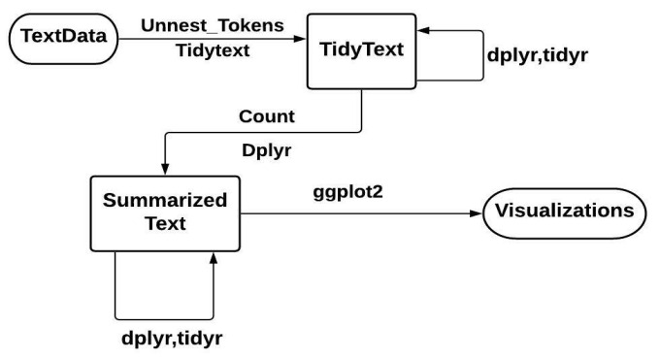
CORPUS PREPROCESSING
Corpus is a collection of written texts of a particular author or a body of writing on a particular subject.
Data preprocessing requires data cleaning which involves sorting out punctuations, abbreviations, contractions and handling upper/lowercase letters to ensure that user data is consistent, reliable, and accurate and organized logically.
Data is managed easily by using tidy data structure which has the variables as columns, observations as rows, and each observational unit type as a table.
Flowchart representation of typical text analysis using principles of tidy data.

Slide 7
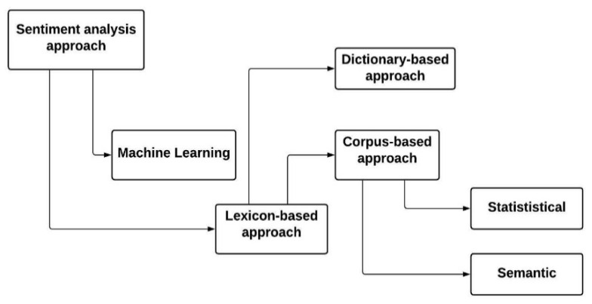
SENTIMENTAL ANALYSIS
Sentiment analysis is an effective way to evaluate written or spoken language to determine if the expression is positive or negative, and to what degree.

Slide 8

LASSO REGRESSION MODEL
This model extends supervised machine learning to text classification.
=> Loss function:
The above equation is the same as the minimization of the sum of squares with constraint which sums absolute values of the estimated parameters. Some of parameters can be shrunk to almost zero.
ƛ is a tuning parameter (amount of shrinkage). When ƛ = 0, no parameters are eliminated.

Slide 9
LASSO REGRESSION MODEL
LASSO takes advantage of shrinkage to accomplish linear regression.
When a data value moves towards a central point, such as a mean, shrinkage occurs.
LASSO aims to minimize quadratic programming problems.
LASSO regularization was applied for the logistic regression model with the glmnet R package which helps to detect keywords in a prediction.

Slide 10
LASSO REGRESSION MODEL
The LASSO model performance was assessed with two other supervised models, called :
Support Vector Machines (SVM)
Random Forest (RF)
Two categorical books about (cardiovascular and digestive diseases) were selected. Total of 2641 documents.
A data frame was created from each document in the dataset. Each document has 8803 document samples.
The model performances are evaluated based on the percentage of correctly classified outcomes over the total outcomes.

Slide 11
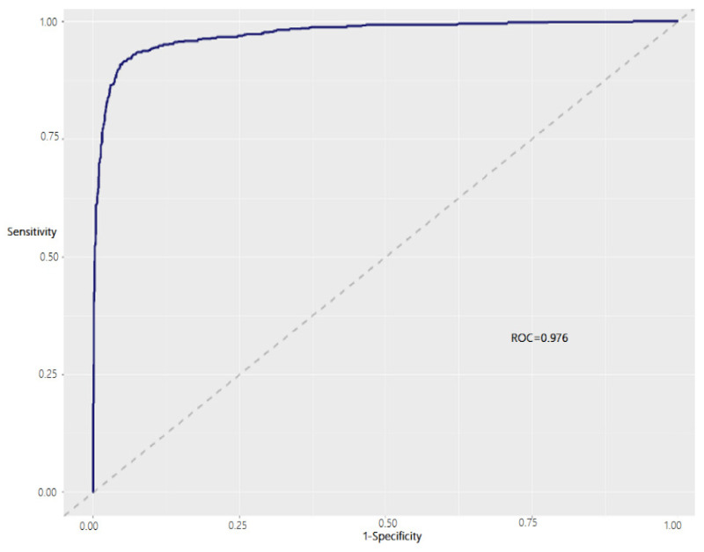
ROC curve for text classification using LASSO regularized regression.
True Positive Rate (Sensitivity)
False Postive Rate
(1-Specificity
The Receiver Operating Characteristics (ROC) curves can be used in medical diagnosis to test the model’s ability to predict text in documents

Slide 12
TEXT CLASSIFICATION WITH ML
Model | Accuracy(%) | Sensitivity(%) | Specificity(%) | ROC
Support Vector Mechanism | 64.2 | 68.3 | 45.3 | 0.597
Random Forest | 59.0 | 59.8 | 55.4 | 0.613
LASSO | 93.8 | 97.9 | 80.6 | 0.976

Slide 13
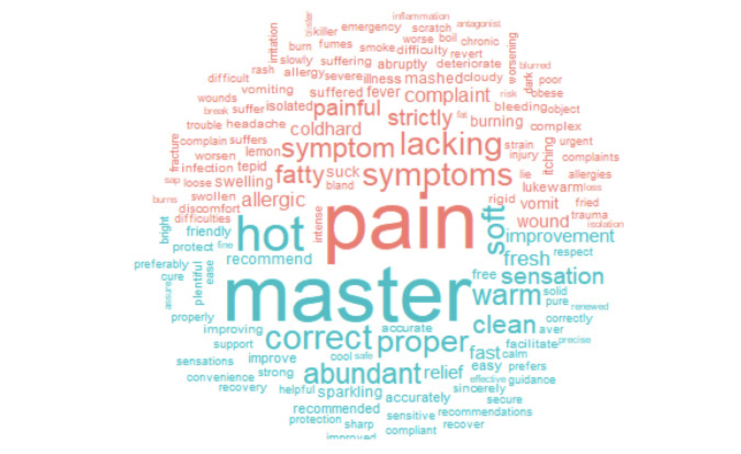
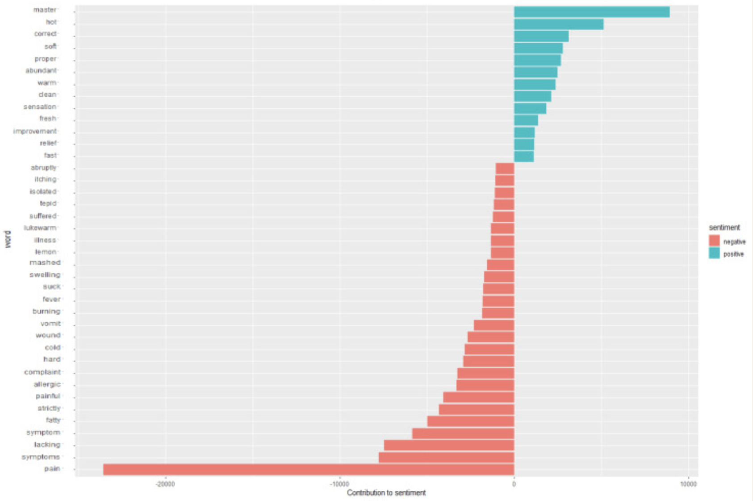
VISUALIZATION OF RESULTS
Sentiment Visualization in the form of word clouds
Contribution to sentiment

Slide 14
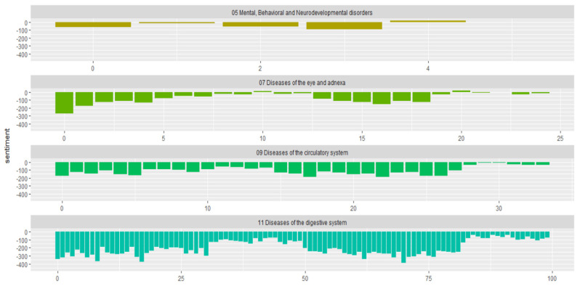
FURTHER ANALYSIS
How sentiments of each symptom varied across categorical diseases of ICD 10 (International Classification of Diseases – 10th Edition)
How sentimental scores (Y-axis) for certain diseases change and become more positive or negative over time (X-axis).

Slide 15
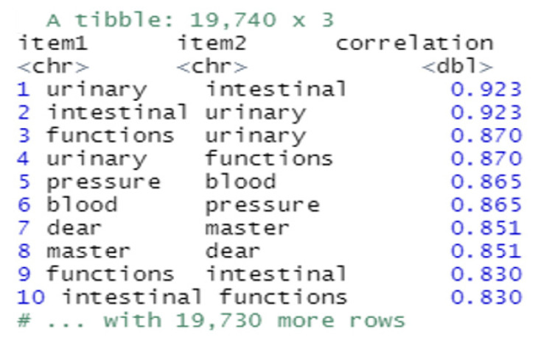
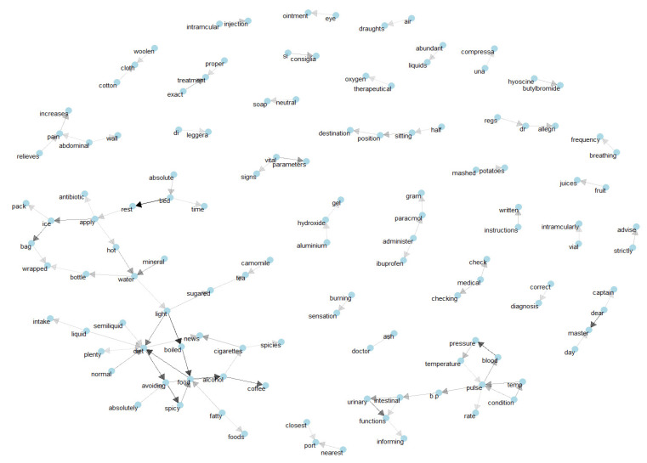
NETWORKS AND CORRELATIONS

Slide 16
CONCLUSION
Tidy-based TM has proven to be a comprehensive and efficient tool.
Using LASSO regression, this study successfully predicted text data among documents with 93.8% accuracy.
References:
https://www.ncbi.nlm.nih.gov/pmc/articles/PMC8945331/
https://cran.r-project.org/web/packages/tidytext/vignettes/tidytext.html

