Slide 1
Efficient L1 and L2 Fusion Solvers for Grouped Regression Data

Slide 2
Introduction
Problem: scalable multi-task/grouped fused regression.
When the number of groups(subsets) increase, the runtime and memory of the existing fit method explodes.
Gap: Fused lasso uses a graph structure that takes in consideration the relationship between different groups.
Legacy methods use full edge regardless of the nature of the graph; which are very costly.
Padilla et al. 2020 use knn to build a sparse graph only utilizing a data-driven approach instead of pre-setting the Graph making sure that only groups which are related will be involved in the computation.
Whatever the case may be, variants that take into consideration the nature of the fusion graph instead of using all the edges may improve runtime/memory.

Slide 3
Contributions
We contribute variants of both L1 and L2 methods that take into consideration the nature of the fusion graph to improve runtime and memory efficiency.
It gives the best gains in terms of computational efficiency when graph is sparse. L1 variants (Adaptive Operator, Chain Approx.):
We propose two experimental variants. Adaptive operator uses active edge matrix formulation.
Chain Approx. uses an approximation technique to build a single chain of Graph using DFS. Despite the nature of the original graph, it reduces the number of edges to (Number of groups - 1) everytime. This does not offer an exact solution but it is a great method to use when you only care about maximum computational efficiency with slightly reduced accuracy.
L2 active-edge construction Extensive open-source real data benchmarking.

Slide 4
Related Work
1. Sparsity and smoothness via the fused lasso, Robert Tibshirani et al. 2005
LASSO was originally proposed by Robert Tibshirani in 1996. Fused lasso is an extension of Lasso which is used for grouped/ordered data. It has both sparsity and smoothness/fusion penalty. He also proposed hinge loss for fussed lasso SVC for classification tasks.
Difference: This literature proposes the fused lasso. We build on top of it to solve the fused lasso problem by introducing variants to take advantage of the graph structure for optimization and efficiency gains.

Slide 5
Related Work
2. A path algorithm for the Fused Lasso Signal Approximator (2009 Holger Hoefling)
This literature solves a specific fused lasso problem related to signal approximation.
Standard regression, we use a matrix of input features (X) to predict an output (Y).
In FLSA, the predictor matrix is the identity matrix (X = I). This implies that the algorithm is directly smoothing and denoising a single ordered sequence of noisy data points (Y) instead of finding weights for different independent variables.
The paper develops a highly efficient path algorithm for the FLSA which computes exact solutions for all possible values of lambda and gamma simultaneously.
Difference: We focus primarily on general grouped regression problem where we have a matrix of independent features X used to predict a distinct outcome Y but this literature is a special case for this where X = I.

Slide 6
Related Work
3. Graph-Structured Multi-task Regression and an Efficient Optimization Method for General Fused Lasso (2010 by Chen et. al)
The paper solves a joint multiple output regression problem. Implying that every task represents predicting a different continuous output variable based on a common set of high-dimensional inputs.
It assumes that the relationships between the multiple output variables are correlated with one another in a complex way, hence can be represented using an output graph with fused penalties. It proposes proximal-gradient optimization. Difference: This literature deals with several distinct but interconnected output variables, we use only consider a single regression output divided into different groups.

Slide 7
Related Work
4. A Two-Graph Guided Multi-task Lasso Approach for eQTL Mapping (2012 by Chen et. al)
Expression quantitative trait loci (eQTL) mapping is the process of statistically finding significant associations between genetic variants and gene expression traits. Traditionally, researchers used pairwise correlation, testing one genetic variant against one gene at a time but this leads to spurious associations.
Proposes a two-graph multi-task fused lasso approach where one graph represents feature domain and the other represents label domain. This is all baked into a unified model. Difference: This paper improvises two graph approach specifically for multi-task problems like eQTL mapping, our work exploits a single graph structure (for single task) for efficiency gains.

Slide 8
Related Work
5. Fused Lasso Additive Model, FLAM (Petersen et. al, 2014)
Proposes FLAM as an additive model where the contribution of each individual feature is estimated to be a piecewise constant function. It implements adaptively chooses knots to decide where the step function jumps up or down. It also implements sparsity based on LASSO principles.
Difference: This paper builds a non-linear function because it creates a series of steps for individual features, our adaption is based on the original fused model which is a linear regression model. This work doesnt exploit the graph structure of the data. It creates its own 1D sequence by sorting feature data and applying fusion penalty along that line to build step-function.

Slide 9
Related Work
6. Gene regulatory network inference using fused LASSO on multiple data sets (Omranian et al., 2016)
The paper constructs Gene regulatory network using fused lasso with multiple real data sets. They use a standard benchmark dataset to compare the reconstructed network. Then they present the AUROC, AUPR Difference: This paper uses the original fussed lasso on multiple datasets as groups. This work doesnt exploit the graph structure of the data.

Slide 10
Related Work
7. The DFS Fused Lasso: Linear-Time Denoising over General Graphs by Hernan et. al 2018
Constructs a 1D chain sequence using DFS backtracking from a 3D graph purely for signal denoising so that problem can be formulated as a fused lasso problem. This gives it a computational efficiency (it is still far slower to solve the fused lasso over an arbitrary graph than it is to solve the fused lasso over a chain). We used this idea to formulate our Approx. Chain method.
Difference: Regular fused lasso predicts an outcome based on the weights of features, this paper reconstructs y labels thereby denoising it. Regular fused lasso uses two hyper-params (lambda and gamma), this one only uses gamma.

Slide 11
8. Fused Group Lasso Regularized Multi-Task Feature Learning and Its Application to the Cognitive Performance Prediction of Alzheimer’s Disease by Lui et. al 2019
Literature proposes fused group lasso to solve the progression of Alzheimer’s Disease over time. This Alzheimer's paper uses a simple 1D timeline for its temporal structure, but adds the Group Lasso to strictly enforce which brain regions are selected. They employed the alternating direction method of multipliers (ADMM) to efficiently solve the proposed non-smooth formulation.
Difference: This literature fuses the outputs (time points) to predict patient’s cognitive score at different time points.
Our pipeline is not dependent on specific domain and we fuse the input features.

Slide 12
9. Graph-based regularization for regression problems with highly-correlated designs, Li et. al 2018.
Uses correlation to formulate the graph (Graph Total Variation penalty) for the fused lasso high dimensional problems. Provides mathematical proofs as to why it works especially in cases where features are highly correlated which is the case in many real world applications.
Difference: In our work, we focus on optimizing current l1 and l2 methods especially in large group(k) regimes and taking advantage of the structure in the graph (most efficiency gains occur in sparse graphs). In terms of the graph structure, we need a priori to guide the graph.

Slide 13
10. Fused lasso for feature selection using structural information, Cui et. al, 2021
Literature unifies the minimization problem of Fused Lasso and propose the fused lasso for feature selection using structural information represented as graph (InFusedLasso). Uses the structural information between samples. This is done to balance relevancy (how good a feature is) with redundancy (if two features do the exact same thing). We got the dense sort idea from this paper because in this paper, they use sorting to organize features so that similar features will be close (Graph Alignment).
Difference: This paper builds on top of fused lasso to incorporate structural information, our work optimizes the fused lasso (in relation to this, we use dense sort to sort uniform dense graph to improve computational efficiency).

Slide 14
11. Split Bregman method for large scale fused Lasso, Ye et. al 2011
When we talked about the Alzheimer's paper, we discussed how ADMM replaced the slow, brute-force Quadratic Programming (QP) of the original 2005 paper. This 2011 paper by Ye and Xie introduces the Split Bregman method, which is essentially the mathematical sibling to ADMM. It was the major breakthrough that allowed the original 1D Fused Lasso to finally run on massive datasets.
Difference: Our main optimization family that we use is Smoothed proximal gradient Descent (Chen et. al 2012). It is generally preferred when the problem is massive.

Slide 15
12. Graph-Guided Fused Regularization for Single- and Multi-Task Regression on Spatiotemporal Data (2026 by Lin et. al)
New generalized graph-guided fused lasso for spatiotemporal matrix regression (single-task + multi-task), with a modified Halpern Peaceman-Rachford (HPR) optimizer and convergence/theory claims. Difference: We are not modeling matrix-valued spatiotemporal structure explicitly. We are doing subgroup fusion regression with practical solver variants and runtime/memory benchmarking on public grouped datasets.

Slide 16
14. Application of fused lasso
These papers apply fused lasso in a specific field without any major algorithm propositions.
Classification of spectral data using fused lasso logistic regression, Yu et. al 2015
Spatial smoothing and hot spot detection for CGH data using the fused lasso, Tibshirani et. al, 2007
Spacing Test for Fused Lasso, Tasaka et. al 2025

Slide 17
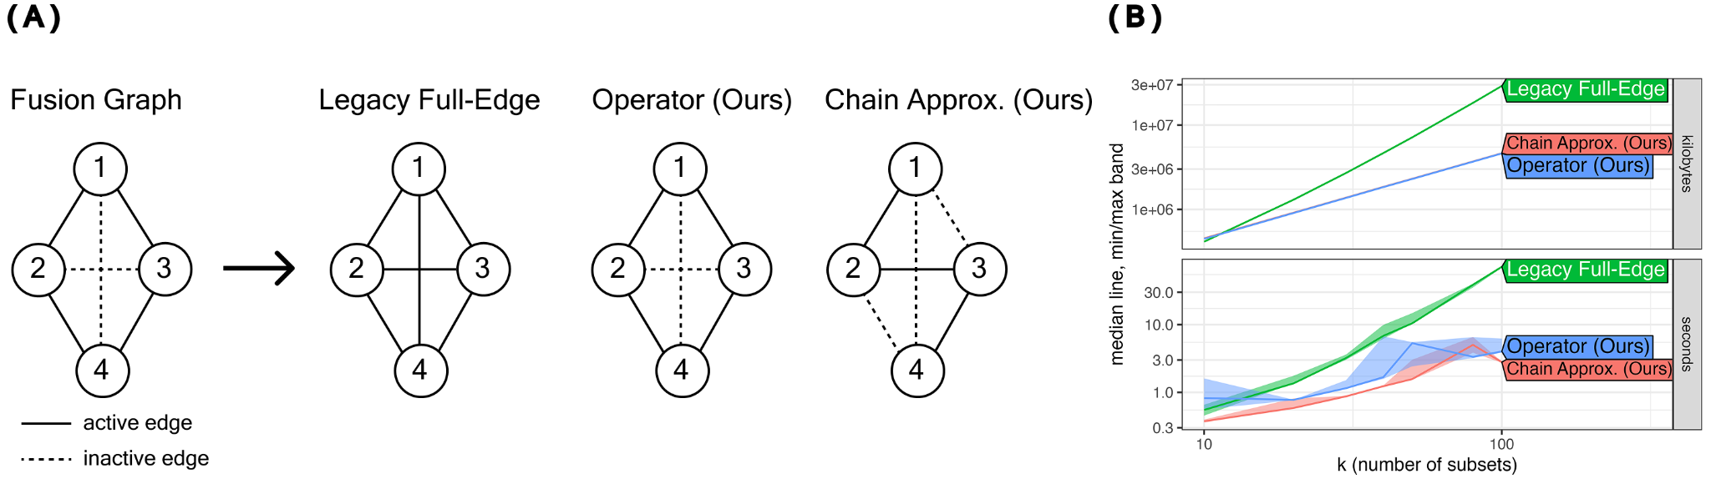
L1 Optimization Concept
Fusion Graph Construction. Legacy Full-Edge (Dondelinger et. al 2016) forms a combined constraint matrix.
Asymptotic Complexity. Synthetic data with p = 120, n_group_train = 35 so at k = 100, n = 3500. Graph is sparse chain structure. All other hyper-params are fixed. From O(pk^3) to O(pm)

Slide 18
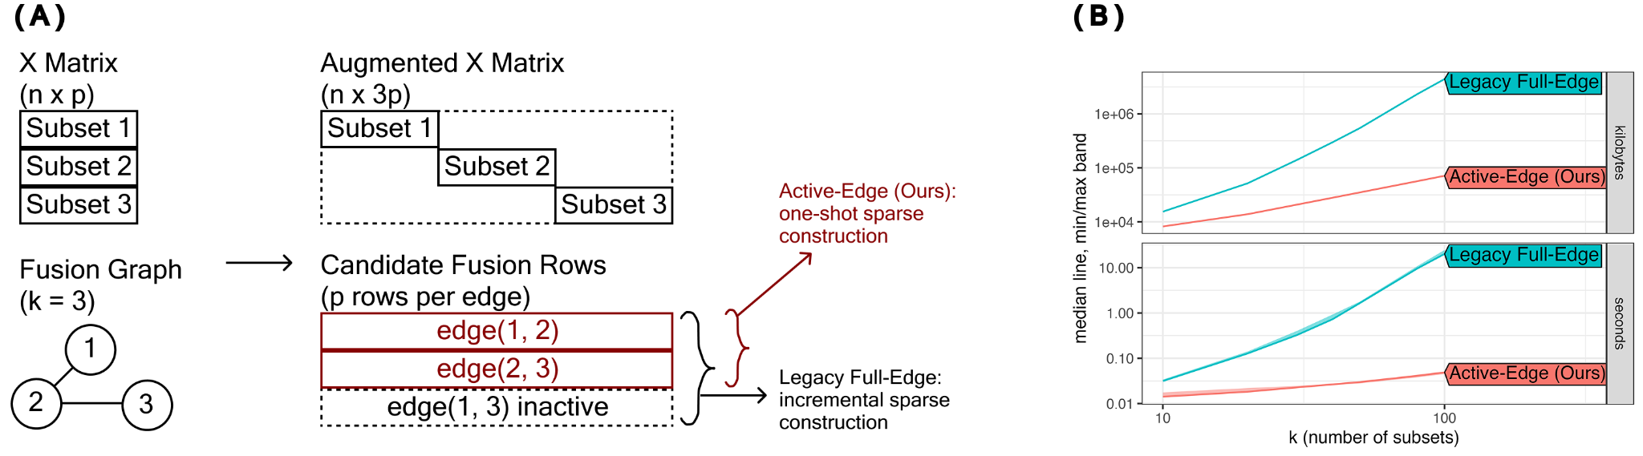
L2 Optimization Concept
Augmented Matrix Construction. Legacy Full-Edge (Dondelinger et. al 2016) forms a combined constraint matrix.
Asymptotic Complexity. Synthetic data with p = 120, n_group_train = 35 so at k = 100, n = 3500. Graph is sparse chain structure. All other hyper-params are fixed. From O(pk^2) to O(pm)

Slide 19
Real Grouped Regression Benchmark Datasets
Real Data | N | P | K | SubsetType | Citation
communities_crime | 1,991 | 100 | 43 | Cities | Redmond, M. (2002). Communities and Crime [Dataset].
rdatasets_exam_inner_london | 4057 | 7 | 64 |  | Goldstein, H., Rasbash, J., et al. (1993). A multilevel analysis of school examination results. Oxford Review of Education, 19, 425–433
rdatasets_dietox | 861 | 6 | 72 |  | Lauridsen, C., Højsgaard, S., & Sørensen, M. T. C. (1999). Influence of dietary rapeseed oil, vitamin E, and copper on pigs. Journal of Animal Science, 77, 906–916
rdatasets_crime4 | 630 | 57 | 90 |  | Cornwell, C., & Trumbull, W. N. (1994). Estimating the economic model of crime with panel data. Review of Economics and Statistics, 76, 360–366.
electricity_load | 200000 | 3 | 120 |  | Trindade, A. (2015). UCI ML Repository. https://doi.org/10.24432/C58C86
rdatasets_empluk | 1031 | 5 | 140 |  | Arellano, M., & Bond, S. (1991). Some tests of specification for panel data. Review of Economic Studies, 58, 277–297.
school_ilea | 7185 | 10 | 160 |  | Pinheiro, J., Bates, D., & R Core Team. (2025). nlme (R package).

Slide 20
Experimental Setup
Sparse Graph: Normally, graphs are set using a pre-determined information (priori). In our set-up, we adapted the k-NN initial sparse graph (Idea taken from Hallac et al. 2015 and Padilla et al. 2020) as a data-driven way to build the initial graph. Implementation builds k-NN from group centroids on training data and uses the inverse distance for the 5 closest neighbors (other group centroids), then we symmetrize the output.
Hyper-param Tuning: We warm start the lambda using cv.glmnet then we use that to tune the gamma using 3-Fold CV.
Metrics: 5 fold CV RMSE, wall time (fit stage elapsed time), peak RSS (fit worker peak RSS).
Environment: Monsoon, R

Slide 21
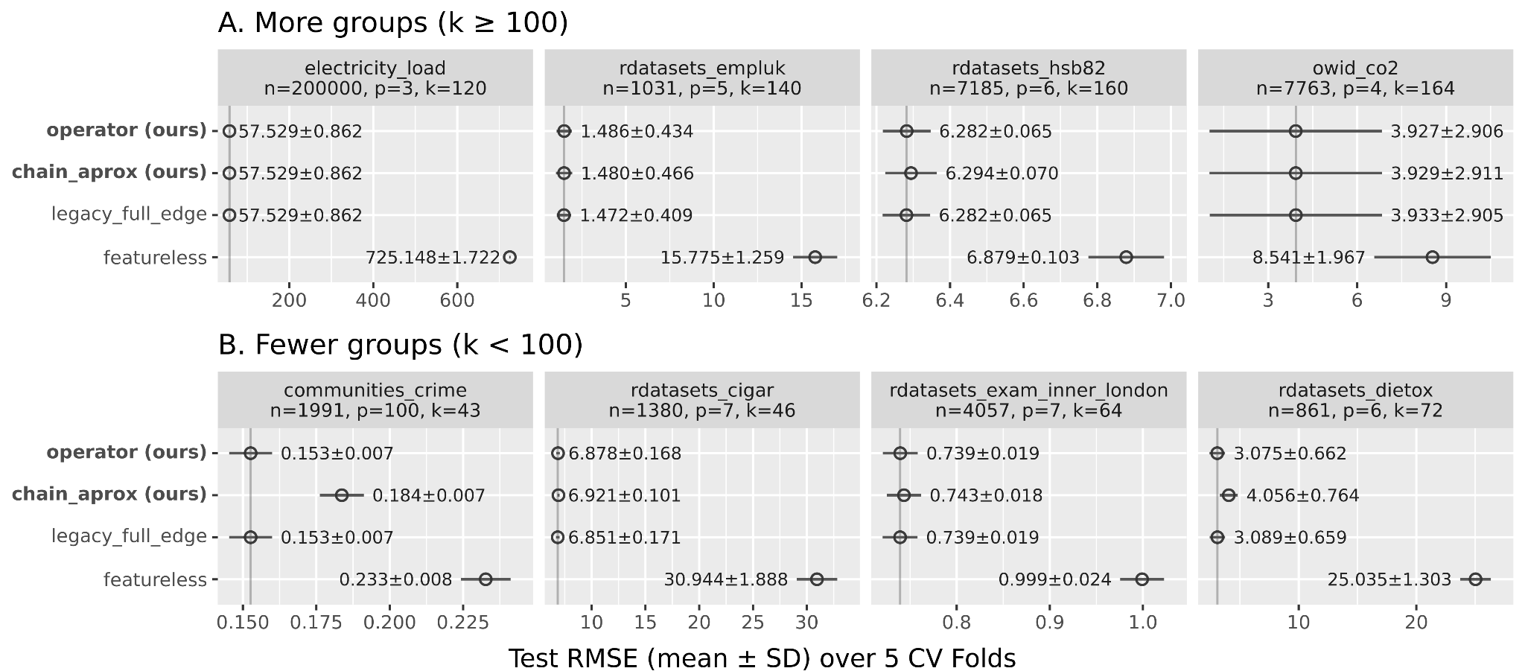
L1 RMSE Test Error Experiment
>= 100, get rid of it
Given the same budget and same hyper-param tuning strategy, are our proposed L1 methods similar to the legacy full edge in prediction.

Slide 22
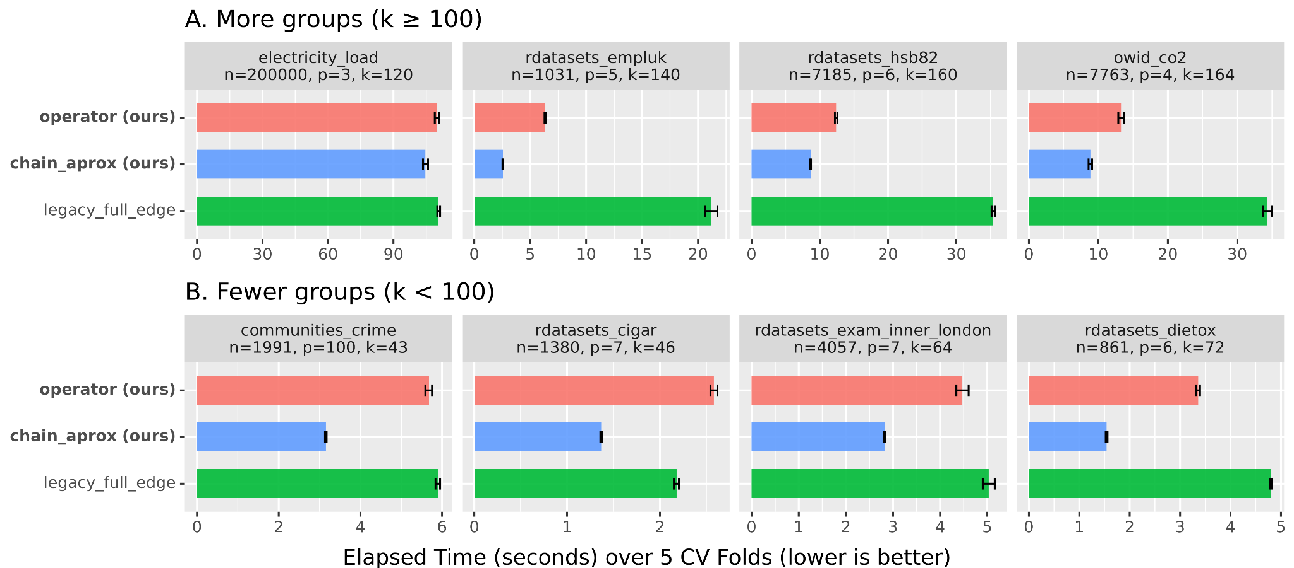
L1 Timing Experiment
Same color
log
Given that are our proposed L1 solvers are similar to the legacy full edge in terms of prediction, how much time do we save with them?

Slide 23
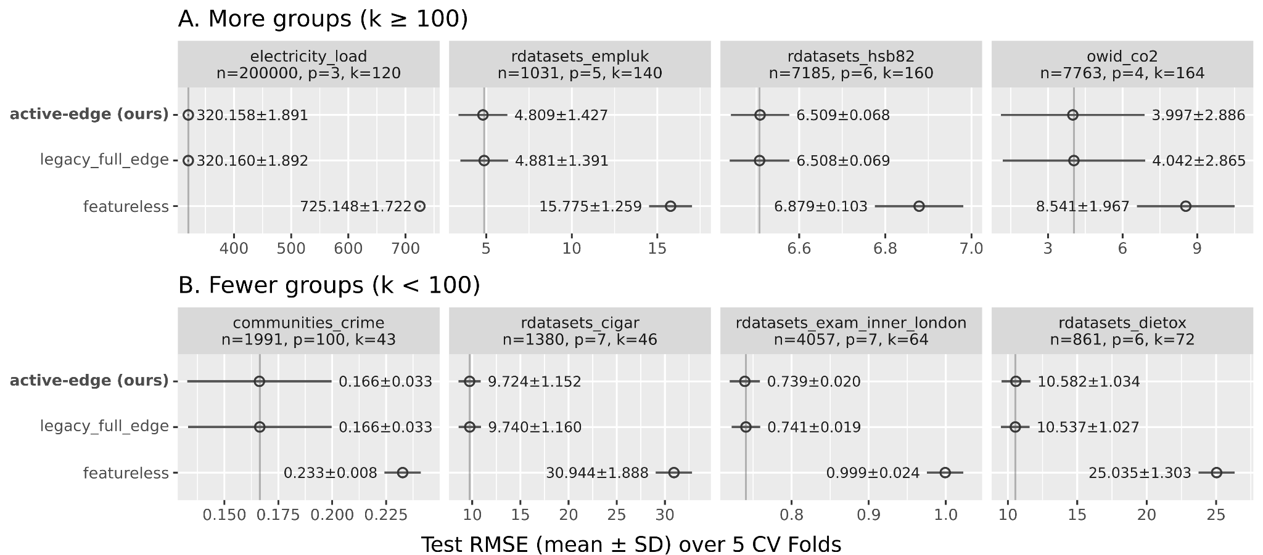
L2 RMSE Test Error Experiment
Given the same budget and same hyper-param tuning strategy, is our proposed L2 method similar to the legacy full edge in prediction.

Slide 24
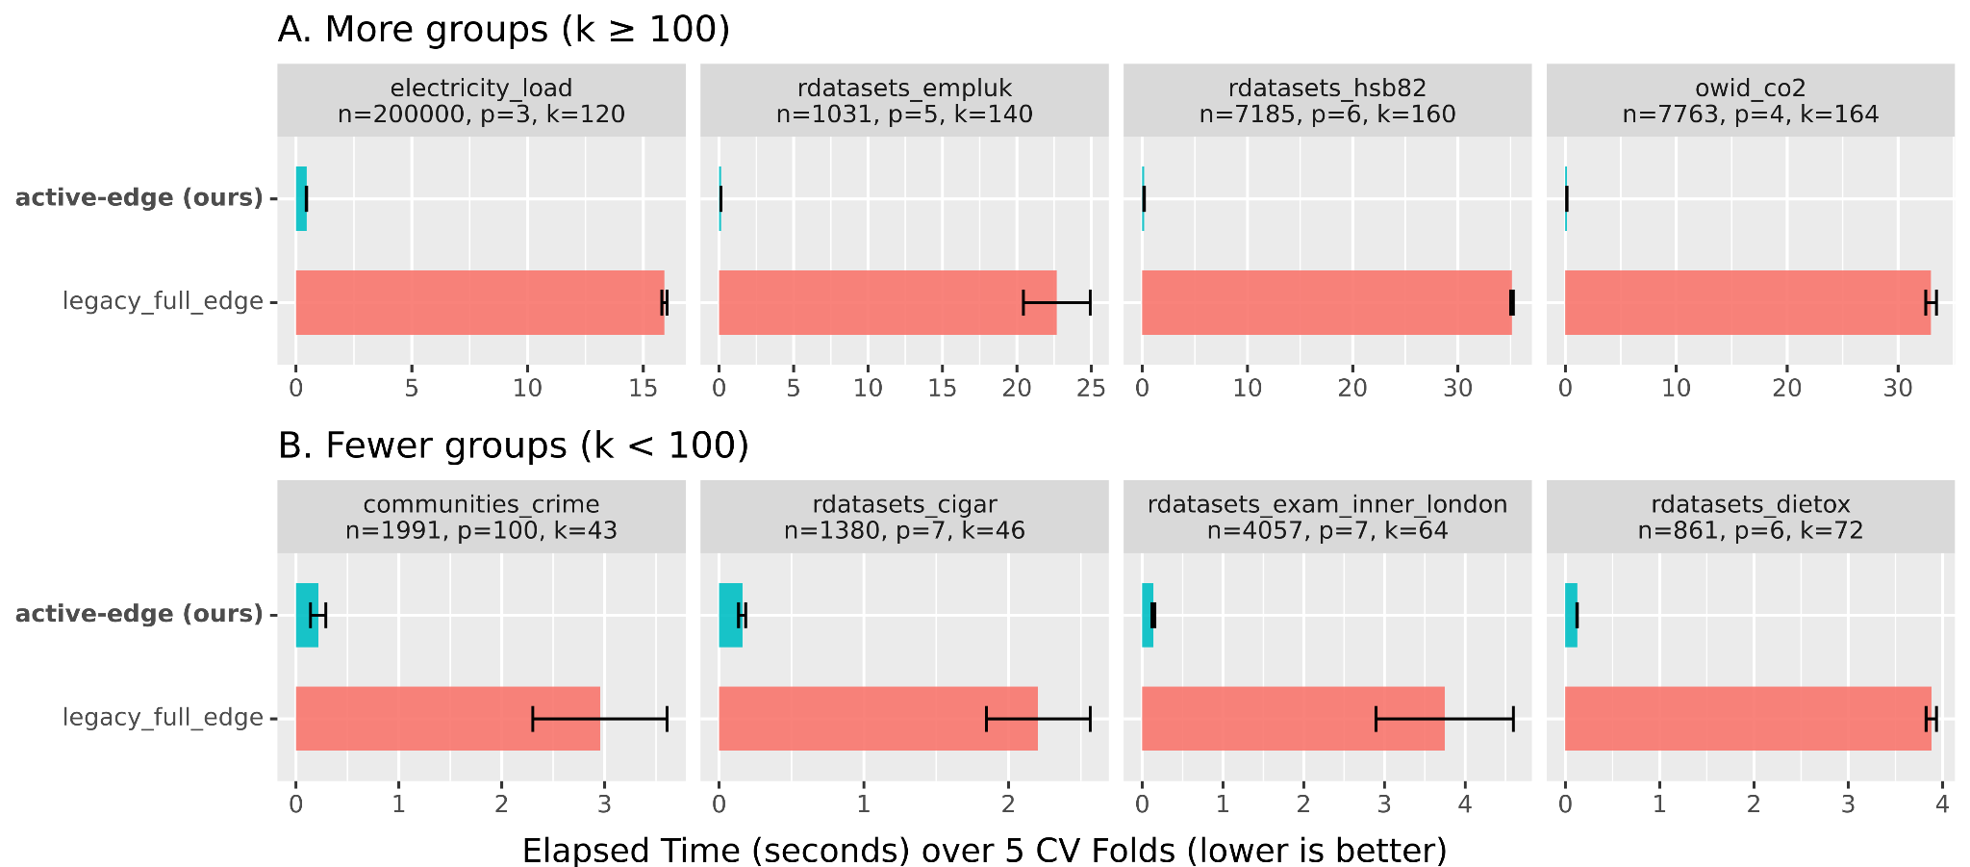
L2 Timing Experiment
Given that our proposed L1 method is the same as the legacy full edge in terms of prediction, how much time do we save with them?

Slide 25
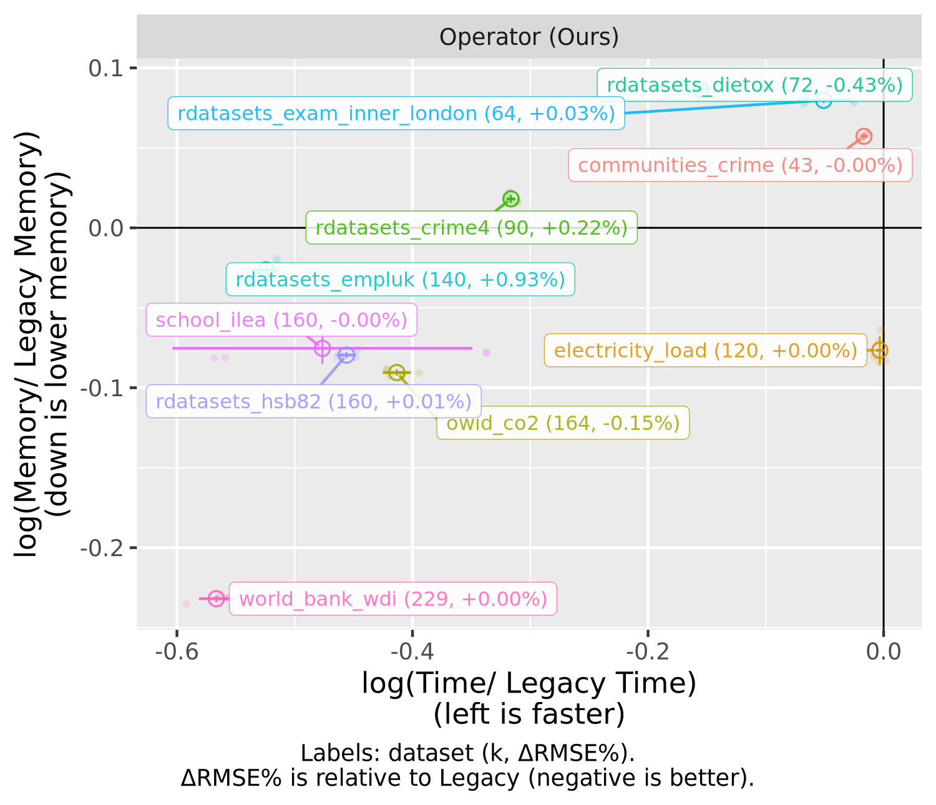
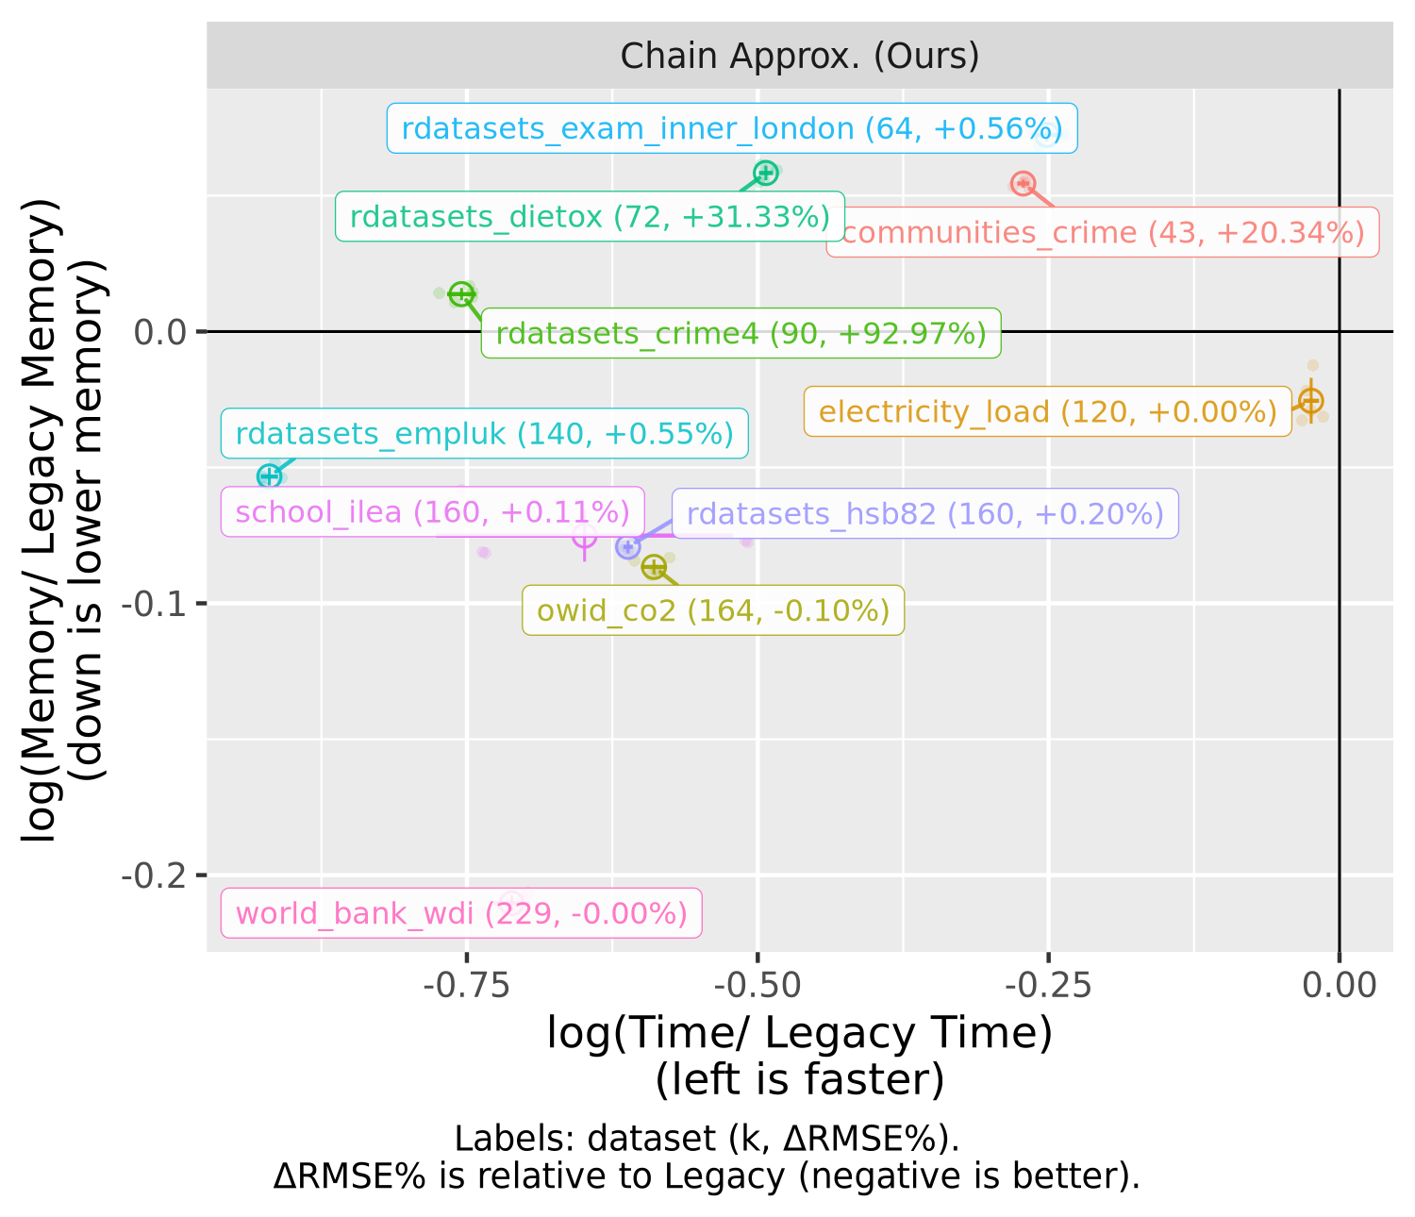
Put n and p too
Get rid of it.. rdatasets
L1 Pareto Experiment
How much time and space do we save for each of the real datasets we tested?

Slide 26
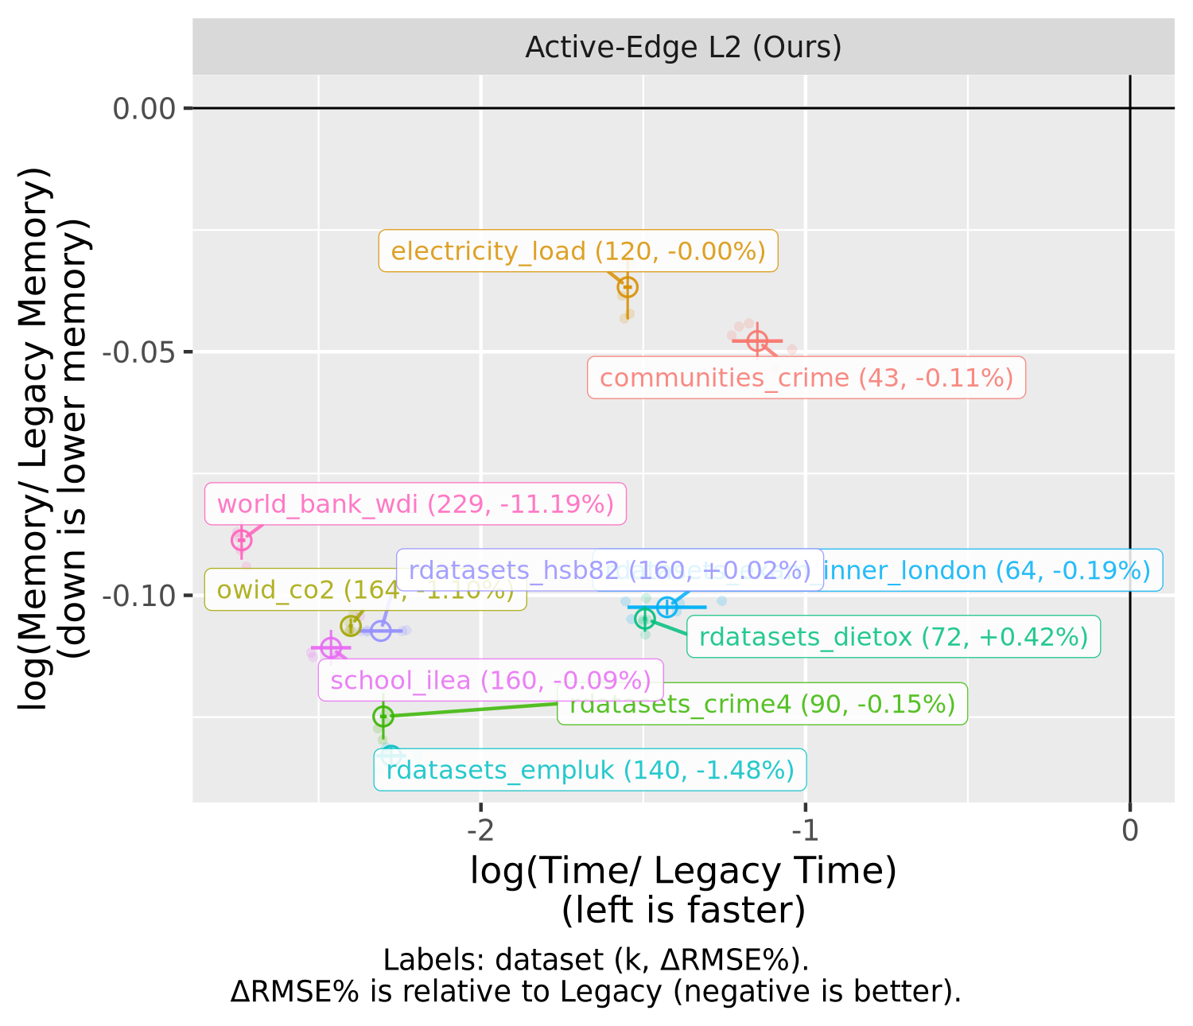
L2 Pareto Experiment
How much time and space do we save for each of the real datasets we tested for the L2 experiment?
Add glmnet Why do we need fuser at all.

Slide 27
Hallac, Leskovec, Boyd (KDD 2015), Network Lasso: Clustering and Optimization in Large Graphs
https://stanford.edu/~boyd/papers/network_lasso.html
PDF: https://stanford.edu/~boyd/papers/pdf/network_lasso.pdf
Padilla et al. (Biometrika 2020), Adaptive nonparametric regression with the K-nearest neighbour fused lasso
https://pmc.ncbi.nlm.nih.gov/articles/PMC7228543/
Data (internal id) n p k Citation you can use in paper
communities_crime 1991 100 43 Redmond, M. (2002). Communities and Crime [Dataset]. UCI ML Repository. https://doi.org/10.24432/C53W3X
rdatasets_dietox 861 6 72 Lauridsen, C., Højsgaard, S., & Sørensen, M. T. C. (1999). Influence of dietary rapeseed oil, vitamin E, and copper on pigs. Journal of Animal Science, 77, 906–916. (via geepack::dietox)
rdatasets_exam_inner_london 4057 7 64 Goldstein, H., Rasbash, J., et al. (1993). A multilevel analysis of school examination results. Oxford Review of Education, 19, 425–433. (via mlmRev::Exam)
rdatasets_crime4 630 57 90 Cornwell, C., & Trumbull, W. N. (1994). Estimating the economic model of crime with panel data. Review of Economics and Statistics, 76, 360–366. (via wooldridge::crime4)
rdatasets_empluk 1031 5 140 Arellano, M., & Bond, S. (1991). Some tests of specification for panel data. Review of Economic Studies, 58, 277–297. (via plm::EmplUK)
school_ilea 7185 10 160 Pinheiro, J., Bates, D., & R Core Team. (2025). nlme (R package). https://doi.org/10.32614/CRAN.package.nlme ; Pinheiro, J. C., & Bates, D. M. (2000). Mixed-Effects Models in S and S-PLUS. Springer. (inferred: your school_ilea is built from nlme::MathAchieve + MathAchSchool)
rdatasets_hsb82 7185 6 160 Raudenbush, S., & Bryk, A. (2002). Hierarchical Linear Models (Chapter 4). Sage. (for mlmRev::Hsb82)
owid_co2 7763 4 164 Ritchie, H., Rosado, P., & Roser, M. (2023). CO₂ and Greenhouse Gas Emissions (Our World in Data). (dataset pages cite Global Carbon Budget with OWID processing)
electricity_load 200000 3 120 Trindade, A. (2015). ElectricityLoadDiagrams20112014 [Dataset]. UCI ML Repository. https://doi.org/10.24432/C58C86
world_bank_wdi 10830 4 229 World Bank. World Development Indicators (DataBank database). https://databank.worldbank.org/id/464fc223 (DataBank marks source as WDI and instructs indicator-level metadata citation)

