Slide 1


Slide 2
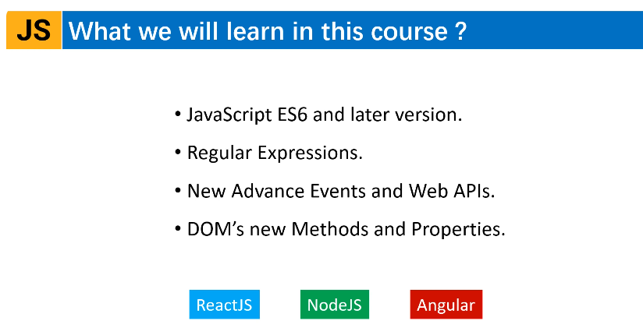

Slide 3


Slide 4
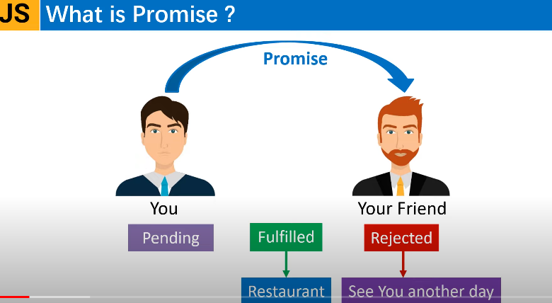

Slide 5
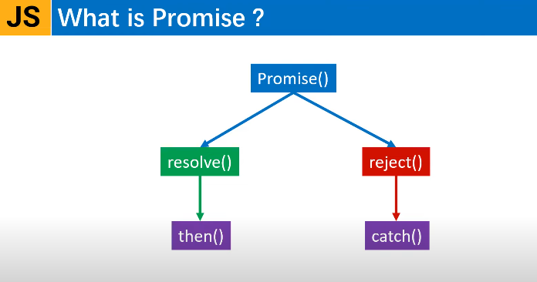

Slide 6
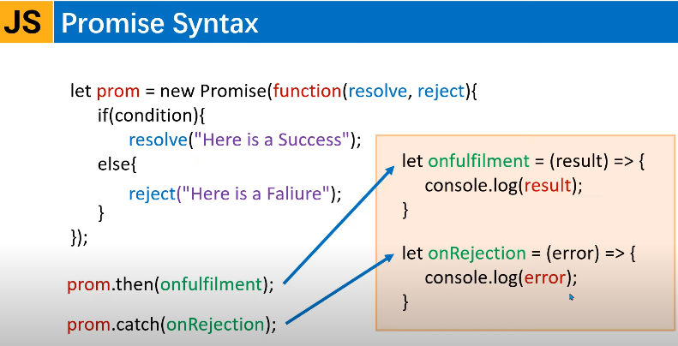

Slide 7


Slide 8
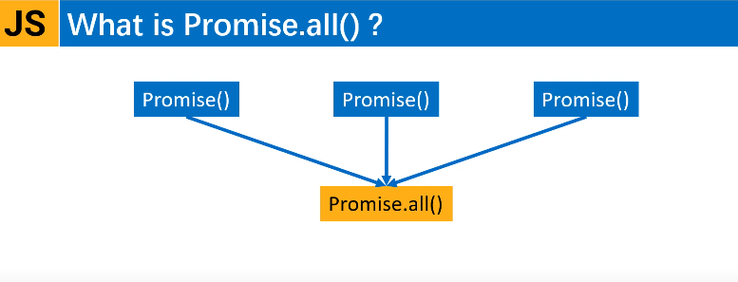

Slide 9
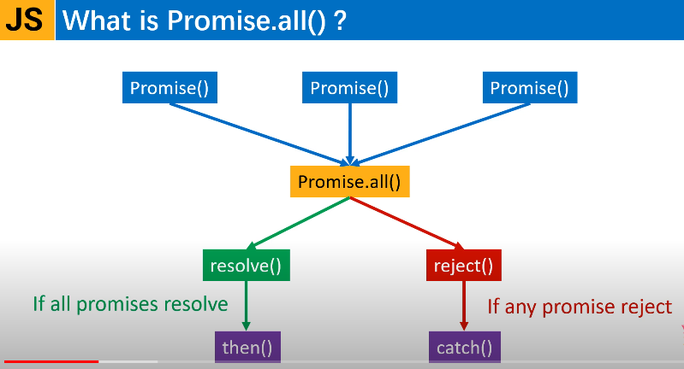

Slide 10
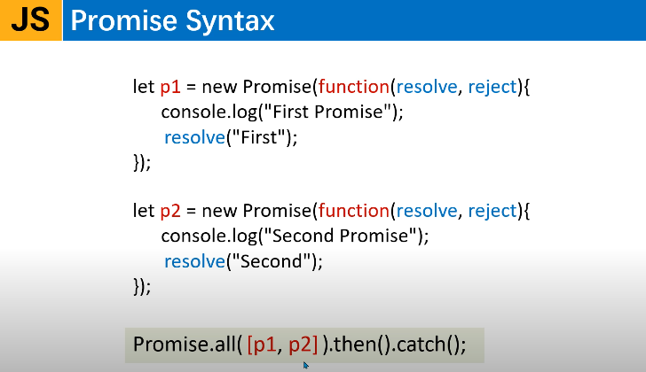

Slide 11
// Creating a simple Promise
const myPromise = new Promise((resolve, reject) => {
const isSuccessful = true; // Change this to false to test rejection
if (isSuccessful) {
resolve("The promise was fulfilled!");
} else {
reject("The promise was rejected.");
}
});
// Consuming the Promise
myPromise
.then((message) => {
console.log(message); // Logs if the promise is resolved
})
.catch((error) => {
console.error(error); // Logs if the promise is rejected
});

Slide 12


Slide 13
