Slide 1


Slide 2
Object Oriented Programming
Presented By : Muhammad Hamza

Slide 3
Topics Outline
Introduction to OOP
OOP Concepts and Examples
OOP Classes and Objects Example
OOP Principles
Code Implementation and Examples
Conclusion

Slide 4
Introduction to OOP
Object-Oriented Programming (OOP) is a programming paradigm that relies on the concept of Objects & Classes. With the help of this core principle, designing code and building software becomes much easier. Object-Oriented Programming makes it easier to create modular, reusable, and maintainable software.

Slide 5
OOP Concepts and Examples
OOP stands for Object-Oriented Programming.
Object-oriented programming is about creating objects that contain both data and methods.
OOP is faster and easier to execute.
OOP provides a clear structure for the programs.

Slide 6
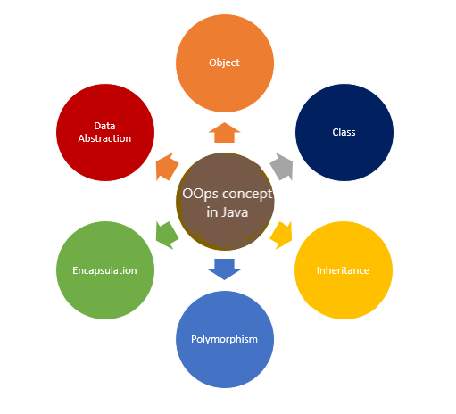

Slide 7
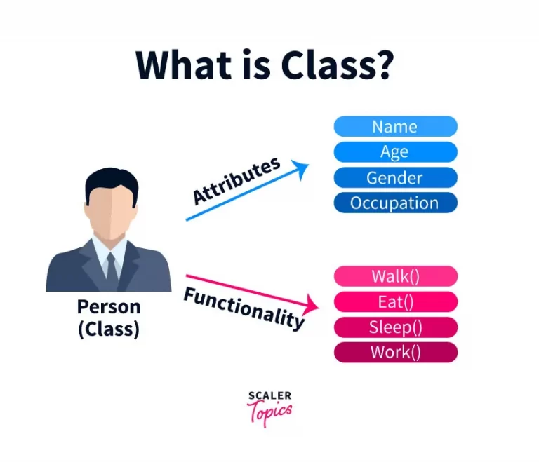
Class and Object

Slide 8
Class and Object Example
Public Class Person // Class (Person)
{
public string Name {get; set;}
public string Age {get; set;}
public void Walk() // Functionality/Method
{
Console.WriteLine(“This person is walking !!”);
}
}
Program.cs
Person p = new Person(); // Create an Object (Person)
p.Name = "Ali";
p.Age = 25;
p.Walk();
Console.WriteLine(p.Name);
Console.WriteLine(p.Age);
Console.Read();
Attributes

Slide 9
OOP Principles
Encapsulation: The meaning of Encapsulation is to make sure that “ Sensitive” data is hidden from users.
Inheritance: The ability of a class to inherit properties and methods from its parent class.
Polymorphism: The ability to use a single interface to represent different types or forms.
Abstraction: Abstraction is a process of hiding certain information details and showing essential information's to the users.

Slide 10
Code Implementation and Examples (OOP Principles)

Slide 11
Encapsulation
Public class Person { // Class Person
Private string name; // Data is Hidden
Public string Name {
get { return name; }
set {name = value;}
} }
Program.cs
Person p = new Person(); // Create an Object
p.Name = “Ali”;
Console.Writeline(p.Name);
Console.ReadLine();
Encapsulated Behavior

Slide 12
Inheritance
Public Class Animal { // Base Class
Public void Eat() {
Console.WriteLine(“All animal eating food..”);
} }
Public Class Dog : Animal { // Derived Class that inherits from an another class
Public void Bark() {
Console.WriteLine(“The Dog is Barking..”) ;
} }
Program.cs
Animal a = new Animal(); // Create an object Animal
a.Eat();
Dog d = new Dog(); // Create an object Dog
d.Bark();

Slide 13
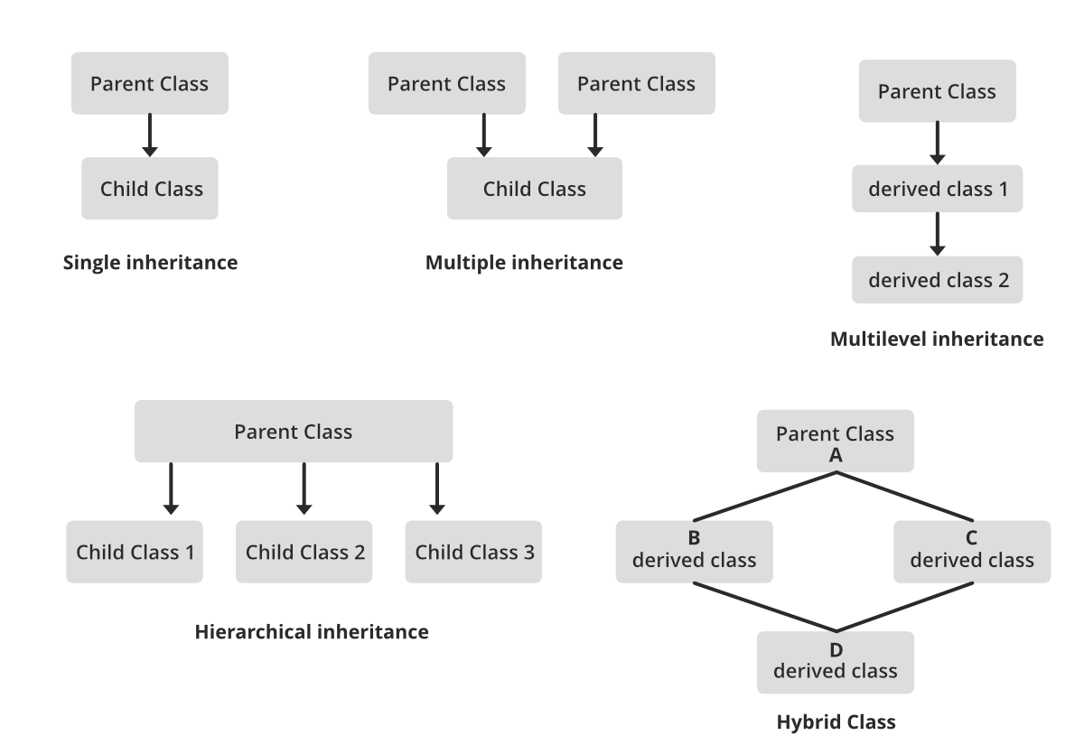
Types of Inheritance

Slide 14
Polymorphism
There are two types of polymorphism: compile-time polymorphism (static polymorphism) and runtime polymorphism (dynamic polymorphism).
Compile Time Polymorphism (Method Overloading)
Run Time Polymorphism (Method Overriding)

Slide 15
Polymorphism (Method Overloading/Compile Time)
Public Class Calculator {
Public void Add(int a , int b) // Same name same class but different perameters:
{
Return a+b;
}
Public void Add(int a , int b , int c) // Same name same class but different perameters:
{
Return a+b+c;
}
Program.cs
Calculator calculator = new Calculator();
int result1 = calculator.Add(5, 10); // Calls the first Add method with two arguments.
int result2 = calculator.Add(2, 4, 6); // Calls the second Add method with three arguments. Console.WriteLine(result1);
Console.WriteLine(result2);

Slide 16
Polymorphism (Method Overriding/Run Time)
Public Class Animal { //Base class
Public virtual void MakeSound()
{
Console.WriteLine(“Animal make a sound..”);
} }
Public Class Dog : Animal // Derived class inherit with Base class.
{
Public override void MakeSound() // MakeSound() method is overriding in the (Dog ) class. These are called Run Time.
{
Console.WriteLine(“The Dog Barks..”);
} }
Program.cs
Animal a = new Animal(); // Object Animal
Animal dog = new Dog(); //Object Dog
a.MakeSound();
Dog.MakeSound();

Slide 17
Abstraction
Public abstract Class Vehicle { // Base Class
Public abstract void Start();
public abstract void Stop();
Public Class Car : Vechicle { // Derived Class
Public override void Start() {
Console.WriteLine("Car Engine Started..");
}
public override void Stop() {
Console.WriteLine("Car Enigine Stoped !!");
}
}
Program.cs
Car c = new Car(); // Create a Car object
c.Start();
c.Stop();

Slide 18
Conclusion
Summarize the key points discussed in the presentation, emphasizing the importance and relevance of OOP in modern software development.

Slide 19
Procedural Programming
Presented By : Muhammad Hamza

Slide 20
Topics Outline
Introduction to Procedural Programming
Procedural Programming Concepts and Examples
Hierarchical charts
Key Features of Procedural Programming
Advantages
Disadvantages
Code Implementation and Examples
Difference between OOP and Procedural Programming
Conclusion

Slide 21
Introduction to POP
This programming approach involves breaking down a task into smaller routines (or subroutines) and using variables.
It follows a step-by-step sequence of instructions, ensuring that the computer can understand and execute each step in order.

Slide 22
POP Concepts and Examples
Procedural Oriented programming is divided into small parts called functions.
The Procedural Programming follows a Top-Down approach.
It does not provide any inheritance.
There is no concept of virtual classes.
The case of overloading isn’t possible in the case of Procedural Programming.
Some common examples of Procedural Programming are C, Fortran, VB, and Pascal.

Slide 23
Hierarchical charts:

Slide 24
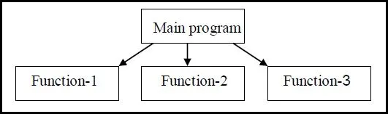

Slide 25
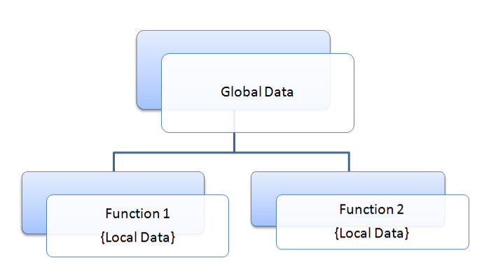
Function Can Communicate with Global variables

Slide 26
Key Features of Procedural Programming
Predefined functions
Predefined functions, also known as built-in functions or standard library functions
Global Variable
A global variable is a variable that is declared at the top level of a program and is accessible from any part of the program
Local Variable
A local variable is a variable that is declared within a specific block, function, or procedure.
Parameter Passing
There are different ways of parameter passing, including pass-by-value and pass-by-reference (or pass-by-pointer).

Slide 27
Advantages
Procedural Programming is excellent for general-purpose programming.
The coded simplicity along with ease of implementation of compilers and interpreters.
The program flow can be tracked easily.

Slide 28
Disadvantages
The Procedural code is often not reusable, which may pose the need to recreate the code if is needed to use in another application
Difficult to relate with real-world objects.
The data is exposed to the whole program, making it not so much security friendly.

Slide 29
Code Implementation and Examples with (POP & OOP)

Slide 30
#include <stdio.h>
// Function to calculate the sum of two numbers
int calculateSum(int num1, int num2)
{
return num1 + num2;
}
int main()
{
int number1, number2;
printf("Enter the first number: ");
scanf("%d", &number1);
printf("Enter the second number: ");
scanf("%d", &number2);
int sum = calculateSum(number1, number2);
printf("Sum: %d\n", sum);
return 0;
}

Slide 31
using System;
namespace ObjectOrientedExample
{
class Calculator
{
public int CalculateSum(int num1, int num2)
{
return num1 + num2;
}
}
class Program
{
static void Main(string[] args)
{
Calculator calculator = new Calculator();
Console.Write("Enter the first number: ");
int number1 = Convert.ToInt32(Console.ReadLine());
Console.Write("Enter the second number: ");
int number2 = Convert.ToInt32(Console.ReadLine());
int sum = calculator.CalculateSum(number1, number2);
Console.WriteLine("Sum: " + sum);
}
}
}

Slide 32
Difference between OOP and Procedural Programming

Slide 33
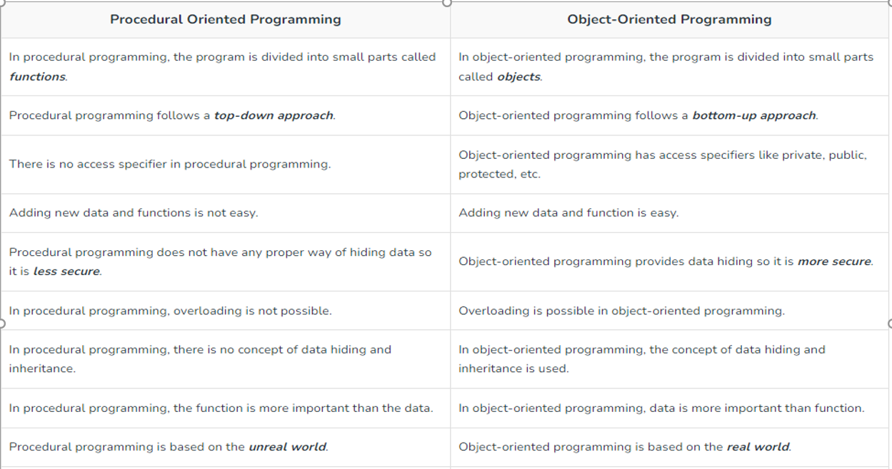

Slide 34
Conclusion
The most important difference that you should note here is that procedural programming follows a step-by-step approach to break down a job into a collection of routines and variables by following a series of instructions.
object-oriented programming uses objects and classes to create models based on real world environment.

Slide 35


