Slide 1


Inside : Designing Modernistic Websites
Session – 01
Introduction to
the Web
Prepared by: Sir Muhammad Hamza
1

Slide 2
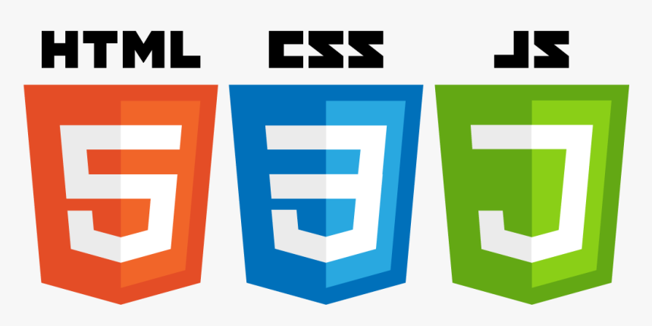

Objectives
Explain evaluation of HTML
Explain the page structure used by HTML
List the drawbacks in HTML 4 XHTML
List the new features of HTML5
Explain CSS
Explain JavaScript
Explain jQuery
Explain browser support for HTML5
Prepared by: Sir Muhammad Hamza

Slide 3

Introduction
Hypertext Markup Language was introduced in 1990.
HTML5 was recommended as a standard by W3C in 1997.
HTML5 is the next version and will be the new standard.
Majority of the browsers support HTML5 element and Application Programming Interface (API) .
Prepared by: Sir Muhammad Hamza
3

Slide 4
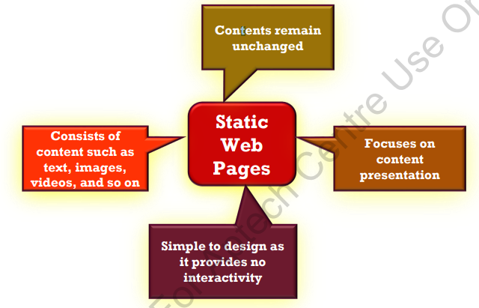
Static Web Pages
Prepared by: Sir Muhammad Hamza
4

Slide 5
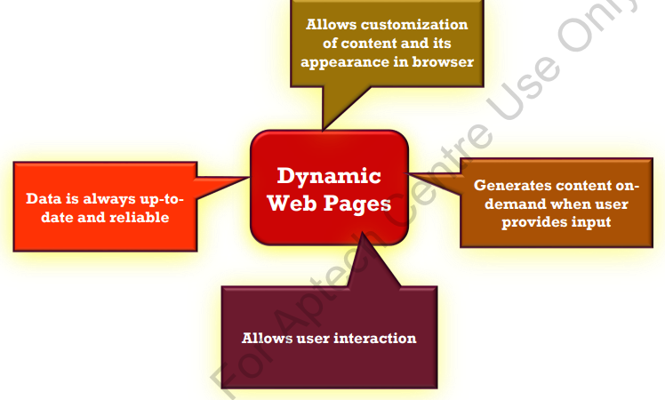
Dynamic Web Pages
Prepared by: Sir Muhammad Hamza
5

Slide 6
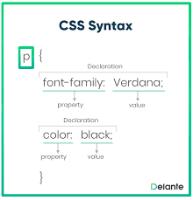
Introduction to CSS
CSS stands for Cascading Style Sheets. CSS describes how HTML elements are to be displayed on screen, paper, or in other media. CSS saves a lot of work. It can control the layout of multiple web pages all at once. External stylesheets are stored in CSS files.

Slide 7
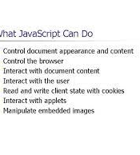
JavaScript
JavaScript is a scripting language for creating dynamic web page content. It creates elements for improving site visitors' interaction with web pages, such as dropdown menus, animated graphics, and dynamic background colors.

Slide 8
jQuery
What is jQuery? jQuery is a fast, small, and feature-rich JavaScript library. It makes things like HTML document traversal and manipulation, event handling, animation, and Ajax much simpler with an easy-to-use API that works across a multitude of browsers

Slide 9


Slide 10
Session-1 End
Thank You
Any Question?
Prepared by: Sir Muhammad Hamza
10

