Slide 1


Session – 04
Creating Hyperlinks
And Anchors
Prepared by: Sir Muhammad Hamza
1

Slide 2


Objectives
Describe Hyperlinks
Explain Absolute and Relative paths
Explain how to Hyperlink to a Web page and Email address
Explain how to Hyperlink to anchors and other content
Prepared by: Sir Muhammad Hamza

Slide 3
Hyperlinks [1-2]
HTML links are hyperlinks.
You can click on a link and jump to another document.
When you move the mouse over a link, the mouse arrow will turn into a little hand.
Note: A link does not have to be text. A link can be an image or any other HTML element!
The HTML <a> tag defines a hyperlink. It has the following syntax:
<a href="url">link text</a>
Prepared by: Sir Muhammad Hamza
3

Slide 4
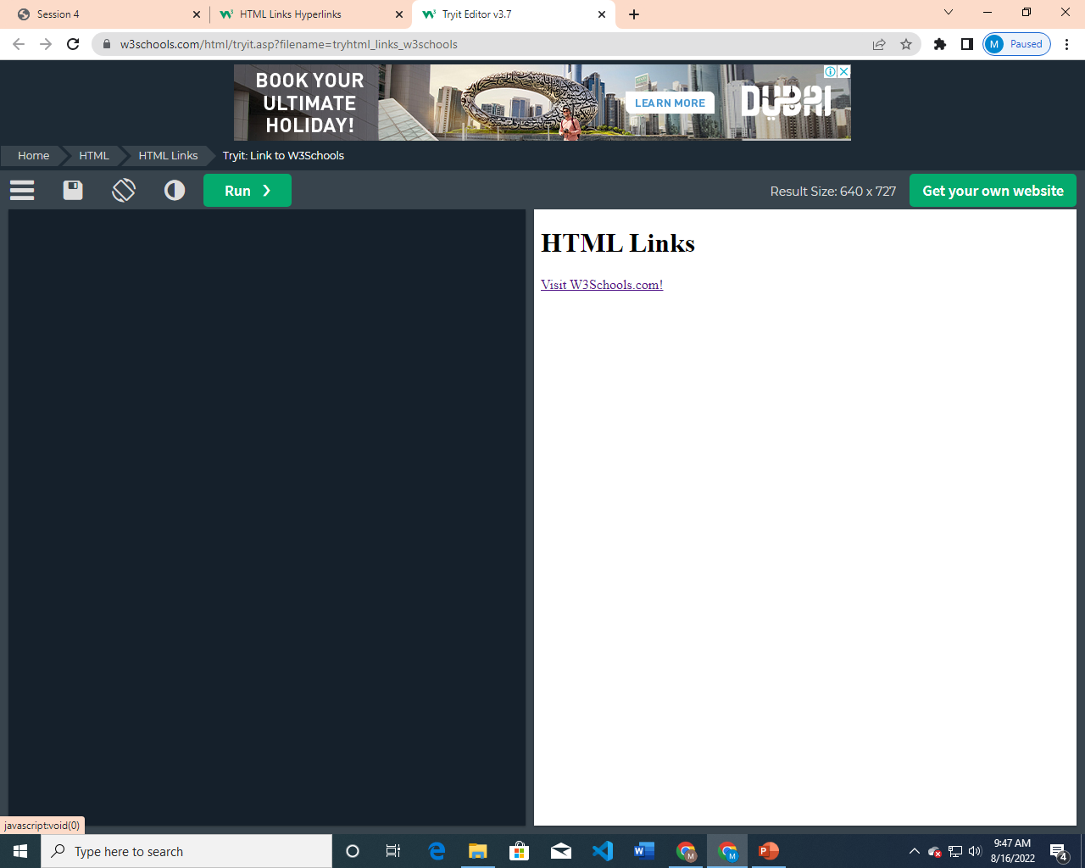
Hyperlinks [2-2]
<!DOCTYPE html>
<html>
<body>
<h1>HTML Links</h1>
<p><a href="https://www.w3schools.com/">Visit W3Schools.com!</a></p>
</body>
</html>
Prepared by: Sir Muhammad Hamza
4

Slide 5
Target Attribute
The target attribute specifies where to open the linked document
Value | Description
_blank | Opens the linked document in a new window or tab
_self | Opens the linked document in the same frame as it was clicked (this is default)
_parent | Opens the linked document in the parent frame
_top | Opens the linked document in the full body of the window
Prepared by: Sir Muhammad Hamza
5

Slide 6
HTML File Paths
A file path describes the location of a file in a web site's folder structure.
Path | Description
<img src="picture.jpg"> | The "picture.jpg" file is located in the same folder as the current page
<img src="images/picture.jpg"> | The "picture.jpg" file is located in the images folder in the current folder
<img src="/images/picture.jpg"> | The "picture.jpg" file is located in the images folder at the root of the current web
<img src="../picture.jpg"> | The "picture.jpg" file is located in the folder one level up from the current folder
Prepared by: Sir Muhammad Hamza
6

Slide 7
File Path Types
Absolute Path
An absolute file path is the full URL to a file:
<img src="https://www.w3schools.com/images/picture.jpg" alt="Mountain">
Relative Path
A relative file path points to a file relative to the current page.
In the following example, the file path points to a file in the images folder located at the root of the current web:
<img src="picture.jpg" alt="Mountain">
<img src="/images/picture.jpg" alt="Mountain">
<img src="images/picture.jpg" alt="Mountain">
<img src="../images/picture.jpg" alt="Mountain">
Prepared by: Sir Muhammad Hamza
7

Slide 8
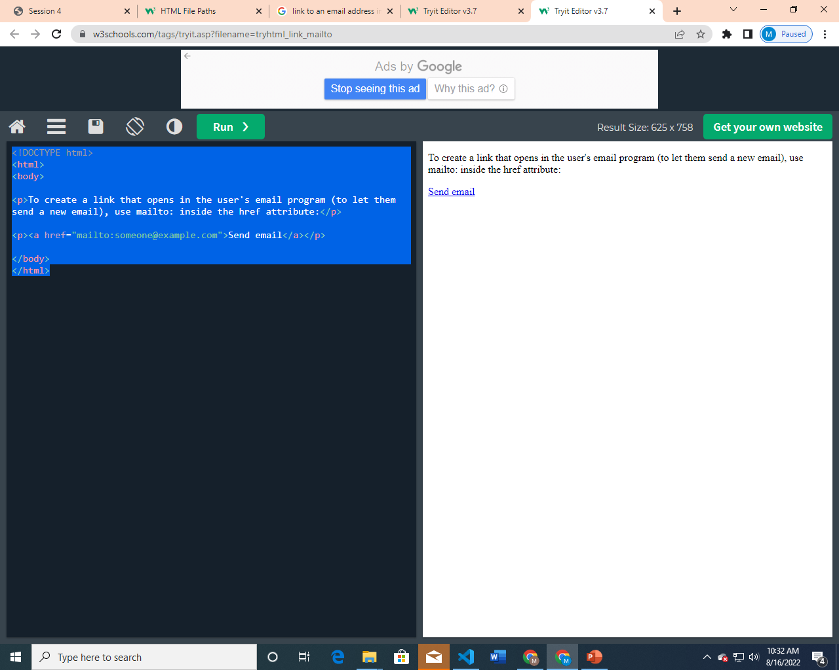
Hyperlink to an E-mail Address
<!DOCTYPE html>
<html>
<body>
<p>To create a link that opens in the user's email program (to let them send a new email), use mailto: inside the href attribute:</p>
<p><a href="mailto:someone@example.com">Send email</a></p>
</body>
</html>
Prepared by: Sir Muhammad Hamza
8

Slide 9
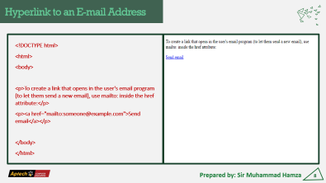
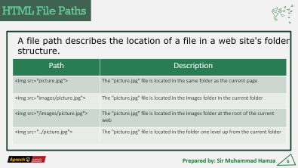
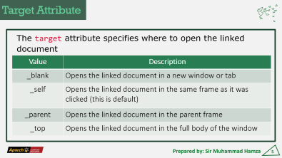
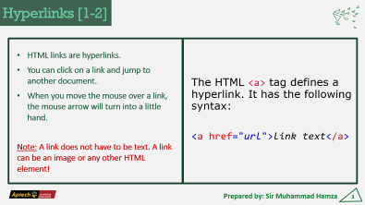
Summary
Prepared by: Sir Muhammad Hamza
9

Slide 10
Session-4 End
Thank You
Any Question?
Prepared by: Sir Muhammad Hamza

