Slide 1


Session – 5
Introduction to CSS (Cascading Style Sheet)
Prepared by: Sir Muhammad Hamza
1

Slide 2

Objectives
Identify the new function of CSS
Explain the different types of Selectors
Explain the Nested Tags
Define Class and ID for applying style
Explain the process to apply style to hyperlink
Prepared by: Sir Muhammad Hamza

Slide 3
Introduction
CSS stands for Cascading Style Sheets
CSS is the language we use to style an HTML document.
CSS describes how HTML elements should be displayed.
It informs the browser how to present a document.
Prepared by: Sir Muhammad Hamza
3

Slide 4
CSS 3
Used for adding style such as fonts, colors and spacing to Web document
Has multiple levels and profiles.
Updates each level of CSS from the earlier version, by adding new features.
Denotes version as CSS1, CSS2, CSS3 and CSS4, where the numbers are different for each version or level.
Is divided into multiple documents called ‘modules’ and each of these modules have new capabilities or extend the features present in CSS2
Started drafting of CSS3 when publication of the original CSS2 recommendation was released.
Prepared by: Sir Muhammad Hamza
4

Slide 5
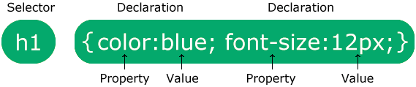
CSS Syntax [1-2]
Prepared by: Sir Muhammad Hamza
5

Slide 6
CSS Syntax [2-2]
A CSS rule consists of a selector and a declaration block.
The selector points to the HTML element you want to style.
The declaration block contains one or more declarations separated by semicolons.
Each declaration includes a CSS property name and a value, separated by a colon.
Multiple CSS declarations are separated with semicolons, and declaration blocks are surrounded by curly braces
Prepared by: Sir Muhammad Hamza
6

Slide 7
CSS Measurement Units [1-2]
CSS has several different units for expressing a length.
Many CSS properties take "length" values, such as width, margin, padding, font-size, etc.
Length is a number followed by a length unit, such as 10px, 2em, etc.
h1 { font-size: 60px; } p { font-size: 25px; line-height: 50px; }
Prepared by: Sir Muhammad Hamza
7

Slide 8
CSS Measurement Units [1-2]
The ABSOLUTE LENGTH units are fixed and a length expressed in any of these will appear as exactly that size.
Unit | Description
cm | Centimeters
mm | Millimeters
in | inches (1 in = 96px =2.54cm)
px | pixels (1px = 1/96th of 1in)
pt | points (1pt = 1/72 of 1in)
pc | picas (1pc = 12 pt)
Prepared by: Sir Muhammad Hamza
8

Slide 9
CSS Measurement Units [2-2]
RELATIVE LENGTH units specify a length relative to another length property. Relative length units scales better between different rendering mediums.
Unit | Description
em | Relative to the font-size of the element (2em means 2 times the size of the current font)
vw | Relative to 1% of the width of the viewport*
vh | Relative to 1% of the height of the viewport*
% | Relative to the parent element
Prepared by: Sir Muhammad Hamza
9

Slide 10
Types of Style Sheets
CSS can be added to HTML documents in 3 ways:
Inline - by using the style attribute inside HTML elements
Internal - by using a <style> element in the <head> section
External - by using a <link> element to link to an external CSS file
The most common way to add CSS, is to keep the styles in external CSS files.
Prepared by: Sir Muhammad Hamza
10

Slide 11
Inline CSS
An inline CSS is used to apply a unique style to a single HTML element.
An inline CSS uses the style attribute of an HTML element.
The following example sets the text color of the <h1> element to blue, and the text color of the <p> element to red:
<h1 style="color:blue;">A Blue Heading</h1> <p style="color:red;">A red paragraph.</p>
Prepared by: Sir Muhammad Hamza
11

Slide 12
Internal CSS
An internal CSS is used to define a style for a single HTML page.
An internal CSS is defined in the <head> section of an HTML page, within a <style> element.
<!DOCTYPE html> <html> <head> <style> body {background-color: powderblue;} h1 {color: blue;} p {color: red;} </style> </head> <body> <h1>This is a heading</h1> <p>This is a paragraph.</p> </body> </html>
Prepared by: Sir Muhammad Hamza
12

Slide 13
External CSS
An external style sheet is used to define the style for many HTML pages.
To use an external style sheet, add a link to it in the <head> section of each HTML page:
<!DOCTYPE html> <html> <head> <link rel="stylesheet" href="styles.css"> </head> <body> <h1>This is a heading</h1> <p>This is a paragraph.</p> </body> </html>
Prepared by: Sir Muhammad Hamza
13

Slide 14
CSS Selectors
CSS selectors are used to "find" (or select) the HTML elements you want to style.
We can divide CSS selectors into five categories:
Simple selectors (select elements based on name, id, class)
Combinator selectors (select elements based on a specific relationship between them)
Pseudo-class selectors (select elements based on a certain state)
Pseudo-elements selectors (select and style a part of an element)
Attribute selectors (select elements based on an attribute or attribute value)
Prepared by: Sir Muhammad Hamza
14

Slide 15
Element Selectors
The element selector selects HTML elements based on the element name.
Here, all <p> elements on the page will be center-aligned, with a red text color:
p { text-align: center; color: red; }
Prepared by: Sir Muhammad Hamza
15

Slide 16
ID Selectors
The id selector uses the id attribute of an HTML element to select a specific element.
The id of an element is unique within a page, so the id selector is used to select one unique element!
To select an element with a specific id, write a hash (#) character, followed by the id of the element
#para1 { text-align: center; color: red; }
Prepared by: Sir Muhammad Hamza
16

Slide 17
Class Selectors
The class selector selects HTML elements with a specific class attribute.
To select elements with a specific class, write a period (.) character, followed by the class name.
.center { text-align: center; color: red; }
Prepared by: Sir Muhammad Hamza
17

Slide 18
Universal Selectors
The universal selector (*) selects all HTML elements on the page.
The CSS rule below will affect every HTML element on the page:
* { text-align: center; color: blue; }
Prepared by: Sir Muhammad Hamza
18

Slide 19
Group Selectors
The grouping selector selects all the HTML elements with the same style definitions.
Look at the following CSS code (the h1, h2, and p elements have the same style definitions):
h1, h2, p { text-align: center; color: red; }
Prepared by: Sir Muhammad Hamza
19

Slide 20
CSS Combinator
Descendant Selector:
The descendant selector matches all elements that are descendants of a specified element.
The following example selects all <p> elements inside <div> elements:
div p { background-color: yellow; }
Visit for more
Child Selector (>):
The child selector selects all elements that are the children of a specified element.
The following example selects all <p> elements that are children of a <div> element:
div > p { background-color: yellow; }
Prepared by: Sir Muhammad Hamza
20

Slide 21
CSS Pseudo-classes
A pseudo-class is used to define a special state of an element.
For example, it can be used to:
Style an element when a user mouse over it
Style visited and unvisited links differently
Style an element when it gets focus
Syntax
selector:pseudo-class { property: value; }
Prepared by: Sir Muhammad Hamza
21

Slide 22
Anchor Pseudo-classes
Links can be displayed in different ways:
unvisited link: a:link { color: #FF0000; } visited link: a:visited { color: #00FF00; }
mouse over link: a:hover { color: #FF00FF; } selected link: a:active { color: #0000FF; }
Prepared by: Sir Muhammad Hamza
22

Slide 23
CSS Pseudo-Elements
CSS - The :first-child Pseudo-class:
A CSS pseudo-element is used to style specified parts of an element.
For example, it can be used to:
Style the first letter, or line, of an element
Insert content before, or after, the content of an element
Syntax
selector::pseudo-element { property: value; }
Prepared by: Sir Muhammad Hamza
23

Slide 24
CSS Pseudo-Elements
The ::first-line Pseudo-element:
The ::first-line pseudo-element is used to add a special style to the first line of a text.
The following example formats the first line of the text in all <p> elements:
Syntax
p::first-line { color: #ff0000; font-variant: small-caps; }
Prepared by: Sir Muhammad Hamza
24

Slide 25
CSS Pseudo-Elements
The ::first-letter Pseudo-element:
The ::first-letter pseudo-element is used to add a special style to the first letter of a text.
The following example formats the first letter of the text in all <p> elements:
Syntax
p::first-letter { color: #ff0000; font-size: xx-large; }
Prepared by: Sir Muhammad Hamza
25

Slide 26
CSS Attribute Selectors
CSS [attribute] Selector:
It is possible to style HTML elements that have specific attributes or attribute values.
The [attribute] selector is used to select elements with a specified attribute.
The following example selects all <a> elements with a target attribute:
Syntax
a[target] { background-color: yellow; }
Prepared by: Sir Muhammad Hamza
26

Slide 27
CSS Attribute Selectors
CSS [attribute="value"] Selector:
The [attribute="value"] selector is used to select elements with a specified attribute and value.
The following example selects all <a> elements with a target="_blank" attribute:
Syntax
a[target="_blank"] { background-color: yellow; }
Prepared by: Sir Muhammad Hamza
27

Slide 28
CSS Attribute Selectors
CSS [attribute~="value"] Selector:
The [attribute~="value"] selector is used to select elements with an attribute value containing a specified word.
The following example selects all elements with a title attribute that contains a space-separated list of words, one of which is "flower":
Syntax
[title~="flower"] { border: 5px solid yellow; }
Prepared by: Sir Muhammad Hamza
28

Slide 29
CSS Attribute Selectors
CSS [attribute|="value"] Selector:
The [attribute|="value"] selector is used to select elements with the specified attribute, whose value can be exactly the specified value, or the specified value followed by a hyphen (-).
Note: The value has to be a whole word, either alone, like class="top", or followed by a hyphen( - ), like class="top-text"
Syntax
[class|="top"] { background: yellow; }
Prepared by: Sir Muhammad Hamza
29

Slide 30
CSS Attribute Selectors
CSS [attribute^="value"] Selector:
The [attribute^="value"] selector is used to select elements with the specified attribute, whose value starts with the specified value.
The following example selects all elements with a class attribute value that starts with "top":
Syntax
[class^="top"] { background: yellow; }
Prepared by: Sir Muhammad Hamza
30

Slide 31
CSS Attribute Selectors
CSS [attribute*="value"] Selector:
The [attribute*="value"] selector is used to select elements whose attribute value contains a specified value.
The following example selects all elements with a class attribute value that contains "te“:
Syntax
[class*="te"] { background: yellow; }
Prepared by: Sir Muhammad Hamza
31

Slide 32
CSS Comments
CSS comments are not displayed in the browser, but they can help document your source code.
Comments are used to explain the code, and may help when you edit the source code at a later date.
Comments are ignored by browsers.
A CSS comment is placed inside the <style> element, and starts with /* and ends with */
Syntax
/* This is a comment */ p { color: red; }
Prepared by: Sir Muhammad Hamza
32

Slide 33
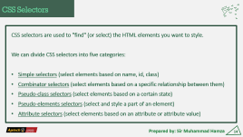
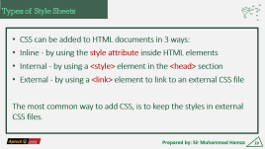
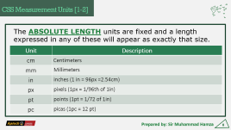
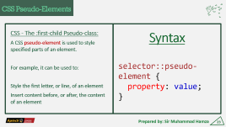
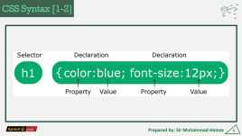
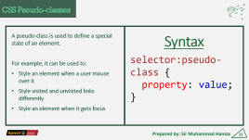
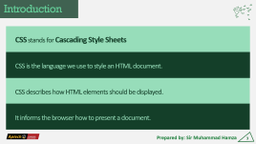
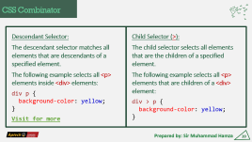
Summary
Prepared by: Sir Muhammad Hamza
33

Slide 34
Session-2 End
Thank You
Any Question?
Prepared by: Sir Muhammad Hamza
34

