Slide 1

SECTOR 04
Automotive
Servicing the vehicles that move India, from petrol cars to electric scooters
6
3
IX-XII
job roles on the PSSCIVE list
approved in the list of 88 (Samagra Shiksha)
offered from Class 9 to Class 12
Notes:
Welcome to the Automotive module. Servicing the vehicles that move India, from petrol cars to electric scooters. Key numbers: 6 job roles on the PSSCIVE list; 3 approved in the list of 88 (Samagra Shiksha); IX-XII offered from Class 9 to Class 12.

Slide 2




What is the Automotive sector?
The automotive sector designs, makes, sells and services two-, three- and four-wheelers and commercial vehicles. Electric vehicles (EVs) and connected-vehicle technology are creating many new jobs.
Vehicle Service
Electric Vehicles
Routine service and repair of cars and two-wheelers
EV batteries, motors, chargers and safety
Where people work
Authorised service centres and dealerships, multi-brand workshops, EV service and charging stations, vehicle manufacturing plants, auto-component makers and roadside assistance companies.
Engine & Systems
Auto Electronics
Sector Skill Council: Automotive Skills Development Council (ASDC)
Engine, transmission, brakes and suspension
Auto electrical design and IIoT applications
Notes:
The automotive sector designs, makes, sells and services two-, three- and four-wheelers and commercial vehicles. Electric vehicles (EVs) and connected-vehicle technology are creating many new jobs. Where people work: Authorised service centres and dealerships, multi-brand workshops, EV service and charging stations, vehicle manufacturing plants, auto-component makers and roadside assistance companies. The Sector Skill Council is Automotive Skills Development Council (ASDC).

Slide 3




How a student moves through the sector
Class IX-X
Class XI-XII
On-the-job training
Next step
Foundation job roles
NSQF Level 1-2
Advanced job roles
NSQF Level 3-4
Field visits and OJT at farms, units and labs
Job, apprenticeship, own enterprise, or diploma / degree
Each class level adds Employability Skills (communication, self-management, ICT, entrepreneurship, green skills) alongside the job-role subject.
Notes:
Students can start a job role in Class IX and continue to a higher-level role in Class XI. Every year includes employability skills, practical work, field visits and on-the-job training. After Class XII they can take up a job, an apprenticeship, start their own enterprise, or study further.

Slide 4
Automotive job roles at a glance
Class IX-X
Class XI-XII
Four Wheeler Service Assistant
Approved
Four Wheeler Service Technician
Approved
Auto Electrical Design Technician
FY 24-25
Electric Vehicle Service Assistant
Approved
Auto Service Technician (2 & 3 Wheeler)
Automotive IIOT Application Technician
FY 24-25
Approved = in the list of 88 job roles for Samagra Shiksha. FY 24-25 = in the additional list approved for FY 2024-25.
Four Wheeler Service Assistant and Technician were earlier called Auto Service Technician L3 and L4.
Notes:
Green tags are the approved roles we cover one by one in the next slides. Amber roles were added in the FY 2024-25 approval list. Grey roles have a PSSCIVE curriculum but are not in either approved list.

Slide 5
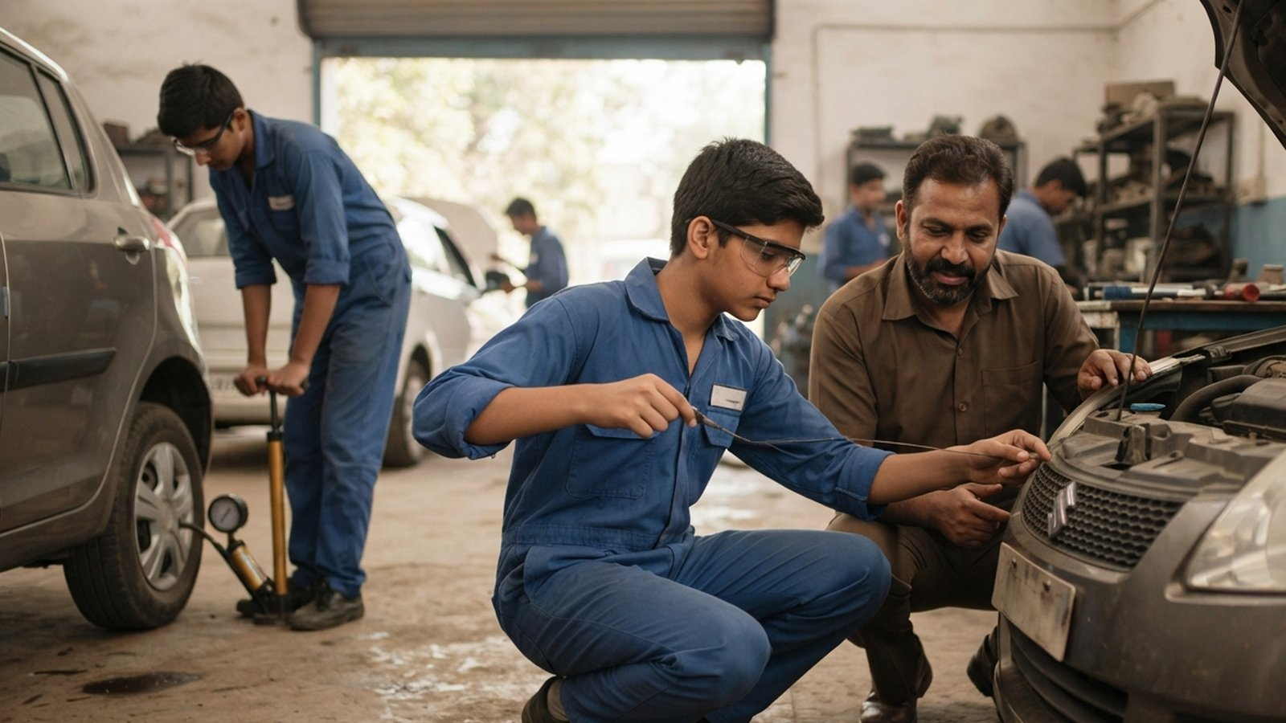
AUTOMOTIVE | JOB ROLE 1 OF 3
Four Wheeler Service Assistant
QP: ASC/Q1401
Class IX-X
NSQF Level 1-2
Approved (88 list)
What students learn
History and types of automobiles
Major systems and parts of a car
Workshop tools and safe working
Routine checks: oil, coolant, tyres, battery
Road safety and care for the environment
Key lab tools & equipment
Air compressor
Spanner sets
Screwdrivers and pliers
Career options
Workshop assistant, service-station helper, path to service technician
Spark plug cleaner
Tool box
Notes:
Four Wheeler Service Assistant (ASC/Q1401), Class IX-X, NSQF Level 1-2. Approved in the list of 88. Students learn: History and types of automobiles; Major systems and parts of a car; Workshop tools and safe working; Routine checks: oil, coolant, tyres, battery; Road safety and care for the environment. Key lab items: Air compressor, Spanner sets, Screwdrivers and pliers, Spark plug cleaner, Tool box. Careers: Workshop assistant, service-station helper, path to service technician.

Slide 6
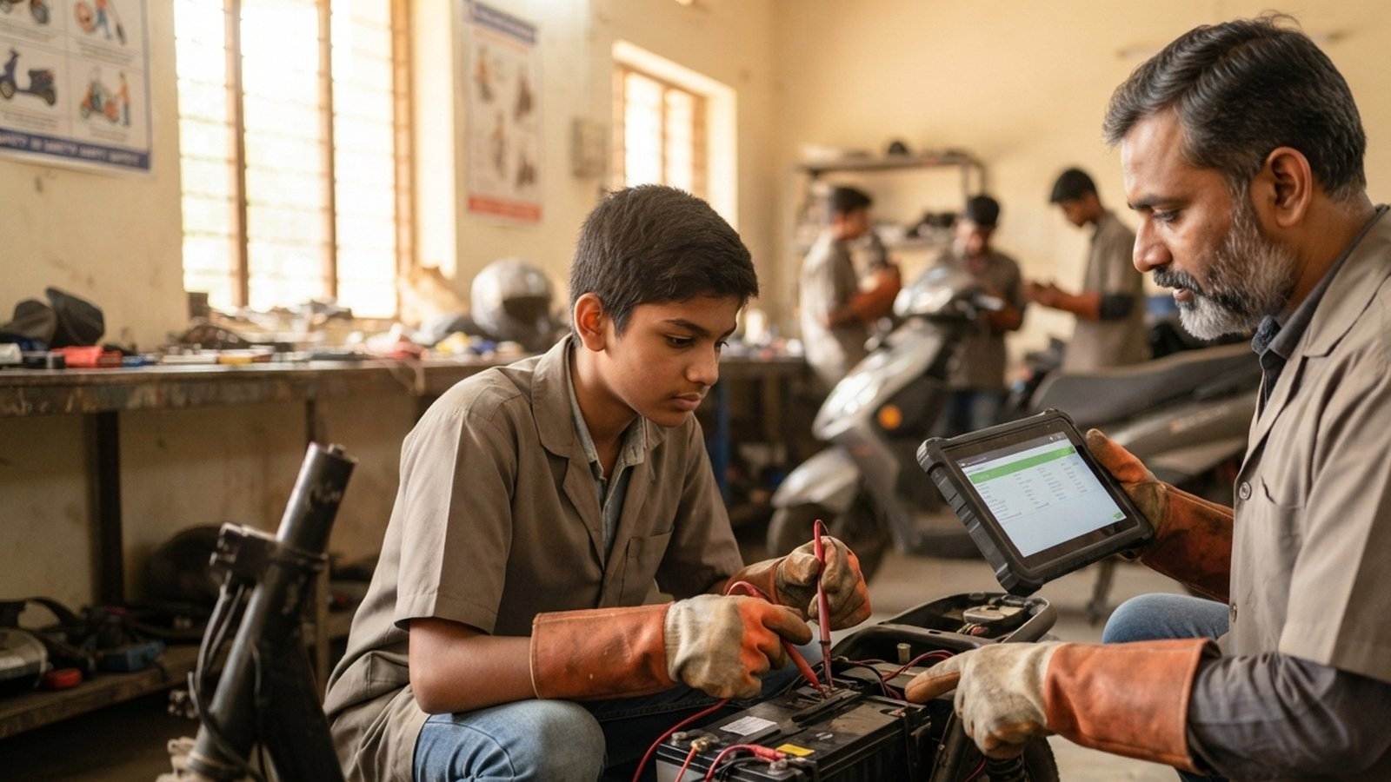
AUTOMOTIVE | JOB ROLE 2 OF 3
Electric Vehicle Service Assistant
QP: ASC/Q1435
Class IX-X
NSQF Level 1-2
Approved (88 list)
What students learn
Types of electric vehicles and how they work
Battery, motor, controller and charging system
Insulated tools and high-voltage safety
Routine service of 2-, 3- and 4-wheeler EVs
Workshop health and safety
Key lab tools & equipment
EV two-wheeler training kit
DC fast charger
Career options
EV service assistant, charging-station attendant, EV dealer workshop
Insulated tool set
Digital multimeter
Torque wrench
Notes:
Electric Vehicle Service Assistant (ASC/Q1435), Class IX-X, NSQF Level 1-2. Approved in the list of 88. Students learn: Types of electric vehicles and how they work; Battery, motor, controller and charging system; Insulated tools and high-voltage safety; Routine service of 2-, 3- and 4-wheeler EVs; Workshop health and safety. Key lab items: EV two-wheeler training kit, DC fast charger, Insulated tool set, Digital multimeter, Torque wrench. Careers: EV service assistant, charging-station attendant, EV dealer workshop.

Slide 7
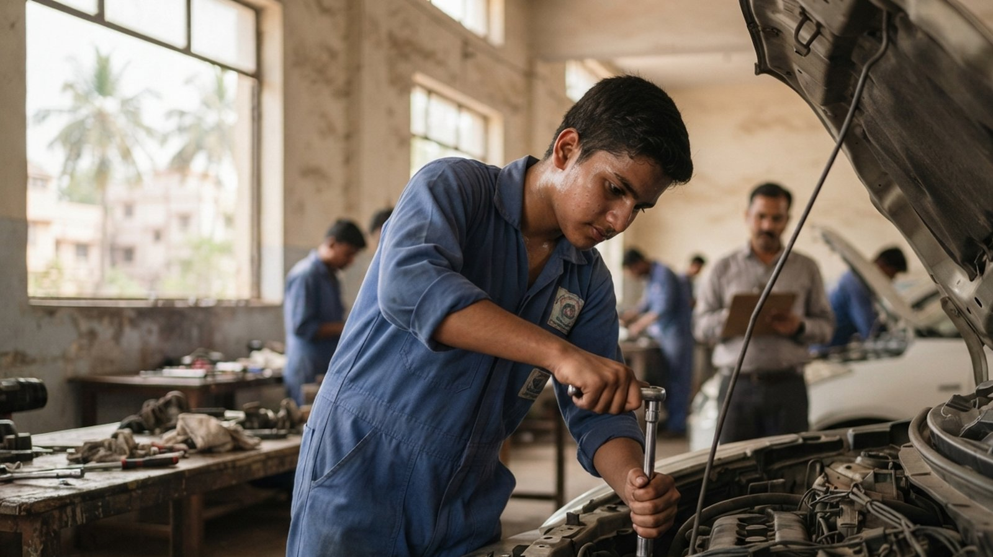
AUTOMOTIVE | JOB ROLE 3 OF 3
Four Wheeler Service Technician
QP: ASC/Q1402
Class XI-XII
NSQF Level 3-4
Approved (88 list)
What students learn
Engineering basics, fasteners and materials
Using measuring instruments
Engine maintenance
Transmission, gearbox, wheels and brakes service
Finding and fixing common faults
Key lab tools & equipment
Vernier caliper and micrometer
Multimeter and tachometer
Career options
Service technician at dealerships and workshops, own garage
Hydraulic jack and ramp
Socket spanner set
Tyre pressure gauge
Notes:
Four Wheeler Service Technician (ASC/Q1402), Class XI-XII, NSQF Level 3-4. Approved in the list of 88. Students learn: Engineering basics, fasteners and materials; Using measuring instruments; Engine maintenance; Transmission, gearbox, wheels and brakes service; Finding and fixing common faults. Key lab items: Vernier caliper and micrometer, Multimeter and tachometer, Hydraulic jack and ramp, Socket spanner set, Tyre pressure gauge. Careers: Service technician at dealerships and workshops, own garage.

Slide 8
Other Automotive job roles
Job role | QP code | Class | Status
Auto Service Technician (Two and Three Wheeler) | ASC/Q1411 | XI-XII | Curriculum available
Auto Electrical Design Technician | 2022/AUT/KSDC/05919 | XI-XII | FY 2024-25 list
Automotive IIOT Application Technician | ASC/Q6413 | XI-XII | FY 2024-25 list
Notes:
These roles have a PSSCIVE curriculum but are not in the list of 88. Amber rows were approved in the additional FY 2024-25 list, so states may also offer them.

Slide 9
Quick quiz
Q1
Why do EV service staff use insulated tools?
Q2
Name two instruments a Four Wheeler Service Technician uses to measure parts accurately.
Q3
Name the Sector Skill Council for the Automotive sector.
Notes:
Ask the group to answer before moving to the next slide. Answers: Q1: To stay safe from the high-voltage battery and electrical system; Q2: Vernier caliper and micrometer (also feeler and dial gauges); Q3: Automotive Skills Development Council (ASDC)

Slide 10

Quiz answers
Why do EV service staff use insulated tools?
To stay safe from the high-voltage battery and electrical system
Name two instruments a Four Wheeler Service Technician uses to measure parts accurately.
Vernier caliper and micrometer (also feeler and dial gauges)
Name the Sector Skill Council for the Automotive sector.
Automotive Skills Development Council (ASDC)
Notes:
Discuss the answers and connect each one back to the job-role slides.

Slide 11
Key takeaways
1
Automotive has 6 job roles on the PSSCIVE list and 3 approved in the list of 88
2
Class IX-X starts with service assistant roles, including electric vehicles
3
Labs need hand tools, measuring instruments, a compressor, and EV kits with insulated tools
4
EV and connected-vehicle skills are the fastest-growing area of the sector
Notes:
Summarise the module and invite questions before moving to the next sector.

