Slide 1
Introduction to STM32 Microcontroller

Slide 2
Rundown
GPIO with blinking LED example
UART sending and receiving in interrupt mode
Timer and PWM with ultrasonic sensor example

Slide 3
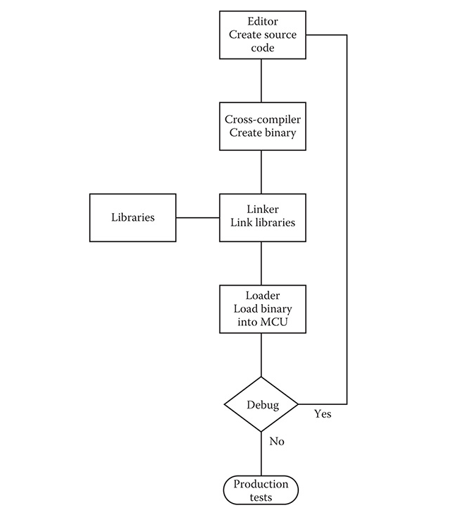
Workflow for STM32
STM32CubeIDE
STM32CubeProgrammer
Notes:
The first step in the process is to create the source code, then using a cross compiler to generated binary code that will run on the stm32
Then the linker will link all necessary binary libraries to form a fully executable MCU program
The generated binary code will be load on the STM32 by the cubeprogrammer

Slide 4
GPIO

Slide 5

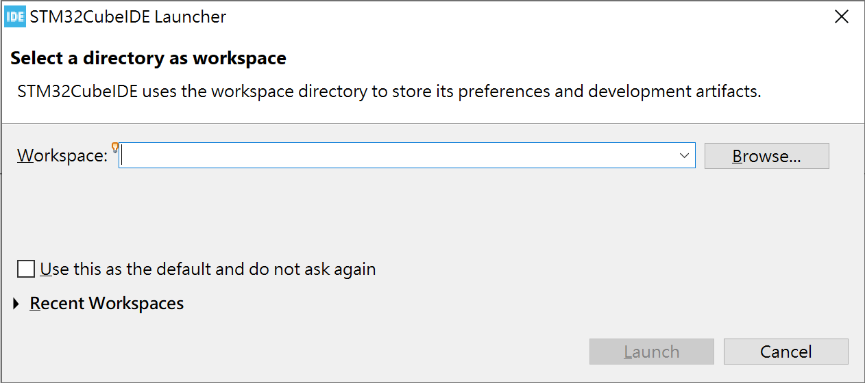
Step 1: Create New Project
Launch STM32CubeIDE
The Project will be saved in the directory of the workspace

Slide 6
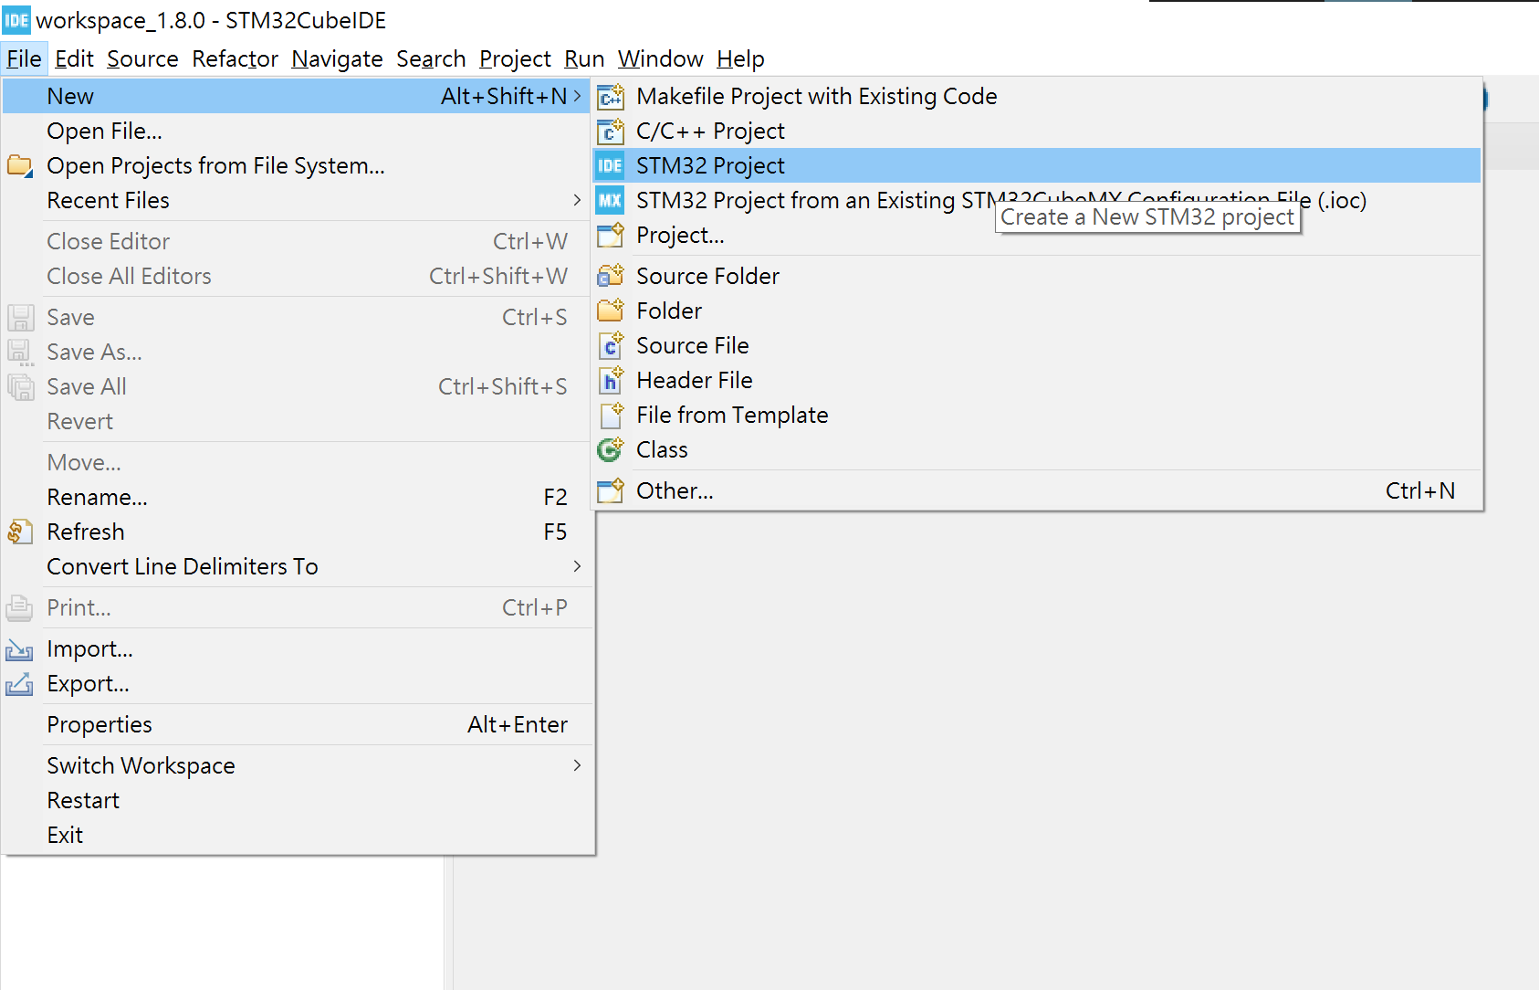

Slide 7
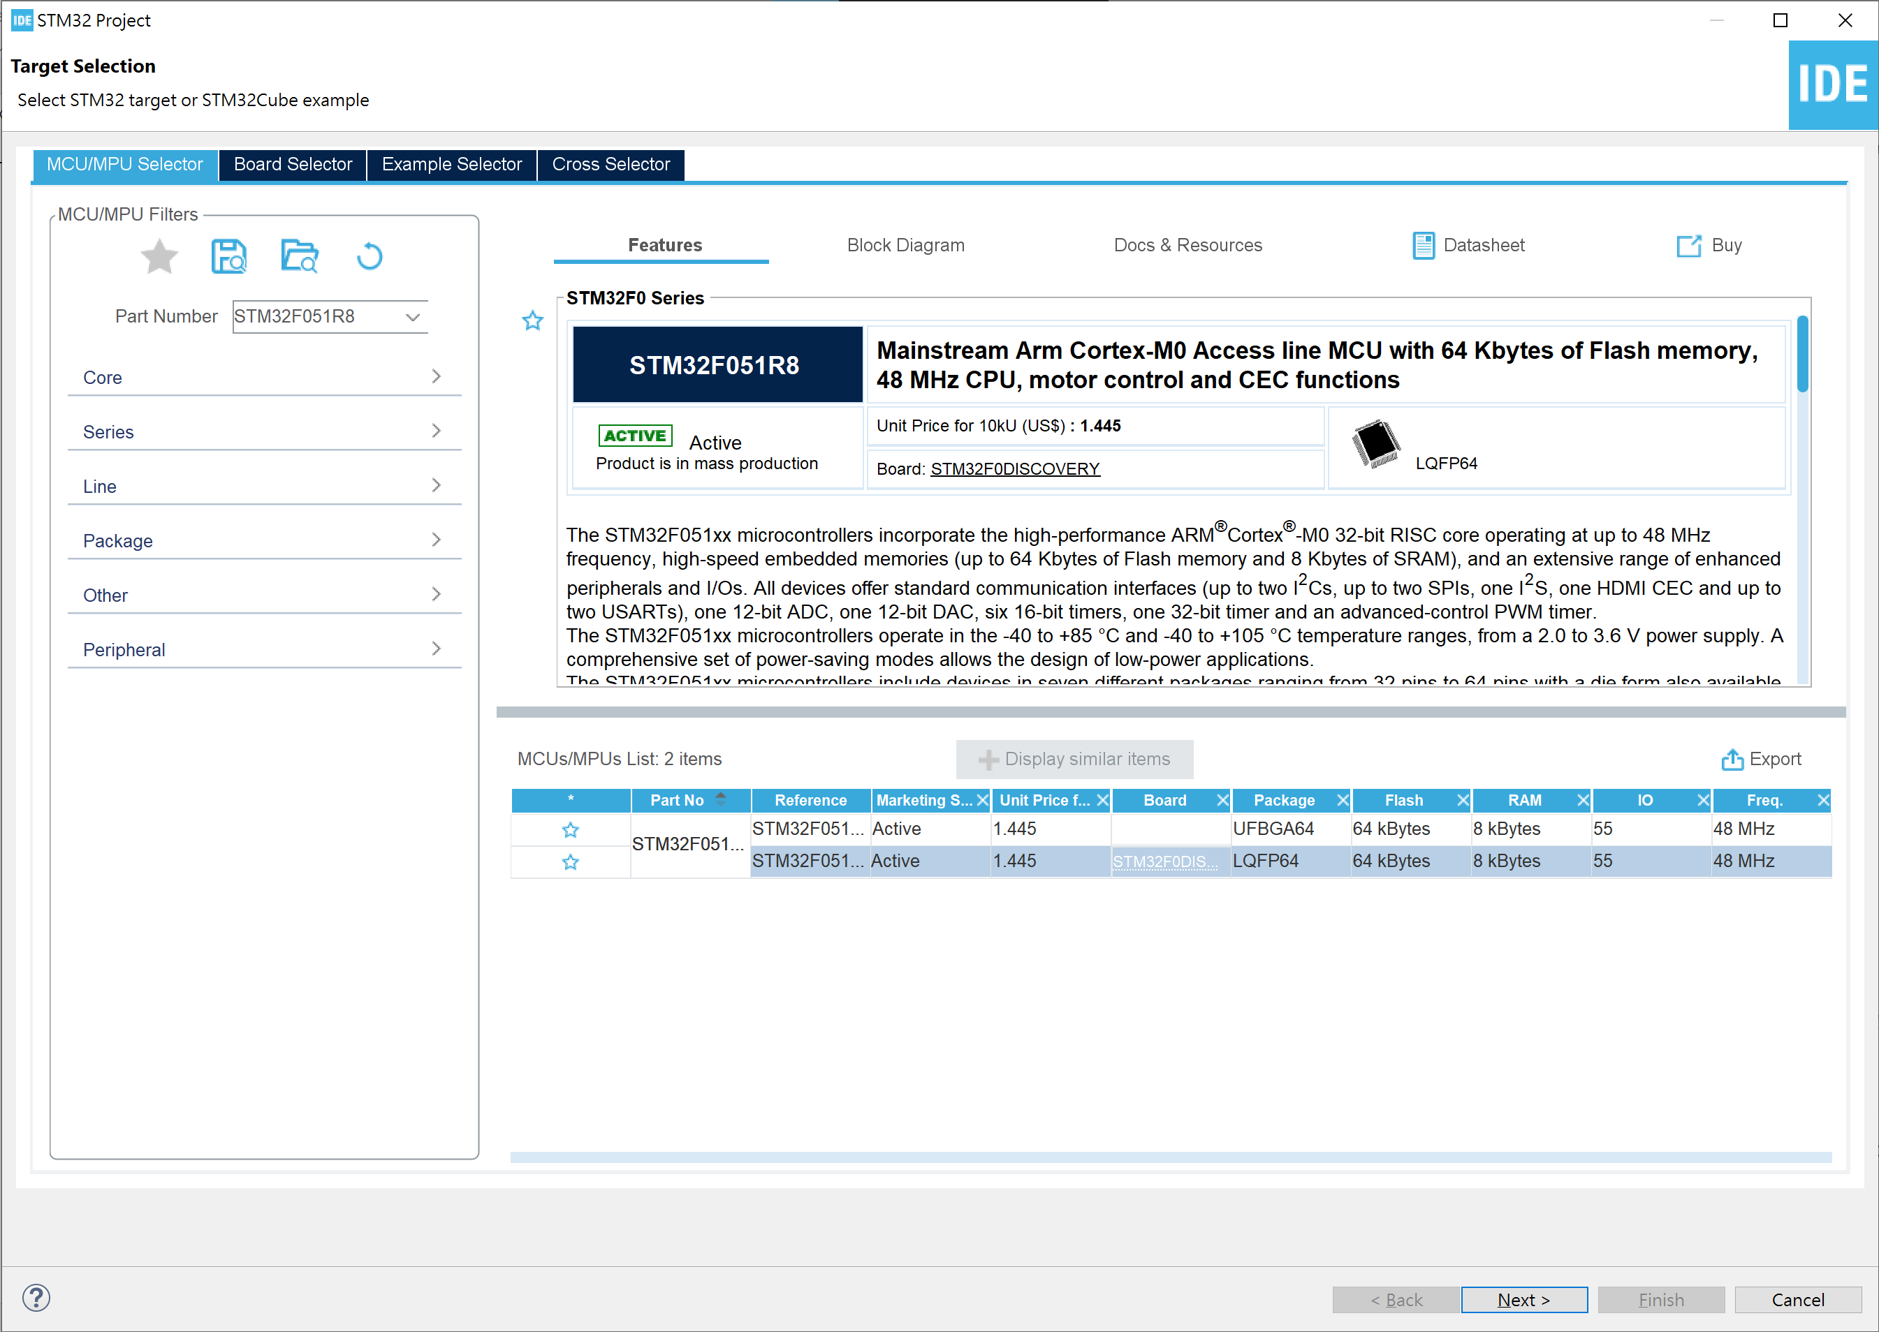

In the Part Number Type:
STM32F051R8
Then select Package LQFP64
Click next

Slide 8
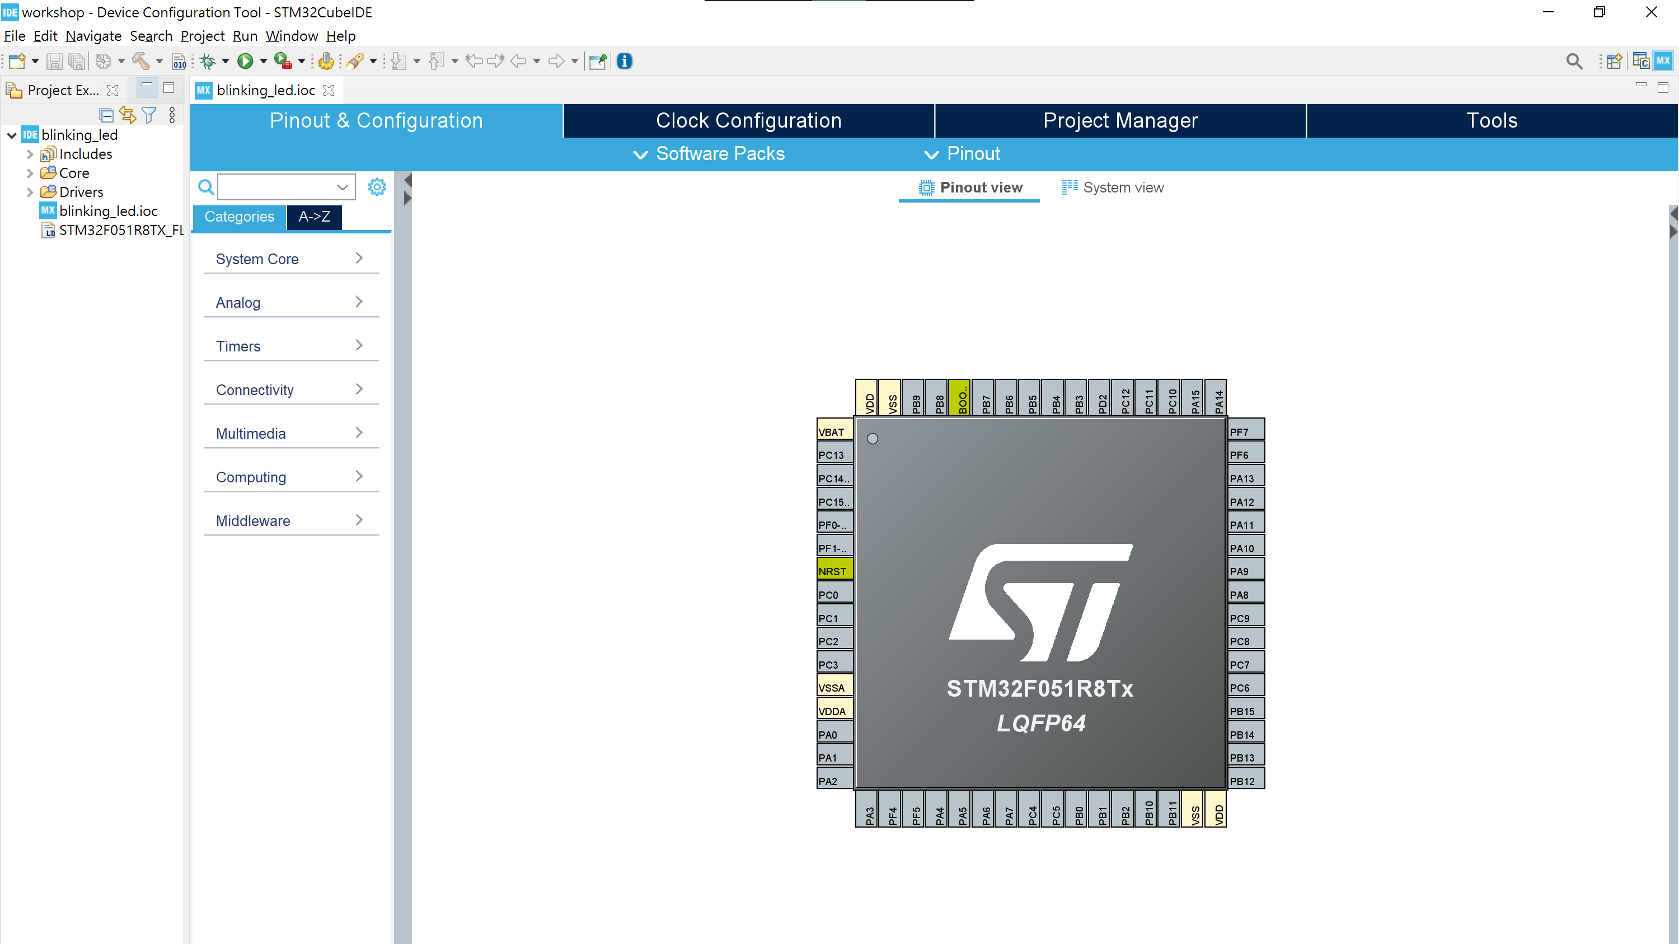

Slide 9
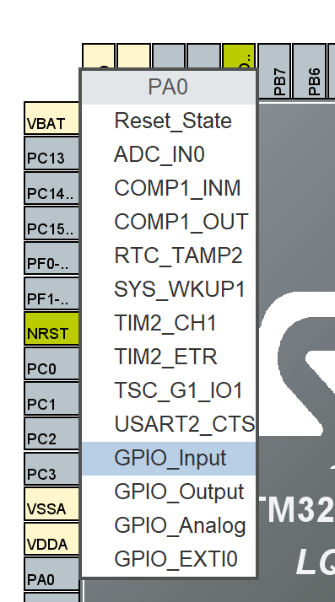
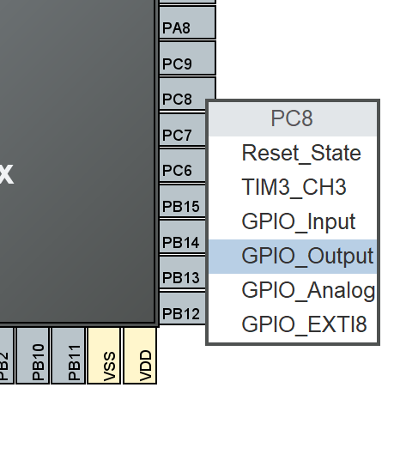
Step 2: GPIO Pin Configuration
Click PC8 and select GPIO_Output
Click PA0 and select GPIO_Input

Slide 10
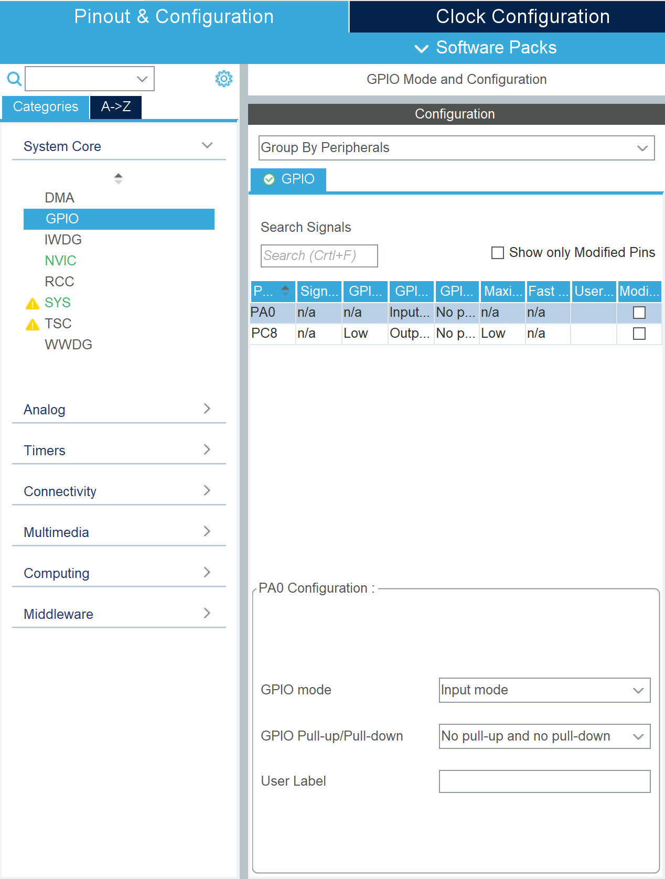
In System Core -> GPIO select PA0
In the User Label box type in BUTTON
For PC8, type in LED
Save the STM32CubeMX settings by Ctrl + S, and then select YES to start generating source code.

Slide 11
Step 3: User code
Insert the following code in the while loop under main()
Build the application by pressing Ctrl + B, or in menu Project → Build All
int main(void) {
while (1) {
if (HAL_GPIO_ReadPin(BUTTON_GPIO_Port, BUTTON_Pin) == GPIO_PIN_SET) {
HAL_GPIO_WritePin(LED_GPIO_Port, LED_Pin, GPIO_PIN_SET);
HAL_Delay(100);
HAL_GPIO_WritePin(LED_GPIO_Port, LED_Pin, GPIO_PIN_RESET);
HAL_Delay(100);
} else {
HAL_GPIO_WritePin(LED_GPIO_Port, LED_Pin, GPIO_PIN_SET);
HAL_Delay(500);
HAL_GPIO_WritePin(LED_GPIO_Port, LED_Pin, GPIO_PIN_RESET);
HAL_Delay(500);
}
}
}

Slide 12
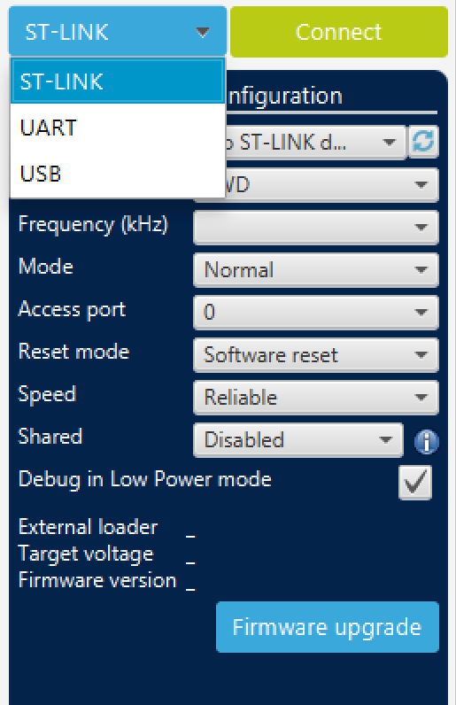
Step 4 : Download to the board
Launch STM32CubeProgrammer
Select ST_LINK
Click Connect

Slide 13
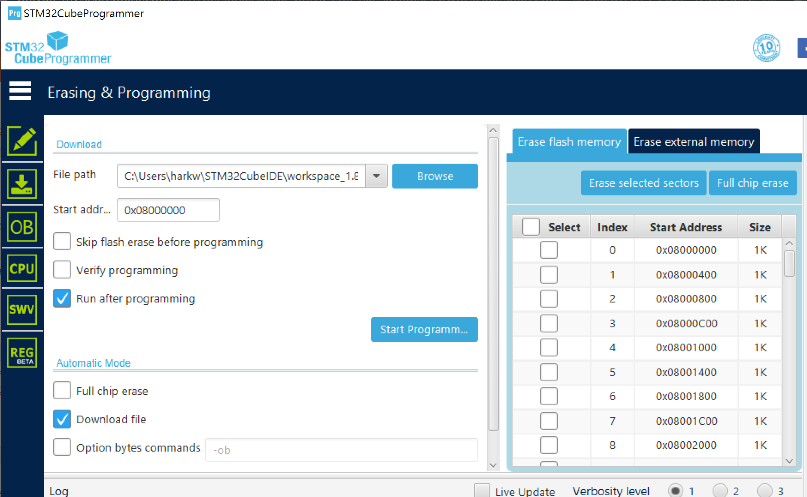
Click the download icon at the right
Browse for the project name.bin in the Debug file under workspace/project name
Click Start Programming

Slide 14
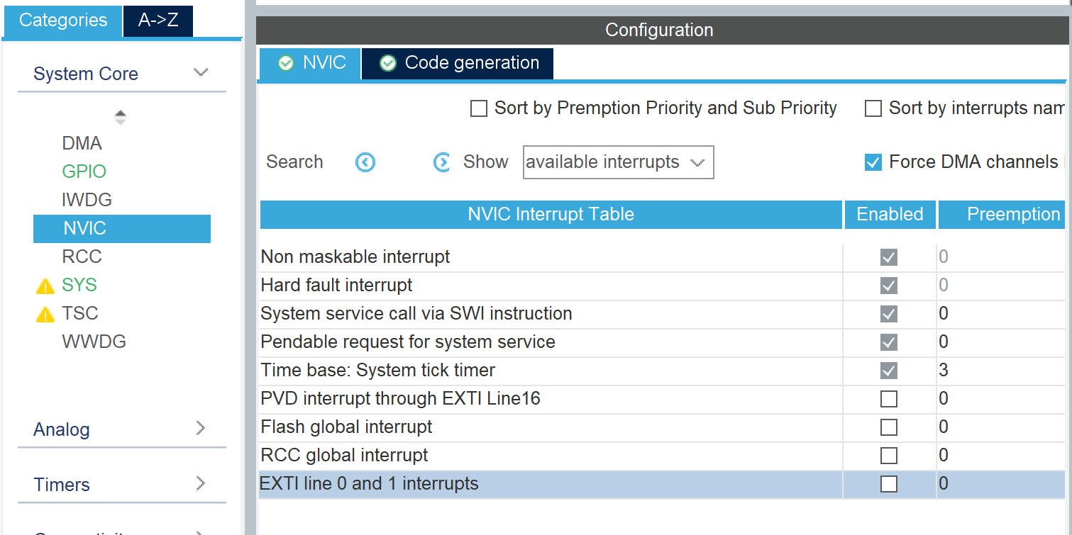
Interrupt
Change Pin PA0 configuration from GPIO_Input to GPIO_EXTI0
In System Core -> NVIC
Enable EXTI line 0 and 1 interrupt

Slide 15
Handle interrupt
In main.c insert the code and remove the code in previous steps
Rebuild and download the application to the board
void HAL_GPIO_EXTI_Callback(uint16_t GPIO_Pin) {
HAL_GPIO_TogglePin(LED_GPIO_Port, LED_Pin);
}

Slide 16
UART

Slide 17
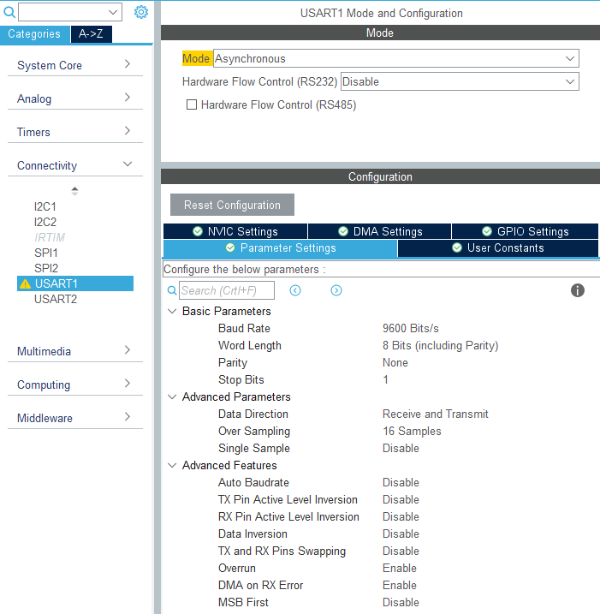
Setup UART
Enable USART1 and set the Baud Rate to 9600

Slide 18
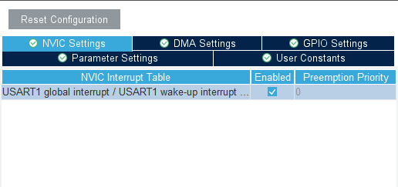
Enable interrupt in NVIC Settings
Save and generate code

Slide 19
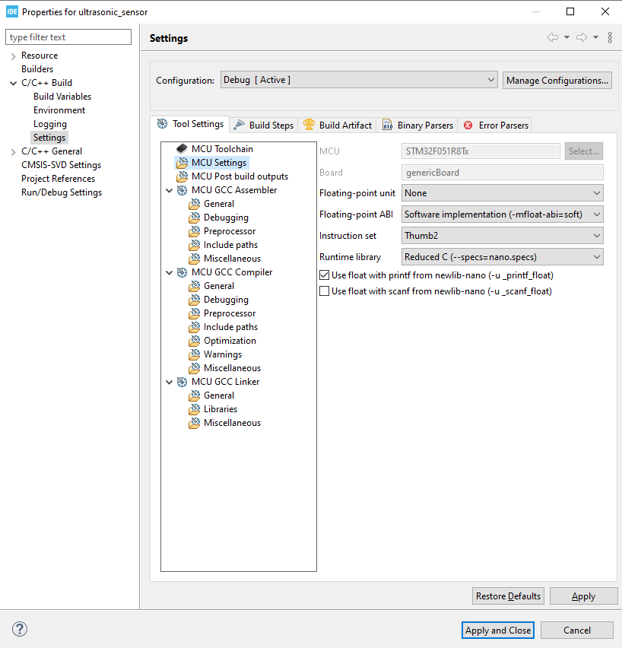
Enable float formatting in setting by right click the project-> Properties -> C/C++ Build -> Settings -> MCU settings -> check Use float with printf…

Slide 20
Send data with interrupt
Use HAL_UART_Transmit_IT() function to send data.
char counter = 0;
char buffer[16] = { 0 };
int main() {
char pause = 0;
while(1) {
if (pause == 0) {
sprintf(buffer, "counter=%03d\n\r", counter++);
HAL_UART_Transmit_IT(&huart1, (uint8_t*) buffer, strlen(buffer));
}
HAL_Delay(1000);
}
}

Slide 21
Receive data with interrupt
char counter = 0;
char buffer[16] = { 0 };
char rx_buffer[16] = {0};
_Bool uart_rx_int = 0;
void HAL_UART_RxCpltCallback(UART_HandleTypeDef *huart) {
if (huart == &huart1) { uart_rx_int = 1; }
}
int main() {
_Bool pause = 0;
while(1) {
if (pause == 0) {
sprintf(buffer, "counter=%03d\n\r", counter++);
HAL_UART_Transmit_IT(&huart1, (uint8_t*) buffer, strlen(buffer));
}
if (uart_rx_int == 1) {
uart_rx_int = 0;
if (strncmp(command, "stop", 4) == 0)
{
pause = 1;
} else if (strncmp(command, "resume", 6) == 0)
{
pause = 0;
}
}
HAL_UART_Receive_IT(&huart1, (uint8_t*) command, 6);
HAL_Delay(1000);
}
}
Use HAL_UART_Receive_IT() to read data
Interrupt will issue when the receiver get enough byte and run HAL_UART_RxCpltCallback() function

Slide 22
Timer and PWM

Slide 23
Basic overview
Pre-scaler and counter period
Pre-scaler is used to reduce the counting speed
Counter period determined how many tick until the counter overflow
Example:
F_{sys} = 48 MHz
Pre-scaler = 1024
Timer gets incremented by 1 every 1024* 1/48000000 s = 21.3 us
If set overflow at full 16-bit (at 65535), and start counting from 0, it will generate a signal every 21.3 us * 65535 = 1395896 us = 1395.896 ms

Slide 24
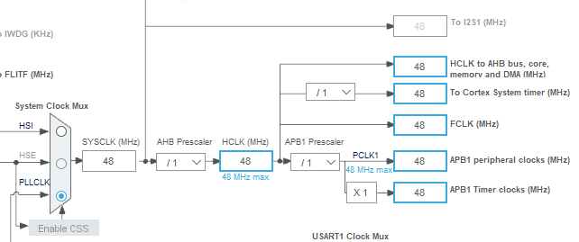
System clock configuration
Set the HCLK to 48 MHz

Slide 25
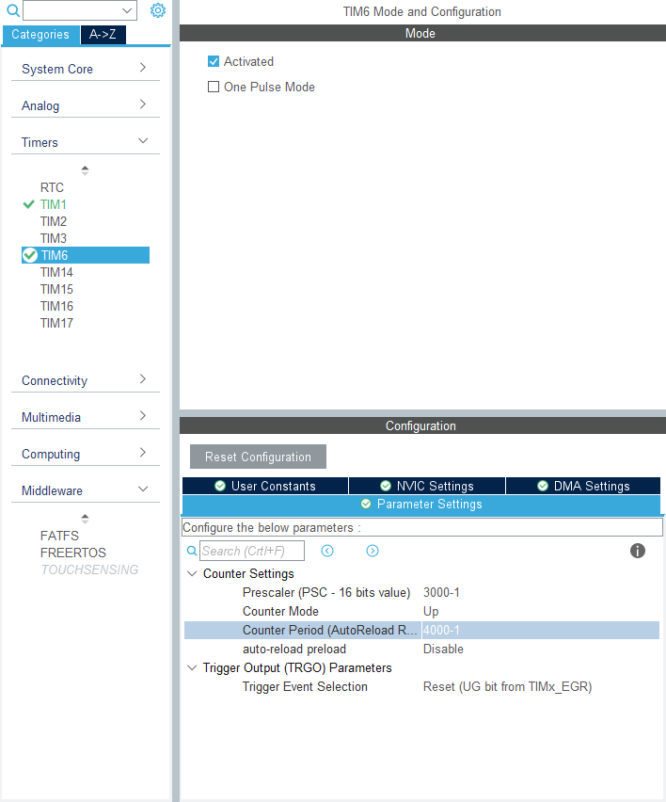
Blinking LED with timer
Enable TIM6 (basic timer)
Set the pre-scaler to 2999 (3000 – 1)
Set the counter period to 3999 (4000 – 1)

Slide 26
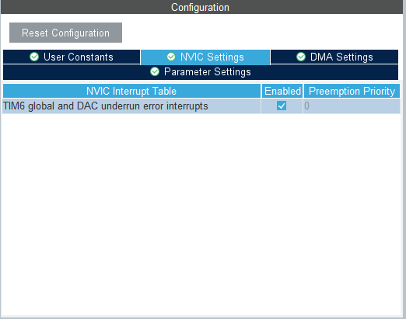
Enable timer interrupt
Enable interrupts in NVIC settings

Slide 27
User code
Start the timer in interrupt mode
Override the callback function when a full period elapses
int main() {
...
HAL_TIM_Base_Start_IT(&htim6);
while (1){...}
}
void HAL_TIM_PeriodElapsedCallback(TIM_HandleTypeDef *htim) {
HAL_GPIO_TogglePin(LED_GPIO_Port, LED_Pin);
}

Slide 28
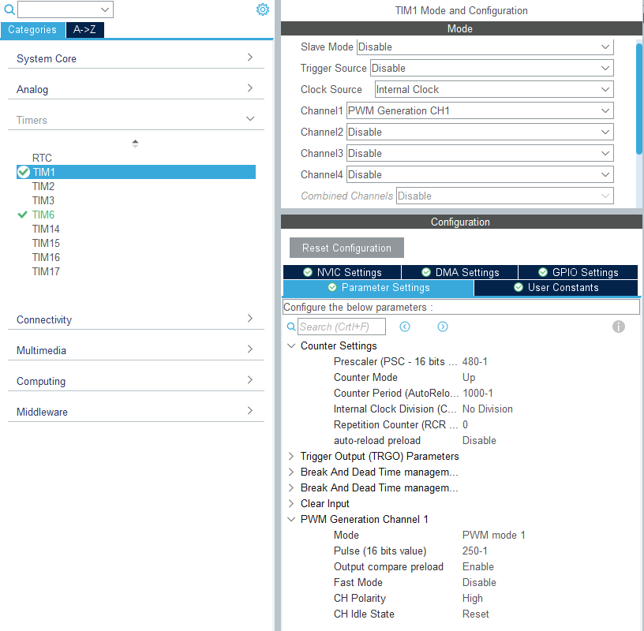
Setup PWM on a Timer
Enable TIM1 and configure Clock Source as Internal Clock
Configure Channel 1 as PWM Generation CH1
Pre-scaler = 480, Counter Period = 1000 -> PWM frequency = 100Hz
PWM Pulse = 250 -> duty cycle = 250/1000 = 25%

Slide 29
User code
Enable the PWM generation as the configuration
int main() {
...
HAL_TIM_PWM_Start(&htim3, TIM_CHANNEL_3);
while (1){...}
}

Slide 30
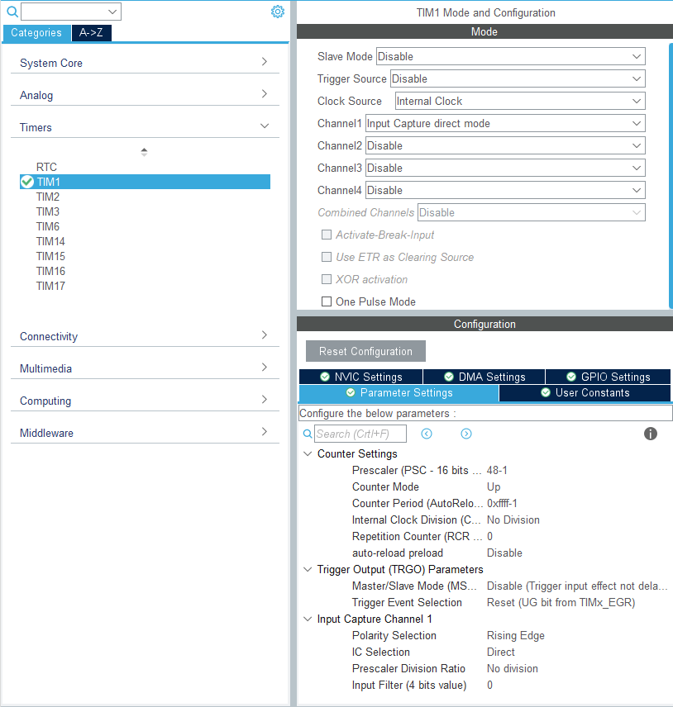
Setup Timer for Input Capture
Change TIM1 Channel 1 to Input Capture direct mode
Configure Pre-scaler to 48 – 1 and Counter Period to 0xffff – 1

Slide 31
User code for ultrasonic sensor
Enable Input Capture interrupt
Create a function for delay in us
Create a function for sending trigger pulse to the ultrasonic sensor
Override the interrupt callback function
int main() {
...
HAL_TIM_IC_Start_IT(&htim1, TIM_CHANNEL_1);
while (1){...}
}
void delay (uint16_t time)
{
__HAL_TIM_SET_COUNTER(&htim1, 0);
while (__HAL_TIM_GET_COUNTER (&htim1) < time);
}
void Ultrasonic_Read()
{
HAL_GPIO_WritePin(US_TRIG_GPIO_Port, US_TRIG_Pin, GPIO_PIN_SET);
delay(10);
HAL_GPIO_WritePin(US_TRIG_GPIO_Port, US_TRIG_Pin, GPIO_PIN_RESET);
__HAL_TIM_ENABLE_IT(&htim1, TIM_IT_CC1);
}

Slide 32
void HAL_TIM_IC_CaptureCallback(TIM_HandleTypeDef *htim)
{
if((htim->Instance == TIM1) && (htim-> Channel == HAL_TIM_ACTIVE_CHANNEL_1)) // if the interrupt source is channel1
{
if (!Is_First_Captured) // if the first value is not captured
{
First_Val = HAL_TIM_ReadCapturedValue(htim, TIM_CHANNEL_1); // read the first value
// Now change the polarity to falling edge
__HAL_TIM_SET_CAPTUREPOLARITY(htim, TIM_CHANNEL_1, TIM_INPUTCHANNELPOLARITY_FALLING);
Is_First_Captured = 1; // set the first captured as true
}
else
{
Sec_Val = HAL_TIM_ReadCapturedValue(htim, TIM_CHANNEL_1); // read second value
__HAL_TIM_SET_COUNTER(htim, 0); // reset the counter
if (Sec_Val > First_Val)
{
Difference = Sec_Val-First_Val;
}
else if (First_Val > Sec_Val)
{
Difference = (0xffff - First_Val) + Sec_Val;
}
Distance = Difference * .034/2;
// set polarity to rising edge
__HAL_TIM_SET_CAPTUREPOLARITY(htim, TIM_CHANNEL_1, TIM_INPUTCHANNELPOLARITY_RISING);
__HAL_TIM_DISABLE_IT(&htim1, TIM_IT_CC1);
Is_First_Captured = 0; // set it back to false
}
}
}

Slide 33
Tasks
Try using UART to send the reading from the ultrasonic sensor
Try using the ultrasonic sensor to control the speed of the motor

