Slide 1

Android App. Dev. Capstone Project MSIT-0668 Winter term 2017 Nova Southeastern University 04/27/2017 Dr. Francisco Mitropoulos
Rapid
Student name : Wesly J. DEROSIER
Project name : Rapid App

Slide 2
Project Overview
Description and Objective
Create an Android application called “Rapid” that allows people to order food from their favorite local restaurants and get it delivered to the location of their choice.

Slide 3
Data Source
Sample data
Live from a web service.

Slide 4
Product perspective
Basic Features
Register
Login
Sign in with Facebook
Reset Password
Available delivery cities
Available restaurants
Shopping cart
PayPal and card payment

Slide 5
Software requirements
Android Studio v. 2.2.3
Integrated Development Environment (IDE)
Backendless v1
Service platform used for user login management, push service, data storage, and file storage
PayPal Android SDK
Repository on GitHub: https://github.com/paypal/PayPal-Android-SDK

Slide 6
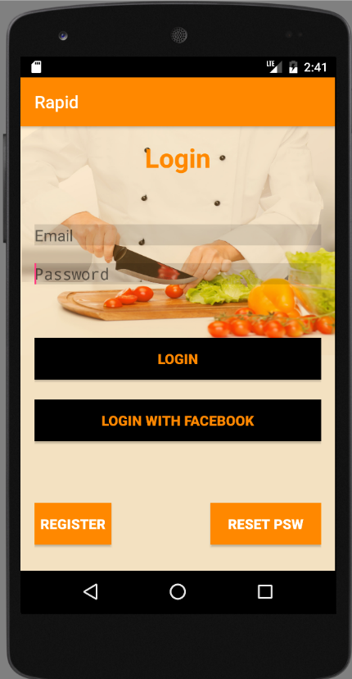
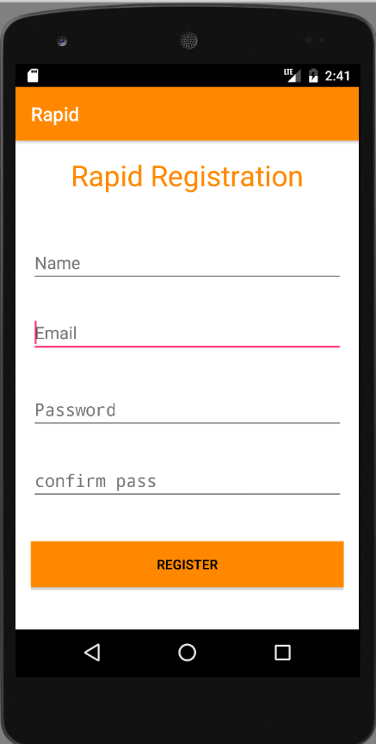
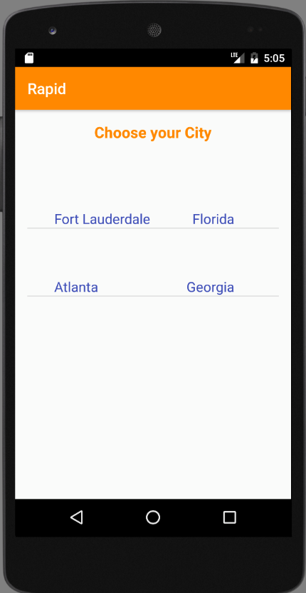
Rapid Screens
Login Registration Cities

Slide 7
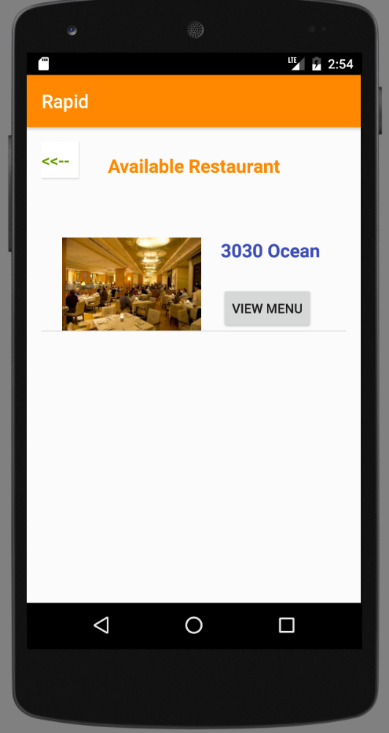
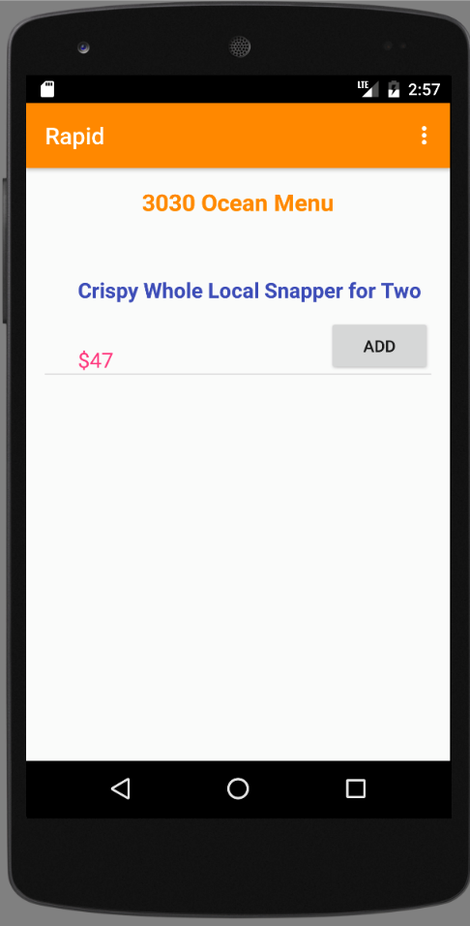
Rapid Screens (continue)
Restaurant Menu

Slide 8
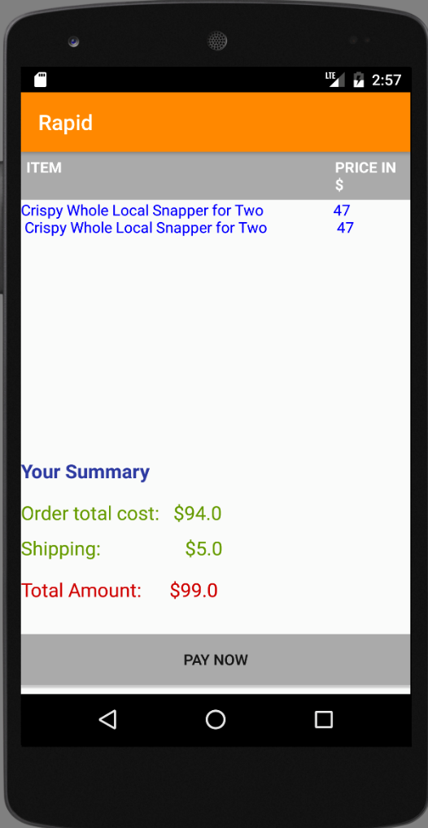
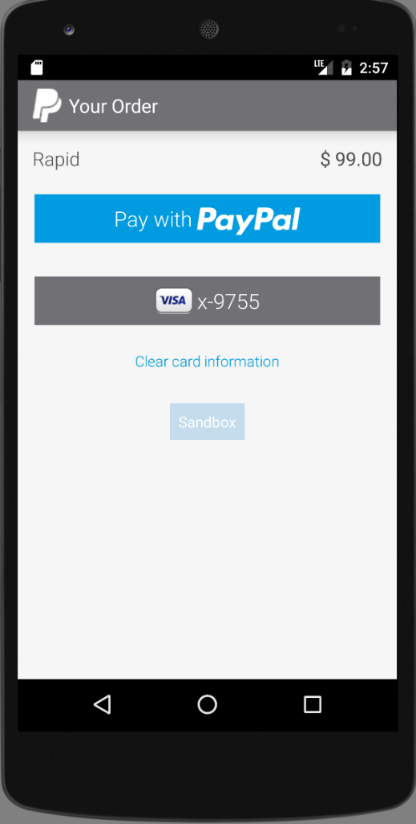
Rapid Screens(continue)
Cart Payment

Slide 9
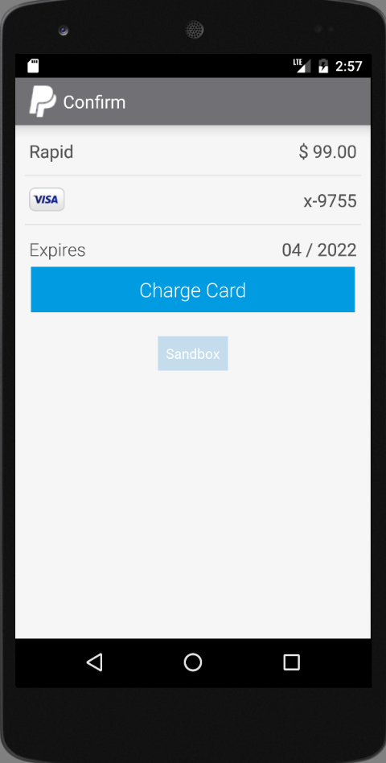
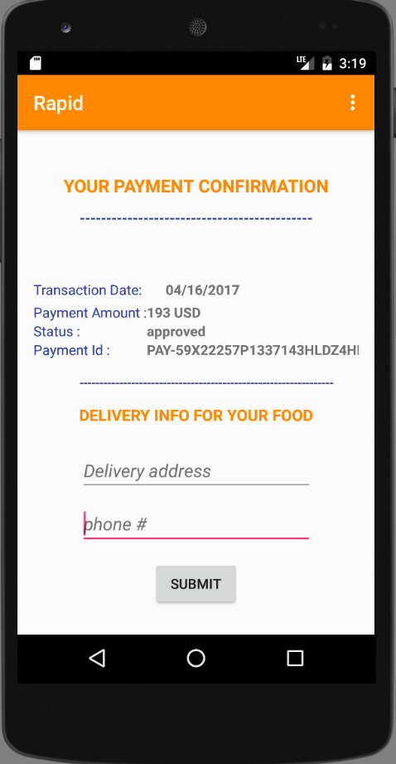
Rapid Screens (continue)
Credit card payment Payment confirmation

Slide 10
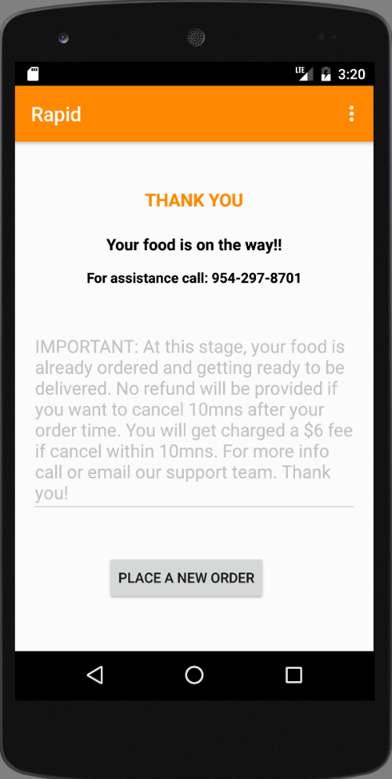
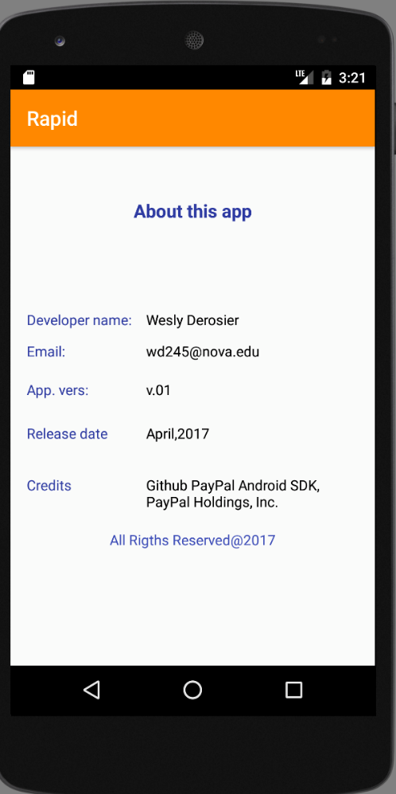
Rapid Screens (end)
Thank you/Terms About

Slide 11
Future Work
Modifications
Enhanced User Interface Design
Push notifications
Email notifications
User account Settings
Track deliveries in a live map
Reviews and rating
Create an iOS version

Slide 12
Project files
https://www.dropbox.com/sh/37ijqdufh86guyl/AADun4UeIo1sTJHzPv-lvNGla?dl=0

Slide 13
Conclusion
App will be submitted to the Apple and Google Play stores after all necessary changes have been made.

Slide 14
The end
Thank you Dr. Mitropoulos !

