Slide 1




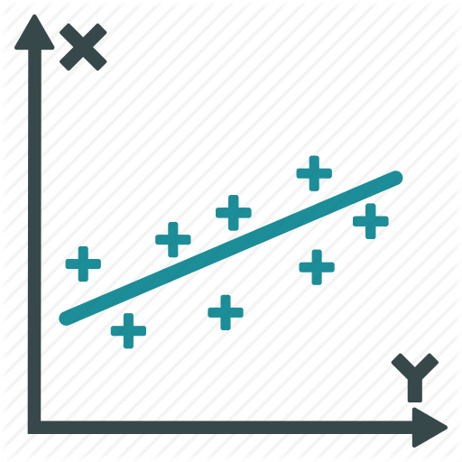
1
2
3
Messy to Tidy
Data Scoring and Cleaning
Data Analysis
Messy
Raw Data
Tidy
Raw Data
Scored
Data
Results
Output

Slide 2
Data
Exploration
3
Data Analysis
Scored
Data
Results
Output

