Slide 1



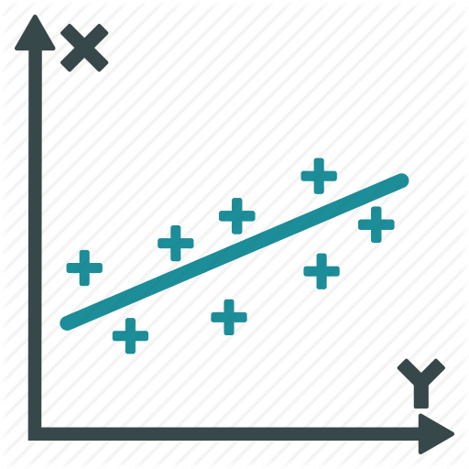
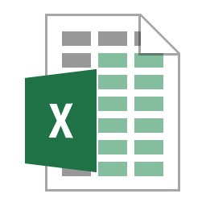



1.
2.
3.
Merge, Filter,
Select
Data Cleaning
and Scoring
Statistical
Analysis
Messy
Raw Data
Tidy
Raw Data
Scored
Data
Results

