Slide 1




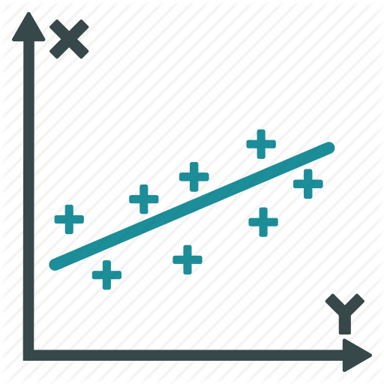
1
2
3
Messy to Tidy
Data Scoring and Cleaning
Data Analysis
Messy
Raw Data
Tidy
Raw Data
Scored
Data
Results
Output

Slide 2



Archival Backup
Data Collection
Data Analysis
*.Rproj
*.Rproj
*.Rproj
masterscript.R
masterscript.R
masterscript.R
Data Files
Data Files
Data Files
*_raw.csv
*_raw.csv
Final_Data.csv
E-Merge
E-Merge
Raw Data
*.emrg2
*.emrg2
*_raw.csv
*.txt
*.txt
Scored Data
edat
edat
*_Scores.csv
*.edat2
*.edat2
R Scripts
Did not finish all sessions
Did not finish
*.edat2
*.edat2
1_*_score.R
R Scripts
R Scripts
2_merge.R
3_Analysis.Rmd
0_*_raw.R
0_*_raw.R
Results
Tasks
Tasks
Output.html
Methods.docx
Session #
Session #
#. Task
*.edat2
#. Task
Documents
Methods.docx

Slide 3
Data Collection
*.Rproj
masterscript.R
Data Files
*_raw.csv
E-Merge
*.emrg2
*.txt
edat
*.edat2
Did not finish
*.edat2
R Scripts
0_*_raw.R
Tasks
Session #
#. Task
*.edat2
Documents
Methods.docx

Slide 4
Data Collection
*.Rproj
masterscript.R
Data Files
*_raw.csv
E-Merge
*.emrg2
3
2
*.txt
edat
*.edat2
Did not finish
*.edat2
R Scripts
0_*_raw.R
Tasks
1
Session #
#. Task
*.edat2
Documents
Methods.docx

Slide 5
Archival Backup
Data Collection
Data Analysis
*.Rproj
*.Rproj
*.Rproj
masterscript.R
masterscript.R
masterscript.R
Data Files
Data Files
Data Files
*_raw.csv
*_raw.csv
Final_Data.csv
E-Merge
E-Merge
Raw Data
*.emrg2
*.emrg2
*_raw.csv
*.txt
*.txt
Scored Data
edat
edat
*_Scores.csv
*.edat2
*.edat2
R Scripts
Did not finish all sessions
Did not finish
*.edat2
*.edat2
1_*_score.R
R Scripts
R Scripts
2_merge.R
3_Analysis.Rmd
0_*_raw.R
0_*_raw.R
Results
Tasks
Tasks
Output.html
Methods.docx
Session #
Session #
#. Task
*.edat2
#. Task
Documents
Methods.docx

Slide 6
Data Collection
Data Analysis
*.Rproj
*.Rproj
masterscript.R
masterscript.R
Data Files
Data Files
*_raw.csv
Final_Data.csv
E-Merge
Raw Data
*.emrg2
*_raw.csv
*.txt
Scored Data
edat
*_Scores.csv
*.edat2
R Scripts
Did not finish
*.edat2
1_*_score.R
R Scripts
2_merge.R
3_Analysis.Rmd
0_*_raw.R
Results
Tasks
Output.html
Session #
#. Task
*.edat2
Documents
Methods.docx

Slide 7
Data Analysis Project
Central Data Repository
Data Analysis Project
Data Analysis Project

