Slide 1
Artificial Intelligence in Daily Life
Understanding the Basics of AI

Slide 2
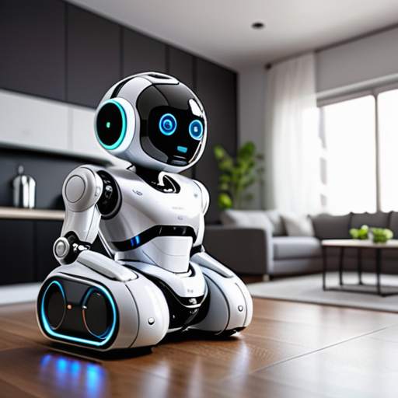
Artificial Intelligence in Daily Life
An image of smart home appliances and AI robots.

Slide 3
Advantages of AI
Enhances efficiency
Automates repetitive tasks
Improves decision-making
Transforms industries
Revolutionizes healthcare
Enables personalized treatment
Enhances entertainment experiences
Recommended content based on user data

Slide 4
Conclusion
AI is transforming daily life by enhancing efficiency, automating tasks, and providing personalized experiences.

