Slide 1
The Universe
Exploring the Vast Cosmos

Slide 2
Introduction
The universe encompasses all of space, time, matter, and energy. It includes galaxies, stars, planets, and the vast voids in between.

Slide 3
Key Components of the Universe
Galaxies: Massive systems of stars, gas, and dark matter
Stars: Luminous celestial bodies powered by nuclear fusion
Planets: Diverse worlds orbiting stars
Nebulae: Clouds of gas and dust, often stellar nurseries
Dark Matter & Dark Energy: Mysterious substances shaping the cosmos

Slide 4
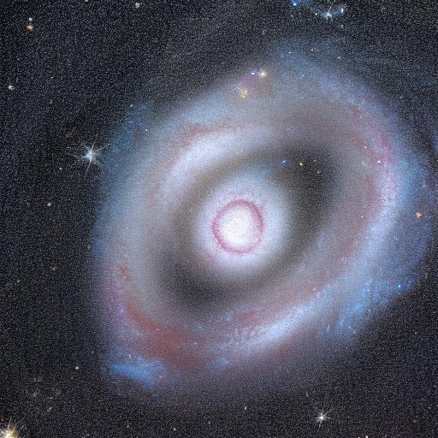
Galaxies
Galaxies are enormous systems of stars, gas, and dark matter, held together by gravity.

Slide 5
Black Holes
Formed when massive stars collapse under their own gravity
Regions where gravity is so strong that not even light can escape
Found at the centers of many galaxies, including the Milky Way
Critical for understanding spacetime and relativity

Slide 6
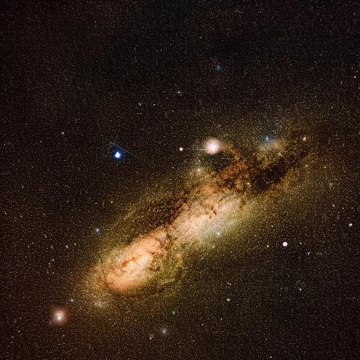
The Milky Way
Our home galaxy, containing billions of stars and solar systems.

Slide 7
Conclusion
The universe is a vast and complex system, full of mysteries yet to be unraveled. From the smallest particles to the largest cosmic structures, it invites us to explore and discover.

Slide 8
The Universe
Exploring the Vast Cosmos

Slide 9
Introduction
The universe encompasses all of space, time, matter, and energy. It includes galaxies, stars, planets, and the vast voids in between.

Slide 10
Key Components of the Universe
Galaxies: Massive systems of stars, gas, and dark matter
Stars: Luminous celestial bodies powered by nuclear fusion
Planets: Diverse worlds orbiting stars
Nebulae: Clouds of gas and dust, often stellar nurseries
Dark Matter & Dark Energy: Mysterious substances shaping the cosmos

Slide 11
Galaxies
Galaxies are enormous systems of stars, gas, and dark matter, held together by gravity.

Slide 12
Black Holes
Formed when massive stars collapse under their own gravity
Regions where gravity is so strong that not even light can escape
Found at the centers of many galaxies, including the Milky Way
Critical for understanding spacetime and relativity

Slide 13
The Milky Way
Our home galaxy, containing billions of stars and solar systems.

Slide 14
Conclusion
The universe is a vast and complex system, full of mysteries yet to be unraveled. From the smallest particles to the largest cosmic structures, it invites us to explore and discover.

