Slide 1

微型指令集架构设计 与解释器实现
汇报人：罗琰佳、邢菲琳、欧天勤
汇报日期：2025/6/10
指导老师：王量弘

Slide 2
Code & Functions
str
uint8_t parse_binary(const char *str) {
uint8_t val = 0;
for (int i = 0; i < 8 && str[i]; i++) {
val <<= 1;
if (str[i] == '1') val |= 1;
}
return val;
}
1
0
1
1
0
0
0
0
0
0
1
1
0
0
0
0
0
0
0
0
0
0
0
0
0
0
1
1
1
1
val
void run_program(uint8_t program[], size_t len) {
while (running && PC < len) {
execute(program[PC]);
}
}
(11)₁₀

Slide 3
Code & Functions
case 0b001: // MOV
R[op1] = op2;
printf("R%d = %d\n", op1, R[op1]);
break;
case 0b010: // SUB
R[op1] -= R[op2];
printf("R%d = R%d - R%d = %d\n", op1, op1, op2, R[op1]);
break;
...
default:
printf("Unknown opcode: %d\n", opcode);
}
PC++;
}
void execute(uint8_t instr) {
uint8_t opcode = (instr >> 5) & 0x07;
uint8_t op1 = (instr >> 3) & 0x03;
uint8_t op2 = instr & 0x07;
switch (opcode) {
case 0b000: // ADD
R[op1] += R[op2];
printf("R%d = R%d + R%d = %d\n", op1, op1, op2, R[op1]);
break;

Slide 4

Command
Opcode | BIN | OPT | MEAN
0 | 000 | ADD | R[op1] += R[op2]
1 | 001 | MOV | R[op1] = op2
2 | 010 | SUB | R[op1] -= R[op2]
3 | 011 | LD | R[op1] = MEM[op2]
4 | 100 | ST | MEM[op2] = R[op1]
5 | 101 | JMP | PC = op2（jump）
6 | 110 | AND | R[op1] = R[op1] & R[op2]
7 | 111 | OR | R[op1] = R[op1] | R[op2]

Slide 5

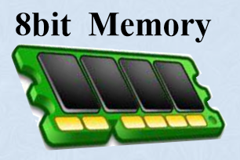
Command
ADD
初始化
R0=4, R1=8
R2=5, R3=3
R0
R1
R2
R3
R0
R3
4
8
5
3
7
3
等一下要算加法哦！
First Num：R0
Second Num：R3
Input
0
0
0
0
0
0
1
1
Output: R0=R0+R3=7
ENTER

Slide 6
Command
MOV
初始化
R0=4, R1=8
R2=5, R3=3
R0
R1
R2
R3
R1
R3
4
8
5
3
0
3
等一下要算赋值哦！
First Num：R1
Second Num：0
Input
0
0
1
0
1
0
0
0
Output: R1=0
ENTER

Slide 7
Command
SUB
初始化
R0=4, R1=8
R2=5, R3=3
R0
R1
R2
R3
R0
R3
4
8
5
3
1
3
等一下要算减法哦！
First Num：R0
Second Num：R3
Input
0
1
0
0
0
0
1
1
Output: R0=R0-R3=1
ENTER

Slide 8
Command
SUB (Exceptional)
R3
初始化
R0=4, R1=8
R2=5, R3=3
R0
R1
R2
R3
R3
4
255
4
8
5
3
3
等一下要算减法哦！
First Num：R3
Second Num：R0
Output: R3=R3-R0=255
Input
0
1
0
1
1
0
0
0
(-4)_{原}:10000100
(-4)_{反}:11111011
(-4)_{补}:11111100
(3)_{补}：00000011
(-4)_{补}：11111100
ENTER
11111111

Slide 9
Command
ST
初始化
R0=4
R1=8
R2=5
R3=3
R0
R1
R2
R3
4
8
5
5
3
等一下要存东西哦！
First Num：R2
Second Num：MEM3
Output :
MEM[3] = R2 = 5
Input
1
0
0
1
0
0
1
1
MEM
5

Slide 10
Command
LD
初始化
R0=4
R1=8
R2=5
R3=3
R0
R1
R2
R3
5
4
8
5
3
等一下要取东西哦！
First Num：R0
Second Num：MEM3
Output :
R0 = MEM[3] = 5
Input
0
1
1
0
0
0
1
1
5
MEM
5

Slide 11
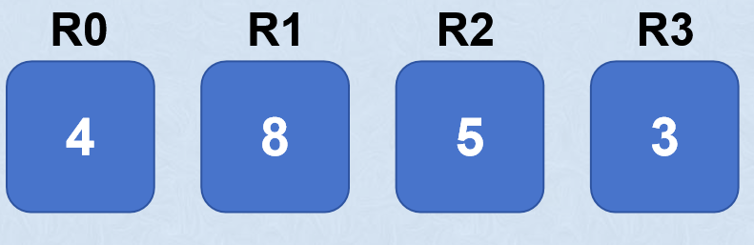
Command
JMP
7
3
Output :
JMP TO 2
R0=R0+R3=7
等一下要跳转哦！
First Num：R0
Second Num：2
1
0
1
0
0
0
1
0
Program
Counter
Input
0
0
1
1
1
0
0
0
0
1
2
等一下要算加法哦！
0
0
0
0
0
0
1
1
First Num：R0
Second Num：R3

Slide 12
Command
AND
初始化
R0=4
R1=8
R2=5
R3=3
R0
R1
R2
R3
4
8
5
1
3
3
等一下要算AND哦！
First Num：R2
Second Num：R3
Output :
R2 = R2 & R3 = 1
Input
1
1
0
1
0
0
1
1
R2: 0000 0101
AND:只有上下全1才是1，其他情况都是0
R3: 0000 0011
OR:只有上下全0才是0，其他情况都是1
0000 0001

Slide 13
Thanks for your attention！

