Slide 1
Digital Explorer Access Model 2.0
David Stevens

Slide 2
Aim
Ensure all users are validated before accessing the platform (inc. DXC employees)
Allow Non DXC employees access to the DE platform “explorers”
Non employee accounts are valid for only 30 days
Allow non employees to ability to extend for 15 more days
Capture last login and login frequency for users

Slide 3
Revised Authentication Model
All users must login before viewing any content
Update each modules landing page with a “login” prompt
Allow users to register
Validation form
Email initial password
Change on first login
Profile page to allow non-dxc users to change password and extend access

Slide 4
Roles and Access Model
Internal DE roles | Admin | Trend viewer | Trend creator | Trend reviewer | Digital Stories Reader | Agenda Manager | Agenda Creator | Agenda Viewer | Solution Viewer | Solution Editor | Workspace
DXC Employee | X | X | X | X | X | X | X | X | X | X | X
Explorer |  | X |  |  | X |  | X¹ | X² | X³ | X⁴ | X
Limited to training account only
Limited to assigned accounts only
Limited to reference solutions only
Limited to assigned solution only

Slide 5
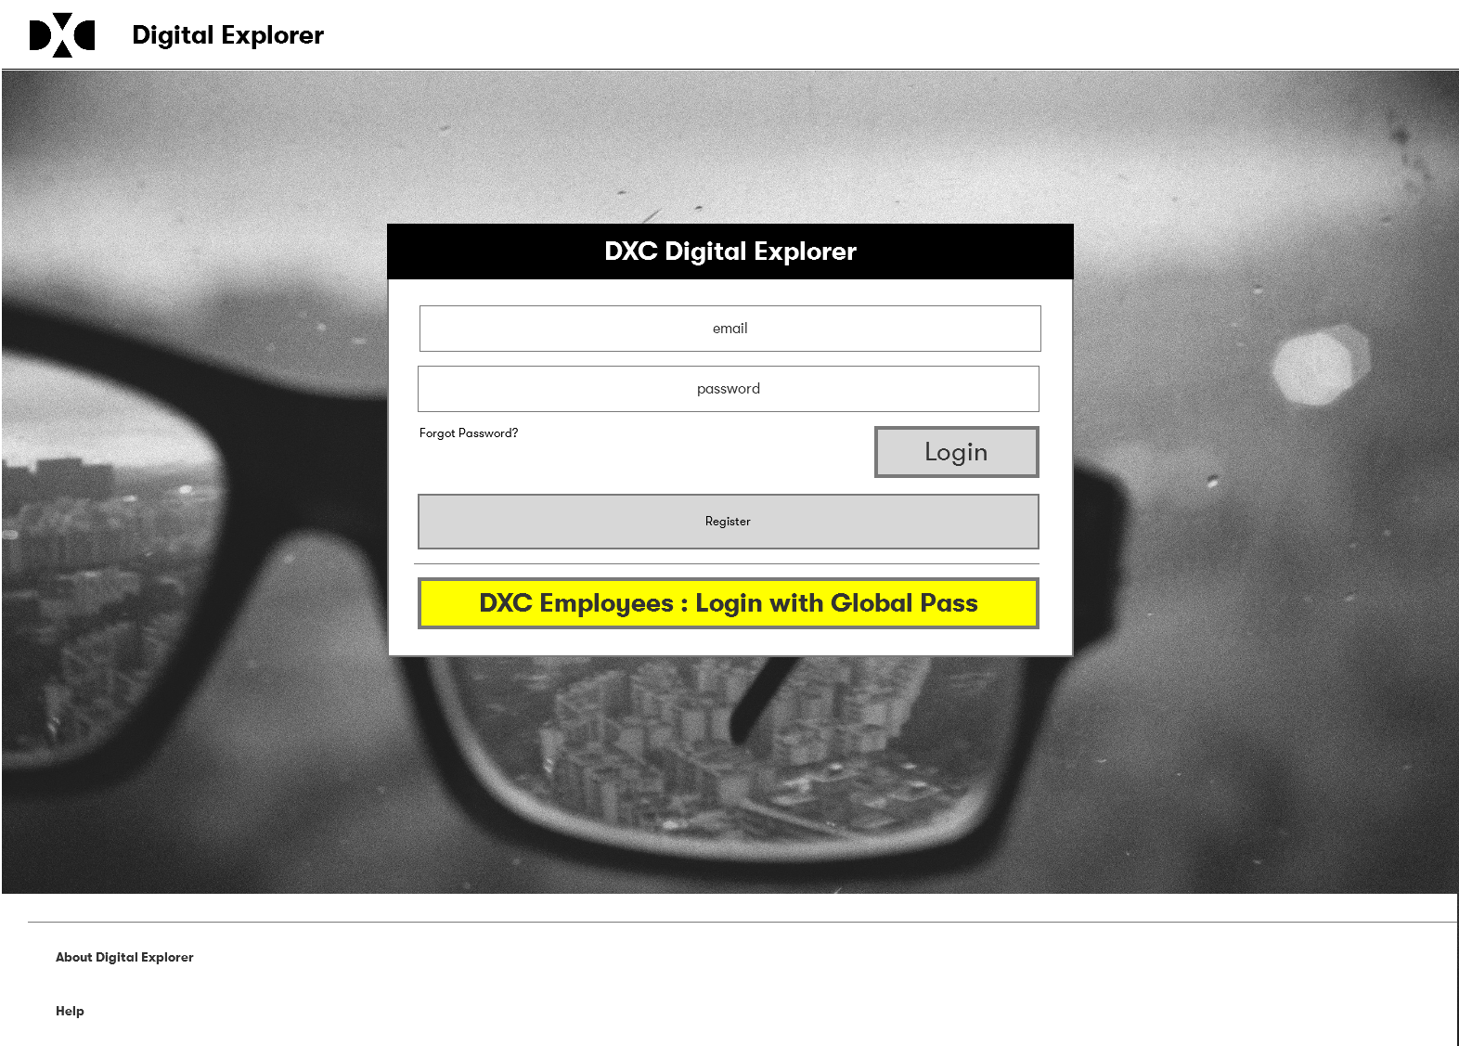
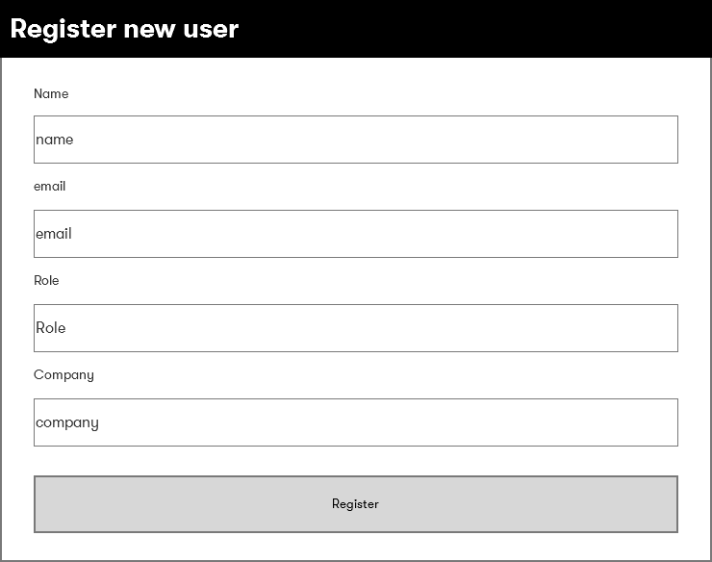
Login page
Email address must be unique.
Login and initial password emailed to new users
New users, change password upon 1st login
Forgotten password, resets password and resend login email

Slide 6
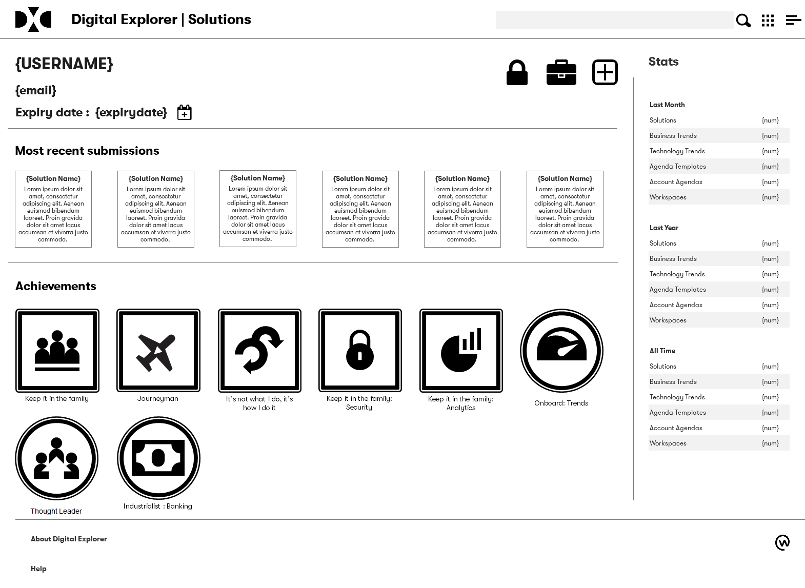
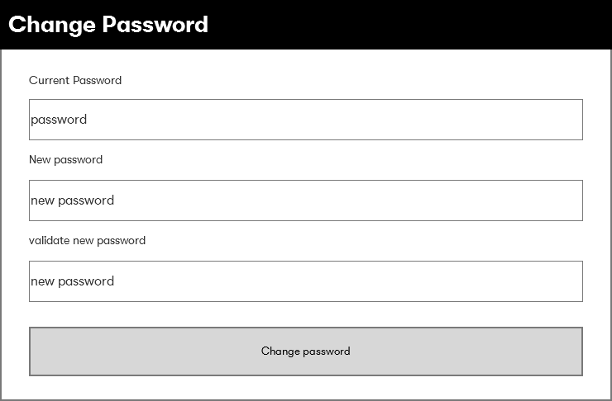
Profile Page
New information shown for “explorer” accounts
Expiry date, plus option to extend for 15 more days (must be within 5 days of expiry date)
Password change (padlock icon)

Slide 7
Data model
2 new data nodes
Login Day
Company
Registered users create or relate to existing “Company” node
DXC employees relate to “DXC” node
All users relate to login day node
Created first time anyone logs in
Label : yyyymmdd
Last login date retained within Person node

Slide 8
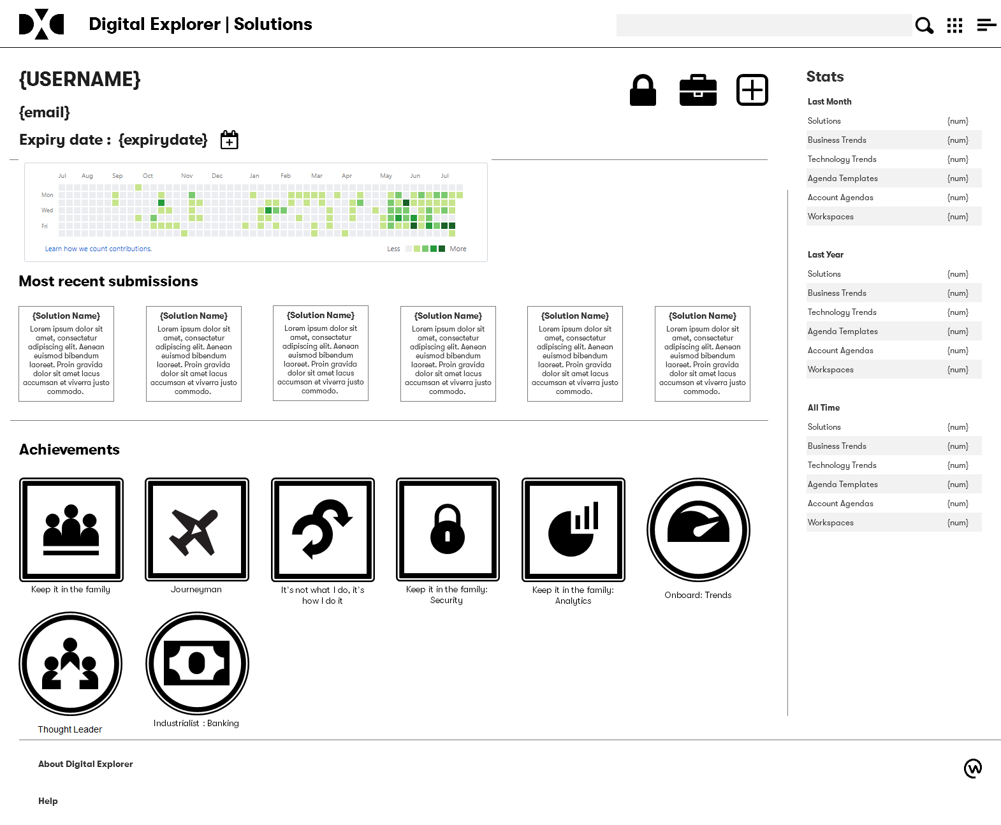
Login History
Future release
Heatmap of each day the user has logged in
Shown within user profile pages

Slide 9
Data clean-up rules
Expired accounts are deleted after 15 days (after expiry date)
Agenda content created by “explorer” users is deleted 30 days after the account is deactivated
Solutions are marked as non-searchable if there are no longer assigned people against it

Slide 10
Special cases to potentially consider
Partners : how to provide explorer level access but potential remove 30 day limit?

