Slide 1


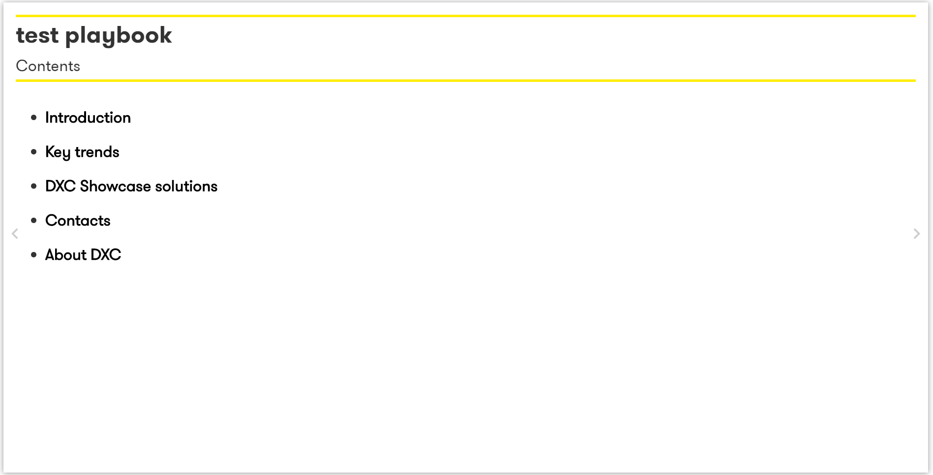
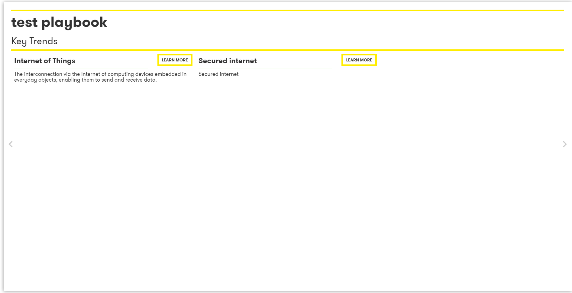
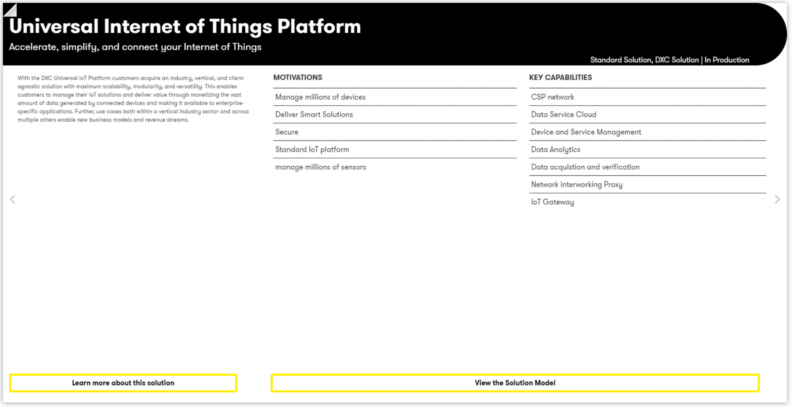

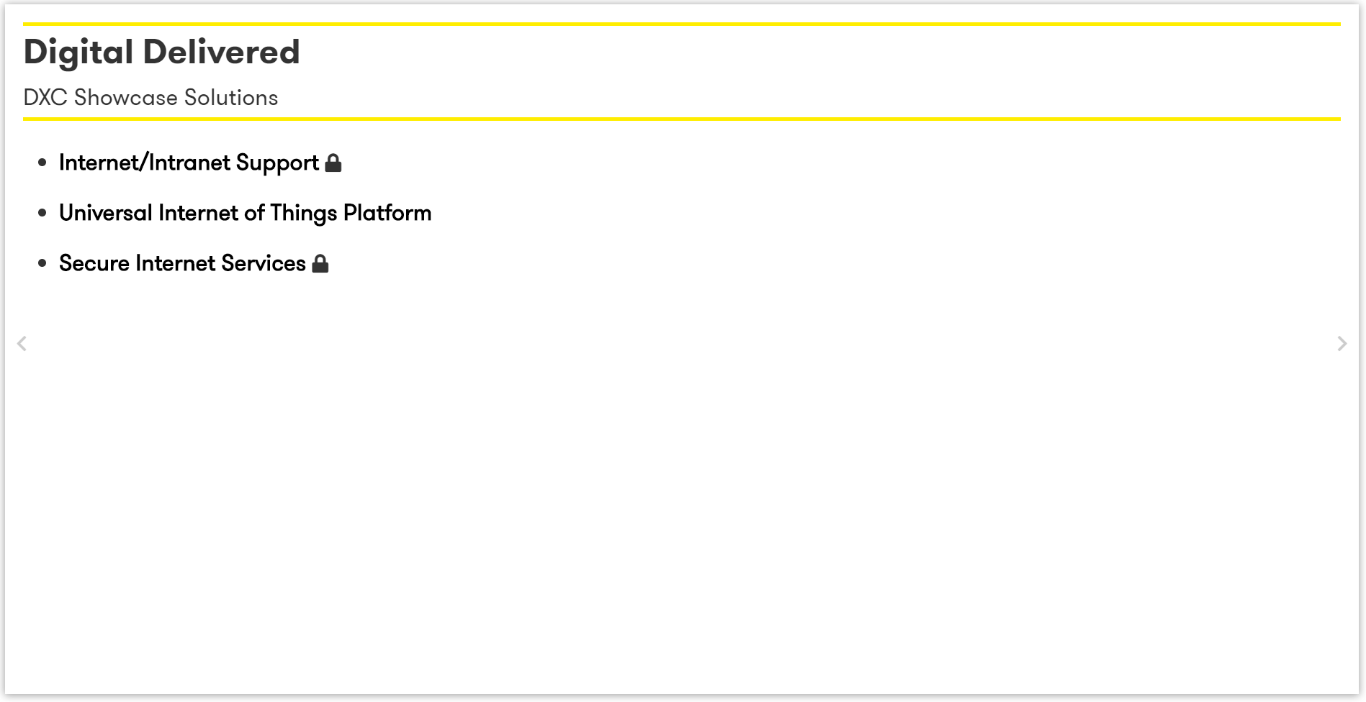
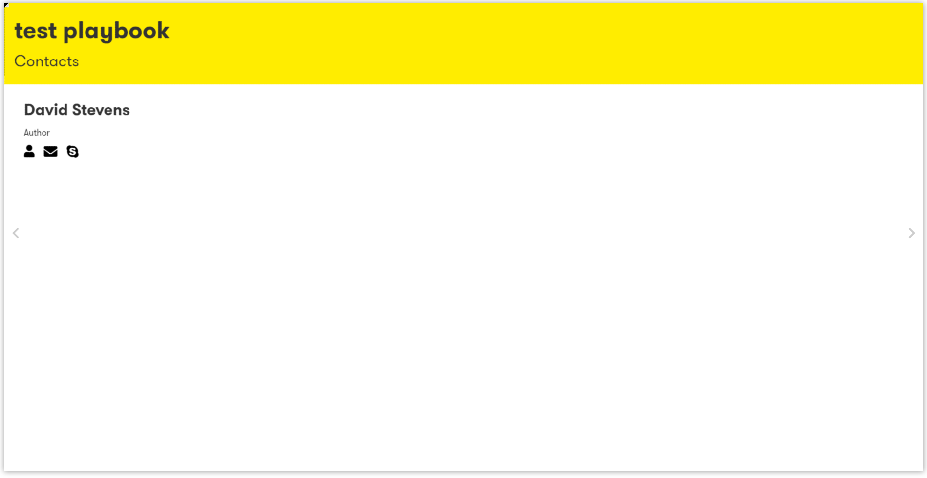
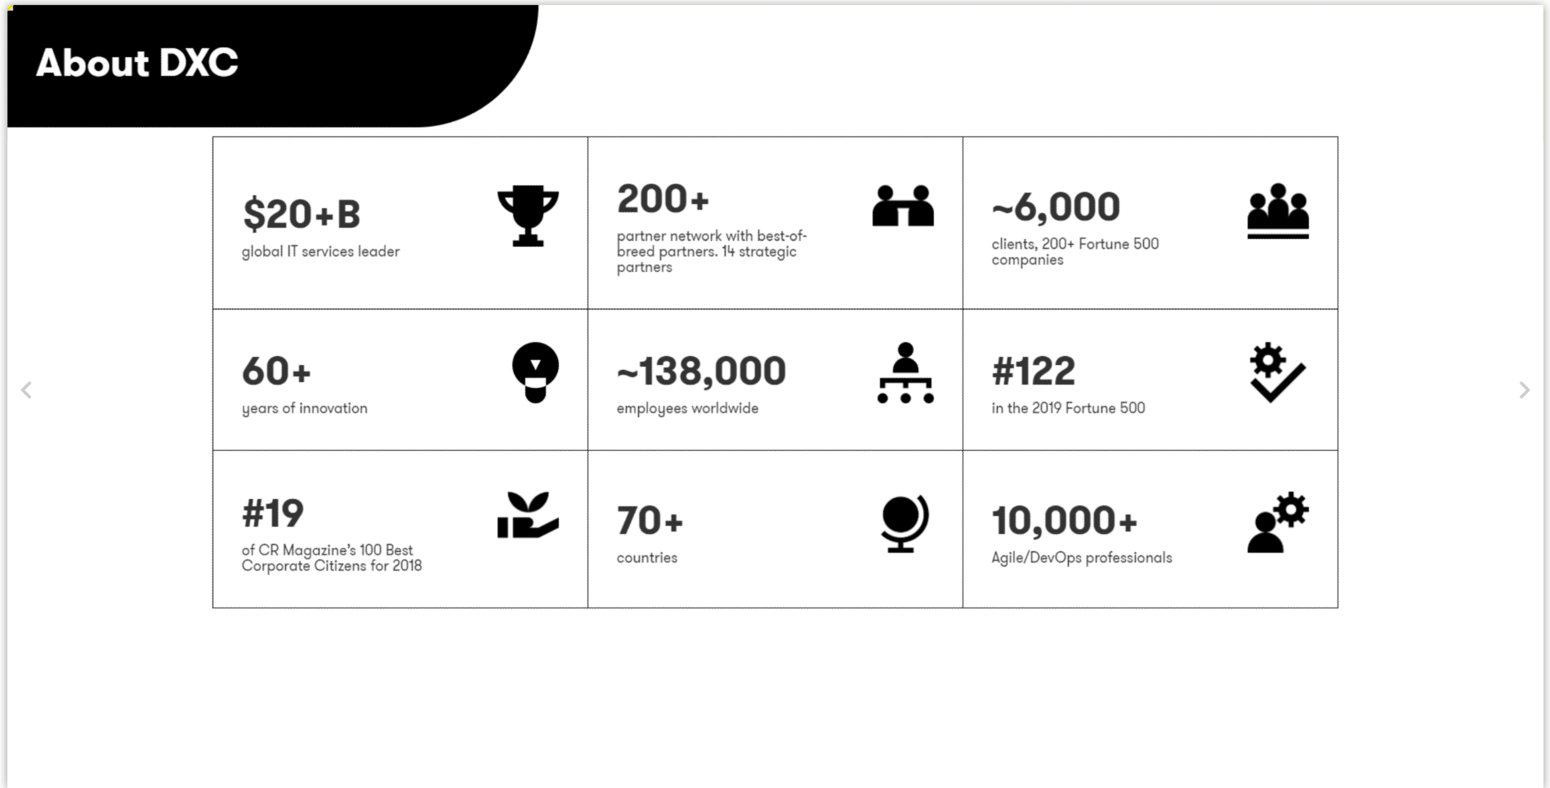

Front cover
Playbook contents
Pages
Key Trends
Solution Pages
Solution Section Intro Page
Solution contents
Solution Page
Contacts
About DXC
Back cover

Slide 2
 | Front Cover | Contents | Pages | Trends | Solution Section Intro Page | Solutions | Contacts | About DXC | Back Cover
Pages Only | X | X | X |  |  |  | X | X | X
Trends Only | X |  |  | X |  |  | X | X | X
Solutions Only | X |  |  |  |  | X | X | X | X
Pages & Trends | X | X | X | X |  |  | X | X | X
Pages & Solutions | X | X | X |  | X | X | X | X | X
Trends & Solutions | X | X |  | X | X | X | X | X | X
All | X | X | X | X | X | X | X | X | X

Slide 3
Solutions Only
Front cover
Solution contents
Solution Page
Contacts
About DXC
Back cover

