Slide 1
Digital Insights
Current insights from the DXC Digital Explorer Platform
As of Dec 1st 2018
David Stevens DXC Distinguished Architect Digital Explorer Product Owner & Architect

Slide 2
Contents
Introduction
Top level numbers
Heatmap of top trends
Timeline of top trends
Clusters of top trends
Summary of Ideas
Heatmap of trends associated to account ideas
Timeline of trends associated to account ideas
Clusters of key trends
Conclusion and Recommendations

Slide 3
Introduction
DXC Digital Explorer is the enabling platform for the DXC Digital Transformation methodology; capturing the key aspects of the DXC Digital Blueprint

Slide 4
Total blueprints : 90
Breakdown by Industry
Breakdown by Region

Slide 5
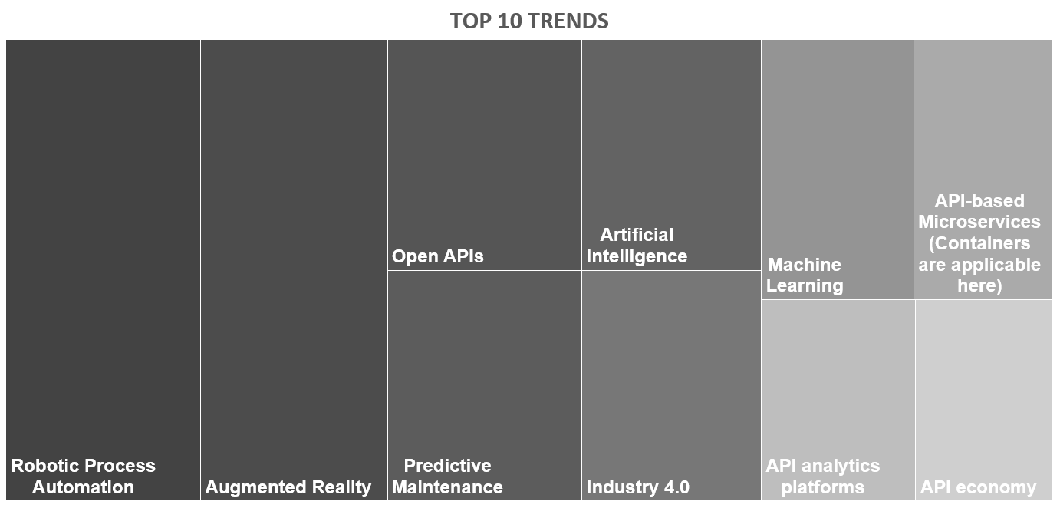
Heatmap of top trends

Slide 6
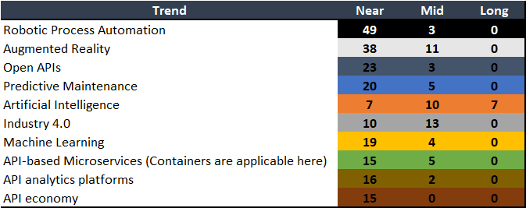
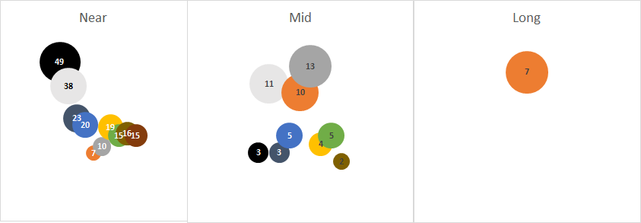
Timeline of top trends
Notes:
Min count would be 3

Slide 7
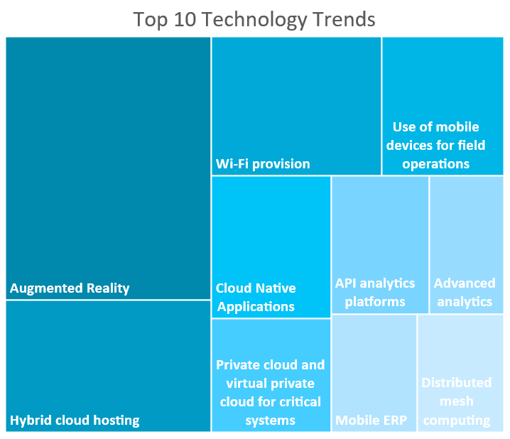
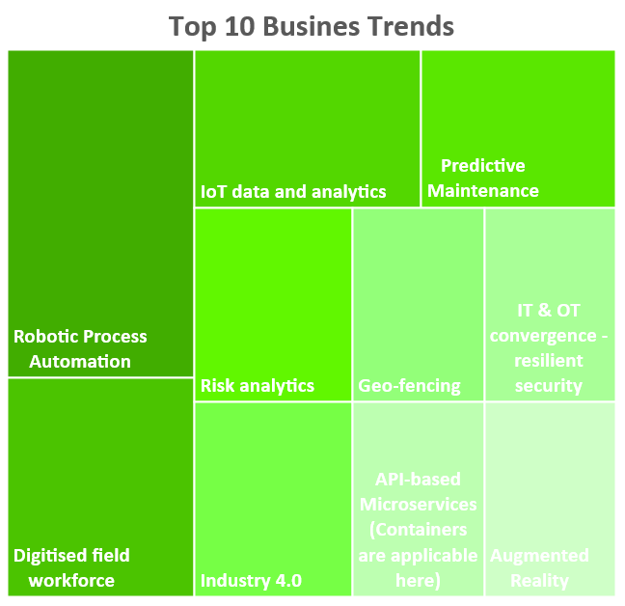
Clusters of top trends
Notes:
Min of 3 grouped trends

Slide 8
Ideas
An Idea is captured through the refinement of the DXC Digital Transformation Map or DXC Innovation Agenda.
Trends within the blueprint are tagged as “focus trends” and assigned to one or more ideas

Slide 9
Total number of ideas : 162
Breakdown by Industry
Breakdown by Region

Slide 10
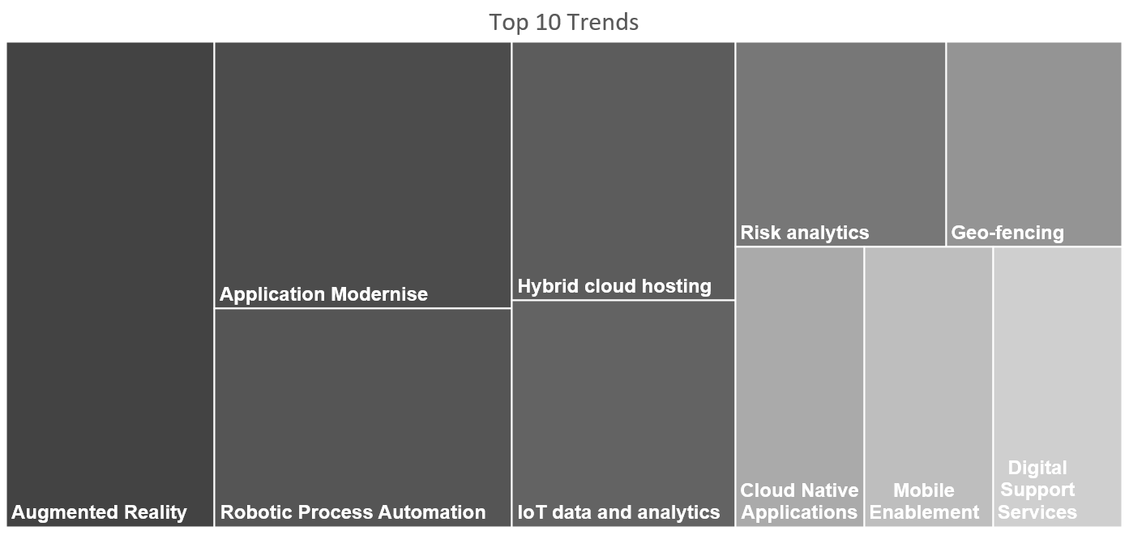
Heatmap of key trends within Ideas

Slide 11
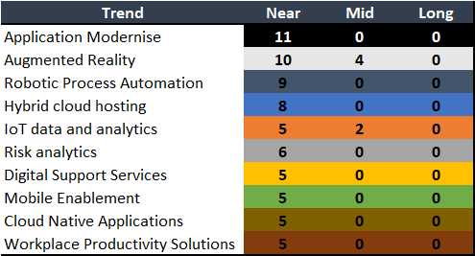
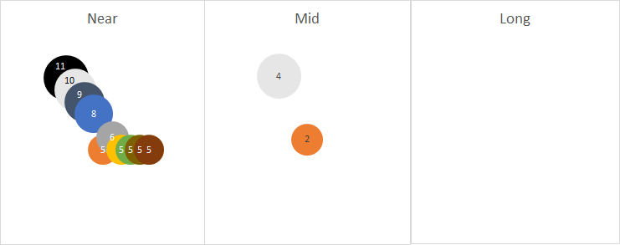
Timeline of key trends within Ideas
Positive validation of the blueprint approach.
Ideas should be pulling in focus trends from the near term, whereas mid and long term are the targets for next year and beyond.

Slide 12
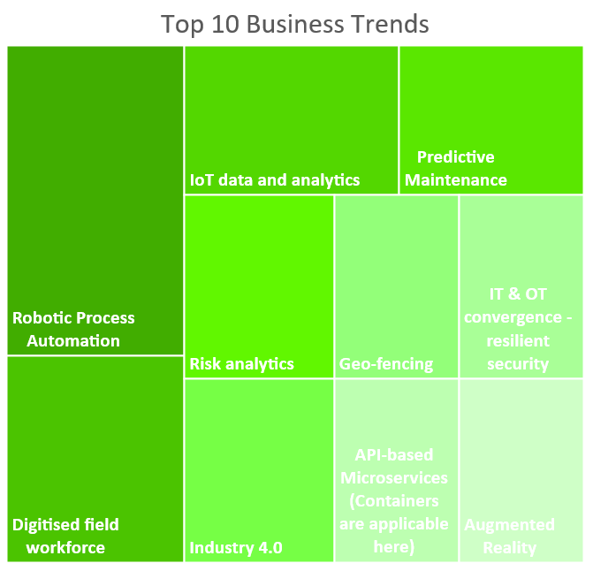
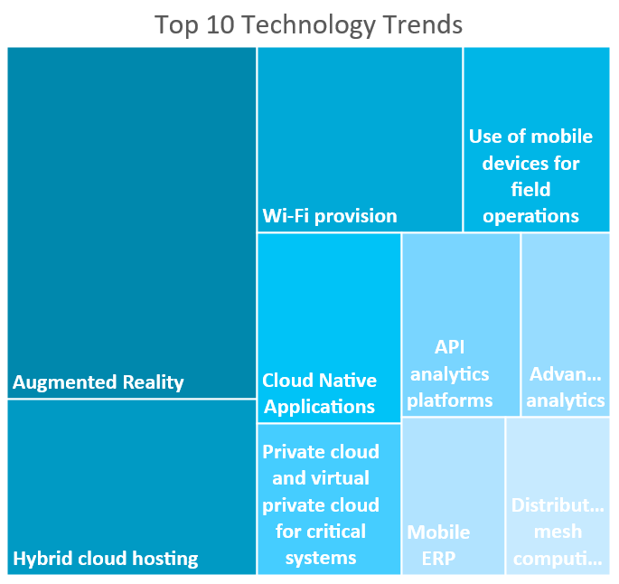
Cluster of key trends within Ideas

Slide 13
Conclusion and Recommendations
Clear demand for automation and cloud platforms
New user interfaces and AR demand signals
Digital signals are strong (mobile, digital agents, cloud native)
Dataset is still too limiting - DXC Digital Explorer needs to be mandatory for all DXC account teams
Adoption within the Energy sector is good to see, but this has put a strong bias on the results shown here.

Slide 14
All these insights are available realtime on the DXC Digital Explorer platform, click here to view
Digital Explorer Insights

