Slide 1
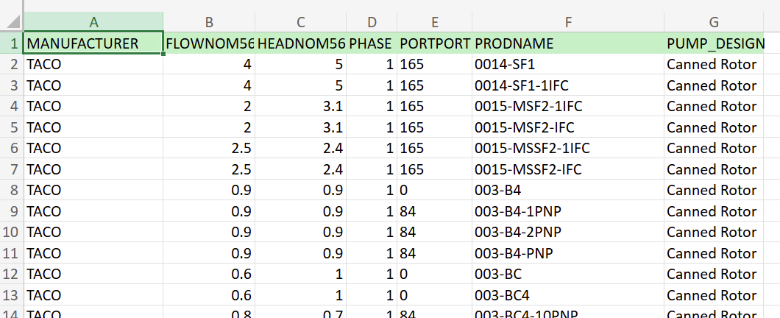
Data description
Given “MANUFACTURER” and “PRODNAME”, find “FLOWNOM56”, “HEADNOM56” and “PHASE”
“PUMP_DESIGN” and “PORTPORT” can be ignored

