Slide 1
Comprehensive Analysis of Police-Recorded Crime Data Trends, Patterns, and Insights for Evidence-Based Crime Prevention
Presented by: Ibrahim Ismaila
Date: October 2024

Slide 2
Introduction Project Overview This data analysis project explores police-recorded crime statistics. Aims: Identify crime trends, examine patterns, explore correlations, and provide actionable insights. Data Source: Excel document with detailed crime data (types, locations, periods).

Slide 3


Slide 4
Project Aim and Objective TO: Assess the impact of changes in crime reporting and outcomes. Provide insights into inconsistencies and anomalies in reported data. Offer actionable insights to improve data validation and decision-making.

Slide 5
Problem Definition Investigating the shift from detection-focused to outcome-based crime reporting. Examine data trends and their implications for policy and law enforcement strategies. Ensure the consideration of external factors and ethical concerns in data interpretation.

Slide 6
Data Description FOR The Dataset Overview: Columns: Financial Year, Quarter, Force Name, Offense Description, Group, Subgroup, Offense Code, Number of Offenses. Data Description: Rows represent individual crime records with time period, location, and offense details. The analysis covers both financial years and quarterly periods.

Slide 7
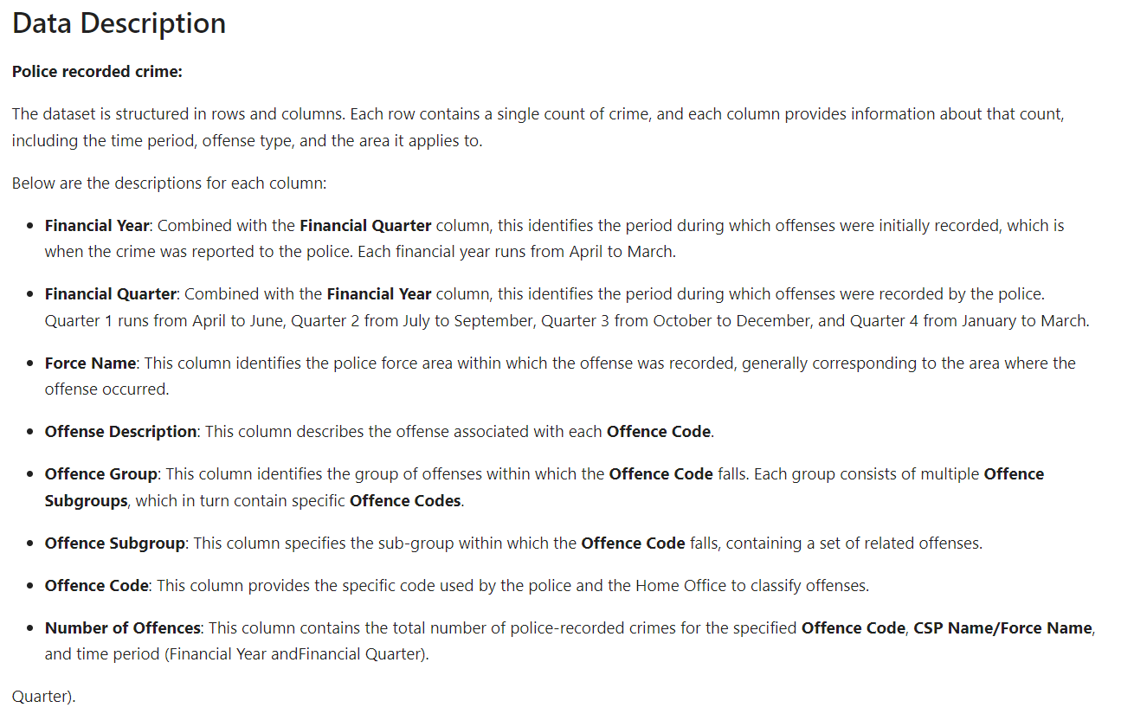

Slide 8





Tech Stack: Tools and Methods Programming Language: Python (LIBRARIES INCLUDE Pandas, NumPy, Matplotlib, Seaborn). Methods: Data cleaning, exploratory data analysis, data visualization. Objective: TO Create data-driven visualizations and insights for stakeholders(TECHNICAL AND NON TECHNICAL).

Slide 9
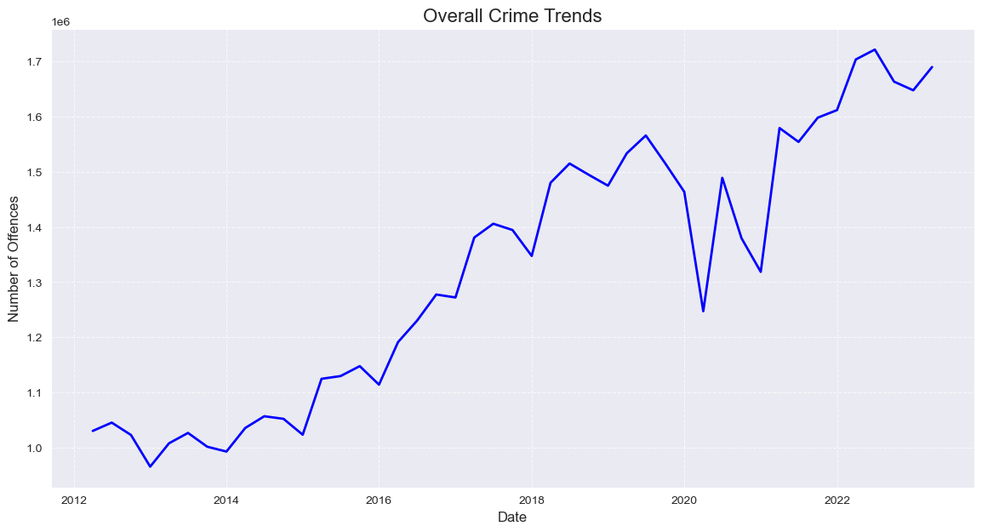
Research Question 1: How Have Overall Crime Trends Changed Over Time? Key Observations: Fluctuations in crime rates with notable increases in recent years. External factors like economic downturns and societal unrest likely influenced these changes.
Visualization: Line chart showing overall crime trends (2012–2022).

Slide 10
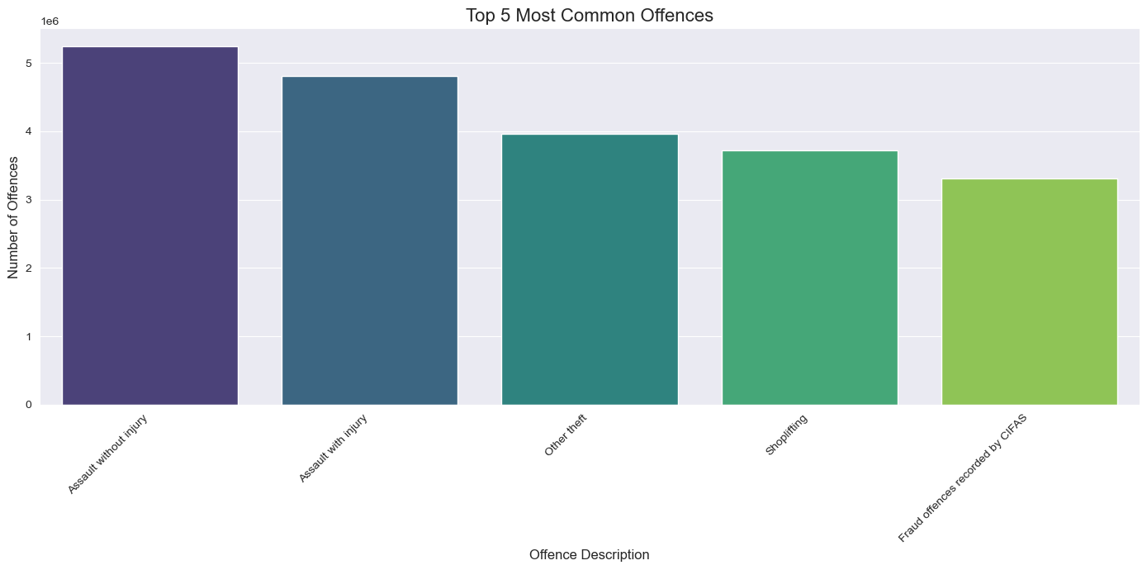
Research Question 2: What Are the Top 5 Most Common Offenses? Key Observations: These common crimes highlight areas for targeted prevention and resource allocation.
Visualization: Bar chart highlighting top five offenses (Assault without Injury, Theft, Shoplifting, etc.).

Slide 11
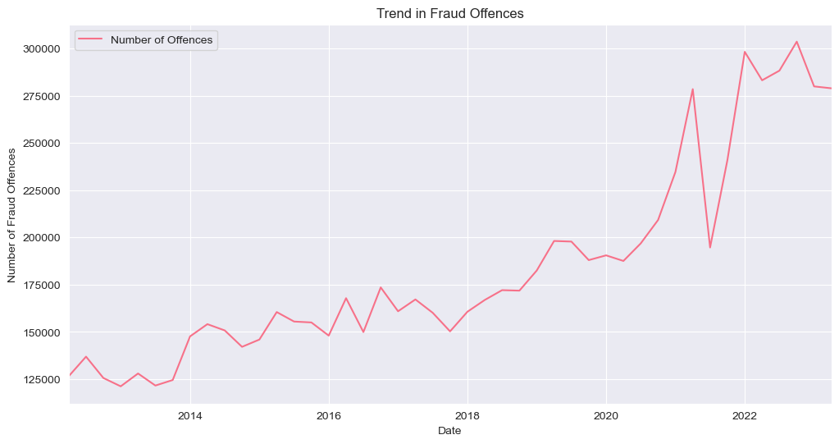
Research Question 3 Title: How Have Fraud Offenses Evolved Over Time? Key Observations: Significant increase in fraud offenses, suggesting a need for enhanced fraud prevention measures.
Visualization: Line chart showing fraud offenses trends.

Slide 12
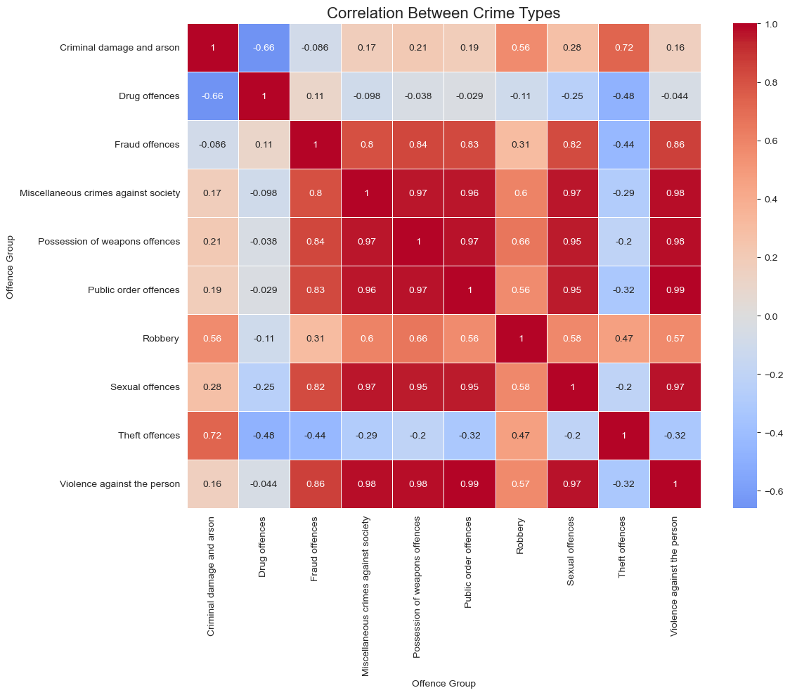
Research Question 4: Is There a Correlation Between Different Crime Types? Key Observations: Strong correlations between property and violent crimes, indicating these may occur together. Insights into how different crime types are interconnected for comprehensive crime prevention.
Visualization: Correlation matrix heatmap.

Slide 13
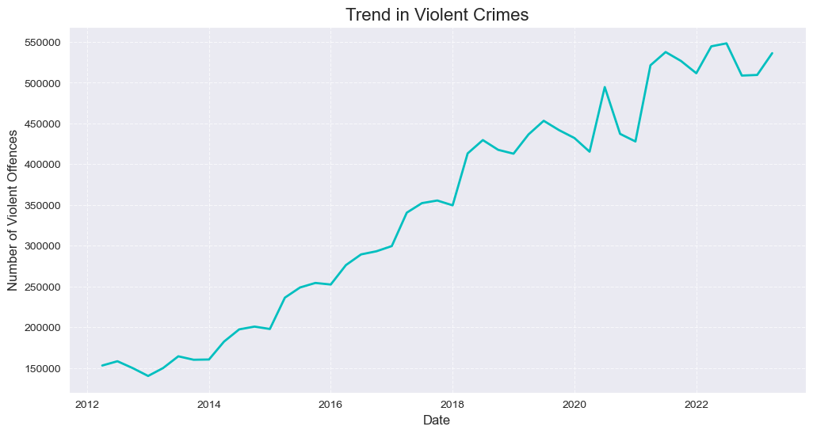
Research Question 5: How Have Violent Crimes Changed Over Time? Key Observations: Increasing violent crime trends over time, signaling a need for focused interventions.
Visualization: Line chart tracking violent crime trends.

Slide 14
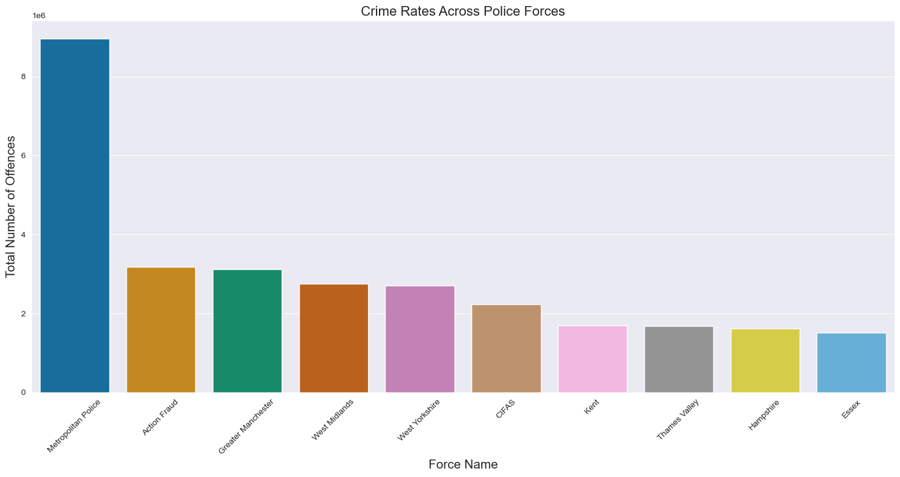
Research Question 6: Crime Rates Across Different Police Forces Visualization: Map or bar chart comparing crime rates by police force (Metropolitan, Greater Manchester, etc.). Key Observations: Metropolitan Police tops the list, with significant variation across forces.
Visualization: Map or bar chart comparing crime rates by police force (Metropolitan, Greater Manchester, etc.).

Slide 15
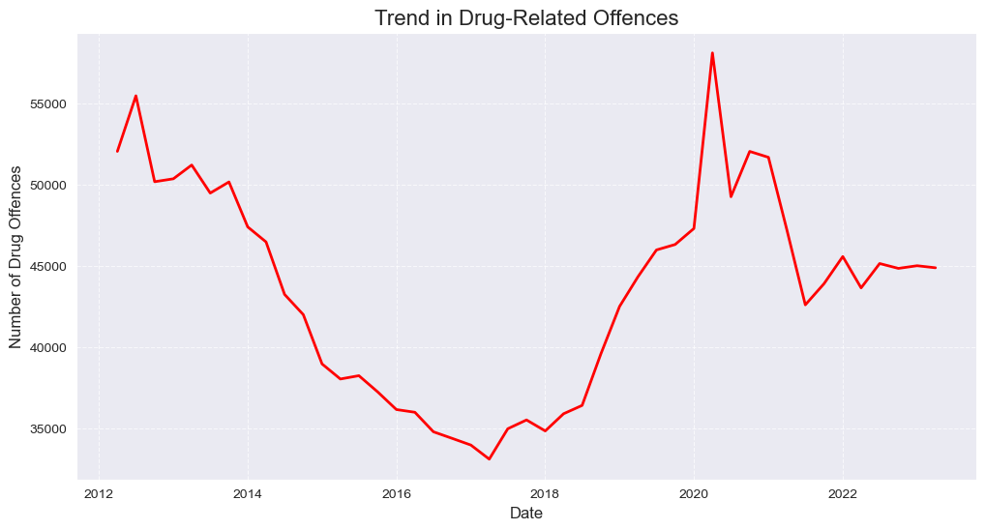
Research Question 7: Trends in Drug-Related Offenses Key Observations: A sharp rise in recent years; indicating need for stronger drug enforcement policies.
Visualization: Line chart showing the trend of drug offenses.

Slide 16
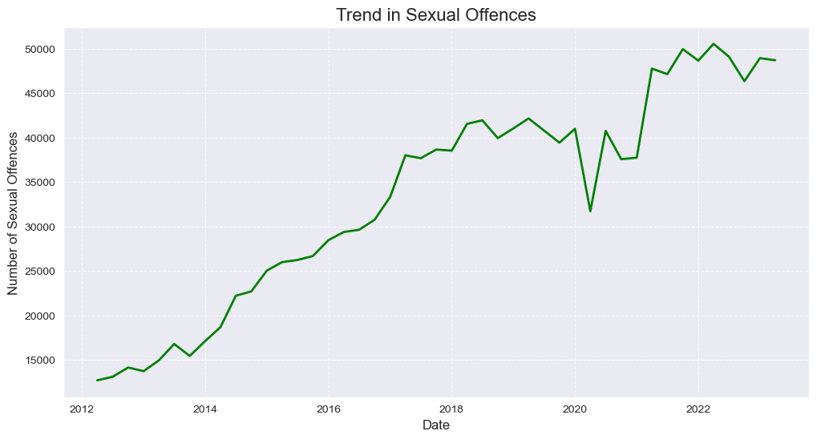
Research Question 8 How Have Sexual Offenses Changed Over Time? Key Observations: Increased reporting and awareness lead to higher statistics in recent years.
Visualization: Line chart illustrating the trend in sexual offenses.

Slide 17
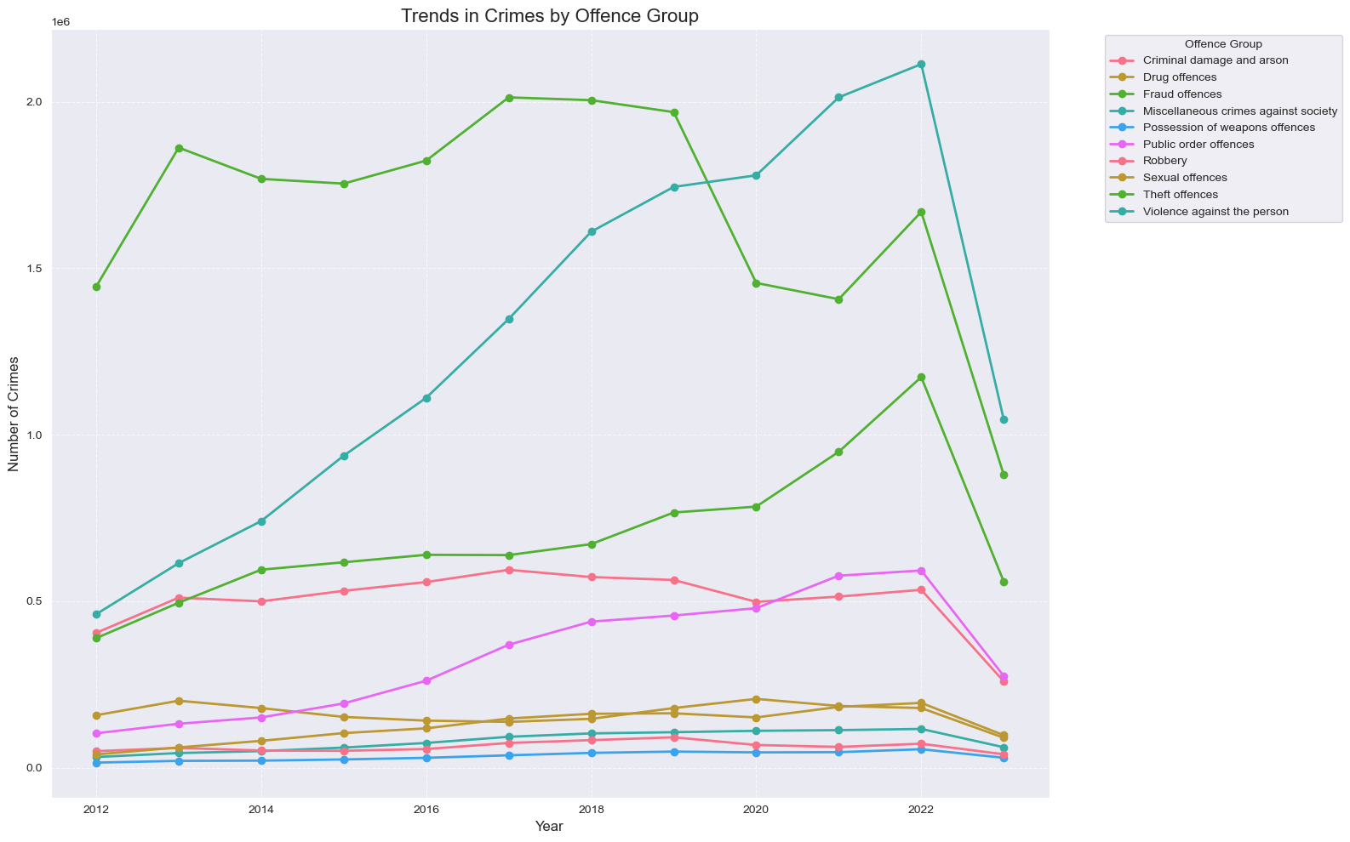
Research Question 9 Breakdown of Crimes by Offense Group Key Observations: Distinct trends across categories like public order, fraud, and drug-related offenses.
Visualization: Stacked bar chart displaying different offense groups over the years.

Slide 18
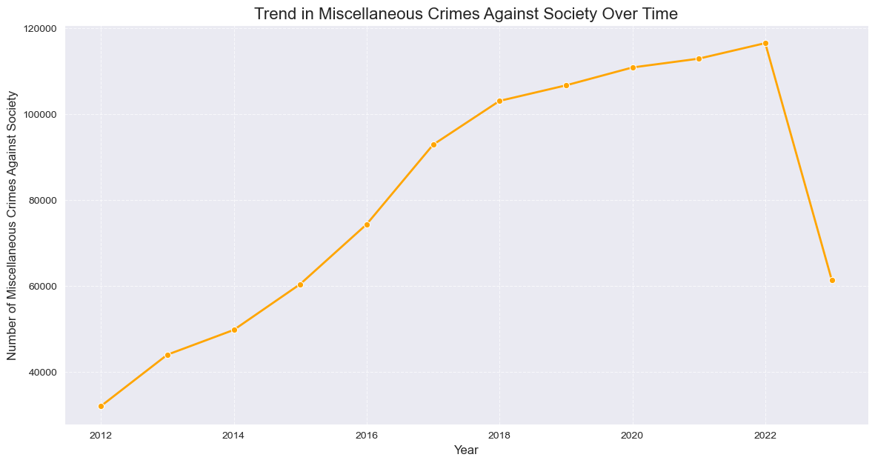
Research Question 10 Trends in Miscellaneous Crimes Against Society Key Observations: Fluctuations influenced by societal or economic stressors, with sharp changes in recent years.
Visualization: Line chart tracking trends in miscellaneous crimes.

Slide 19
Key Insights & Recommendations Key Insights: Overall crime rates are rising, especially violent and drug-related crimes. Fraud and sexual offenses require enhanced prevention and reporting mechanisms. Recommendations: Increase law enforcement resources in high-crime areas. Develop targeted community programs to reduce violence and drug-related crimes. Enhance fraud detection systems and public awareness campaigns.

Slide 20
Recommendations: Increase law enforcement resources in high-crime areas. Develop targeted community programs to reduce violence and drug-related crimes. Enhance fraud detection systems and public awareness campaigns.
Targeted Interventions: Prioritize high-crime regions, focusing on violent and property crimes. Develop specialized units to address these correlated offenses.
Fraud Monitoring: Strengthen efforts to combat fraud through better reporting and investigation.
Resource Allocation: Use data-driven insights to allocate resources efficiently, focusing on high-frequency offenses like assault and theft.
Public Awareness Campaigns: Increase awareness campaigns, particularly for drug and sexual offenses, encouraging reporting and preventative action.

Slide 21
Conclusion Police-recorded crime data offers valuable insights for policy and decision-making. Continuous monitoring and adaptable law enforcement strategies are essential. Data-driven approaches can enhance public safety and crime prevention efforts.
Crime Trends: Most crime types show an upward trend, particularly fraud, sexual offences, and drug-related crimes. This could reflect better reporting mechanisms and heightened enforcement.
Correlations: Certain crime types are correlated, such as violent and property crimes, suggesting that an increase in one type may lead to or coincide with increases in another.
Awareness Impact: Increased public awareness, especially around issues like sexual assault and fraud, appears to have driven up reporting, which may signal progress in societal attitudes toward addressing these crimes.
Geographic Disparities: Crime is not evenly distributed across regions, highlighting the need for location-specific crime prevention strategies.

Slide 22


