Slide 1
Comprehensive Analysis of Police-Recorded Crime Data Trends, Patterns, and Insights for Evidence-Based Crime Prevention
Presented by: Ibrahim Ismaila
Date: October 2024

Slide 2
Introduction Project Overview: This data analysis project explores police-recorded crime statistics. Aims: TO Identify crime trends, examine patterns, explore correlations, and provide actionable insights. Data Source: Excel document with detailed crime data (types, locations, periods).

Slide 3


Slide 4
Project Objective: TO Assess the impact of changes in crime reporting and outcomes. TO Provide insights into reported data. TO Offer actionable insights to improve data validation and decision-making.

Slide 5
Problem Definition: Investigating the shift from detection-focused to outcome-based crime reporting. ExaminING data trends and their implications for policy and law enforcement strategies. EnsurING the consideration of external factors and ethical concerns in data interpretation.

Slide 6
OUTCOME-BASED
DETECTION-FOCUSED

Slide 7
The analysis covers FOR THE financial years FROM 2012 TO 2024.
The Dataset Description
Overview:
COLUMNS:
ROWS:
Financial Year
Financial Quarter
Force Name
Offense Description
Group
Subgroup
Offense Code
Number of Offenses.
Individual crime records with time period,
Location
Offense details.

Slide 8
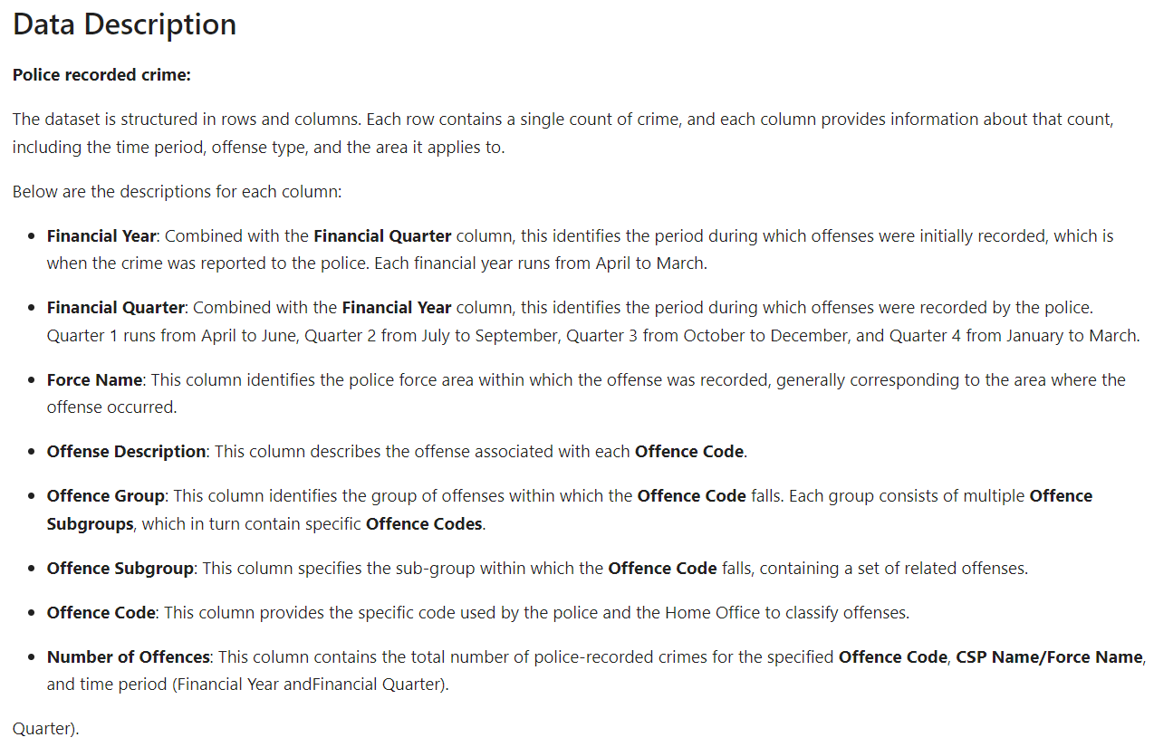

Slide 9
DATA DESCRIPTION
Financial Year
Each financial year runs from April to March
Offence Group
Group of offences identified offence falls
Consists of multiple subgroups
Offence Code
Assigned code used by police to classify offenses
Financial Quarter
Force Name
Offense Description
January to April
Police area crime was reported to
Describes the offense

Slide 10





Tech Stack: (Tools and Methods) Programming Language: Python (LIBRARIES INCLUDE Pandas, NumPy, Matplotlib, Seaborn). Methods: Data cleaning, exploratory data analysis, data visualization. Objective: TO Create data-driven visualizations and insights for stakeholders(TECHNICAL AND NON TECHNICAL).

Slide 11
RESEARCH QUESTIONS
How Have Overall Crime Trends Changed Over Time?
What Are the Top 5 Most Common Offenses?
How Have Fraud Offenses Evolved Over Time?
Is There a Correlation Between Different Crime Types?
How Have Violent Crimes Changed Over Time?
Crime Rates Across Different Police Forces
Trends in Drug-Related Offenses
How Have Sexual Offenses Changed Over Time?
Breakdown of Crimes by Offense Group
Trends in Miscellaneous Crimes Against Society

Slide 12
ANALYSIS AND VISUALIZATIONS

Slide 13
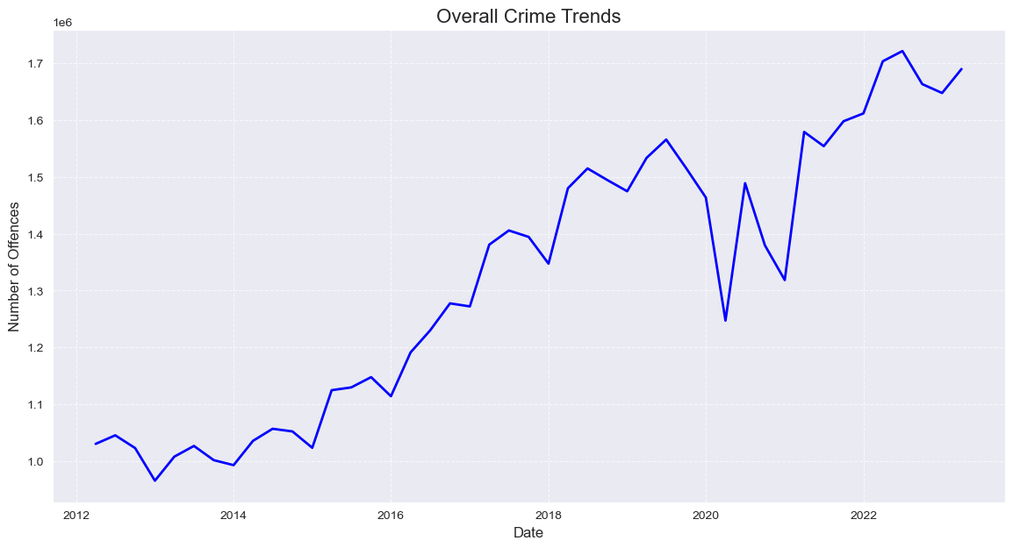
1:How Have Overall Crime Trends Changed Over Time? Key Observations: Fluctuations in crime rates with notable increases in recent years. External factors like economic downturns and societal unrest likely influenced these changes.
Visualization: Line chart showing overall crime trends (2012–2022).

Slide 14
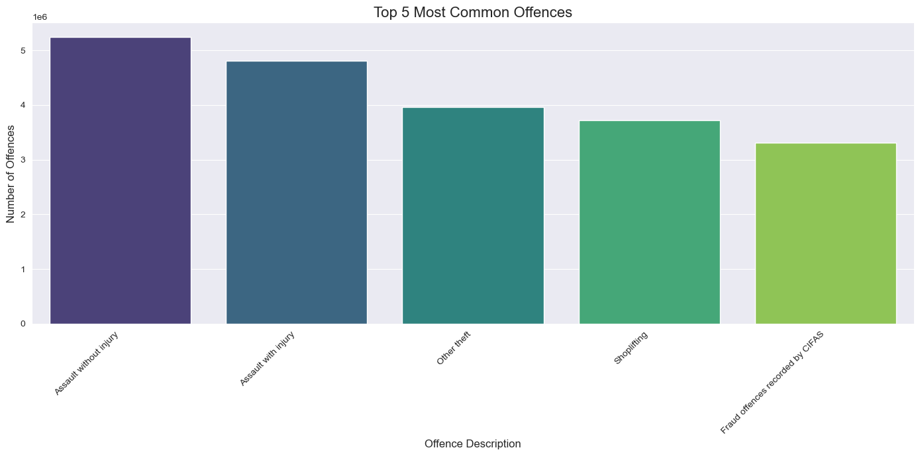
2:What Are the Top 5 Most Common Offenses? Key Observations: These common crimes highlight areas for targeted prevention and resource allocation.
Visualization: Bar chart highlighting top five offenses (Assault without Injury, Theft, Shoplifting, etc.).

Slide 15
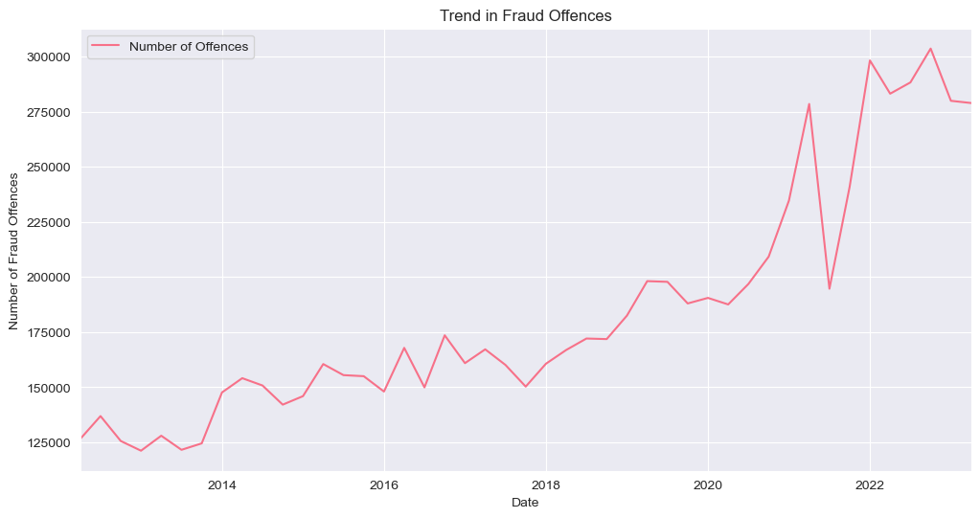
3: How Have Fraud Offenses Evolved Over Time? Key Observations: Significant increase in fraud offenses, suggesting a need for enhanced fraud prevention measures.
Visualization: Line chart showing fraud offenses trends.

Slide 16
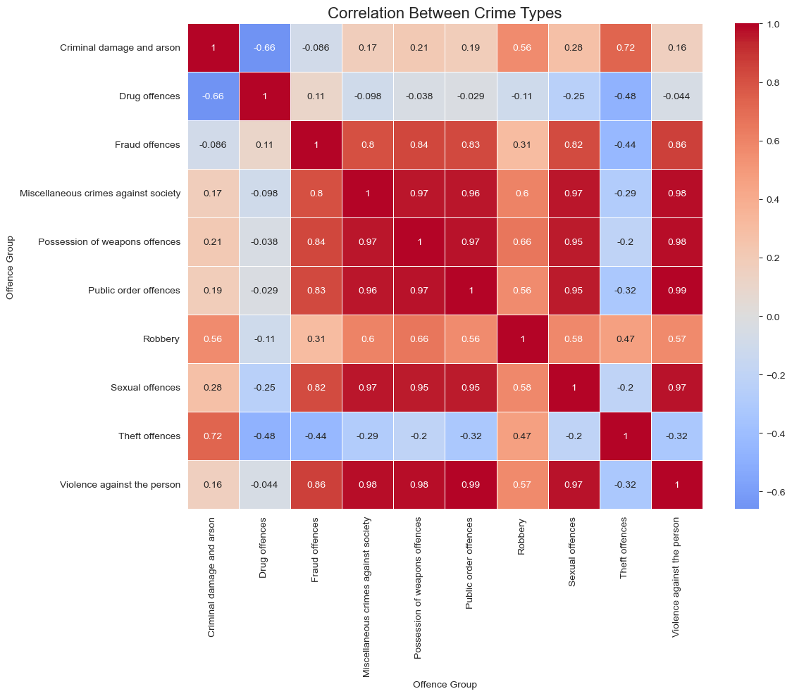
4:Is There a Correlation Between Different Crime Types? Key Observations: Strong correlations between property and violent crimes, indicating these may occur together. Insights into how different crime types are interconnected for comprehensive crime prevention.
Visualization: Correlation matrix heatmap.

Slide 17
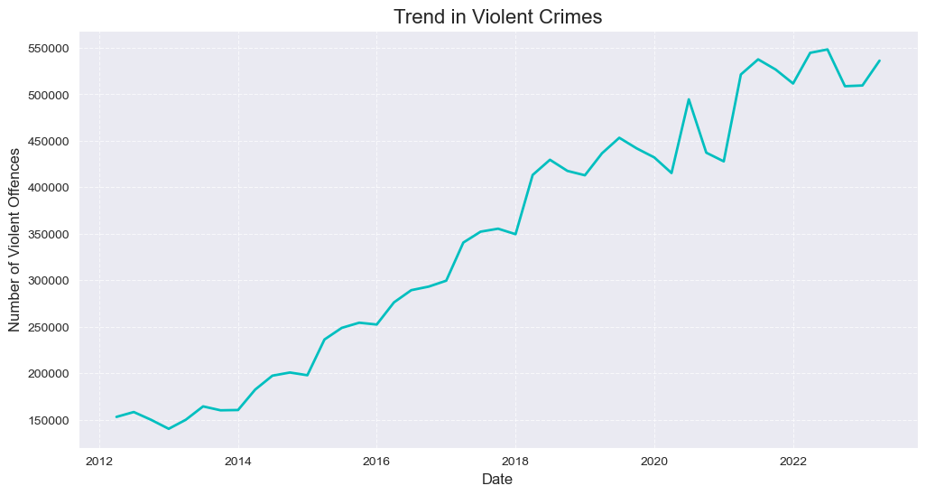
5: How Have Violent Crimes Changed Over Time? Key Observations: Increasing violent crime trends over time, signaling a need for focused interventions.
Visualization: Line chart tracking violent crime trends.

Slide 18
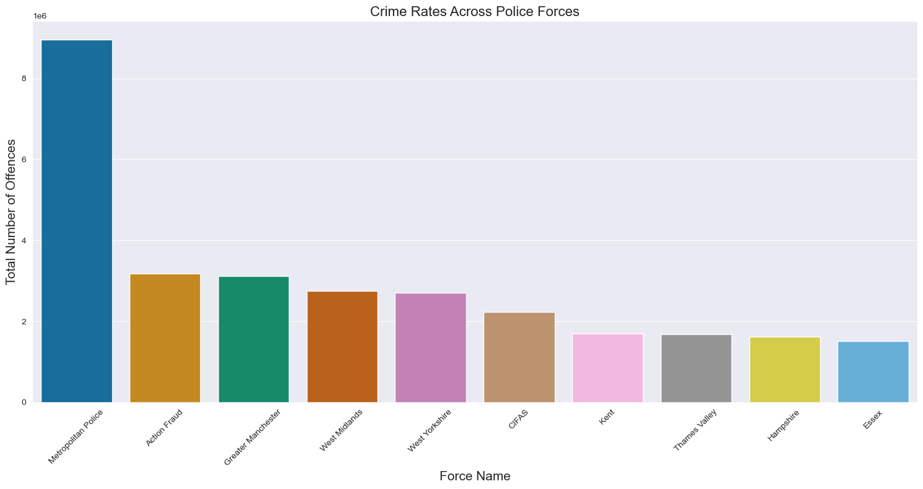
6: Crime Rates Across Different Police Forces Visualization: Map comparing crime rates by police force (Metropolitan, Greater Manchester, etc.). Key Observations: Metropolitan Police tops the list, with significant variation across forces
Visualization: Map or bar chart comparing crime rates by police force (Metropolitan, Greater Manchester, etc.).

Slide 19
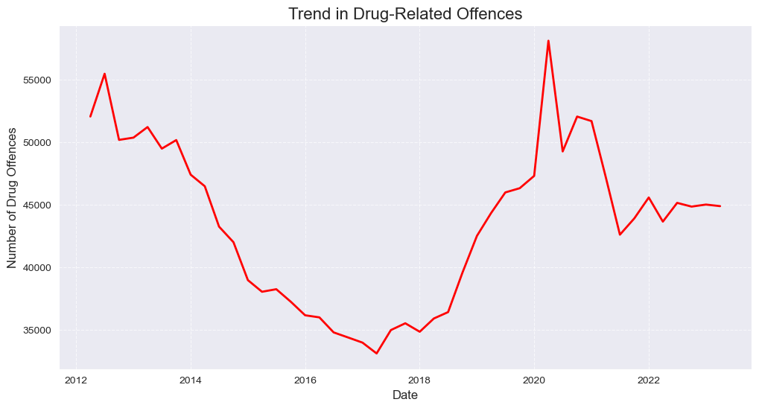
7:Trends in Drug-Related Offenses Key Observations: A sharp rise in recent years; indicating need for stronger drug enforcement policies.
Visualization: Line chart showing the trend of drug offenses.

Slide 20
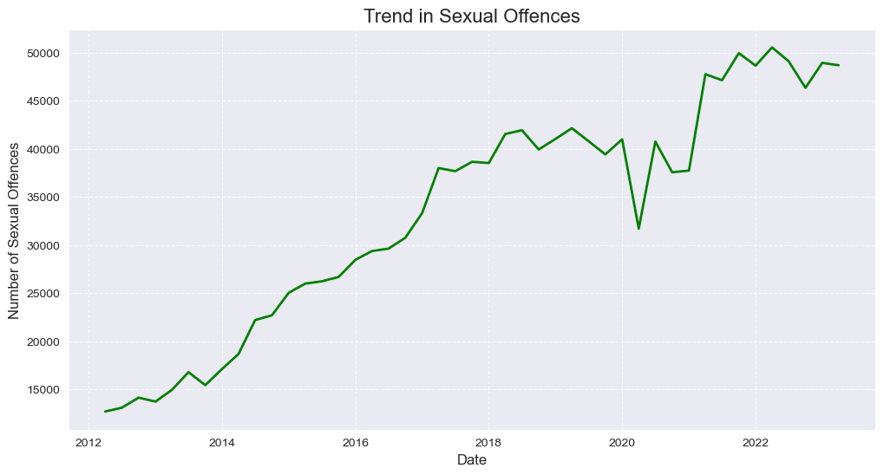
8: How Have Sexual Offenses Changed Over Time? Key Observations: Increased reporting and awareness lead to higher statistics in recent years.
Visualization: Line chart illustrating the trend in sexual offenses.

Slide 21
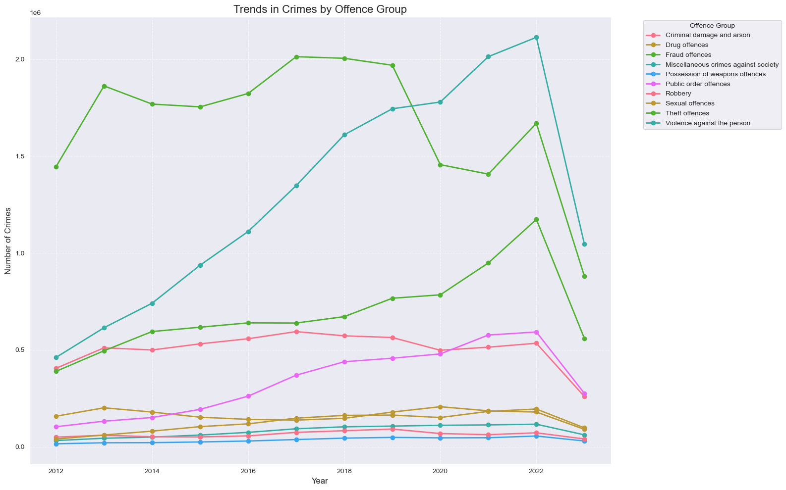
9: Breakdown of Crimes by Offense Group Key Observations: Distinct trends across categories like public order, fraud, and drug-related offenses.
Visualization: Stacked bar chart displaying different offense groups over the years.

Slide 22
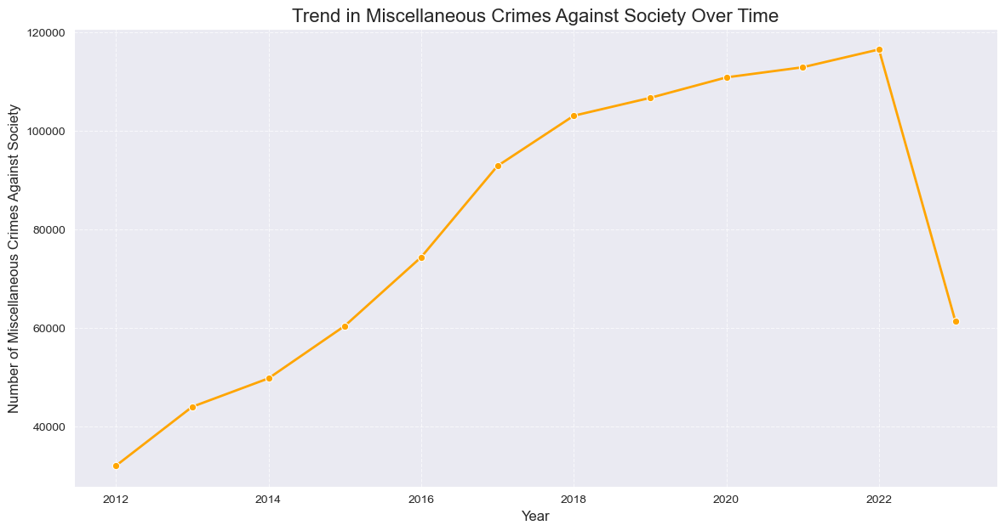
10: Trends in Miscellaneous Crimes Against Society Key Observations: Fluctuations influenced by societal or economic stressors, with sharp changes in recent years.
Visualization: Line chart tracking trends in miscellaneous crimes.

Slide 23
Key Insights & Recommendations

Slide 24
Key Insights: Overall crime rates are rising, especially violent and drug-related crimes. Fraud and sexual offenses require enhanced prevention and reporting mechanisms. Crime Trends Overview: Overall Crime Trends: Crime trends have fluctuated over time, with a notable increase in recent years, potentially due to external factors like economic downturns, societal unrest, or policy changes. Continuous adaptation in law enforcement strategies is essential to respond to these evolving crime patterns. Top 5 Most Common Offences: The most prevalent offences include: Assault without Injury Assault with Injury Other Theft Shoplifting Fraud Offences These common offences require prioritized resources for effective prevention.

Slide 25
Specific Crime Insights
Fraud Offences: Since the introduction of Action Fraud, reports of fraud have significantly increased. More awareness campaigns are necessary to enhance fraud detection.
Correlation Between Crime Types:
Positive correlation between violent crimes and property crimes, suggesting interdependence.
Weaker correlations between drug crimes and public order offences.
Violent Crimes: The rising trend in violent crimes calls for focused interventions to address root causes of violence.
Drug-related Offences: There has been a distinct upward trend in drug-related crimes, highlighting the need for ongoing monitoring and evaluation of drug prevention programs.
Sexual Offences: Sharp increases in sexual offences are likely due to greater awareness, improved reporting, and social movements. Supporting victims and further promoting reporting is crucial.
Regional Crime Variations: Some regions are crime hotspots, requiring targeted interventions based on socioeconomic factors like poverty and unemployment.
Miscellaneous Crimes: These offences have fluctuated, often tied to political unrest or social changes, stressing the need for careful monitoring during periods of uncertainty.

Slide 26
Recommendations:
Targeted Interventions: Prioritize high-crime regions, focusing on violent and property crimes. Develop specialized units to address these correlated offenses.
Fraud Monitoring: Strengthen efforts to combat fraud through better reporting, EnhanceD fraud detection systems and investigation.
Resource Allocation: Use data-driven insights to allocate law enforcement resources efficiently, focusing on high-frequency offenses like assault and theft AND high-crime areas
Public Awareness Campaigns: Increase awareness campaigns, particularly for drug and sexual offenses, encouraging reporting and preventative action, BY DevelopING targeted community programs to reduce violence and drug-related OFFENCES .

Slide 27
Conclusion THE Police-recorded crime data ANALYSIS offers valuable insights for policy and decision-making. Continuous monitoring and adaptable law enforcement strategies are essential. HENCE Data-driven approaches can enhance public safety and crime prevention efforts.
Crime Trends: Most crime types show an upward trend, particularly fraud, sexual offences, and drug-related crimes. This could reflect better reporting mechanisms and heightened enforcement.
Correlations: Certain crime types are correlated, such as violent and property crimes, suggesting that an increase in one type may lead to or coincide with increases in another.
Awareness Impact: Increased public awareness, especially around issues like sexual assault and fraud, appears to have driven up reporting, which may signal progress in societal attitudes toward addressing these crimes.
Geographic Disparities: Crime is not evenly distributed across regions, highlighting the need for location-specific crime prevention strategies.

Slide 28


