Slide 1
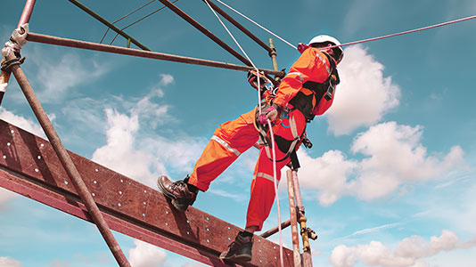
Construction Safety Monitoring System
Munesh Kumar – VGU6PB
Subject: Construction Information Technology Project
Instructor: Dr Arpad Barsi

Slide 2
Project Overview
Safety Monitoring
Construction sites are among the most hazardous workplaces
High risk of accidents – safety and health of workers is critical
Key Features
Environmental Indicators:
Fire alarm
Temperature & humidity alarm
Laser security system (fall prevention from rooftops)
Danger Alerts:
Buzzer sound and blinking LED
Can be manually turned off via a push-button
Project Objective
Design a real-time safety monitoring system
System Components
Arduino Uno
Enhance on-site safety measures using smart technology
Sensor Kit (for monitoring environmental conditions)

Slide 3
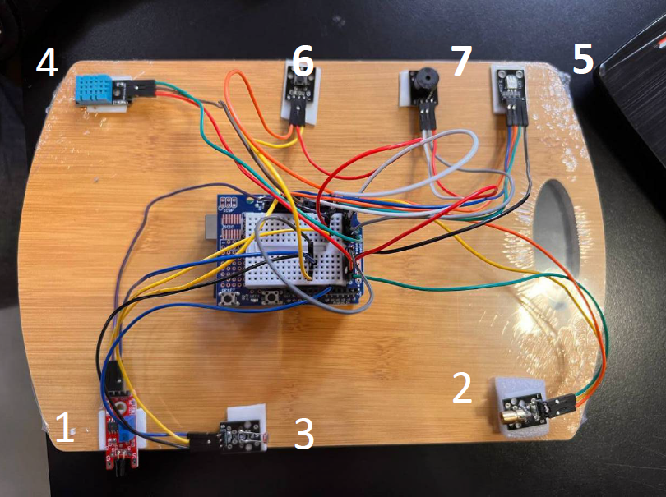
Sensors
1. Flame Sensor
2. Laser Emitter
3. Laser Resistor
4. Temperature and Humidity Sensor
5. LED
6. Button
7. Buzzer

Slide 4
Operational principle
🔥 Flame Detection
Flame sensor detects presence of fire
Triggers: Buzzer + Green blinking LED
🌡️ Temperature Alert
If temperature exceeds predefined limit:
System triggers buzzer
Blue blinking LED indicates overheating
💧 Humidity Alert
When humidity crosses threshold:
Same alerts as temperature system
Buzzer + Blue blinking LED
🛑 Rooftop Edge Perimeter Warning
Laser emitter creates a safety perimeter
If beam is interrupted, activates:
Buzzer
Red blinking LED
🖲️ Manual Override Button
Deactivates all alarms (buzzer + LEDs)
Allows quick manual control in emergency or testing situations

Slide 5
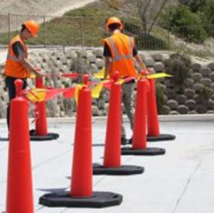
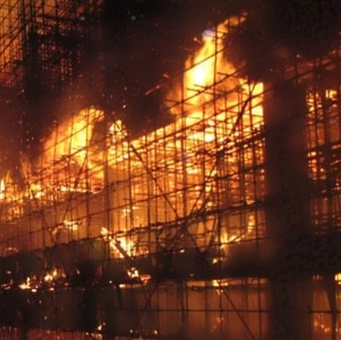
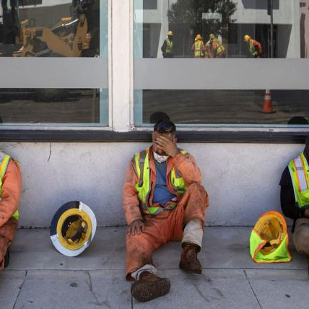
unsafe areas conditions
Fires risk
bad weather conditions

Slide 6
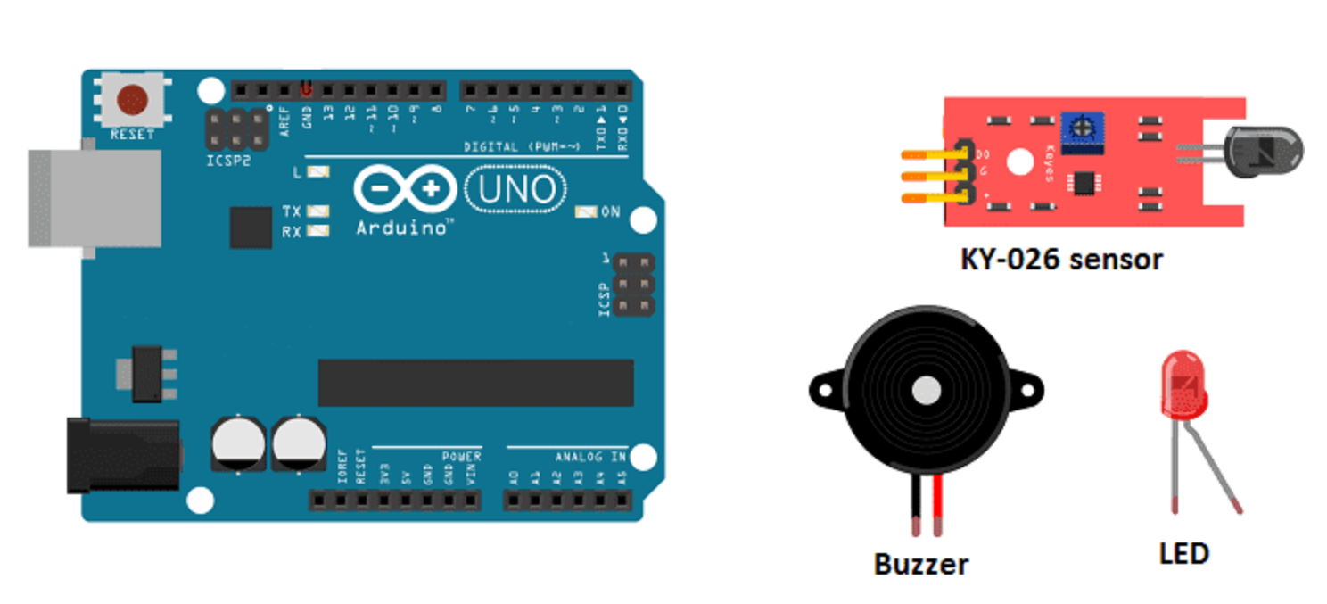
Demonstration of flame detection
Aim: Detection of flame or open fire near on site
Here: representation by using a lighter as flame
In case of fire detection: Buzzer & LED activation (blinking green)

Slide 7
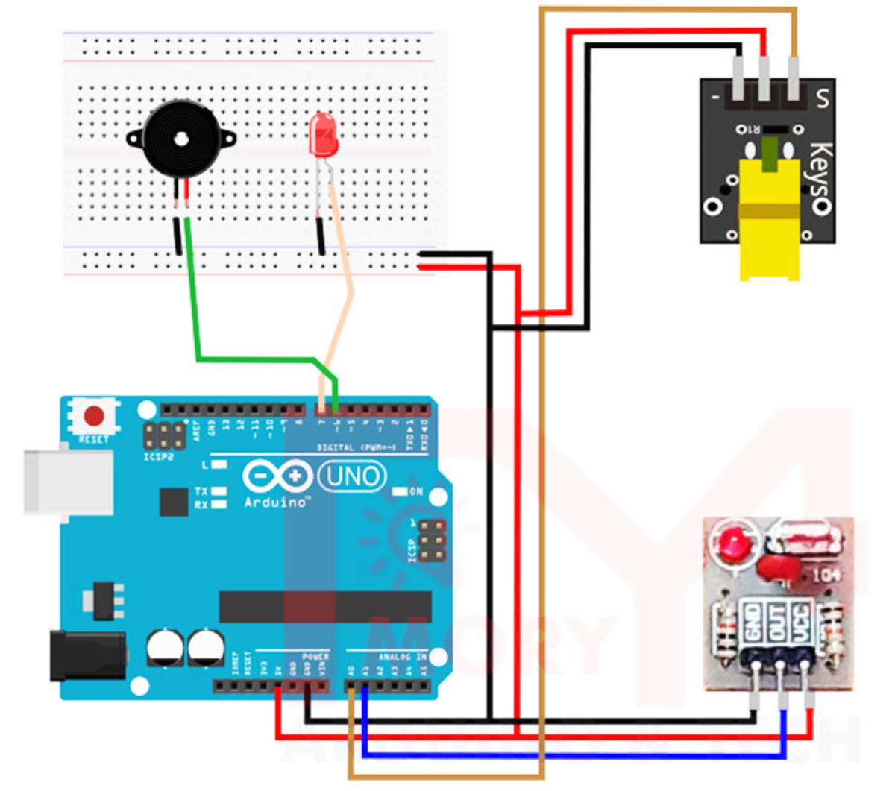
Demonstration of laser perimeter system
Aim: Creating a virtual safety boundary on the roof by a laser beam
If someone crosses the entrance-detecter line, it signals that the worker is in a dangerous area by a buzzer and a Blue blinking LED
Utilization in reality: The OSHA-defined distance between the rooftop edge and working area is minimum 6 feet
Laser perimeter system could be set up at that distance too

Slide 8
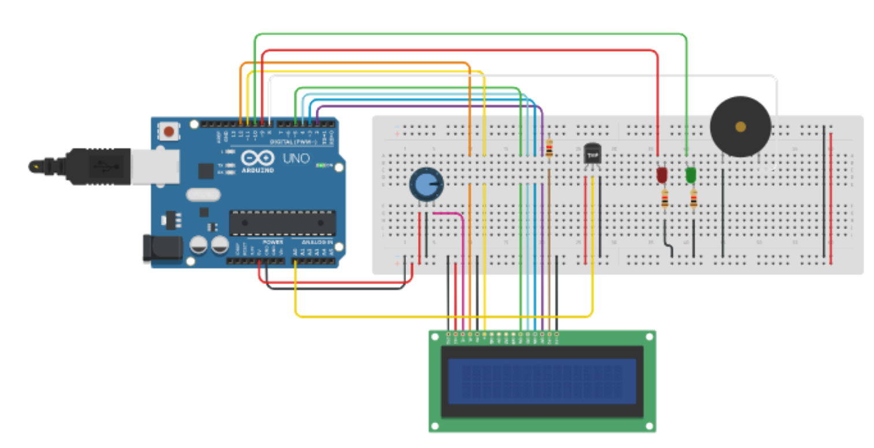
Demonstration of temperature and humidity alert
Aim: Detection of abnormal temperature and humidity for proper working conditions
The values have to be within OSHA-defined ranges: they can’t exceed 35 °C or 29 °C with 75% humidity.
If one or both limits are exceeded, the system triggers the buzzer and the LED that blinks Red.
Here: lower limits used for representation purpose
Aim of using different LED colors is to indicate which warning system singals

Slide 9
Demonstration

Slide 10
Conclusion
Construction Safety Monitoring System: minimizes the occurence of various safety risks on construction site.
Improves safety on construction sites.
Alerts workers to fires, unsafe areas, and bad weather conditions.
Effective solution for enhancing safety
Further improvement possibilities: regular testing, calibration, personnal treaining

Slide 11
Thank you for your attention!
Questions?
Munesh Kumar – VGU6PB
Mirna Makhlouf – X70AKT
Petra Hédl – SUX9GX
Construction Information Technology Project

Slide 12
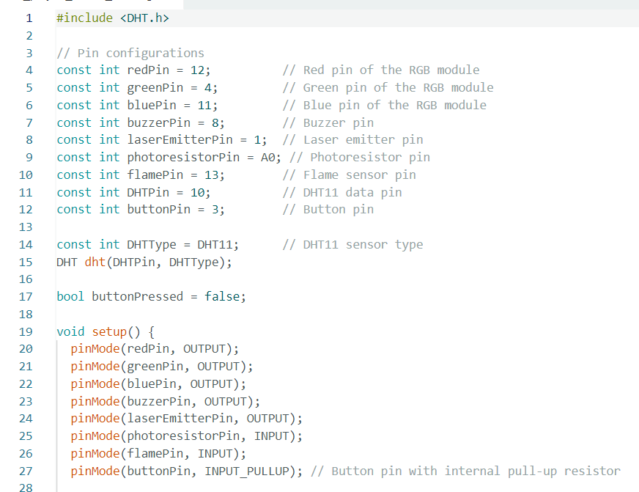
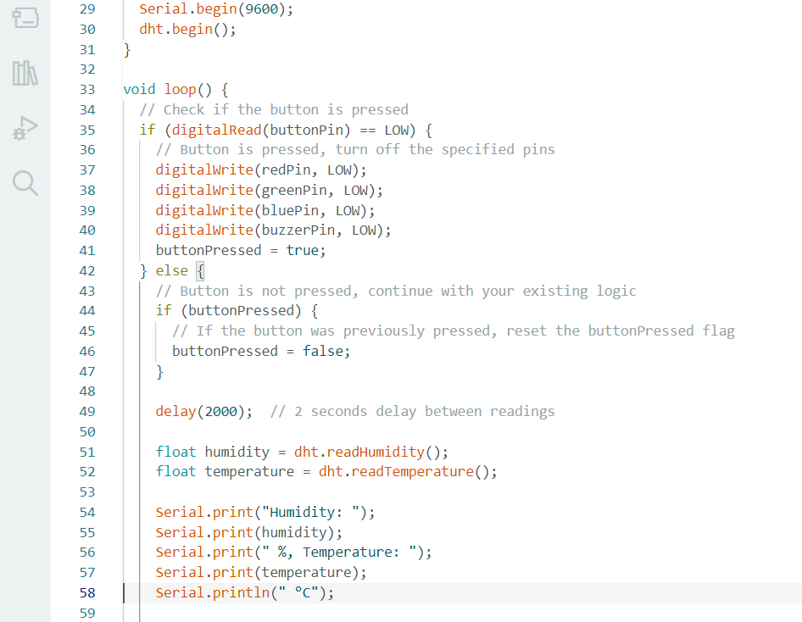
Code

Slide 13
