Slide 1

AIRLINE_DATASET_DB
CREATED BY
OJIRIKA JOHN CHIBUEZE
ON
28/03/2026

Slide 2

TABLE OF CONTENT
1. Introduction
2. Database Design
3. Data Loading
4. Queries & Analysis
5. Conclusion

Slide 3

INTRODUCTION
The AIRLINE_DATASET_DB is a structured PostgreSQL database designed to store, manage, and analyze airline passenger and flight information. It was created to provide a centralized system for handling operational data, enabling management to gain insights into passenger demographics, flight performance, and airport activity.
This database is built from the Airline_Dataset_v2.csv, which contains detailed records of passengers, flights, and operational attributes. Each entry captures essential information such as passenger identity, flight routes, pilot assignments, and flight status. By organizing this data into a relational structure, the database supports efficient querying, reporting, and visualization.

Slide 4
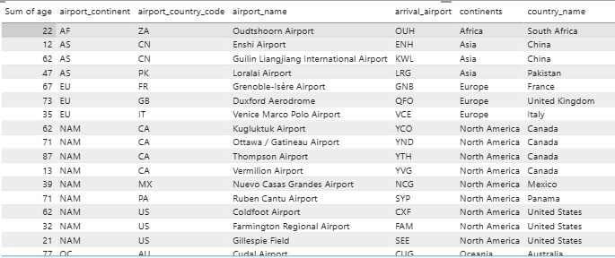
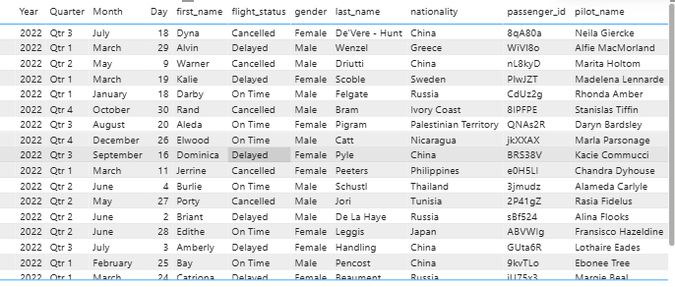
ALL THE DATA LOADED
LIMIT 20
However, the total number of records loaded is 98,619

Slide 5
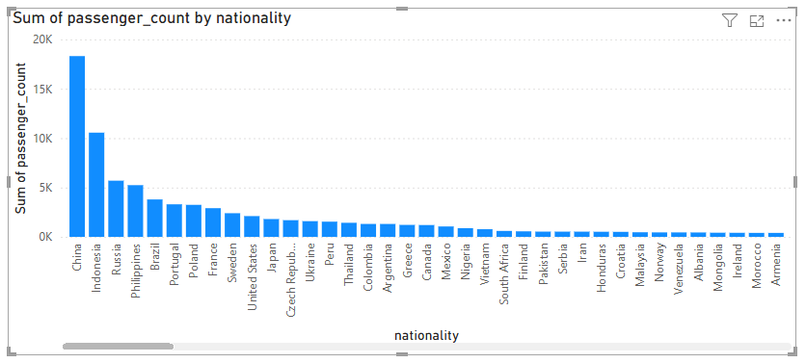
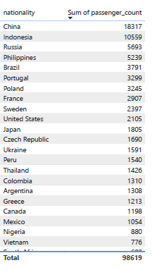
PASSENGER COUNT BY NATIONALITY
﻿[]﻿﻿ ﻿﻿ ﻿﻿Sum of passenger count was highest for China at 18317, followed by Indonesia and Russia.﻿﻿ ﻿﻿ ﻿﻿China accounted for 18.57% of Sum of passenger count.﻿﻿ ﻿﻿ ﻿﻿Across all 240 nationality, Sum of passenger count ranged from 1 to 18317.﻿﻿ ﻿﻿ ﻿

Slide 6
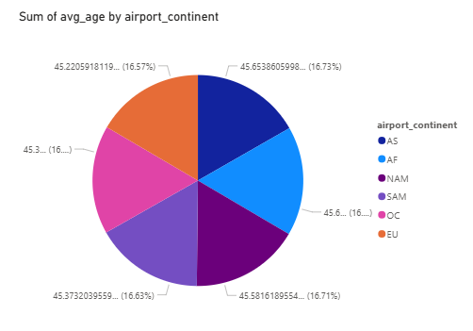
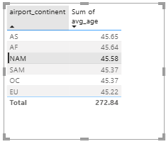
AVERAGE AGE OF PASSENGERS PER CONTINENT
North America (NAM): 45.58 years, Africa (AF): 45.63 years, Asia (AS): 45.65 years, Oceania (OC): 45.37 years
South America (SAM): 45.37 years, Europe (EU): 45.22 years.
Asia has the highest average (45.65), while Europe has the lowest (45.22).

Slide 7
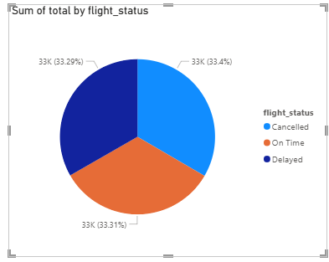
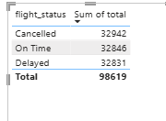
FLIGHT STATUS DISTRIBUTION
﻿Cancelled had the highest Sum of total at 32942, followed by On Time at 32846 and Delayed at 32831.﻿﻿ ﻿﻿ ﻿﻿Cancelled accounted for 33.40% of Sum of total.﻿﻿ ﻿﻿ ﻿

Slide 8
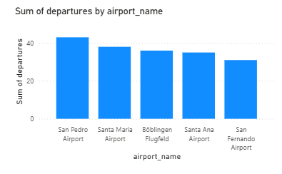
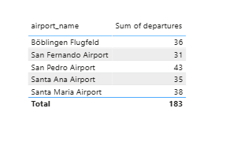
TOP 5 BUSIEST AIRPORTS (BY DEPARTURES)
﻿At 43, San Pedro Airport had the highest Sum of departures and was 38.71% higher than San Fernando Airport, which had the lowest Sum of departures at 31.﻿﻿ ﻿﻿ ﻿﻿﻿ ﻿﻿ ﻿﻿San Pedro Airport accounted for 23.50% of Sum of departures.﻿﻿ ﻿﻿ ﻿﻿Across all 5 airport name, Sum of departures ranged from 31 to 43.﻿﻿ ﻿﻿ ﻿

Slide 9
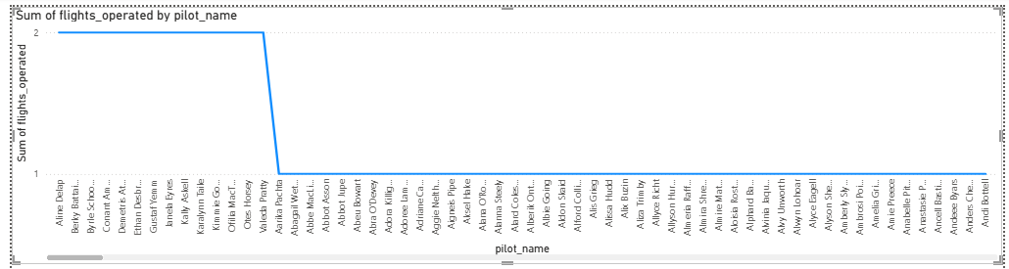
NUMBER OF FLIGHTS HANDLED BY EACH PILOT
Indicates a highly uneven distribution of workload.
Suggests potential for optimizing pilot assignments.
﻿ ﻿﻿KEY INSIGHTS: The top 14 pilots operated 2 flights.﻿﻿ ﻿﻿ ﻿﻿﻿﻿412 pilots operated 1 flight. ﻿﻿Across all 1,000 pilot name, Sum of flights operated ranged from 1 to 2.﻿﻿ ﻿﻿ ﻿Indicates a highly uneven distribution of workload. Suggests potential for optimizing pilot assignments.

Slide 10
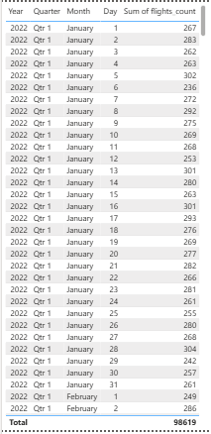
FLIGHTS PER DEPARTURE DATE

Slide 11
CONCLUSION
The dataset reveals a highly uneven workload distribution among pilots.
Passenger demographics vary widely, with some nationalities contributing significantly more.
Operational efficiency can be improved by balancing pilot assignments and diversifying airport usage.
Visualizations provide management with clear decision-making tools for resource allocation.
Recommendation: Use these insights to optimize scheduling, improve passenger services, and enhance operational balance.

