Slide 1

SEPN CHARGES DATABASE PROJECT
Analysis of Import, Export, and Residual Charges
CREATED BY
OJIRIKA JOHN OJIRIKA
21-03-2026

Slide 2
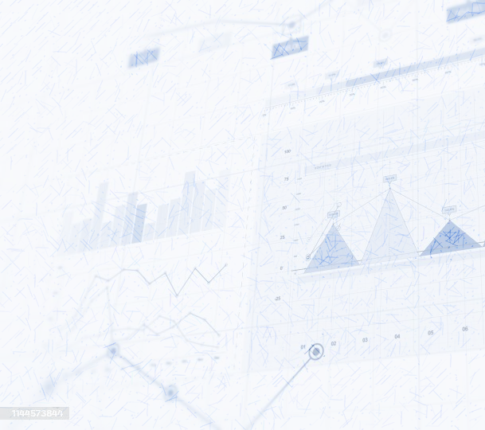
TABLE OF CONTENTS
1. Introduction
2. Database Design
3. Data Loading
4. Queries & Analysis
5. Additional Queries
6. Conclusion

Slide 3
INTRODUCTION
SEPN (Secure EFTPOS Network) ensures secure, tamper-proof digital payments.
Purpose: Protect POS and e-commerce transactions from cyber threats.
Benefits: Trusted connectivity and fraud prevention.
Transaction Charges: Fees banks apply for processing customer payments.
Types of Charges: Import/Export Super Red Charges, Fixed Charges, Residual Charging Band.

Slide 4
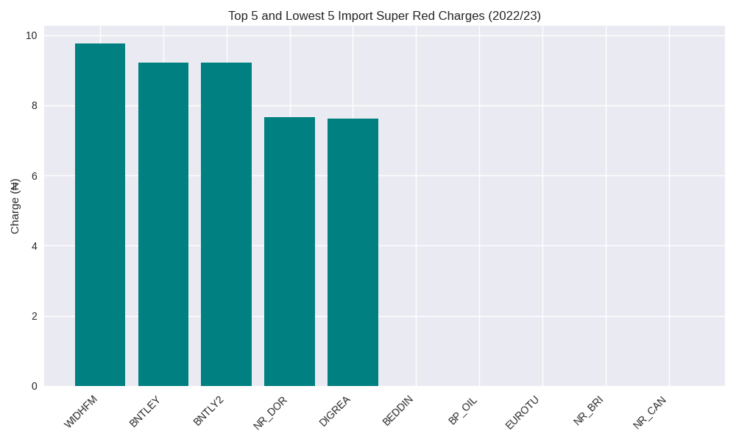
Import Super Red Charge (2022/23)
Higher charges are due to large transaction volumes or premium secure routing.
Lower charges may reflect minimal imports or negotiated fee waivers.

Slide 5
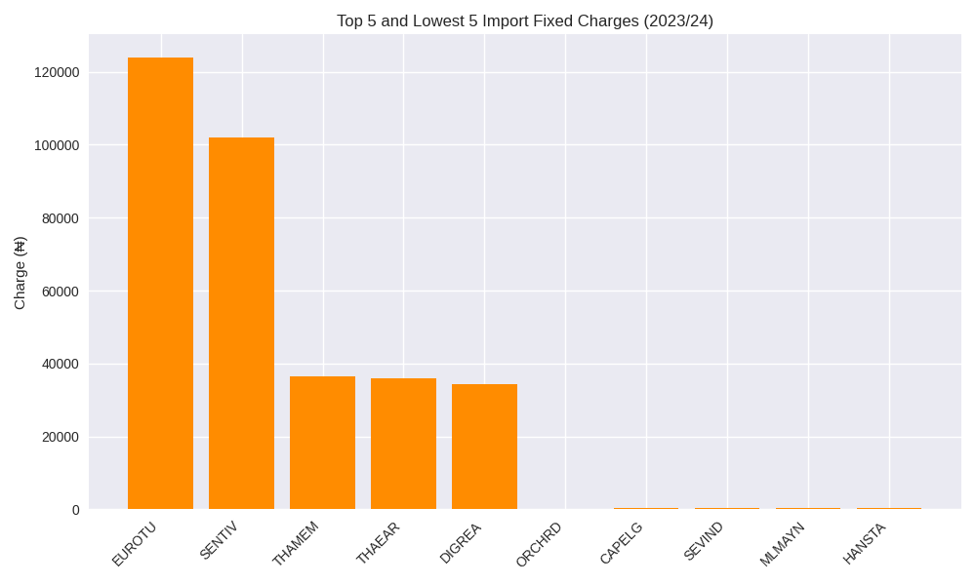
Import Fixed Charge (2023/24)
Highest fixed charges are linked to large enterprises with high POS activity.
Lowest charges are seen in smaller firms or those with limited digital infrastructure.

Slide 6
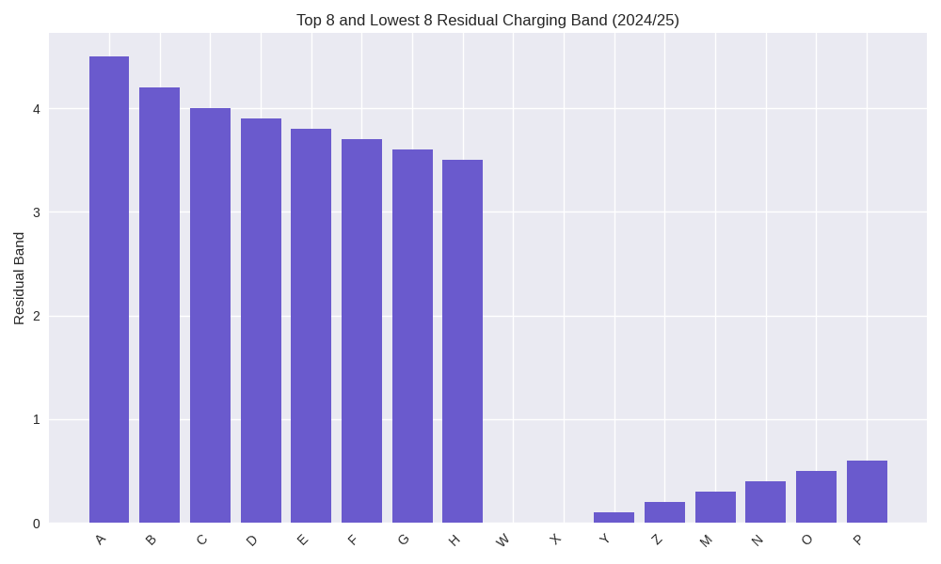
Residual Charging Band (2024/25)
Higher bands indicate final demand customers with active secure payment usage.
Lower bands (0) represent non-final demand customers with minimal residual activity.

Slide 7
Additional Queries
- Count of Non-final and Final Demand Customers
- Annual Import Fixed Charges
- Residual Band Matching Across Years
- Temporary Table Creation

Slide 8

ANALYSIS OF CHARGE VARIATIONS
Factors influencing highest and lowest charges:
- Transaction volume: Higher volumes incur higher charges.
- Customer type: Large enterprises vs small businesses.
- Negotiated fees: Some customers may have discounts.
- Exemptions: Interbank transfers often exempt from charges.

Slide 9
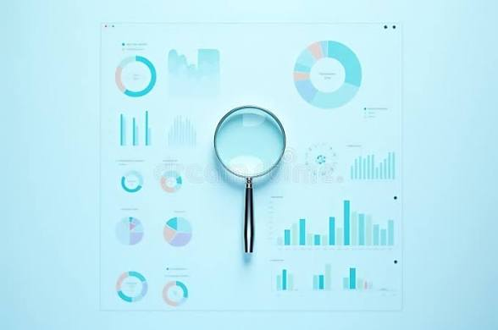
CONCLUSION
Key Insights:
- Wide variation in charges reflects customer size and transaction behavior.
- Residual Charging Band helps classify final vs non-final demand customers.
- Structured database and SQL queries enable efficient analysis.
- Project demonstrates practical application of SQL and data visualization.

